Slide 1
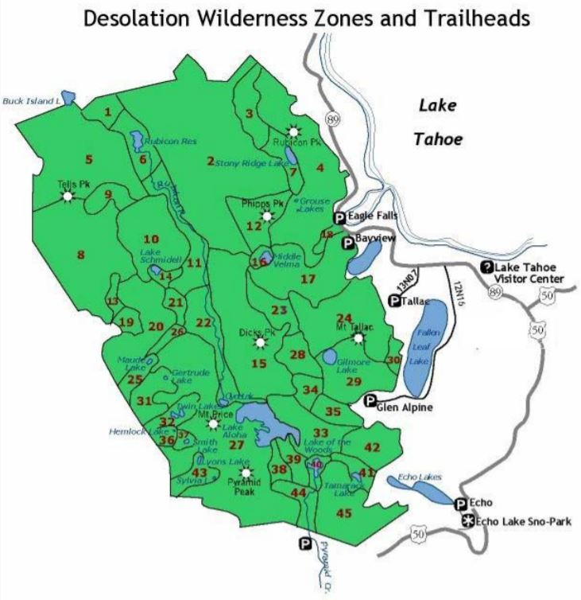
GEOG 375 Introduction to GIS Programming
Search Cursors: Lakes and Zones of Desolation Wilderness
John Welsh
May 19, 2020

Slide 2
About Desolation Wilderness
64,000 acres of sub-alpine and alpine forest, granite peaks, valleys, and lakes
Divided into 45 zones for backpacking use
  Most zones contain one or more lakes
Permit required for backpacking
  Must identify the specific Zone Number that you will camp at on the first night
  No restrictions on where you camp thereafter during the remainder of trip

Slide 3
Project Overview
Created two Search Cursor scripts
  Goal: create tools that simplify the backpacking permit and lake destination planning process
Created a Lakes feature class for script use
  81 Desolation Wilderness lakes created using ArcGIS Pro
  Attribute Table data added includes Lake Name, Zone Number, and Zone Name

Slide 4
Purpose – Search Cursor 1
Identifying Lakes within a Zone Number
  Query: Zone Number
  Data provided by Search Cursor results
    Lake Name
    Zone Number
    Zone Name
  End User
    Backpackers who want to determine which lakes exist within a zone

Slide 5
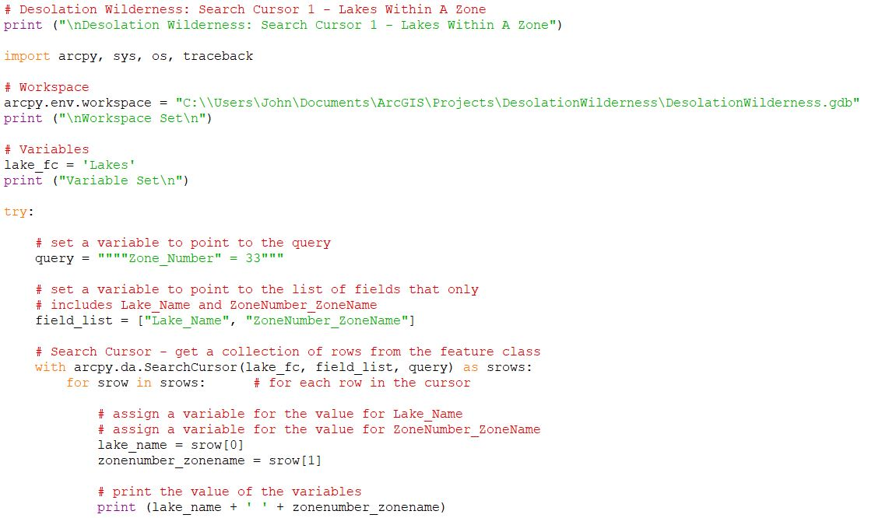
Search Cursor 1 – Lakes within a Zone

Slide 6
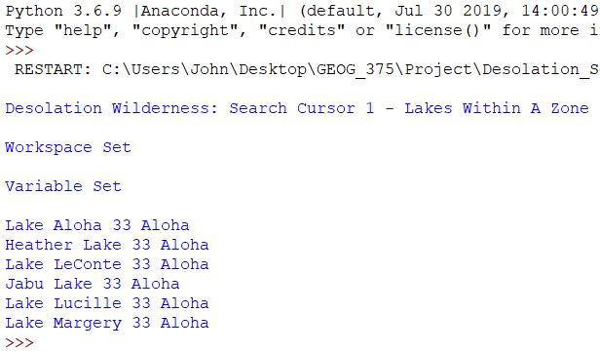
Search Cursor 1 – Results

Slide 7
Purpose – Search Cursor 2
Identifying a Lake’s Zone Number and Zone Name
  Query: Lake Name
  Data provided by Search Cursor results
    Lake Name
    Zone Number
    Zone Name
  End User
    Backpackers who want to query a Lake Name to identify the Zone Number for which he/she will need to acquire a permit

Slide 8
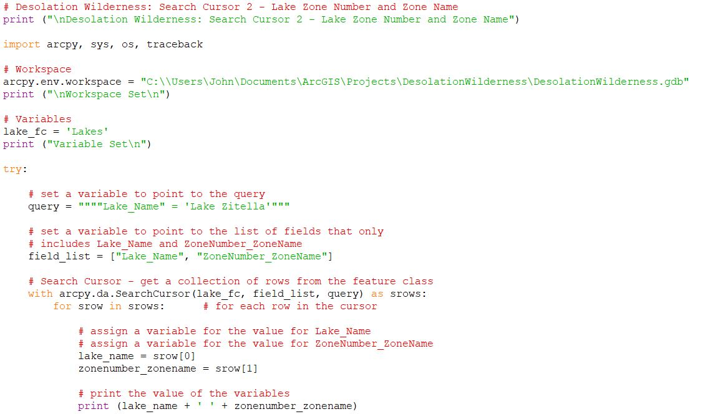
Search Cursor 2 – Lake Zone Number and Zone Name

Slide 9
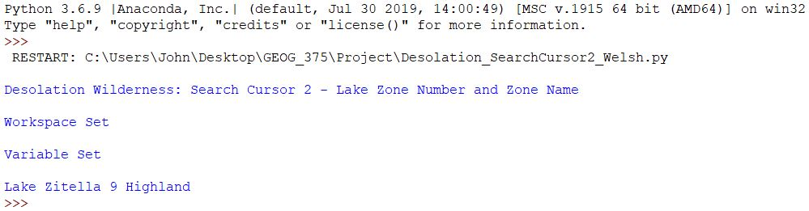
Search Cursor 2 – Results

Slide 10
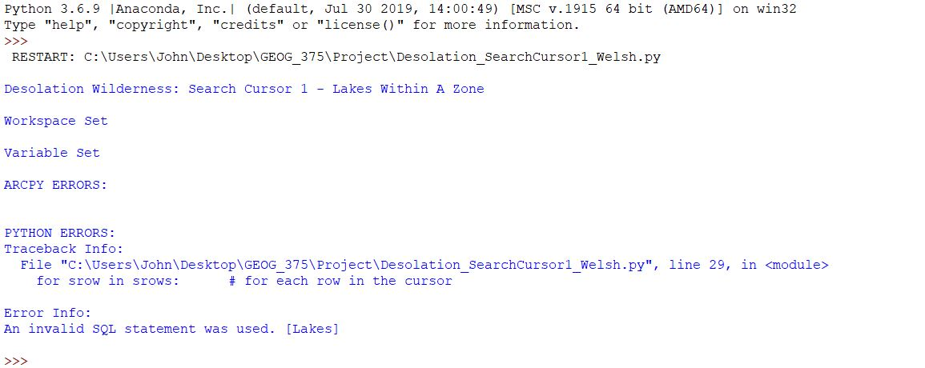
Challenges – Error

Slide 11
Solution and Lesson Learned
Syntax
  Single quotes used for character strings, not numbers

