Slide 1
A Comparison Map of Air Pollution During COVID-19 Situation, Bangkok, Thailand
by Palika Wannawilai

Slide 2
Project’s Purpose
To create a new standalone join table for providing of useful data used for other projects.
To make a join attributes table and a new feature layer for performing of Bangkok layer and its data .
To use the GraduatedColorSymbology for distinguishing of different data in February and March.

Slide 3
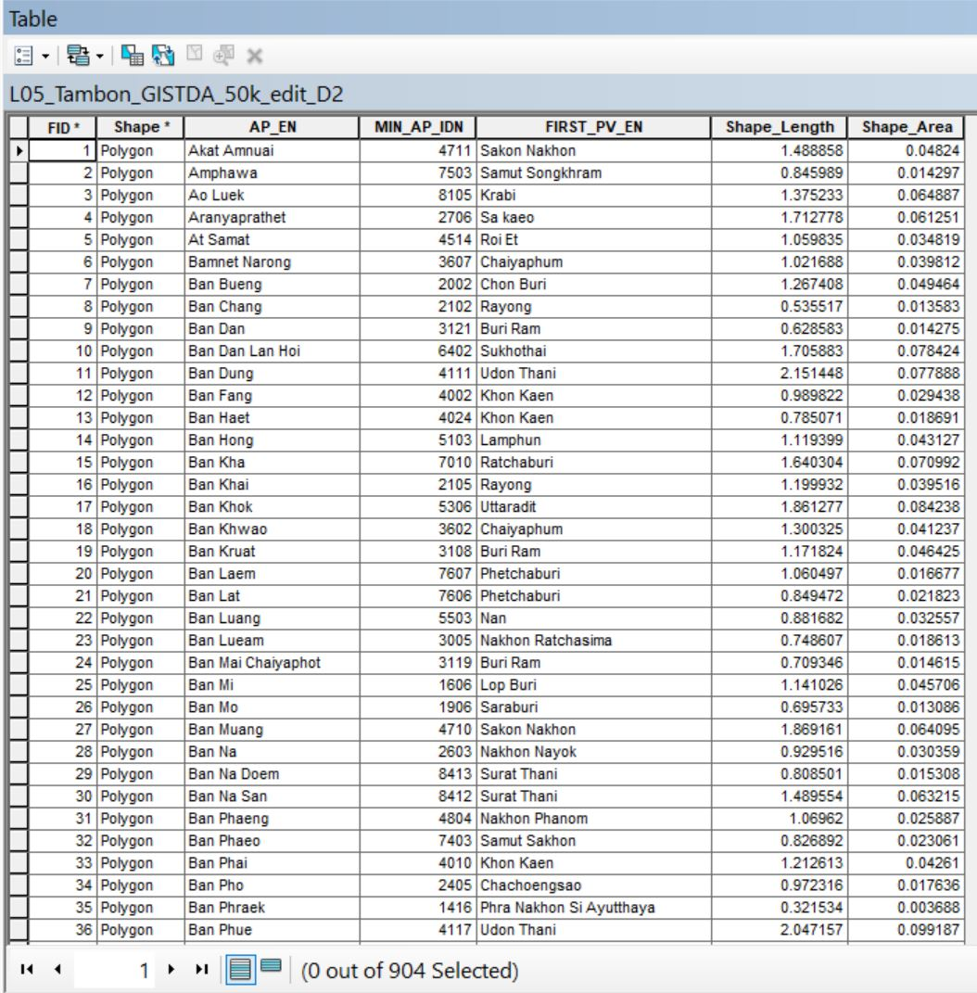
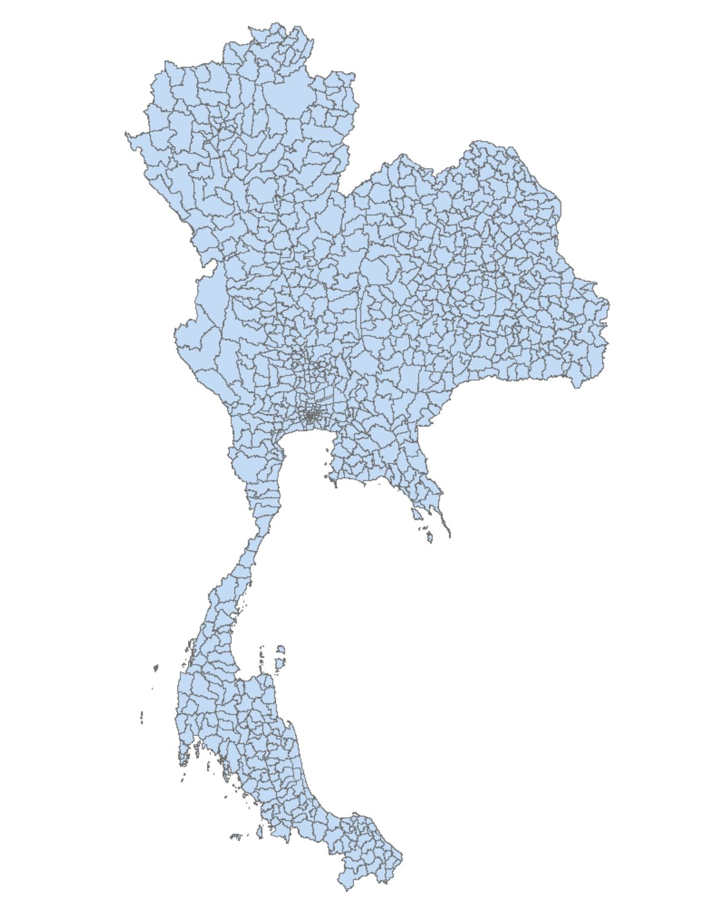
1. Creating a new standalone join table
Join Field
A Thailand Shapefile and its attributes table

Slide 4
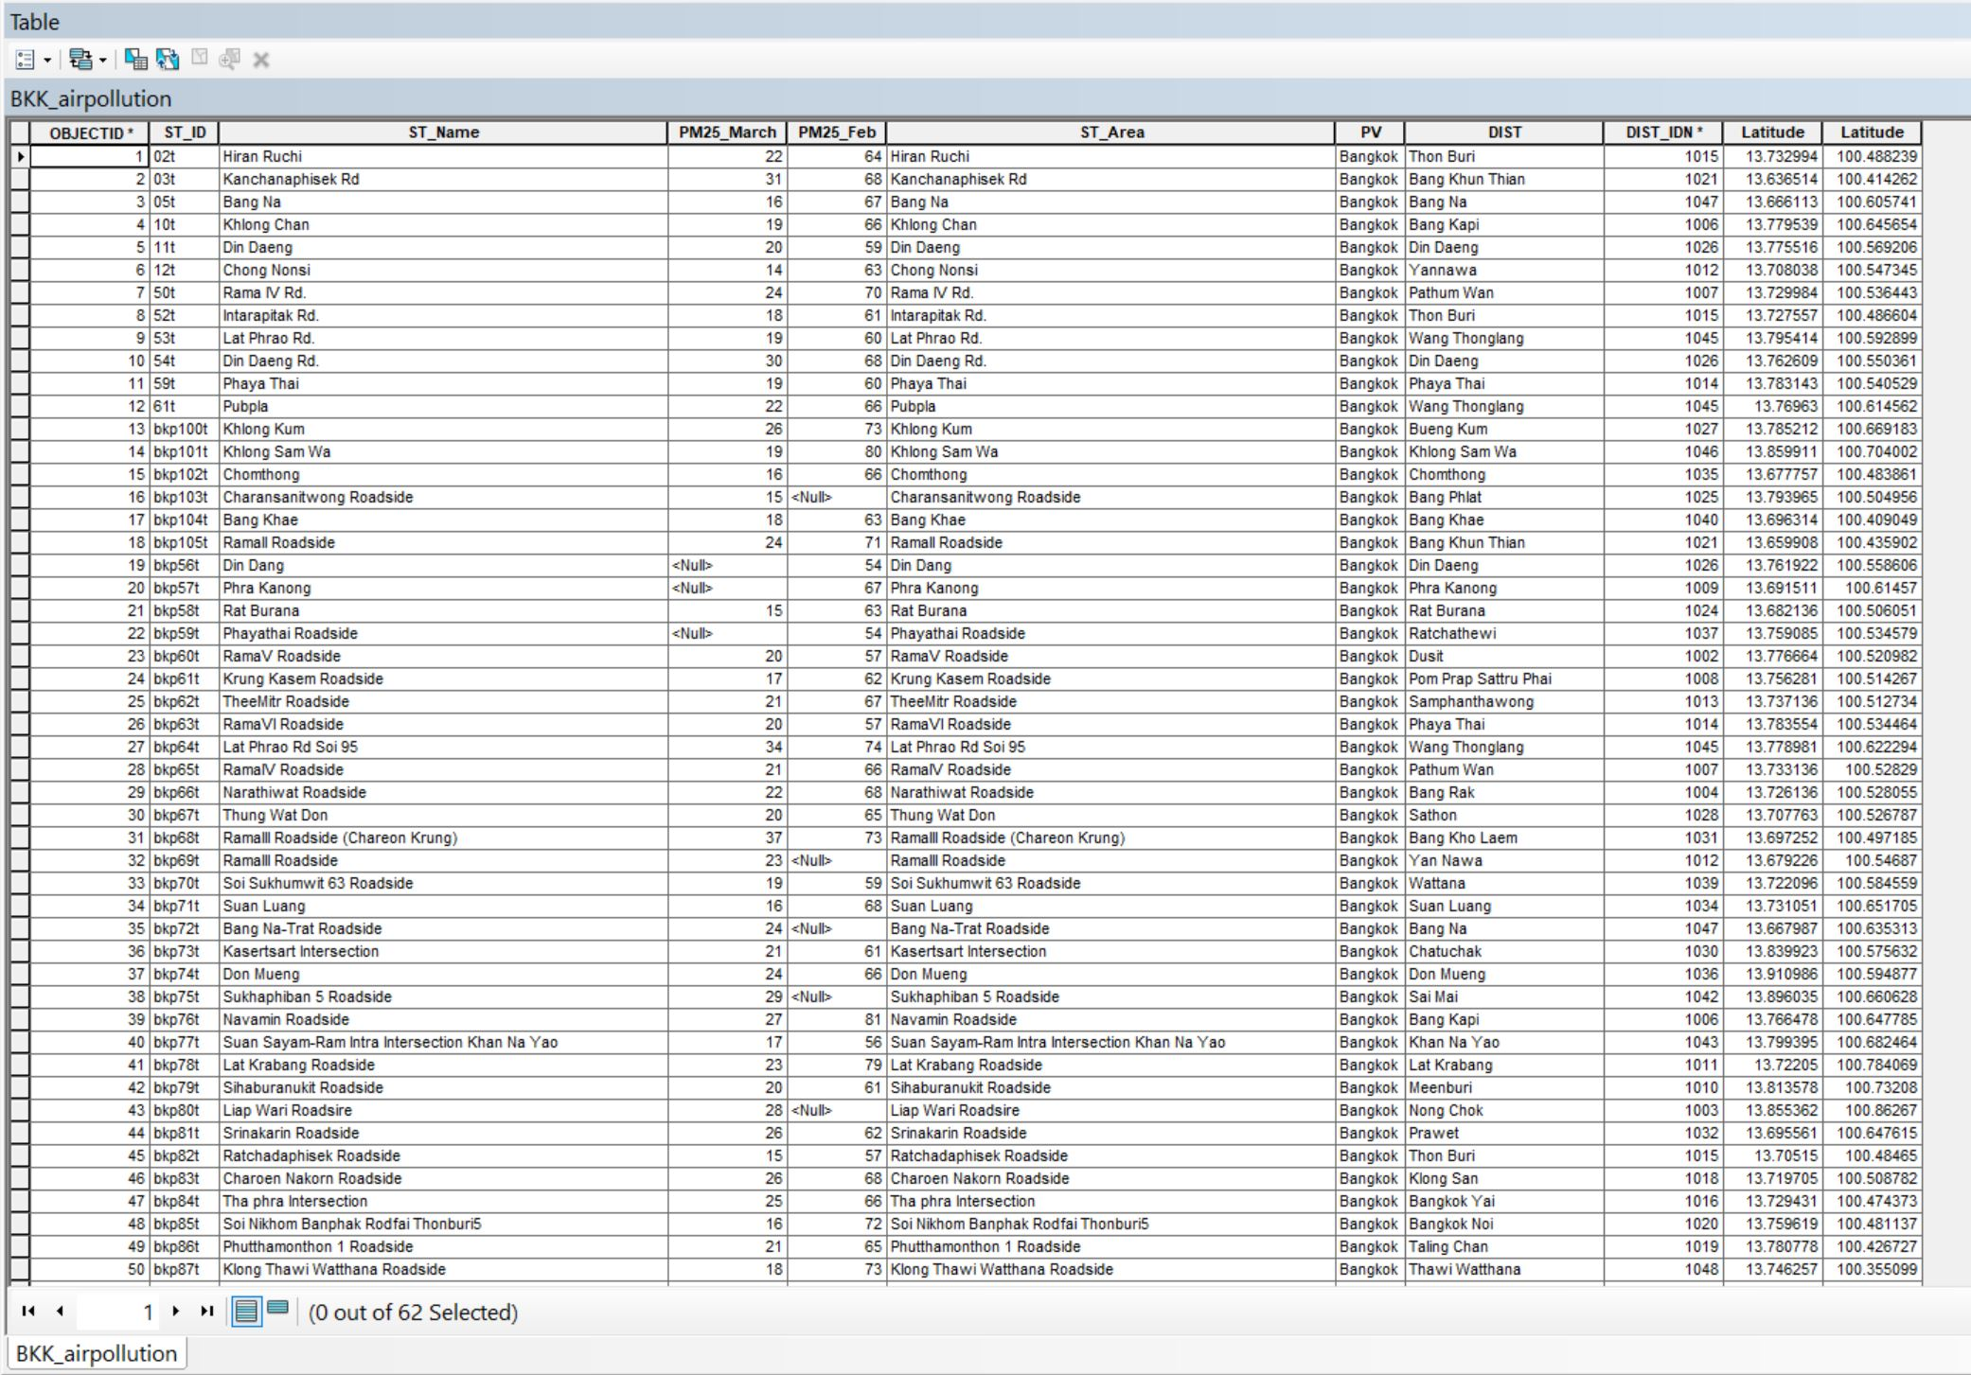
A standalone table (BKK_airpollution)
Join Field

Slide 5
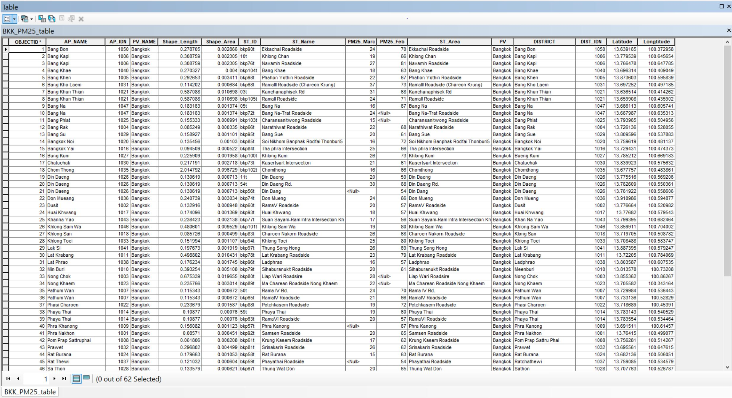
A new standalone table containing the data from two tables
Joined Fields

Slide 6
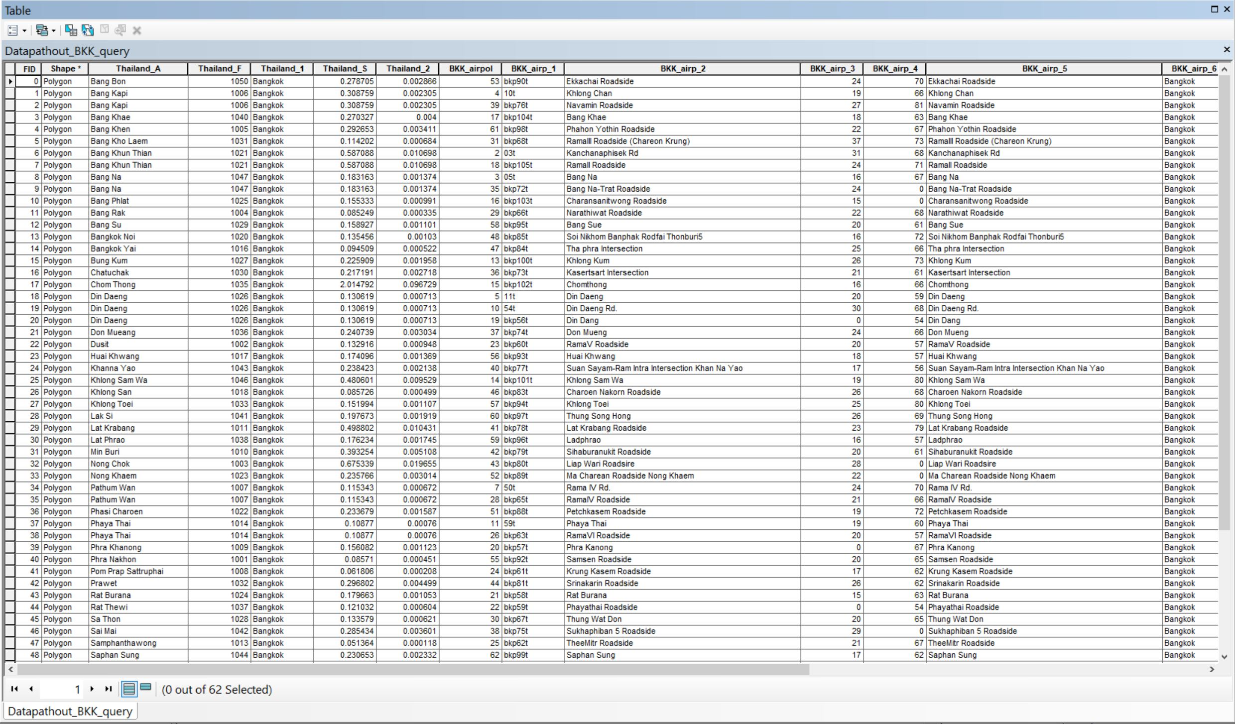
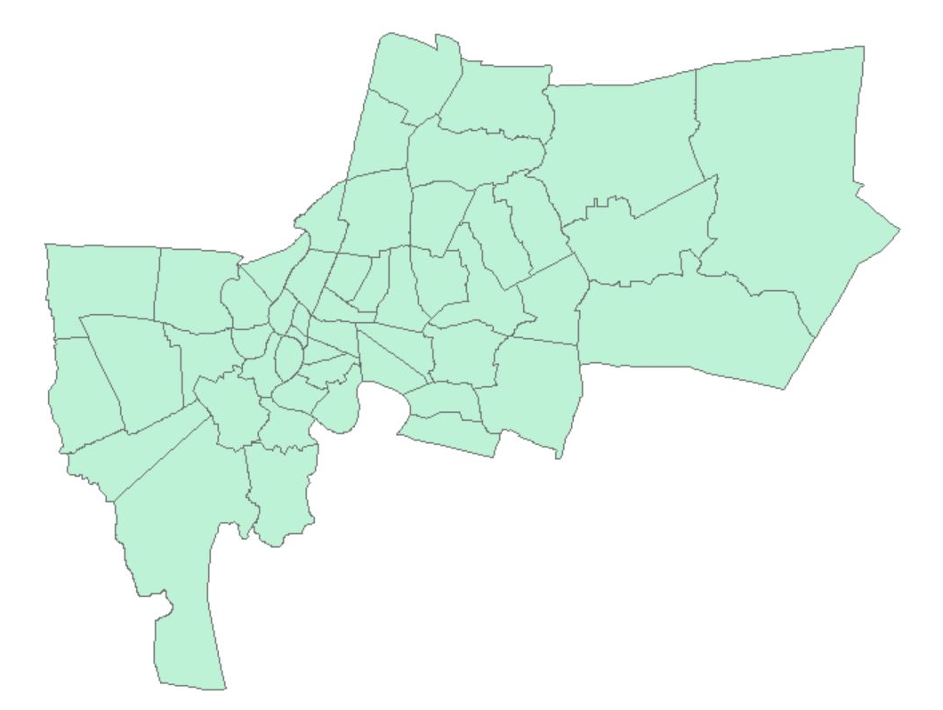
2. Making a join attributes table and a new feature layer
March
Feb
From the table, BKK_airp_3 contains PM 2.5 in March and BKK_airp_4 contains PM 2.5 of February.
Bangkok areas

Slide 7
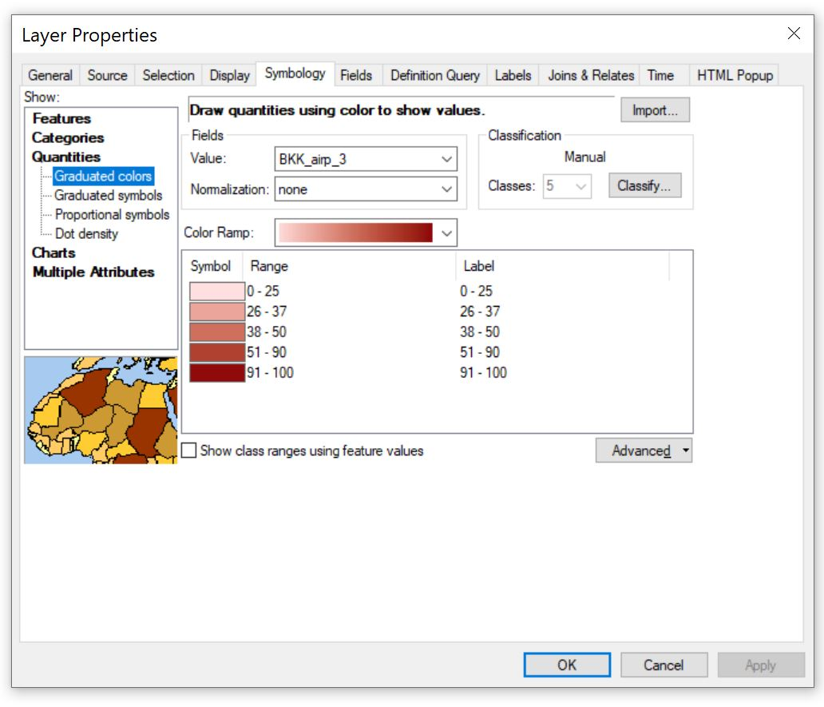
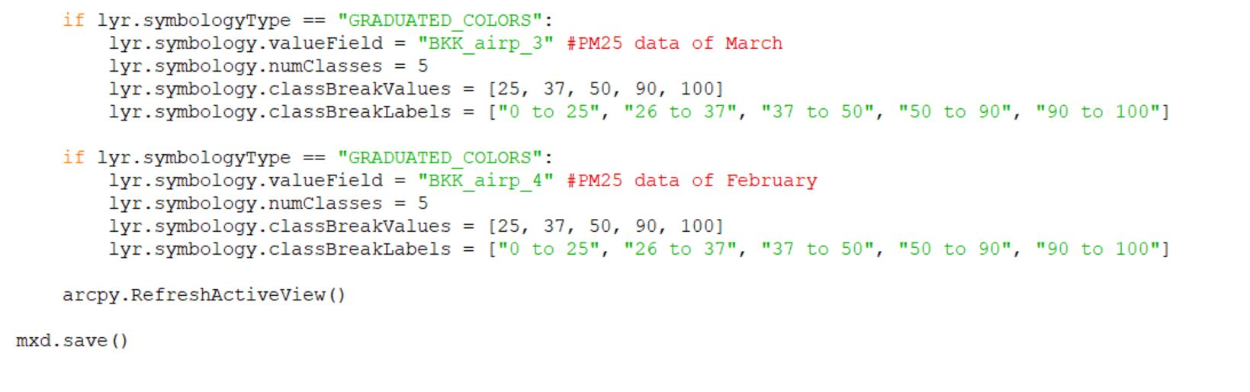
3. Using the GraduatedColorSymbology for distinguishing of different data in February and March.
The script is to read the data and create the symbology to get the result as same as in the right picture, but it doesn’t show the color scheme in the actual result.

Slide 8
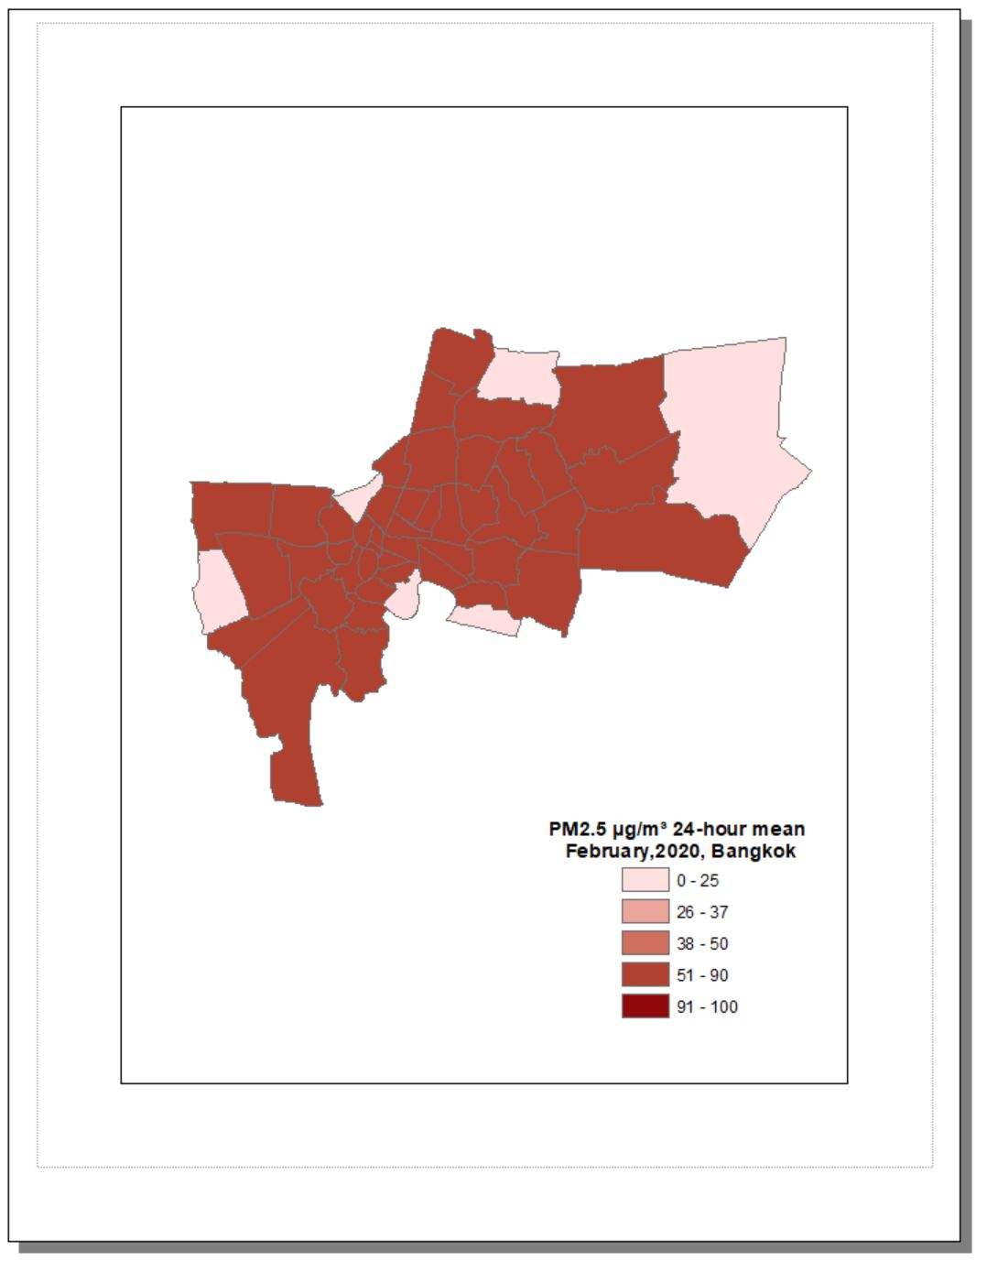
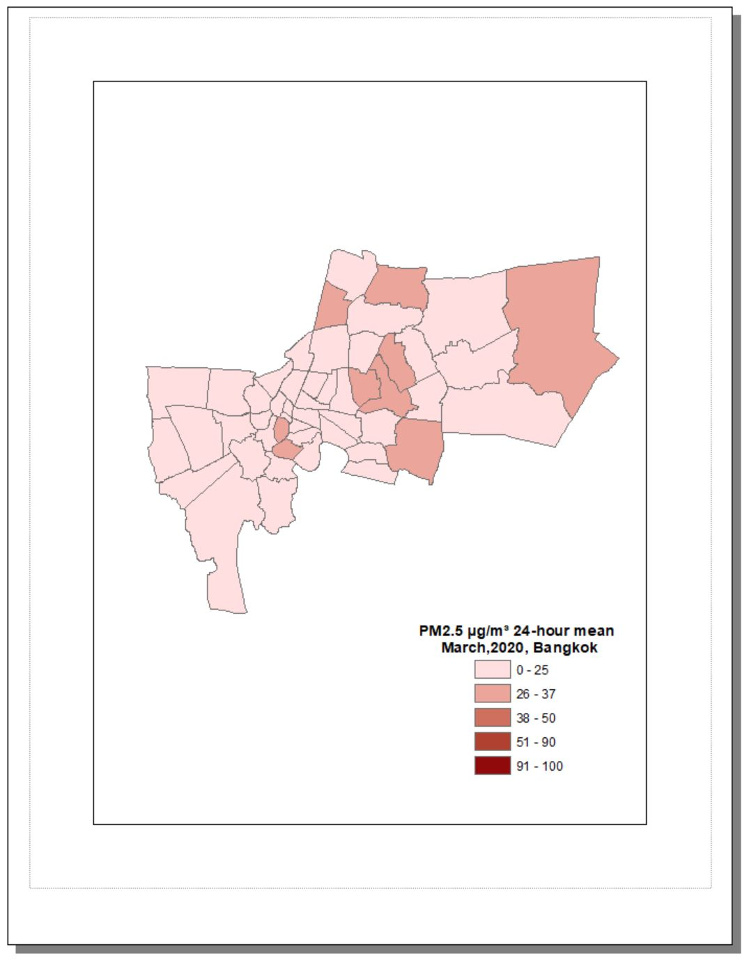
3. Using the GraduatedColorSymbology for distinguishing of different data in February and March.
According to air quality index (AQI) of Bangkok, the standard of PM 2.5 is separated to be 5 levels to measure the situation of the air quality.
PS. Due to the actual script, it doesn’t provide the code to perform the color scheme and legend. However, the purpose is to compare the different data apparently.
Reference: http://air4thai.pcd.go.th/webV2/aqi_info.php

Slide 9
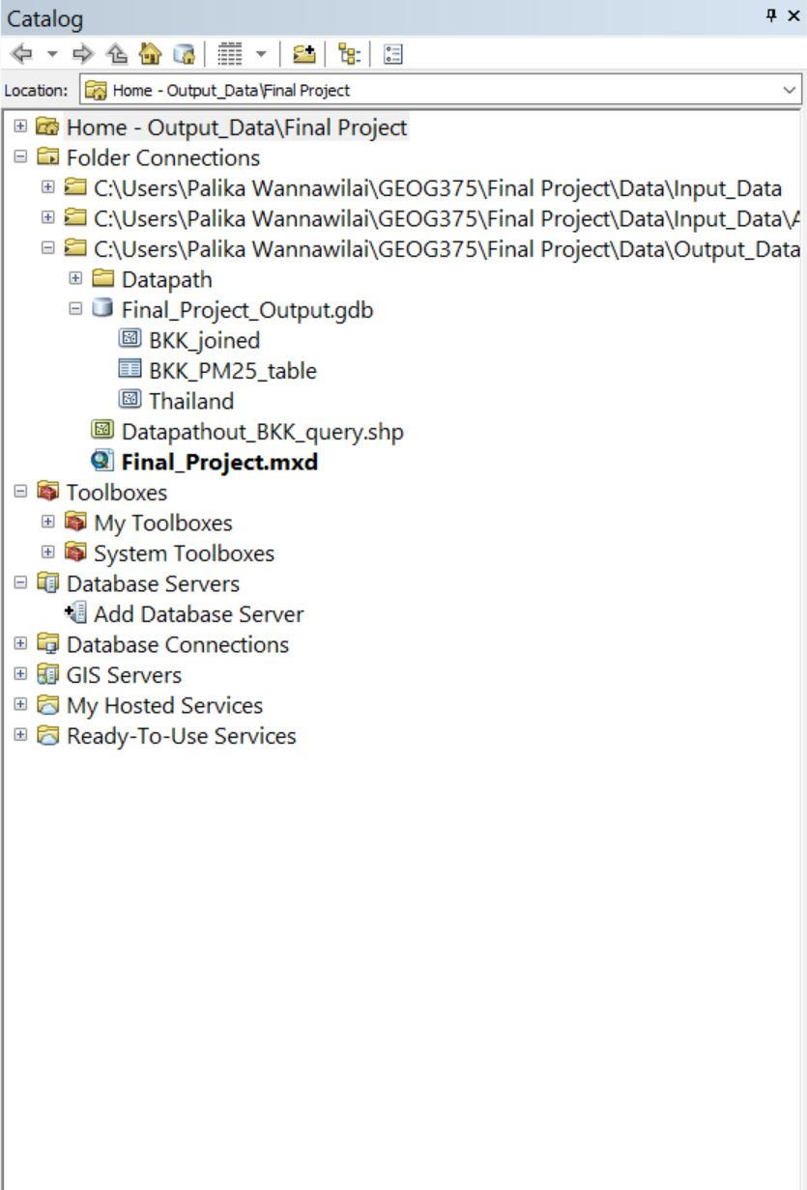
All results are saved in gdb., shp., and mxd. files

