Slide 1
Commercial Parcels Within the Sacramento Grid Neighborhoods
Created By: Korinne Tarien

Slide 2
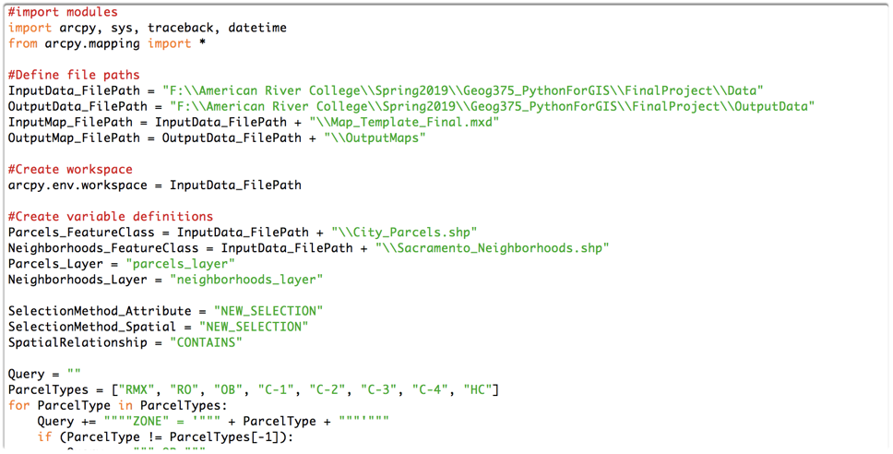
Import Modules
Import necessary modules

Slide 3
Define File Paths
Define file path variables to input location, output destination, map layout template location, and output pdf destination.

Slide 4
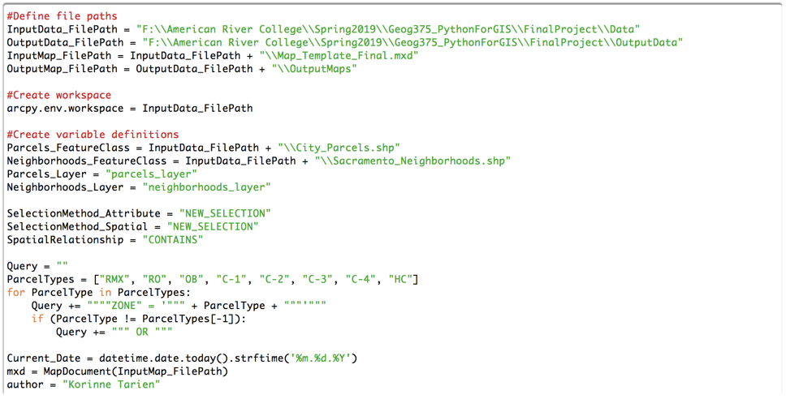
Define Variables
Define variables including input feature classes, feature layers, and variables for selection methods. Also includes some variables for map iteration process.

Slide 5
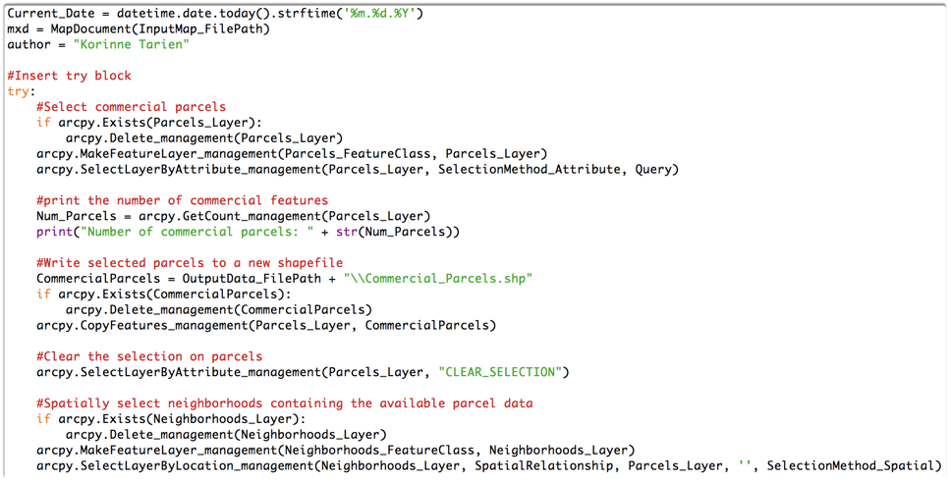
Select Commercial Parcels
Delete existing parcels feature layer, if there is one.
Create parcels feature layer from parcels feature class.
Use Select by Attribute to select parcels with commercial zoning codes from feature layer.

Slide 6
Print # of Commercial Parcels
Print total number of commercial parcels

Slide 7
Create new shape file
Delete existing commercial parcels shapefile, if there is one.
Copy currently selected commercial parcels to new shapefile: CommercialParcels

Slide 8
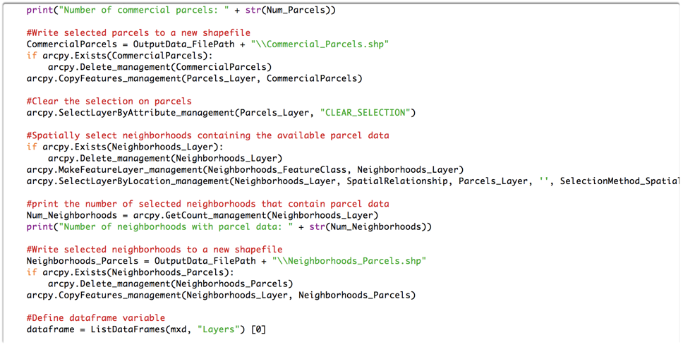
Clear Parcel Selection
Clear the commercial parcels selection to not affect the next selection step

Slide 9
Select Neighborhoods
Delete existing neighborhoods feature layer, if there is one.
Create neighborhoods feature layer from neighborhoods feature class.
Use Select by Location to select neighborhoods that contain parcel data from feature layer.

Slide 10
Print # of Neighborhoods
Print total number of neighborhoods that contain parcel data

Slide 11
Create New Shapefile
Delete existing neighborhoods with parcels shapefile, if there is one.
Copy currently selected neighborhoods to new shapefile: Neighborhoods_Parcels

Slide 12
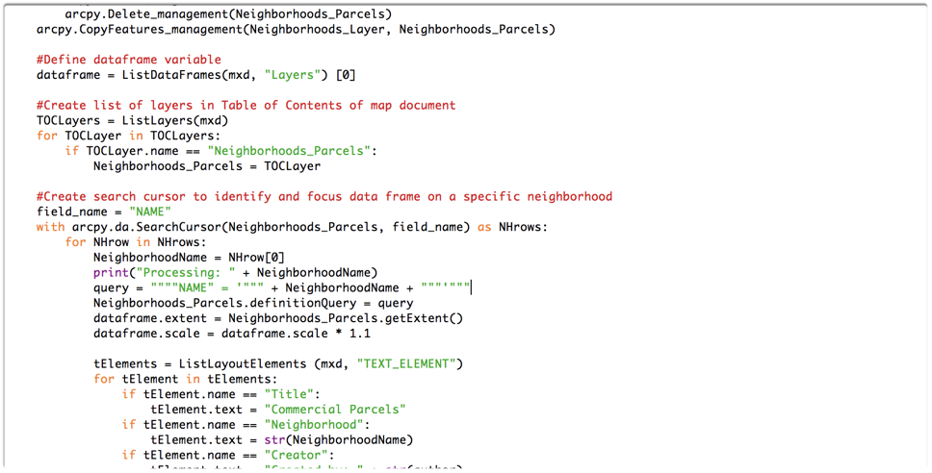
Define Map Variables
Define variables for the data frame and the new Neighborhoods_Parcels layer. These variables will be used to change map layout properties.

Slide 13
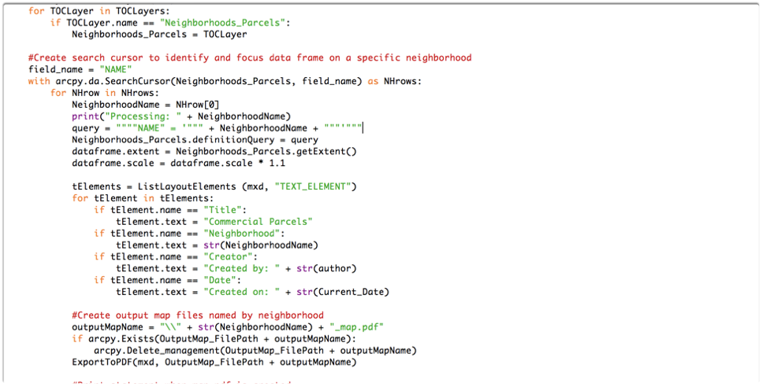
Create Maps
Loop through the neighborhoods.
Print statement to see which neighborhood is currently being processed.
Query for the current neighborhood, set the data frame extent, and scale with 10% buffer.

Slide 14
Change Map Elements
Loop through text elements to change title, neighborhood, creator, and date of creation as needed.

Slide 15
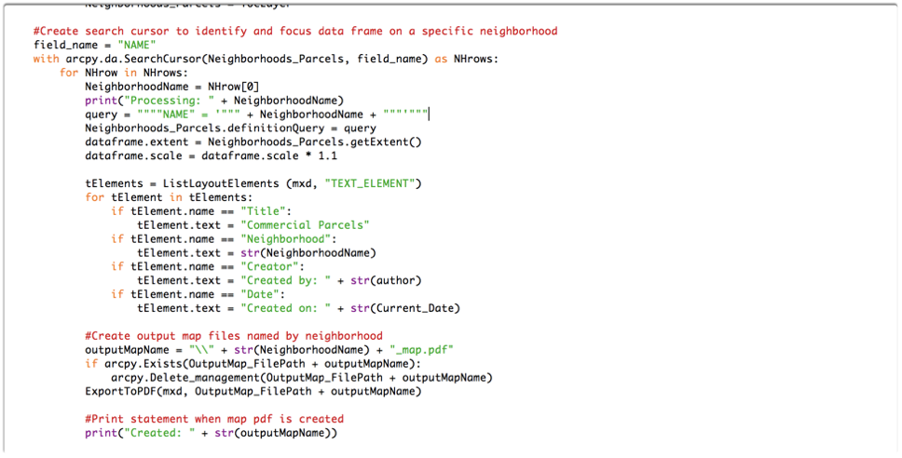
Create PDFs
Define variable for the name of the PDF to include the name of the neighborhood.
Delete existing PDF document with corresponding neighborhood name, if it exists.
Export map to PDF with neighborhood name in name of PDF.

Slide 16
Notify when PDF is created
When the map has been exported to PDF, print statement indicating that the map has been created.

Slide 17
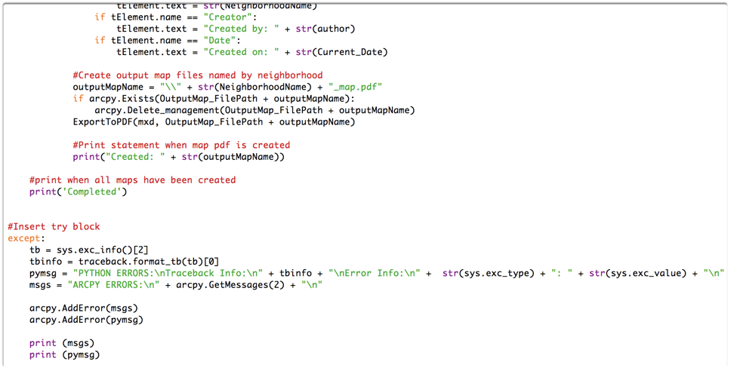
Notice of Completion
Print a statement when all maps have been exported to PDF

Slide 18
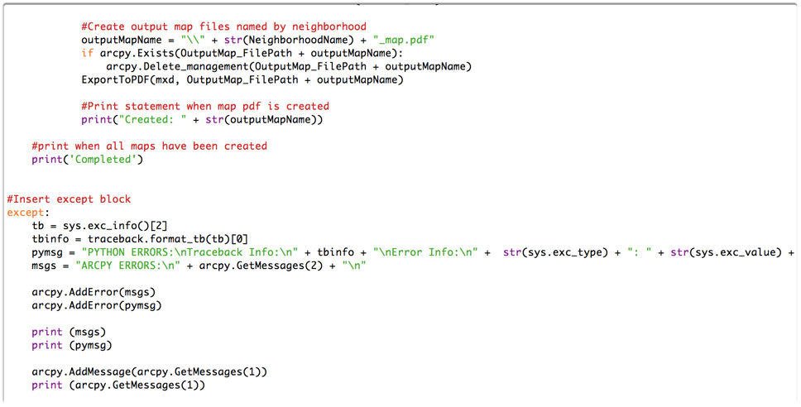
Except Block
Will output errors information.

Slide 19
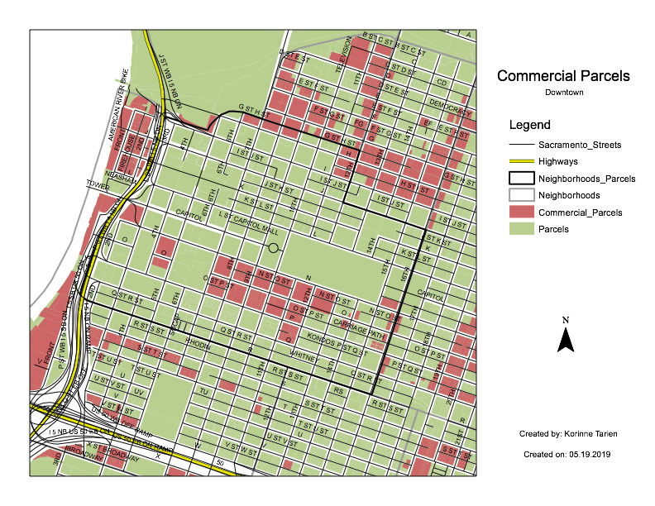
Output Map PDF
There should be a series of PDF documents in the output folder, each focusing on a different neighborhood.

