Slide 1

COVID-19 Case Counts in Select Western States
A Python Script to Export a Map Series
Ben Tang
GIS 375
May 2020

Slide 2
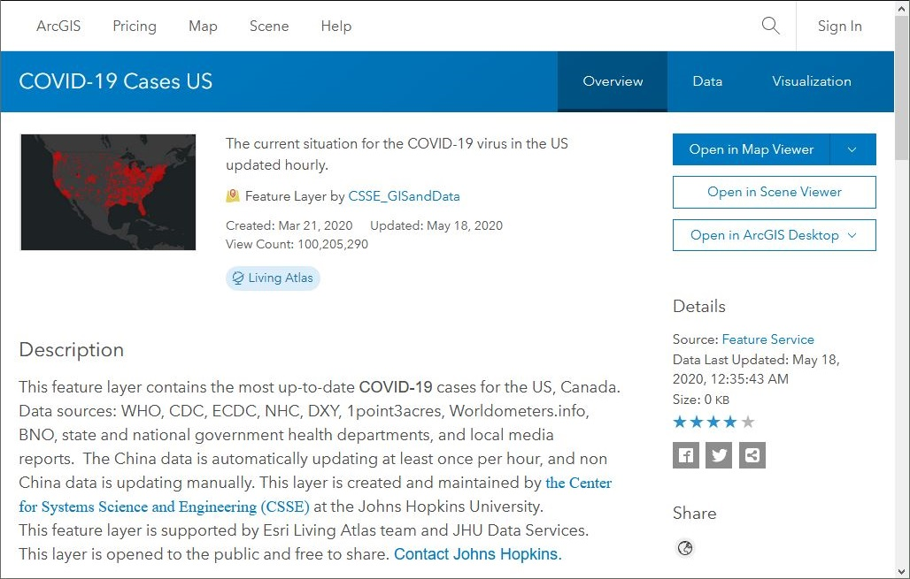
COVID-19 Case Data
COVID-19 cases by US county, tracked by Johns Hopkins
https://coronavirus-resources.esri.com/pages/resources

Slide 3
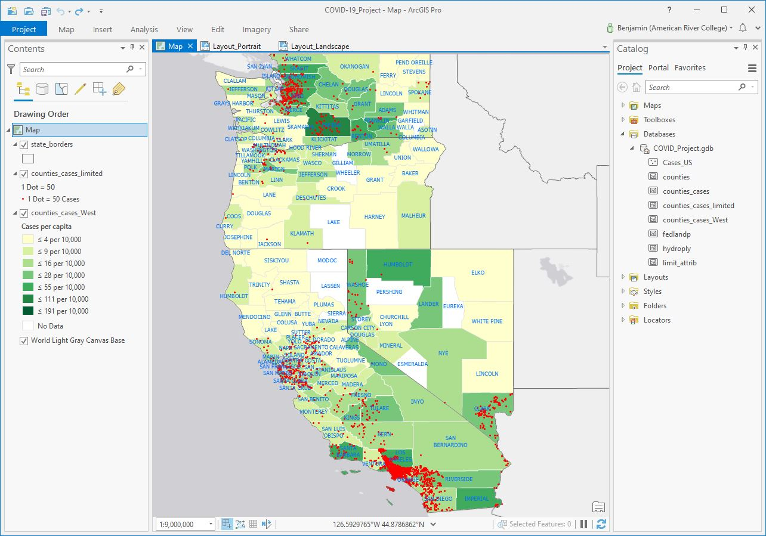
COVID-19 ArcGIS Pro Project

Slide 4
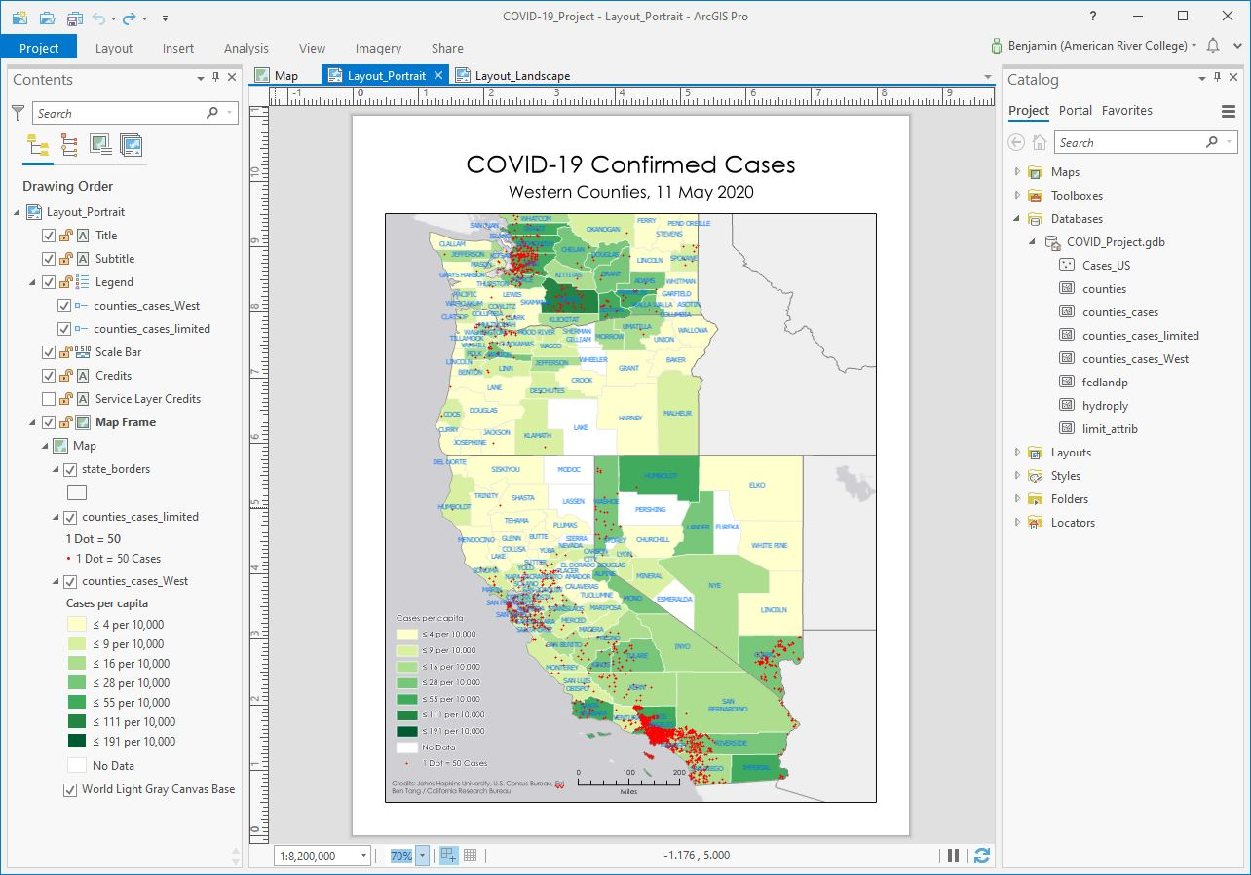
Portrait Layout

Slide 5
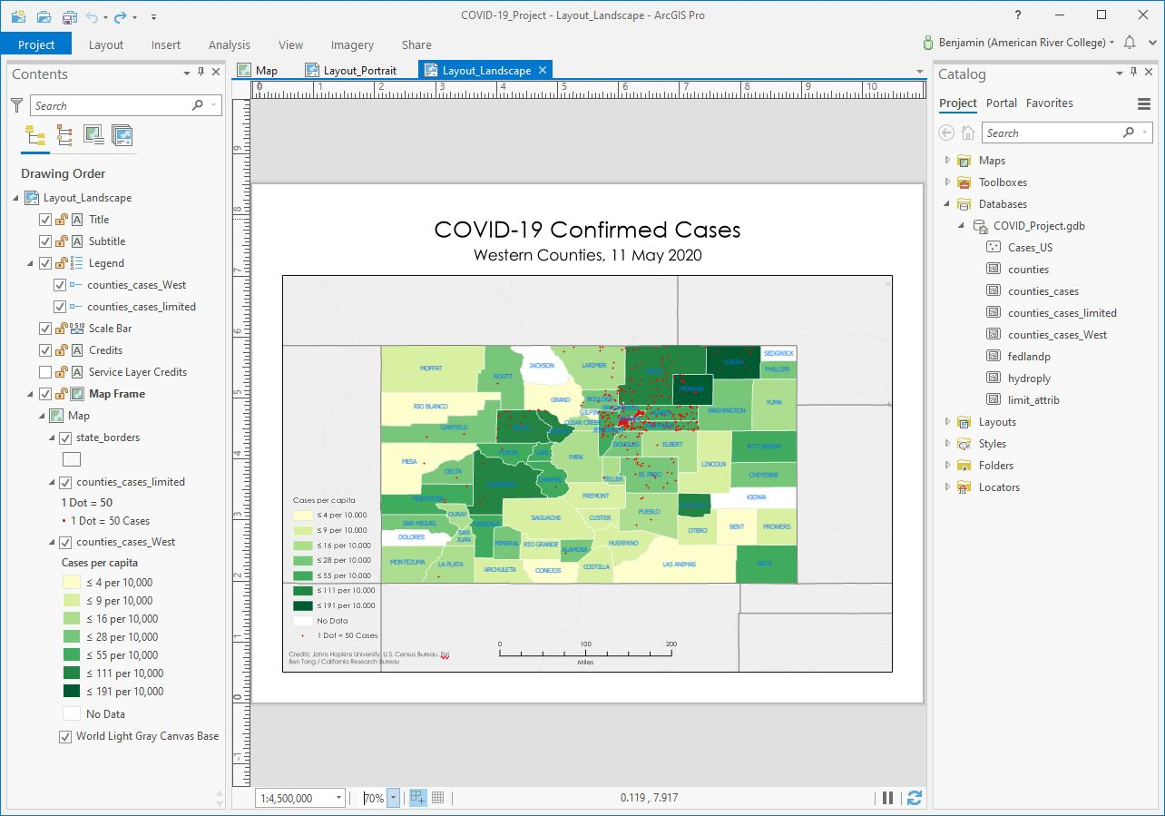
Landscape Layout

Slide 6
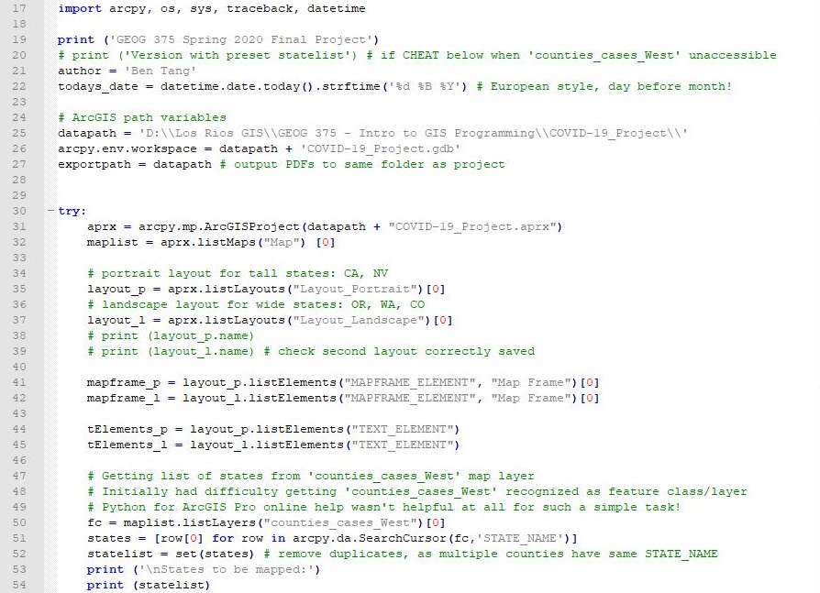
Script: Layouts and SearchCursor
Two layouts, portrait for tall states and landscape for wide states
Get number of maps to export from number of unique states in feature class

Slide 7
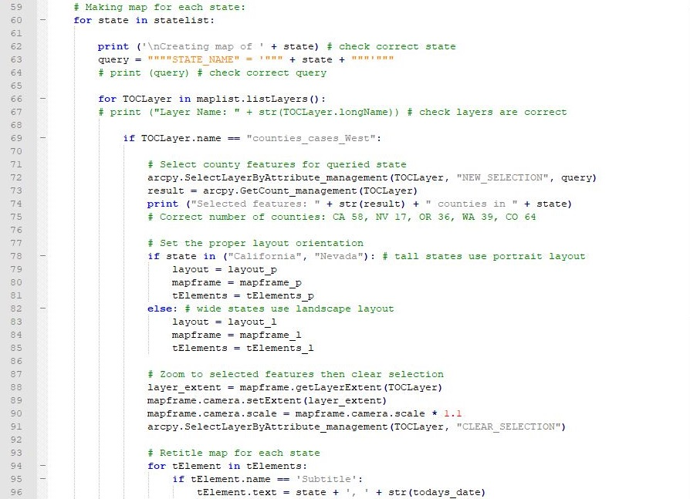
Script: For Loops and Layouts

Slide 8
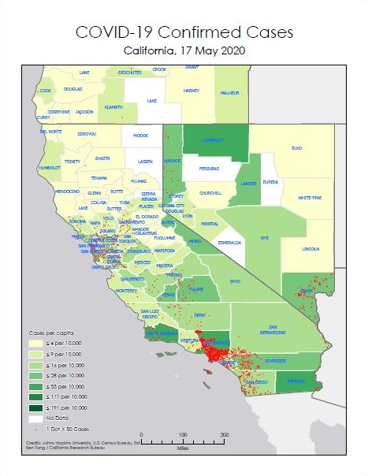
Sample Portrait Export
Retained Web Mercator projection
Option to use Definition Query to display only selected state’s counties, but prefer context of displaying neighboring states
Cases in choropleth are normalized to county population (2015 Census data)
Cases in dot density are displayed as 1 dot per 50 cases
Dot density layer has limiting ancillary attributes (water and parkland areas clipped out)
Subtitle text changes for state name and print date

Slide 9
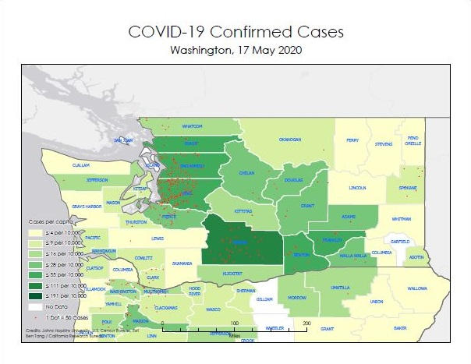
Sample Landscape Export
Legend overwrite problems in all landscape states
Possible fixes: horizontal legend for landscape layout, or legend outside smaller map frame for both layouts

Slide 10
Takeaways
Initial difficulty in getting map layer/feature class recognized in Python script
  Wanted to dynamically set the number of maps to be exported by retrieving number of states from layer data
  Online Esri help for Python for ArcGIS Pro not helpful
Would like to expand map series through time
  Perhaps script to download COVID-19 data from ArcGIS Online in regular intervals to update case data
  However, since case numbers will change, the legend ranges and color classification would also change
Could also display COVID-19 testing or deaths data
  Probably best as separate map projects (focusing on testing or deaths variables instead of confirmed cases)
Utility is mass production of maps for each county, as each state in Western States Pact has many counties
  Minimum 17 (Nevada) to maximum 64 (Colorado)
  Johns Hopkins has data for every U.S. state

