Slide 1
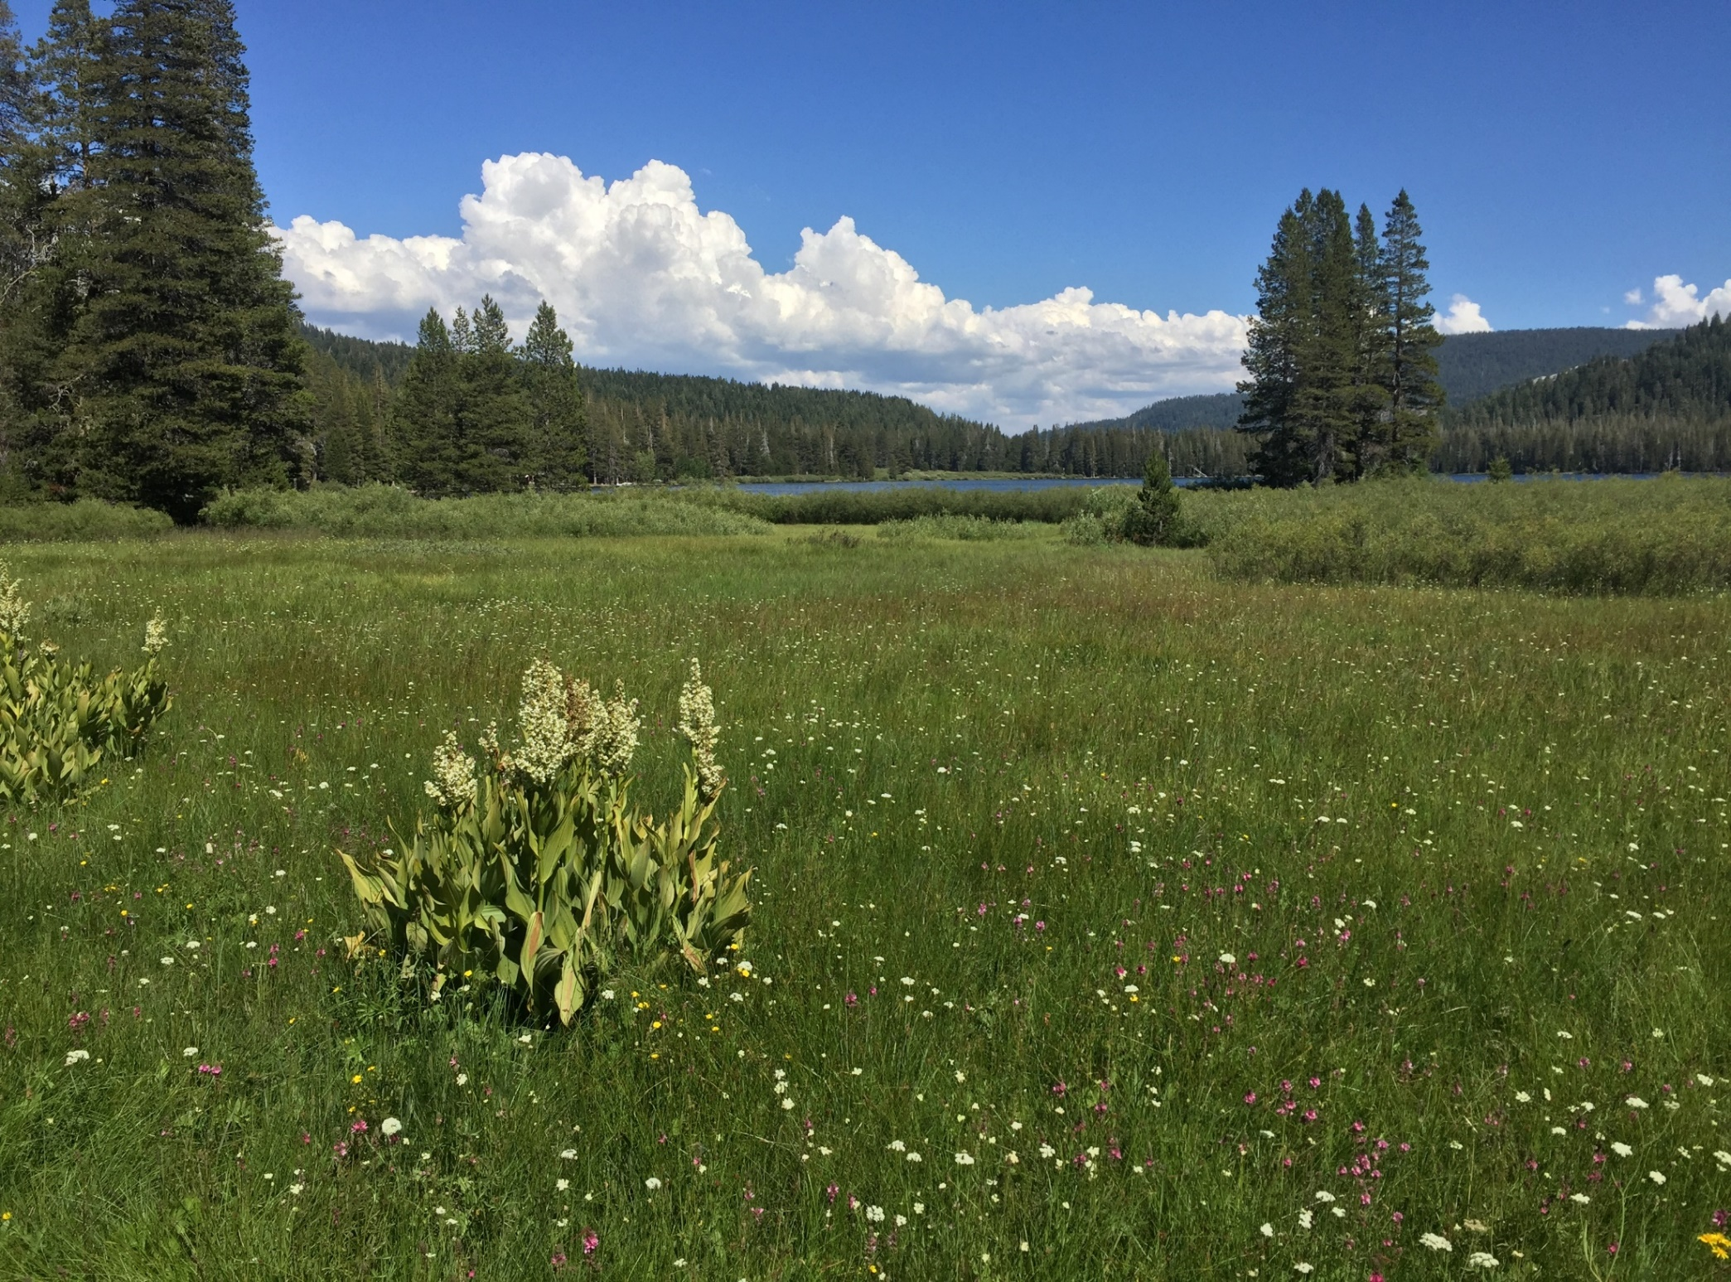
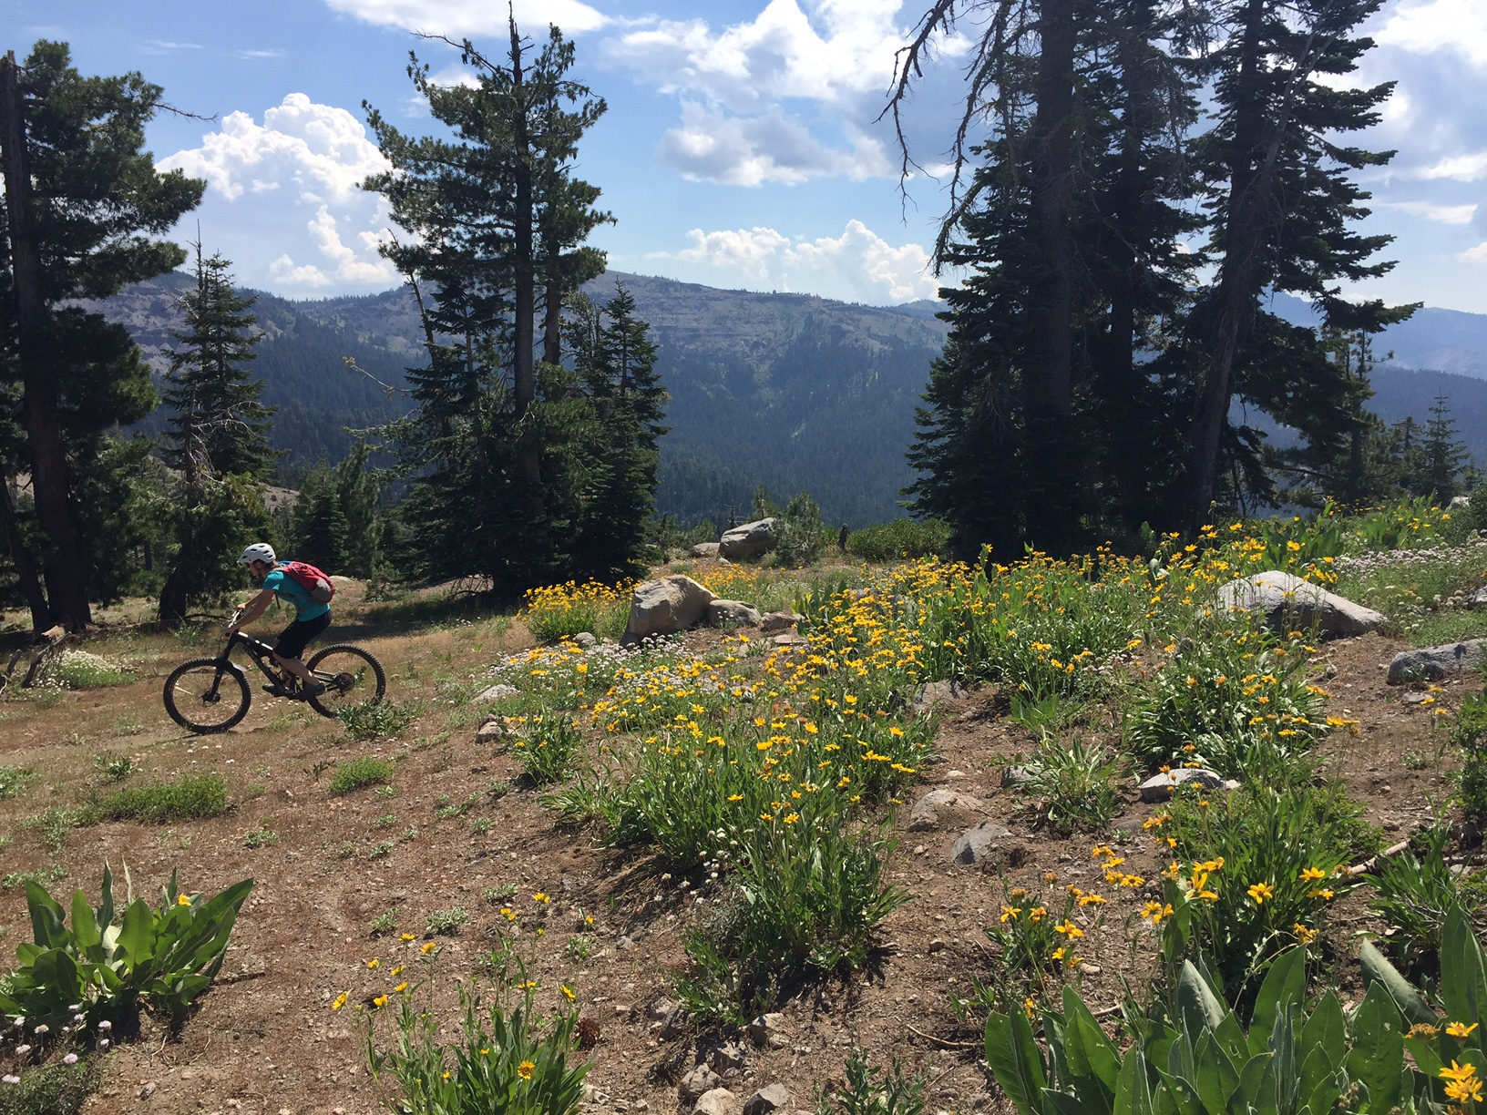
Truckee Donner Land Trust Ten Year Trail Plan
Kevin Starr
Geography 93
Final Project

Slide 2

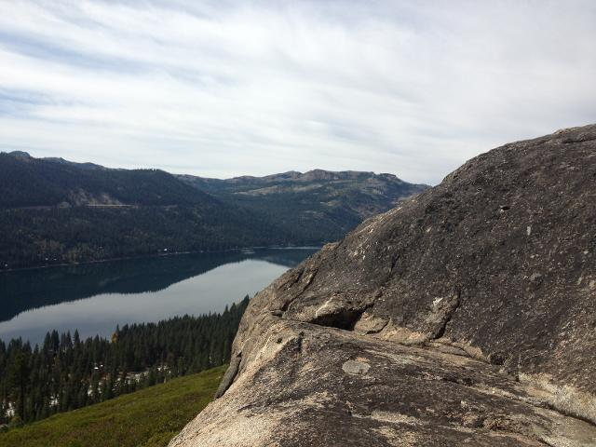
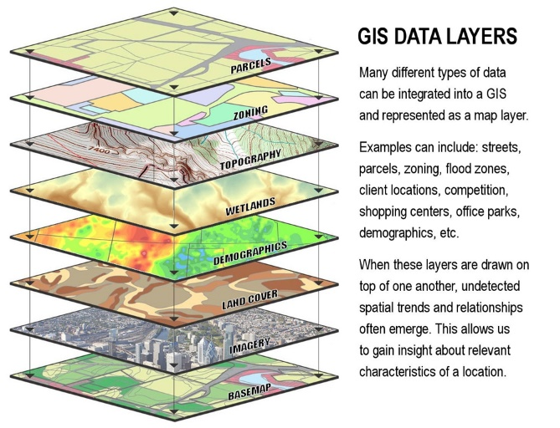
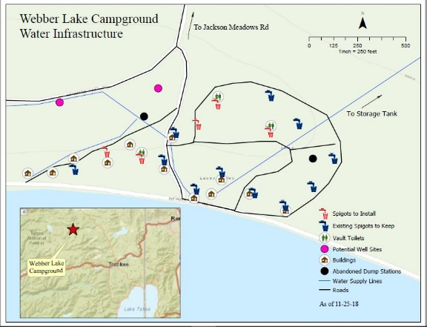
Scope of Project
Create a long-term vision of recreational trails for the organization
Create a database of existing trails and incorporate proposed trail projects
Create a series of maps for internal planning
Ability to have easily sharable data with partner organizations

Slide 3
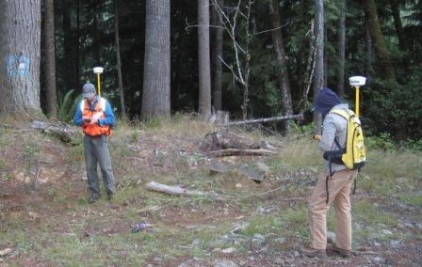
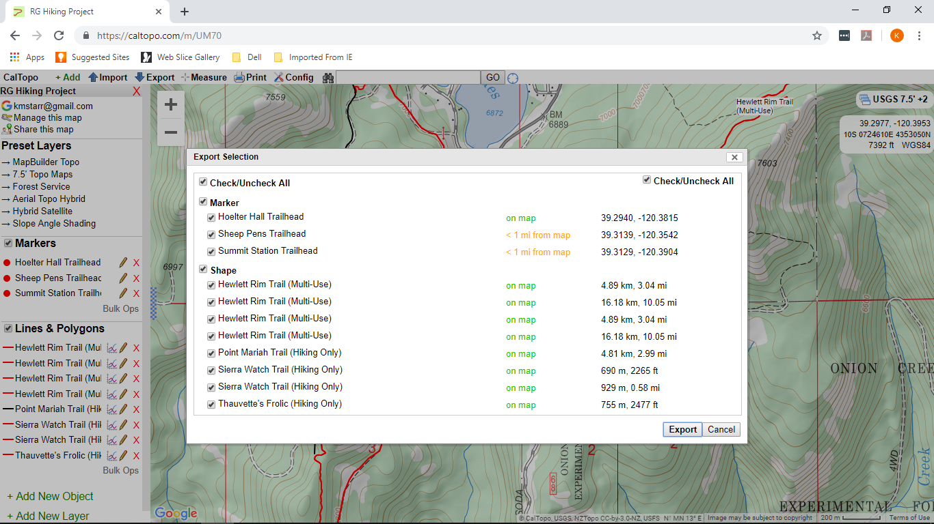
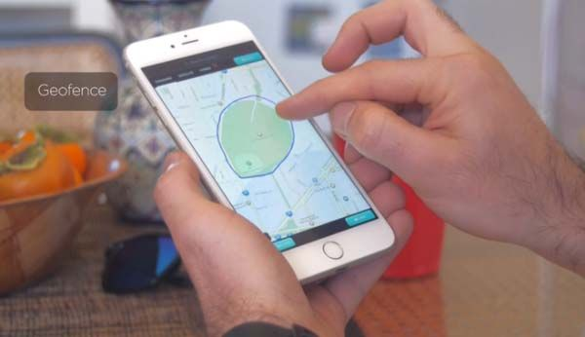
Process
Export .kml and .gpx files from CalTopo and Google Earth
Import files into ArcGis Pro
Convert files into feature classes using analysis tools
Bring in other layers like roads, property ownership, and hydrology

Slide 4
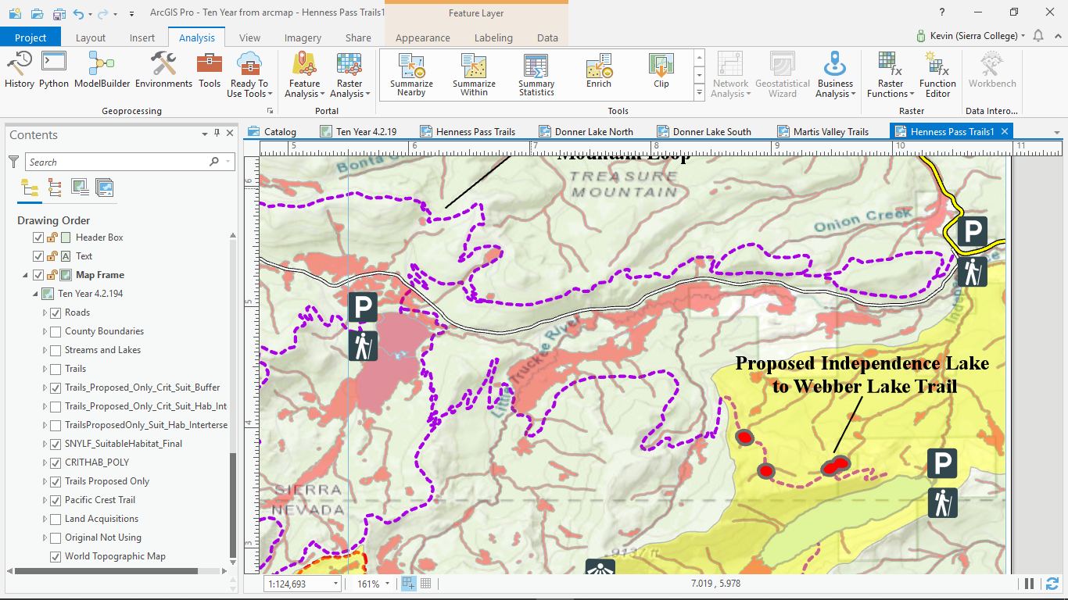
Layers Left for Later
Data sets like vegetation cover, soil types, and sensitive species were too detailed for project
For future reference I did analysis on how some of the proposed trails interacted with sensitive species data
Used two layers, critical habitat and suitable habitat targeting the SNYLF
Trigger point was where proposed trail alignments intersected with both habitat layers
Created buffers around those areas for trail re-alignment

Slide 5
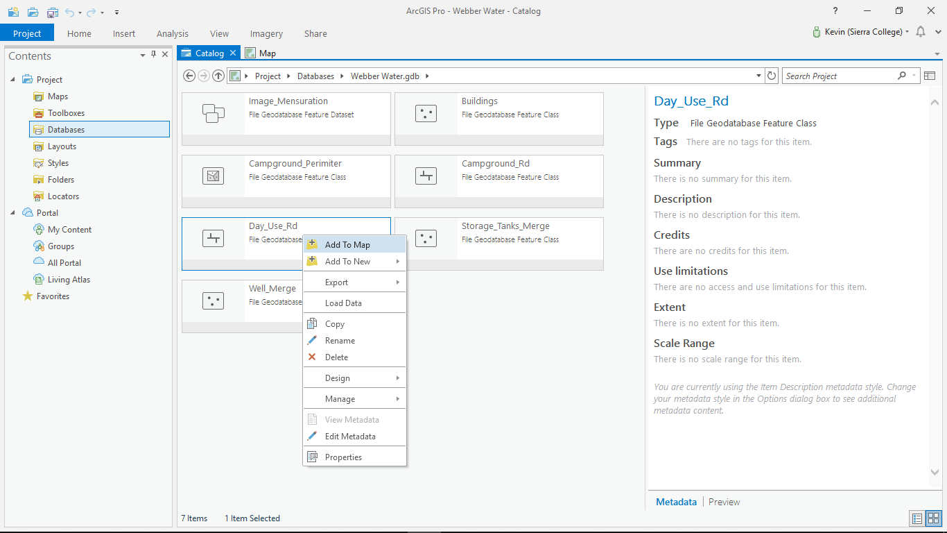
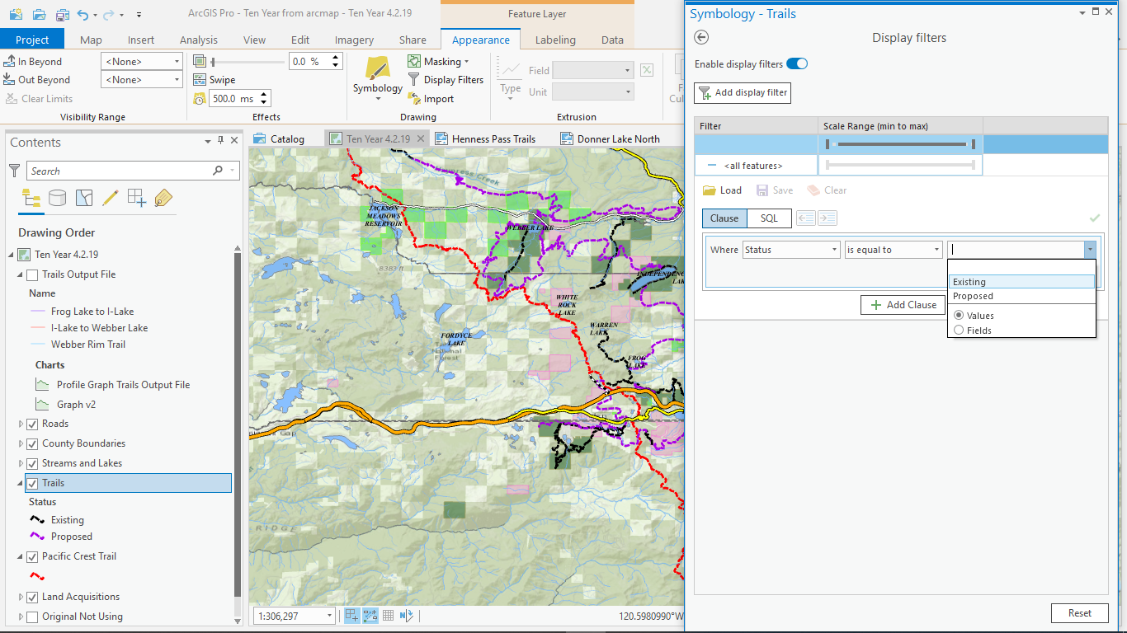
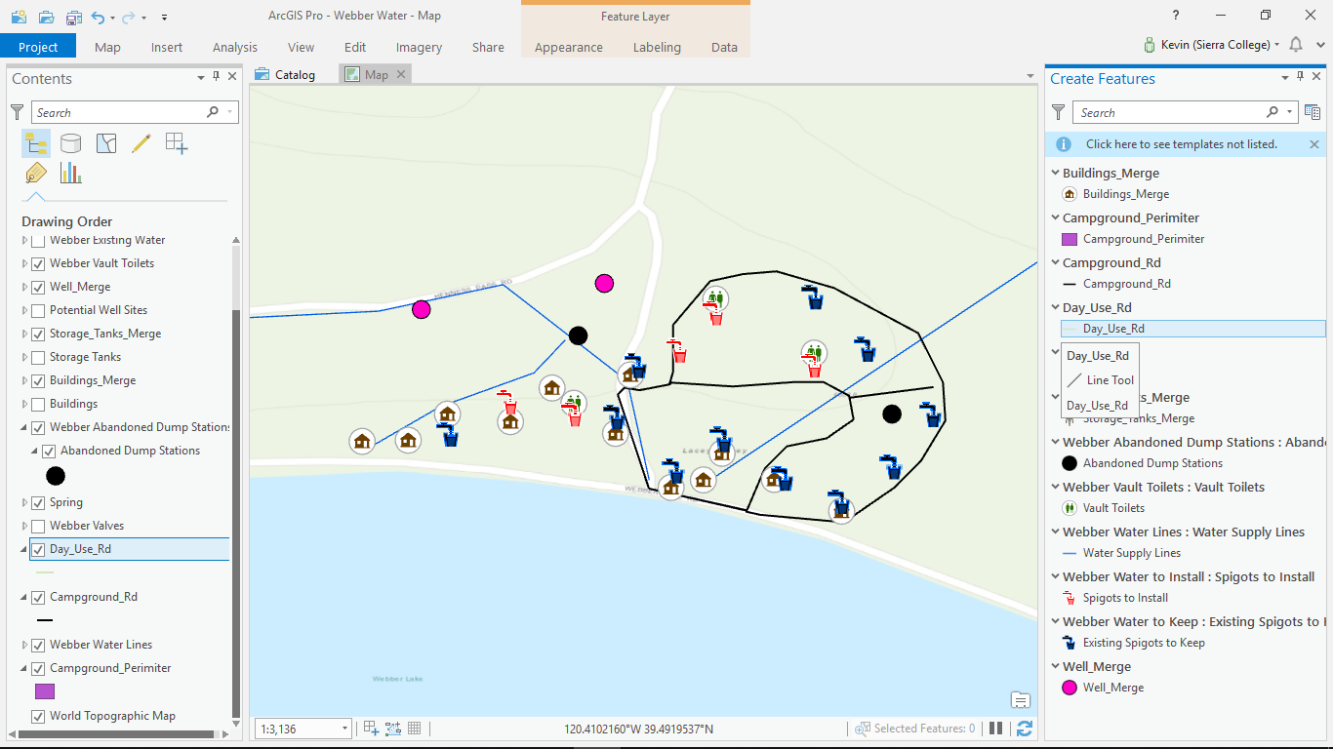
Symbolization
Organized trails in attribute table by status; existing or proposed
Used display filters to symbolize trails
Used graduated symbology for roads and hydrology layers

Slide 6
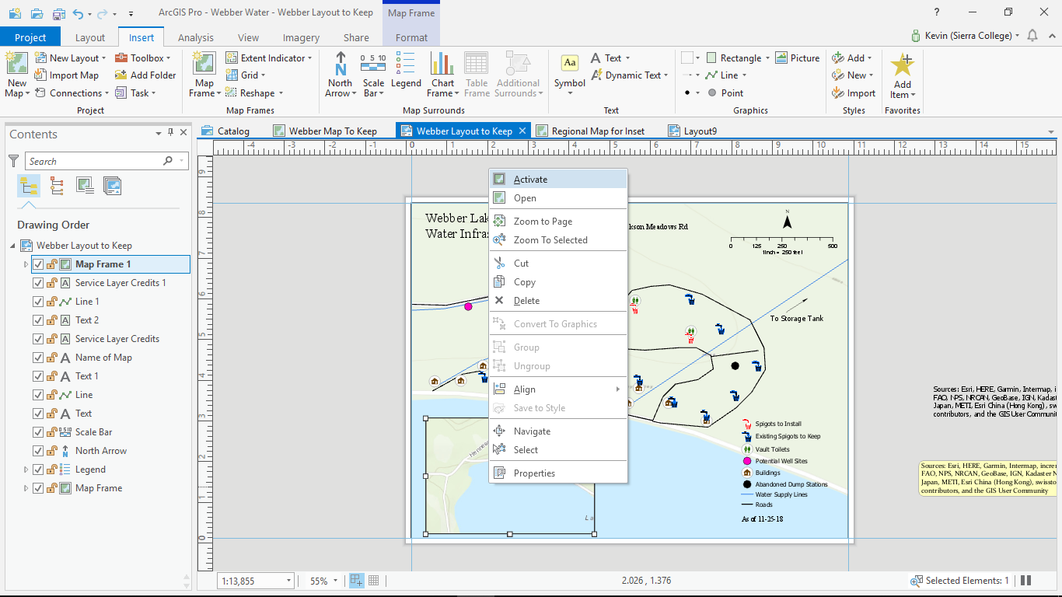
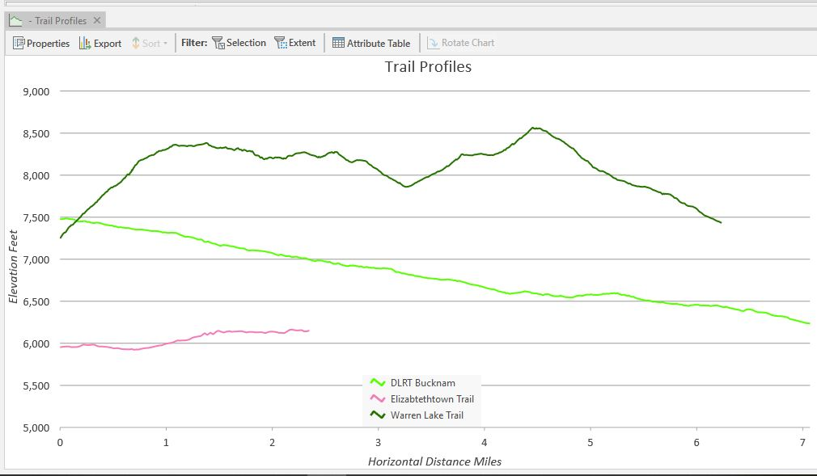
Trail Profiles
Create a 3D version of chosen line features
Right click new layer to create profile graph
Edit features and set numerical parameters

Slide 7
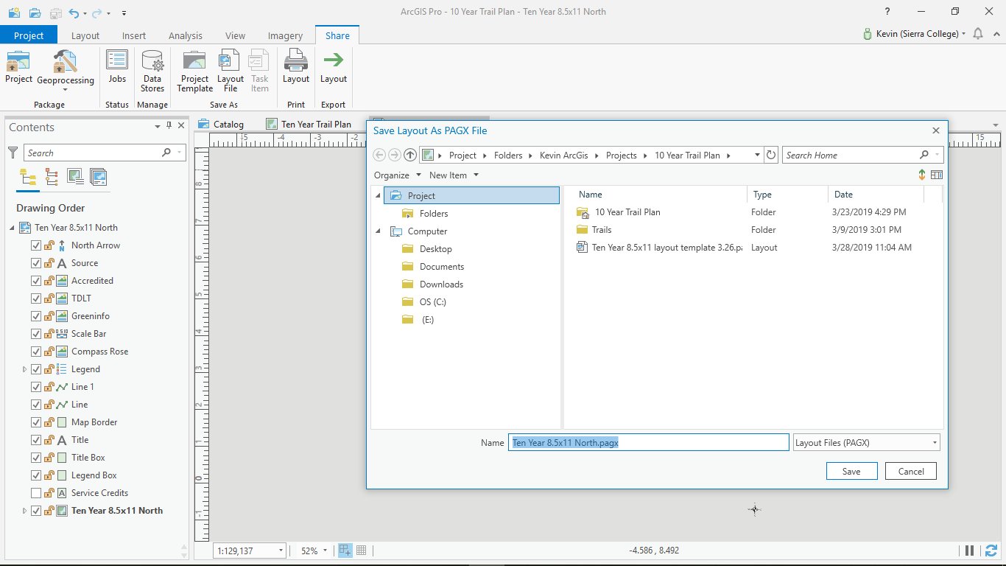
Map Creation
Finalize data input
Create first complete layout map
Save as a layout file for quick duplication
Import layout file as needed for different map frames

Slide 8
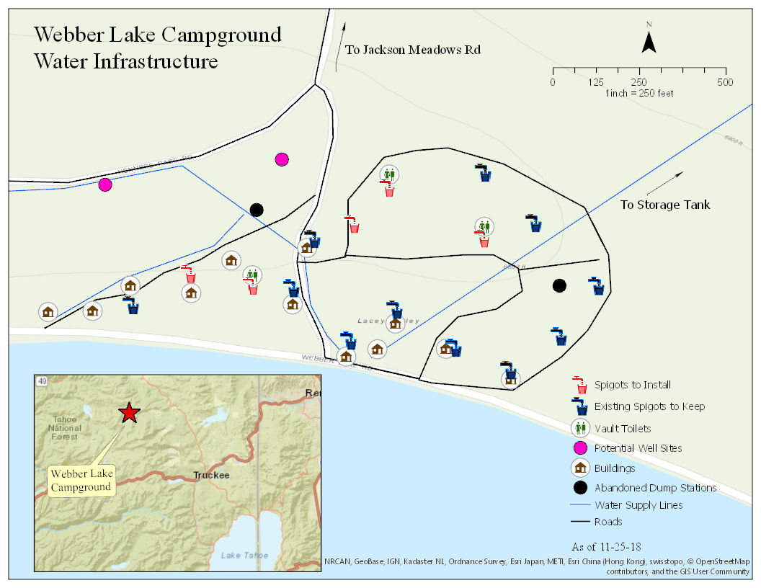
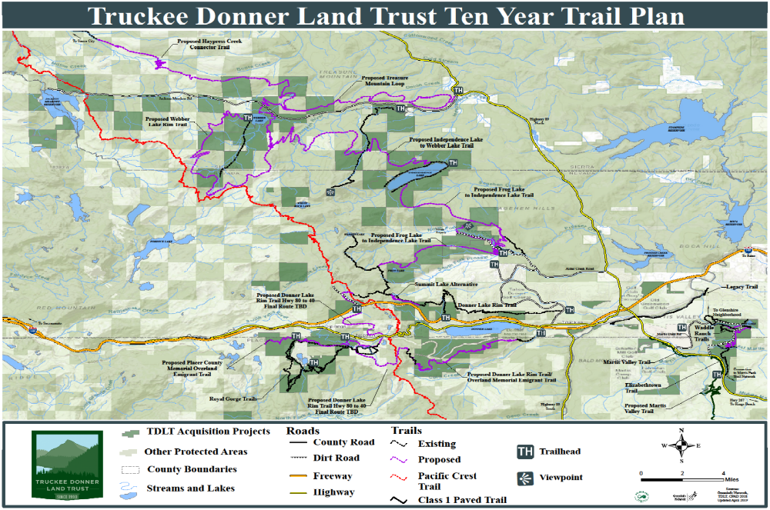
Final Maps
To West Side CG

Slide 9
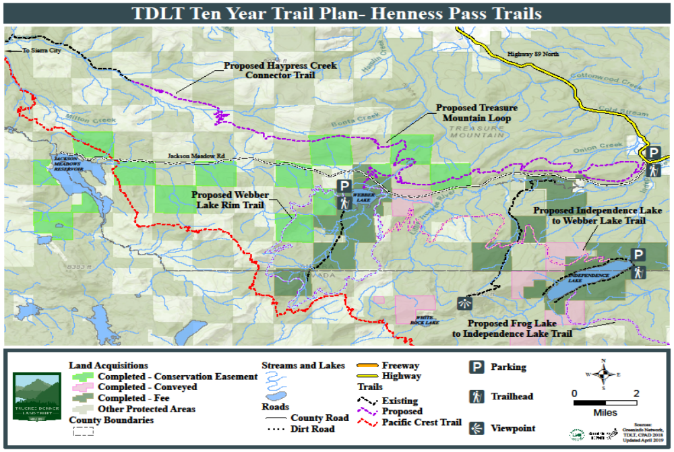
Final Maps
To West Side CG

Slide 10
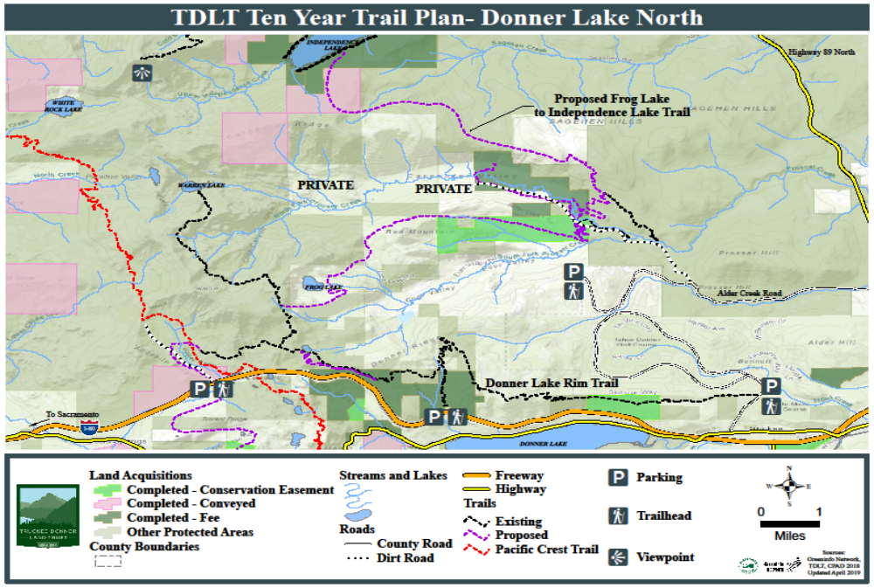
Final Maps
To West Side CG

Slide 11
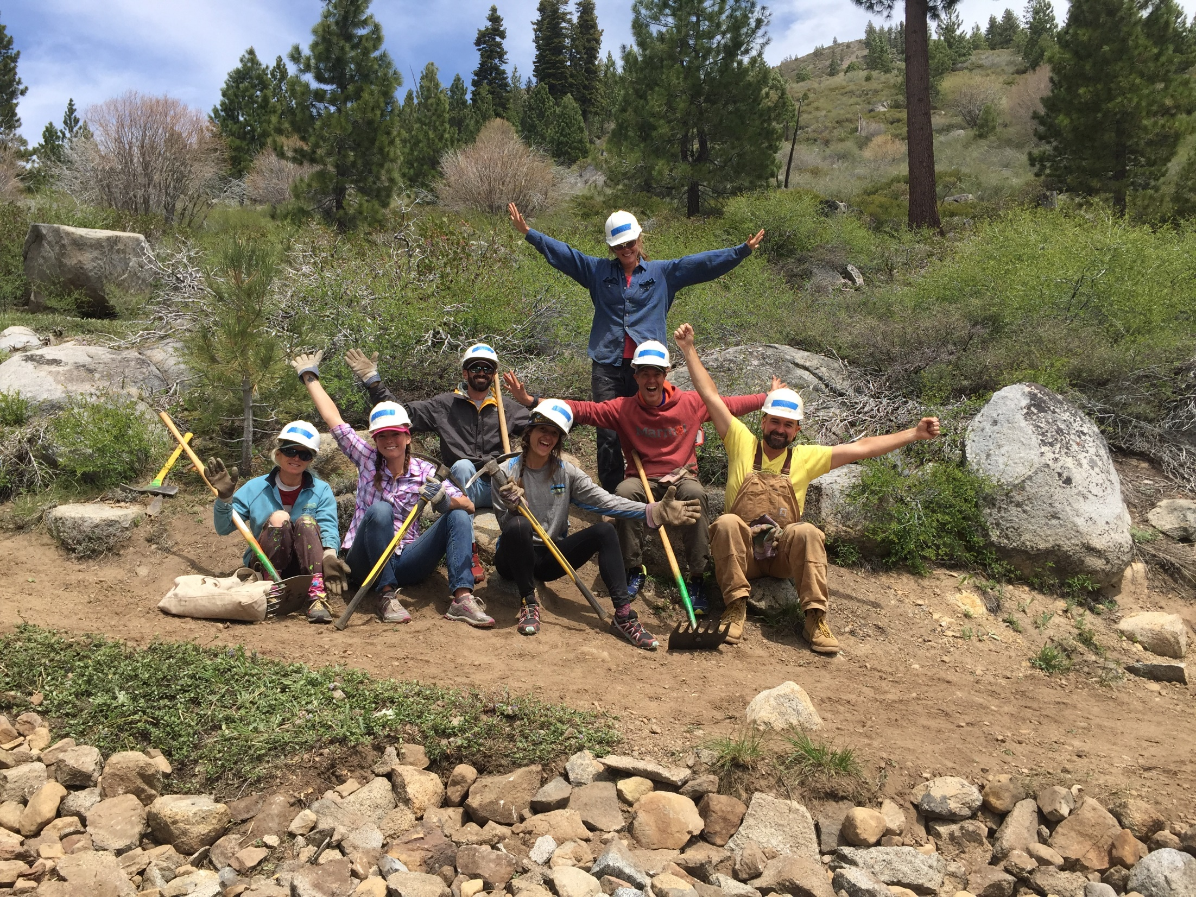
GIS Learning Outcomes
Challenges | Resolutions
Saving work before program crashes | Saving after every challenging geoprocess
Wanting to show too much data to make a concise map for this exercise | Broadened scope of project to be more of an overview
Making graphs to show trail profiles | Had to photoshop certain aspects of graph
Figuring out how to use a the same layout for repeatable maps of same style | Trial and error with using project templates vs layout files

