Slide 1
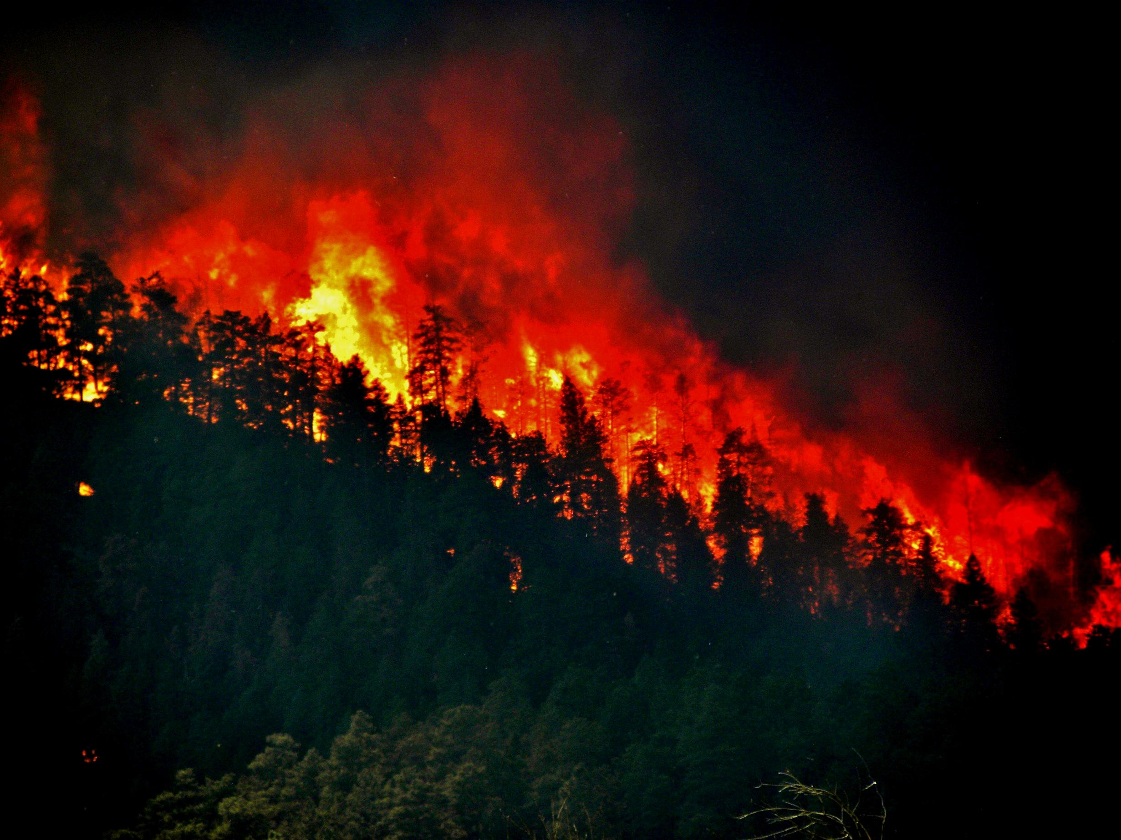
CALIFORNIA WILDFIRES
GEOG-0093 FINAL PRESENTATION
By: Ryan Soulier

Slide 2
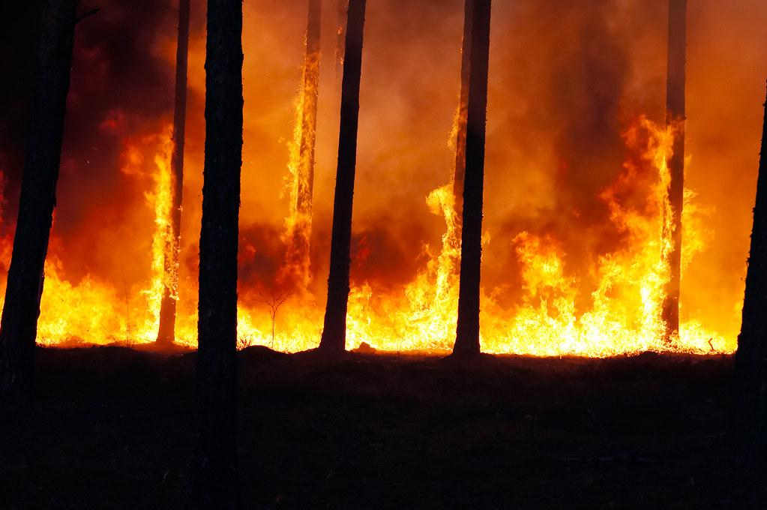
CALIFORNIA’S WILDFIRES
Almost yearly, California is wrought with major wildfires that have devastated the environment and communities throughout the state. 4.3 Million acres burned in just 2020
They cause home displacement, property destruction, unsafe air quality, extreme heat, habitat loss, death, and much more.
In recent years the number of yearly wildfires and acres burned has increased alarmingly
The purpose of my project is to outline where, why and how the fire have burned, identify what and where burns, and showcase preventative methods.
I was interested in fire maps after viewing various fire related maps during the tragic 2020 fire season
ArcGIS Online contained the data I needed after sorting through and finding substantial information

Slide 3
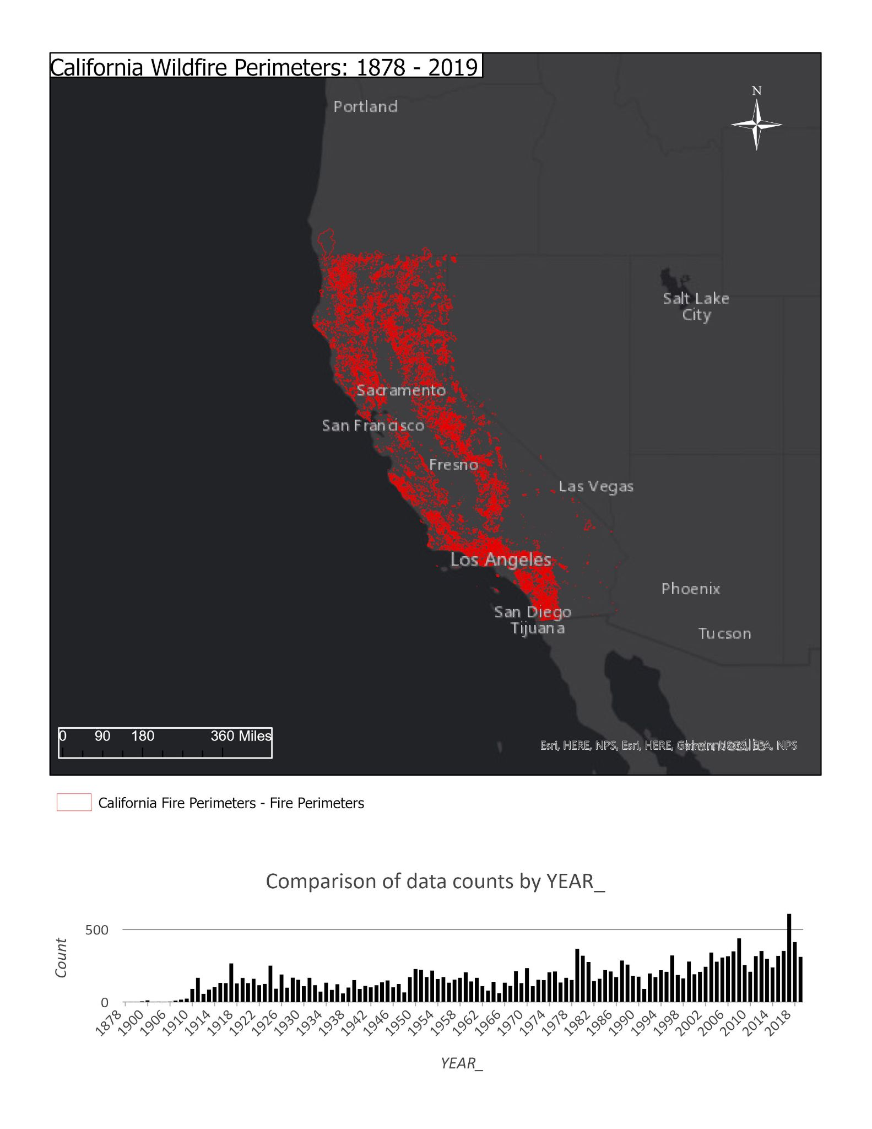
ArcPro Map Layout:
Fire Perimeters 1878 to 2019
California’s wildfires are mostly caused by:
Unattended campfires (human error)
Burning debris (human error)
Downed power lines (human error)
Arson (human error)
Lightning strikes
Weather Patterns
Lava

Slide 4
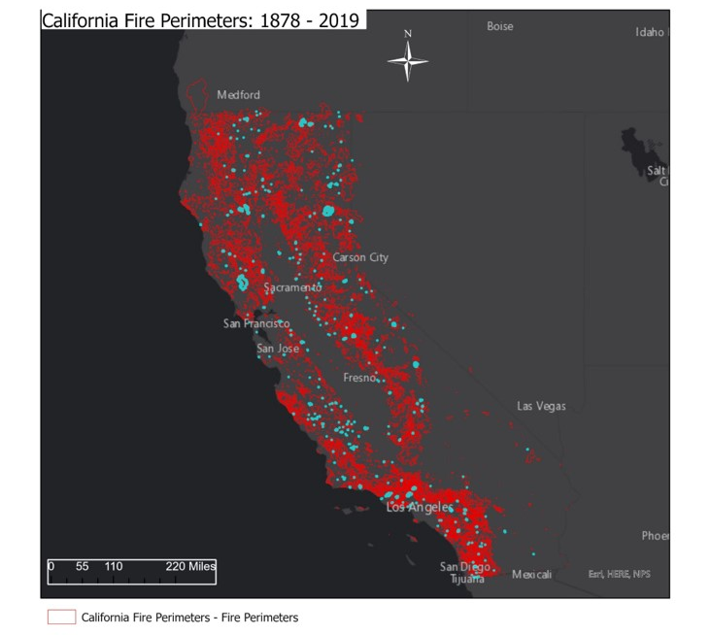
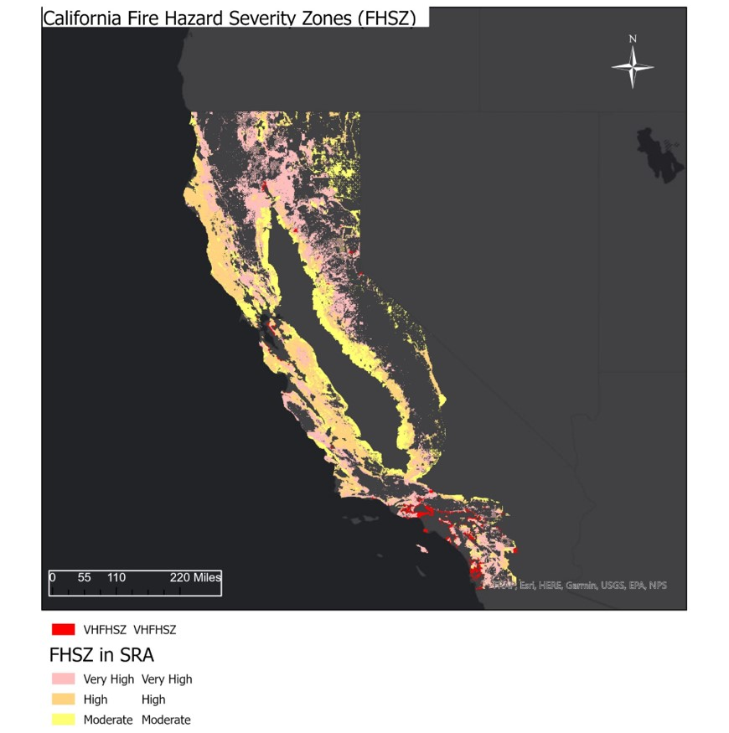
California Wildfires: Comparing FHSZs and Fire Perimeters
FHSZs and
Fire perimeters closely related and correlated as shown
Even areas
of lower fire hazard severity have burned substantially
The outside
portion of California’s interior is scarred significantly more

Slide 5
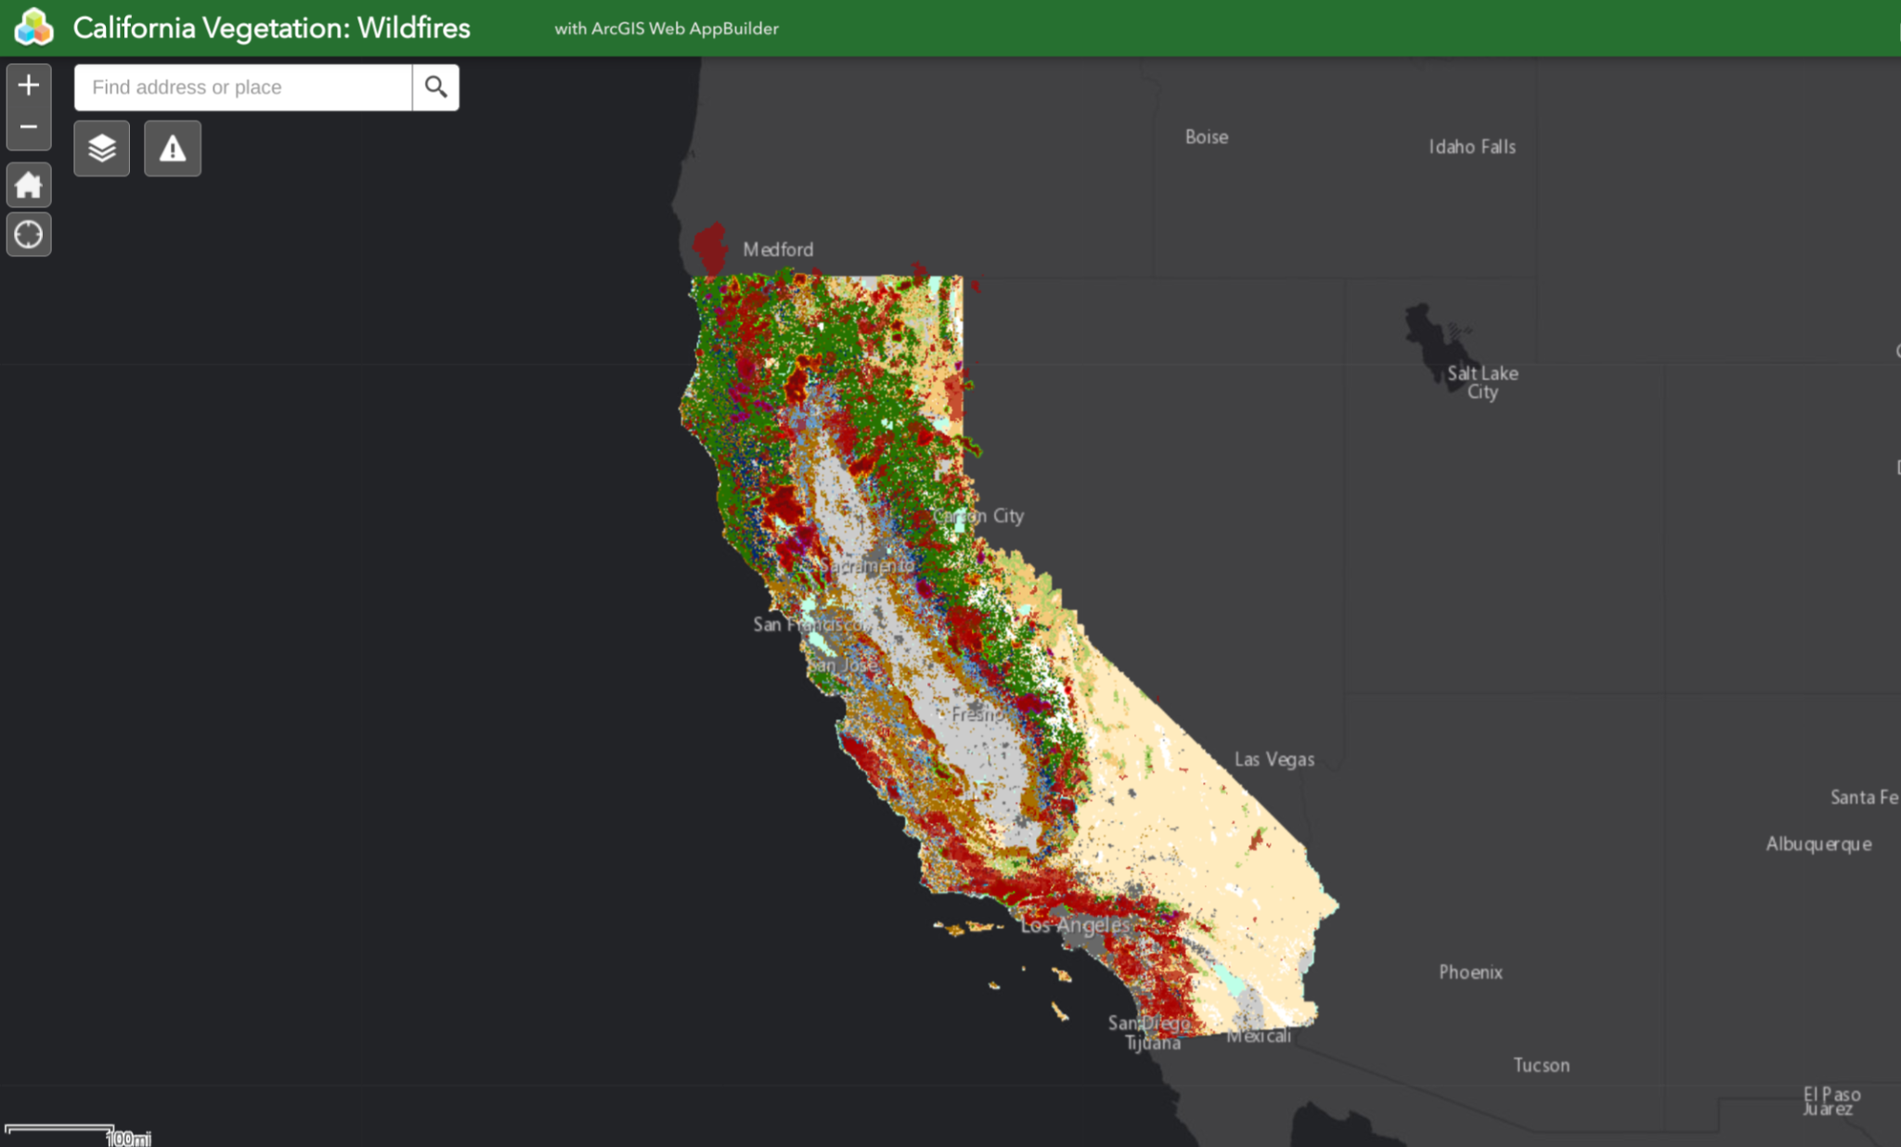
ArcGIS Online Web Map Application
California Vegetation vs. Fire Perimeters
Map Application included foldable theme, layer’s list and incident analysis as the functioning widgets. The legend and print options are in the upper right, for additional analyzation of perimeter dates
and vegetation
https://sierra.maps.arcgis.com/apps/webappviewer/index.html?id=89ad64d405d04ef6a9a6bc5c5ed9dfc3
Comparison of the type of vegetation in California to the location of the fires
Conifer and Hardwood Forests, Shrub, and Herbaceous Vegetation seem to take up the bulk of the burning area in California
The land near the center of California, the central valley and the agriculture (grey) section is almost untouched and burns minimally according to the fire data

Slide 6
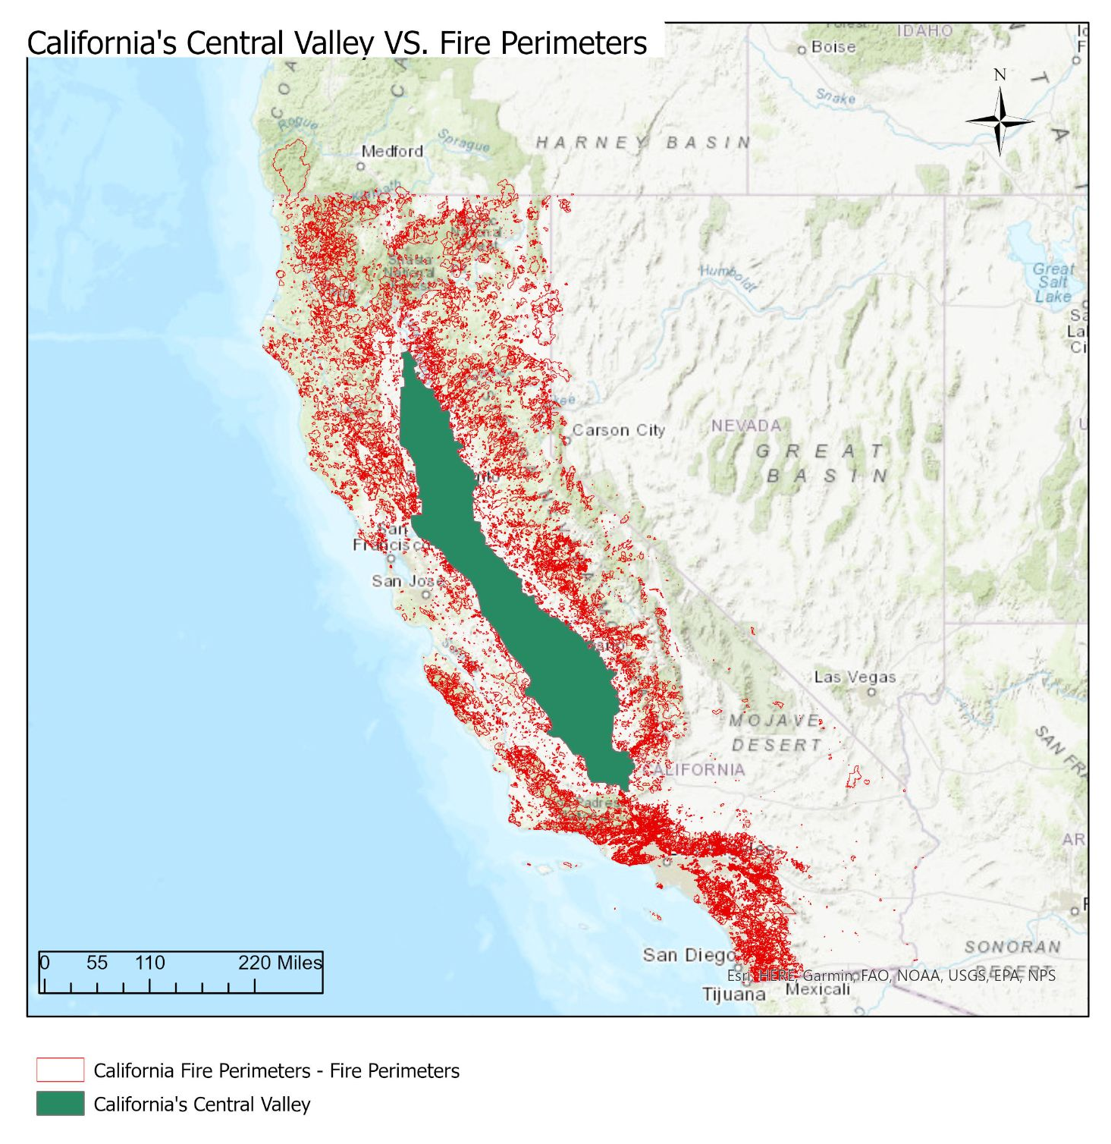
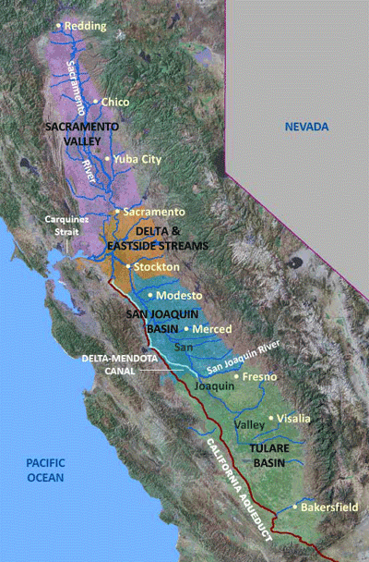

California’s Central Valley
California’s central valley (from about Redding to Bakersfield, around 450 miles) consists mainly of flat agricultural land and has an extremely scarce wildfire history
This basin is one of the only almost untouched sections of California by wildfires
We live in the eastern part of the central valley, the “wildfire safe zone”

Slide 7
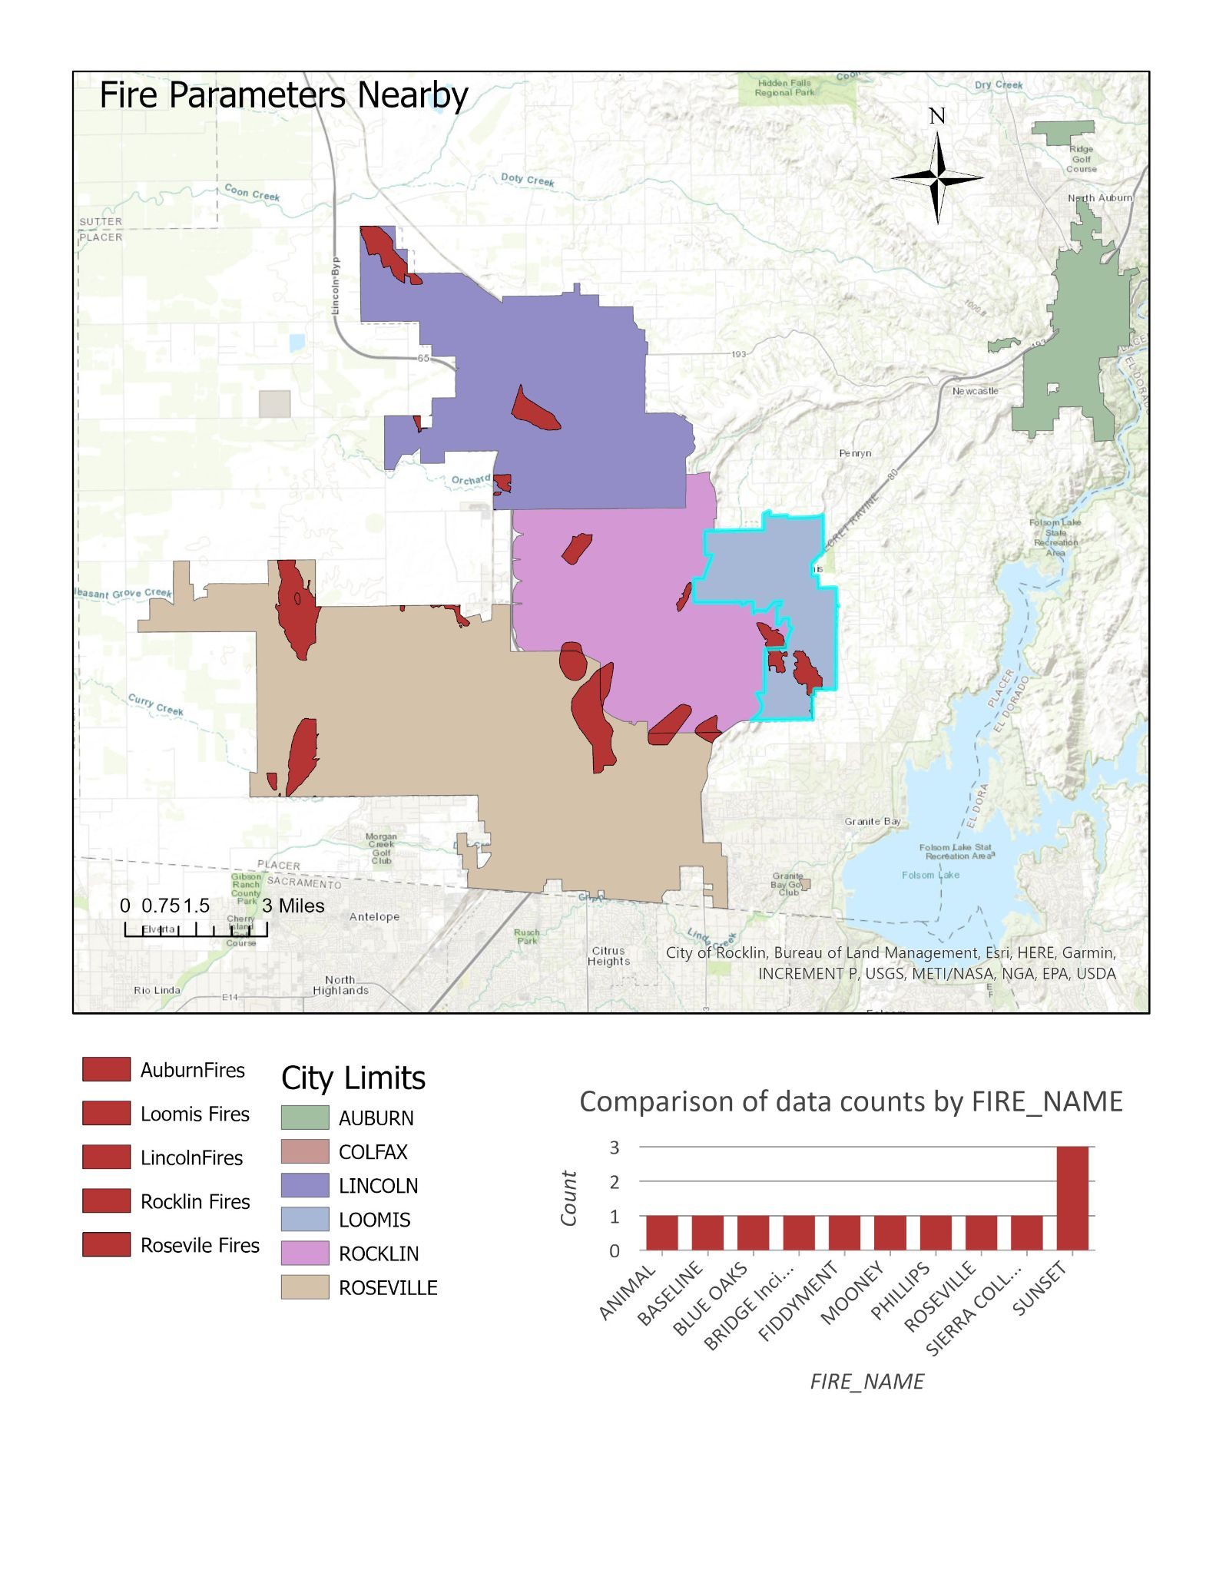
Wildfires in nearby Placer County in the past decade, alarming how close and recent the wildfires are
The past animal fire in Eastern Roseville is extremely close to my house
What can be done by YOU to prevent wildfires:
-Keep vehicles and other heated machines off dry shrubbery
-Douse your campfire entirely
-Limit spark ejection
-Burn debris safely with formidable weather
-Limit pyrotechnic and cigarette use
-Keep a close eye on candles in the outdoors
Wildfires in Cities Nearby: Auburn, Colfax, Lincoln, Loomis, Rocklin, Roseville 2007-2019

Slide 8
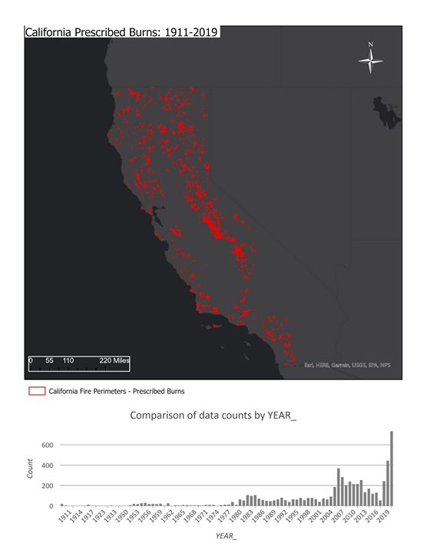
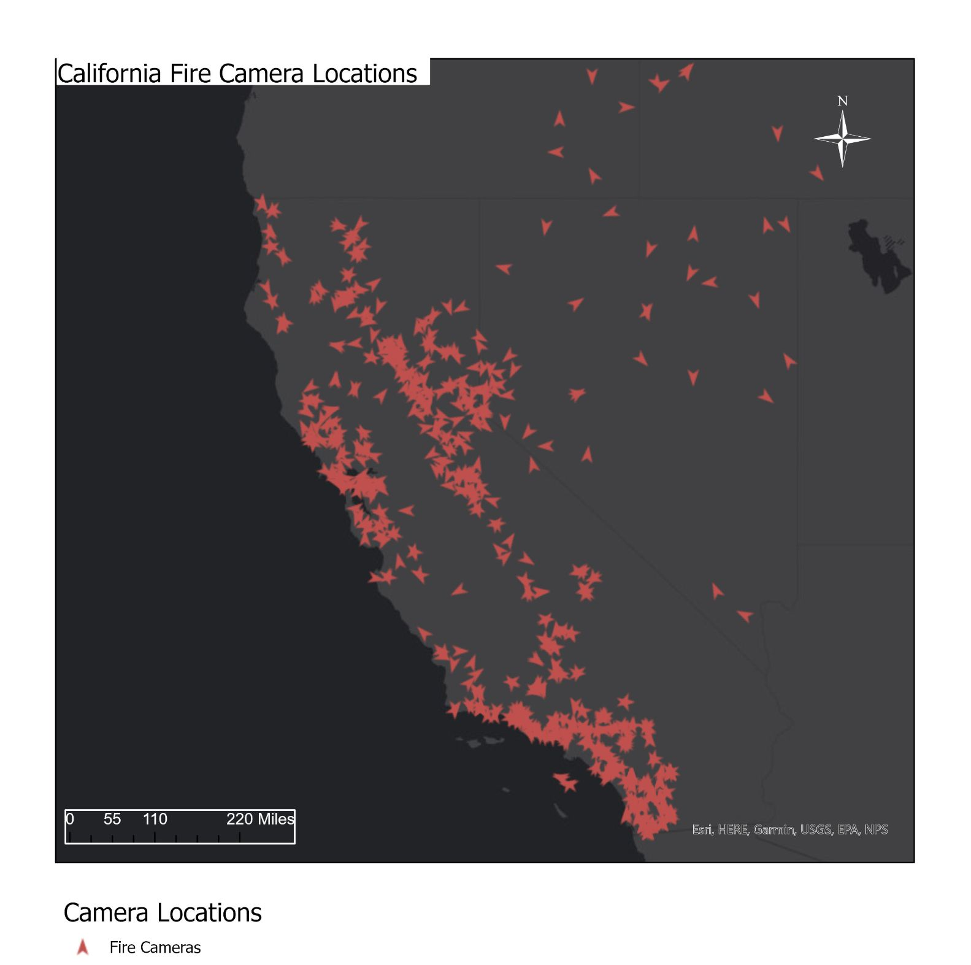
California’s Wildfires: Preventative Methods
What is being done widely?
Prescribed burns or controlled burns manage and reduce hazardous fuel loads near developed areas, manage landscapes, and eliminate excessive flammable brush
Installed Infrared thermal cameras detect radiating heat from fire bodies and track loose embers and out of control flames before they rage into wildfires
Millions of dollars in promoting anti-wildfire habits and procedures

Slide 9
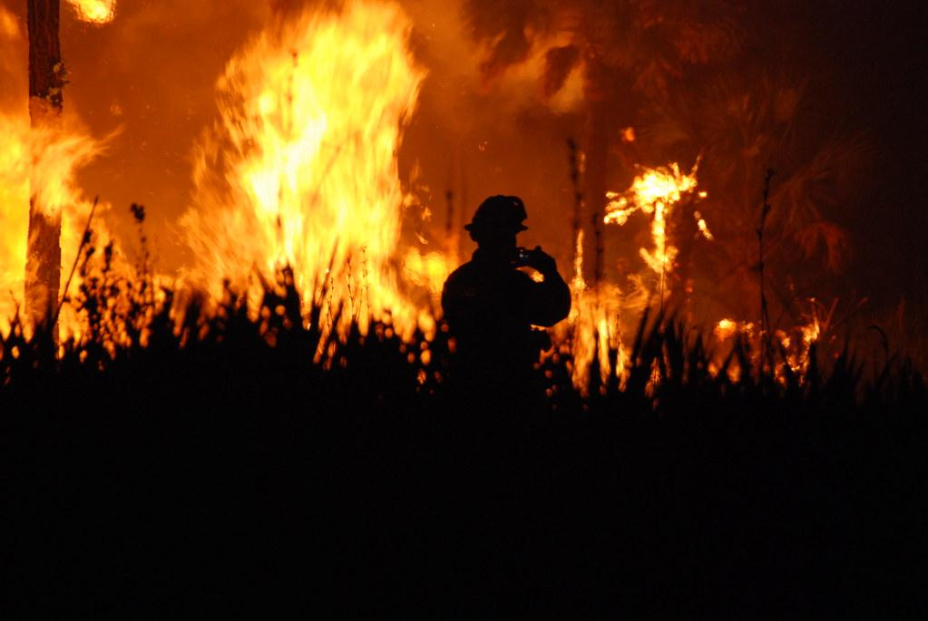
Difficulties and Processes in the Project
Processes:
I processed and sorted through extensive wildfire data on ArcGIS Online, and then saved it as a ArcGIS Pro Project
Styling the Layouts took substantial time
I clipped and exported data to fit my needs
I created polygons in a file geodatabase
I was able to use other analysis tools but didn’t implement them in the end
Difficulties:
Figuring out styling and data, especially finding the right data
Finding out how to save the layouts in the right format that would upload to google slides
Creating my Legend and layouts without unneeded distracting material

Slide 10
Thanks For Listening!

