Slide 1
Covid-19 Vaccine Sites
AZ Counties
Geog 375 Final Project
Eli Renteria
5/14/21

Slide 2
Summary
This project will produce a python script file that will automate the production of a series of bivariate Maps showing Vaccine sites and population density for Arizona counties.
Additionally, I aimed to get a count of how many vaccination sites were in each county.
The goal of this project was to get a better understanding of the state of Arizona’s Covid-19 response

Slide 3
Geoprocessing Tasks
The main geoprocessing processes used include:
SelectLayerByAttribute
arcpy.GetCount_management
mapframe.camera.setExtent
layout.exportToPDF
Query statements
I relied heavily on code from the chapter 9 demo scripts and data provided by Prof. Jennings.

Slide 4
Data
I used data sourced from my Geog 340 Cartography courses’ bivariate map project for the county and various road shapefiles. I used a definition query to select start with only Arizona counties, then clipped all the background information to my county layer.
I was able to find Covid-19 vaccination provider data online from URISA’s GIScorps through ArcGIS hub datasets.

Slide 5
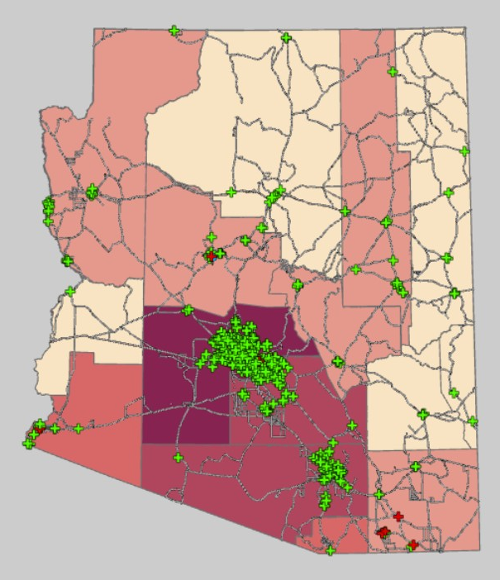
Map
I symbolized the counties with graduated colors the using the 2015 census population normalized by Square Miles.
The Vaccine Sites were symbolized with Unique Values and categorized into 4 classes by status: Closed, Open, Temporarily Closed, and Testing Restricted
Closed and Temporarily closed were given the same symbol
I added a layout, with a legend, and title

Slide 6
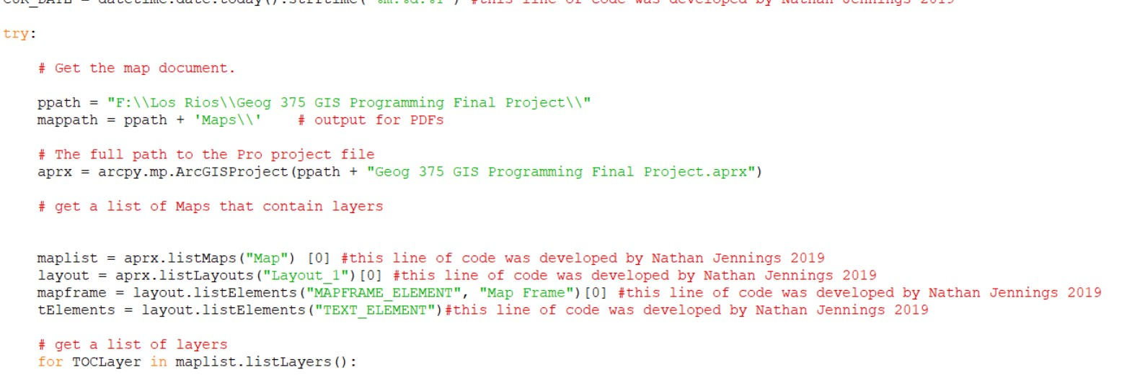
Code
I started with getting the map and a list of layers

Slide 7
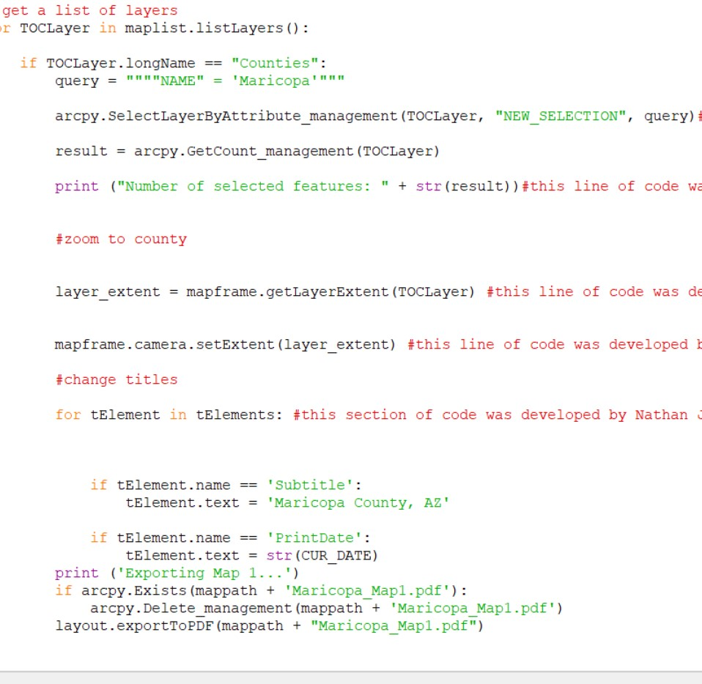
Code
I followed by selecting the Counties payer, then used a query to select the county I wanted, so I could center it for the map.
I then changed the titles, used a print date, and then printed the map
Repeating for the other county I wanted to print

Slide 8
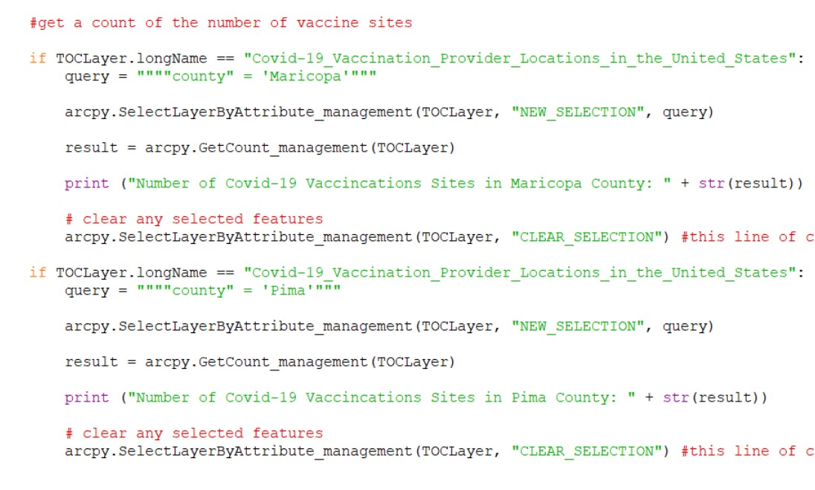
Code
I then wanted to print out the number of vaccine sites for each county, so I selected the vaccine provider layer, and then queried for the county I wanted. Repeated for the other county

Slide 9
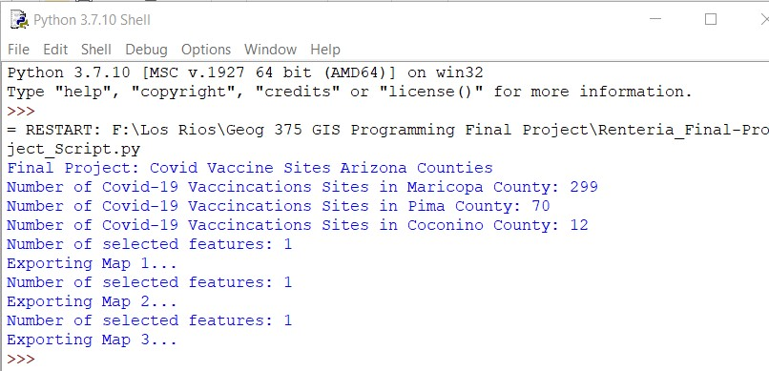
Results: Shell
My python shell results were successful, printing out the number of sites for each county.

Slide 10
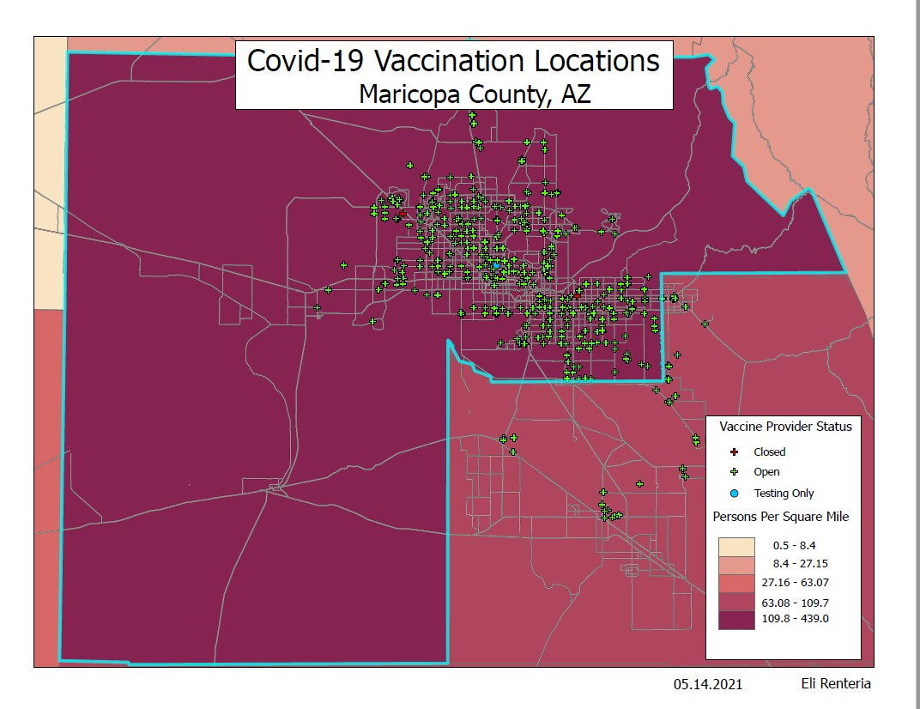
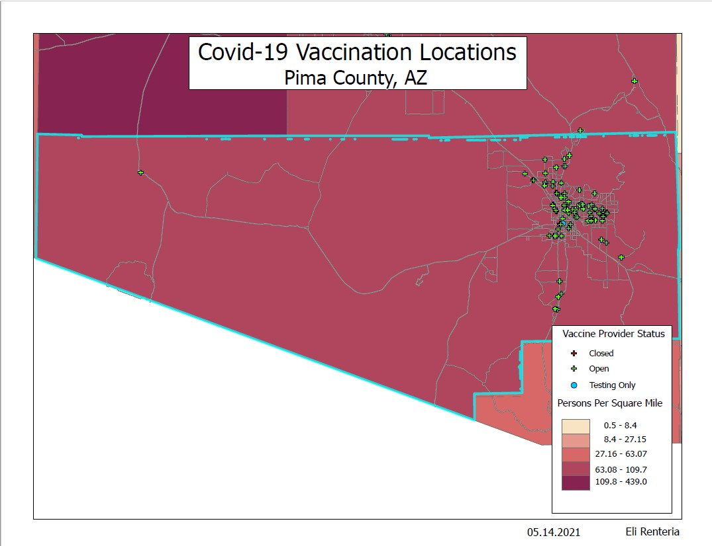
Results: Example Maps

Slide 11
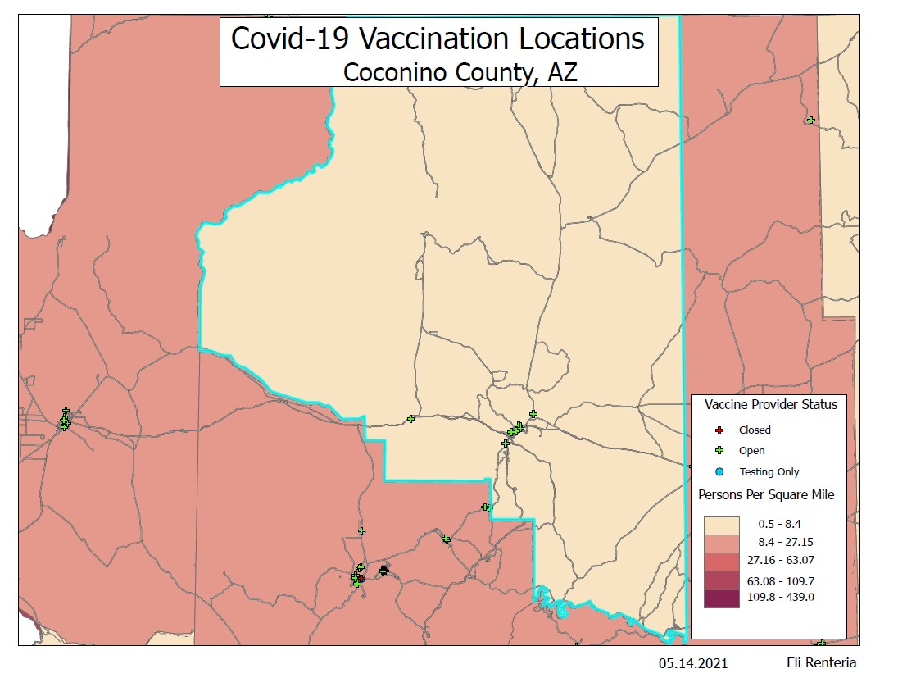
Results: Example Maps Cont.

Slide 12
Main Issues
The covid-19 vaccination data was not clean, so the county vaccination count is inaccurate
My print out in the shell was not in the order I wanted it to be
And the map could be better designed, showing more background information, or making the population density a better color scheme
The covid data is also old data now, and was incomplete as it did not include known vaccination sites on tribal land

