Slide 1

COVID-19 Vaccine Analysis
Intro to GIS Programming
C. Marisol Ramirez
May 5, 2021

Slide 2
Project Overview
Amidst current pandemic, the Covid-19 vaccine has been manufactured and distributed in attempts to curve high infection rates and prevent spread of virus.
First rollout of vaccines began in December 2020 ( outside of clinical trials)
Since then, 3 major brands have been developed and authorized by the FDA:
  Pfizer
  Moderna
  Johnson & Johnson

Slide 3
Project Overview
Conducted analysis using data reporting vaccines administered throughout California
  CA.GOV
Data reported number of vaccines administered by brand
  Pfizer
  Moderna
  Johnson & Johnson
Data separated by date of administration and county

Slide 4
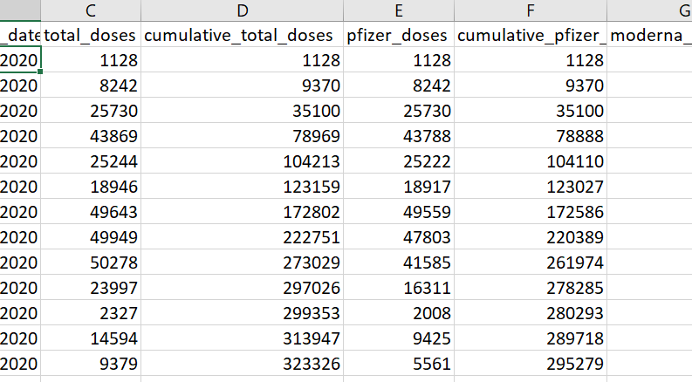

Slide 5

Purpose
Relevant topic of vaccine comparison
Various ways to manipulate the data
  View differences in reported vaccinations between counties
  Compare rates between different vaccine administered dates
  Use data to map administered vaccines by brand throughout the state
Gain a better sense of the rates of vaccines administered in each county, both cumulatively and by individual brand

Slide 6
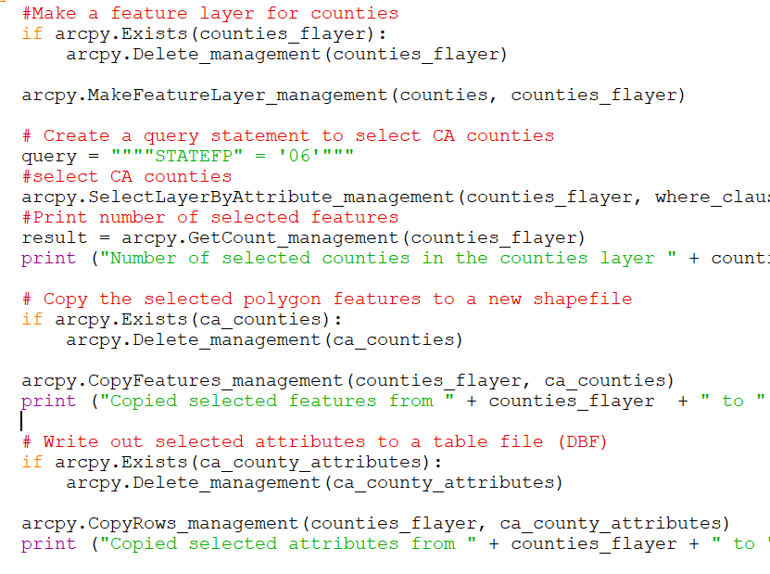
Methods Used
USING COUNTY DATA SHAPEFILE:
Make feature layer to further manipulate data
Select layer by attribute using query
Copy selected features to shapefile and attributes to a table file

Slide 7
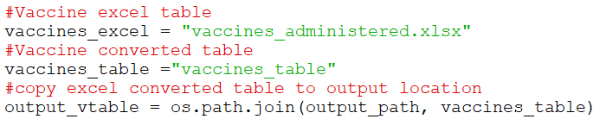
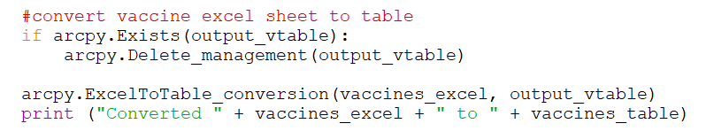
Methods Used Cont.
EXCEL TO TABLE CONVERSION
VARIABLES DEFINED
CONVERTED TABLE LOCATION
CONVERSION SCRIPT

Slide 8
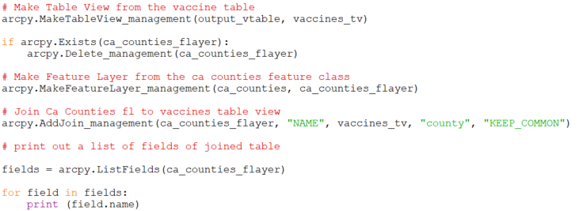
Methods Used
Table Join
Make feature layer to and table view
Join feature layer and table using common field

Slide 9
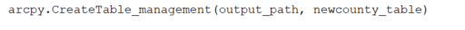

Methods Used Cont.
Focus on a specific date
Create a new table and add fields
  FID
  County
  Total Doses
Pfizer Doses
Moderna Doses
J & J Doses
Using Search and Insert cursor, add data to new table
Use query to only insert data from specified date

Slide 10
Problems
Encountered
&
Resolutions
Issues with created table and converted table
  Made output a File Geodatabase
Insert Cursor was not working
  Variables inserted incorrectly due to table joined to output path?
  Changed field formats to <table_name>.<field_name>
  Triple checked spelling and case sensitivity

Slide 11
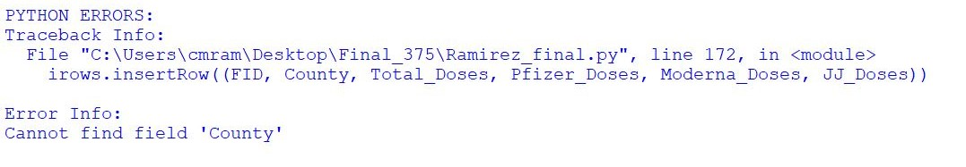
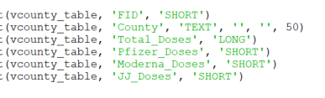
Error Code:

Slide 12
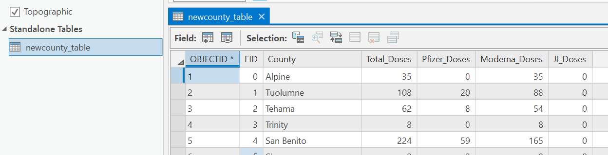
Problems Encountered and Resolutions
Usage Outcome
  created table, not shapefile
    create feature class instead of table
    convert table back to shapefile
    Use select by attribute to map results
  Difficult to perform analysis based on 1 specific administered date
    Could compare earliest date to latest date
    Focus on specific county instead

Slide 13
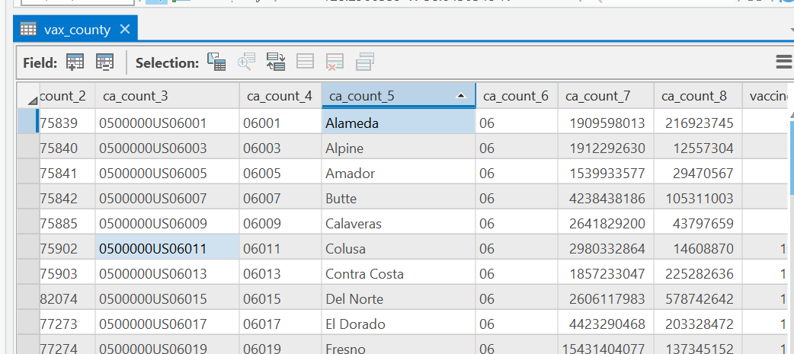
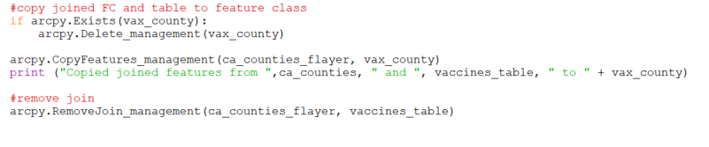
Outcomes
Copied joined features to a feature class
  Attribute table came out weird
  One- to –many relationship

Slide 14
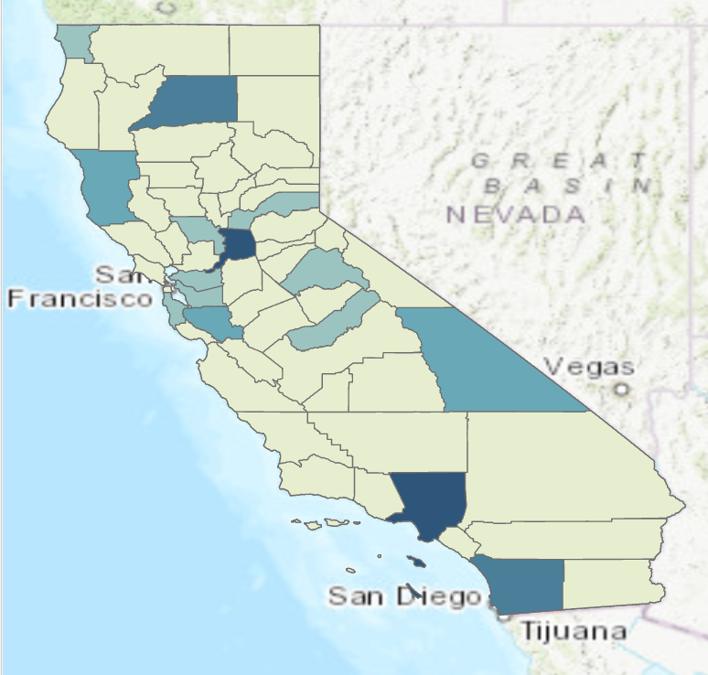
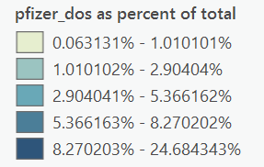
Potential Outcomes
Once one to many join is completed, produce maps of each brand of vaccine
Normalize data by dividing # of vaccines by total vaccinated
Use code to map different dates for comparison (use latest date and divide by cumulative total)

Slide 15
Thanks!

