Slide 1
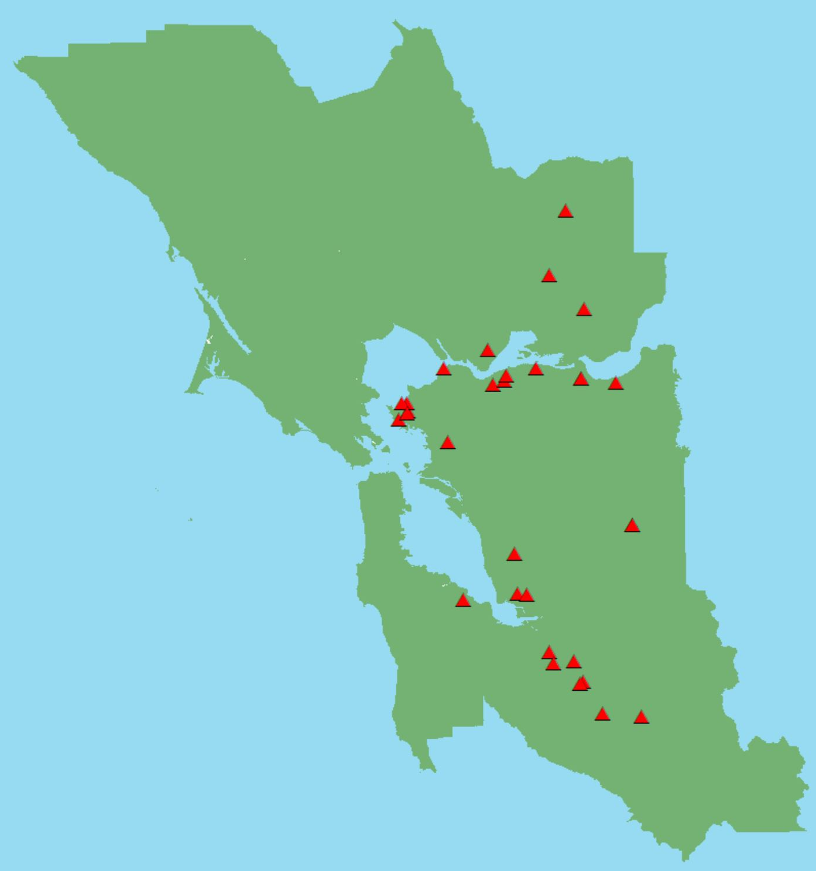
Ranking Hazardous Waste Generators in the Bay Area of California by Vulnerability to Earthquake Induced Hazards
Geography 375: Intro Python for GIS
American River College: Spring 2019
Karri Peters

Slide 2
Purpose
The intention of this script is to create a hazard level ranking for hazardous waste generator sites within the Bay Area.
The script is written so it can be updated with minimal effort as datasets are updated or new data becomes available.

Slide 3
Methods
Import
Import modules and set variables and workspace
Clip
Clip potential hazard risk feature classes to bay area outline feature class
Create
Create feature layers for waste generators and bay area outline feature classes
Select
Select features from waste generators that are within the bay area. Use the get count and print functions to list the number of waste generators in the bay area.
Copy
Copy selected features to new feature class
Join
Join landslide and liquefaction polygon feature class attributes to waste generator point feature class and create new feature class
Add
Add two new fields to final waste generator feature class, one long integer and the other a text field
Sum
Sum the potential risk values of the joined fields from the landslide and liquefaction datasets using a python list, update cursor, and for loop in the long integer field.
Populate
Populate the hazard level text field using a python list, update cursor, for loop, and Boolean logic.

Slide 4
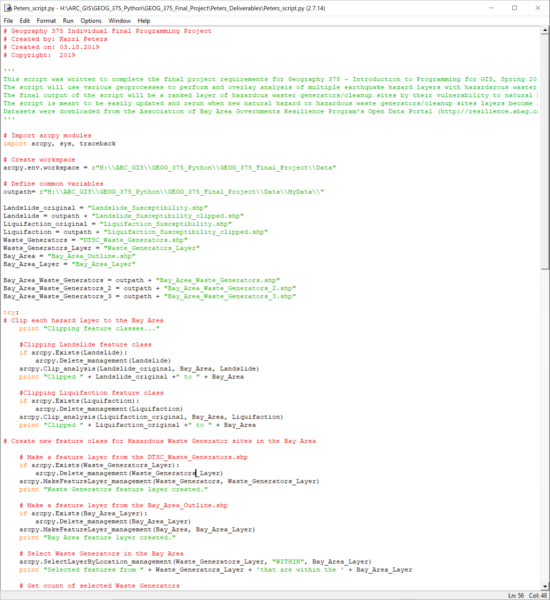
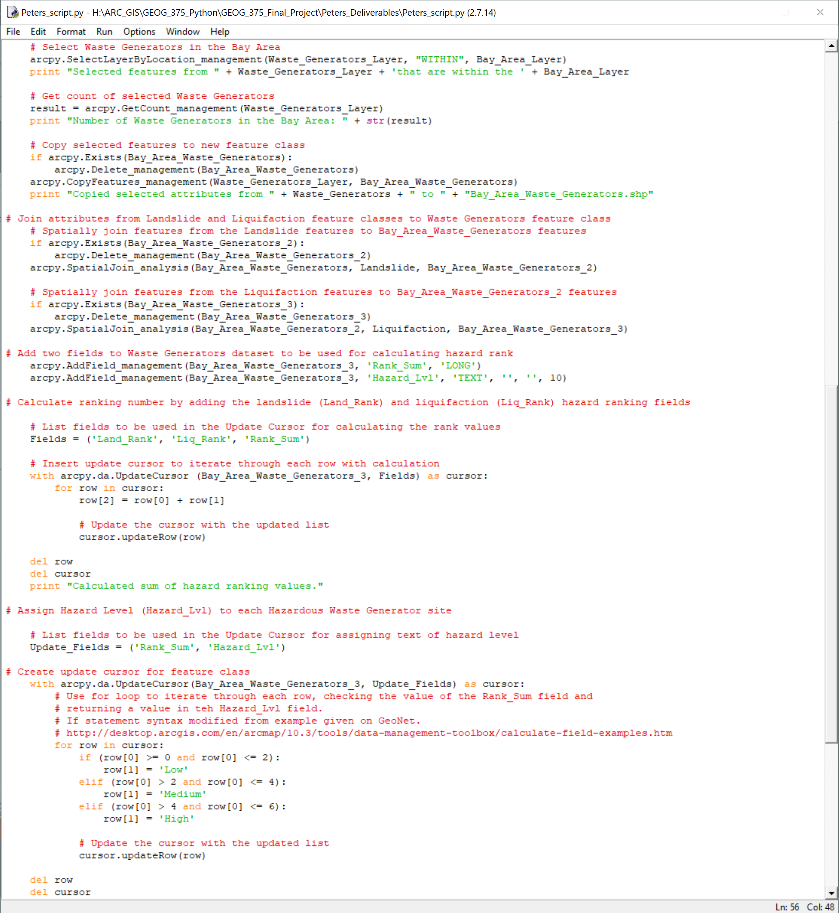

Slide 5
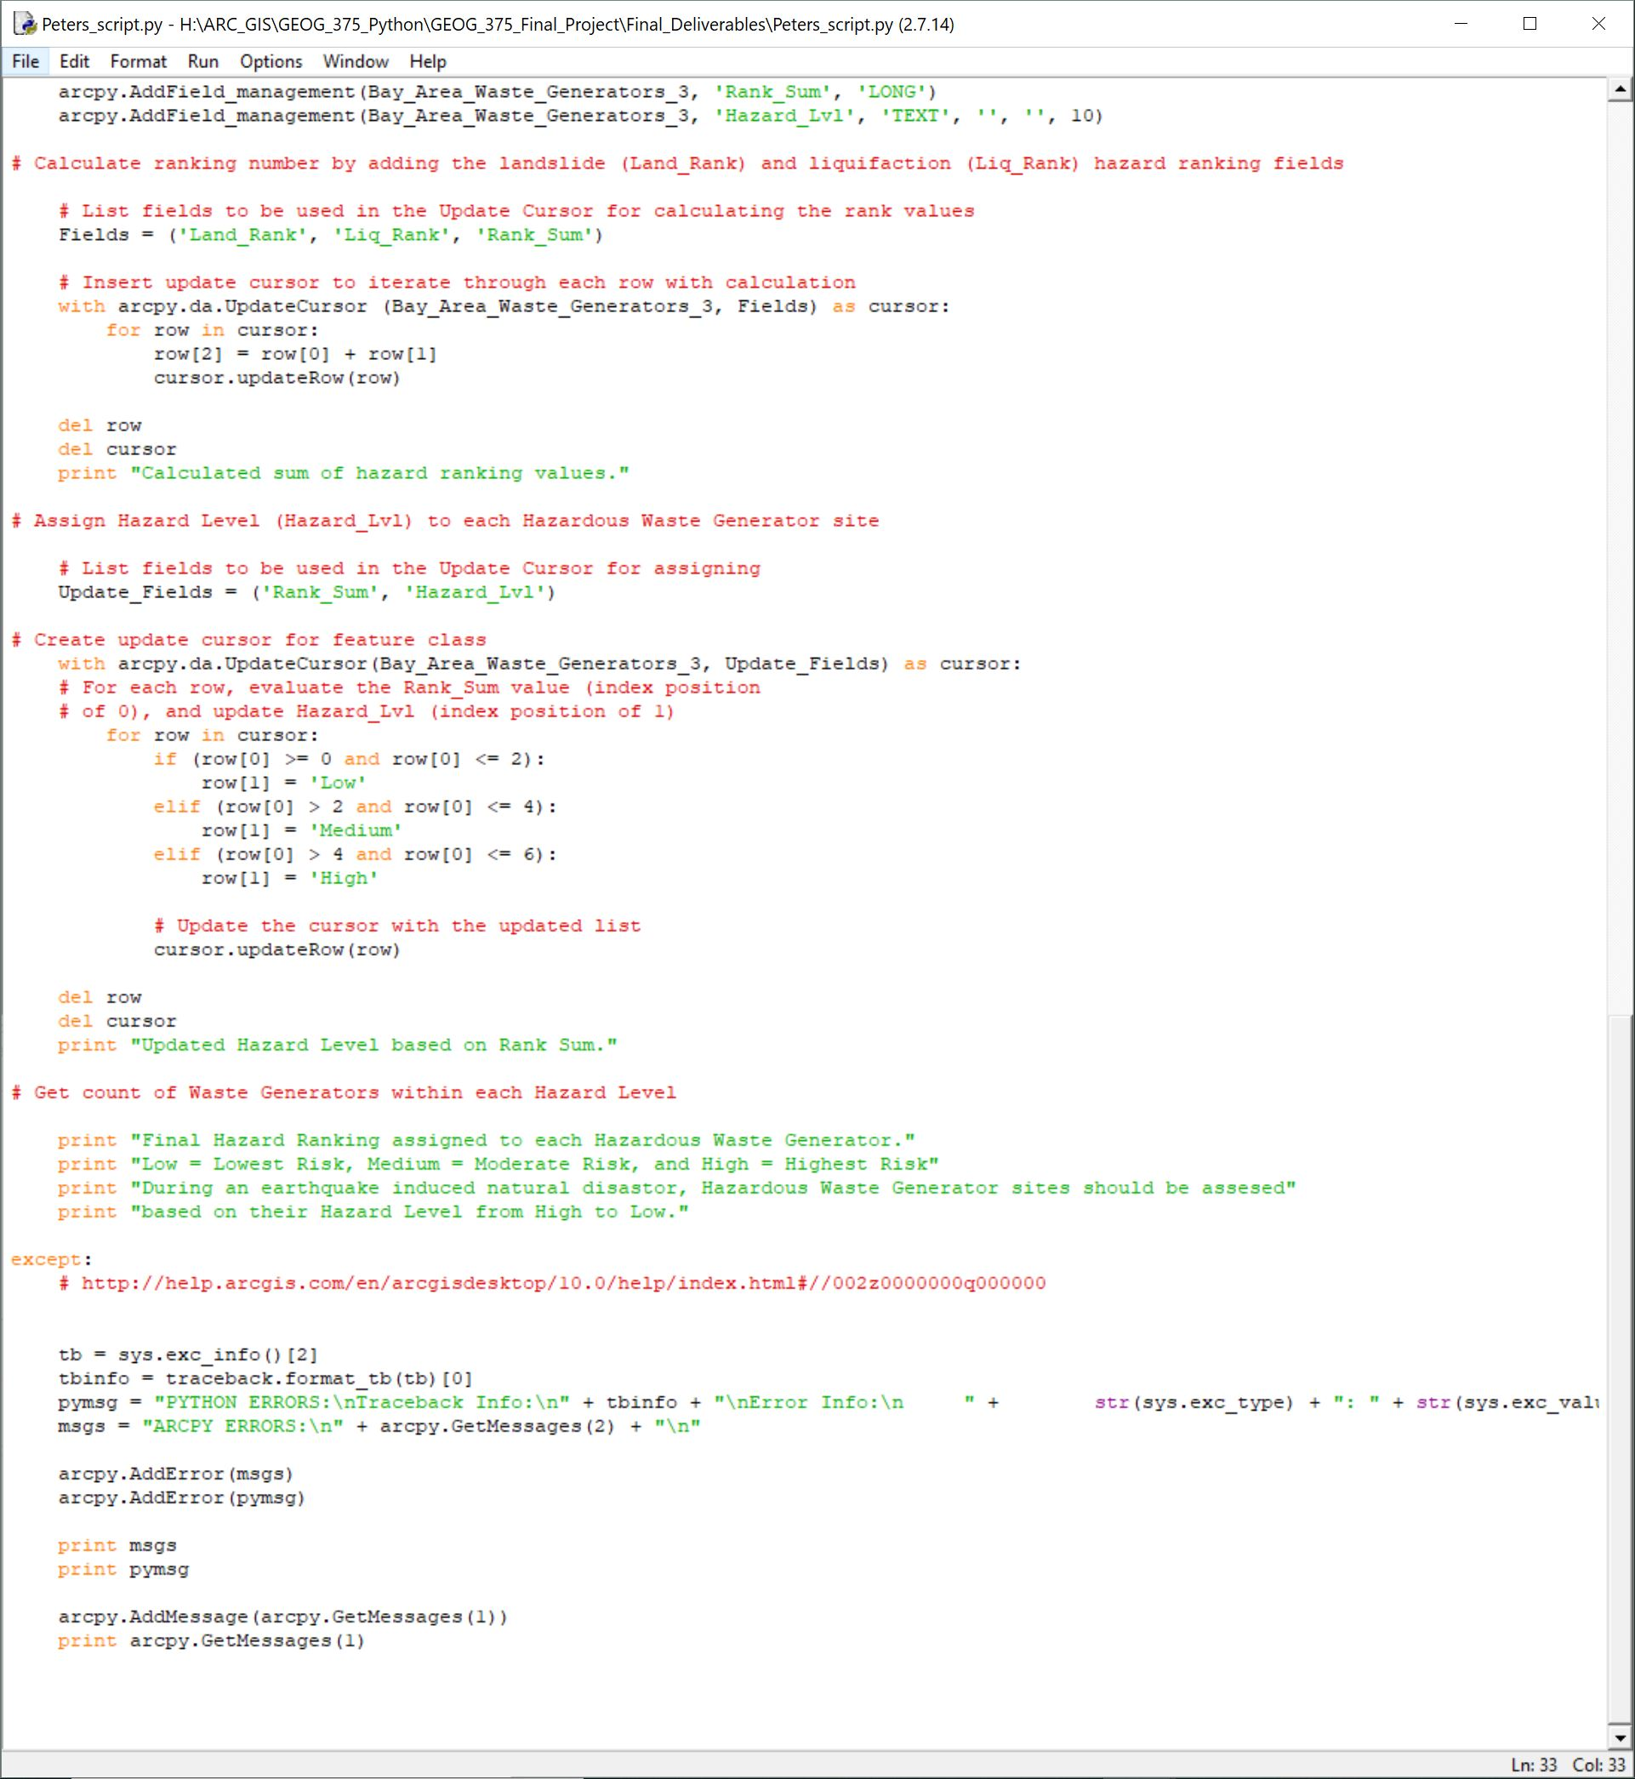
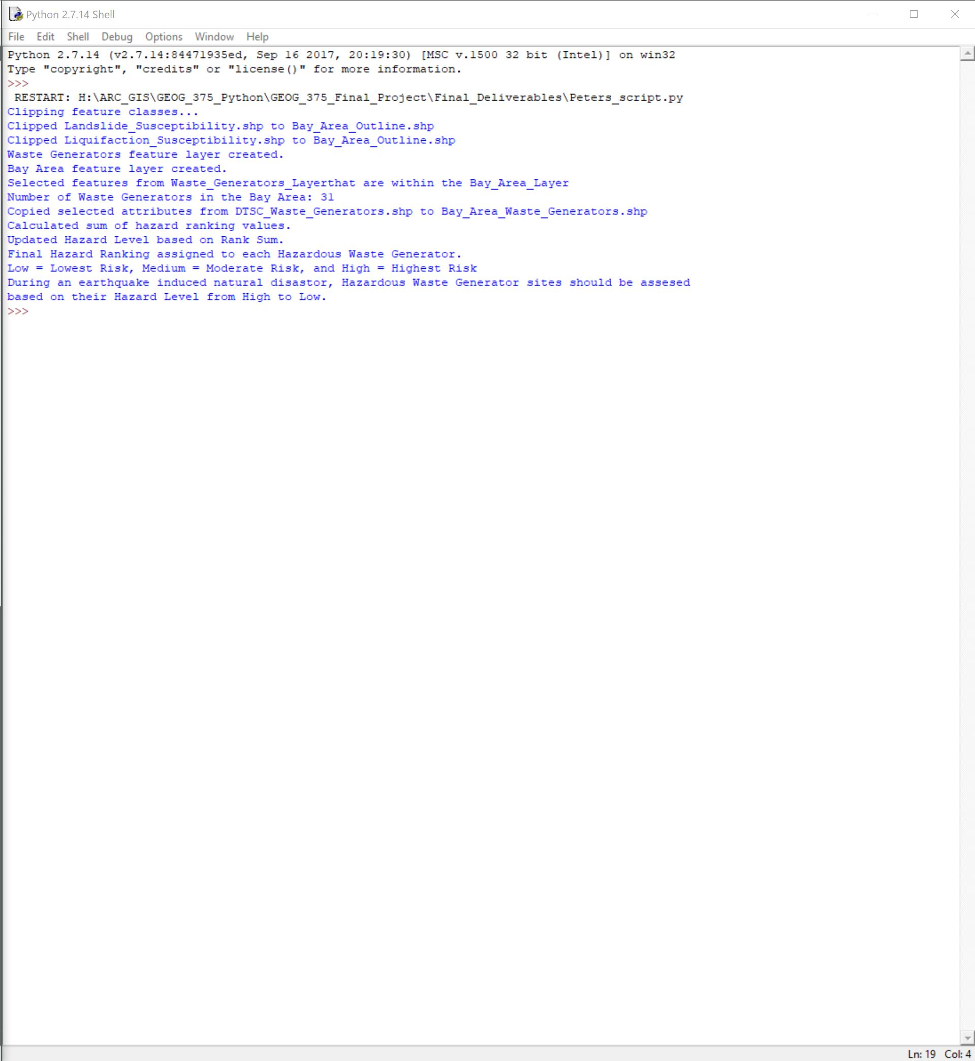

Slide 6
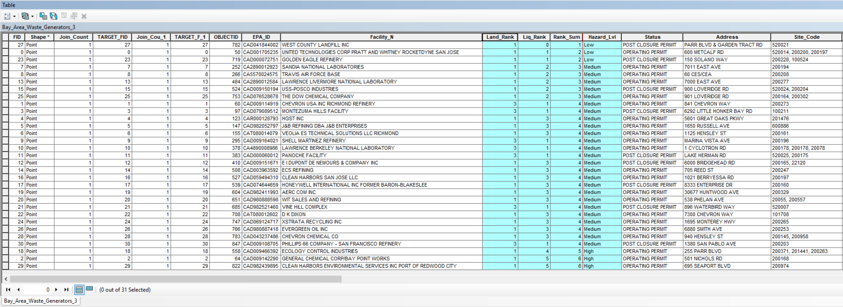
Final output – “Hazard_Lvl” field populated from standalone geoprocessing script

