Slide 1
Automating Image Processing
Using MODIS derived Images of the Mojave Desert Preserve
Britnee Pannell, GEOG 375

Slide 2
The Question:
Is it possible to detect changes in vegetation coverage between wet (2017) and dry (2015) years in the Mojave Desert Preserve using remotely sensed data?

Slide 3
Yes! It is!

Slide 4
The Steps:
Collect MODIS data for the years in question
Automate the processing of the 48 images
Graph results
Share results!

Slide 5
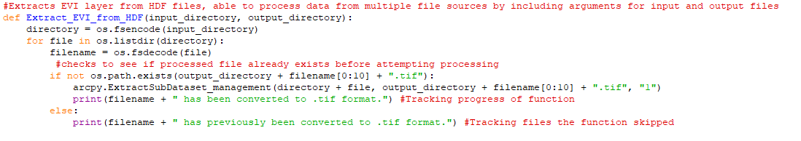
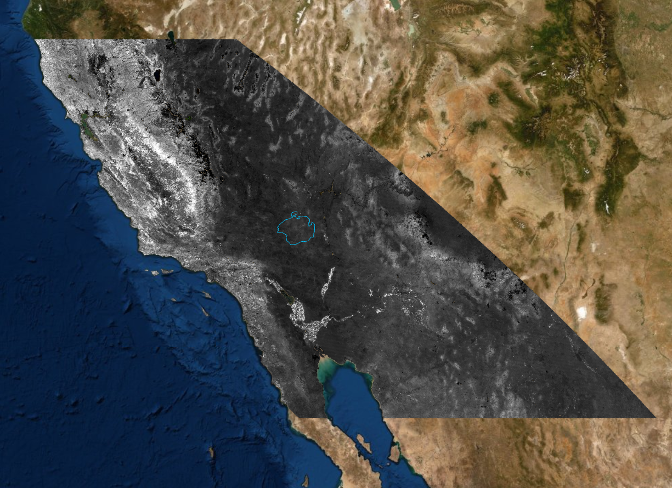
Extract data from MODIS hdf files:
Far too large!

Slide 6
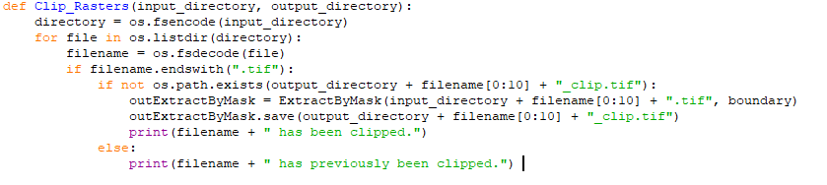
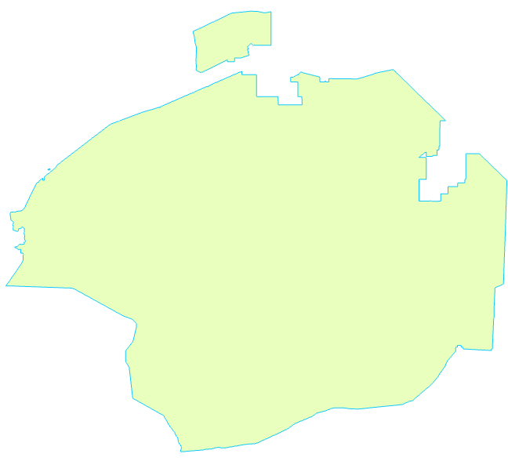
Mask Data:
Mask with boundary
Save output

Slide 7
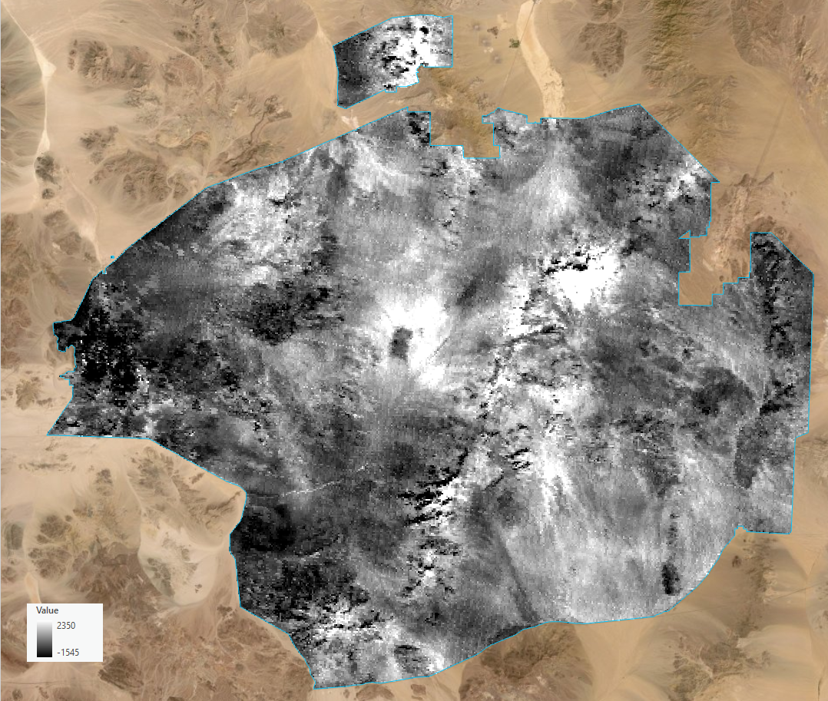

Layer Masked to Study Site:
Remember these values
Much more manageable layer size!

Slide 8
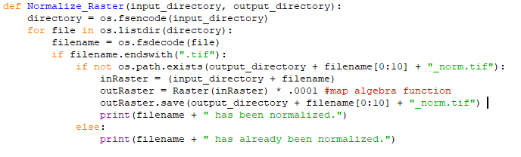
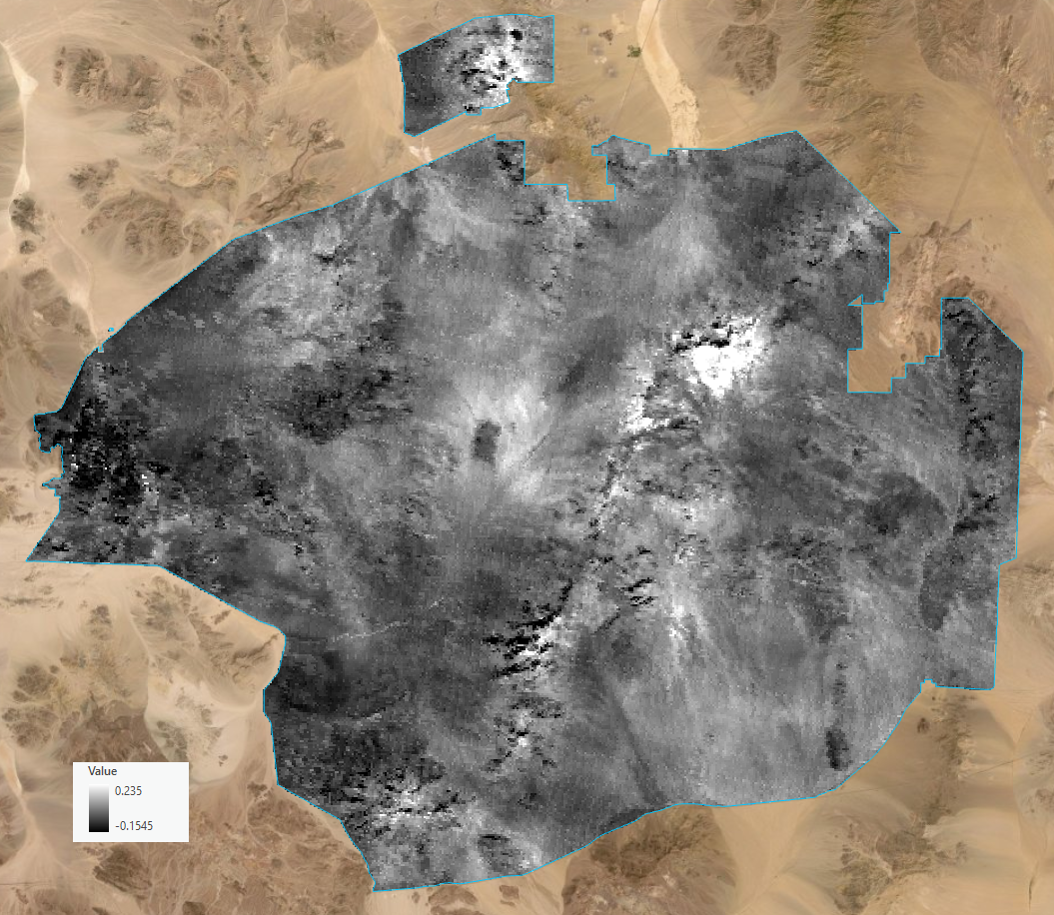
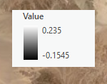
Normalize Data Values:
Adventures with map algebra!
Values now normalized!

Slide 9
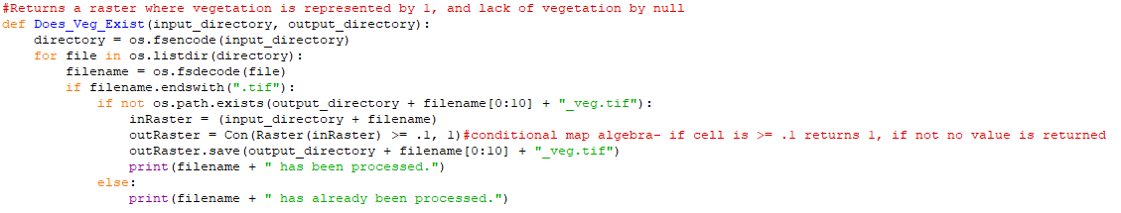
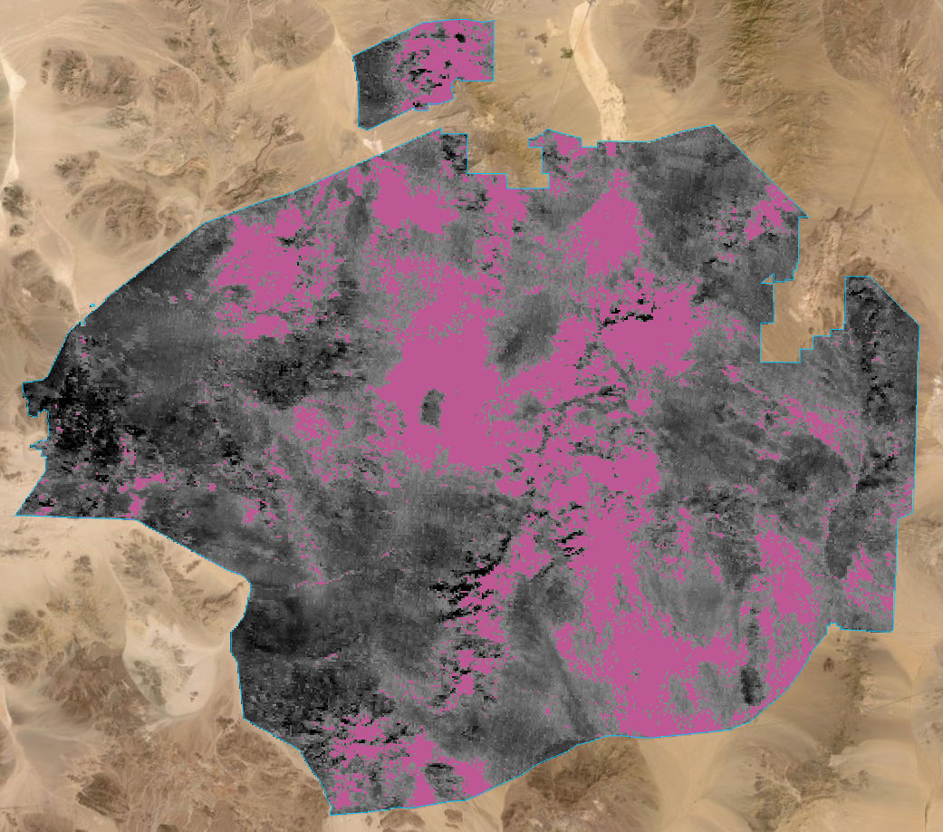
Extract Needed Data:
Apply a conditional statement to this layer
We only need cells >= .1, aka:
the pink cells

Slide 10
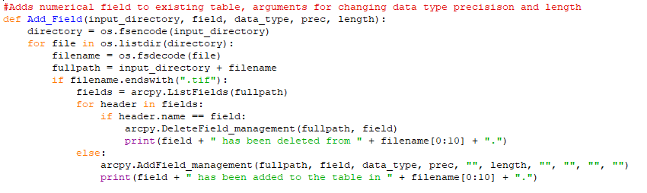
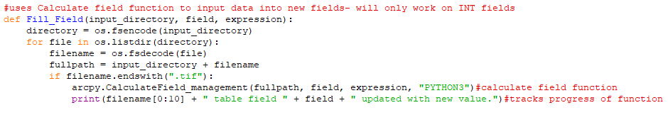
Modify Tables
Add new fields to tables containing a count of the needed cells (pink cells)
Add data to new fields

Slide 11
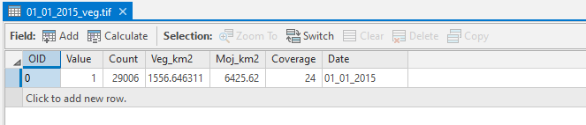
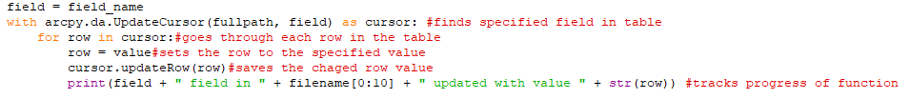
Table Ready for Aggregation
New data from CalculateField tool
New Data from Update Cursor

Slide 12
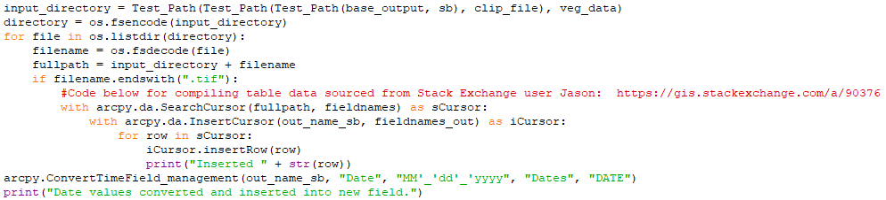
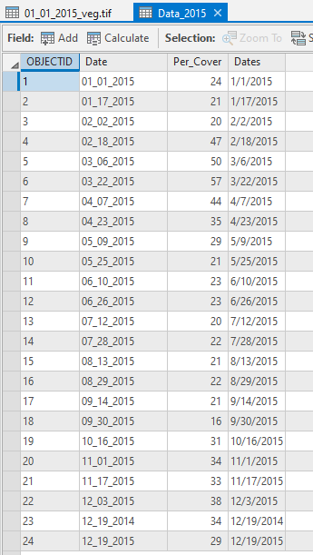
Data Ready to Graph
Aggregate table data by year with Search and Insert Cursors
Make ‘DATE’ Data.
Output table ready for graphing

Slide 13
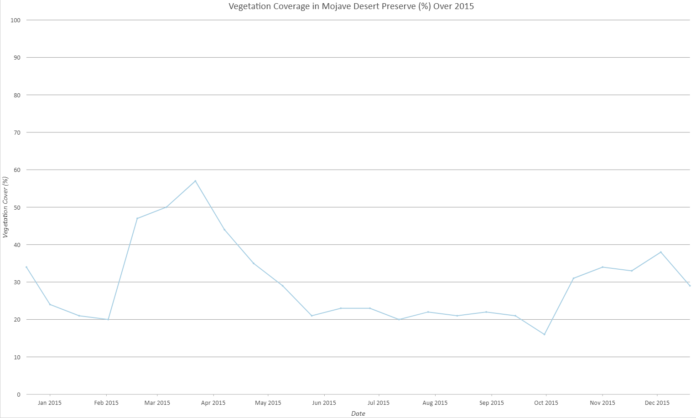
2015 Results!

Slide 14
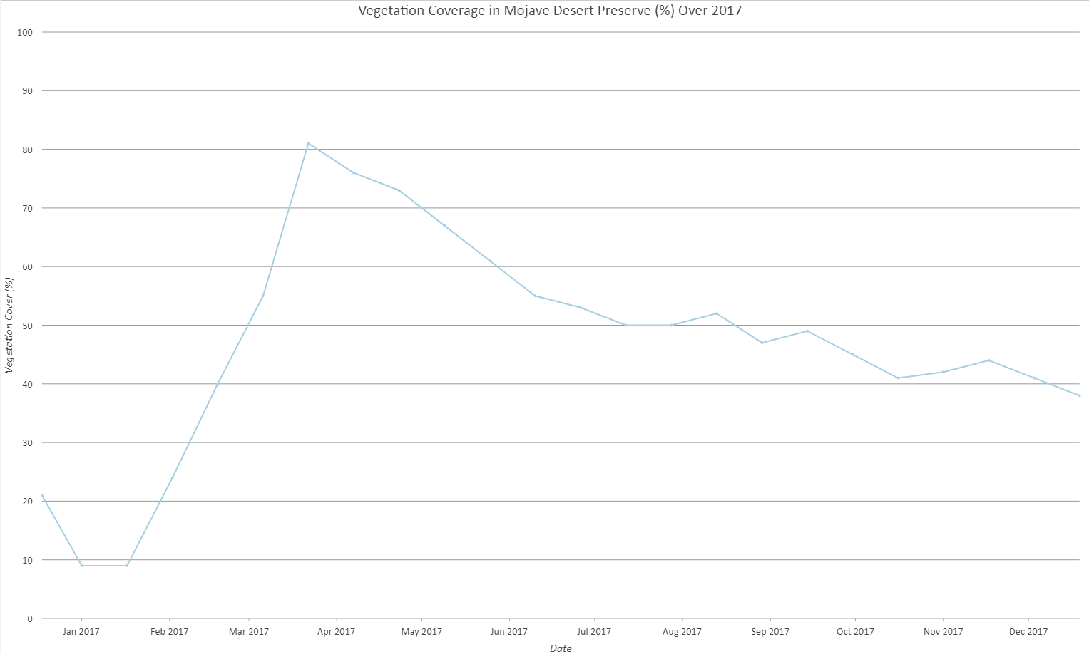
2017 Results!
Look! More Vegetation cover during a wet year.

