Slide 1
Geog 342 Final Project:
Potomac Lidar Exploration
By Shana Negin, May 2021

Slide 2
Goals
To explore lidar processing workflow and tools
To observe a familiar location from a new perspective

Slide 3

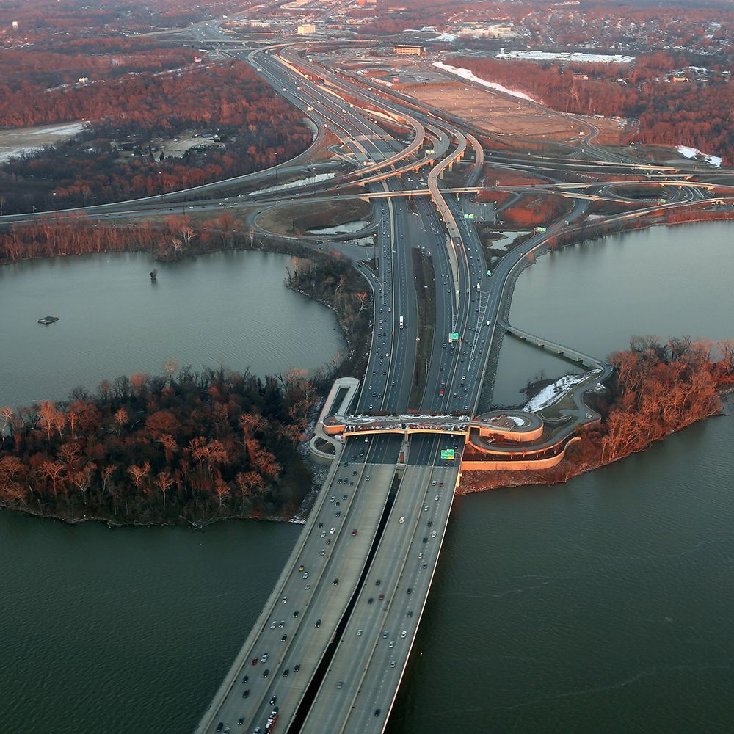
Location: The Potomac River in Maryland, Virginia and Washington D.C.

Slide 4
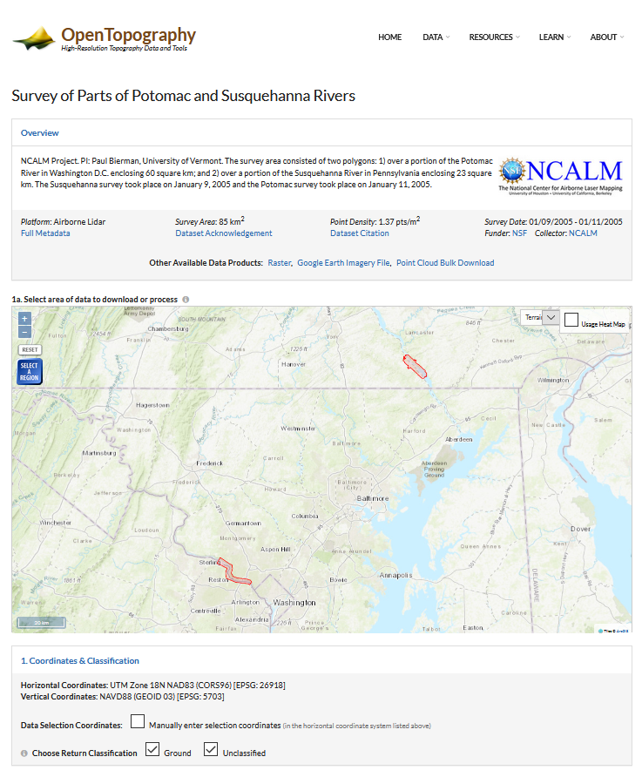
Data: LiDAR Survey of Parts of Potomac and Susquehanna Rivers
Goal: Finding a manageable data set in an area familiar to me
Solution: Open Topography: https://opentopography.org/
Dataset Acknowledgement: National Center for Airborne Laser Mapping (NCALM - http://www.ncalm.org)
Survey Date: 01/09/2005 - 01/11/2005
Publication Date: 03/27/2013

Slide 5
Image Processing Tasks and Methods
Getting Dataset and Decompressing
Visualizing Point Cloud
Derivatives
Download data
LAZ format – needed 3rd party tool to unzip
Model Builder to bulk unzip
Tiles
LAS Dataset
Sites
Classifying: ☹
DEM
Hillshade
TIN
Contour
Slope
Aspect
Terrain Dataset
Multipoint

Slide 6
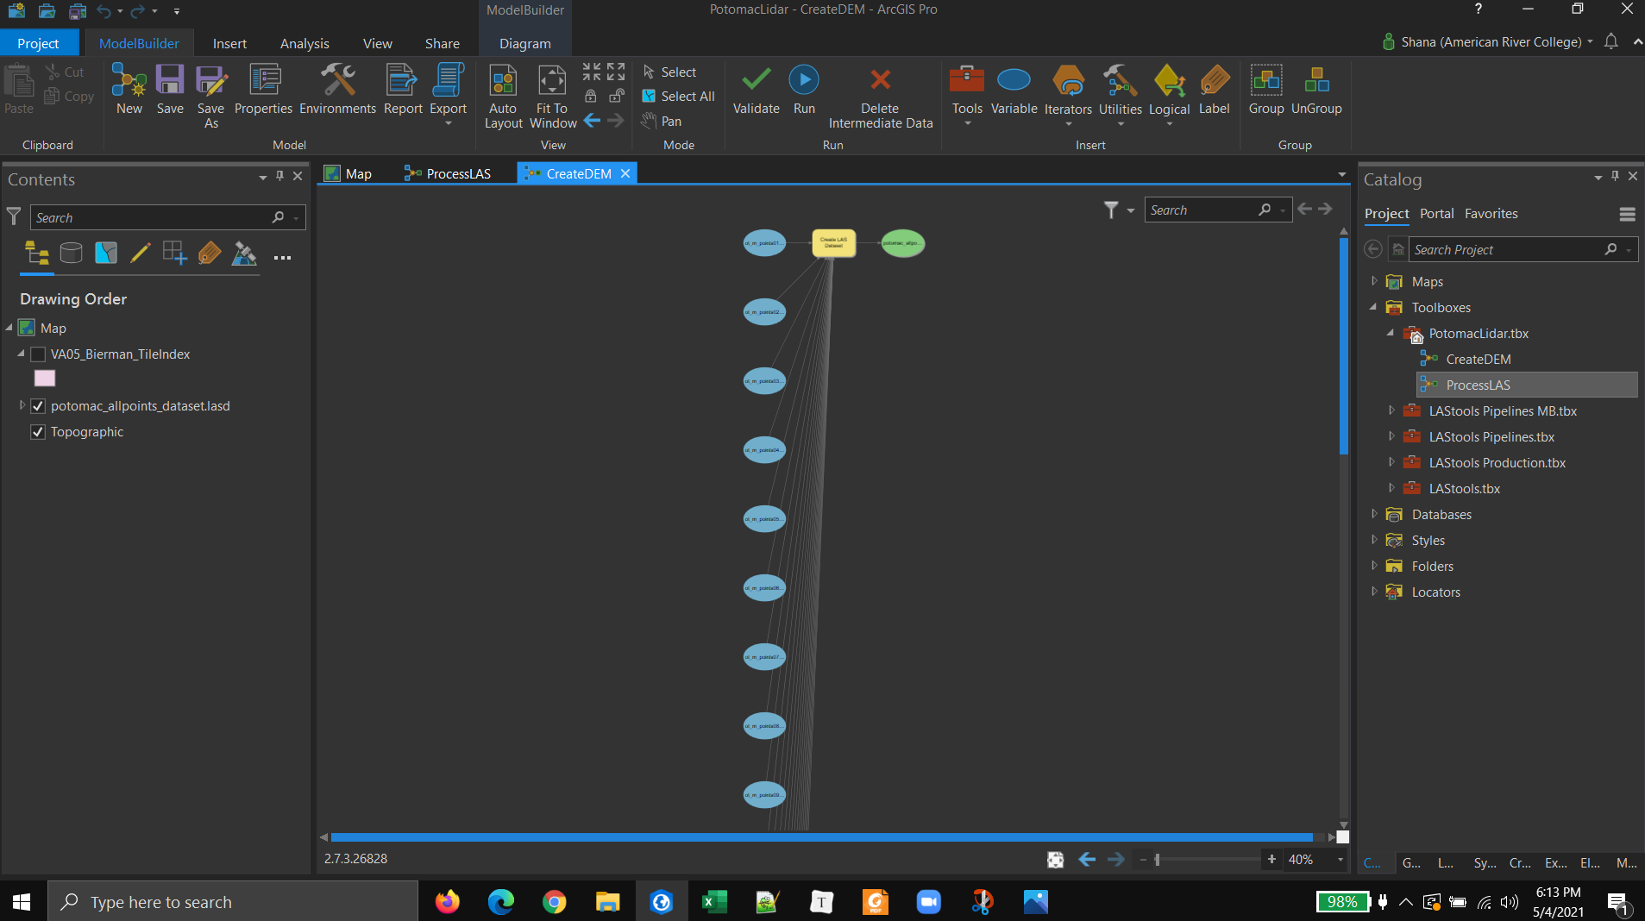
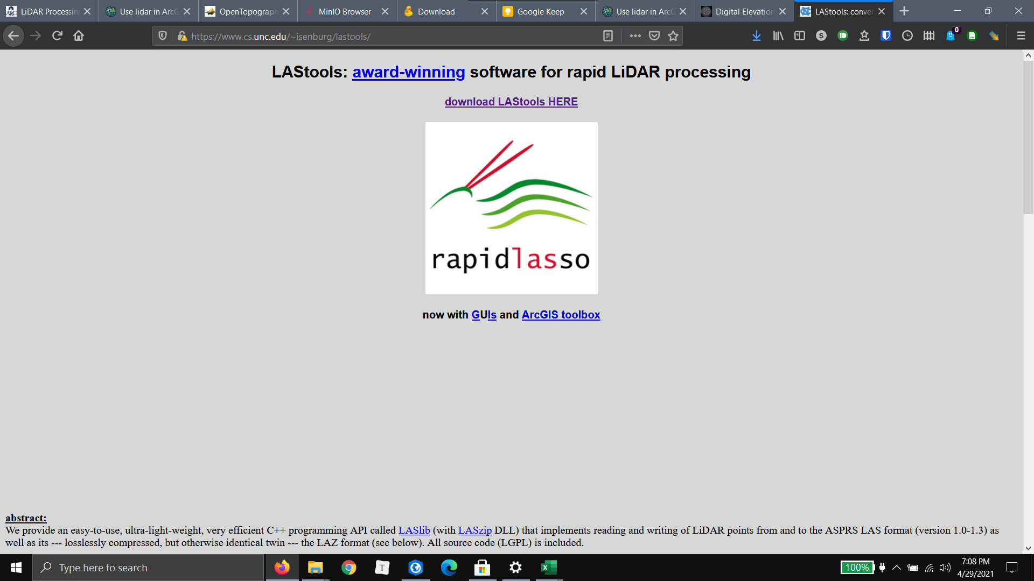
Getting Dataset and Decompressing
Download data
LAZ format – needed 3rd party tool to unzip
Model Builder to bulk unzip

Slide 7
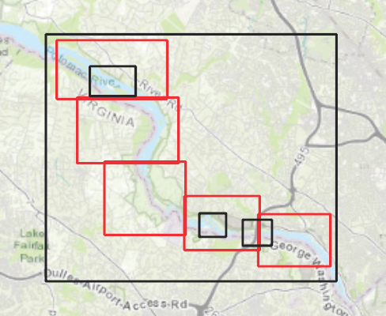
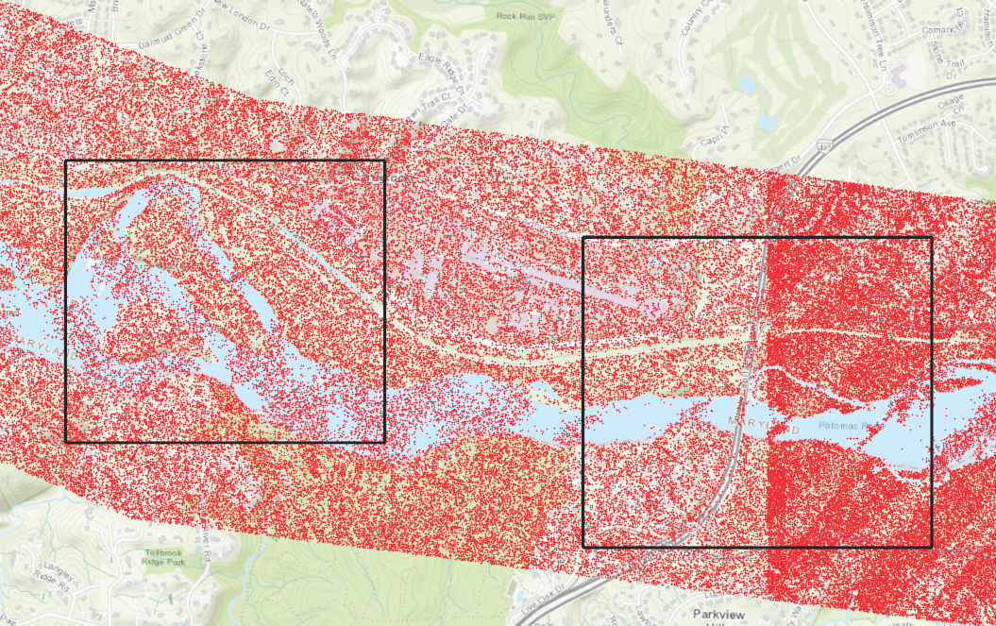
Visualizing Point Cloud
Tiles
LAS Dataset
Sites
Classifying: ☹

Slide 8
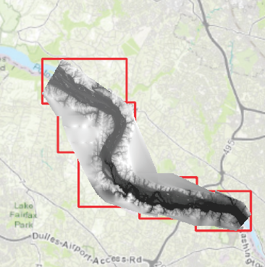
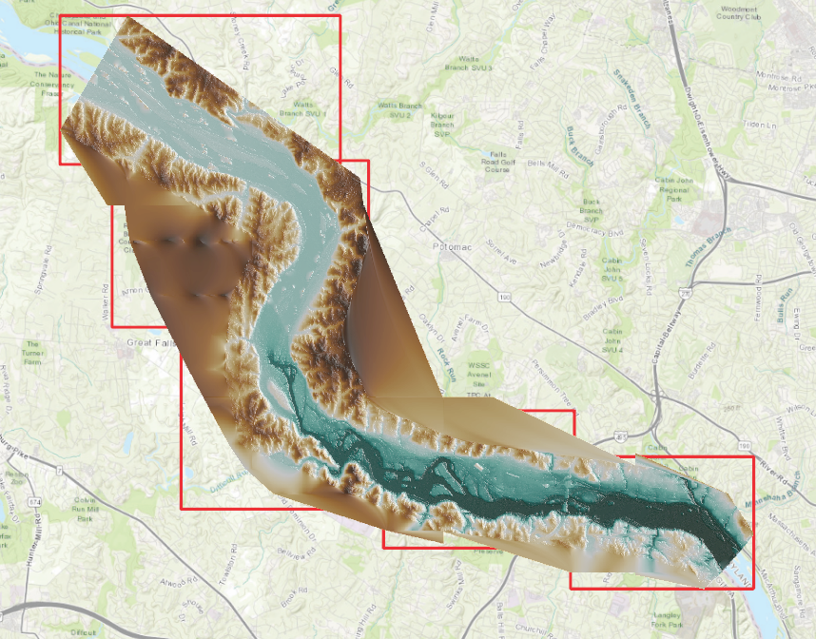
DEM and Hillshade

Slide 9
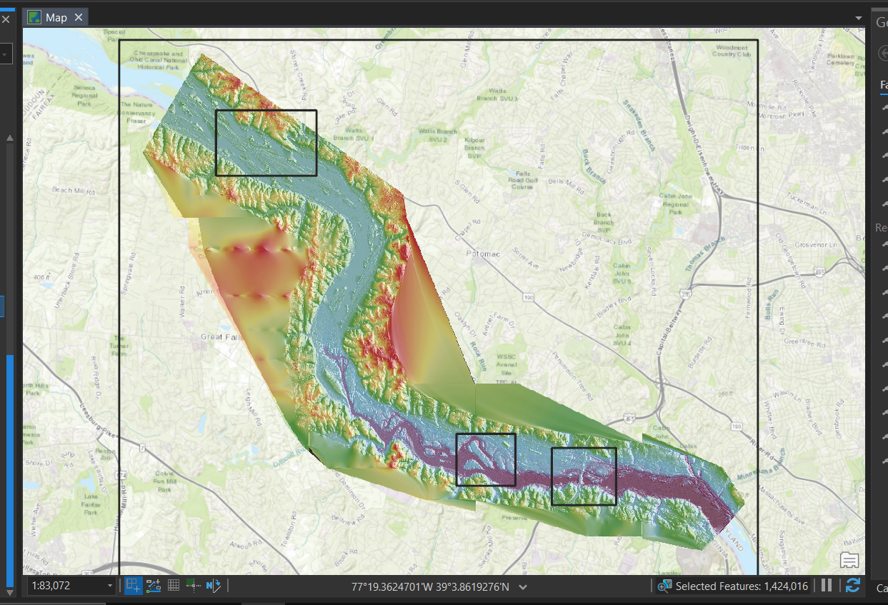
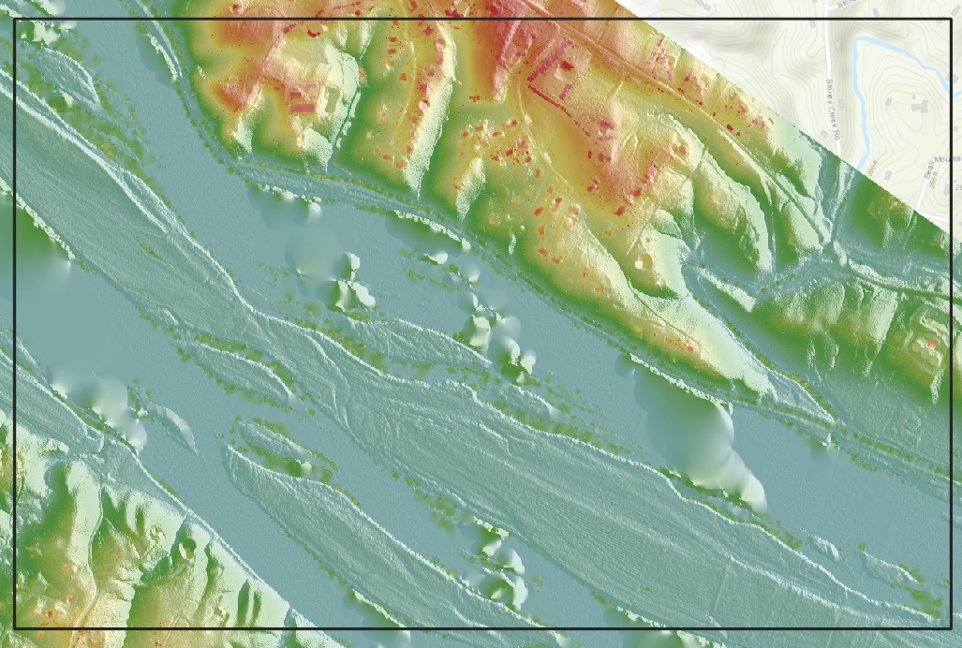
DEM and Hillshade

Slide 10
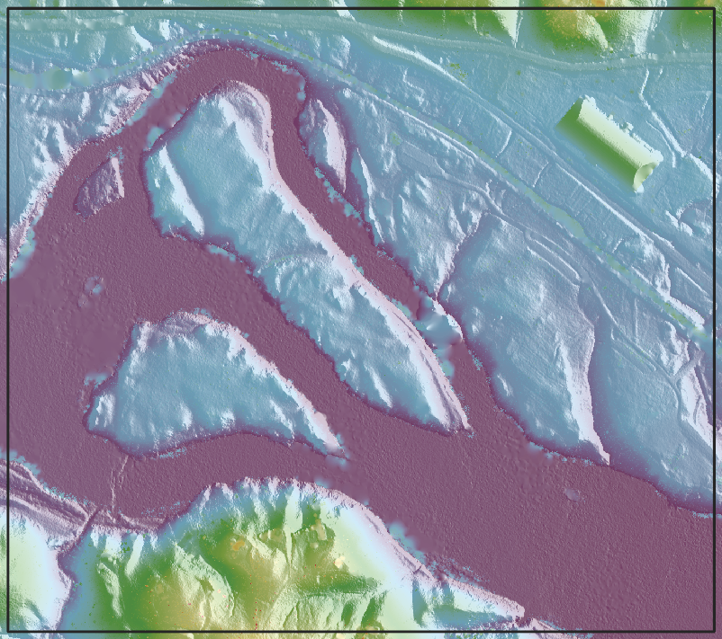
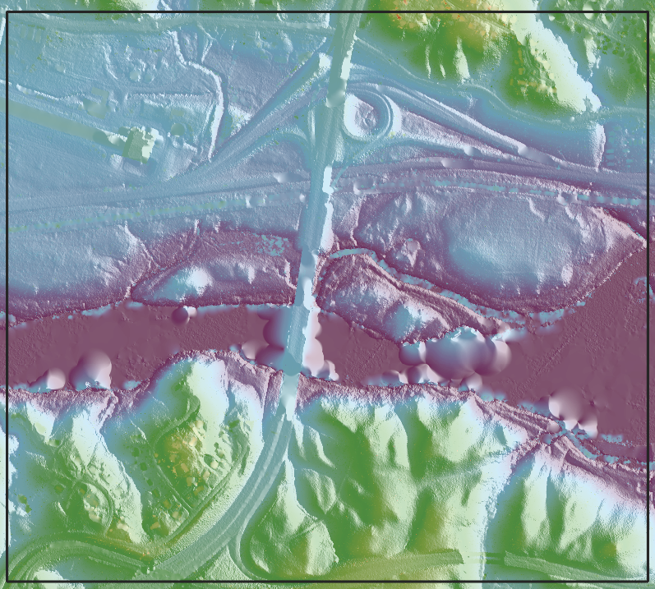
DEM and Hillshade

Slide 11
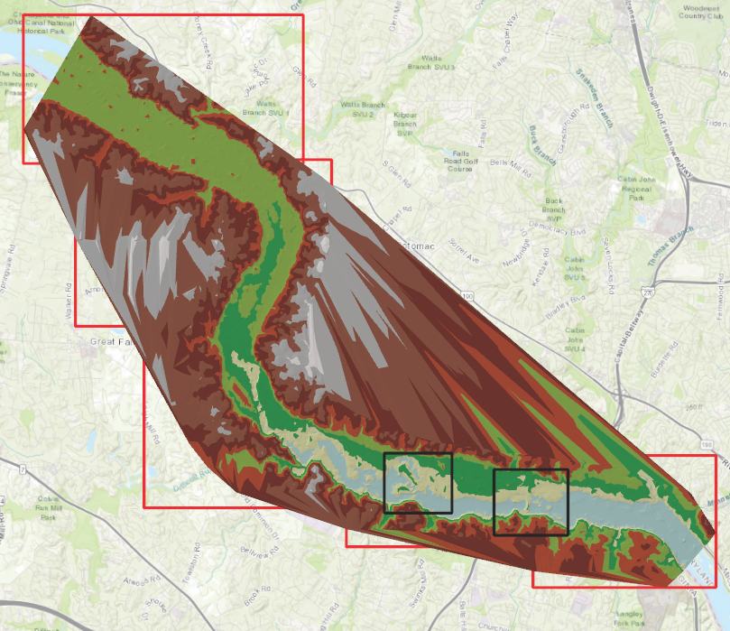
TIN

Slide 12
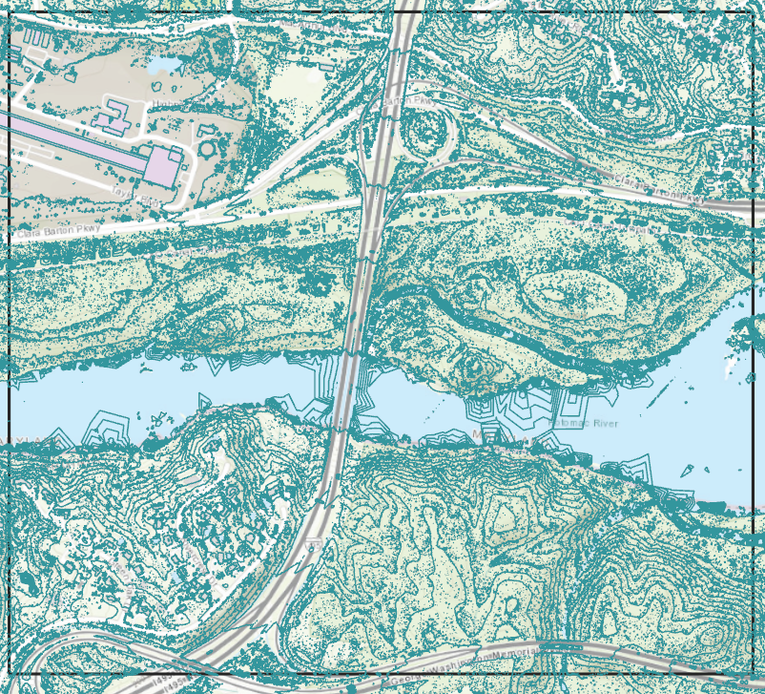
Contour
Contour: Site 2

Slide 13
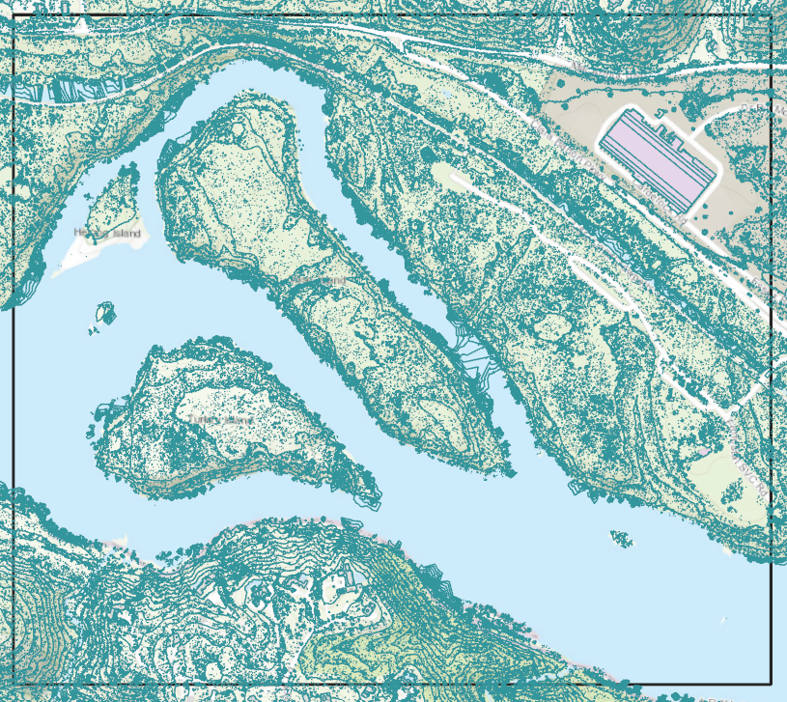
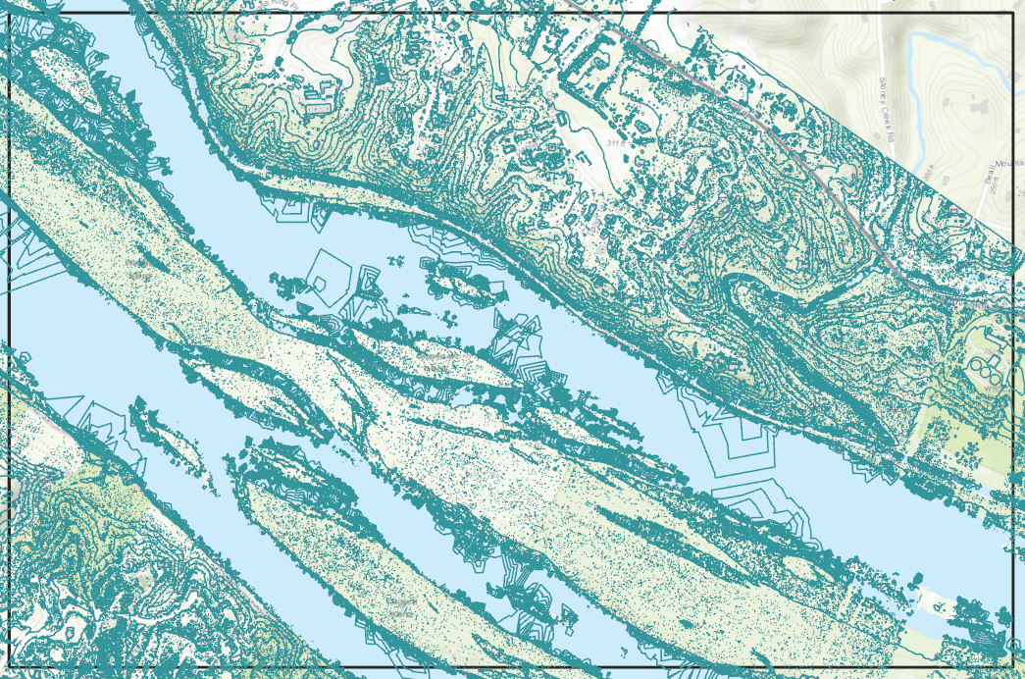
Contour
Contour: Site 1 and Site 3

Slide 14
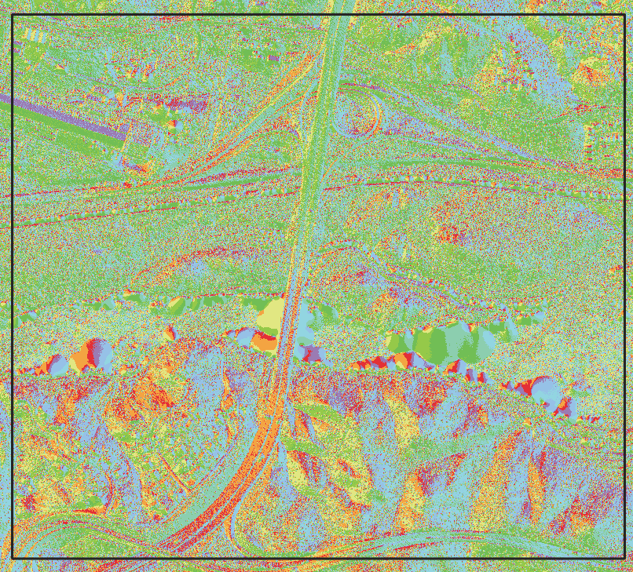
Aspect
Aspect: Site 2

Slide 15
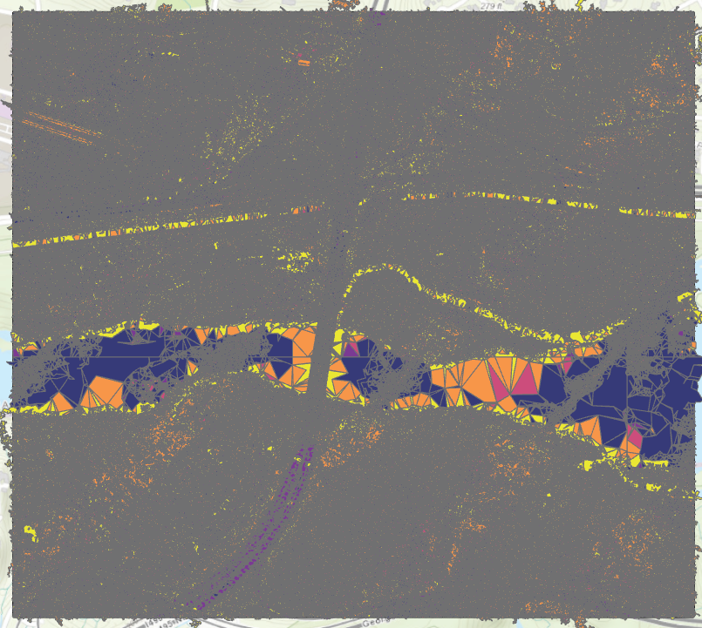
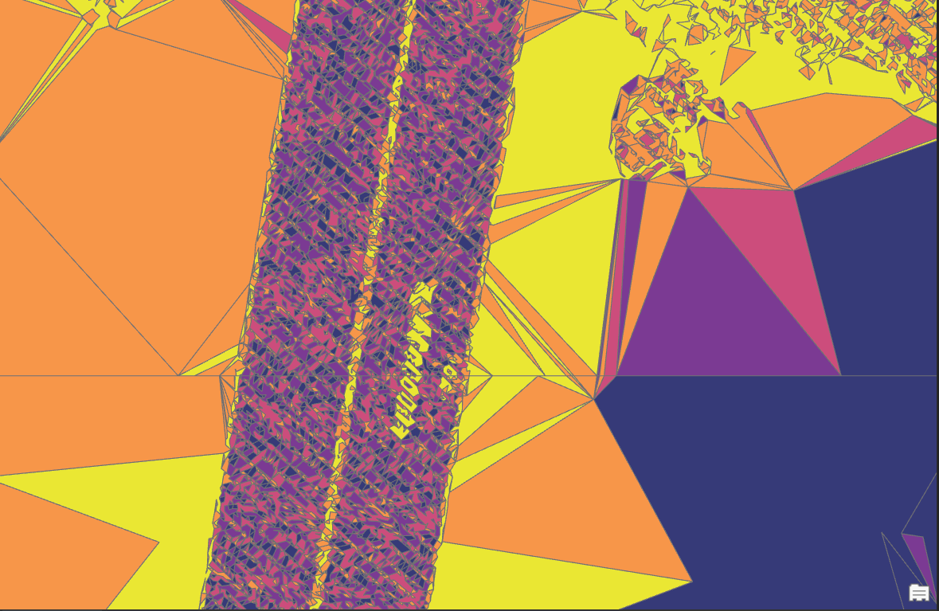
Slope
Slope Site 2

Slide 16
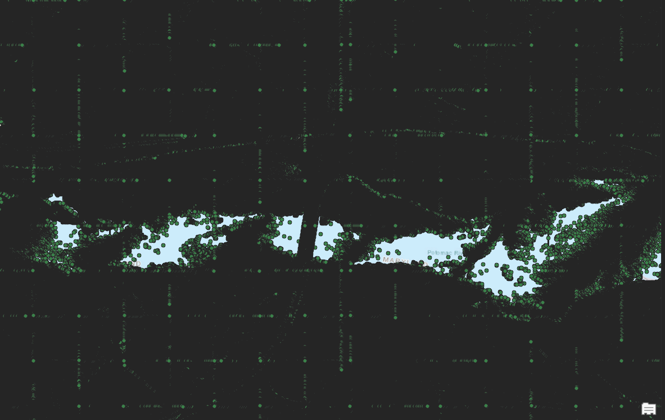
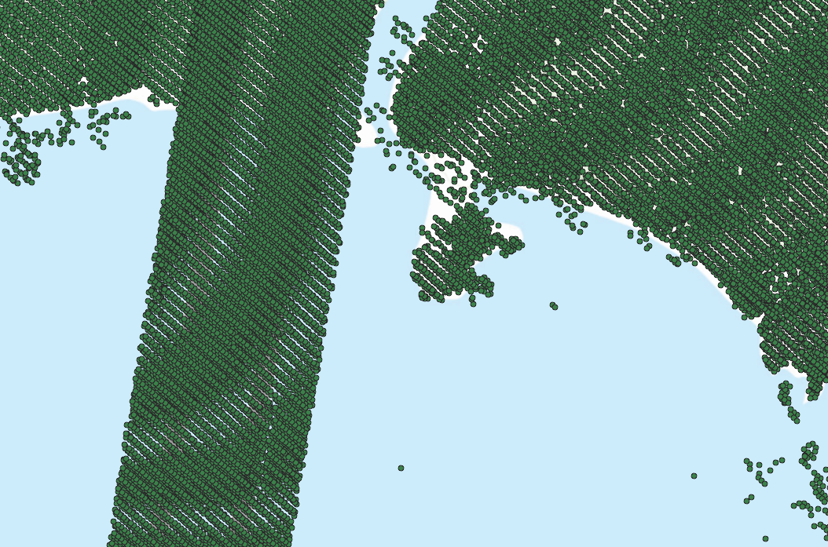
Terrain and Multipatch
Multipatch Site 2 and zoomed

Slide 17
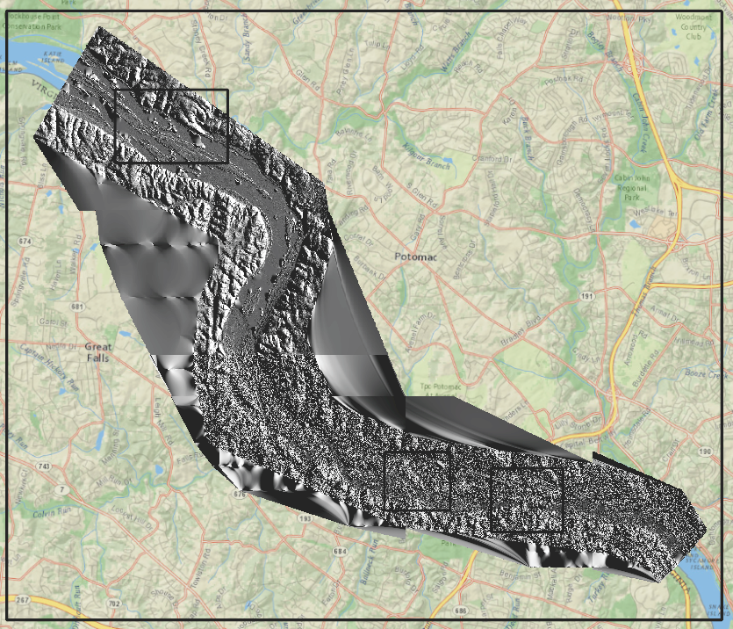
Difficulties and Issues
Picking a project – I restarted 3 or 4 times. (Self driving car data, surface temperature, image classification, then finally this)
Technical Difficulties
  Unzipping Lidar – 3rd party tools to the rescue
  Hillshade quality was not good. Why? Some random little setting somewhere
  Even my small dataset is has a lot, a LOT of points.

Slide 18
Take Aways
I like lidar but I need to get a more powerful computer if I really want to explore it
ArcGIS Pro tools are just the tip of the iceberg – if I want to explore more, I have to probably get into some command line tools

Slide 19
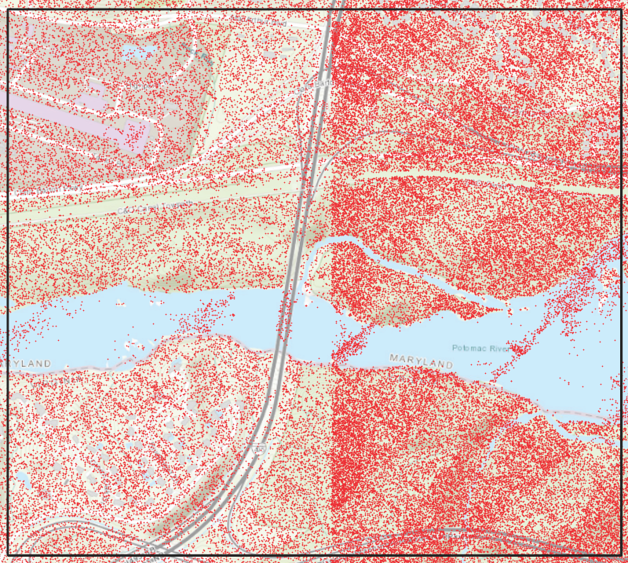
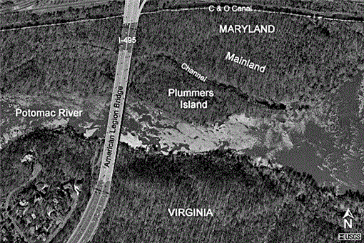
Point Cloud Vs Satellite Image

