Slide 1
Supervised Land Classification
Area around Sacramento International Airport
Justin Murphy
Spring 2021

Slide 2
Project Summary
Sacramento is growing and farmland is where most the growth is occurring. I thought this was most evident around the airport where a new overpass has been built for a subdivision called Northlake which will have over 3,000 new homes.
Data – Landsat 8 imagery from Earth Explorer from 2013 and 2021 (8 years)
Clipped Area – Approximately 10 square miles or 6400 acres
Processed Data
  Segmentation
  Used supervised classification through the classification wizard on ArcGIS PRO
Analyzed Data – Zonal Statistics

Slide 3

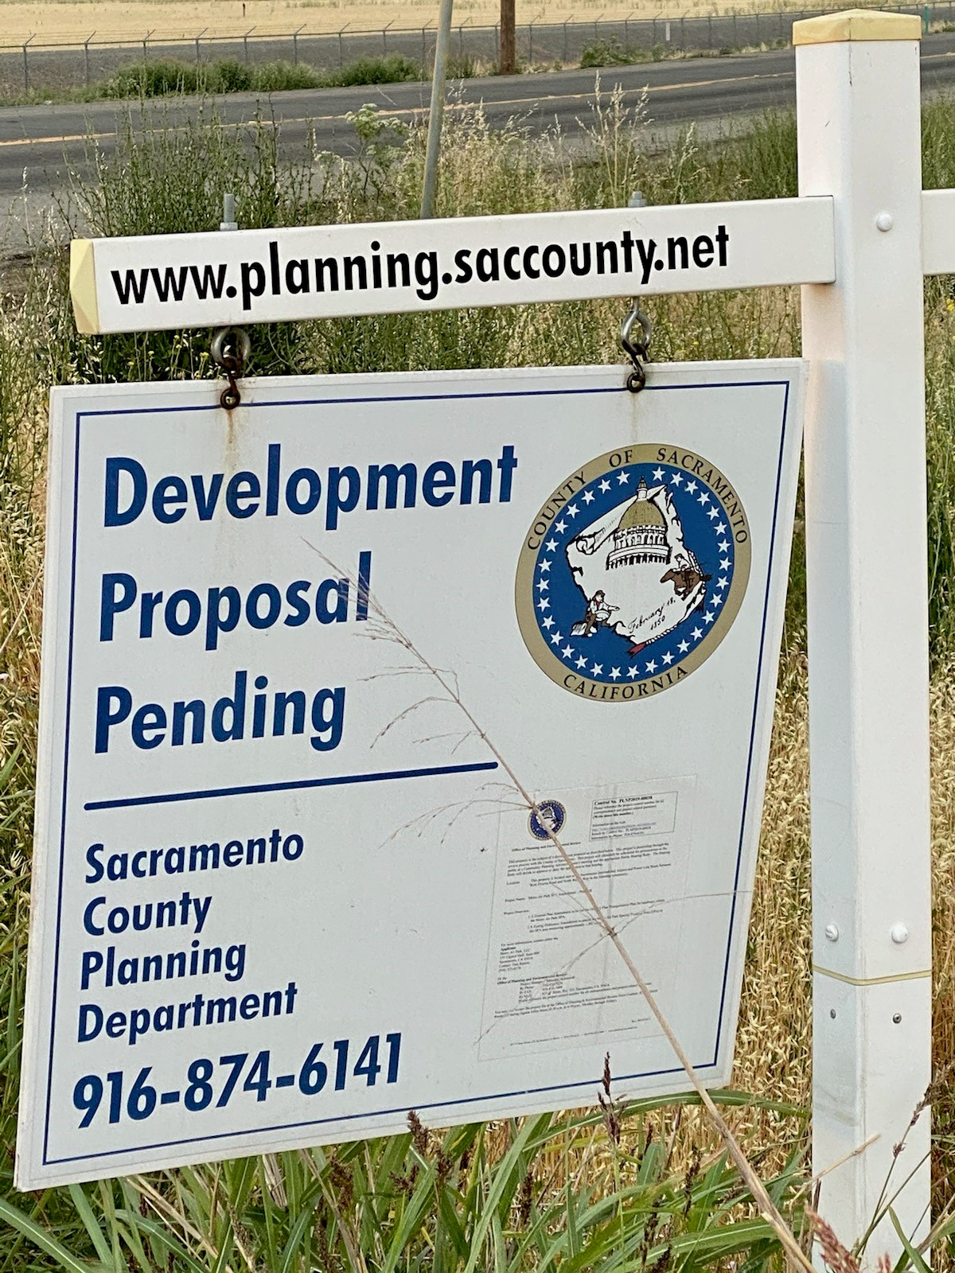
Development

Slide 4
Project Purpose
I was hoping to see significant loss of farmland and an increase of development around the Sacramento Airport through the use of satellite imagery.
Learn how to classify images though ArcGIS PRO and some assistance from Google Earth

Slide 5
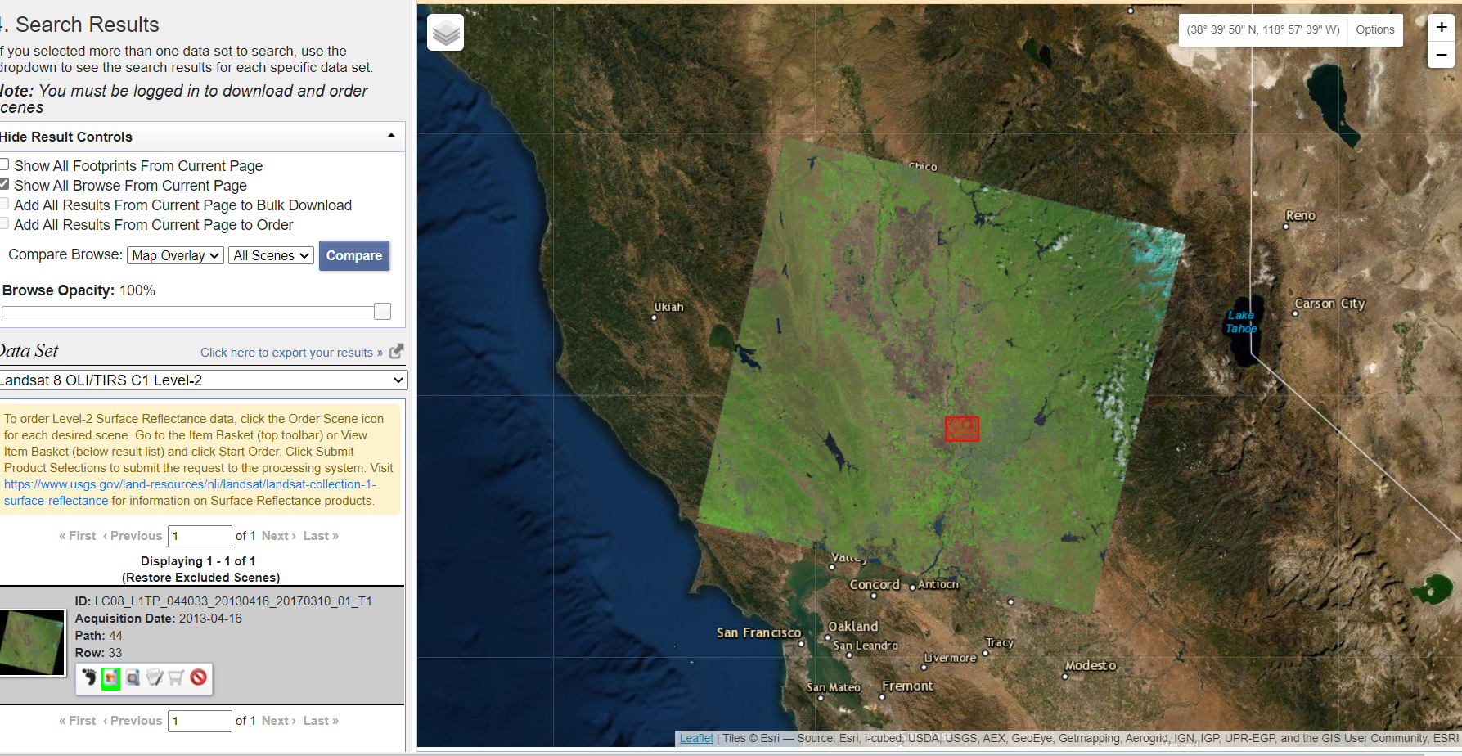
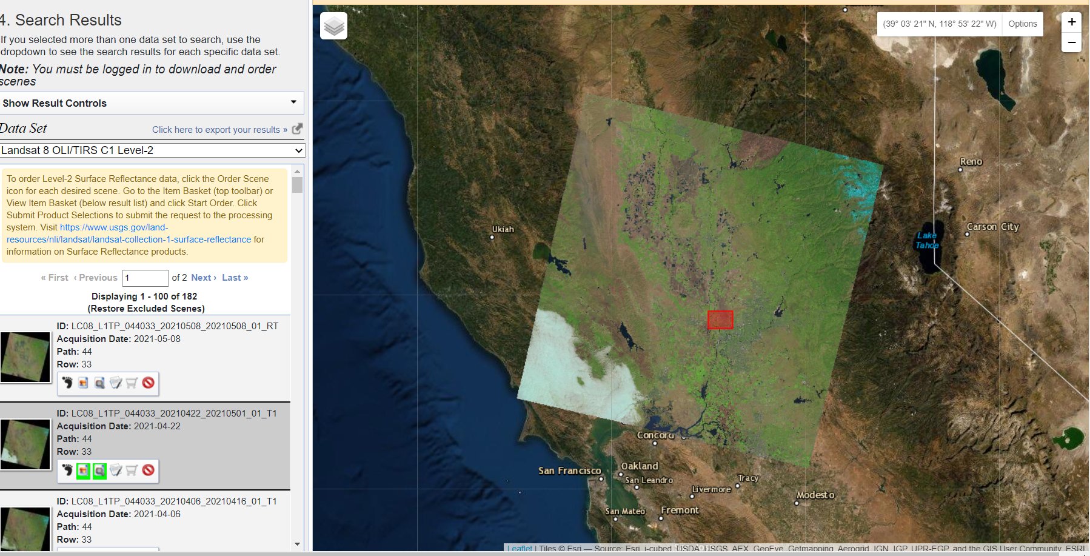
Data – Earth Explorer
2013
2021

Slide 6
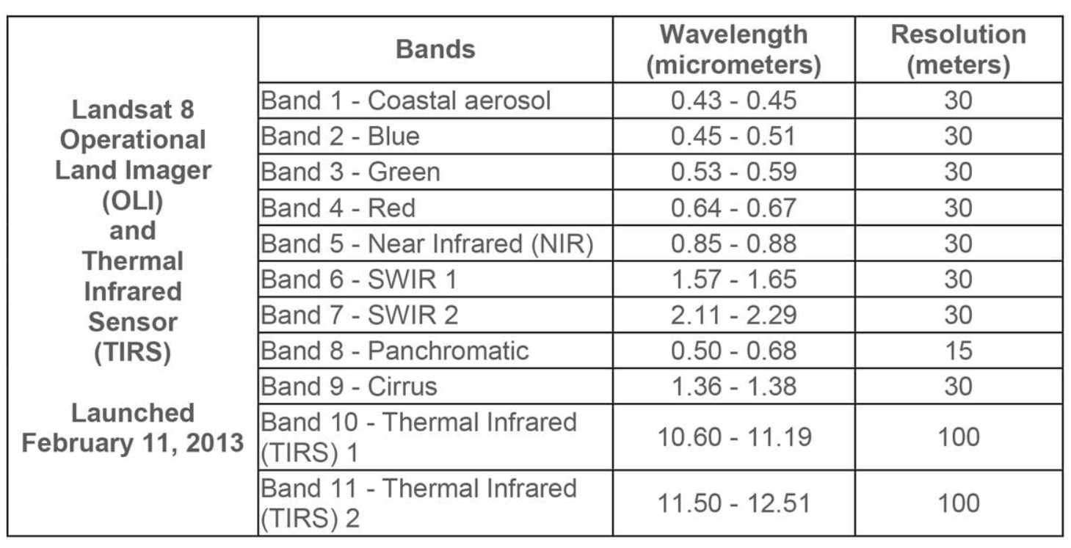
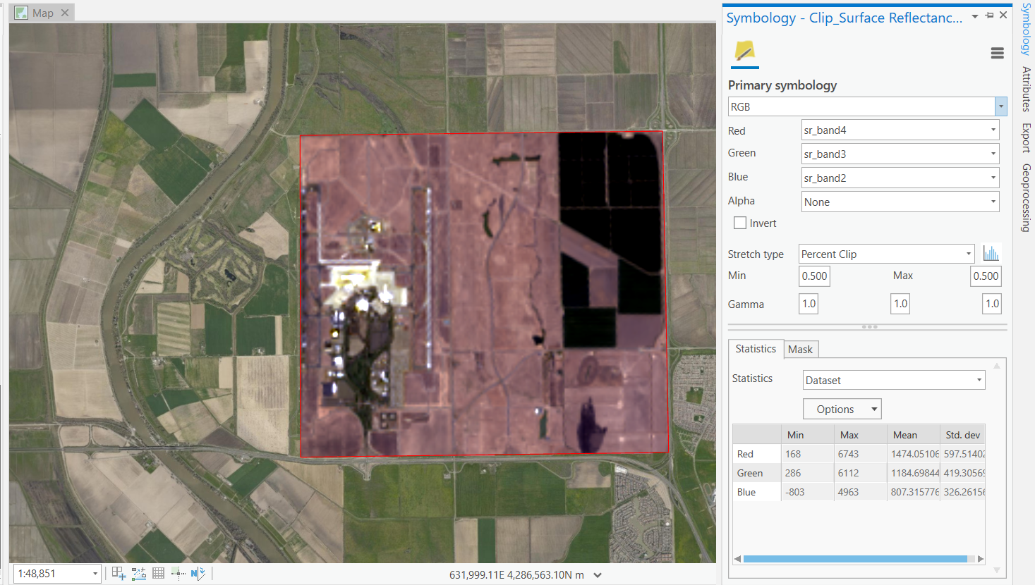
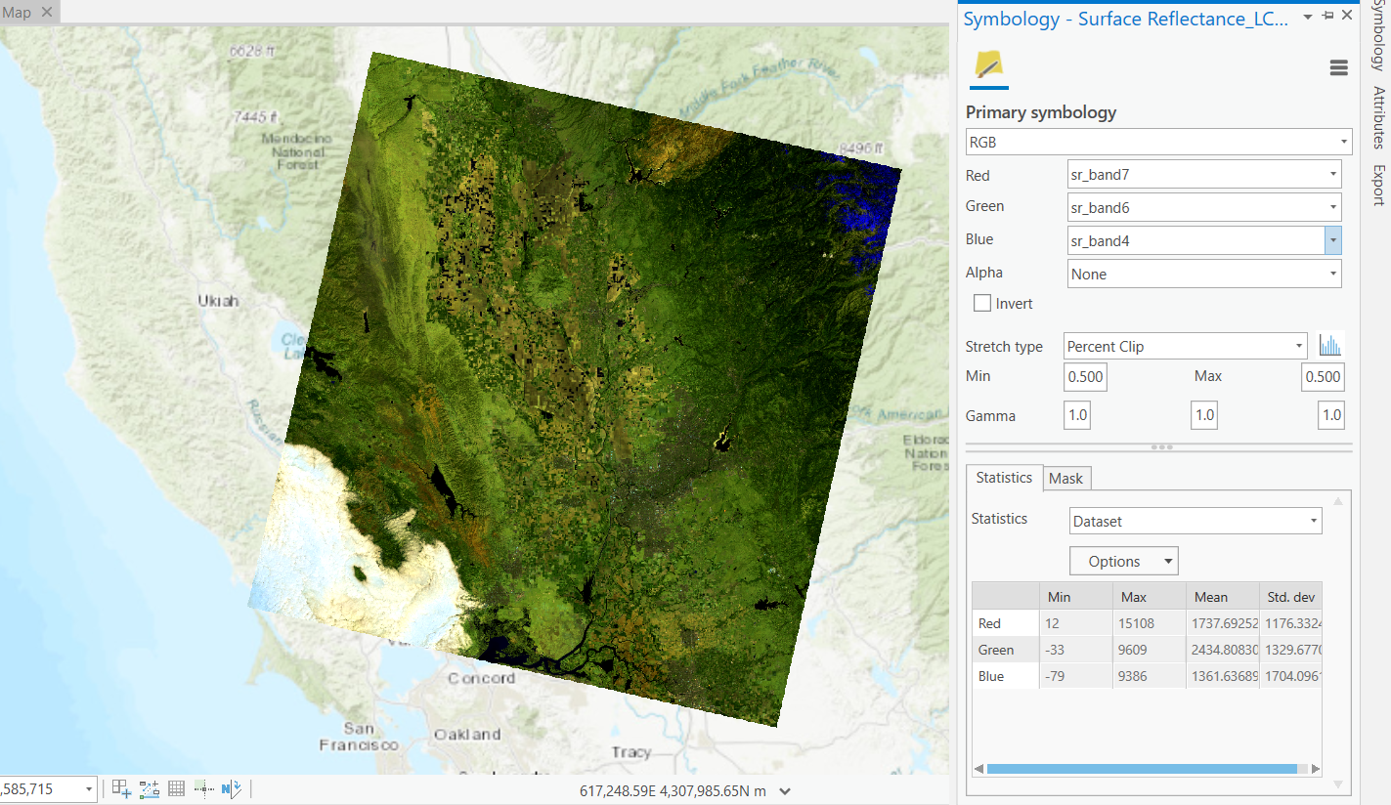
Band Selection
2013 Normal Color
2021 Shortwave IR
Bands 4,3,2
Bands 7,6,4

Slide 7
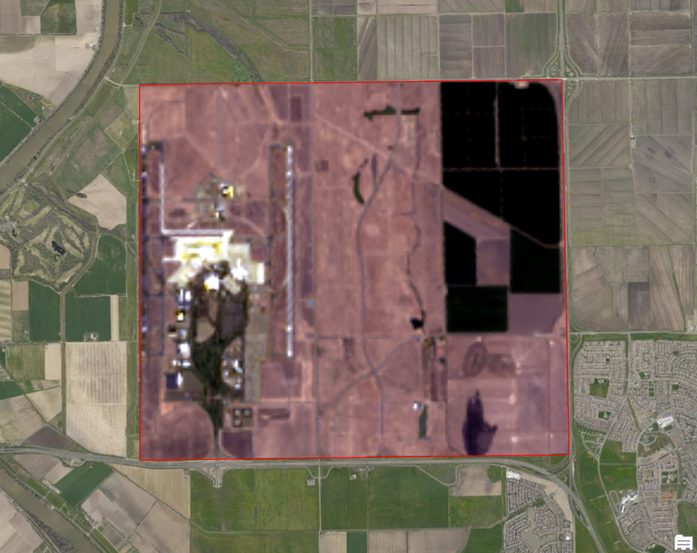
Clipped images using same polygon

Slide 8
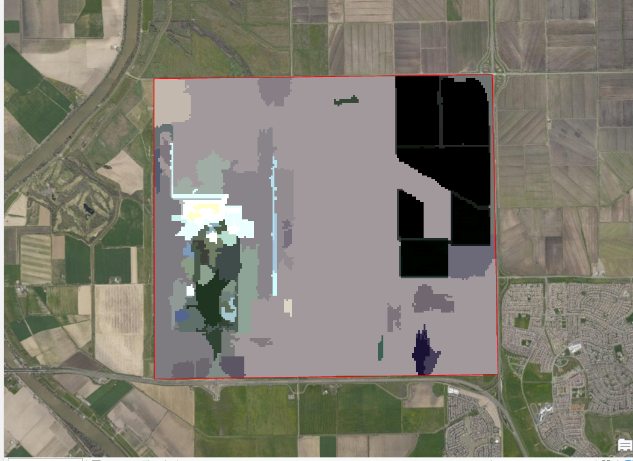
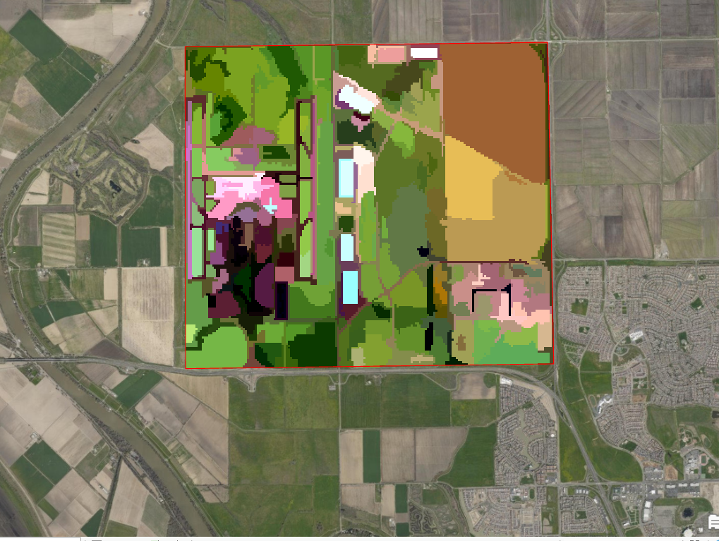
Segmentation
2013
2021

Slide 9
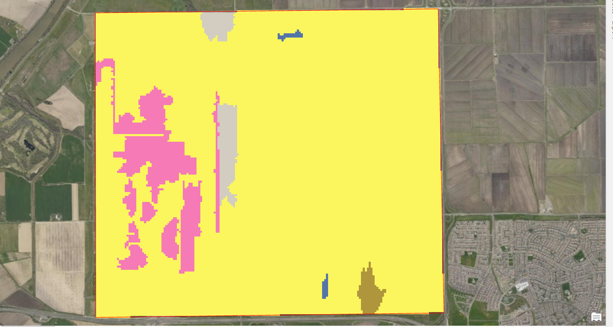
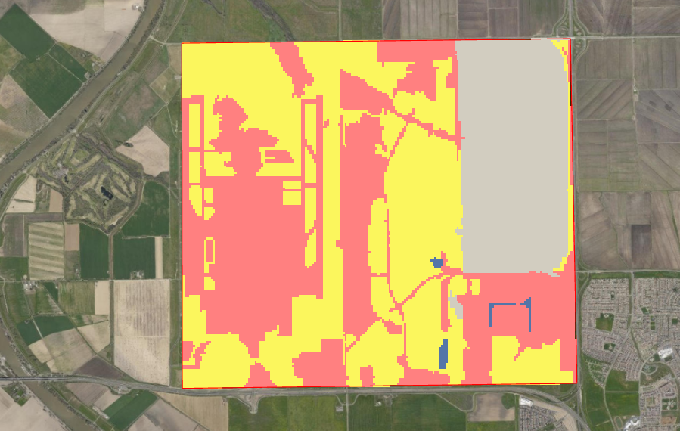
Classify and Train
2013
2021

Slide 10
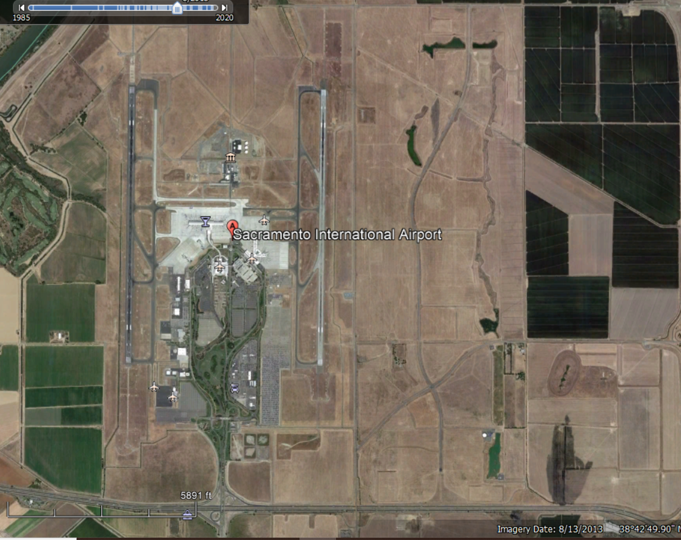
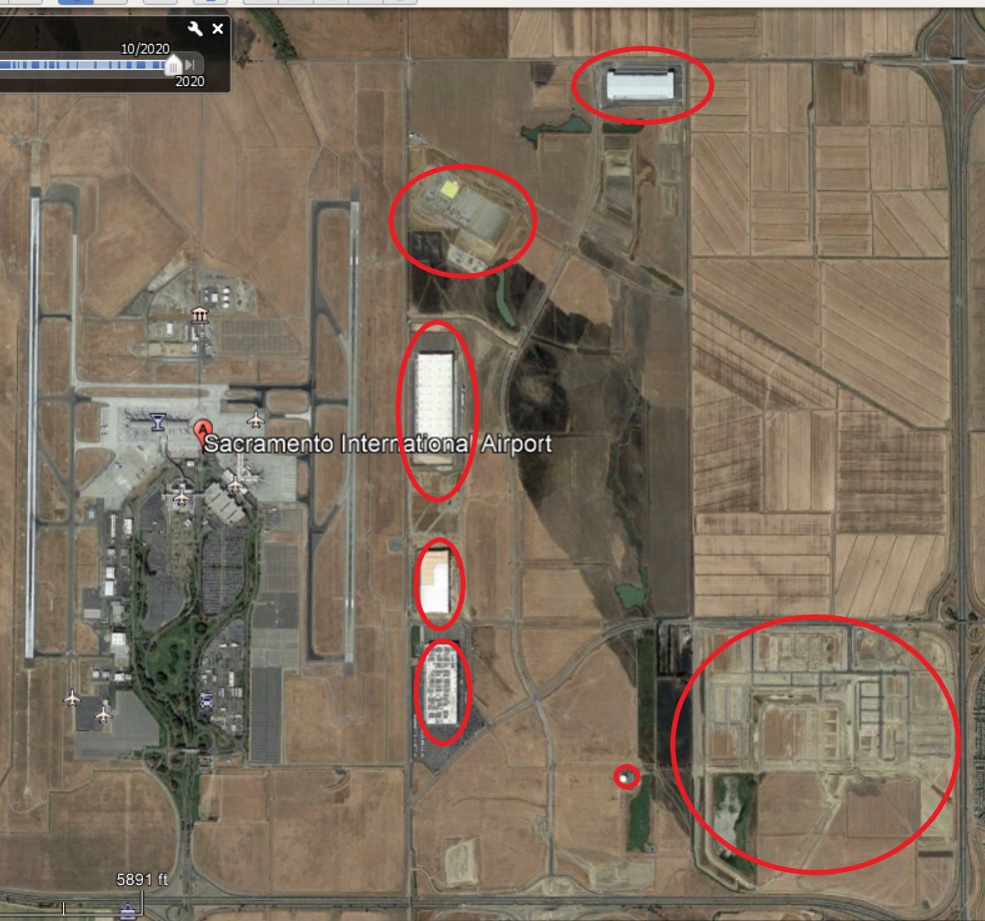
Google Earth
2013
2021

Slide 11
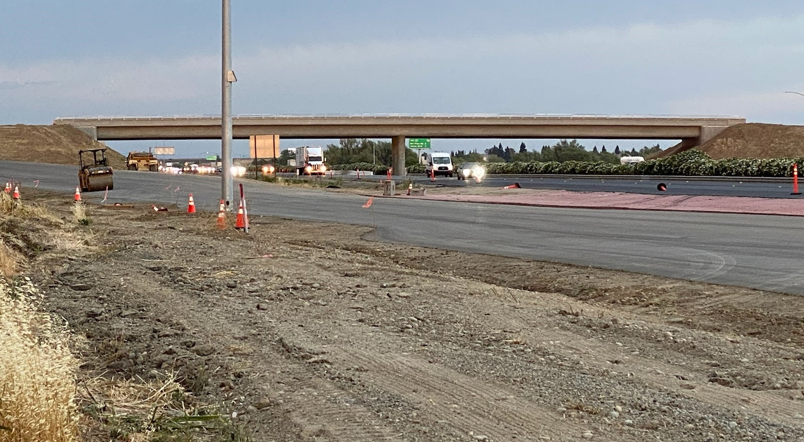
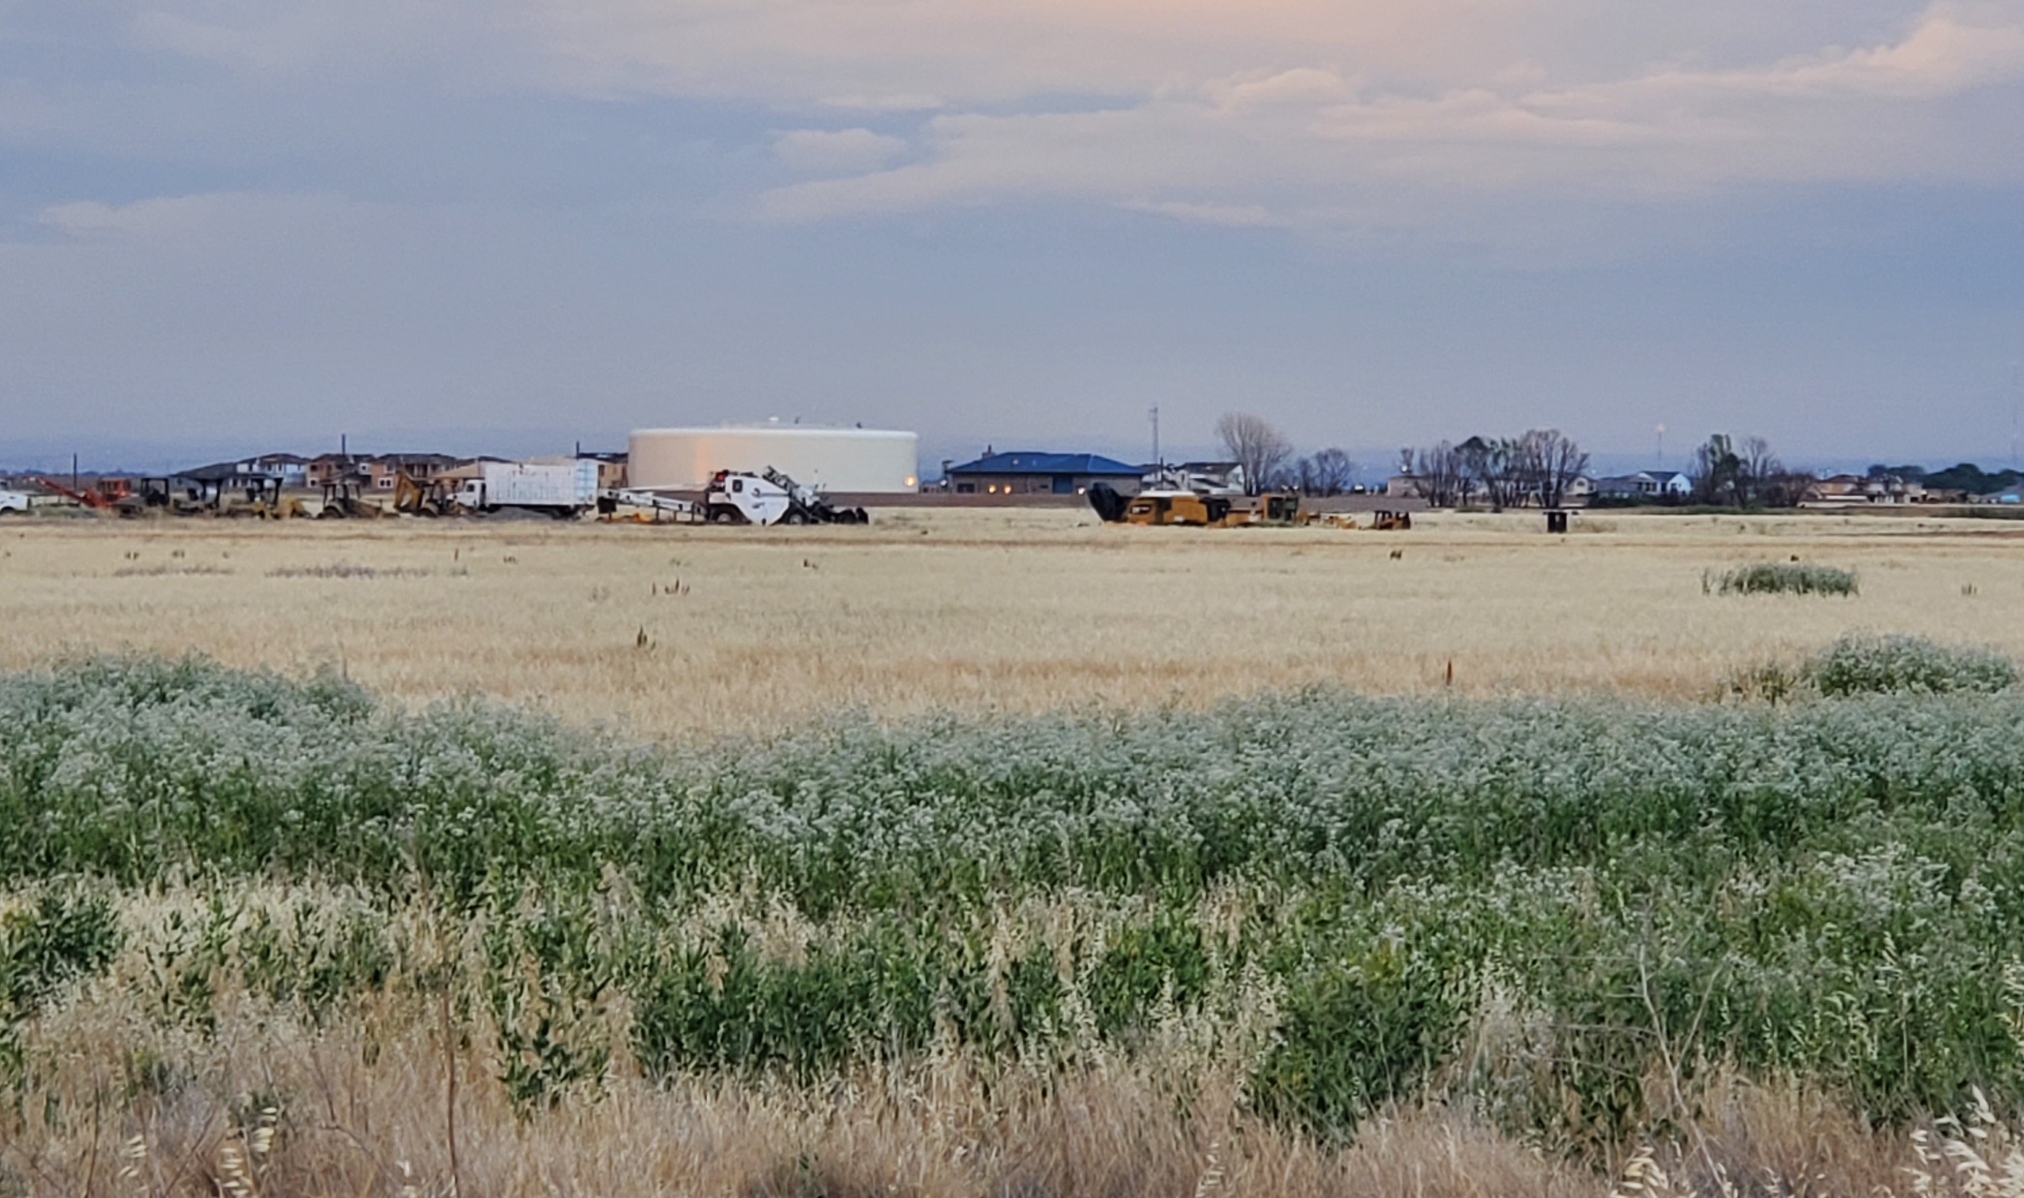
On site

Slide 12
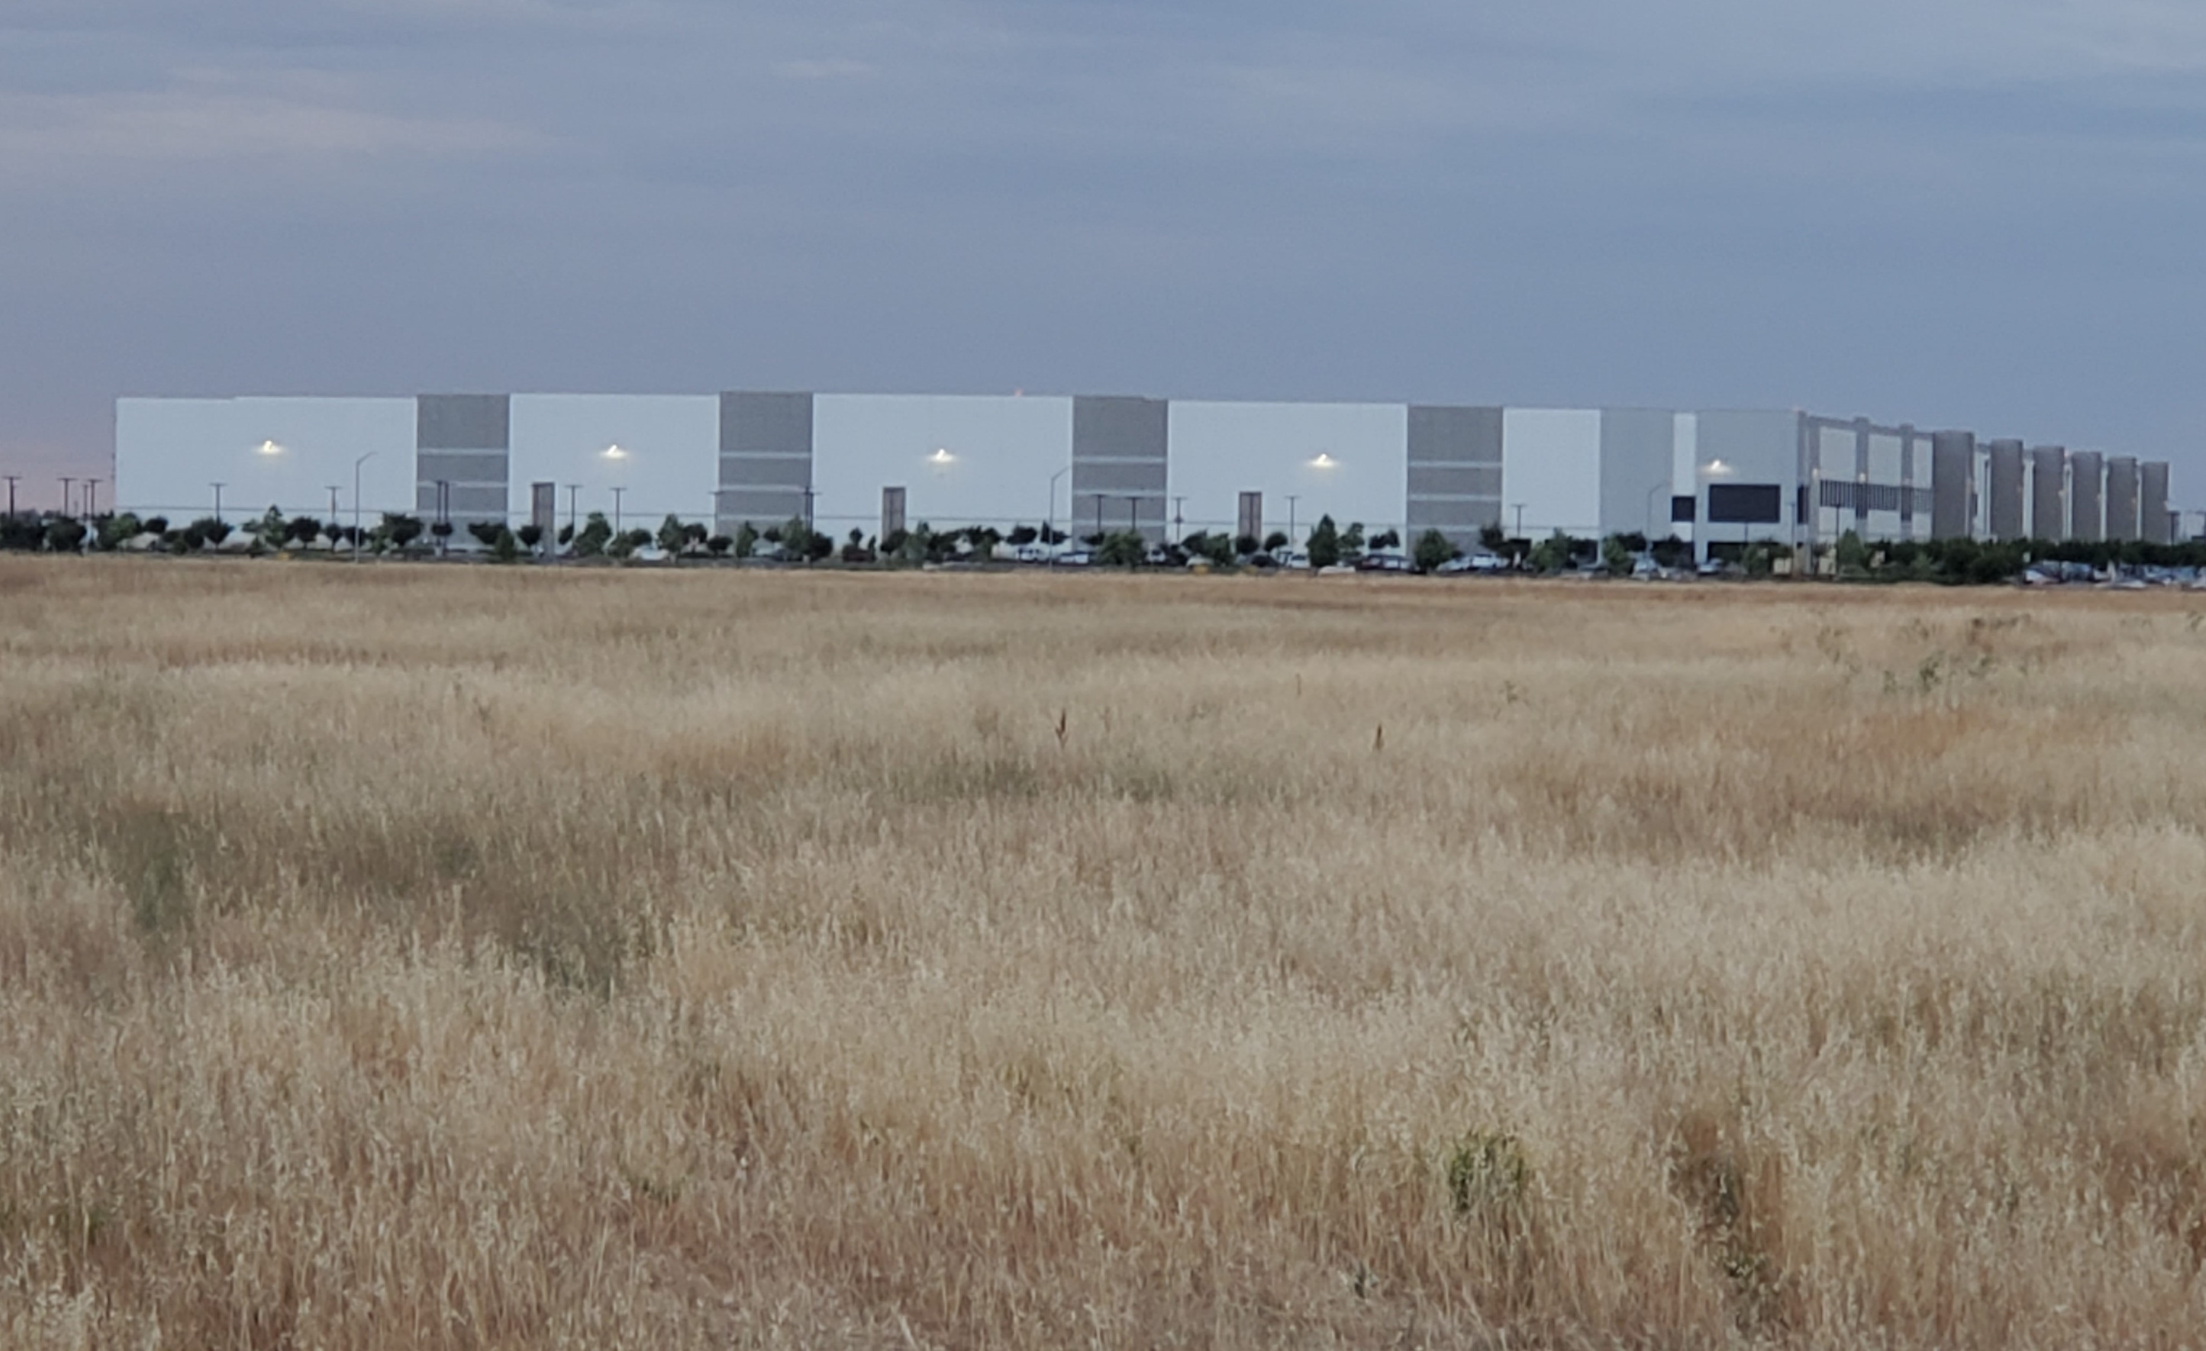
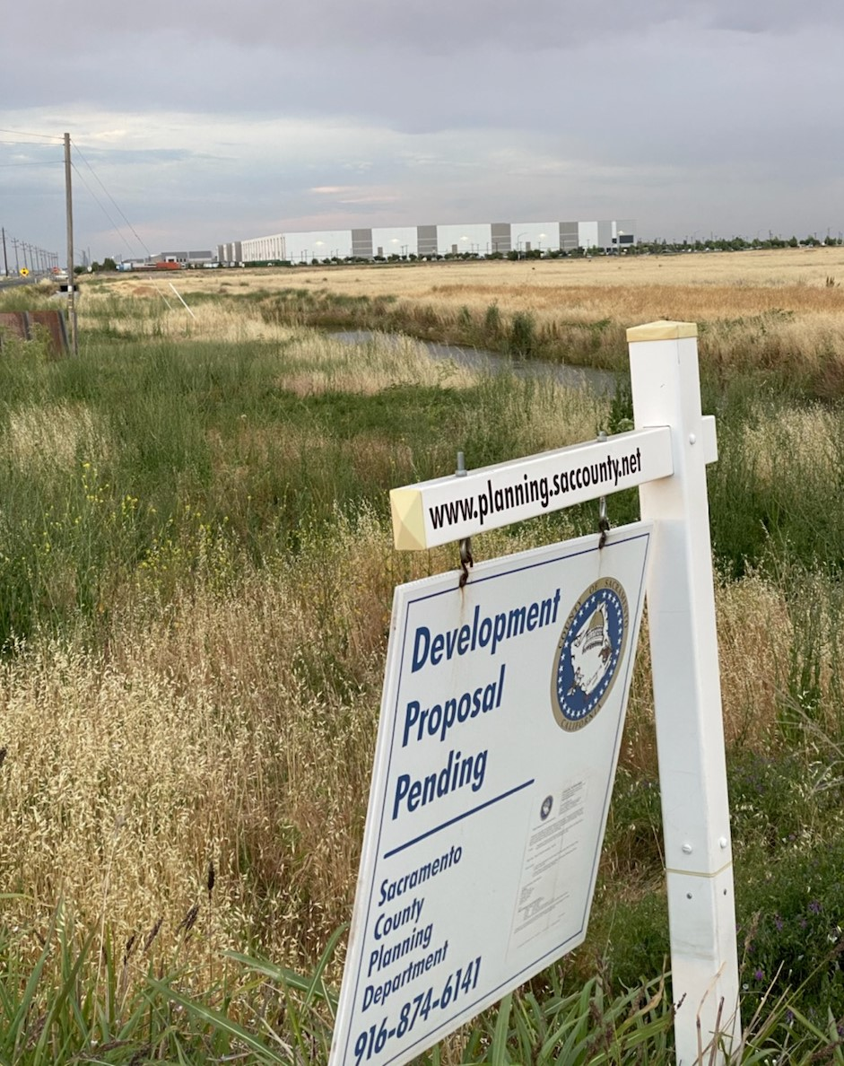
On Site 2

Slide 13
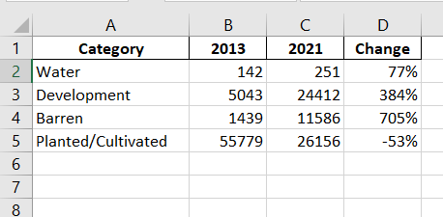
Results via Zonal Statistics (Acres)

Slide 14
Difficulties/Issues
Classification is hard. I think familiarity with the area is key.
Barren land. Didn’t expect this to be present as much as it was. Assumed it would be planted/cultivated.
Thought I had classified all the objects in the area, but the Wizard still made changes during reclassification.
During training on the 2013 image I was not allowed to make any more changes.
Lack of experience.

Slide 15
Conclusion
Proved that farmland is being developed around the Sacramento Airport. However, my data provided by land classification is not remotely accurate.

