Slide 1
Scripting the creation of Census 2020 hard-to-count maps by California geography
By Jim Miller
Geography 375
Spring 2019

Slide 2
Recognition of need
California has 58 counties, 80 Assembly districts, 40 state Senate districts, and 53 congressional districts.
In addition, it has hundreds of cities and unincorporated census-designated places.
Representatives of those areas have increasingly requested maps focused on likely enumeration challenges in Census 2020.
Making the same kind of map for different areas is tedious and time-consuming.
How to automate with customization?

Slide 3
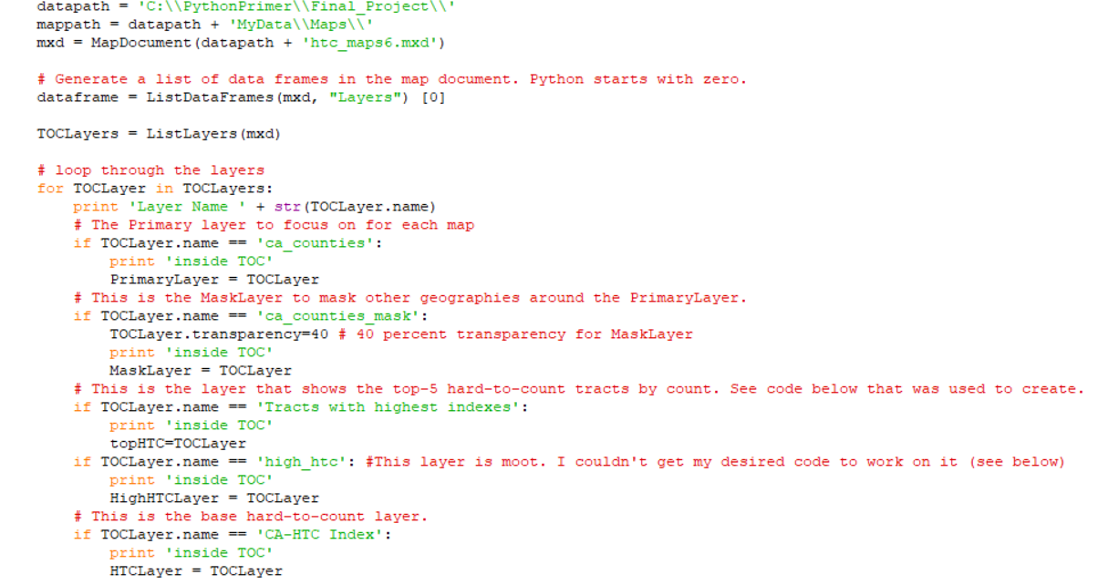
Create the map document, set layer variables

Slide 4
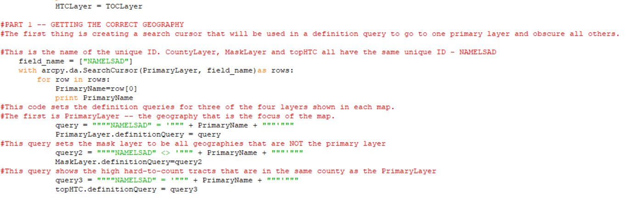
Search cursor and definition queries

Slide 5
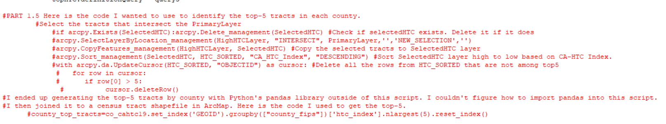
Workaround for hardest-to-count selection
SelectLayerByLocation tool didn’t get me what I needed. So I turned to pandas and shapefile join.

Slide 6
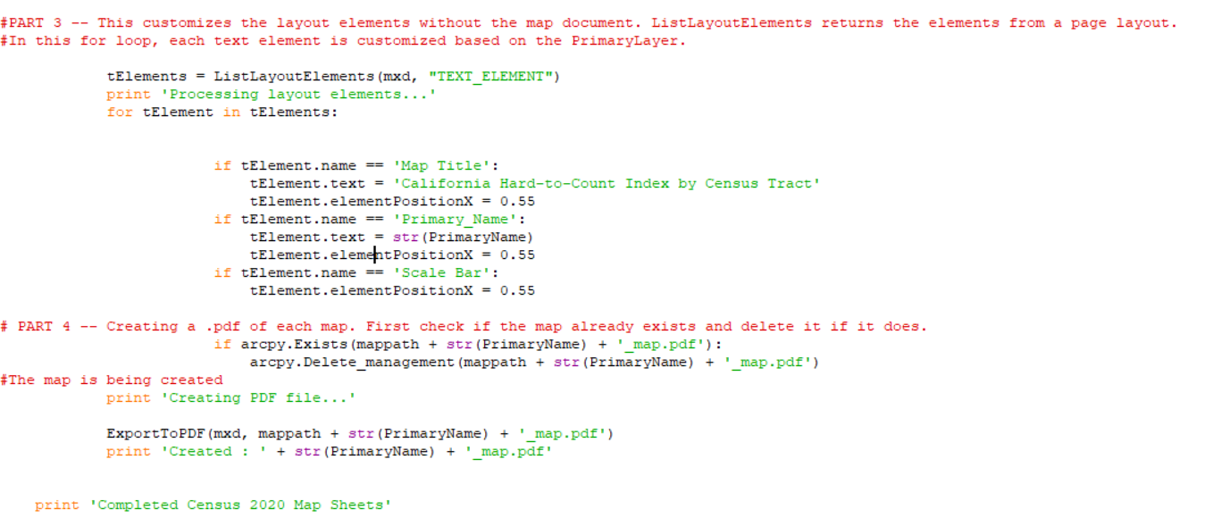
Setting layout elements and producing .pdf’s

Slide 7
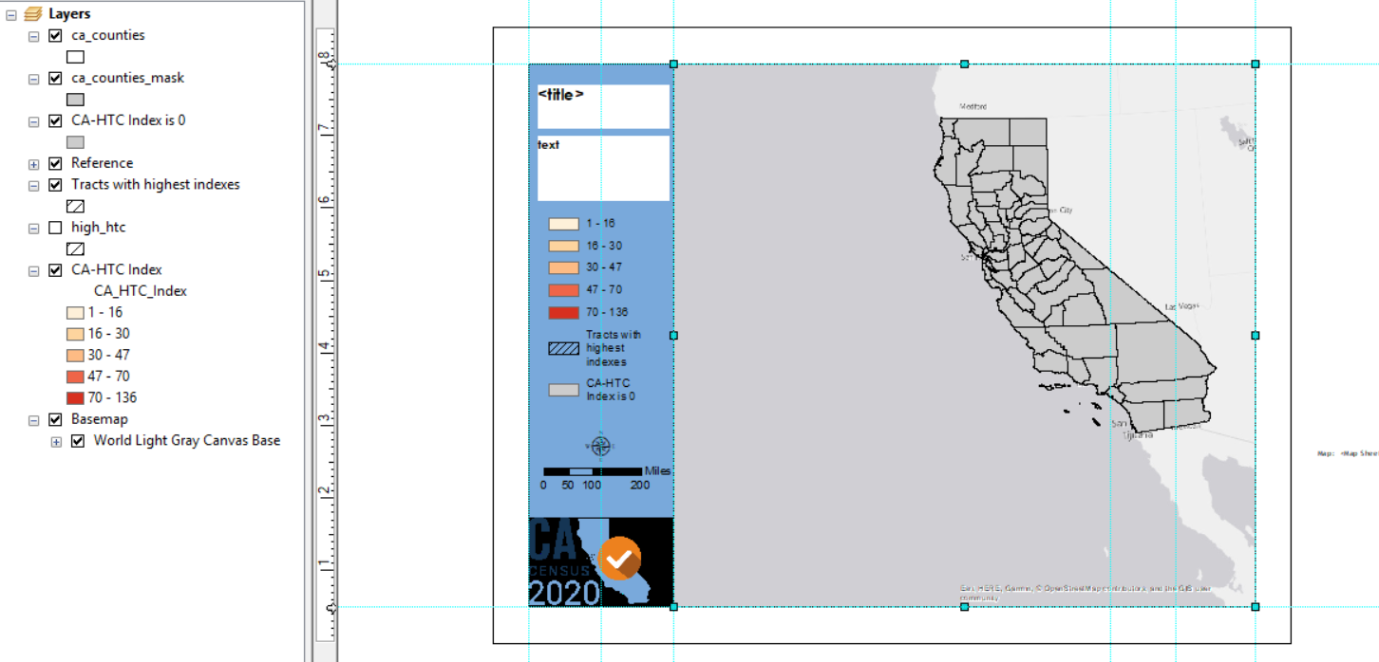
Map document with layers and layout

Slide 8
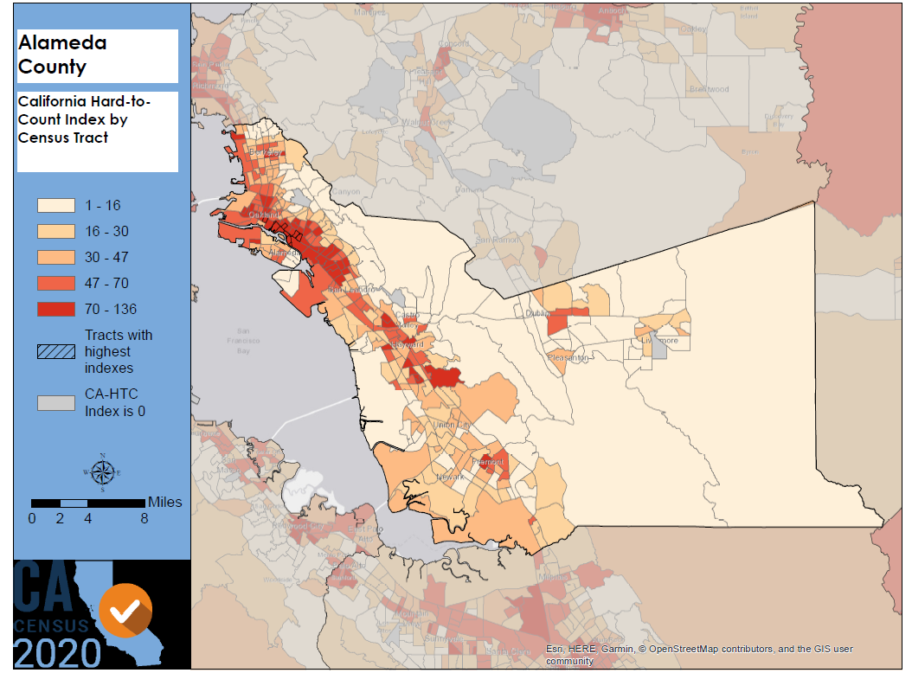
An example of map created by script

Slide 9
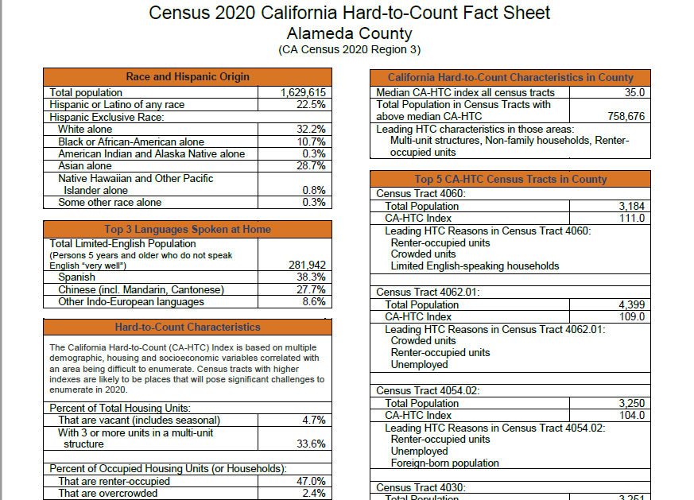
Fact sheets will pair maps with summary data

