Slide 1

Rehabilitating the Sunset-Whitney Golf Course
By: Benjamin McCovery
GEOG 342
Spring 2021

Slide 2
Project Summary
In 1963, The city of Rocklin approved the opening of a large multi-development-spanning golf course called the Sunset-Whitney Golf Course. Over the years, as Boomers aged out and younger homeowners lacked the time or interest in Golf, profits plummeted, and the 187-acre property was sold to a lending partnership in 2011. After three more years of sitting in developer hands, the golf course was officially closed on August 3rd, 2015. Since its closure, the city of Rocklin has shot down many new development deals; from housing to commercial ventures, for the 187-Acre Strip. For this project I want to create informational graphics that show historical change in vegetation along this area as if I was presenting the information to Rocklin’s City Council. I will be using NDVI image Analysis to show changes in vegetation along with infrared imagery as a supplement.

Slide 3
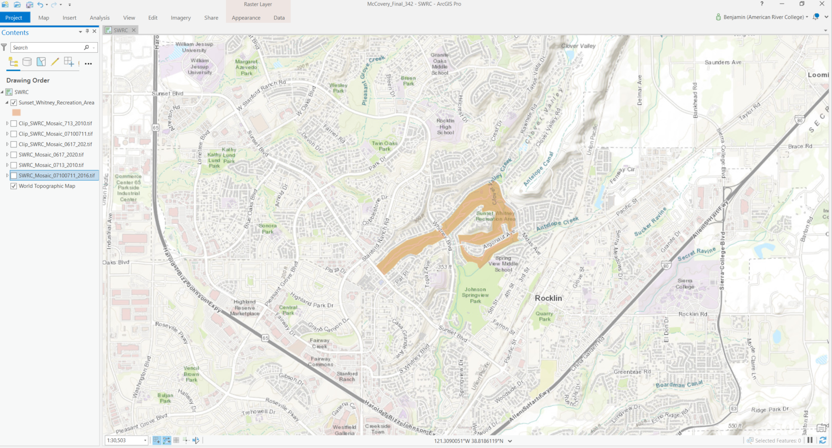
Study Area

Slide 4
Purpose
Speaking as a longtime resident of Northern California and Sierra College alumni, the old Sunset Whitney Golf course has been a community blight since its closure in 2015. The combination of obstinate homeowners refusing new development and developers lacking vision has left the old golf course to lay fallow surrounded by chain link fences. Only recently in November 2019 did the City of Rocklin finally pay to repatriate the land to the city and develop it into the Sunset Whitney Recreation Area. I wanted to make a mock historical presentation showing the vegetation index of the land throughout the drought years to really drive home just how much time and money the city of Rocklin has wasted not utilizing the land in a way that preserves water effectively.

Slide 5
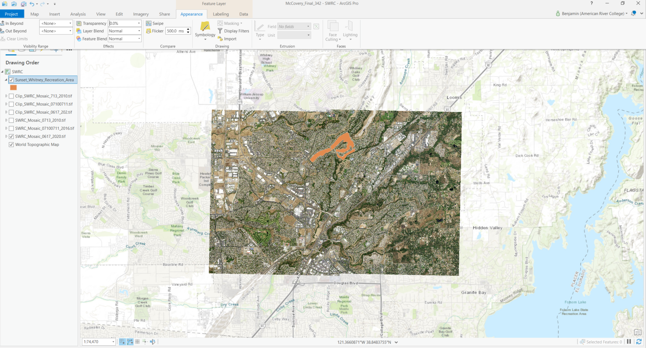
Processing:
Composite Image tile

Slide 6
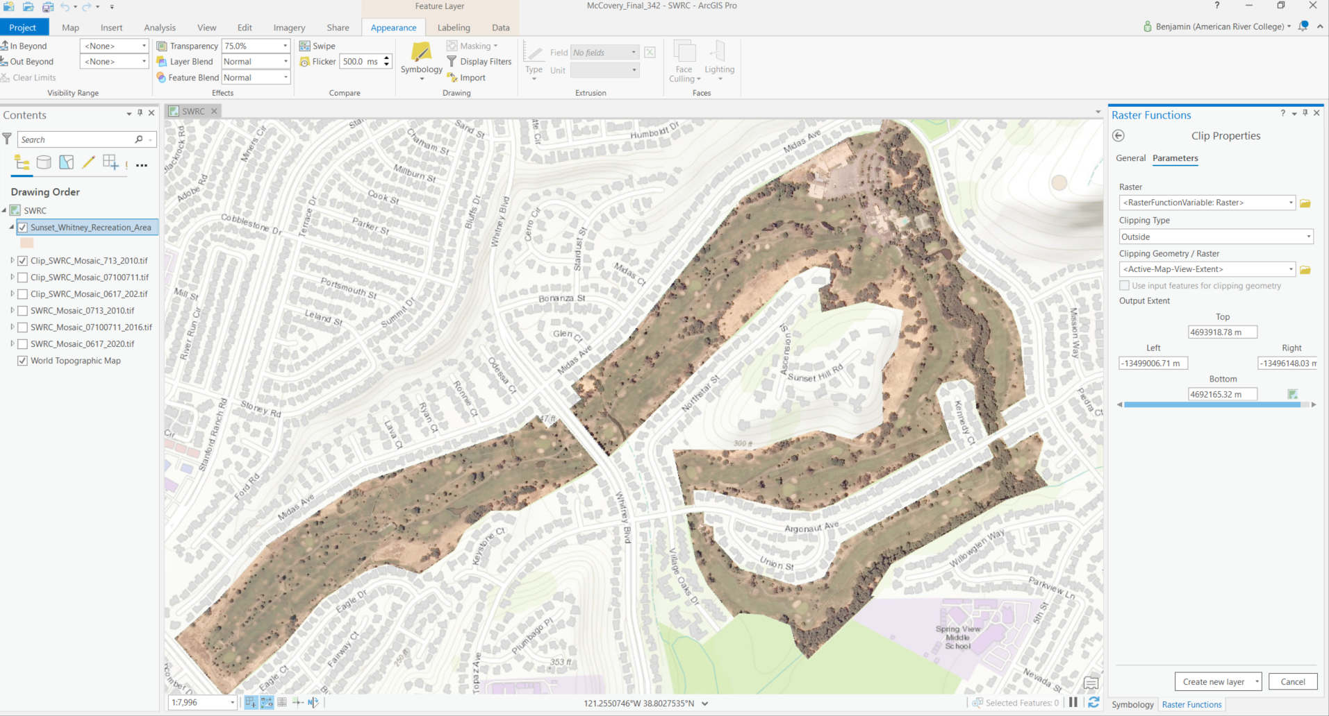
Processing:
Clip

Slide 7
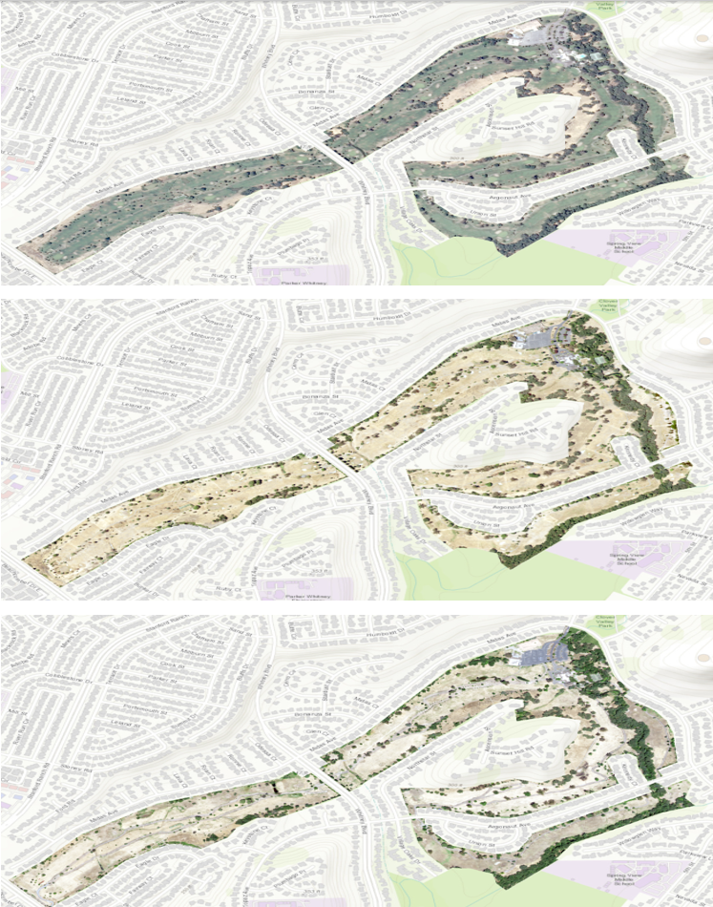
Processing:
Clip

Slide 8
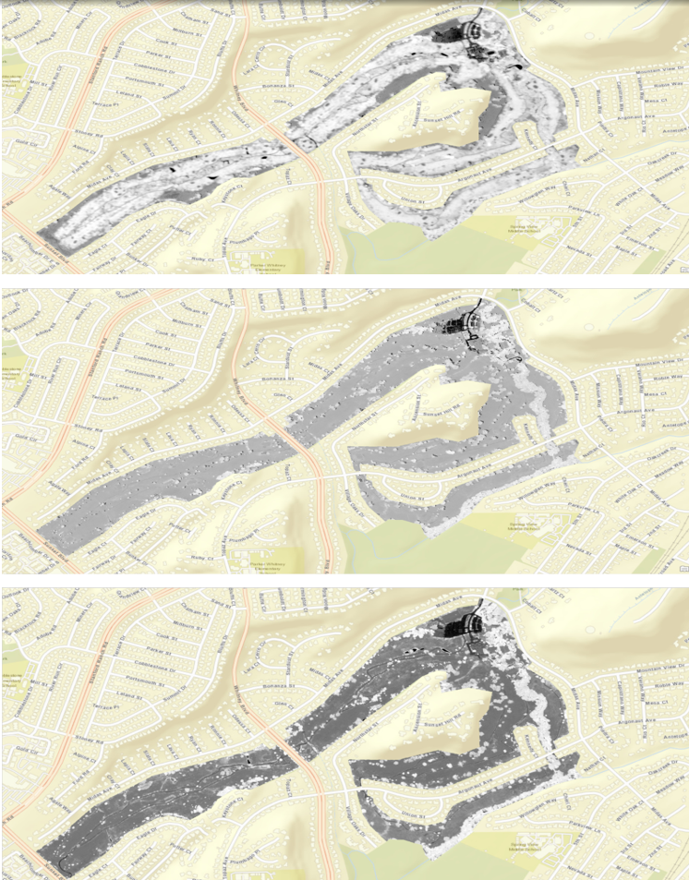
Output:
NDVI

Slide 9
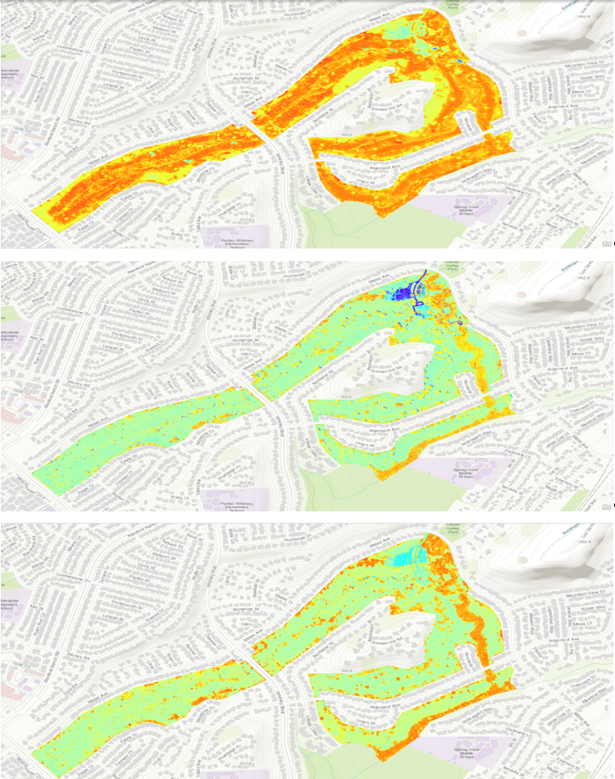
Output:
NDVI (Colorized)

Slide 10
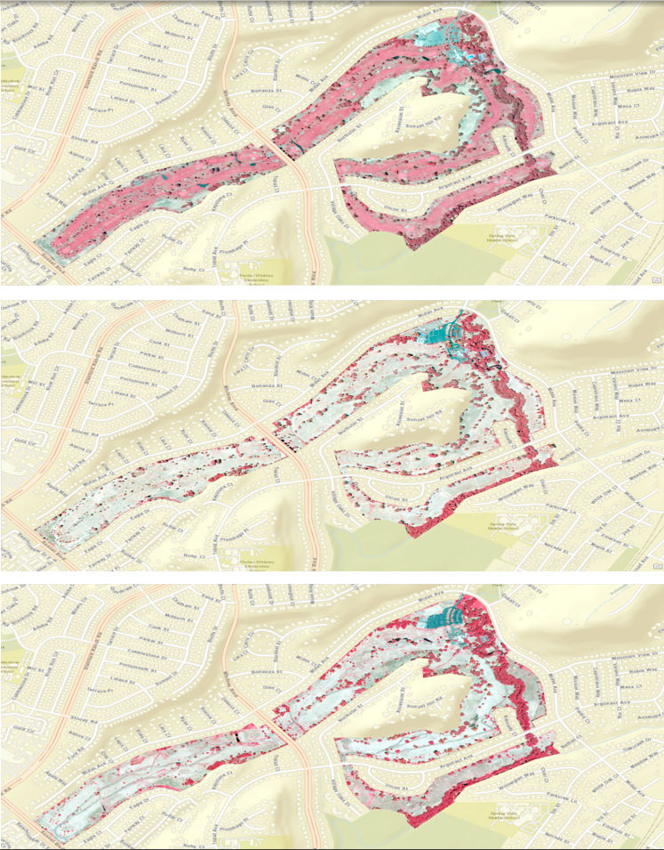
Output:
CIR

Slide 11
Conclusions
Based on the Results of the processed imagery, you can see that water resources were conserved during the drought years (2011-2017), but with a large piece of land laying fallow and unkempt, runoff and contaminant sources were potential issues for the area. I expected the results based on the clearly fallow years presented in the imagery, but I did not expect to see the uptick in moisture and vegetation that the newly paved trail provided. The addition of drought resistant plants and paving of the links leads to better protection of water resources. One thing I would like to do is walk the trail and ascertain if there is a drip/sprinkler system still in operation. One way I could further define this “mock” presentation is using spatial analysis and historical water usage data to see just how much runoff was diverted to Antelope Creek.

Slide 12
Resources
Raster Imagery: https://earthexplorer.usgs.gov/
Sunset Whitney Background: https://www.rocklin.ca.us/news/grant-funding-approved-potential-swra-trails-expansion and https://www.bizjournals.com/sacramento/news/2015/08/05/what-will-happen-to-the-shuttered-rocklin-golf.html
Questions?: ben_mccovery@yahoo.com
Thank You!

