Slide 1
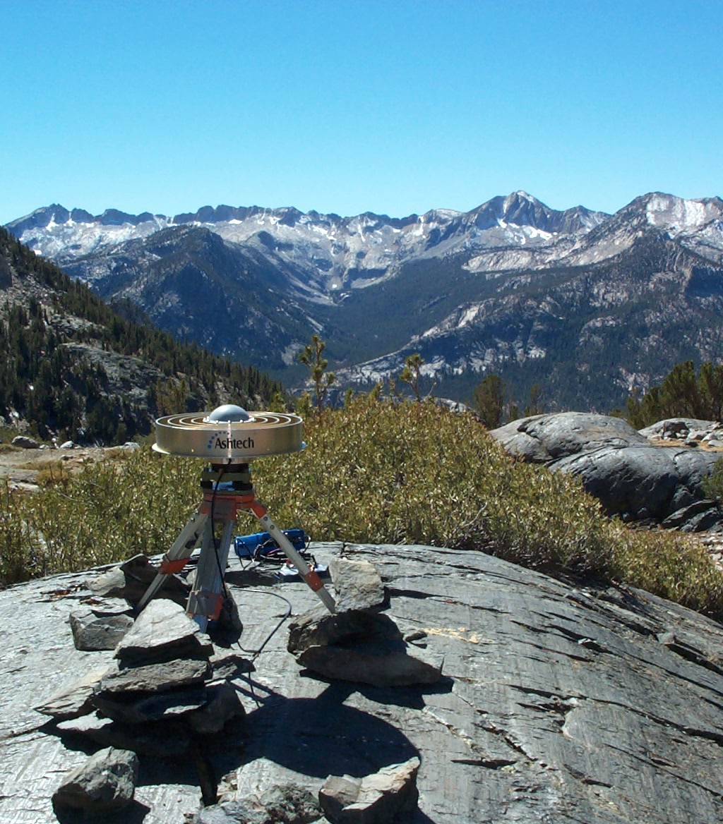
Mapping Significant Earthquakes
Processing USGS GeoJSON Real-time Feeds
Using ArcPy Scripts
Aleta March
GEOG 375
Spring 2020
  Seismic Monitoring Station Northern California Seismic Network U.S.G.S., Menlo Park, CA http://ncedc.org/

Slide 2
Overview
The purpose of this project was to utilize a stand-alone Python script to retrieve real-time GeoJSON data from the USGS Earthquake Hazards website in order to create and export maps showing the location and magnitude of significant earthquakes worldwide.

Slide 3
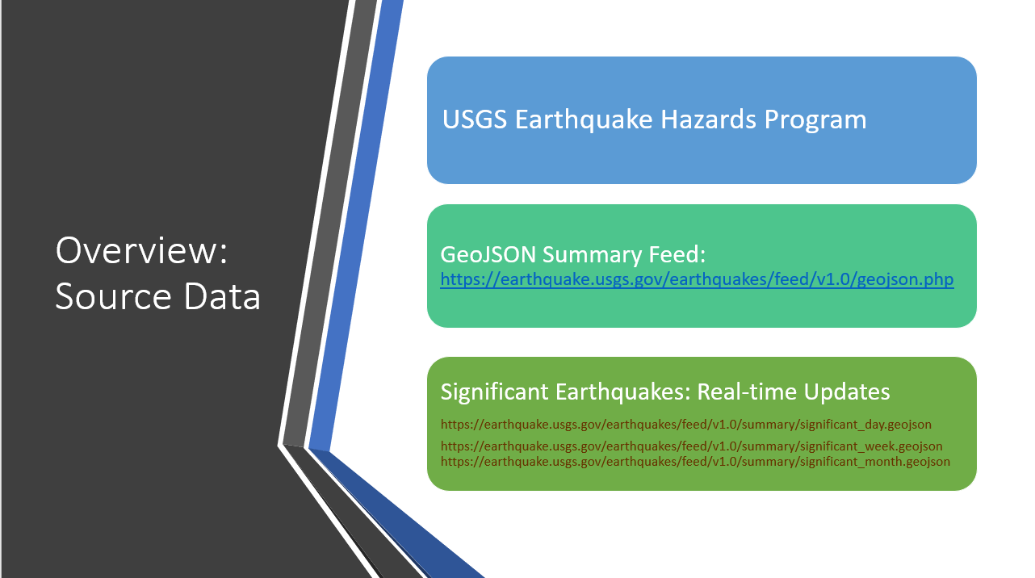

Slide 4
Workflow Overview
Retrieve and Extract
Retrieve and Extract GeoJSON Real-time Data
Create
Create Real-time (RT) Table / Feature Class
Update
Update Cumulative (Base) Table / Feature Class
Create
Create Map Series

Slide 5
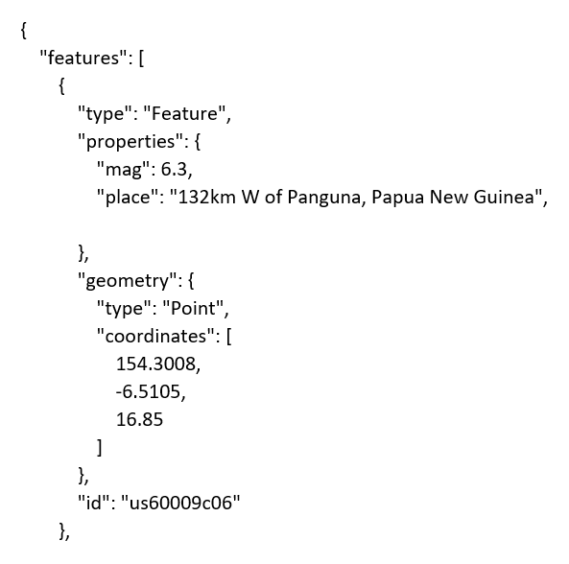
Workflow Detail
Begin with GeoJSON Data

Slide 6
Workflow Detail
Transform Using Geoprocesses
Create Tables
arcpy.CreateTable_management
arcpy.AddField_management
arcpy.Copy_management
Populate Tables
arcpy.da.InsertCursor
insertRow
arcpy.da.SearchCursor
arcpy.da.InsertCursor
Create Point Feature Classes
arcpy.MakeTableView_management
arcpy.management.XYTableToPoint
arcpy.da.InsertCursor (with geometry token)
irows.insertRow

Slide 7
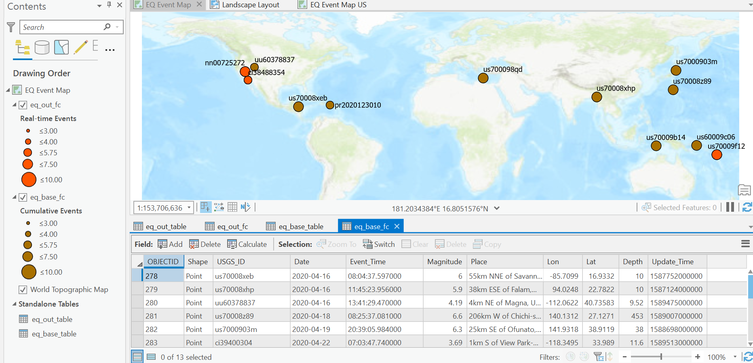
Workflow Detail
Result: Point Features

Slide 8
Workflow Overview Part II
Create
Map Series
Prepare Layout
Assign Variables for Map Layers / Elements
Retrieve Values
Retrieve Real-time Layer Attribute Values
Set Extent
Set Geographic Extent of Events
Export
Export Global and Local Event Maps

Slide 9
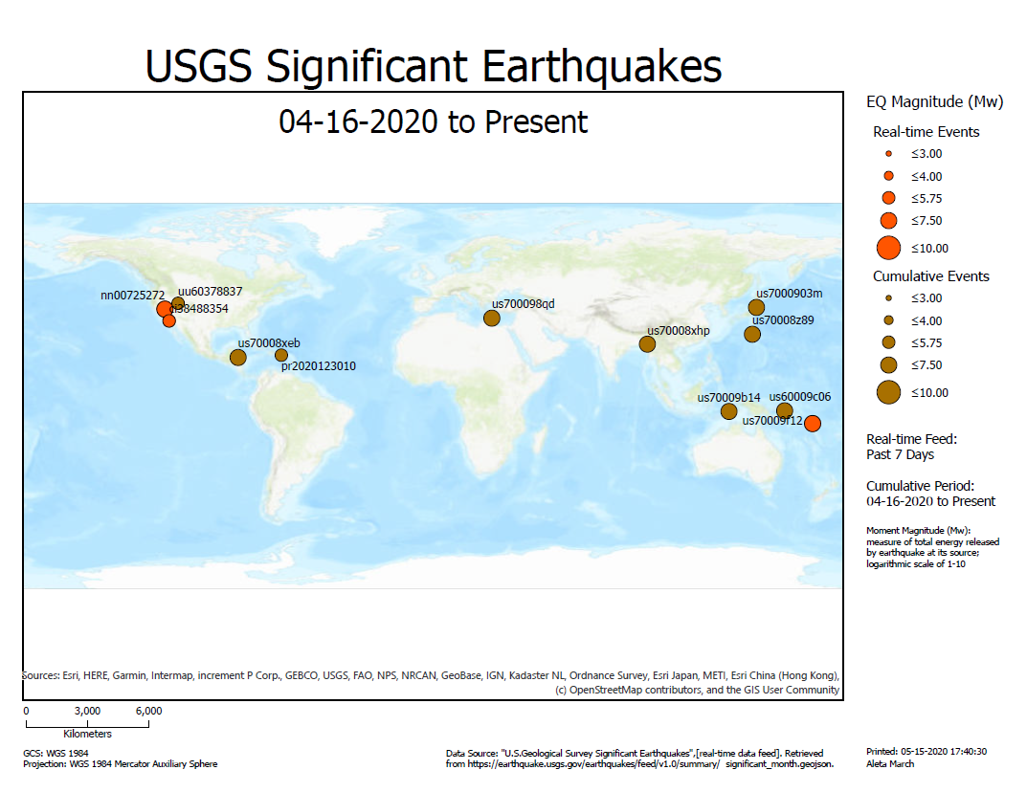
Global Map

Slide 10
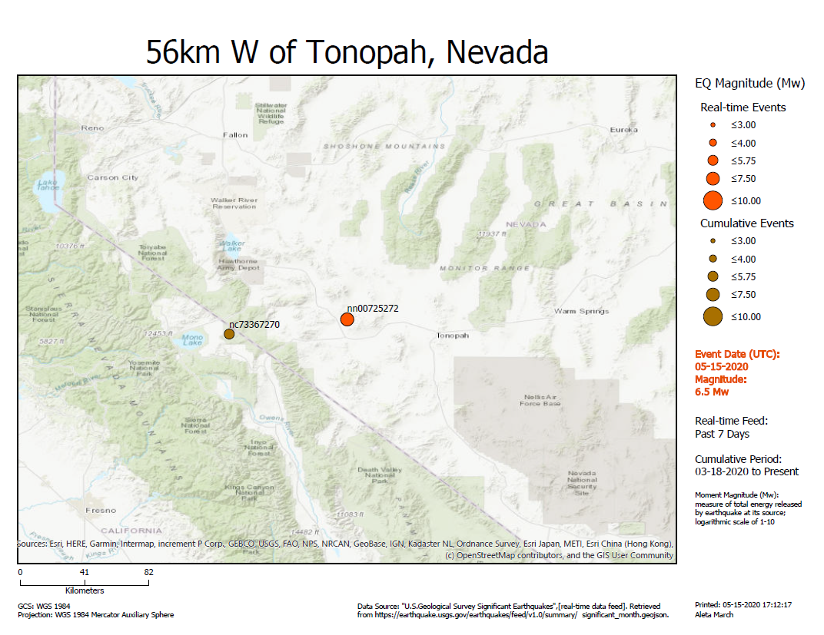
Local
Real-time
Event Map

Slide 11

Local
Real-time
Event Map

Slide 12
Problems and Deficiencies
Sorted Order of Cumulative Base Table
May Result in Lengthy Search Times
Map Feature Reliability
Intermittent Problem: Point Feature Missing on Map
Spatial Reference of Exported Maps
Not Customized According to Map Extent
Exception Code
Not Customized for URL Request / Internet Issues

Slide 13
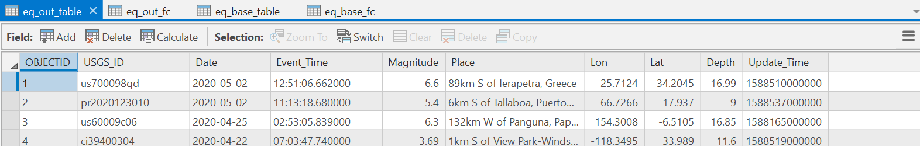
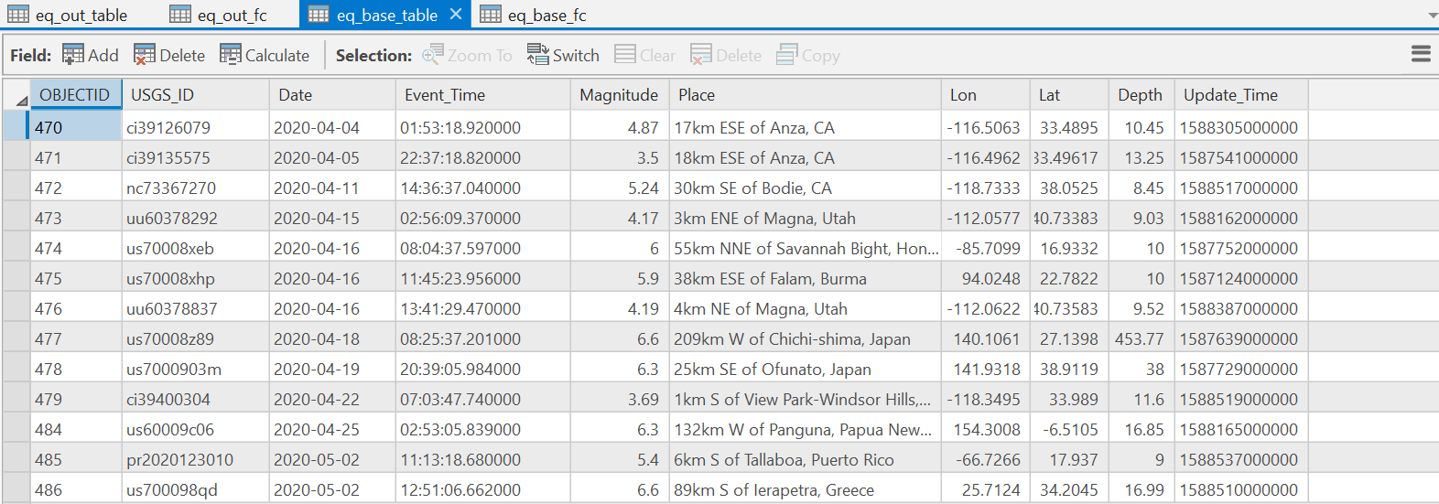
Base Table Order: Ascending
Real-time Table Descending Order by Date/Time
Most recent event at bottom of list
Results from InsertRow adding new rows to bottom of table
Benefit: sort order remains constant throughout update cycles
Drawback: update search will become longer as number of rows increase
  As most matches for updates are found in recent events (at bottom)
Copy New Row Tuple to List
Add From List to Bottom of Table
Base Table in Ascending Order by Date/Time

Slide 14
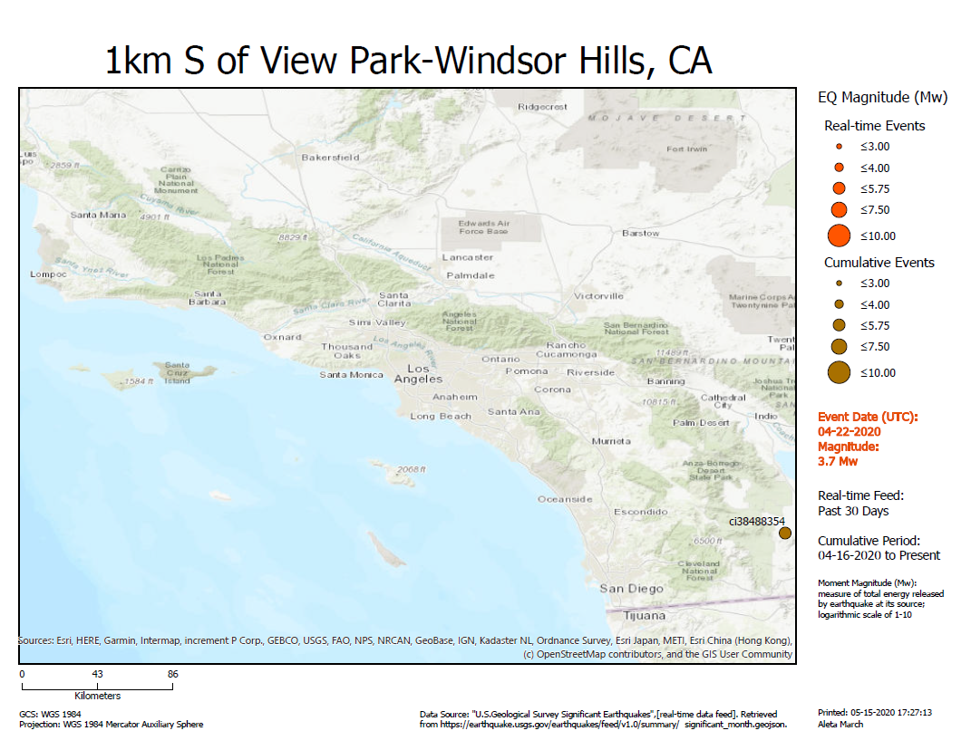
Map Feature Reliability
  Event Missing from Map
    Infrequent
    Unexplained
  Data Format Appears Same
    Input and Processed
  Only Common Element
    USGS ID Prefix: “ci”
Where is
USGS ID ci390400304?

Slide 15

Spatial
Reference
EXCELLENT DISCUSSION
“Allow arcpy.mp to modify spatial reference property of Map/MapFrame”
https://community.esri.com/ideas/12767-allow-arcpymp-to-modify-spatial-reference-property-of-mapmapframe
  Spatial Reference of Exported Maps Not Customized According to Geographic Location and Extent
  Arcpy.mp Does Not Yet Provide a Way to Change the Spatial Reference of Map Frames or Maps
  Functionality Will Be Available ArcGIS Pro 2.6
jbarrette-esristaff Jan 10, 2020 11:01 AM
This is being planned for ArcGIS Pro 2.6.
Jeff - arcpy.mp team

Slide 16
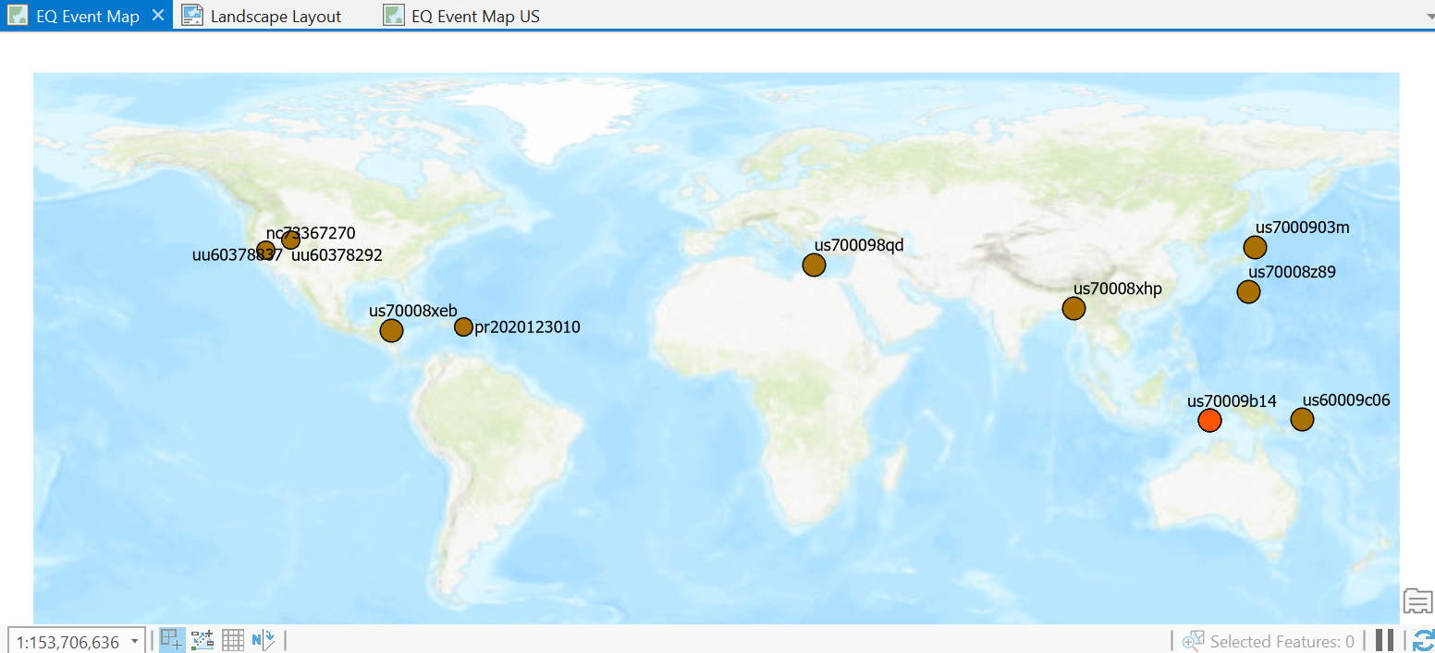
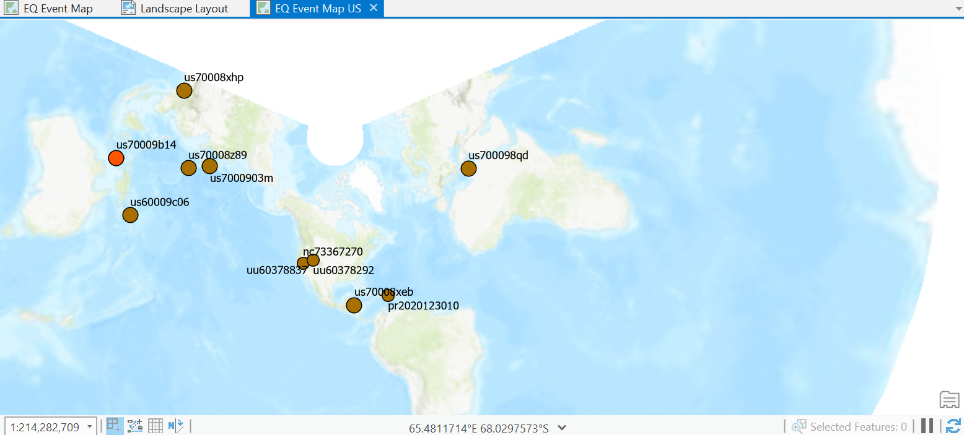
Spatial
Reference
  WORKAROUND: STEP 1
  Make Duplicate Maps Each with a Different Spatial Reference
    GCS WGS 1984
    WGS 1984 Mercator Auxiliary Sphere
    GCS North American 1983
    USA Contiguous Lambert Conformal Conic
WGS 84
NAD 83

Slide 17
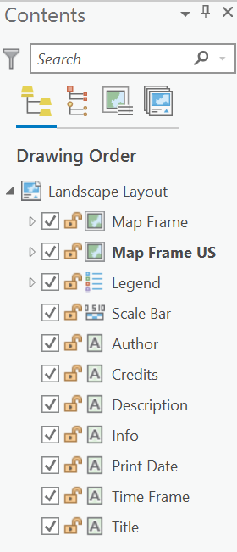
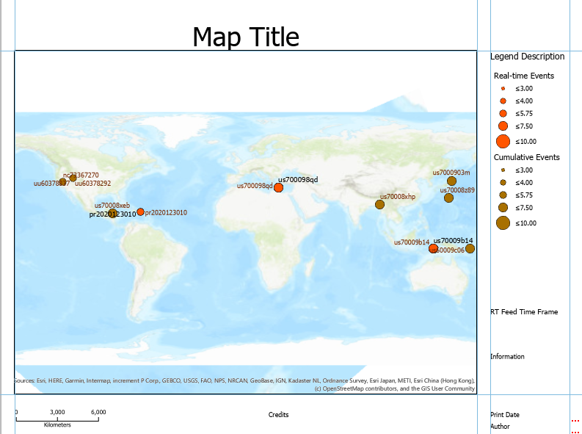
Spatial
Reference
Multiple MapFrames / One Layout
https://community.esri.com/ideas/12767-allow-arcpymp-to-modify-spatial-reference-property-of-mapmapframe
  WORKAROUND: STEP 2
  Stack Multiple MapFrames (with different spatial references) in One Layout
  Use Python Script to Select the Correct MapFrame for the Extent of the Event Map
Stack of MapFrames

Slide 18
Conclusion
This project was a challenge!
I would like to thank Professor Jennings for his help and support. The video sessions were just the ticket to getting me started with Python programming for GIS.

