Slide 1
Using GIS to Determine Trail Suitability for User-Created Trails
    Katie Mansfield
    Geog 93 Final Project

Slide 2
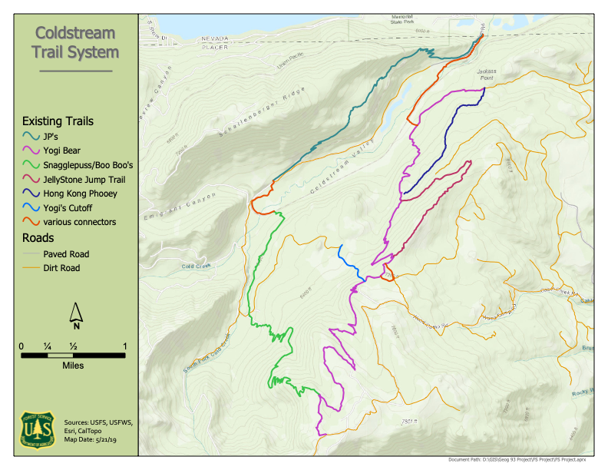
Purpose
GEog 93 final project
Analyze user-created trails to incorporate them into the National Forest Trail System
Use CWHR types to determine potential habitat
Examine trail interaction with sensitive resources (wildlife PACs, den/nest sites, archaeology, etc.)
Determine trail sections that need to be improved or rerouted

Slide 3
CWHR types
GEog 93 final project
CHWR Size | Description | Diameter at Breast Height (DBH)
1 | Seedling | Less than 1 inch
2 | Sapling | 1 to 5.9 inches
3 | Pole | 6 to 11 inches
4 | Small Tree | 11 to 24 inches
5 | Medium/Large Tree | Greater than 24 inches
6 | Multi-layered
Symbolized by preferred CWHR habitat type (4M, 4D, 5M, 5D, 6D)
Queried 4M and above (i.e. above 11in DBH and 40% canopy cover)
Added an acres field & calculated geometry
Used Summarize and Summary Statistics to get total area and area per habitat class
Tree Canopy | Description | % Canopy Cover
S | Sparse | 10 to 24%
P | Open | 25 to 39%
M | Moderate | 40 to 59%
D | Dense | 60 to 100%

Slide 4
CWHR types
GEog 93 final project
CHWR Size | Description | Diameter at Breast Height (DBH)
1 | Seedling | Less than 1 inch
2 | Sapling | 1 to 5.9 inches
3 | Pole | 6 to 11 inches
4 | Small Tree | 11 to 24 inches
5 | Medium/Large Tree | Greater than 24 inches
6 | Multi-layered
Symbolized by preferred CWHR habitat type (4M, 4D, 5M, 5D, 6D)
Queried 4M and above (i.e. above 11in DBH and 40% canopy cover)
Added an acres field & calculated geometry
Used Summarize and Summary Statistics to get total area and area per habitat class
Tree Canopy | Description | % Canopy Cover
S | Sparse | 10 to 24%
P | Open | 25 to 39%
M | Moderate | 40 to 59%
D | Dense | 60 to 100%

Slide 5
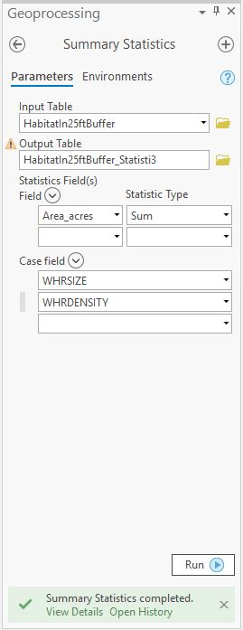
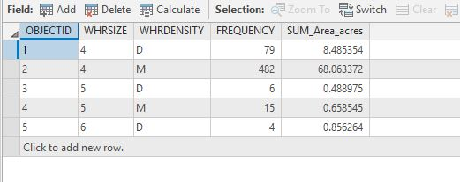
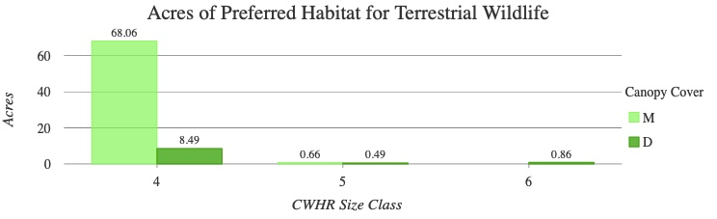
Note: Total area - 126.45 acres

Slide 6
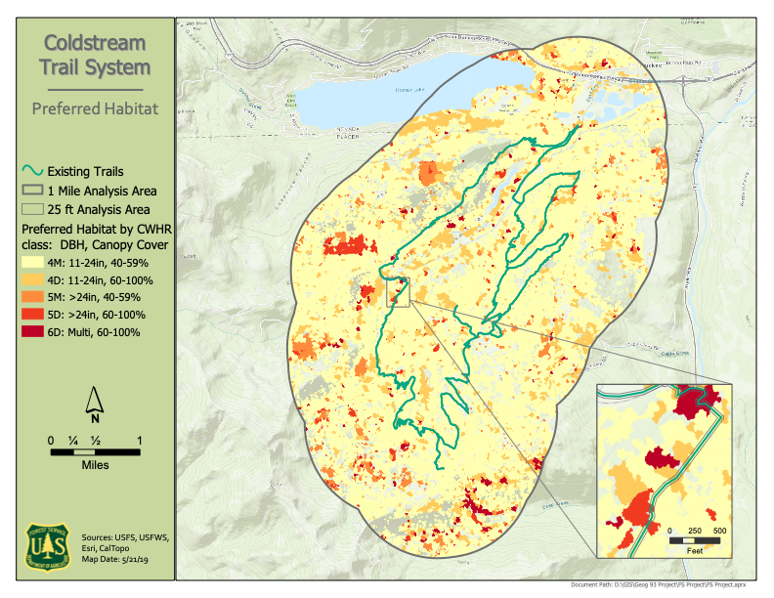

Slide 7
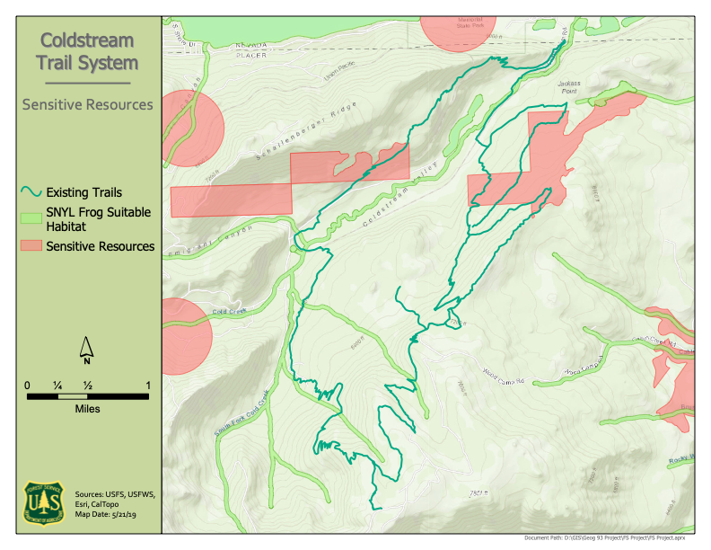
Sensitive Resources
GEog 93 final project
Areas to avoid
Merged sensitive areas
  Protect resources and reduce bias
Added suitable habitat for SNYL Frogs

Slide 8
Trail Reroutes and improvements
GEog 93 final project
Selected highly preferred CWHR classes (5D and 6D), exported, intersected with trails
Intersected sensitive resources and trails
Merged those to create trail segments to potentially reroute
Intersected SNYL Frog suitable habitat with trails
  May require reroute
  At stream crossings — armoring or bridge

Slide 9
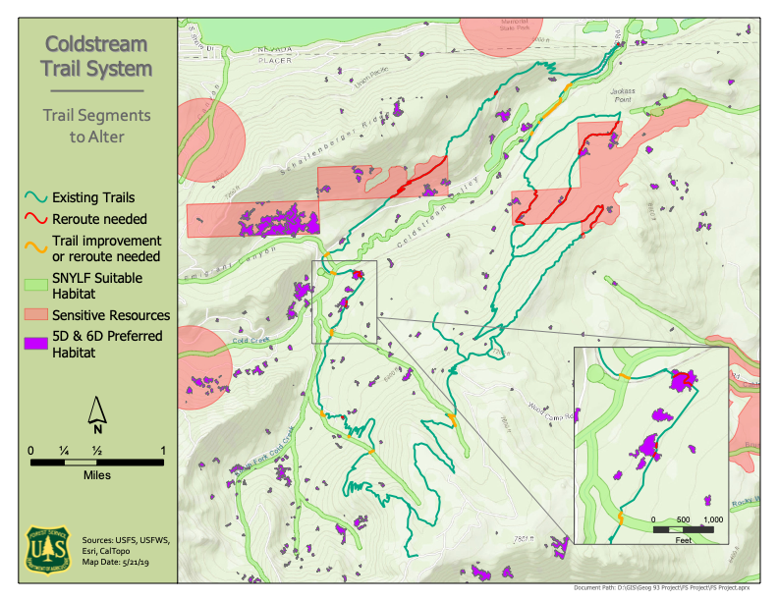

Slide 10
Issues and Resolutions
GEog 93 final project
Mac workaround - somewhat successful
Concurrent use of ArcMap (at work) and ArcGis Pro (at home)
Calculating areas - symbology vs. query issue
Crash during ModelBuilder

Slide 11
Learning Experiences
GEog 93 final project
Import symbology from another layer
Use Summary Statistics to make a bar graph
Discovered the Append tool
Save a master layout file to add multiple layouts to project
Actually learned to SAVE this semester
Everything takes 5 times longer than I think it will

