Slide 1
Automating Graduated Color Maps for Small Business
Russell Lessman

Slide 2
Purpose
Automate a series of Graduated Color maps representing customer data across Northern California for the small business I work for
There is at least ten years of customer data to be mapped
Currently the goal is to make 9 maps per year (possibly more)
The maps will focus on three main fields: Active Customers, Year to date average paid, Year to date total paid
Have already made maps for 2019 without python, was very slow and tedious
Fully leverage Point of Rental whose subscription is not cheap

Slide 3
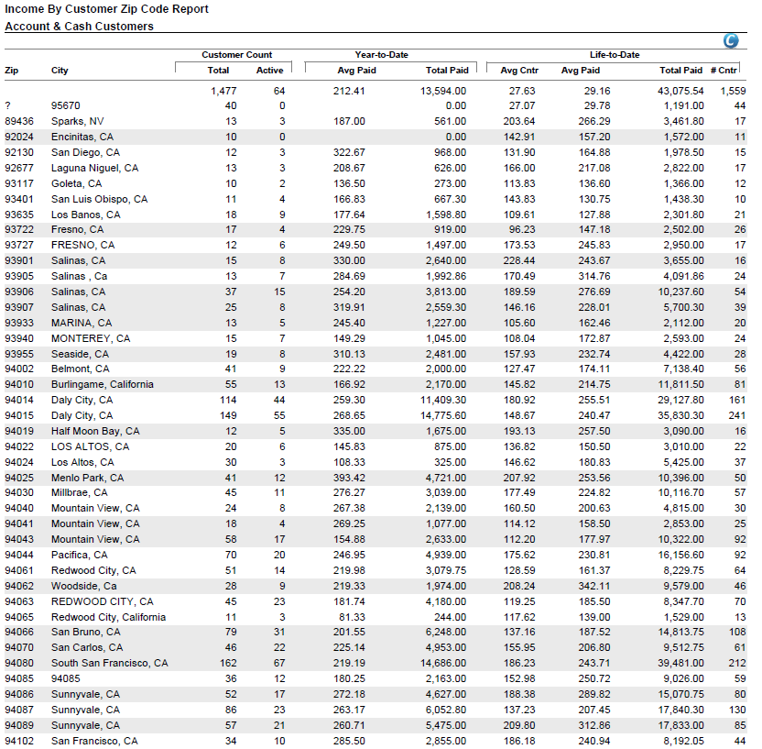
What I wanted to happen
Pull Data from Point of Rental (software my company uses)
Convert Point of Rental PDF table to Excel
Import Excel table into ArcPro
Import US Census Zipcode data
Set up layout and symbology (Graduated Colors)
Run script that Joins the table to Zipcode layer, creates 3 maps for each field, with symbology classification field changing for each

Slide 4
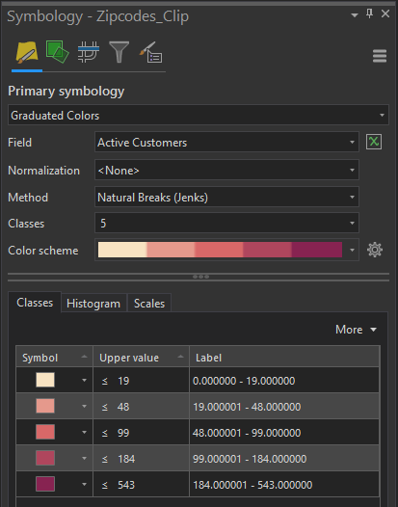
Was unable to get GraduatedColorsRenderer class to work
I was hoping since all I needed to do was change the classification field I would be able to figure it out

Slide 5
What ended up happening
Pull Data from Point of Rental (software my company uses)
Convert Point of Rental PDF table to Excel
Import Excel table into ArcPro
Import US Census Zipcode data
Clip to Area of Interest (to avoid layer extent issues)
Join Zipcode layer and Point of Rental Data
Set Up Graduated Colors Symbology for Active Customers field
Set Up Layout
Run Python Script to produce Active Customers PDF map set
Change Graduated Colors Symbology in Pro for next set of maps (2020AvePaid)
Run Python Script to produce 2020 Ave Paid PDF map set
Change Graduated Colors Symbology in Pro for next set of maps (2020TotalPaid)
Run Python Script to produce 2020 Total Paid PDF map set

Slide 6
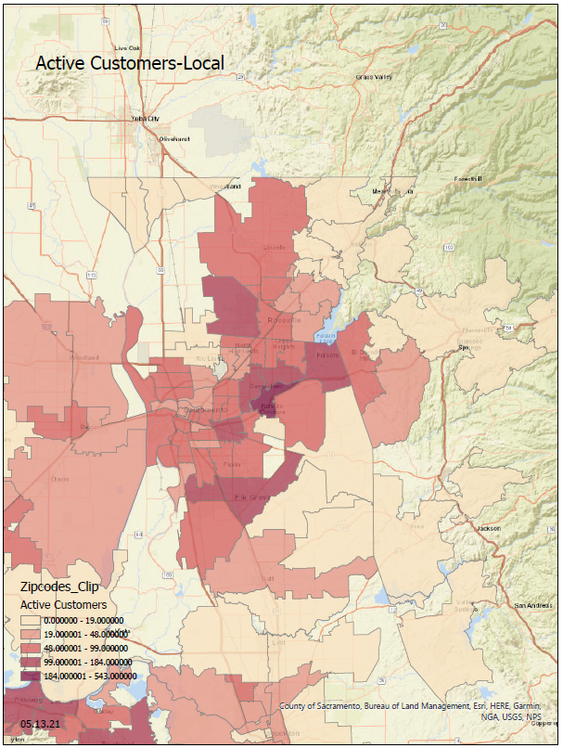
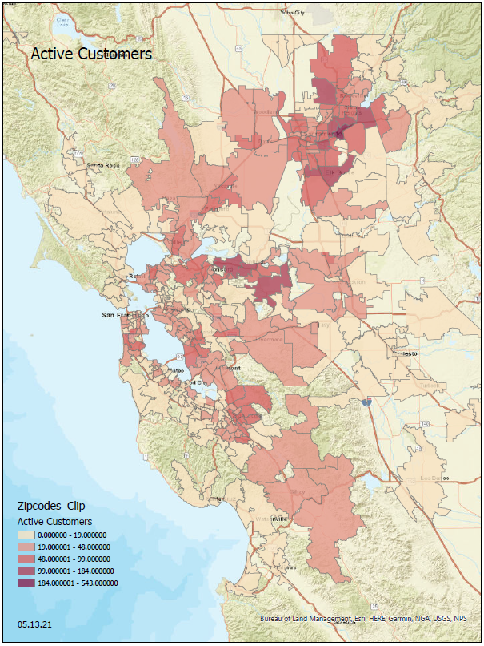
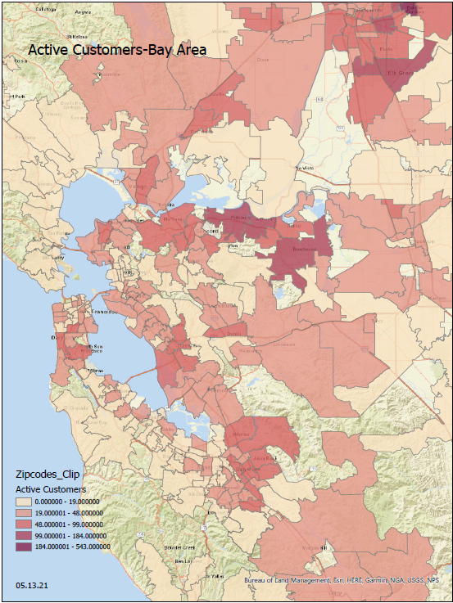
Active Customers Map Set

Slide 7
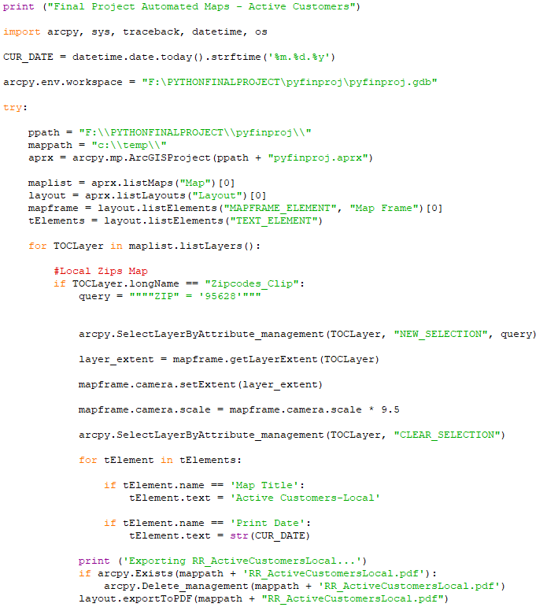
Did a lot of guess and check with Zipcode queries and mapframe.camera.scale to get the right zoom for the Local and Bay Area maps
Despite having to change symbology in Pro, the script still automates the most time consuming part; Mapframe elements and Text elements

Slide 8
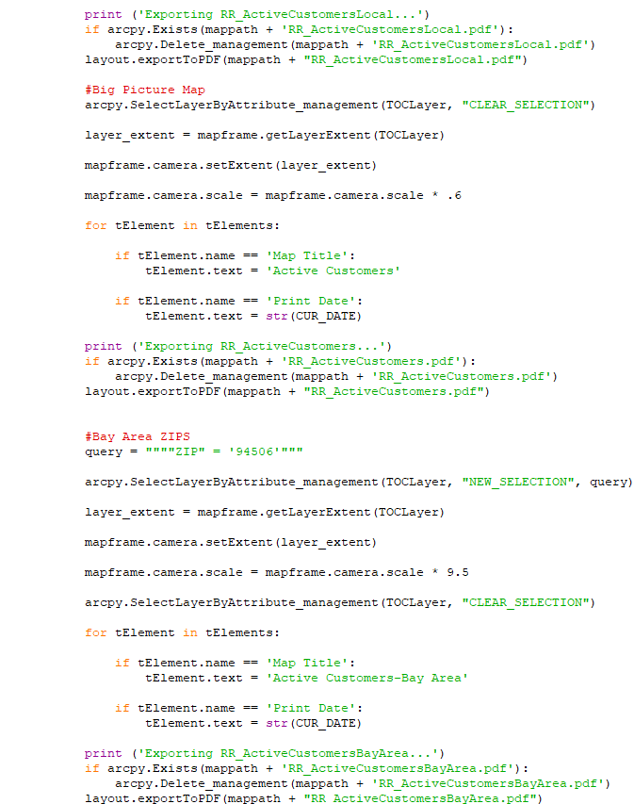
All code was sourced from ESRI help site or class resources / Professor Jennings

Slide 9
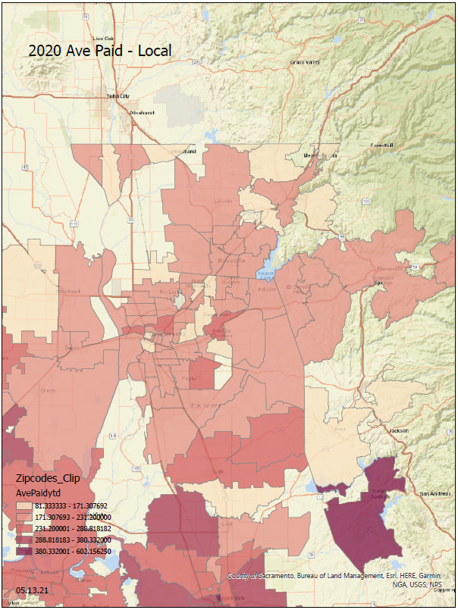
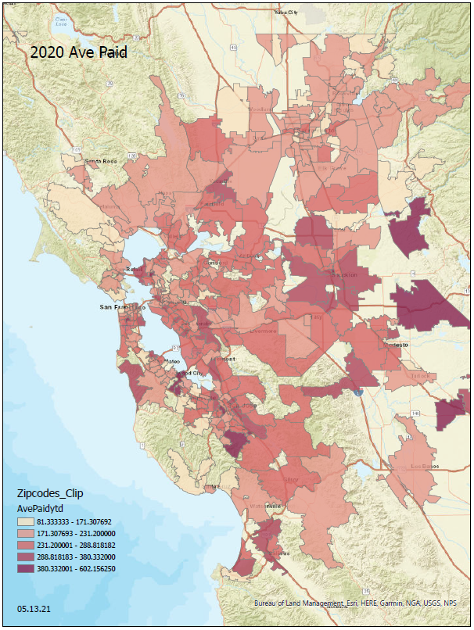
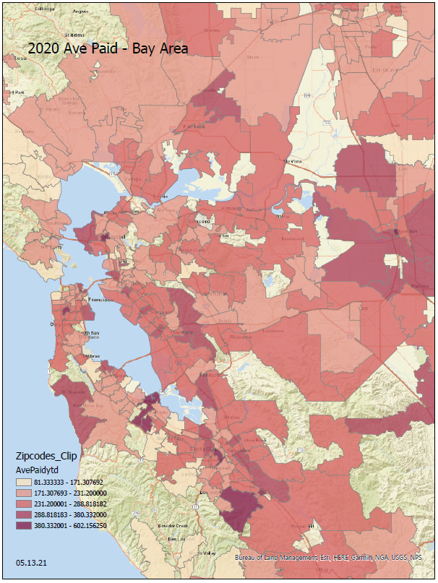
Average Paid Map Set

Slide 10
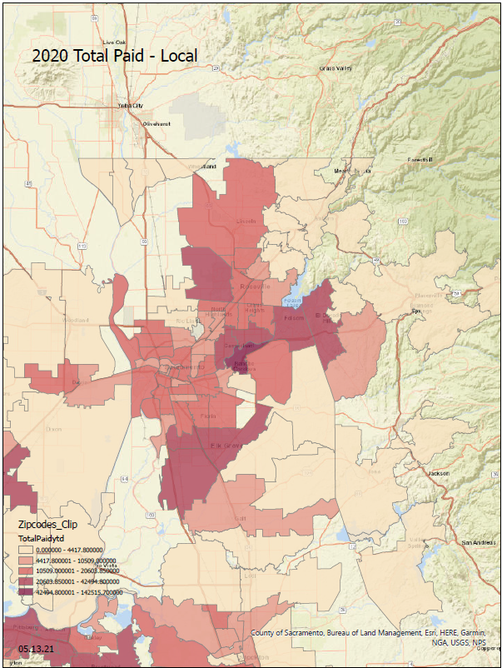
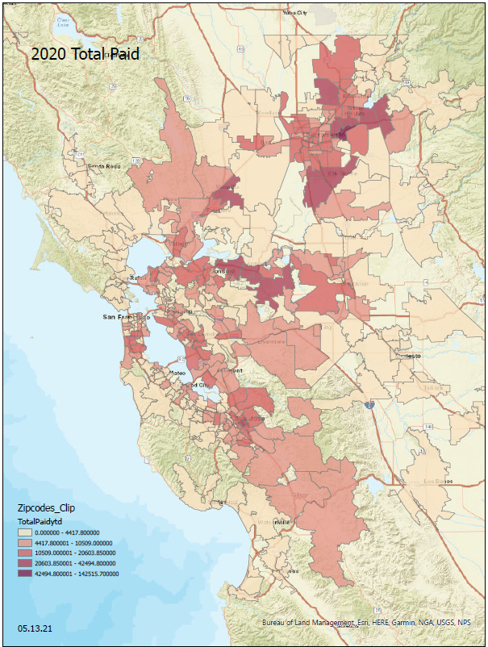
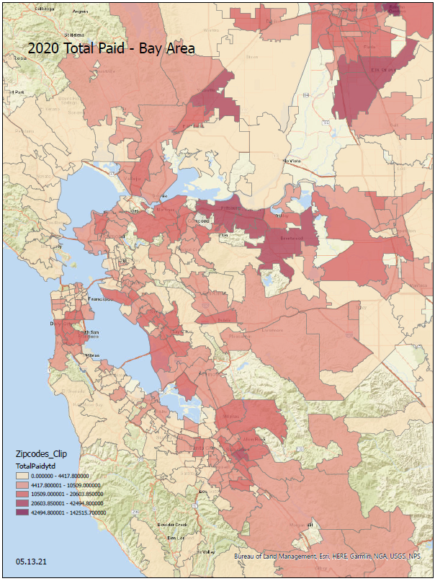
Total Paid Map Set

