Slide 1
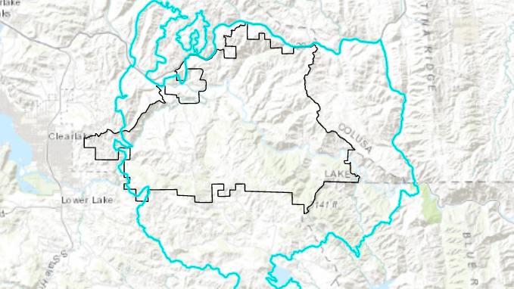
2015 Rocky Fire Impact on Cache Creek Wilderness
Russell Lessman

Slide 2
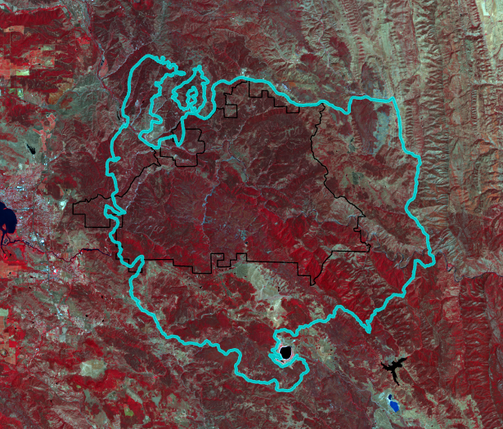
Rocky Fire Perimeter
Basically covered all of Cache Creek Wilderness
We will look at the damage to vegetation and the recovery

Slide 3
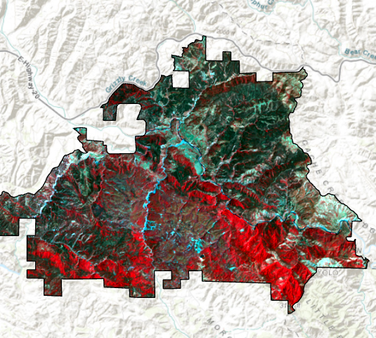
Landsat 8 Clipped to Cache Creek Wilderness
Taken two days before Rocky Fire started on 7/29/2015
Fire was under control by 8/15/2015

Slide 4
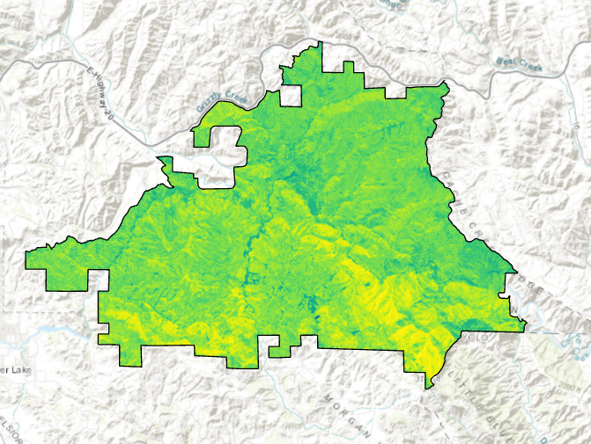
NDVI for Landsat 8
NDVI = (Band 5 – Band 4) / (Band 5 + Band 4)

Slide 5
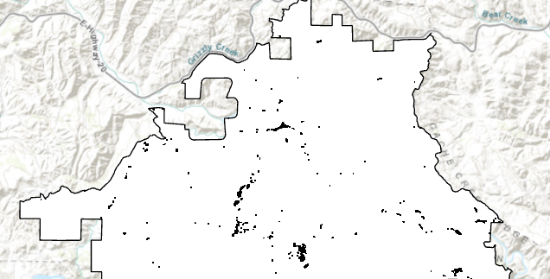
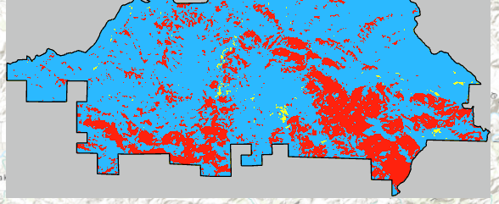
Remapping
Each pixel placed into one of three categories
Barren / Low category is for NDVI values under .2 (this includes barren surfaces)
Sparse category is for NDVI values between .2 and .6
Dense category is for NDVI values above .6
Barren / Low = Yellow
Sparse = Blue
Dense = Red

Slide 6
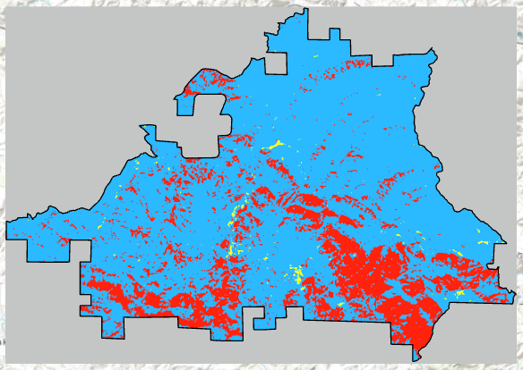
2015
Barren / Low = Yellow
Sparse = Blue
Dense = Red

Slide 7
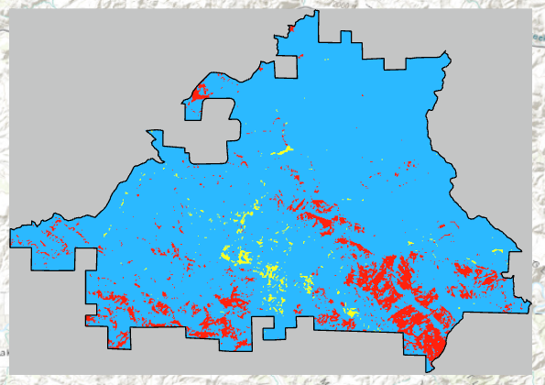
2017 – The Damage
Low Values spike 71%
Sparse Values up 12%
Dense Values plummet 76.5%
Barren / Low = Yellow
Sparse = Blue
Dense = Red

Slide 8
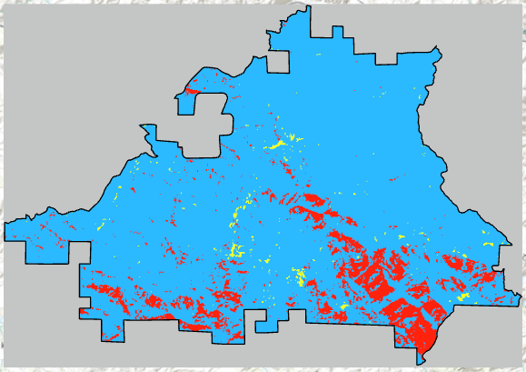
2020 – Recovery
Low Values drop 40%
Sparse Values hold with less than .5% drop
Dense Values up 7%
Barren / Low = Yellow
Sparse = Blue
Dense = Red

Slide 9
Challenges
Clouds!
Finding the correct imagery for what I wanted to do
Imagery from USGS
Cache Creek Wilderness Boarders and Rocky Fire Perimeter from BLM

