Slide 1
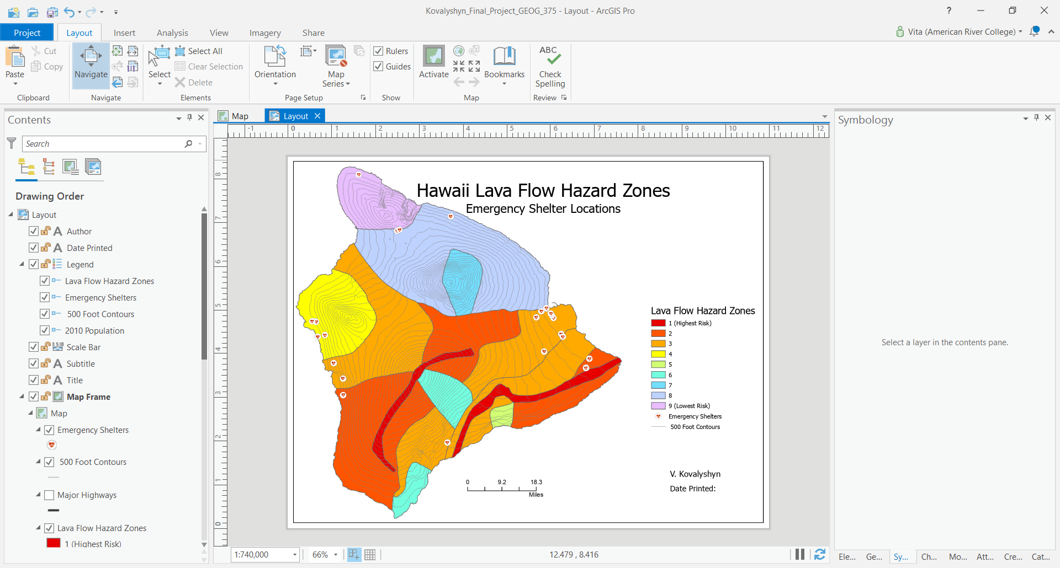
Geog 375 Final Project: Hawaii
(Map Series)

Slide 2
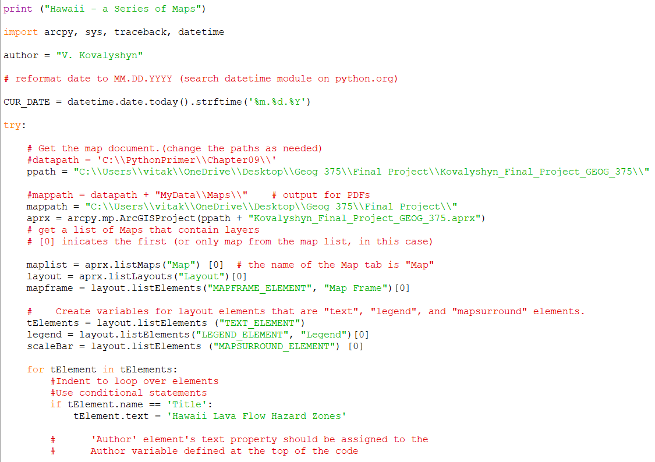
- Setting it up correctly
Name, Date, Import Line, and Try Block
Setting up data paths
Creating a list of variables to be used throughout the projects
- The last part, here, I’m beginning to reference my map elements

Slide 3
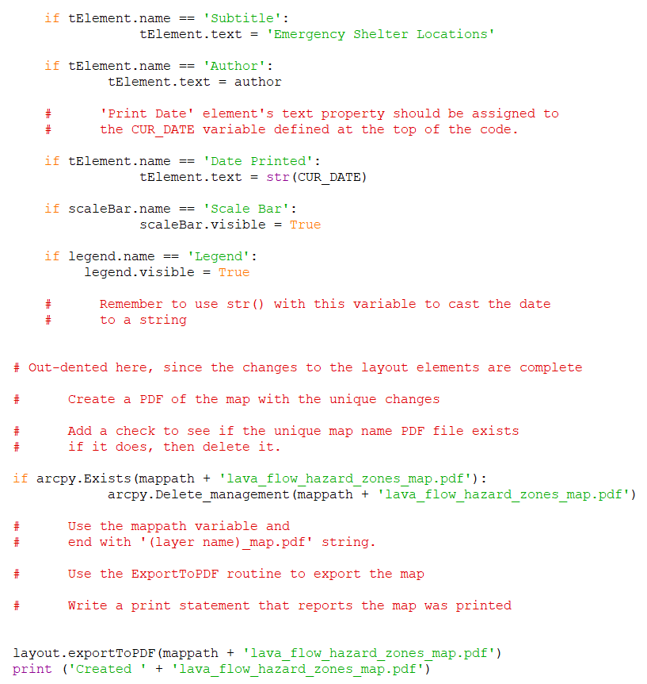
I keep referencing my map elements
Most likely, I didn’t have to reference all of them, as they shower up, even when I tried taking off the code for them. But I decided to keep the code, in casa I decide to do something more later.
- Paying attention to indentation
Checking if the layer exists and if so, deleting it
Exporting the map out to PDF

Slide 4
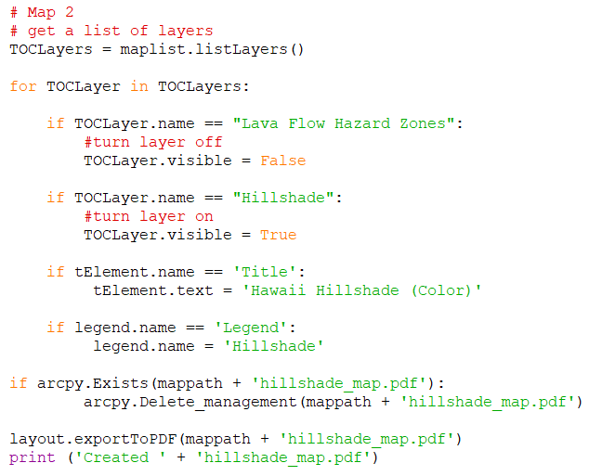
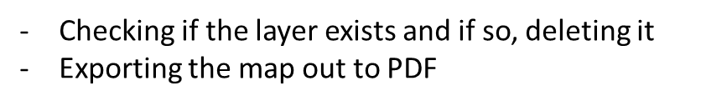
- Turning Layers On and Off
- Updating Map Title with new information
- Trying to add a title to the now updated legend

Slide 5
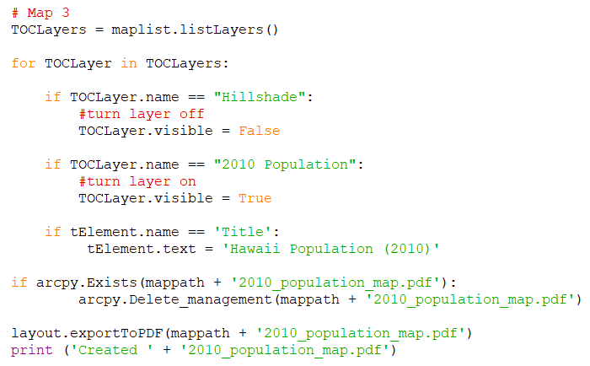
- Turning Layers On and Off
- Updating Map Title with new information
Checking if the layer exists and if so, deleting it
Exporting the map out to PDF

Slide 6
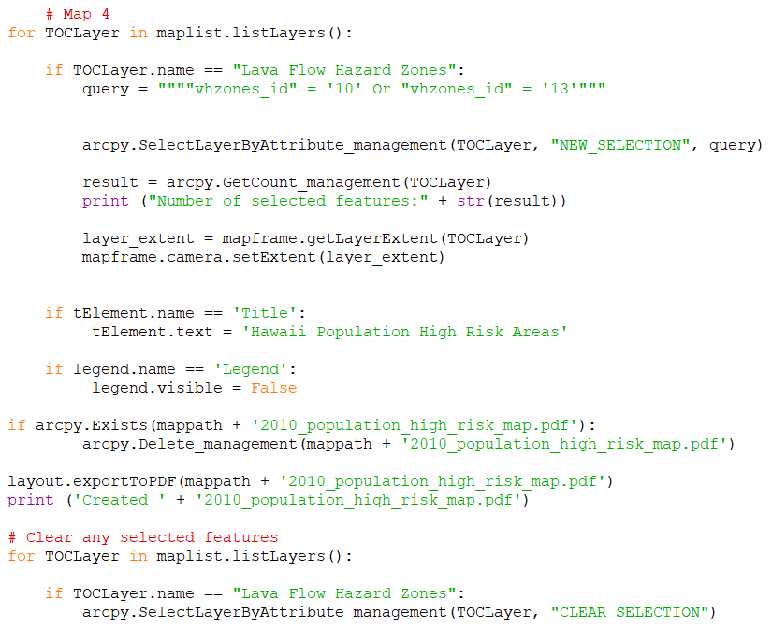
- Writing a query
- Using SelectByAttribute to select areas of high risks and zooming in on the layer to the selected extent
- Updating Map Title with new information
- Trying to turn off legend, didn’t work
- Clearing Selected Features

Slide 7
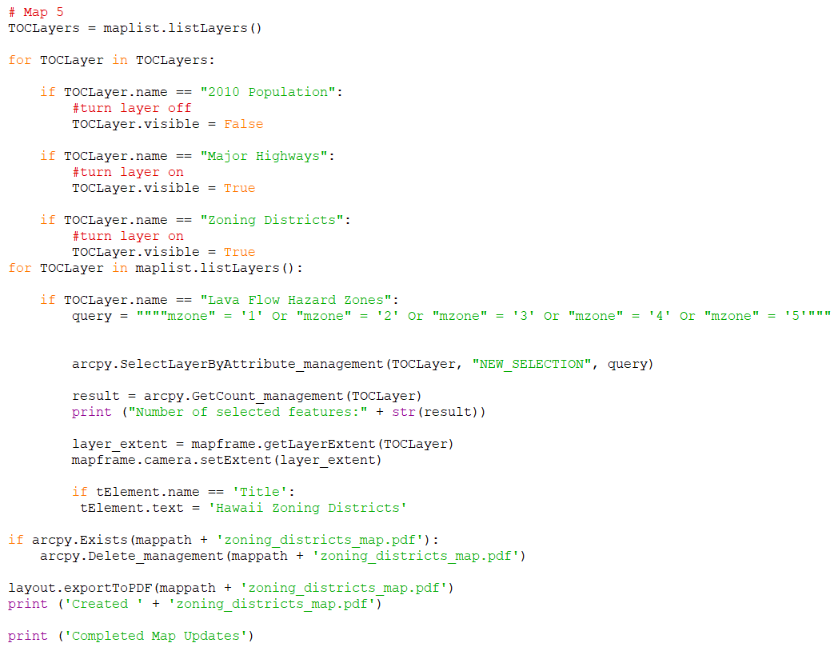
- Turning Layers On and Off
- Using SelectByAttribute to select areas of all Hawaii polygons and zooming in on the layer to the selected extent
- Updating Map Title with new information
Clearing Selected Features
(Not shown in the photo)
Checking if the layer exists and if so, deleting it
Exporting the map out to PDF

Slide 8
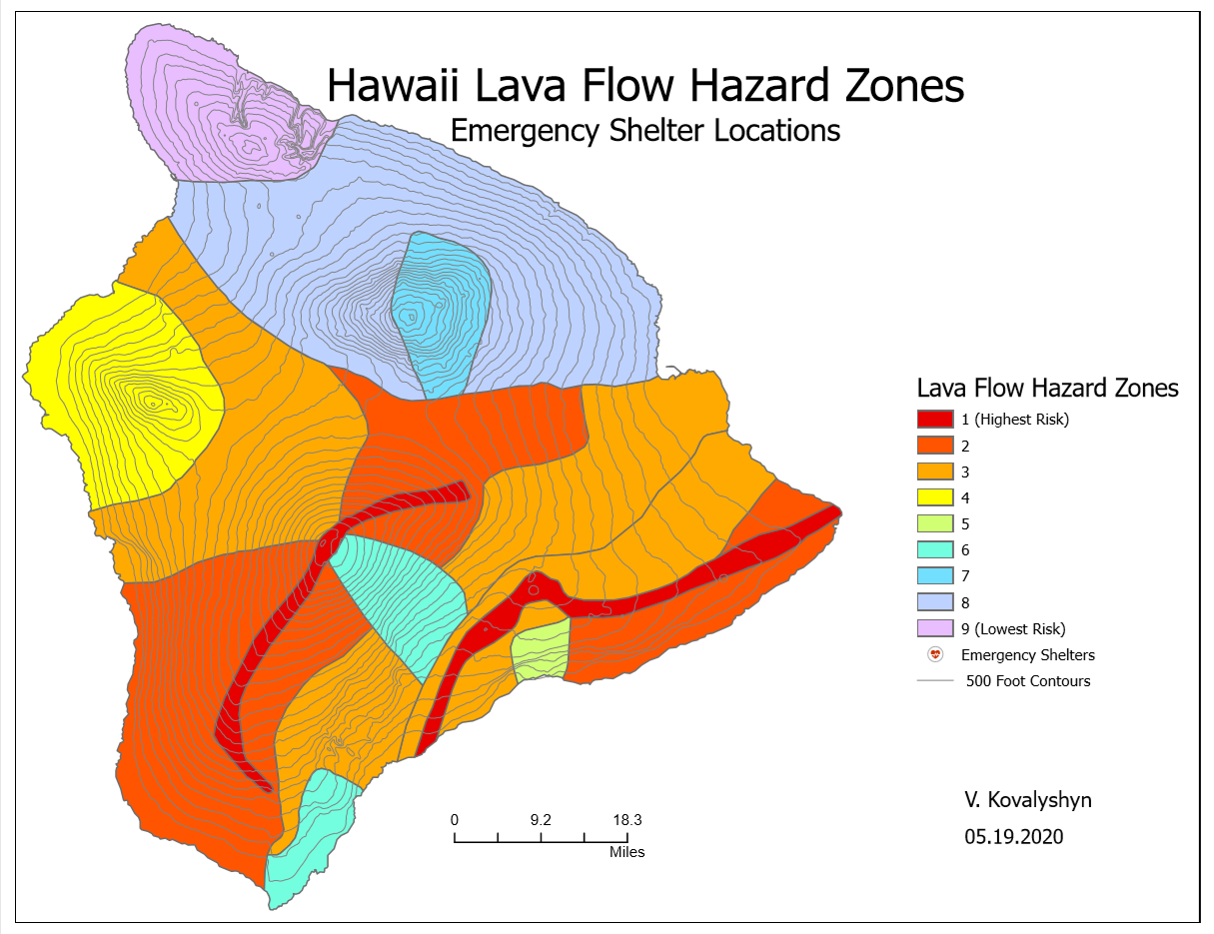
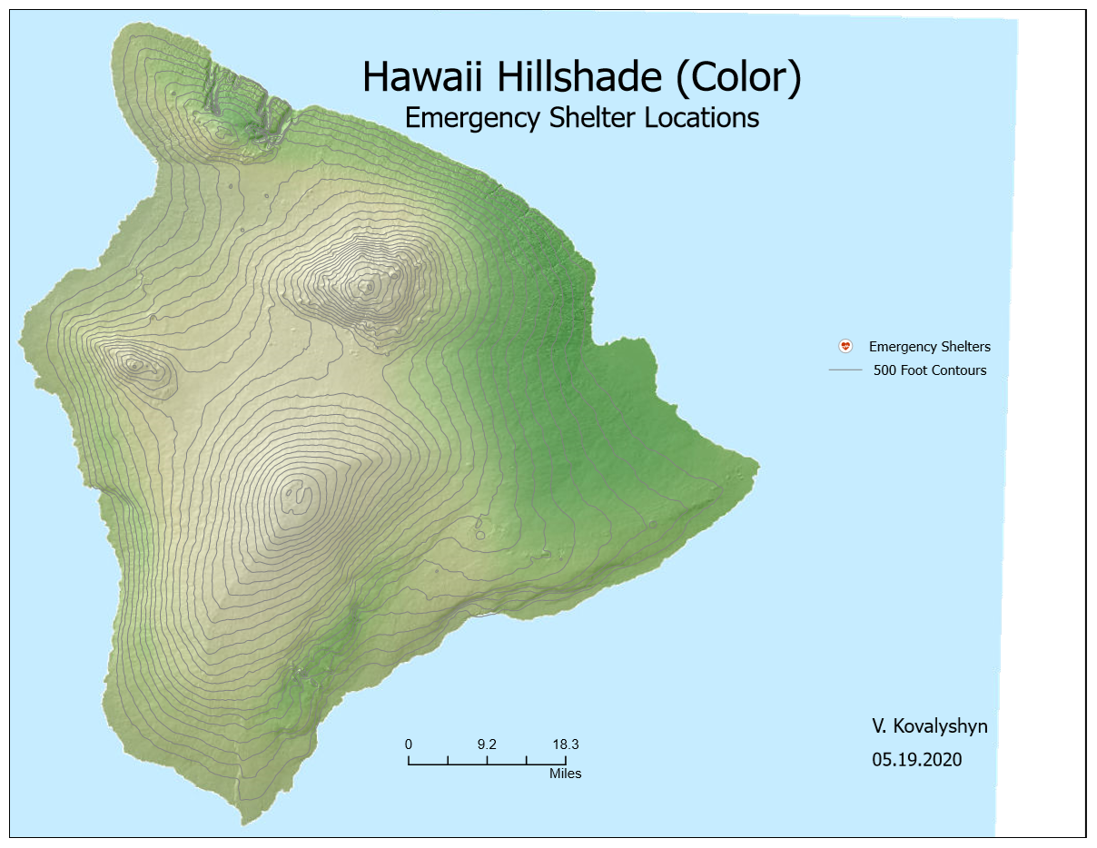
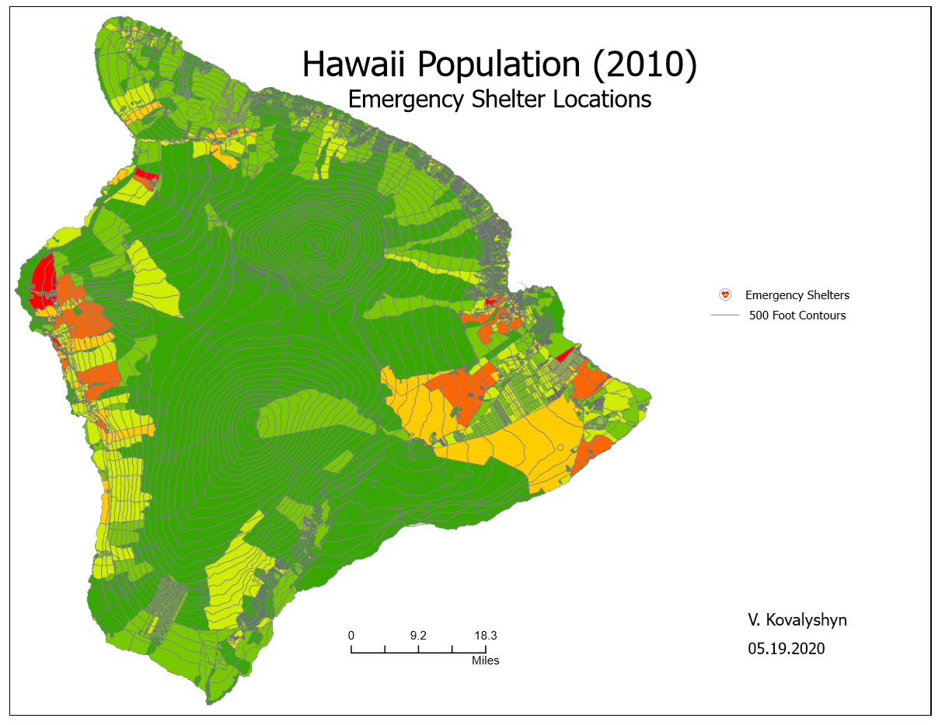
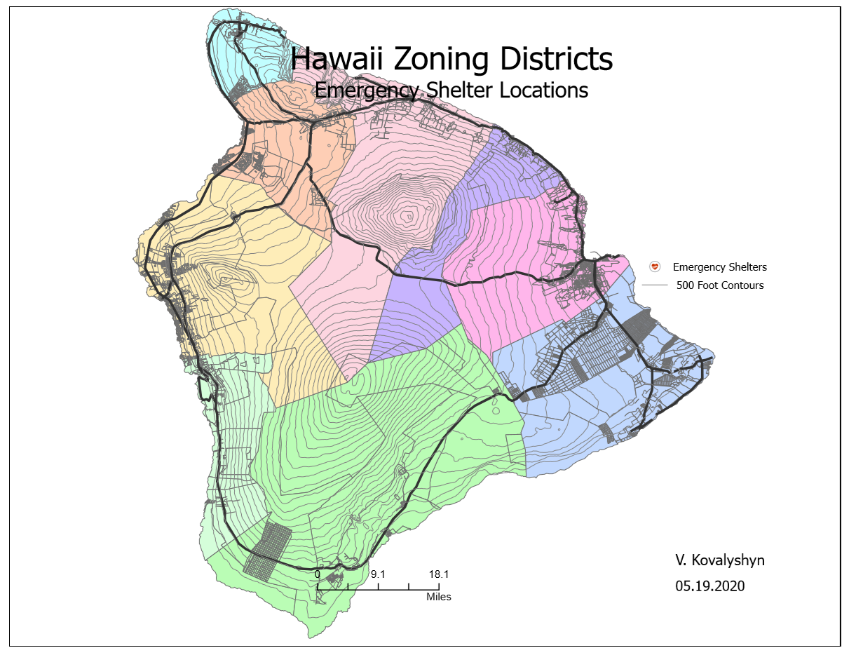
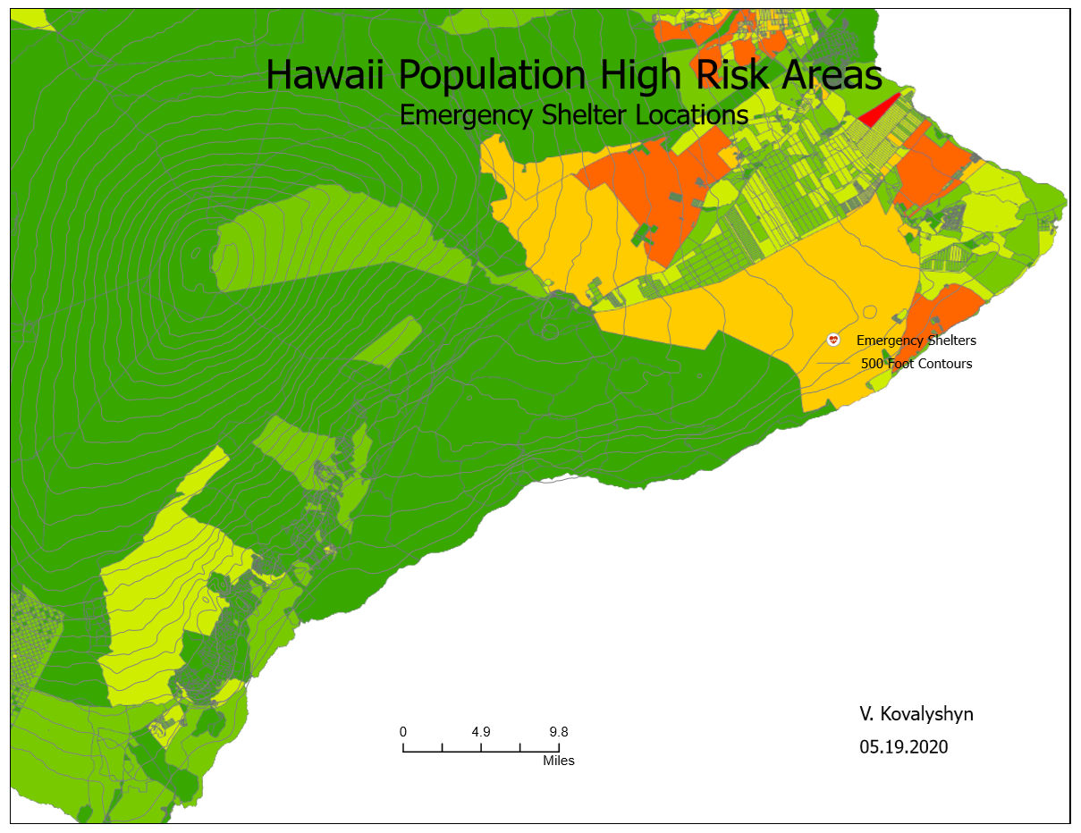

Slide 9
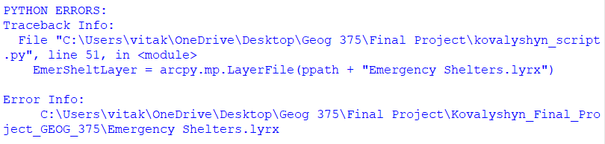
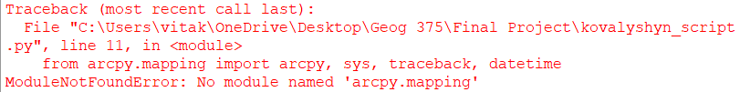
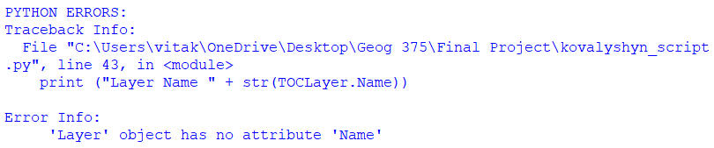
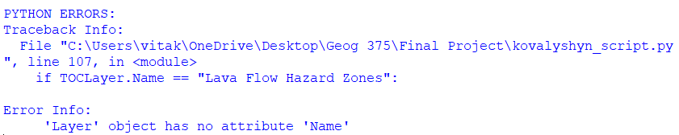
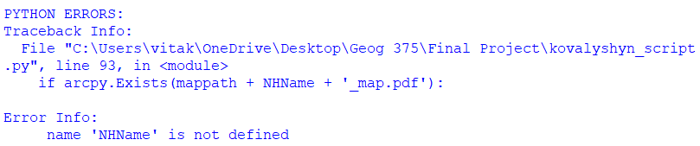
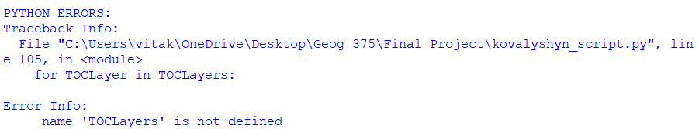
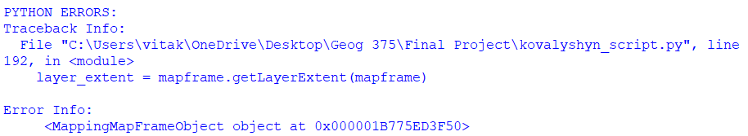
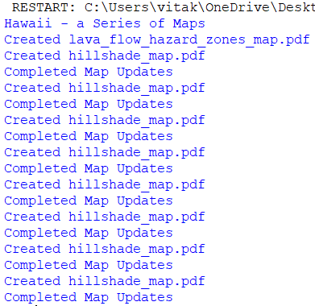
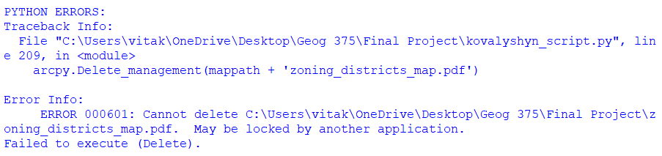
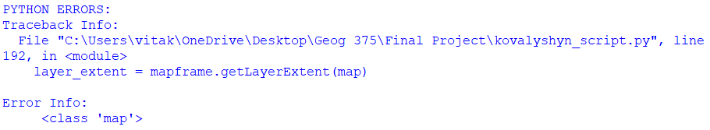
Some Error Messages:

