Slide 1
Creating Vernal Pools in Roseville
Jon Koenig
Geo 93
5/23/19

Slide 2
What are Vernal Pools?
Vernal pools are a type of temporary wetland adapted to wet winters and dry summers.
Shallow ponds that fill during rainy periods then flower and dry.
Support a wide variety of plant and animal species.
Over 90 percent of historical vernal pool habitats in California have been lost.
Reasons range from agricultural development and urban expansion to modifications in hydrology in surrounding areas.

Slide 3
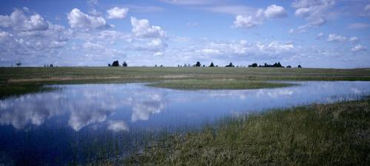
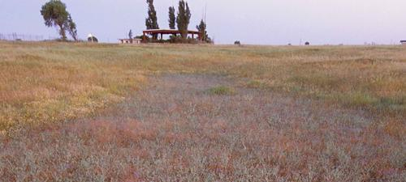
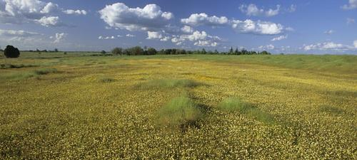
Wet Phase
Dry Phase
Flowering Phase

Slide 4
Purpose of the Project
While vernal pools are now considered a protected wetland, continued habitat loss is still a possibility.
The soil from vernal pools can be transplanted to other locations and if conditions are good, new pools could be established.
The goal of this project is to find parcels within the city of Roseville that meet ideal conditions for vernal pools.
This would be important information as creating new vernal pools would be a useful additional option to ensure these habitats survive.

Slide 5
Data used
Data retrieved from Placer County open data portal
http://gis-placercounty.opendata.arcgis.com/
Includes:
Parcels
County boundary
City limits
Vernal pools
Streams
20ft elevation contours

Slide 6
Changes in Scope
Initially the plan was to perform site suitability on all of Placer and Sacramento counties
This proved to be to large of a scope to effectively manage and create a clear, simple map of.
As project progressed, scope was reduced first to only Placer county, then only to the city of Roseville.
Initial plans also included use of geology and soil data but these plans were scrapped due to not provided particularly interesting results for the project.

Slide 7
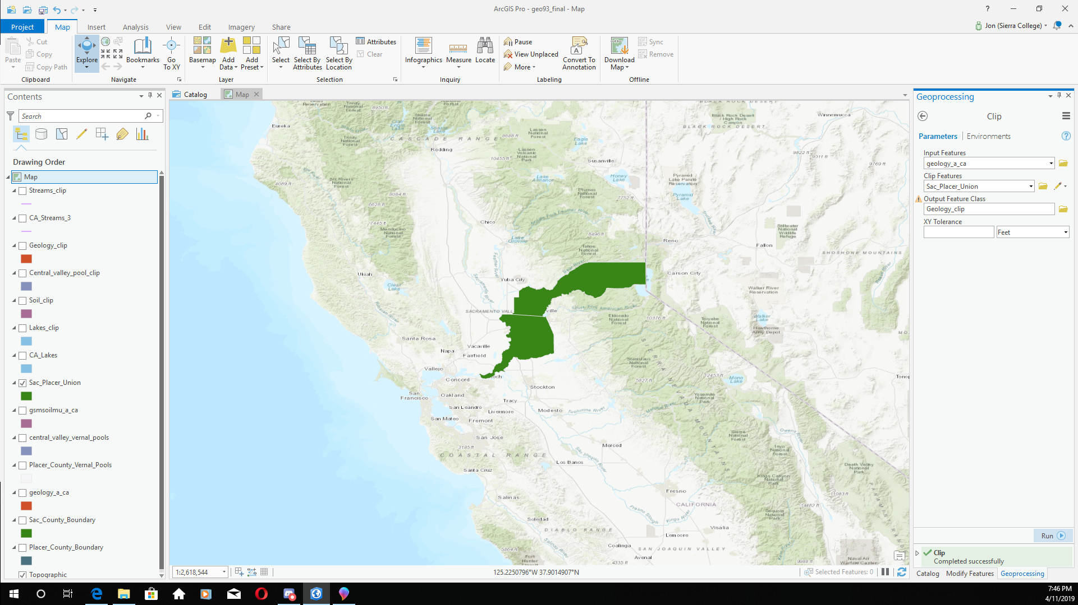
Step 1 Clips
Retrieved data then began clipping to with county boundaries
Also performed attribute query on streams layer to remove any seasonal streams.

Slide 8
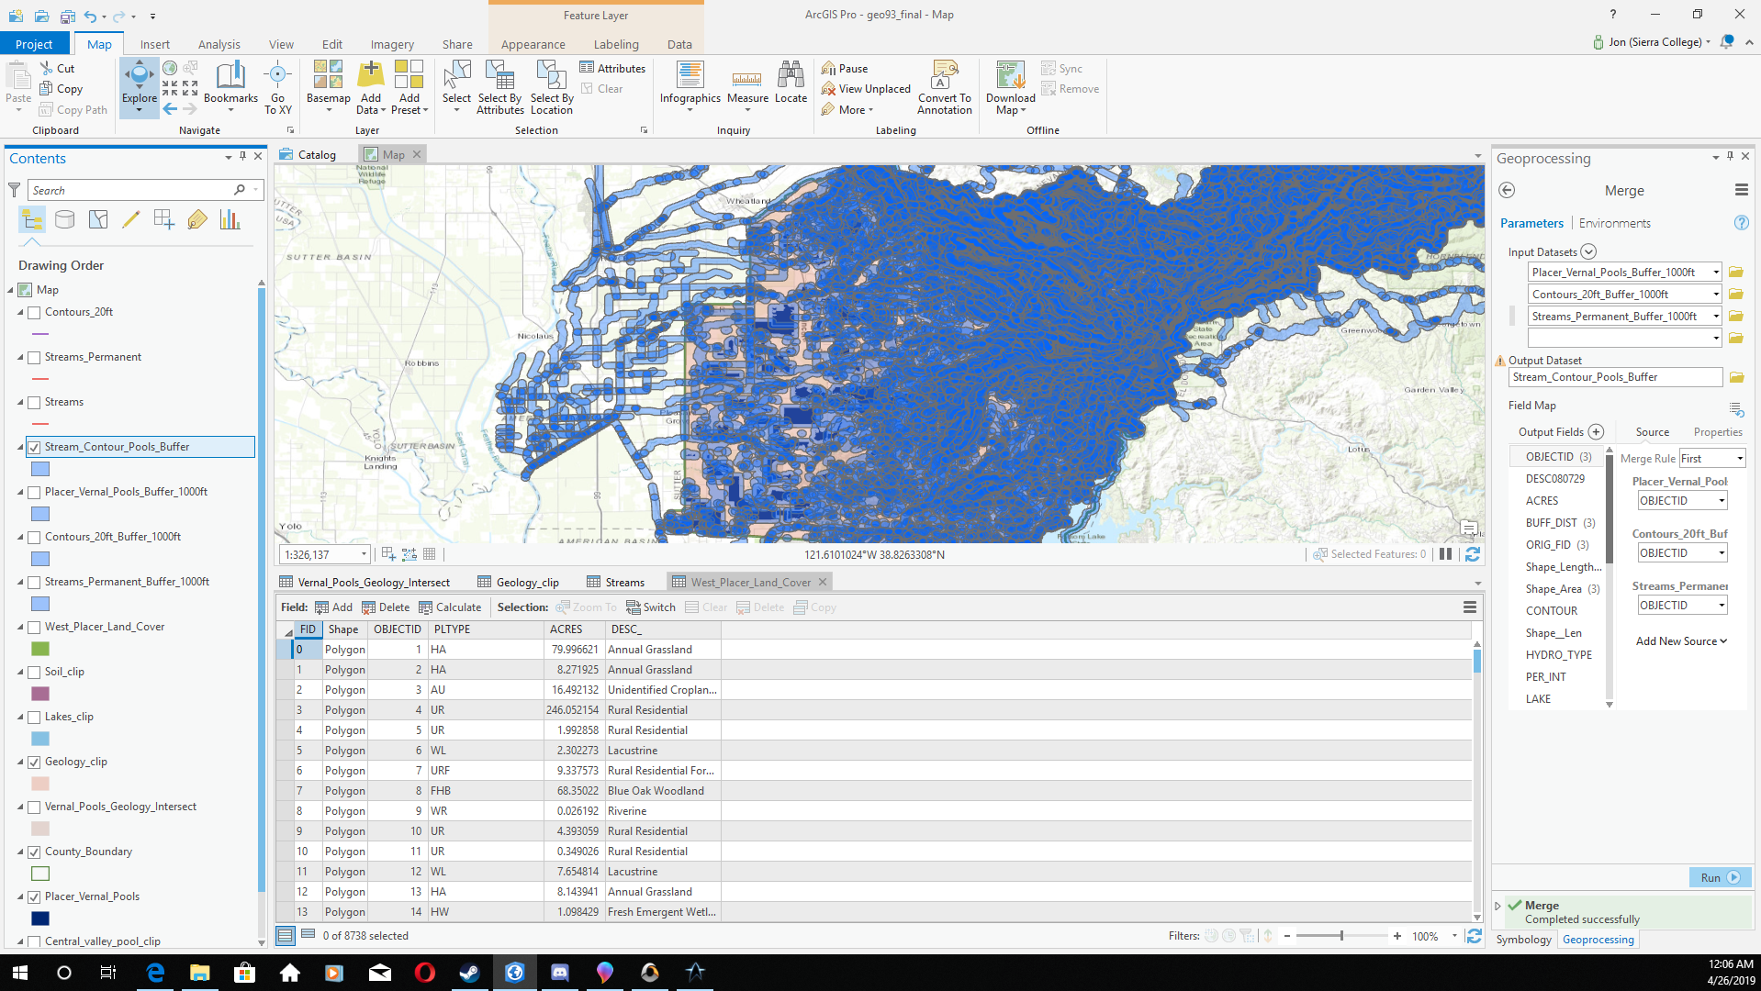
Step 2 Buffers
Created 1000ft buffers for vernal pools, streams and contours.
Creating buffer on the contour layer very time consuming.

Slide 9
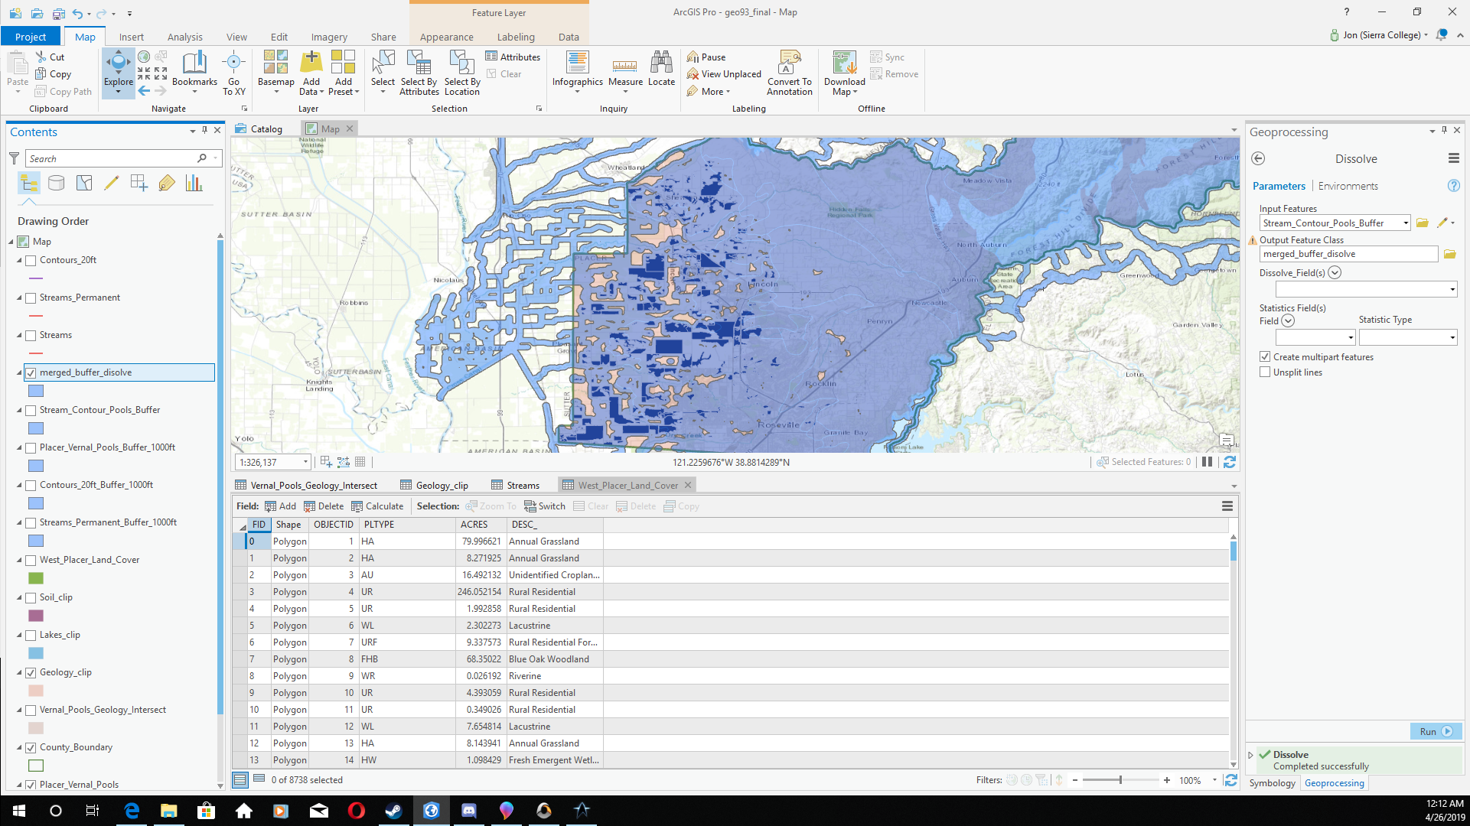
Step 3 Merge and Dissolves
merged the various buffers into single layer, then performed a dissolve.
Final layer now ready for site analysis.

Slide 10
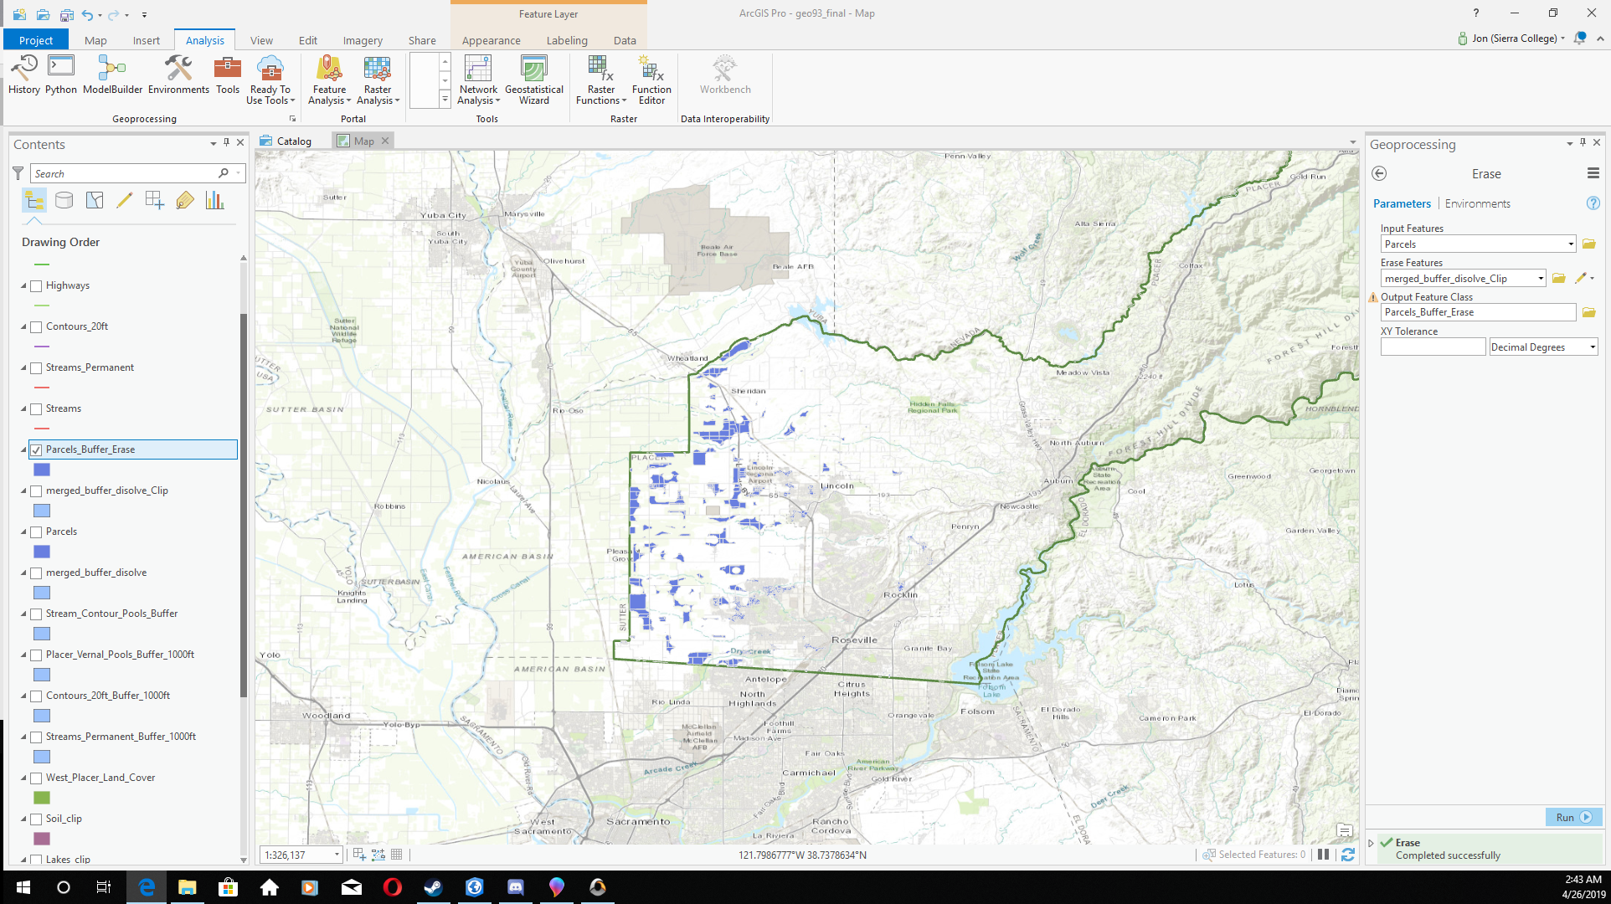
Step 4 Erase tool
Used the erase tool to find any pieces of land outside of the dissolve layer.
Reveal the areas best suited for vernal pool habitats.

Slide 11
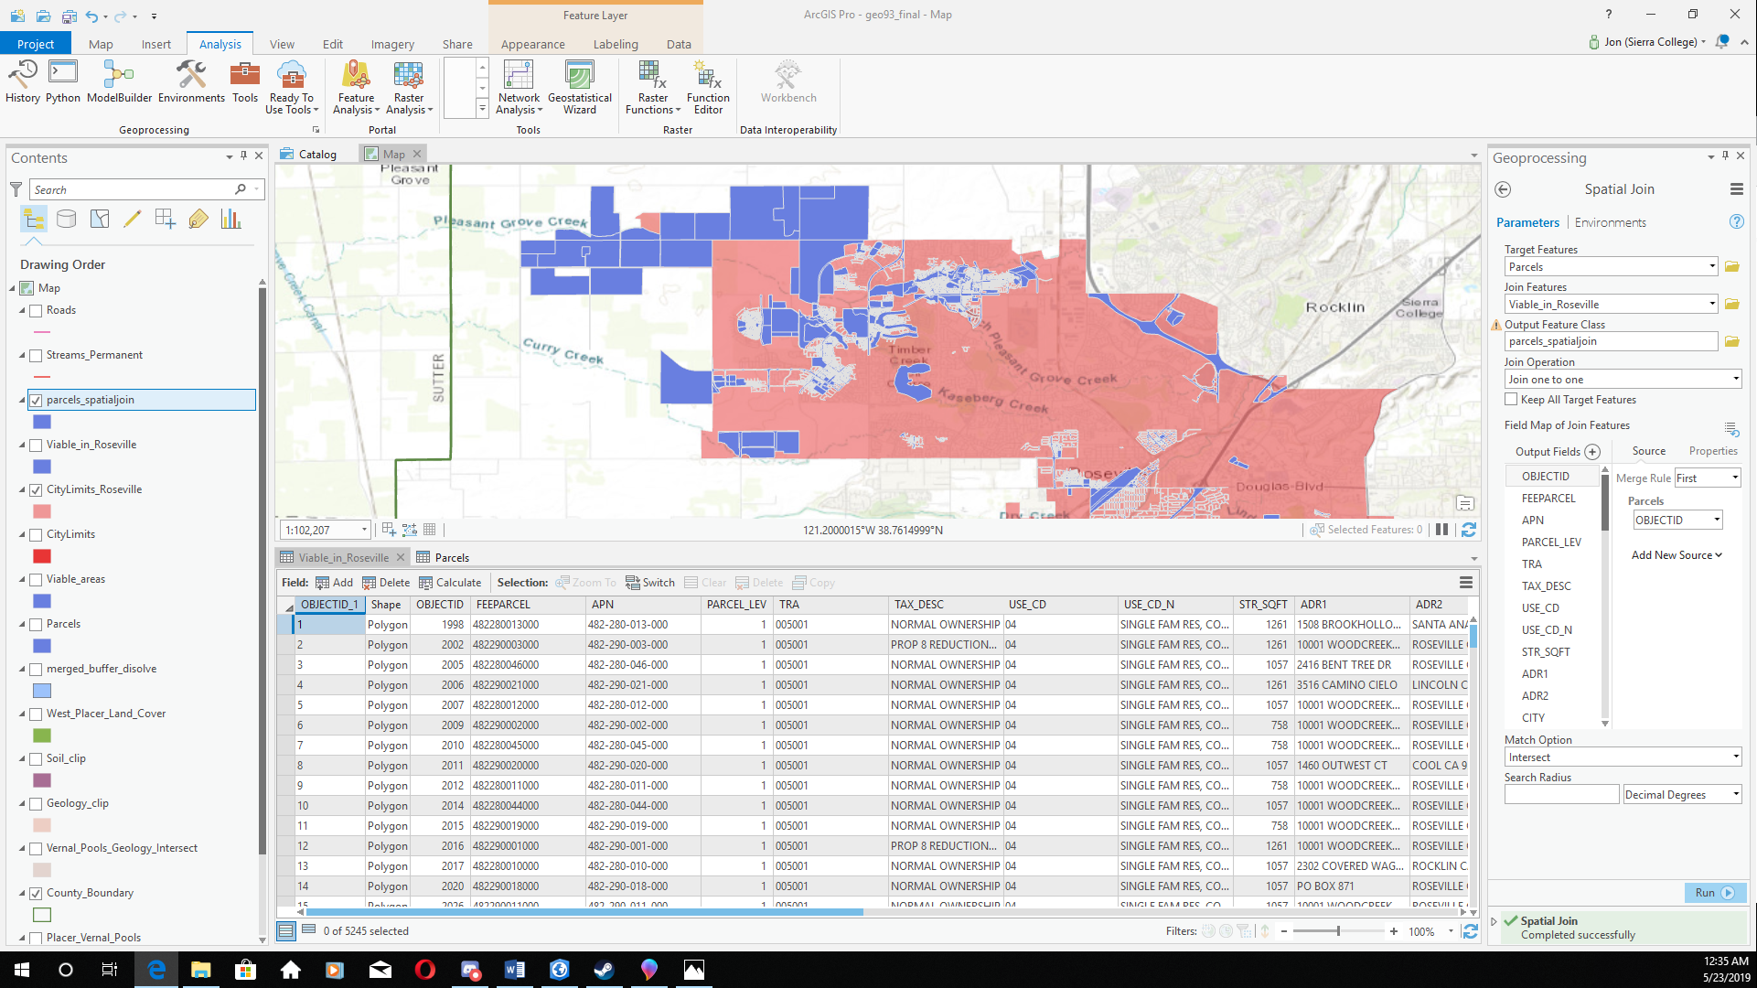
Step 5 Spatial Joins
It is at this point that the project was shifted to focus on only Roseville.
Spatial join performed on the erase layer and the parcel layer.
Manual deletion of parcels mostly outside of Roseville.

Slide 12
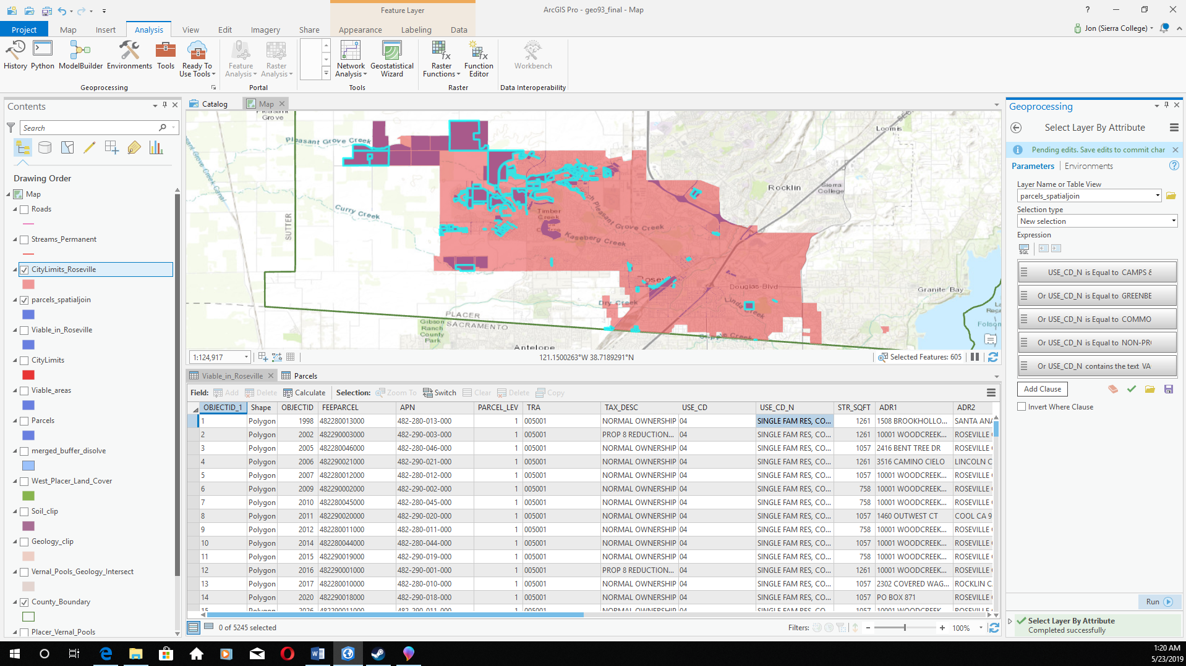
Step 6 Attribute Queries
Performed an additional attribute query to select parcels based on zoning.
Then performed a series of queries to sort parcel by size.

Slide 13
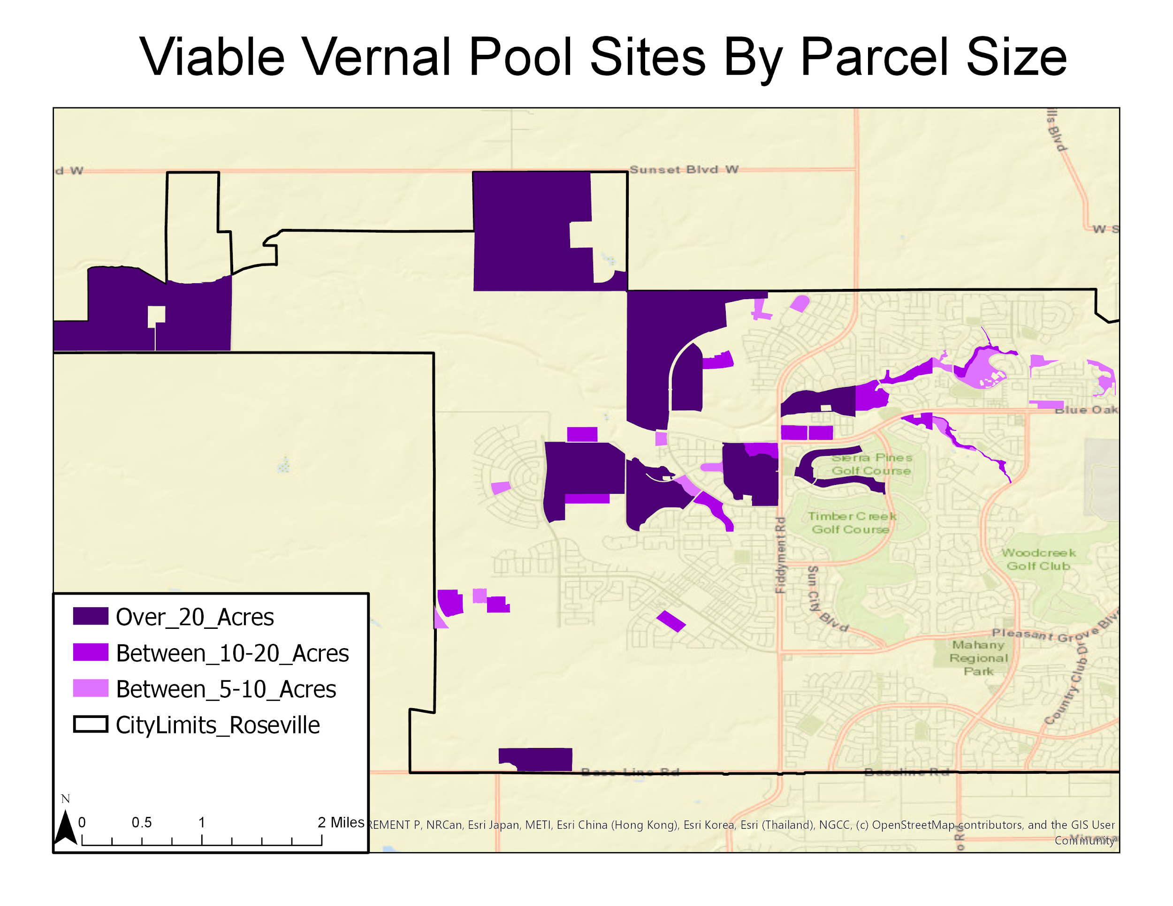
Final Map 1: Parcels by Size

Slide 14
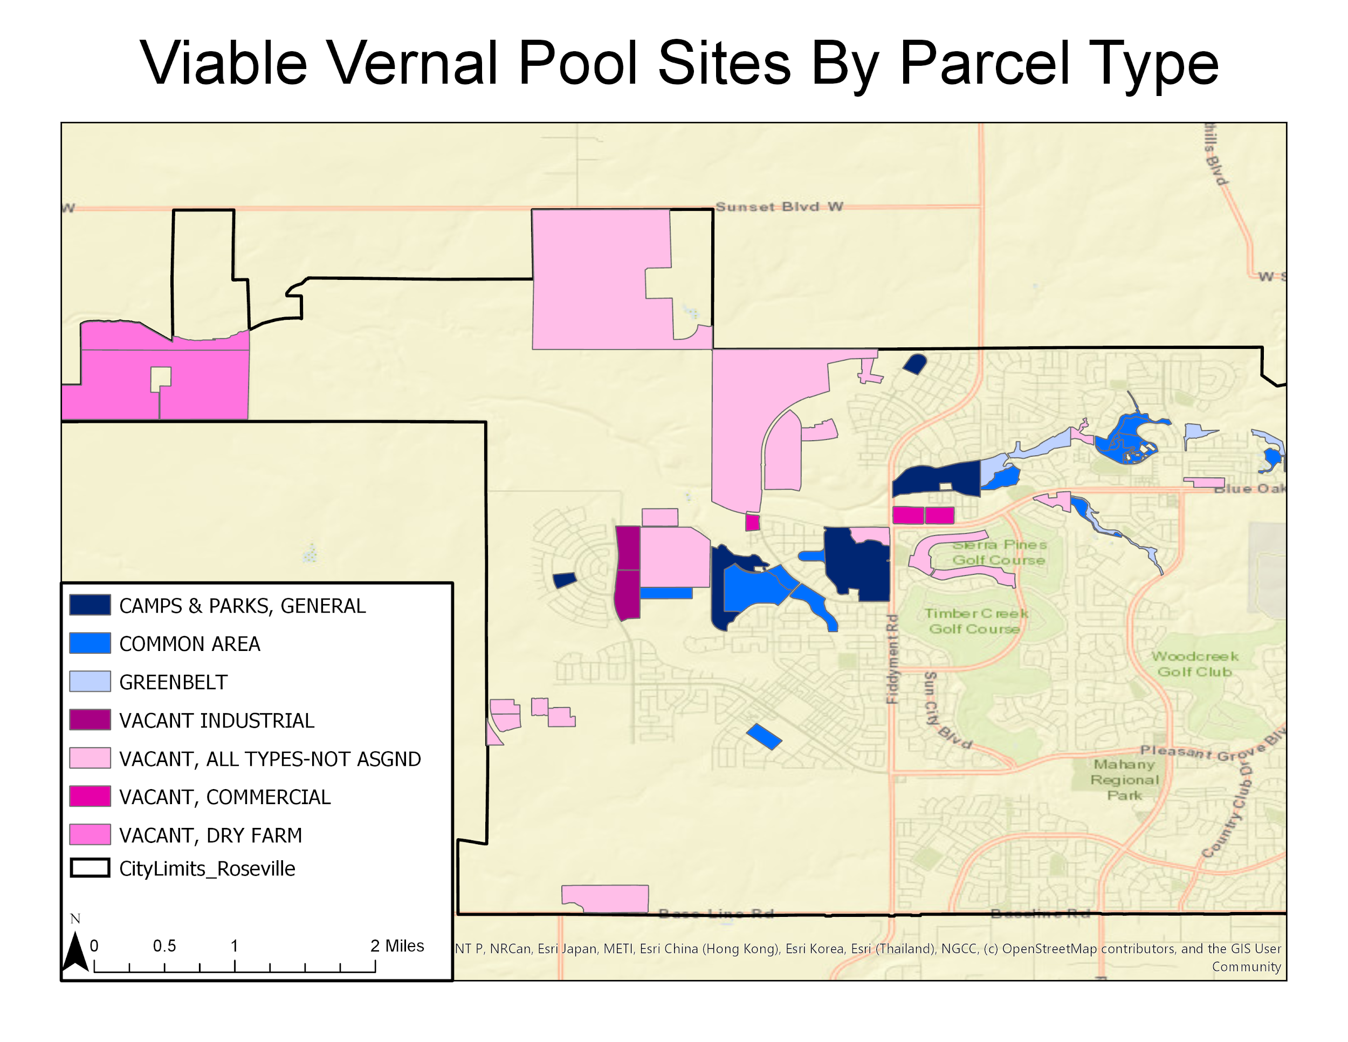
Final Map 2: Parcels by Type

Slide 15
Conclusions
ArcPro has some advantages is ease of access but also some issues, such as not having an easy to find or use way to control zoom level.
Issues in the project mostly came from having too large of an initial scope.
This caused multiple tangents and side projects that ultimately were scrapped.
However exploring these tangents gave me a better grasp of ArcPro.

