Slide 1
Facilitate Creation of Spatial Address Lists Within the TCC Area
Greg Helzerman
Geography 375, Spring 2021

Slide 2
Background: Transformative Climate Communities (TCC)
Goal is to Transform California disadvantaged communities
Areas most impacted by pollution
Funds to target environmental, health and economic benefits
  Development Projects
  Infrastructure Projects

Slide 3
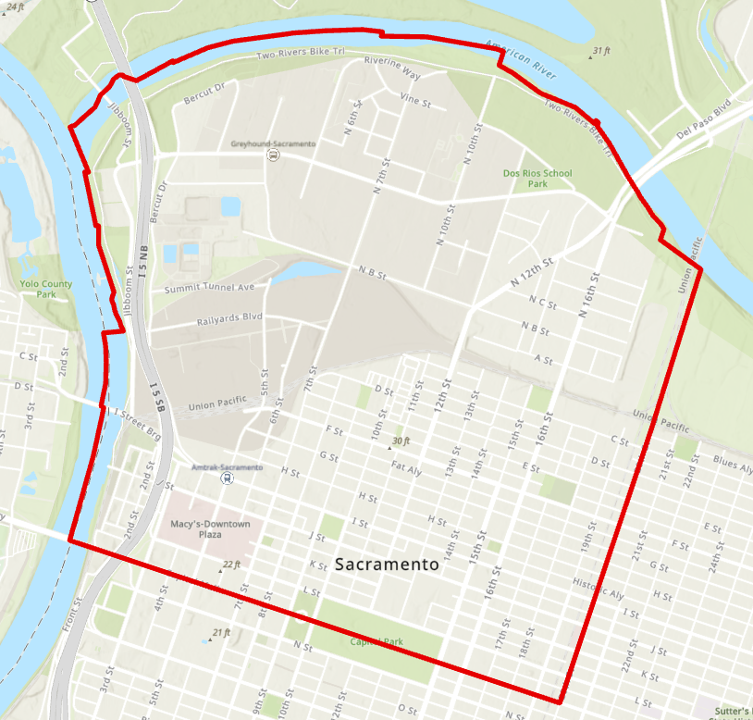
Sacramento
TCC Area
Sacramento TCC (SIMPL: Sacramento Integrated Multimodal Place-based Living Project)
  Mirasol Village Housing Development
  New Light Rail Station Near N 12th and Richards Blvd.
  Tree Planting
  More

Slide 4
Why Address Lists?
Inform and engage the community
Contact businesses about training opportunities and to aid in business retention in the area

Slide 5
Spatial Address List Python Programs
Address Lists
  Parcel Owner Mailing Addresses (With List of All APNs Owned by the Same Owner)
  Master Address Database (MAGMA) Mailing Addresses (USPS Deliverable Only)
  Combination of Owners and Addresses (Without Duplication)
Business Address List
  Business Addresses in the Sacramento City open dataset “Business Operation Tax Information” Geocoded

Slide 6
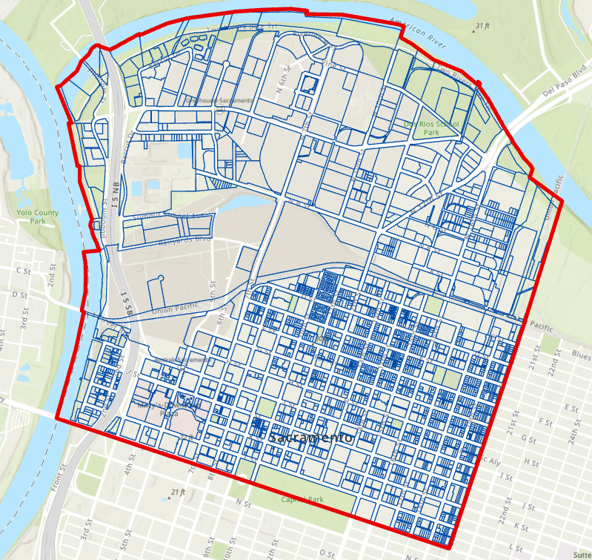
Parcel Owner Addresses (Over 2,300)
If Parcel Owner Owns More Than One Parcel → Consolidated Parcel Owner Mailing Addresses (Over 1,300)
→ List of APNs for each owner Mailing Address

Slide 7
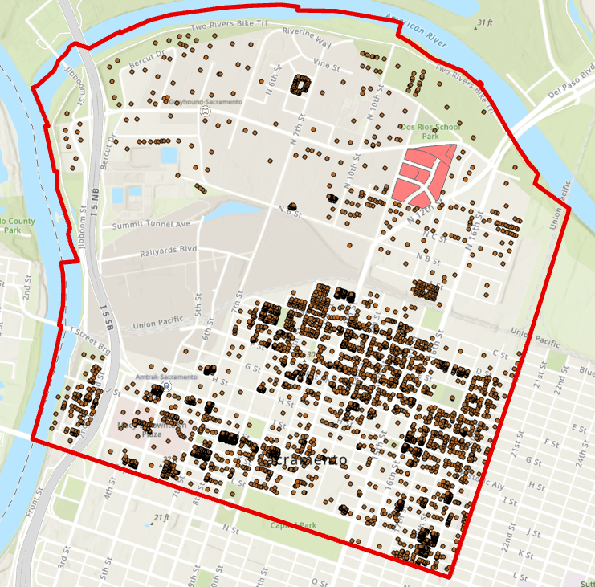
MAGMA Addresses (Over 10,000)
USPS Deliverable without Mirasol (Over 7,800)
Removed Addresses in Mirasol Village (Currently Under Construction)

Slide 8
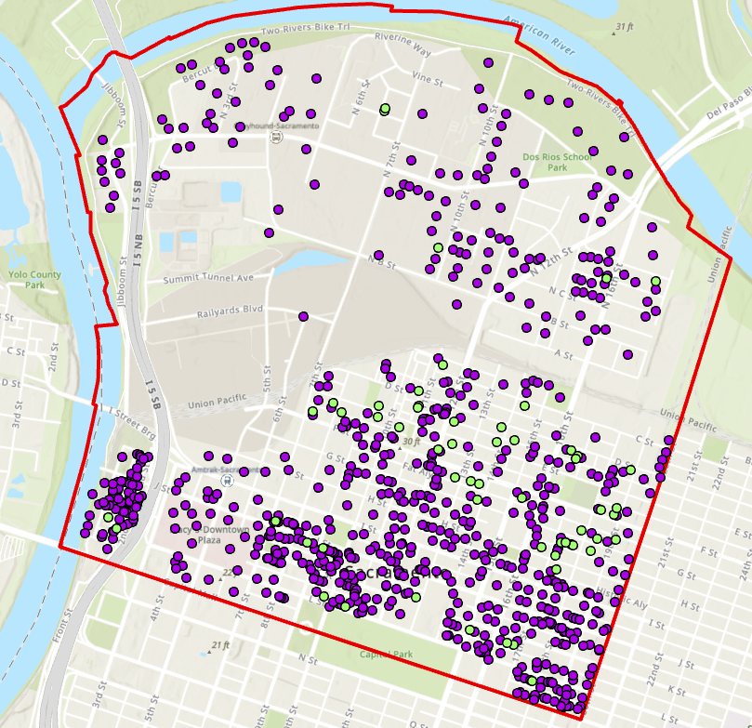
Purple – Business Locations
Green – Business mailing addresses (No business location entered)
Internet business
Photography
Ect.
Business Addresses Geocoded (Over 1,900)
Created a composite locator with MAGMA and Centerlines
arcpy.geocoding.GeocodeAddresses

Slide 9

Used Pandas Python Library Perform Some Operations
Code below will replace all Nulls (nan) with blank to the “bus” pandas data frame.
# Replace Nulls with "" blank
bus.fillna("", inplace = True)

Slide 10
# Highlight the rows that are business mail addresses (No business location provided) def highlight_cells(val): if str(val.Location_Street_Name) == "": return ['background-color: #d9d9d9']*len(val) else: return ['color: black']*len(val) bus_styler = bus.style.apply(highlight_cells, axis=1) busfiltered_styler = busfiltered.style.apply(highlight_cells, axis=1)
Highlight specific rows using a function that would be conveyed to the Excel Formatting
Using Pandas Styler Object

Slide 11
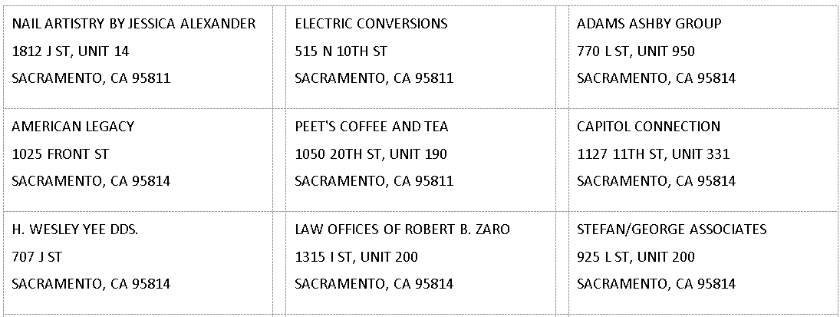
Example Business Addresses Formatted into Mailing Labels Using Microsoft Word
# Format Unit Number
def format_unit(val):
if val == "":
return ""
elif val.count("PMB") > 0:
return ", " + val
elif val.count("STE") > 0:
return ", " + val
elif val.count("SUITE") > 0:
return ", " + val
elif val.count("PO BOX") > 0:
return ", " + val
elif val.count("UNIT") > 0:
return ", " + val
elif val.count("FL") > 0:
return ", " + val
elif val.count("APT") > 0:
return ", " + val
elif val.count("BASEMENT") > 0:
return ", " + val
else:
return ", UNIT " + val
bus["Unit_Formatted"] = bus[["Unit_Number"]].applymap(format_unit)

Slide 12

Thank you

