Slide 1
Land Cover Classification, Accuracy Assessment, and Zonal Statistics
Tyler Harris
Geog 342
Final Project

Slide 2
Purpose
To utilize the skills covered in class to create a Land Cover Classification output from acquired data around Carmichael Park. I chose the location as it is a familiar area and a park I enjoy visiting. I’m interested in discerning the land cover types in the area in and around the park.

Slide 3
Summary
Using California NAIP CIR imagery, my project will focus on a Land Cover Classification output for Carmichael Park. This data was fairly easy to obtain and I think, in light of the circumstances I’ve faced, the project should go fairly smoothly. I should have no trouble performing the Classification and giving a solid Accuracy Assessment.

Slide 4
Methods
To begin the project I first needed to recover some imagery of the site in question. I utilized the search function within the Catalog view in ArcGIS Pro and was able to search for and find NAIP 2020 CIR (Color/Infrared) for California. After finding the Imagery Layer, I was able to Export the raster via the ‘Export Raster’ process from the Contents pane. I set the Clipping Geometry to the Current Display Extent, containing the area of Carmichael Park, and ran the tool. The output generated was a satisfactory representation of the park for my Land Cover Classification idea.

Slide 5
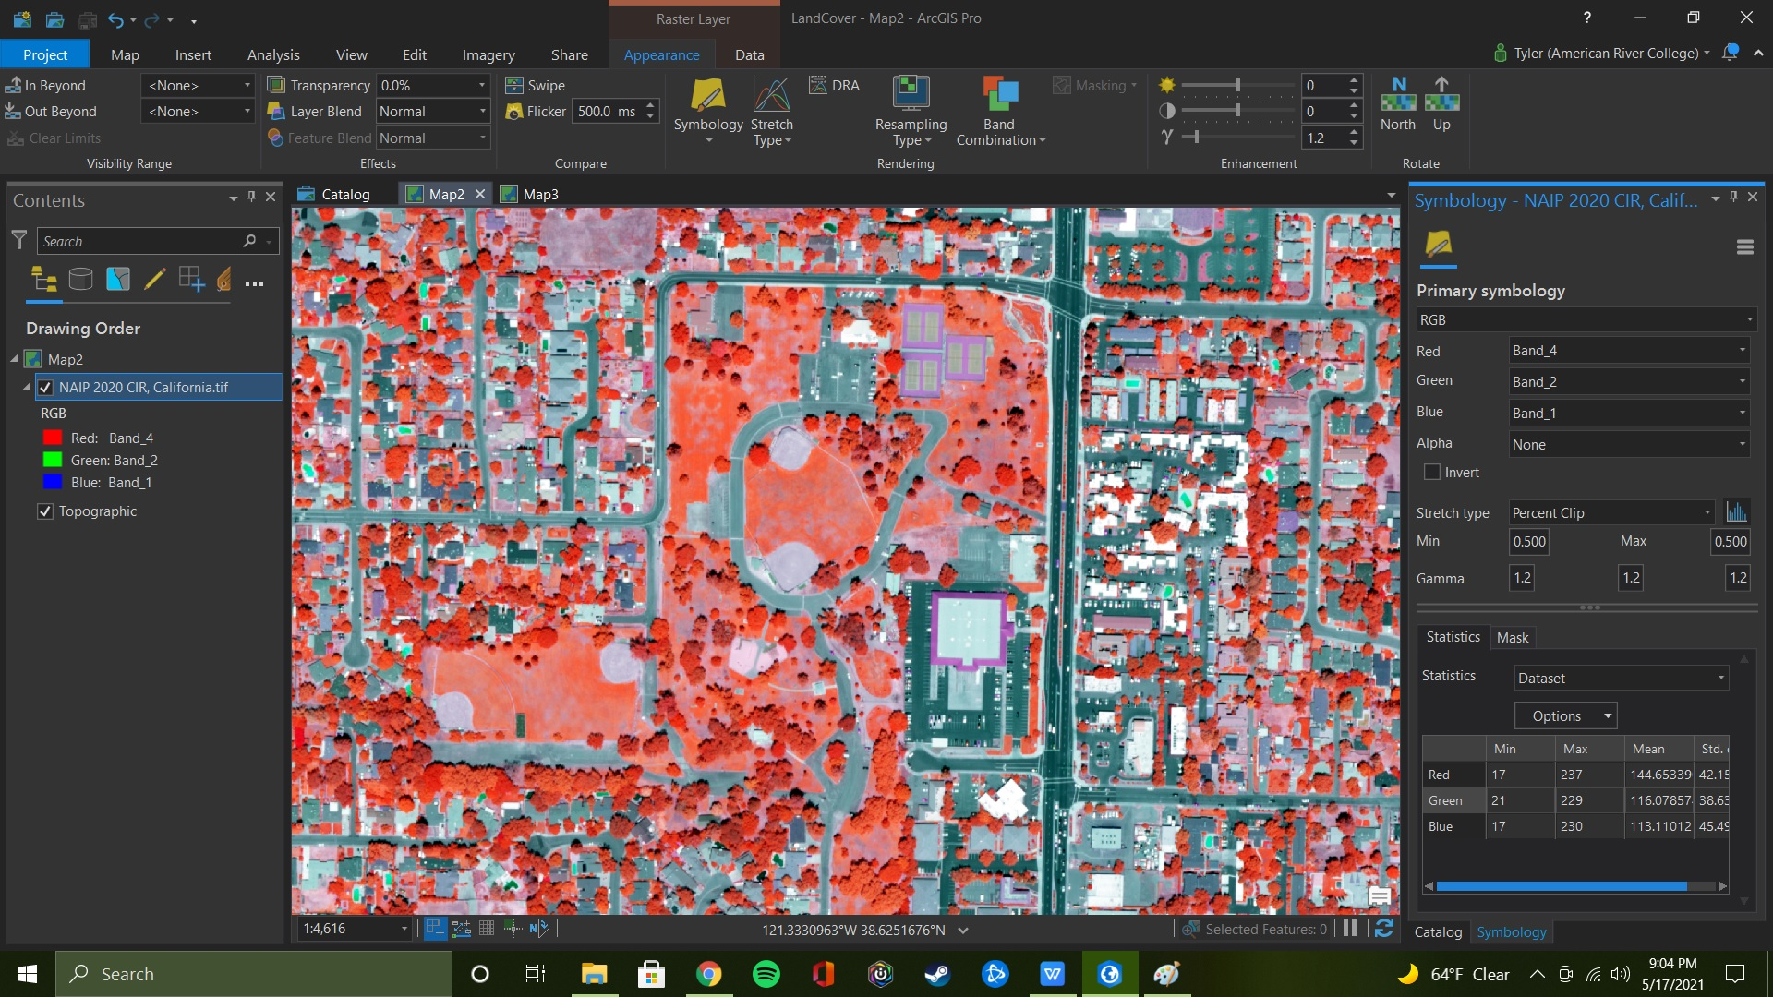
Initial Image

Slide 6
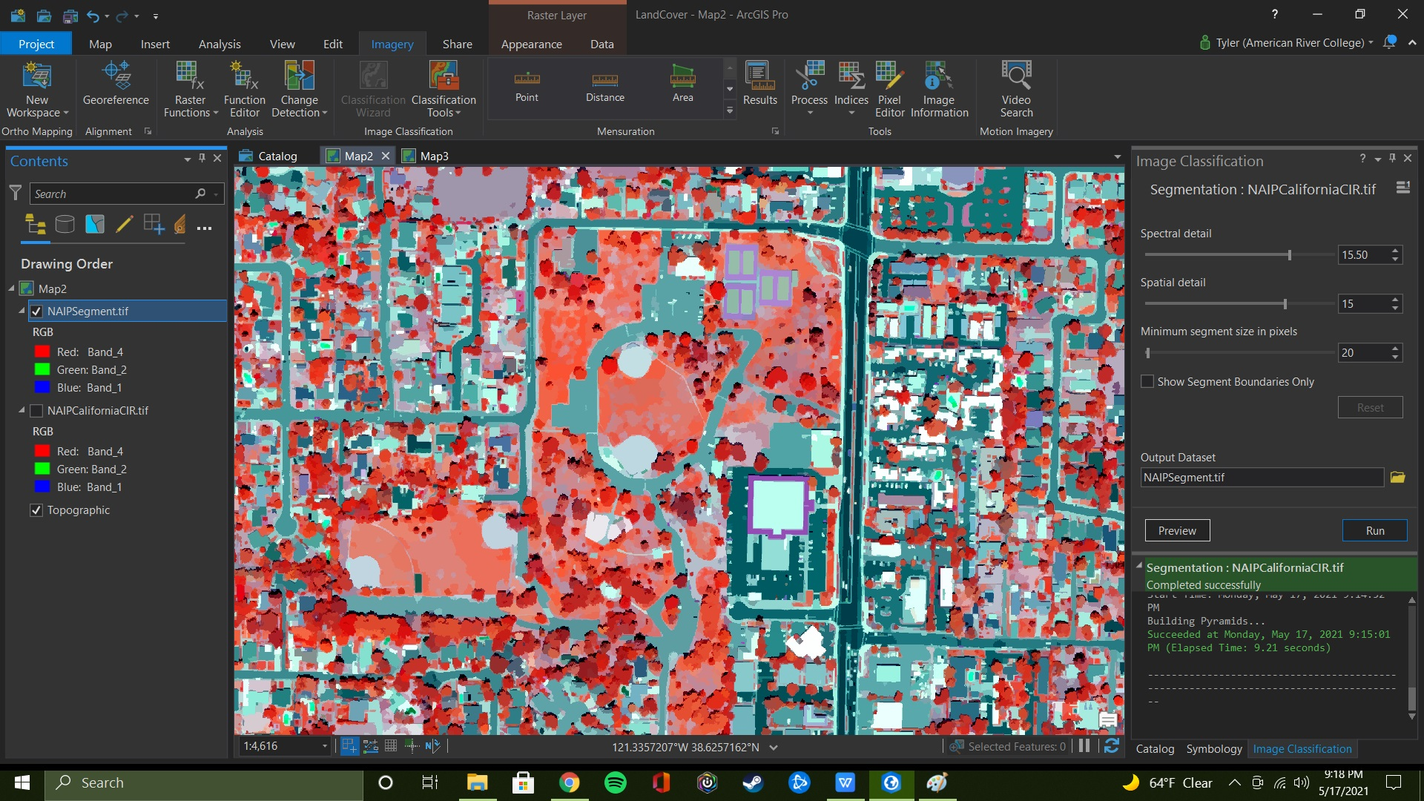
Segmented Image

Slide 7
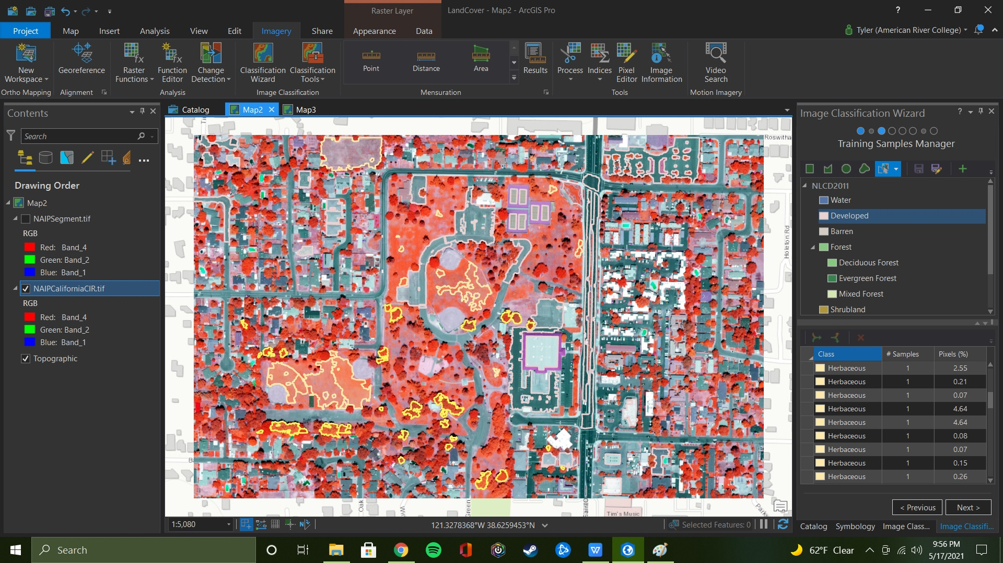
Training Selections

Slide 8
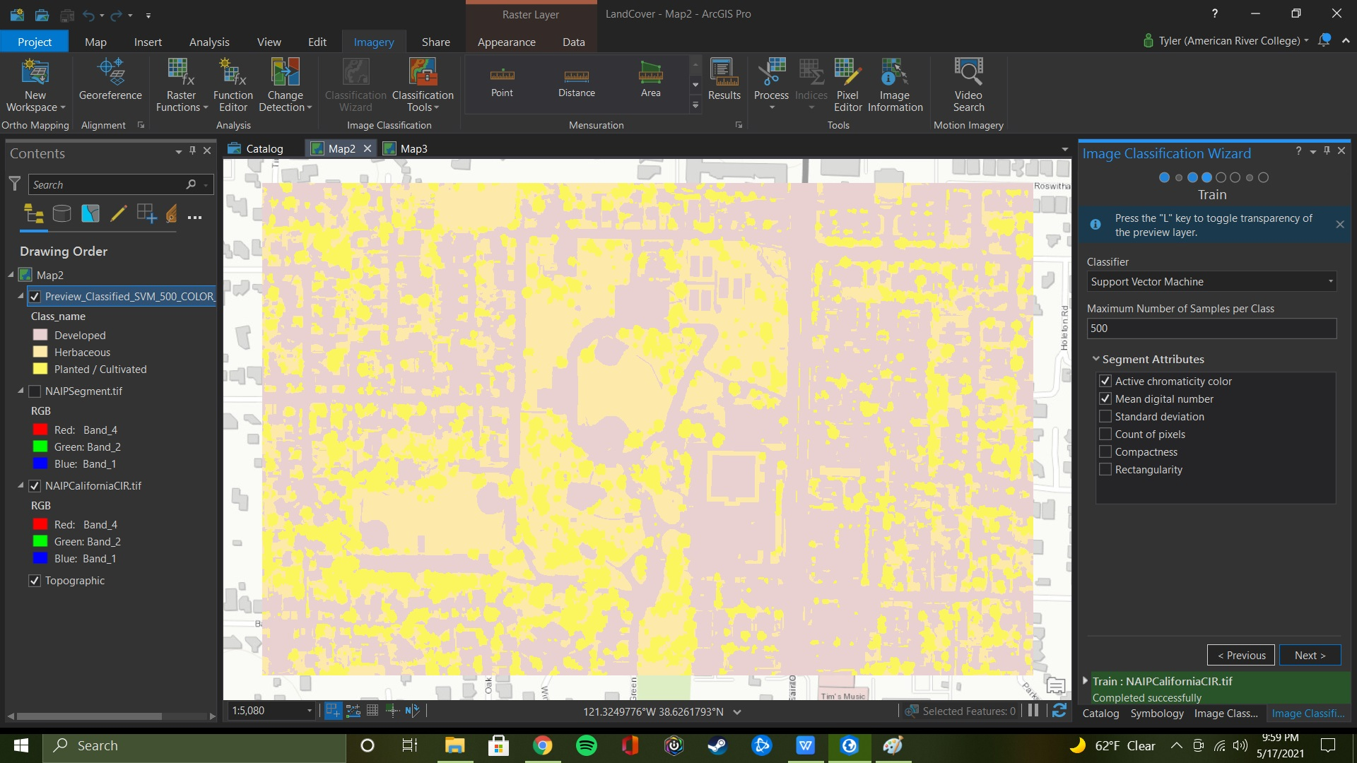
Preview Output

Slide 9
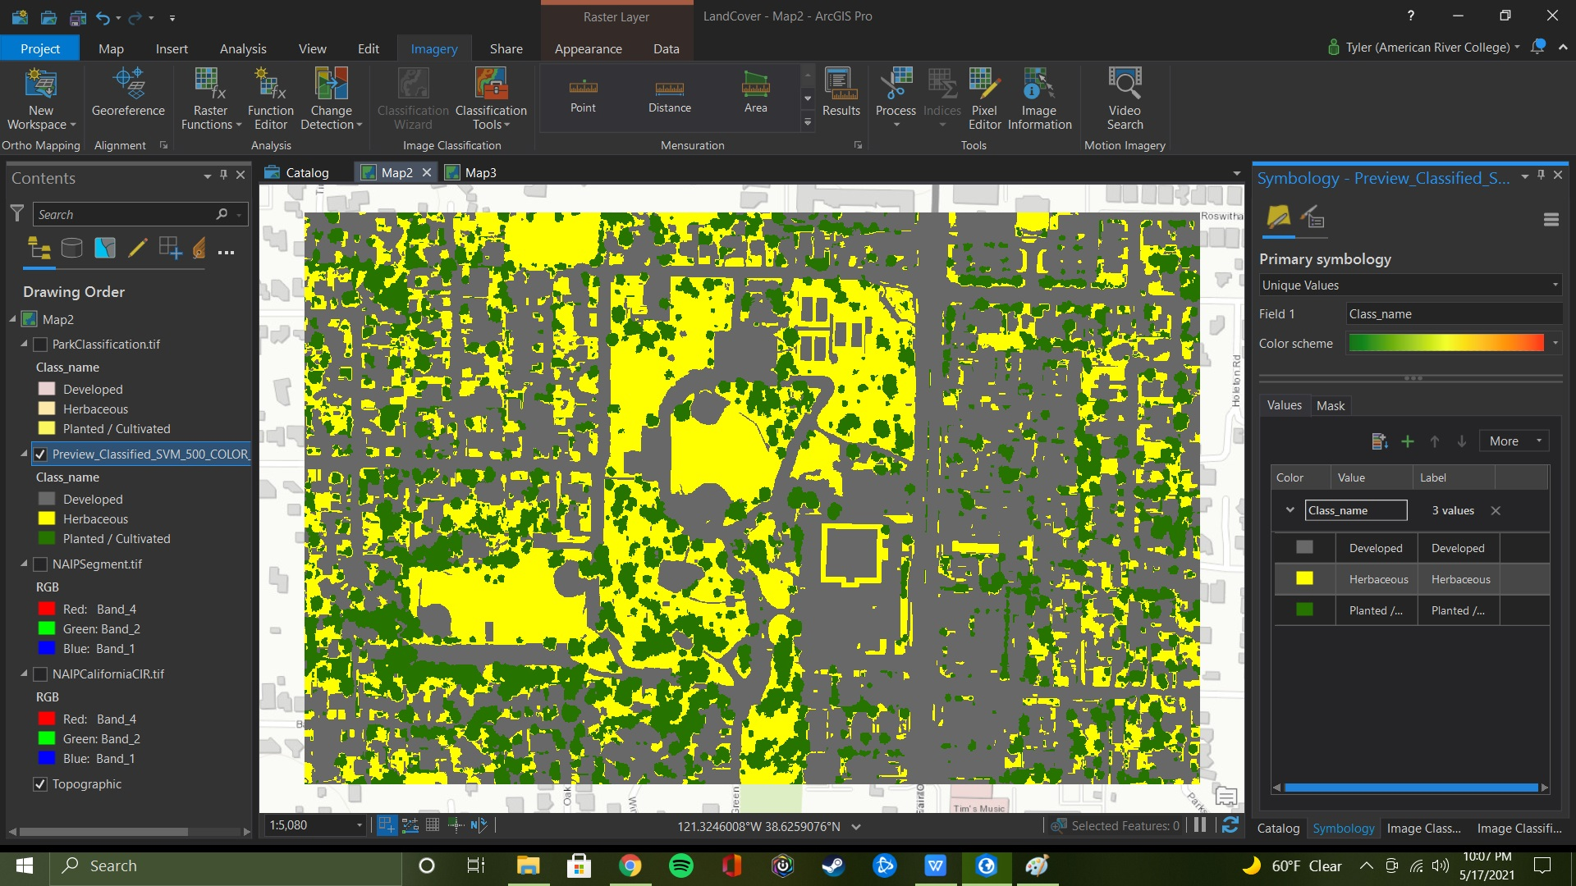
Symbology Changed

Slide 10
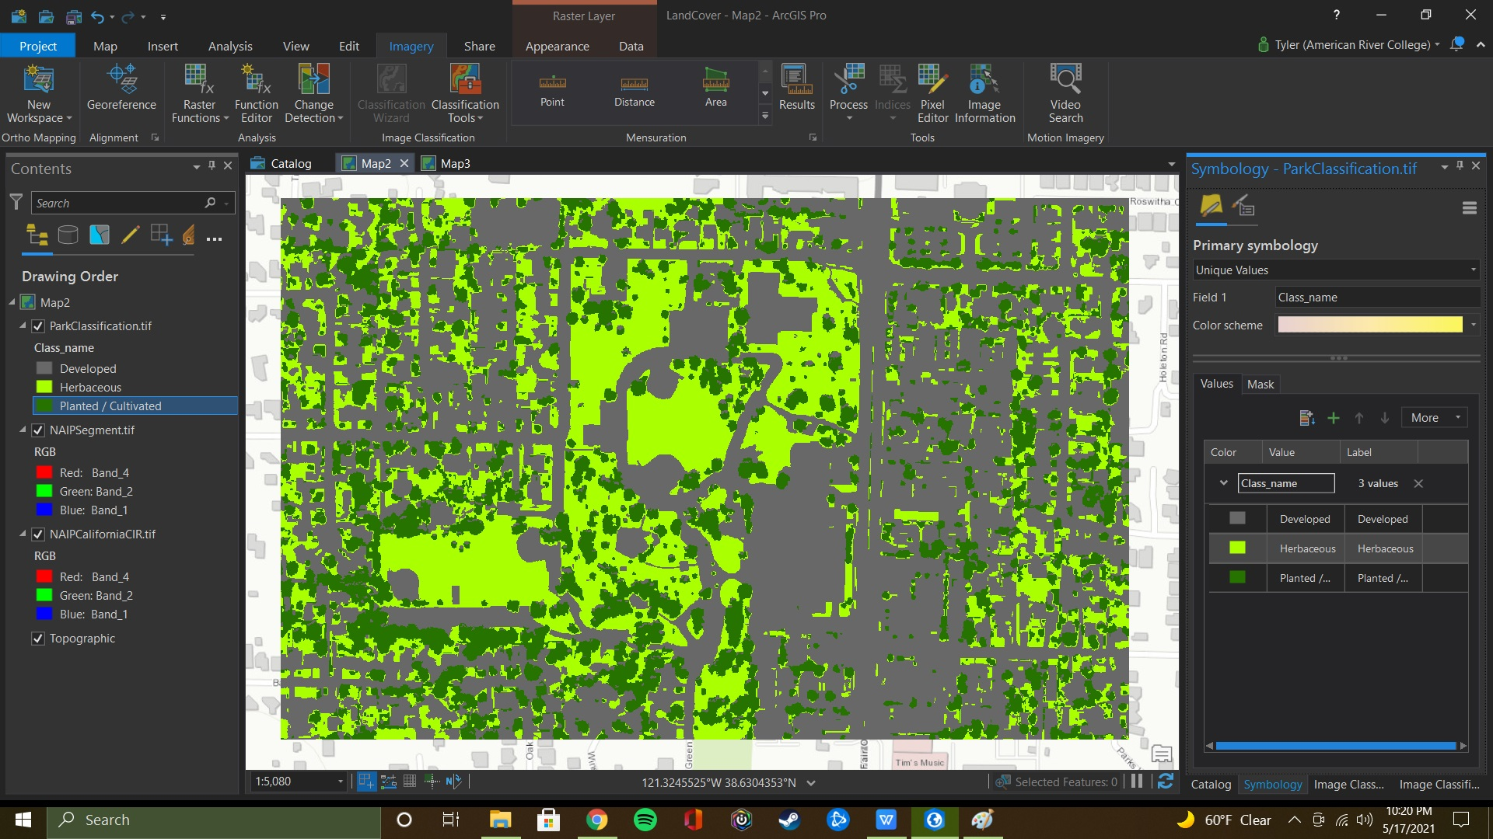
Manual Reclassification

Slide 11
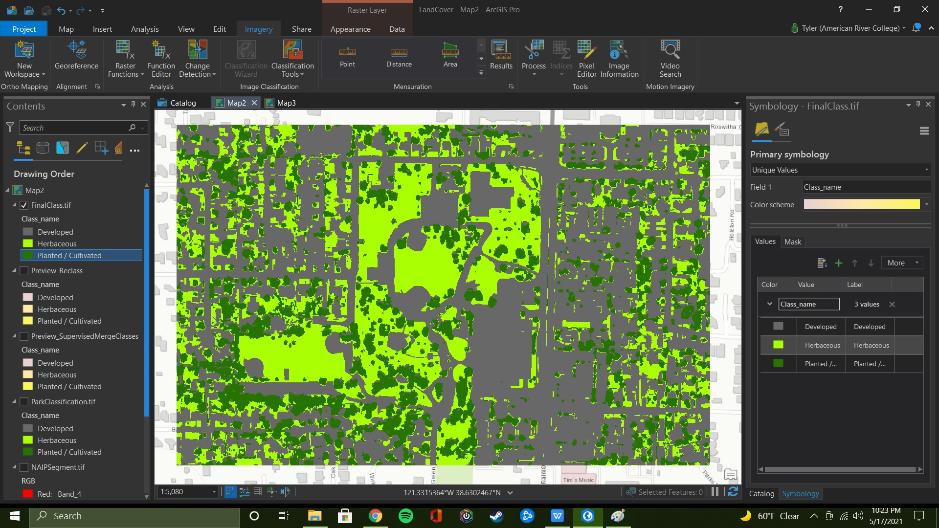
Final Output

Slide 12
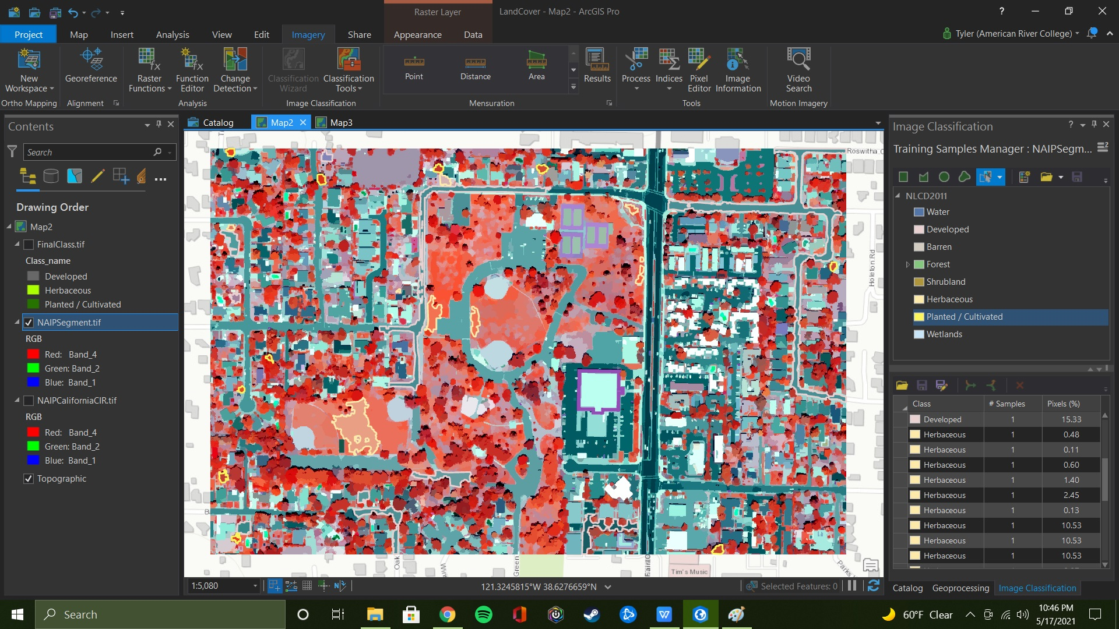
Accuracy Assessment Sets

Slide 13
Accuracy Assessment Sets

Slide 14
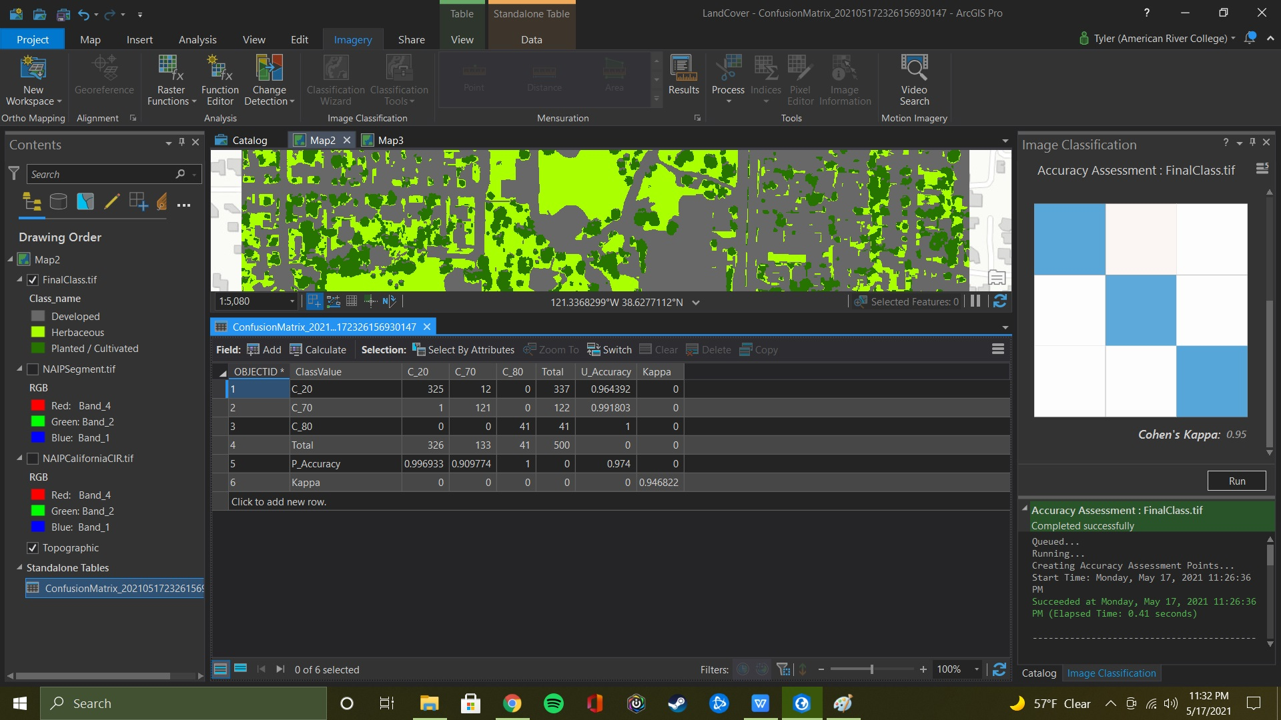
Accuracy Assessment Final

Slide 15
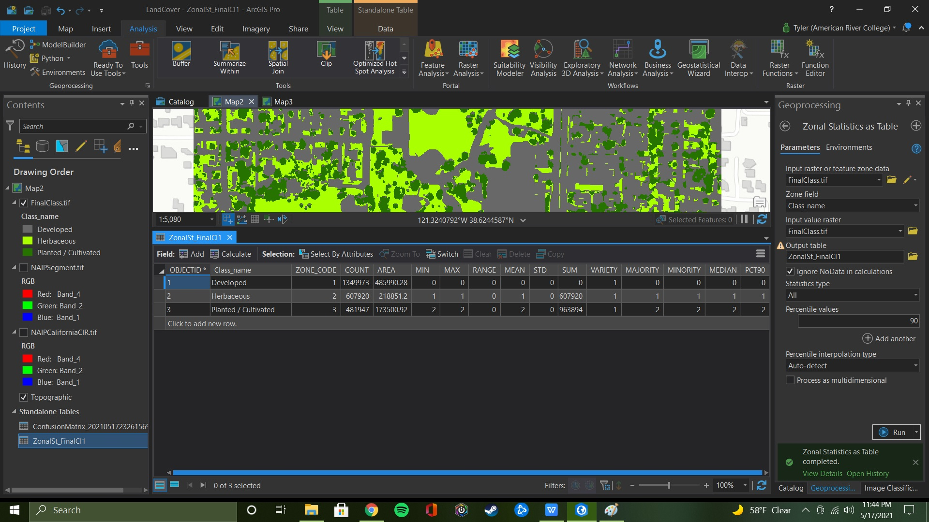
Zonal Statistics Table

Slide 16
Challenges And Conclusion
All in all this project (aside from my loss of previous effort and machine) was good exercise and ended up being very satisfying. The few challenges I ran into were pretty easily overcome with the help of ArcGIS Help and some Google. Given the time constraints and work put in, I feel like I accomplished what I set out to.

Slide 17
Thank You!

