Slide 1
COVID-19 Testing Locations in California Map Series
Cameron Gee
GEOG 375 Spring 2020

Slide 2
Background and Objectives
  COVID-19 testing is becoming more and more available to the general public in California (April-May 2020)
      Maps would be useful for citizens to locate nearby testing sites
  The objective of this project is to develop a script that produces a series of identical maps highlighting testing sites
      Within and around a chosen 3-digit zip code area in California
  Testing sites data is retrieved from GISCorps

Slide 3
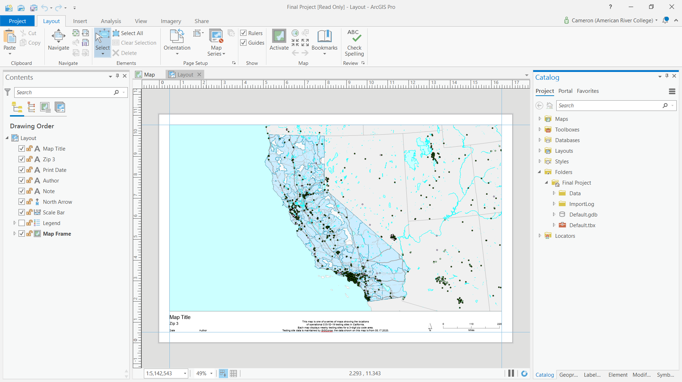
Map and Layout Template
  Before developing the script, a project file, map, and layout was created for the script to reference
  Testing sites data and background layers were added, symbolized, and labeled

Slide 4
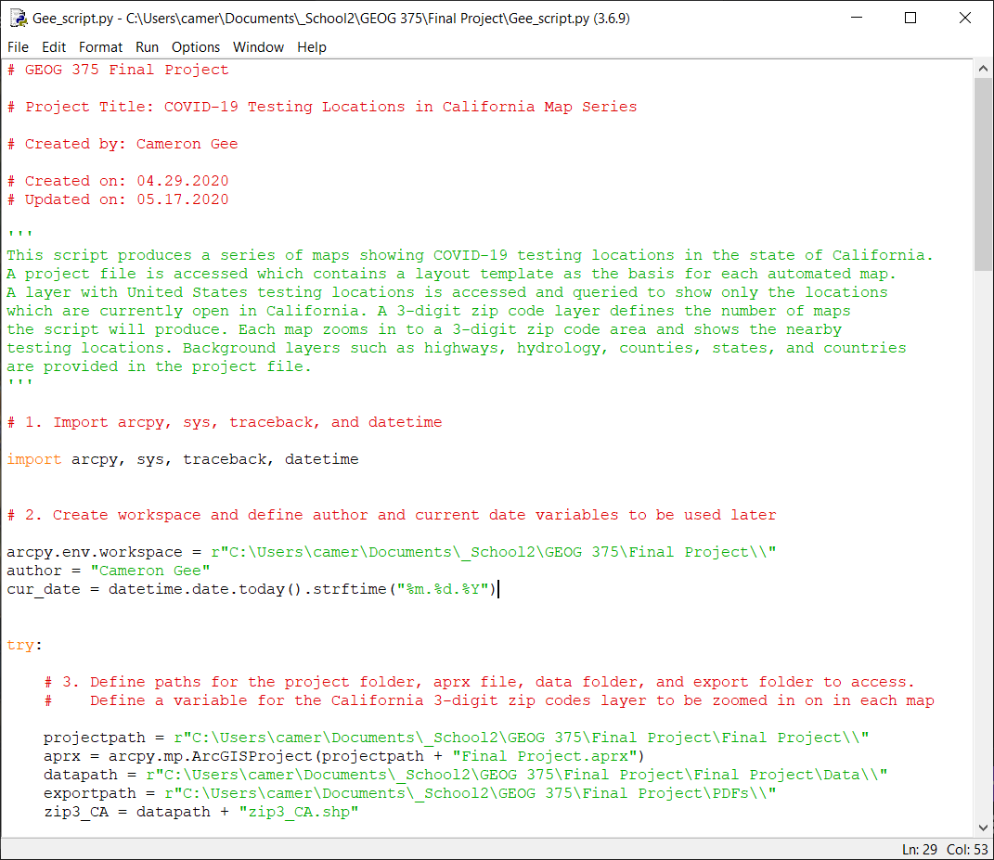
Script – Set-up
  Import modules
  Establish path and project variables
  Define author and date variables to be used later

Slide 5
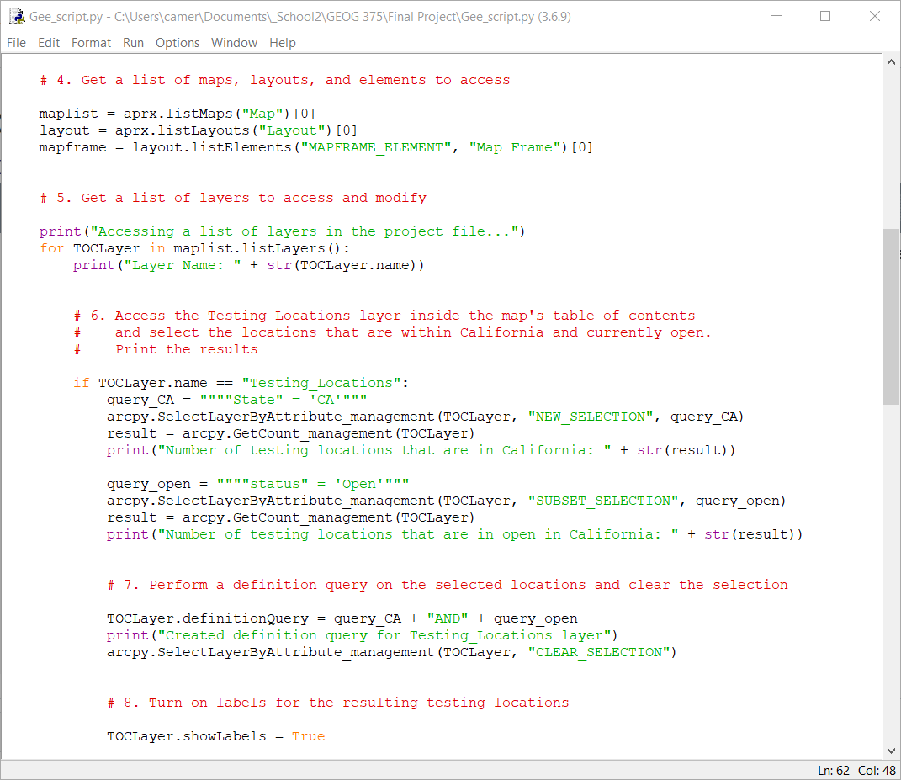
Script – Geoprocessing Tasks
  Access the map, layout, and map frame previously created
  Select Layer by Attributes
      To filter testing sites to California and sites that are open

Slide 6
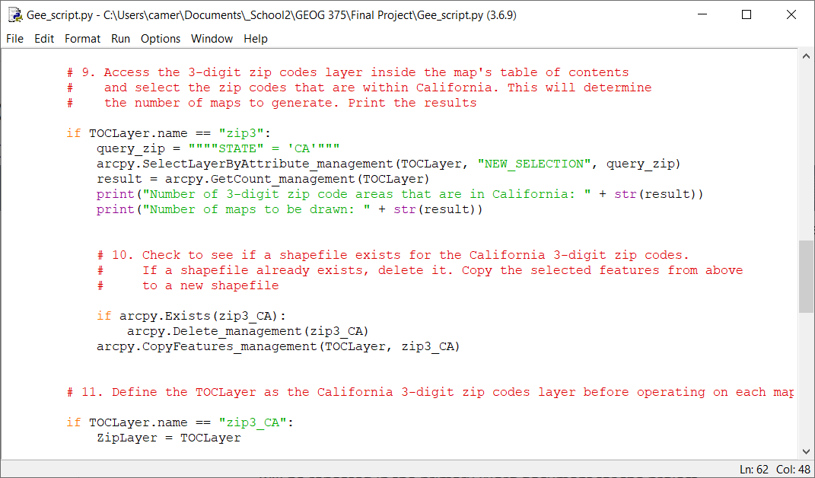
Script – Geoprocessing Tasks
  Select Layer by Attributes
      To filter 3-digit zip codes to California
  Copy Features
      To create a shapefile to be used in a search cursor

Slide 7
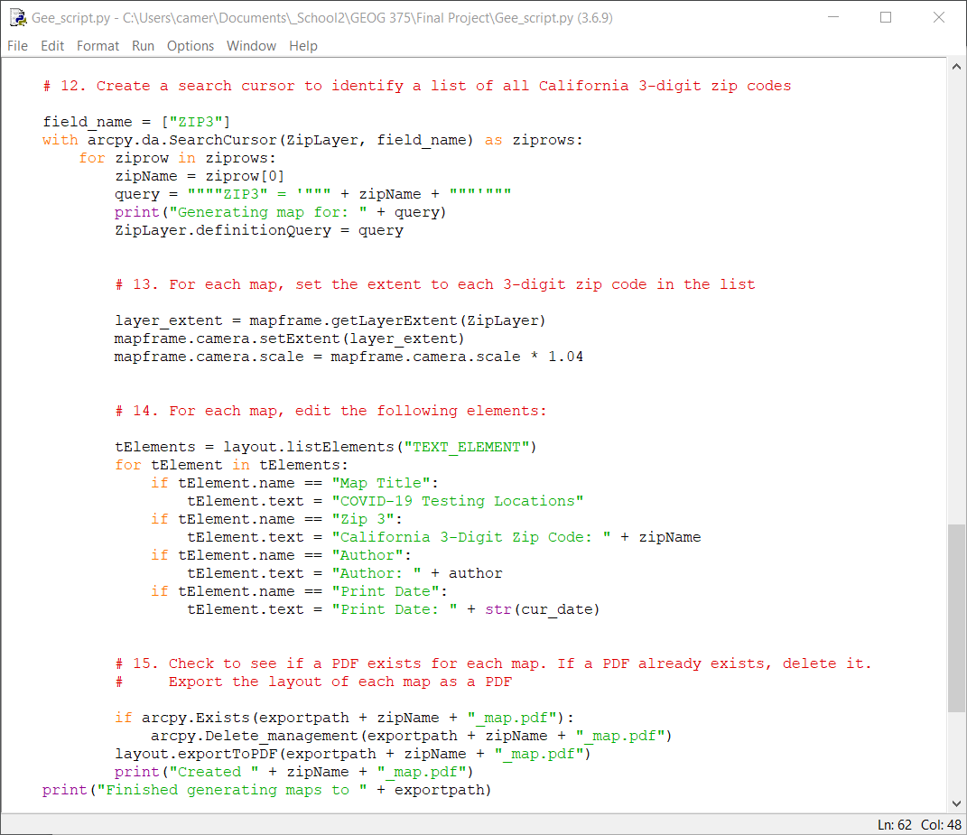
Script – Map Production
  Search Cursor
      To iterate through a list of zip code rows
  For each zip code row, set the map frame extent and modify elements
  Export a PDF

Slide 8
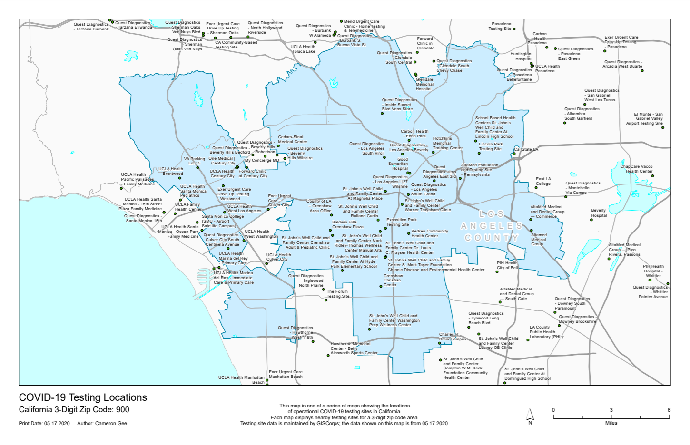
Results
  57 maps total, each zoomed in to a 3-digit zip code area and titled appropriately

Slide 9
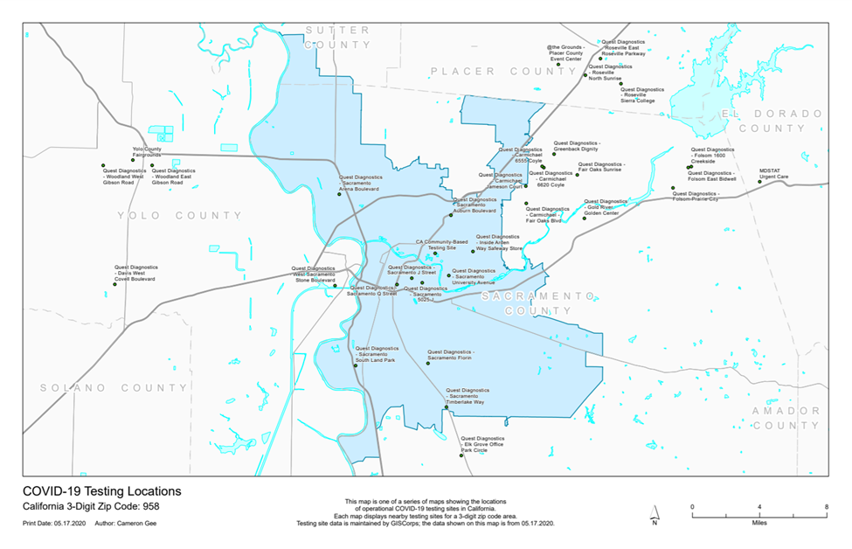
Results
  57 maps total, each zoomed in to a 3-digit zip code area and titled appropriately

Slide 10
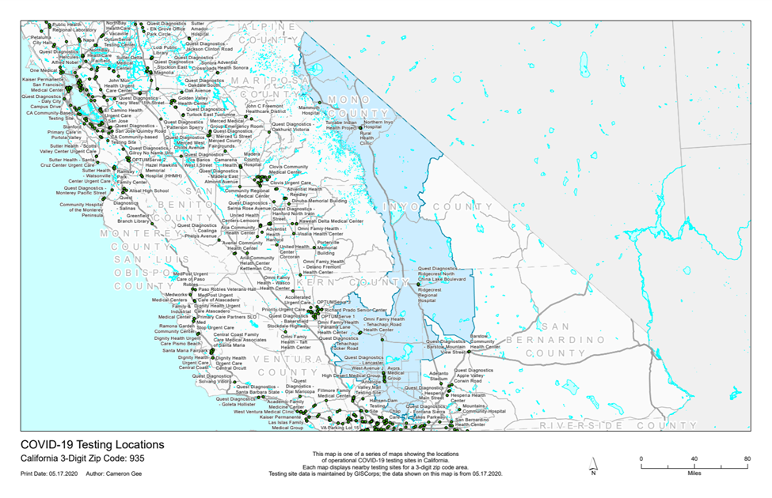
Challenges and Further Considerations
  Zip code areas vary in both shape and size
      Lack of uniformity in scale – some maps could benefit from fewer locations shown, others could benefit from more detailed background information

Slide 11
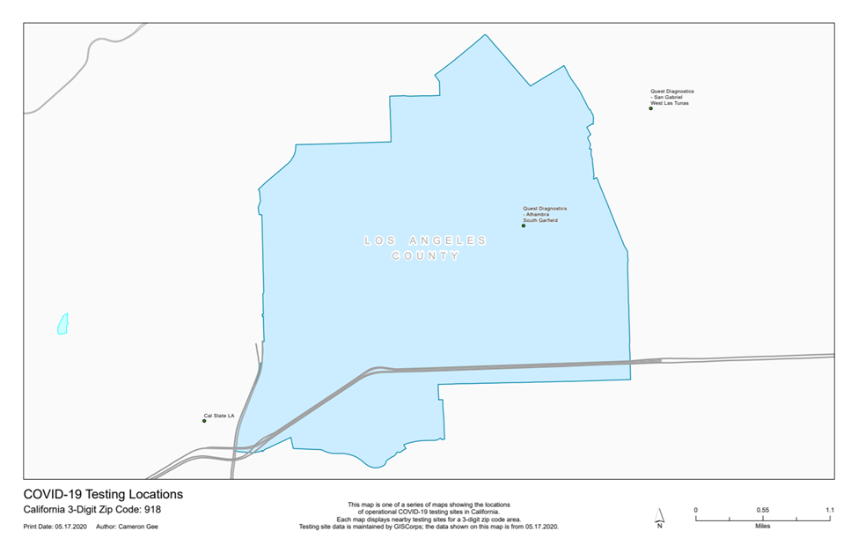
Challenges and Further Considerations
  Zip code areas vary in both shape and size
      Lack of uniformity in scale – some maps could benefit from fewer locations shown, others could benefit from more detailed background information

Slide 12
Challenges and Further Considerations
  Experiment with a more uniform administrative boundary
      Needs to balance size with population and population density (often determines where testing sites are located)
      Utilize a grid index feature (trade-off would be ease of accessing the desired area)
  Other improvements:
      Regularly download and add a new testing sites dataset to ensure accuracy

