Slide 1
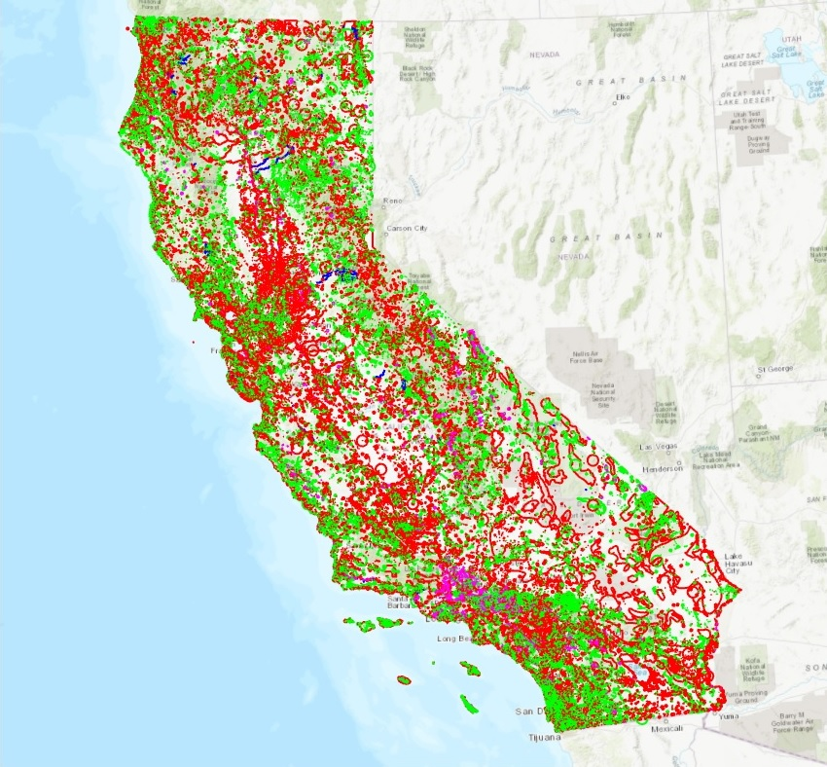
Automating Species Determination During A Spill Response.
Greg Ewing
Geog 375 – Final Project
Spring 2020

Slide 2
Purpose:
Create a Python script with two purposes in mind:
Create a tool that will be a useful for the GIS Analyst during the initial hours of a spill response.
Create a tool that will decrease the time taken to create a finished product so needed information can be placed in the hands of the decision makers sooner without compromising the quality of the product.
This script will create a buffer at a specified distance from a known spill location. It will then take the result and use it to produce a subset of the statewide California Natural Diversity Database (CNDDB) dataset. This desired output layer can now define where the species are geographically through its inclusion in a map, but also can specify what species may be impacted specifically by exporting the attributes of that output layer to a spreadsheet.

Slide 3
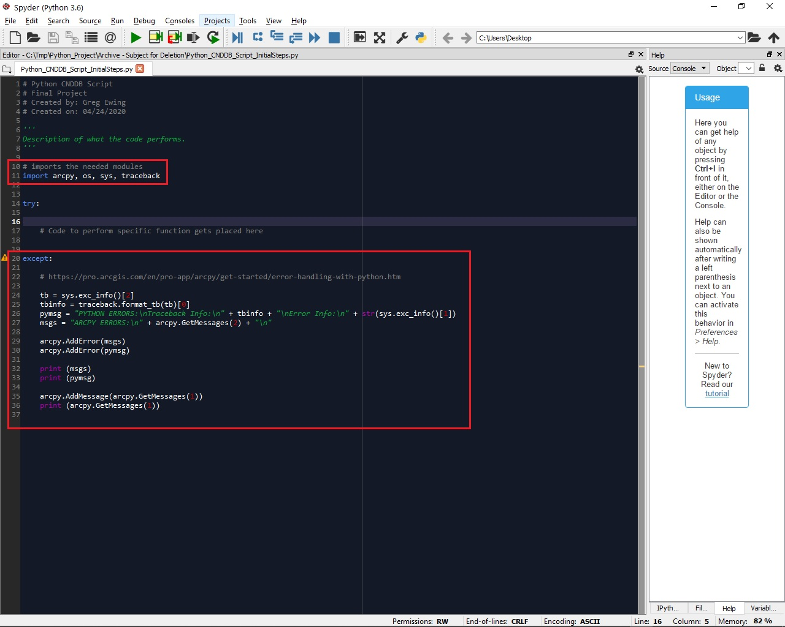
Step 1: Create Initial Code Framework.
As a starting point to any coding project add highlighted code to establish a framework.
Import the needed modules that will be needed for your code.
Create code in the Except block.
  Trap code that creates error.
  Provides feedback to programmer which aids in the correction of those errors.

Slide 4
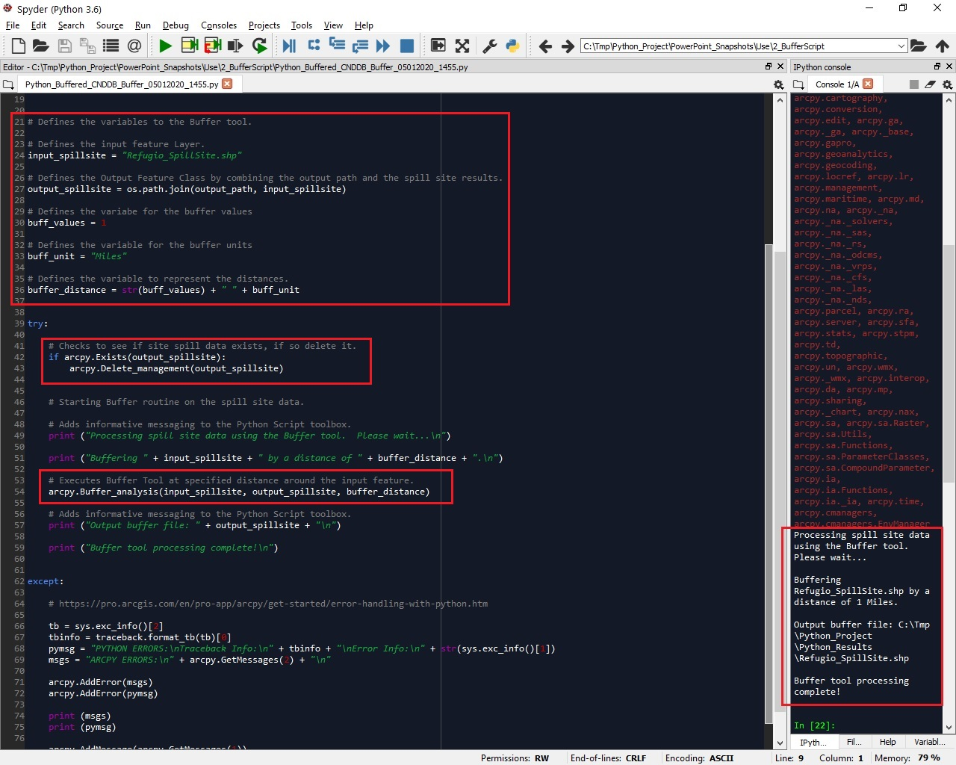
Step 2: Create Variables And Execute Tool To Create A Buffer.
Use Buffer tool:
  Creates a boundary at a defined distance from a point feature (i.e. The location of where an oil spill occurred in this case).
Output from this interim step:
  Represents the distance from spill location, 1 Mile in this case.
  Output defined by defined path.
  Serves as an input to a future step that will be discussed shortly.
Note: Sample code shows the implementation of buffer tool was successful.

Slide 5
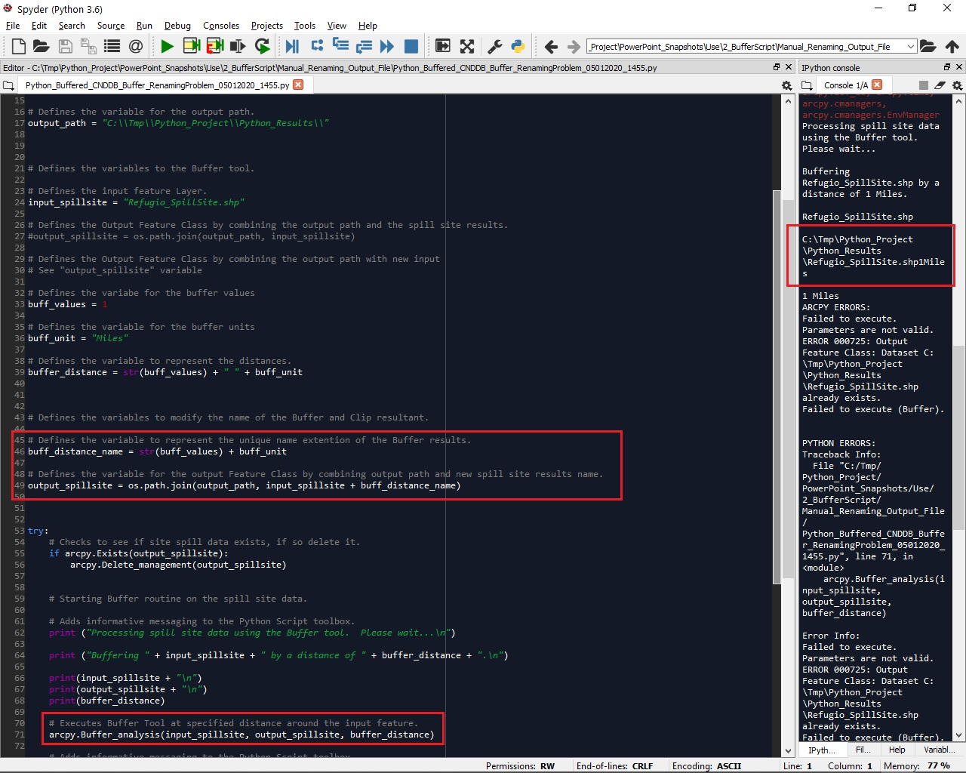
Step 2a: Buffer Output Naming Problem - How Can The Output Be Rename?
With input of Buffer tool being a shapefile with a “.shp” extension, how can output of tool get uniquely name to prevent from being overwritten if Buffer tool is run more that once?
Introduction of a real issue:
  Extension needs to be temporarily removed before file name can be renamed.
  Once renamed extension needs to be reinstated once file name modified.
Note: Sample code shows result of output in console window after “trying” to resolve the issue.

Slide 6
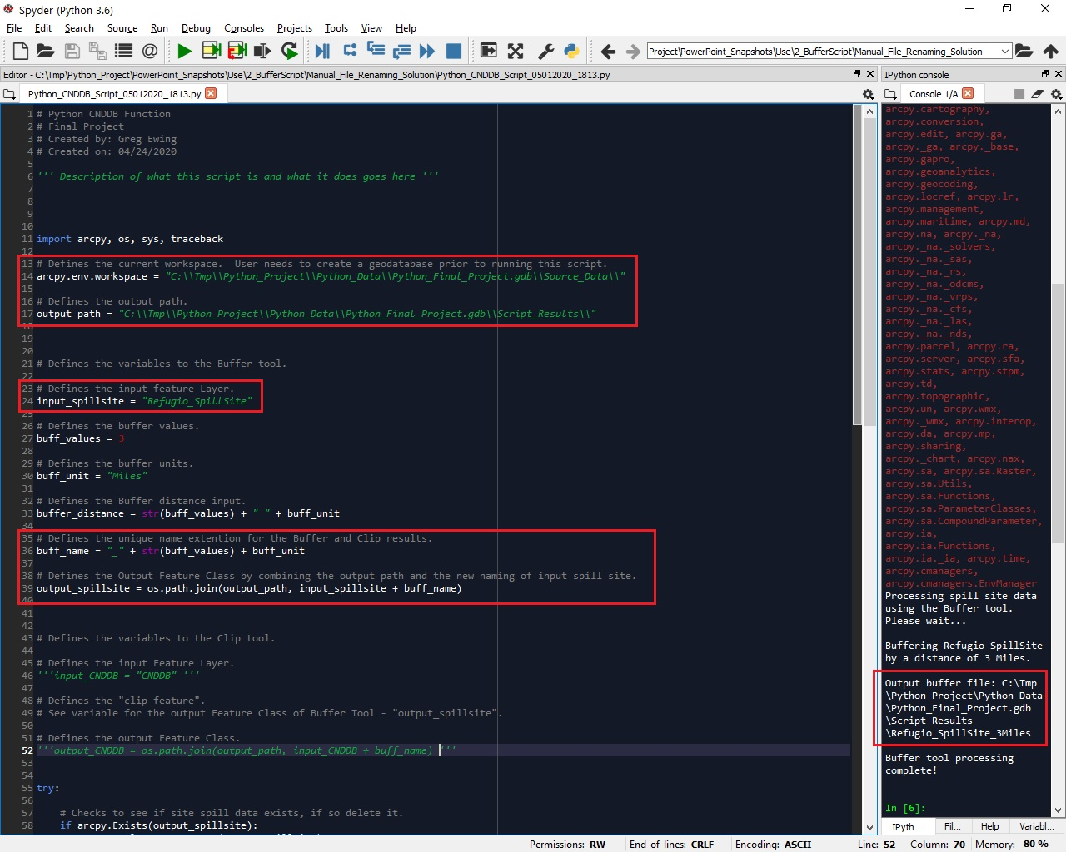
Step 2b: Buffer Output Naming Solution.
Resolution for solving the Buffer output renaming of file:
Create a geodatabase:
  Input to Buffer tool now a feature class.
  Given output of Buffer tool is feature class file name can be renamed since no extension.
Note: Geodatabase created manually. Future version of code will create this.
Sample code shows result of output in console window. Solution found. Renaming successful.
Slide 1 of 2 (Defined variables)

Slide 7
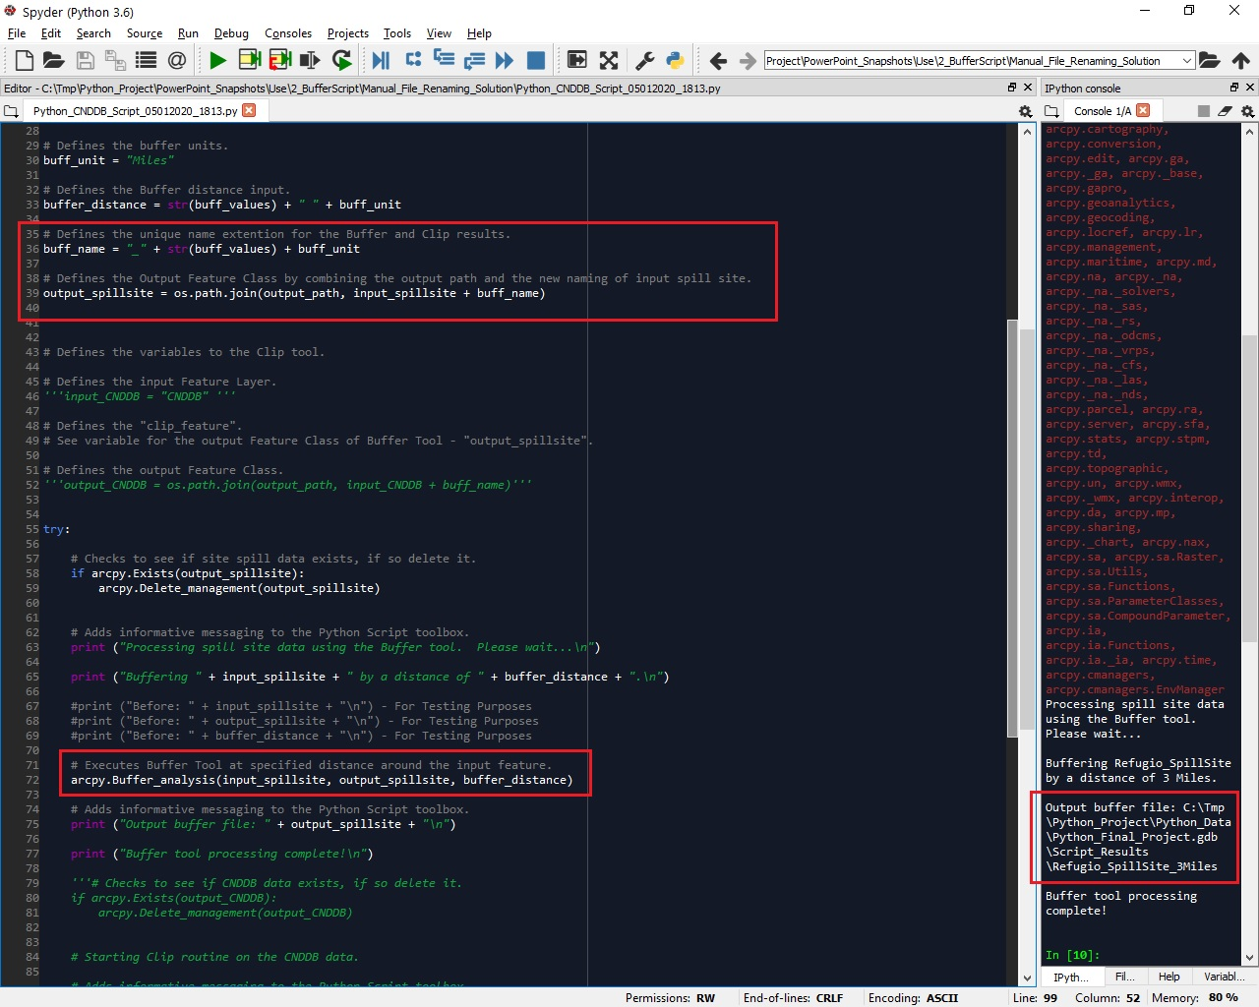
Step 2b: Buffer Output Naming Solution.
Slide 2 of 2 (Code within Try block)

Slide 8
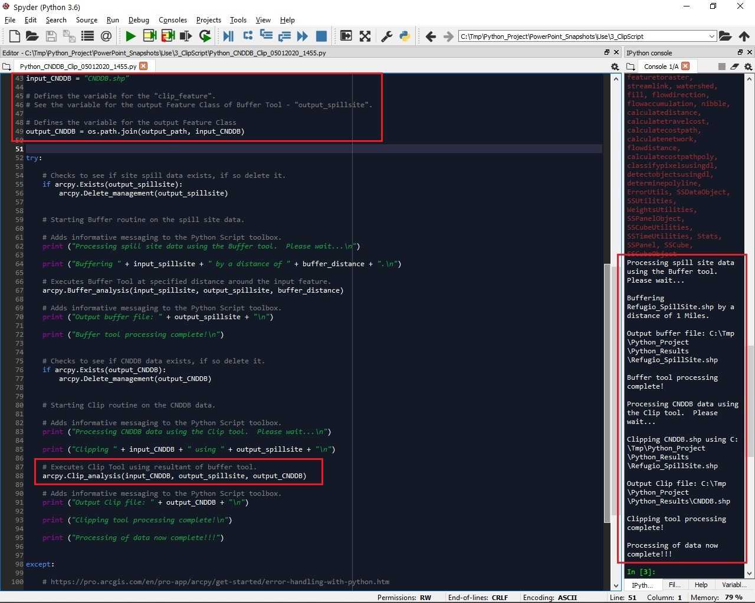
Step 3: Create Variables And Execute Tool To Clip CNDDB dataset.
Use Clip tool:
  Use statewide CNDDB dataset as input.
  Use interim output from buffer tool as clipping boundary for CNDDB input.
  Output location defined by output path.
Note: Sample code shows the implementation of buffer tool was successful.
Output is desired end product. Used in map to define location and specific species of interest.

Slide 9
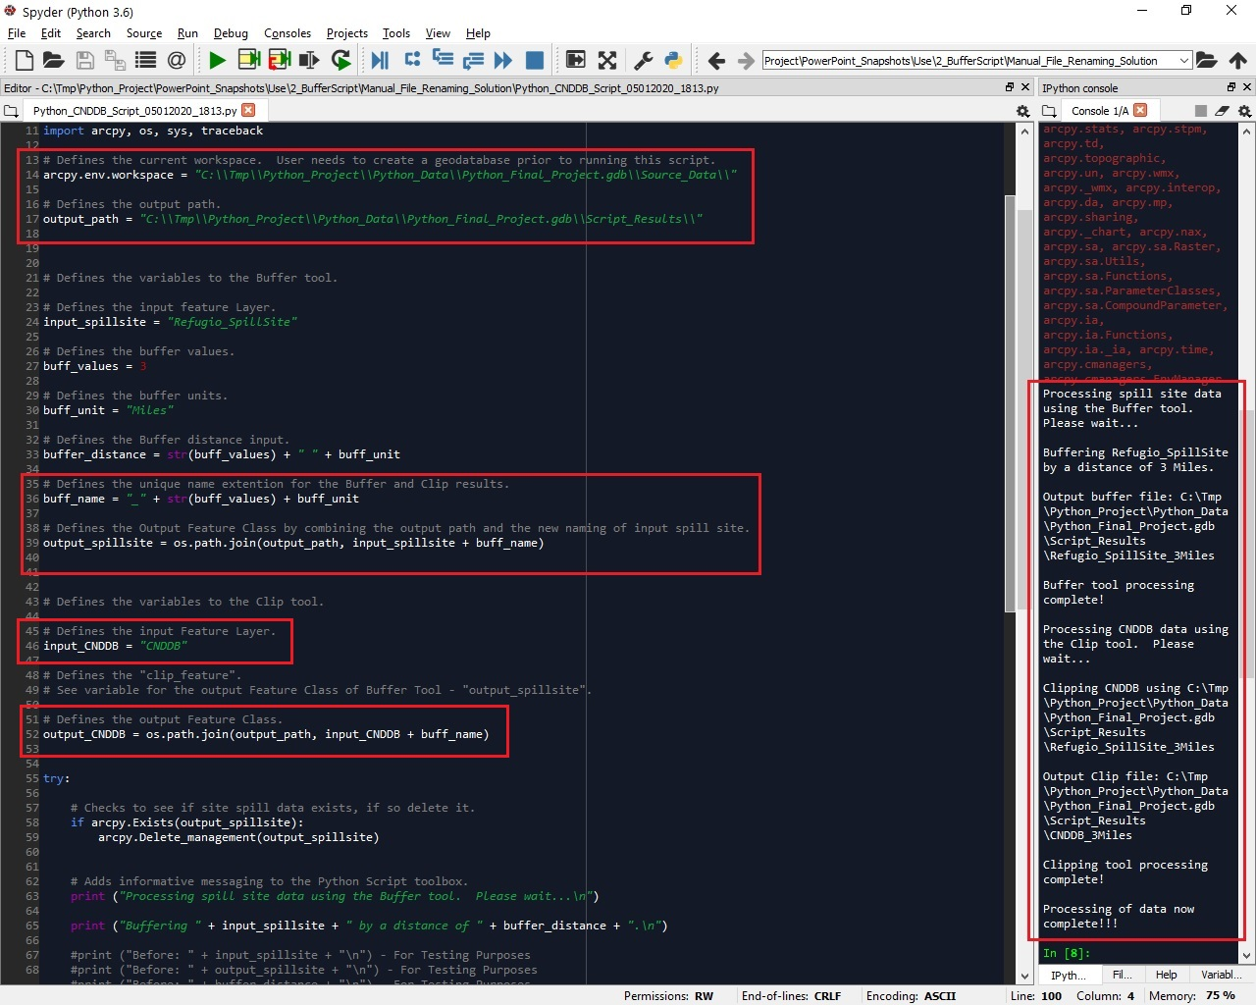
Step 3a: Clip Output Naming Verification.
Resolution used to rename output of Buffer tool also a verifiable solution for renaming of Clip tool output.
Sample code shows result of output in console window. Renaming successful.
Slide 1 of 2 (Defined variables)

Slide 10
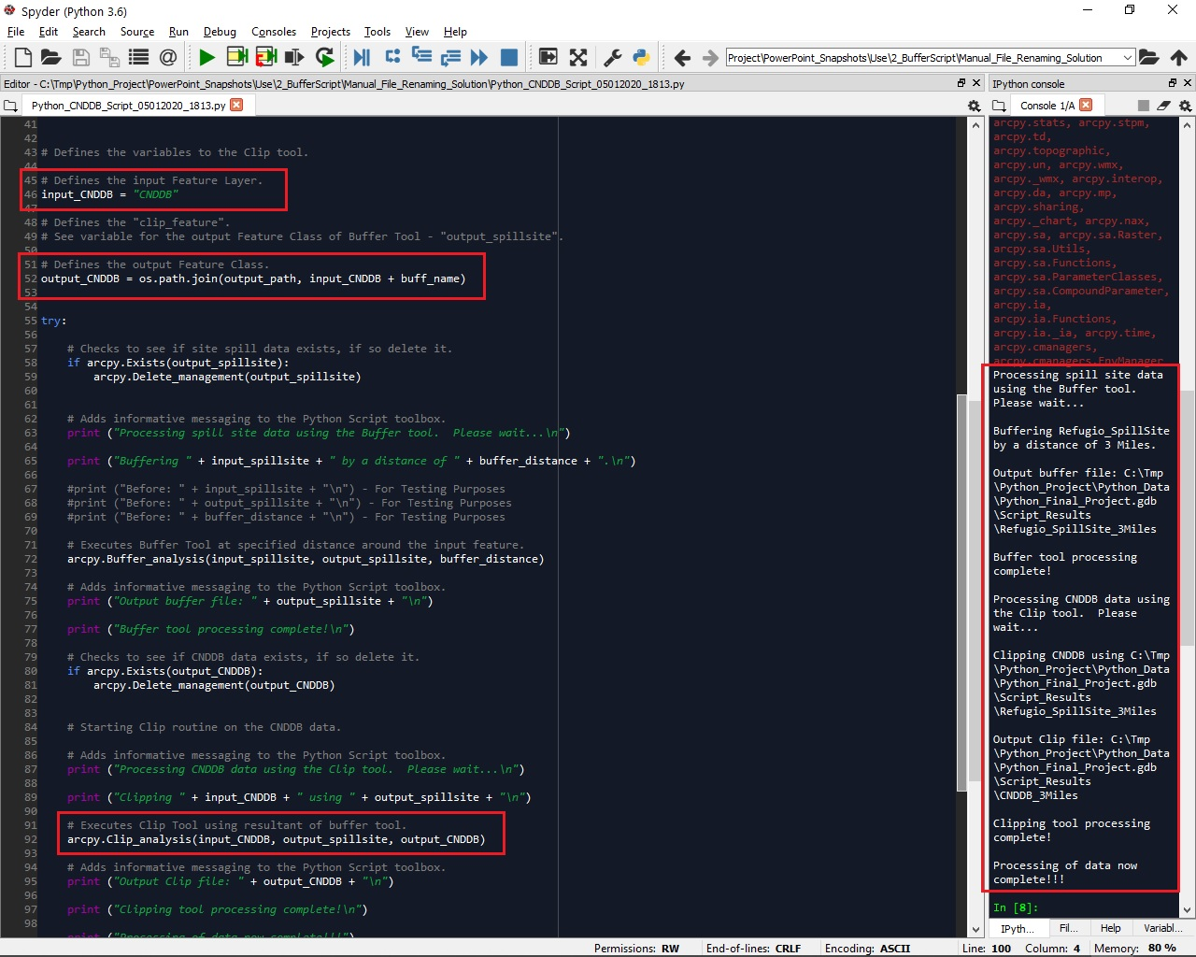
Step 3a: Clip Output Naming Verification.
Slide 2 of 2 (Code within Try block)

Slide 11
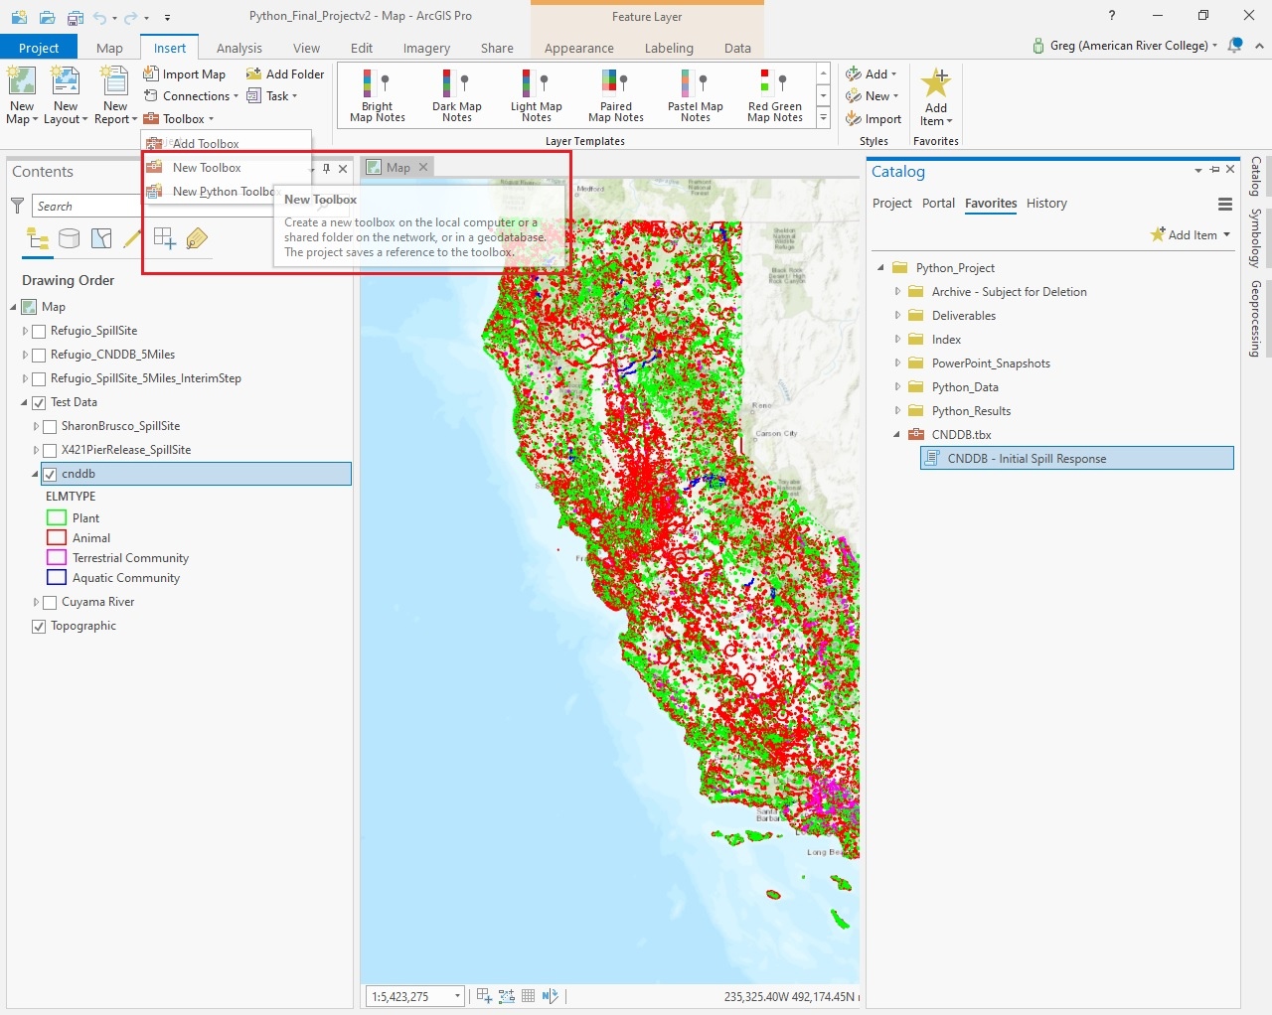
Step 4: Creating Custom Toolbox For User Interface.
From “Insert” tab within ArcGIS Pro:
  Click “Toolbox” – drop down listing will open.
  Select “New Toolbox”.
  Define name of toolbox and location to be saved.
  Right click on Toolbox:
    Populate Name, Label, and Alias
    Populate Description with a brief purpose of toolbox.
  Right click on Toolbox:
    Select “New”.
    Select “Script” from selection.

Slide 12
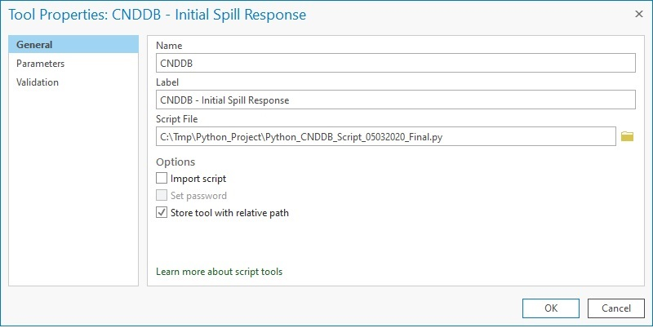
Step 4a: Creating User Interface - Defining General Tab.
Right click on new script and select Properties:
Populate “Name” field
Populate “Label” (This is name that is seen on script within ArcGIS Pro).
Navigate to where code is stored.
Check Import Script (optional).
Check “Store tool with relative path”.
Click OK.

Slide 13
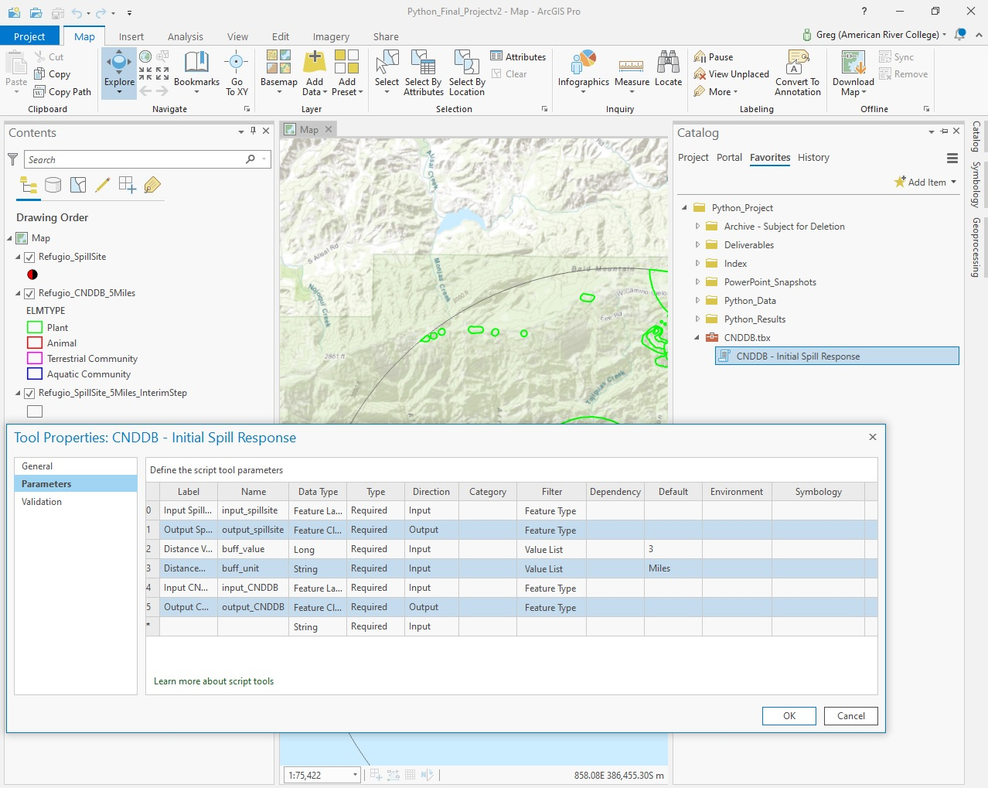
Step 4b: Creating User Interface - Defining Parameters.
Define Parameters:
  Populate “Label” field with desired name.
  Populate “Name” field with variables used in code.
  “Data Type” - define from drop down.
  “Type” - required, optional, or derived field?
  “Direction” - input or output?
  “Filter” - chosen from drop down (Data type selected will define what in filter drop down).
    “Value Lists” – Define desired input options.
  “Default” - default values assigned when tool opens (optional).

Slide 14
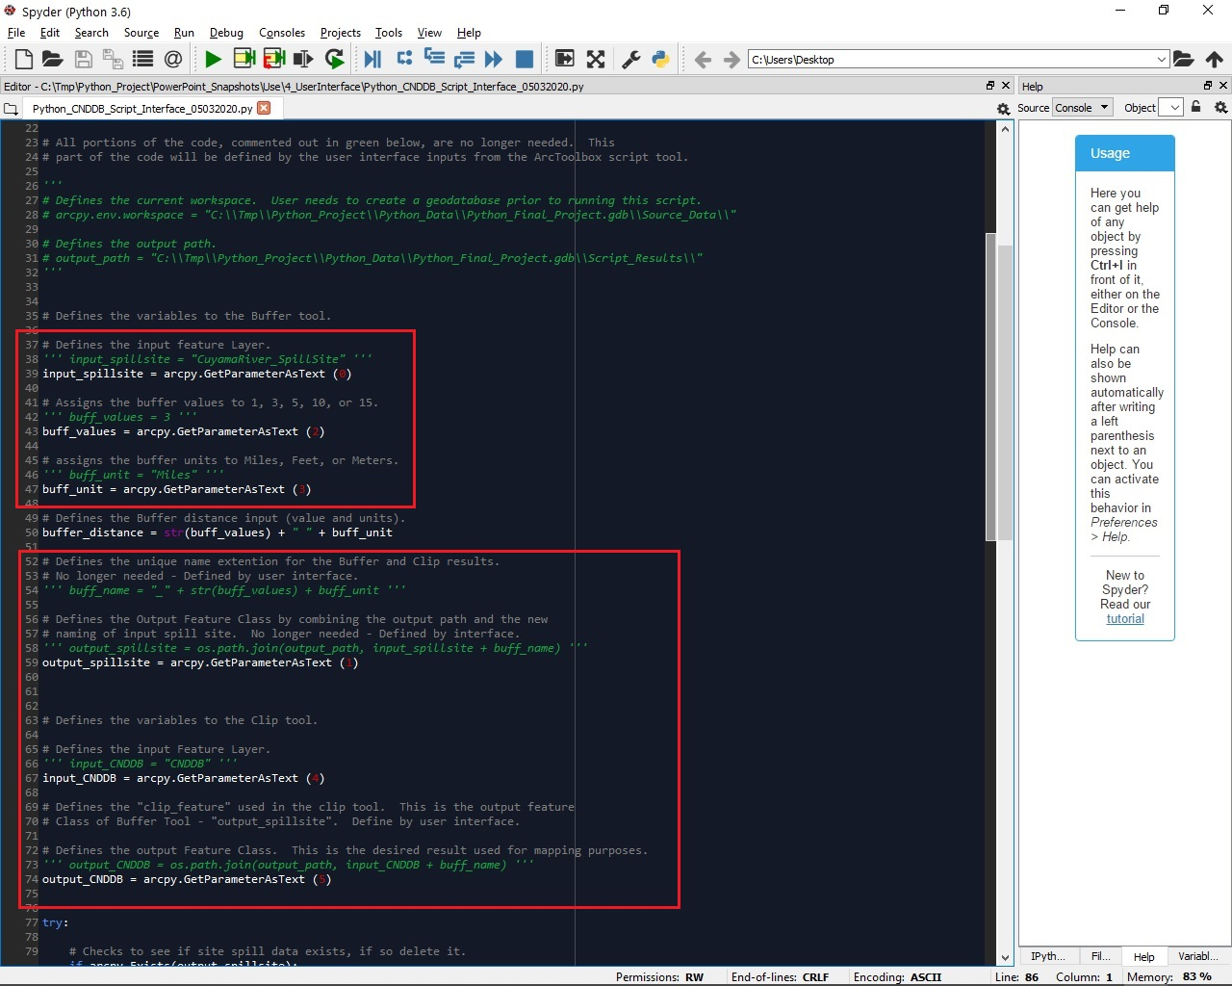
Step 5: User Interface Parameters Defined in Code.
Using GetParameterAsText in code:
Uses any value defined in user interface and returns it as a text string to applicable variable in the code.
Associates the individual user interface input to the applicable variable in the code via an index number.
Note: Highlighted sections of code provides an example of how “GetParameterAsText” is defined in code.

Slide 15
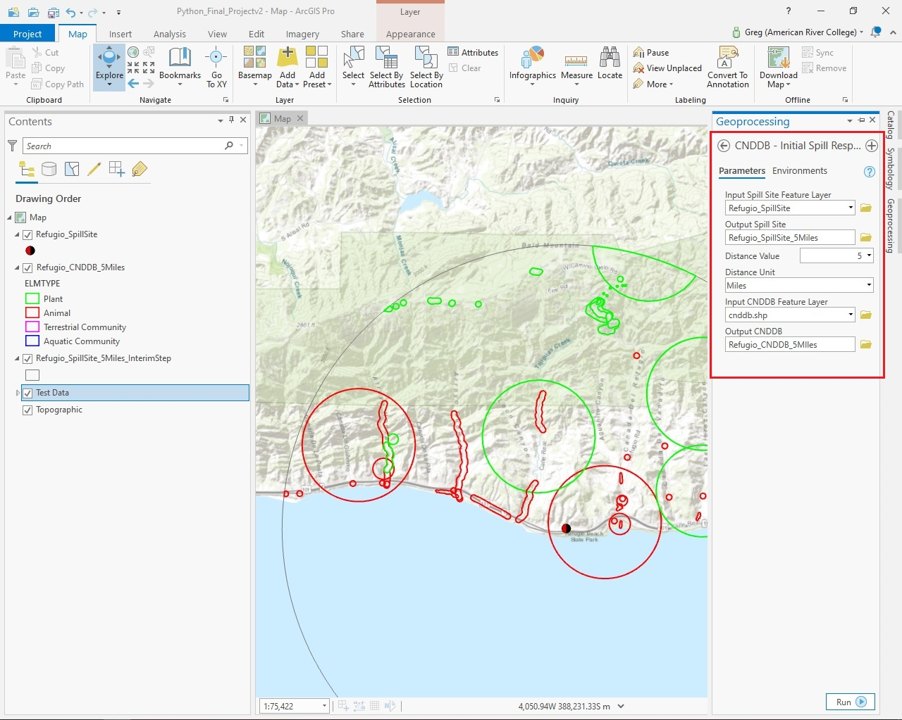
Step 6: User Interface Finished Script.
This image highlights the end result after completing the process of defining all the applicable parameters.
Think your finished…? Almost…

Slide 16
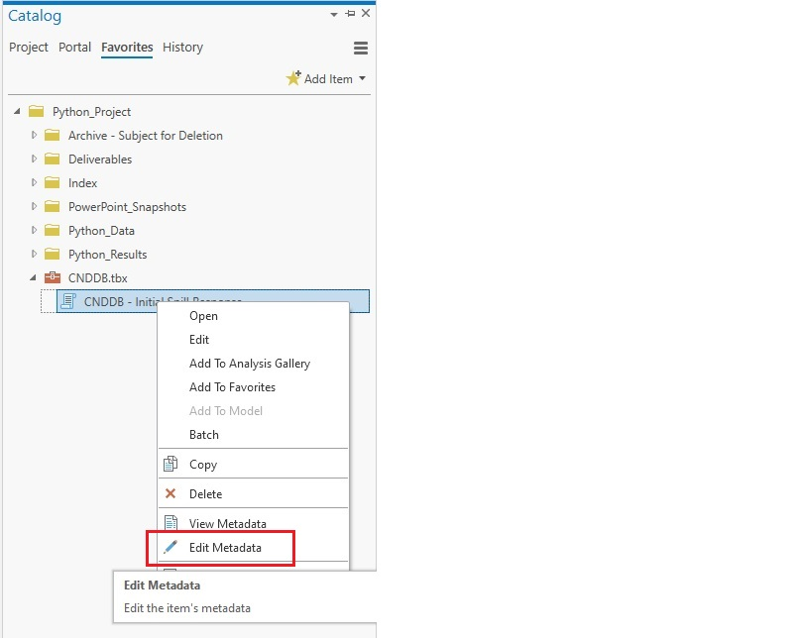
Step 7: Create Metadata On User Interface.
Metadata needs to be completed for the script:
Right click toolbox script
Select “Edit Metadata”.
Populate all fields in template to define details of script.
Reasons complete metadata important:
Provides user tips for each field in interface.
Provides important details if toolbox is shared with peers for their understanding.

Slide 17
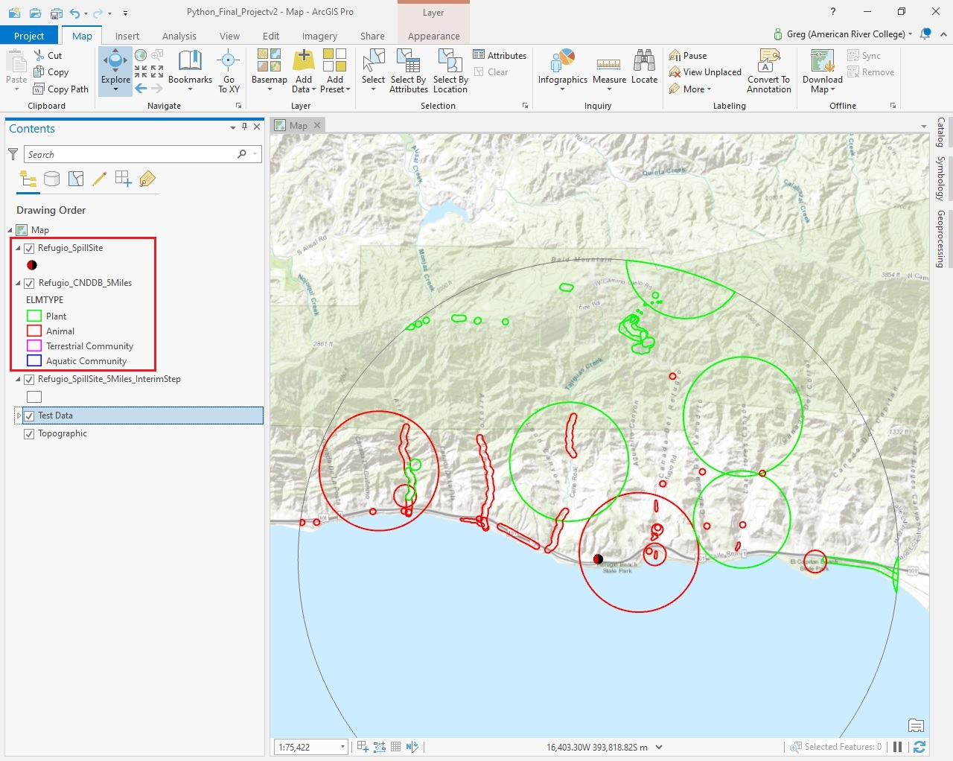
Step 8: Final Product After Executing Tool.
Sample showing the clipped result at a distance of 5 miles from the spill site.
This output can now define where the species are geographically through its inclusion in a map, but also can specify what species may be impacted specifically when exporting the attributes of that output layer to a spreadsheet.

Slide 18
Challenges

Slide 19
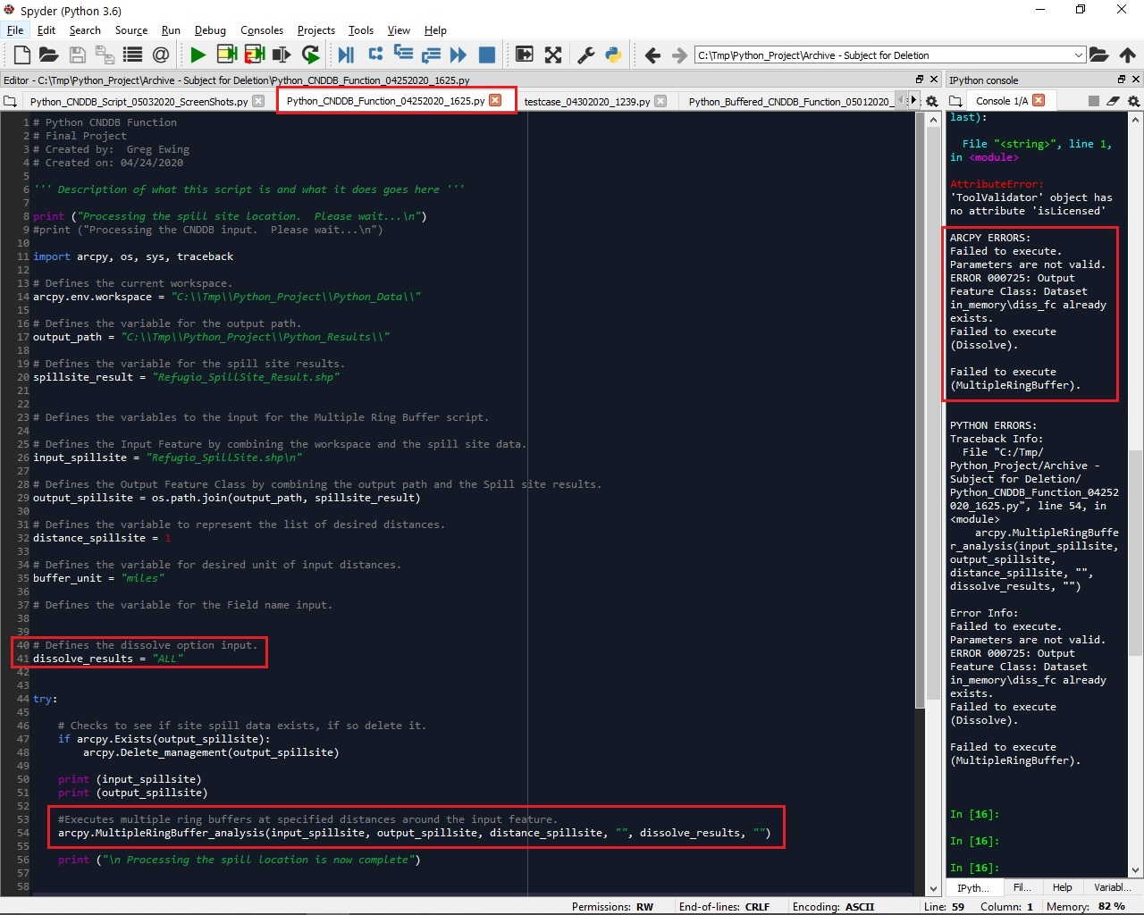
Multiple Ring Buffer
Initially the Multiple Ring Buffer tool was being used in place of the Buffer Tool.
Could not get it to execute successfully even after reading documentation and troubleshooting by making changes to parameters – Sample Error shown.
Realized that even if tool did work the output would complicate what was trying to be achieved.
Because of the error and seeing the difficulty it would create if it did execute properly, this tool was replaced with the Buffer tool.

Slide 20
Renaming A Shapefile File Name Programmatically
It became apparent very quickly that trying to rename a shapefile input is not a straightforward task. Can this be accomplished? Most likely, but after struggling with this “minor detail” for hours, it was realized that something that seems simple enough using an input on a tool interface may not be programmatically. Clearly there is much more to learn.

Slide 21
Lessons Learned

Slide 22
First and foremost programming in Python can be rewarding and fun!!
Programming can help teach one to approach a problem very differently – Break it down to bite-sized manageable pieces and work through it piecemeal.
Being detailed-oriented and consistent when programming can help find or even minimize the number of errors created.
When trying to dive into something new, reading documentation, watching YouTube videos, and looking through other resource can teach a programmer a lot.
There is always more to learn!!!

Slide 23
Data Resources and Documentation References:
Multiple Ring Buffer Tool:
  https://pro.arcgis.com/en/pro-app/tool-reference/analysis/multiple-ring-buffer.htm
Buffer Tool:
  https://pro.arcgis.com/en/pro-app/tool-reference/analysis/buffer.htm
Clip Tool:
  https://pro.arcgis.com/en/pro-app/help/editing/clip-features-using-another-feature.htm
Creating Custom Toolboxes:
  https://pro.arcgis.com/en/pro-app/arcpy/geoprocessing_and_python/comparing-custom-and-python-toolboxes.htm
  https://community.esri.com/blogs/dan_patterson/2016/05/19/toolbox-creation-in-arcgis-pro
  https://pro.arcgis.com/en/pro-app/arcpy/geoprocessing_and_python/adding-a-script-tool.htm
  https://pro.arcgis.com/en/pro-app/arcpy/geoprocessing_and_python/setting-script-tool-parameters.htm
  https://pro.arcgis.com/en/pro-app/arcpy/geoprocessing_and_python/understanding-script-tool-parameters.htm
  https://www.youtube.com/watch?v=Q5ZDwksdLHM

Slide 24
Data Resources and Documentation References:
“GetParameterAsText” function:
  https://pro.arcgis.com/en/pro-app/arcpy/functions/getparameterastext.htm
Influential to the Buffer/Clip portion of the code:
  Jennings, Nathan (2011). Chapter 10 Demo – Clip and Buffer Python Script, Geography 375, Spring 2020. American River College, Sacramento, California.
                Page 2

