Slide 1
Automation of Bullseye Maps
Amber Durant
5/16/2019
MapInfo to ArcMap Migration at CA Department of Food & Agriculture (CDFA)

Slide 2
Background
Data is entered into the Pest Damage Records (PDR) database
Actionable pests require an initial bullseye map to determine what (if any) action is needed as a result of the find
The mapper exports Excel files of the find as well as previous finds and finds within one lifecycle (depending on the pest) from Access with data on the pest and location
The mapper then QCs the find, creates the map, and sends it out along with a copy of the PDR
This process is currently still performed using MapInfo software
To verify functionality, a specific pest was used to set up and run a script that produces a bullseye map from start to finish – this will be used as a template for automating bullseye maps for all pests

Slide 3
Steps
Create .shp files from .xlsx files
Create 1.5 mile buffers around today’s finds and one lifecycle finds as two separate files
Create layers for all finds and buffers and add them to the .mxd
Label & symbolize today’s finds and one lifecycle finds
Zoom to today’s buffer area
Update title on map
Save workspace and export map as .pdf
Print out useful information for mapper

Slide 4
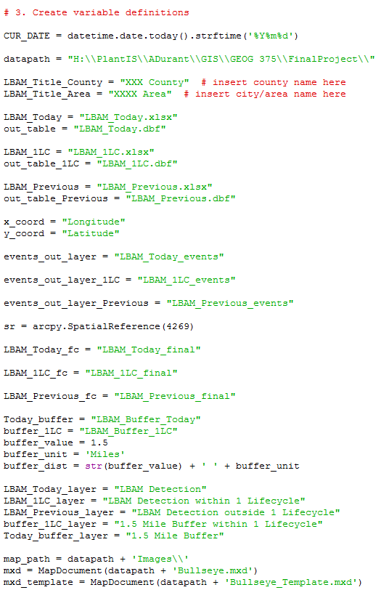
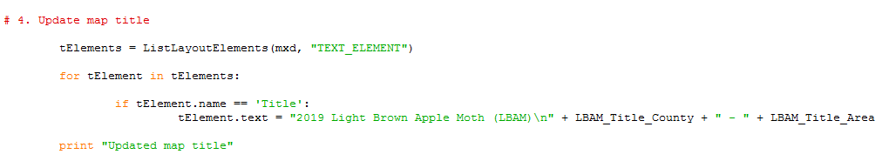
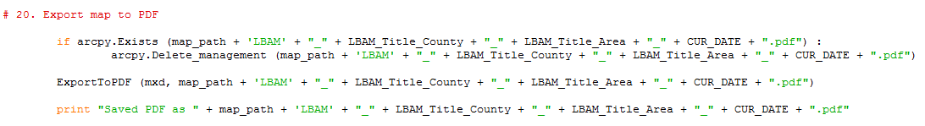
Variables
The only modification needed from the mapper is to set the current city and county. This will be used for the map title as well as the naming convention when saved.

Slide 5
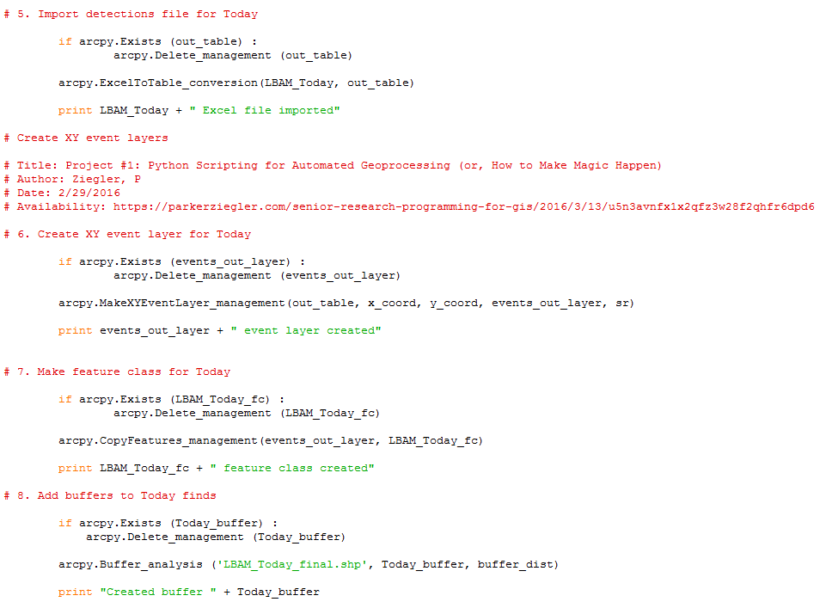
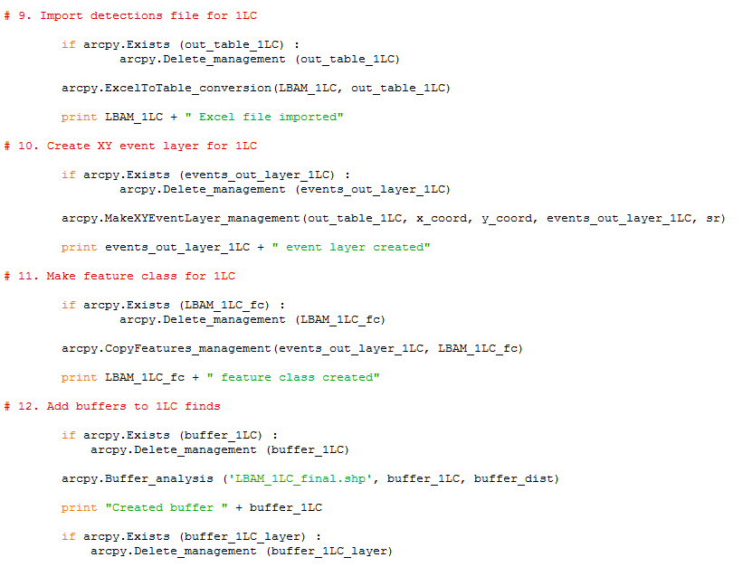
Converting from Excel file to Shapefile and Applying Buffers
Reference for code on creating XY event layers in Python

Slide 6
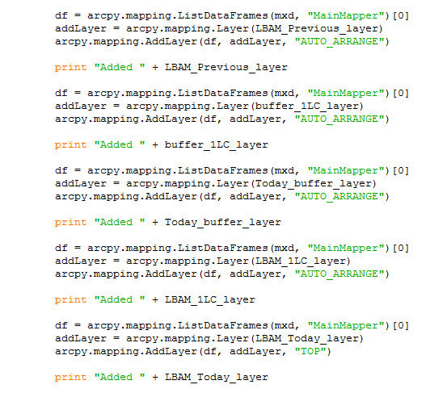
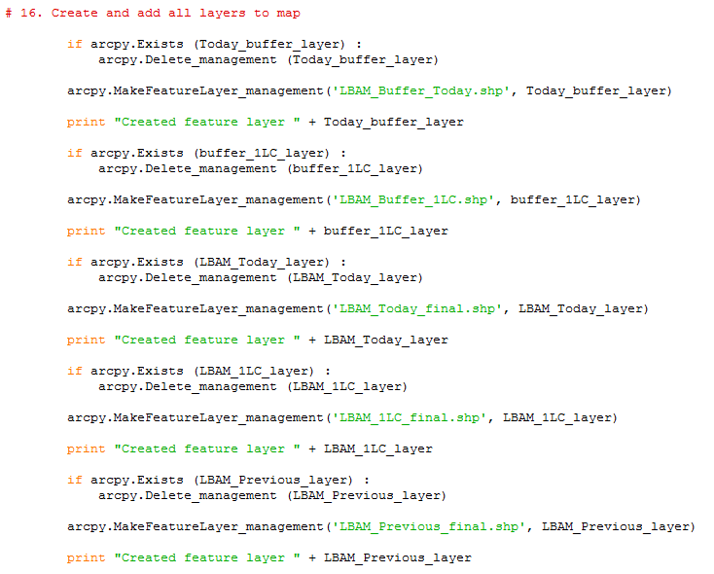
Creating and Adding Layers to Map

Slide 7
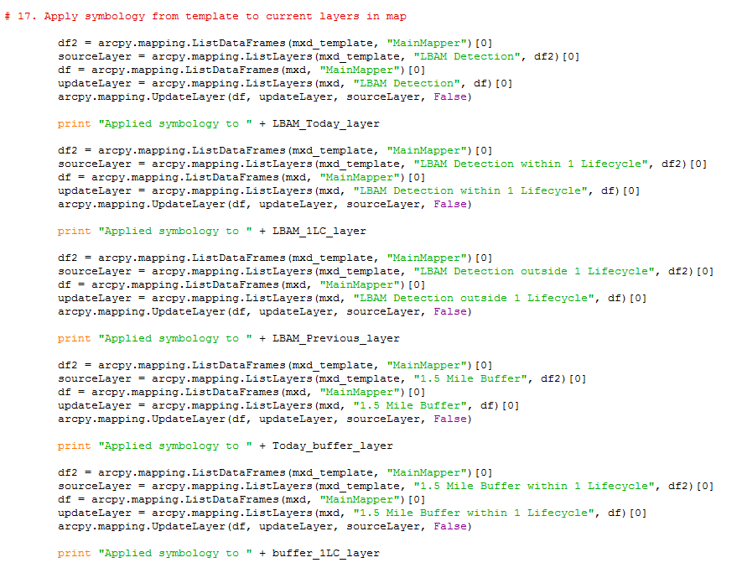
Applying Symbology to Layers
Template with stored layer symbology

Slide 8
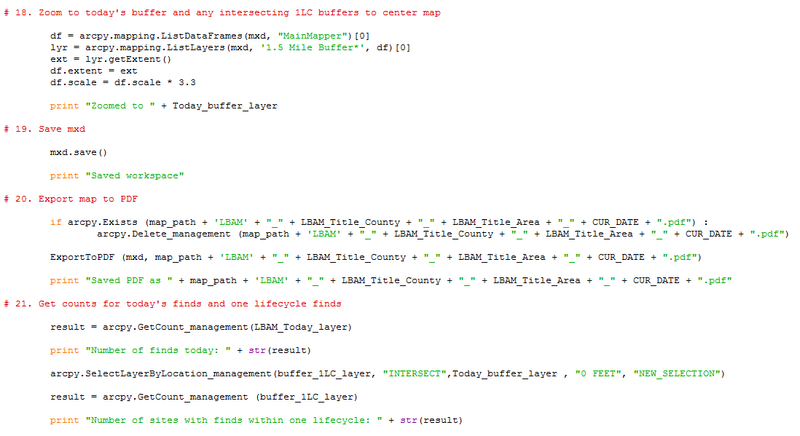
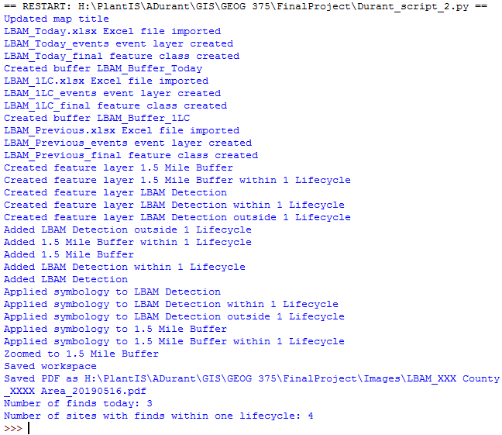
Setting the Extent and Saving/Exporting the Map

Slide 9
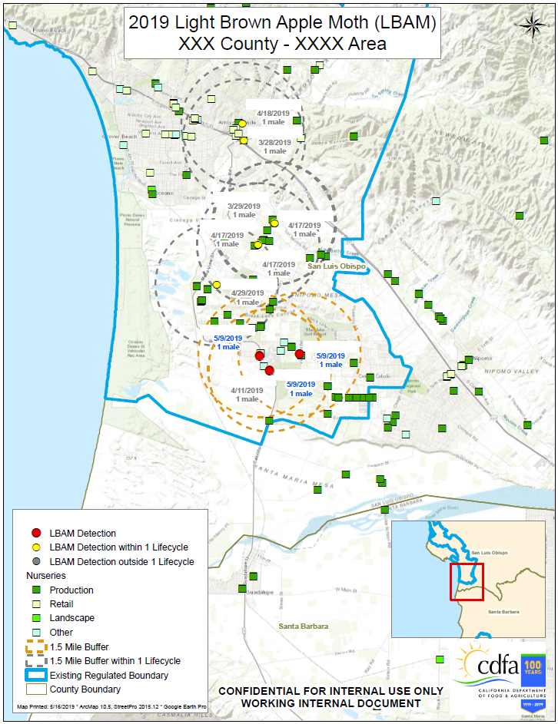
Completed Bullseye Map
Map is zoomed further out and PDR numbers are hidden for confidentiality
Nurseries, regulated boundary & county boundary already exist in workspace
Overview map extent set to extent of main mapper in workspace
Current date programmed into workspace

