Slide 1
The search for solar panels
A project in imagery classification to determine residential solar panels within a study area of Fair Oaks, California
Austin Demshar
Geog 342 - Spring 2021

Slide 2
Project Outline
The basic idea of this project was to look at a small area within Fair Oaks, California to determine which homes are currently equipped with solar panels through a process of imagery analysis.
Living in the vicinity, I noticed many houses that have solar panels. So, my assumption was that this is a good area to perform this in as I could verify not only on the ground, but through imagery as I am familiar with the area.
The easiest, and maybe the most efficient way of doing this is through ArcGIS Pro image segmentation and classification tools (through the wizard).
The rough hypothesis here was: can a user use these tools within ArcGIS Pro on some widely available imagery to properly classify and extract information about solar panel use from the study area?

Slide 3
Imagery specs
Imagery source: USDA National Agricultural Imagery Program
Imagery provider: USGS Earth Explorer (1 image downloaded)
Imagery date: June 2020
Image focus/study area: 1 square mile

Slide 4
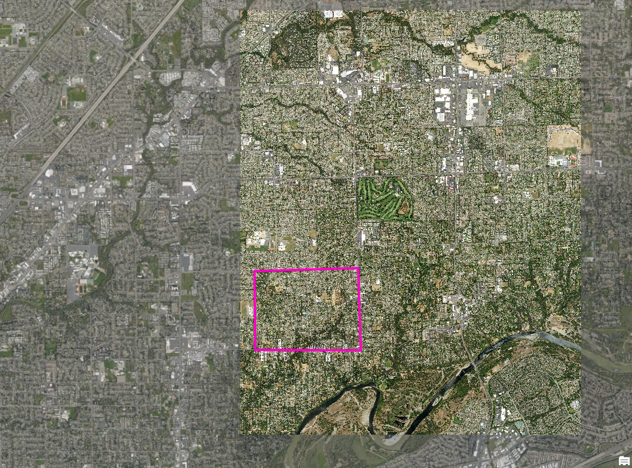
NAIP Image block with the study area defined (greater imagery area Esri basemap)

Slide 5
Image classification workflow
Setup: download NAIP imagery for area of interest, clip imagery to study area.
Step 1: create band combinations that accentuate the solar panel features in the imagery while minimizing the other features (trees, pools, rooftops) that shared similar color representations and collided with panels.
  RGB band arrangements used: 2,2,1; 2,4,3; 4,2,4
Step 2: run image segmentation tool
Step 3: run the image classification wizard > training samples based on segmentation
Step 4: repeat steps 1-3 based on different band combinations
Step 5: examine the classification outcomes across multiple attempts
Step 6: examine classifications and the best fit classification against original NAIP imagery and/or other high resolution imagery to determine accuracy of classification

Slide 6
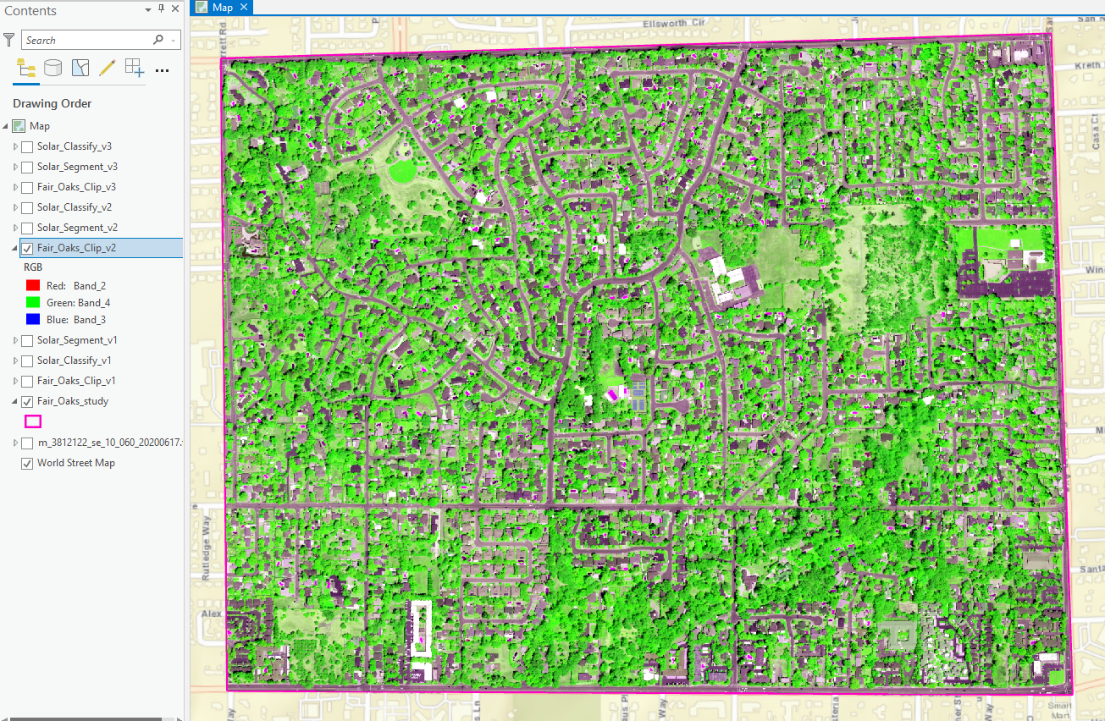
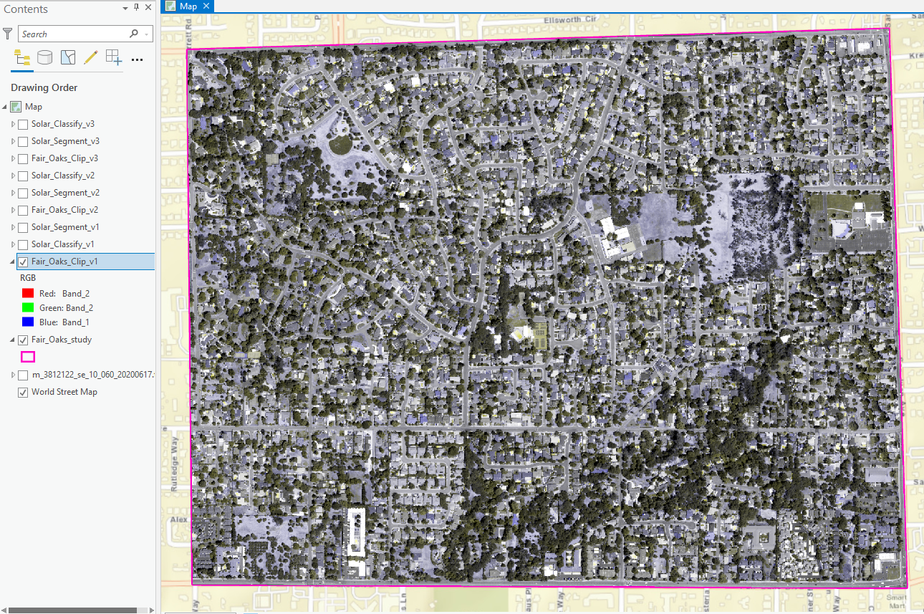
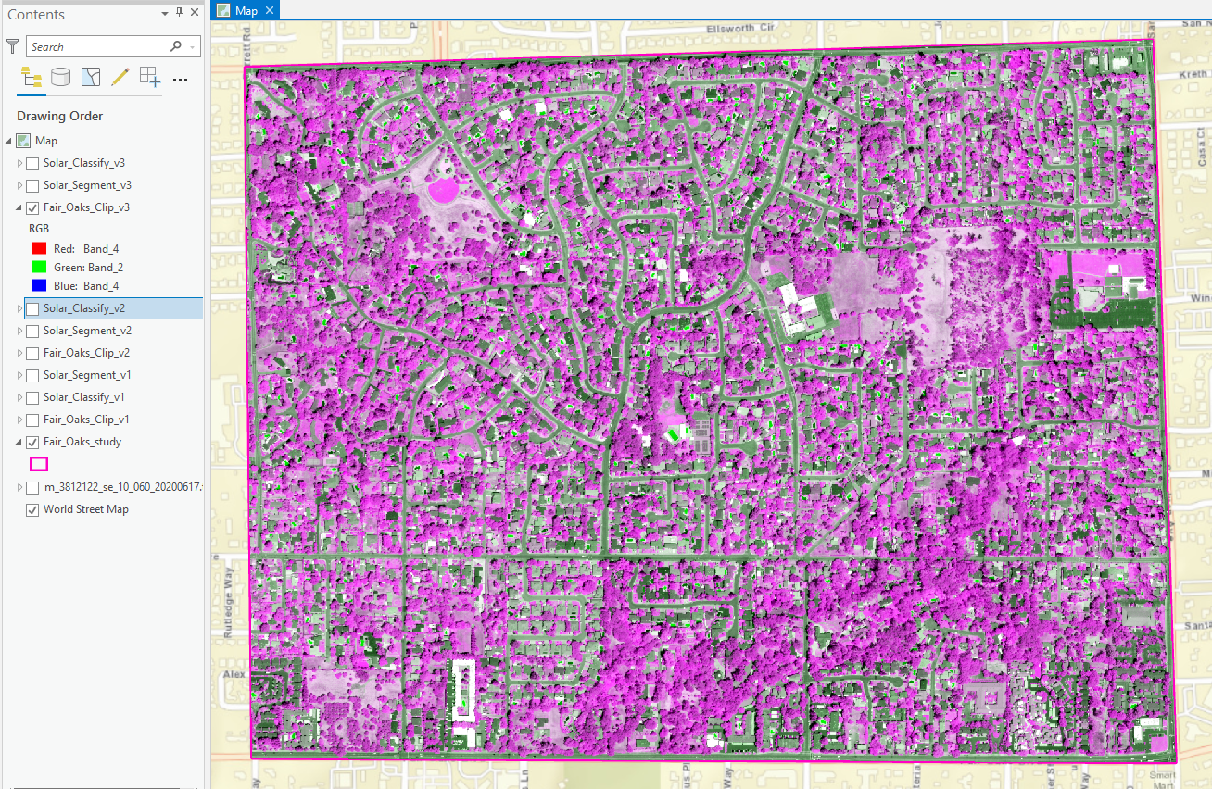
Three band combinations created on the original NAIP imagery:
2,4,3 – primarily green
2,2,1 – primarily blues
4,2,4 – primarily pink

Slide 7
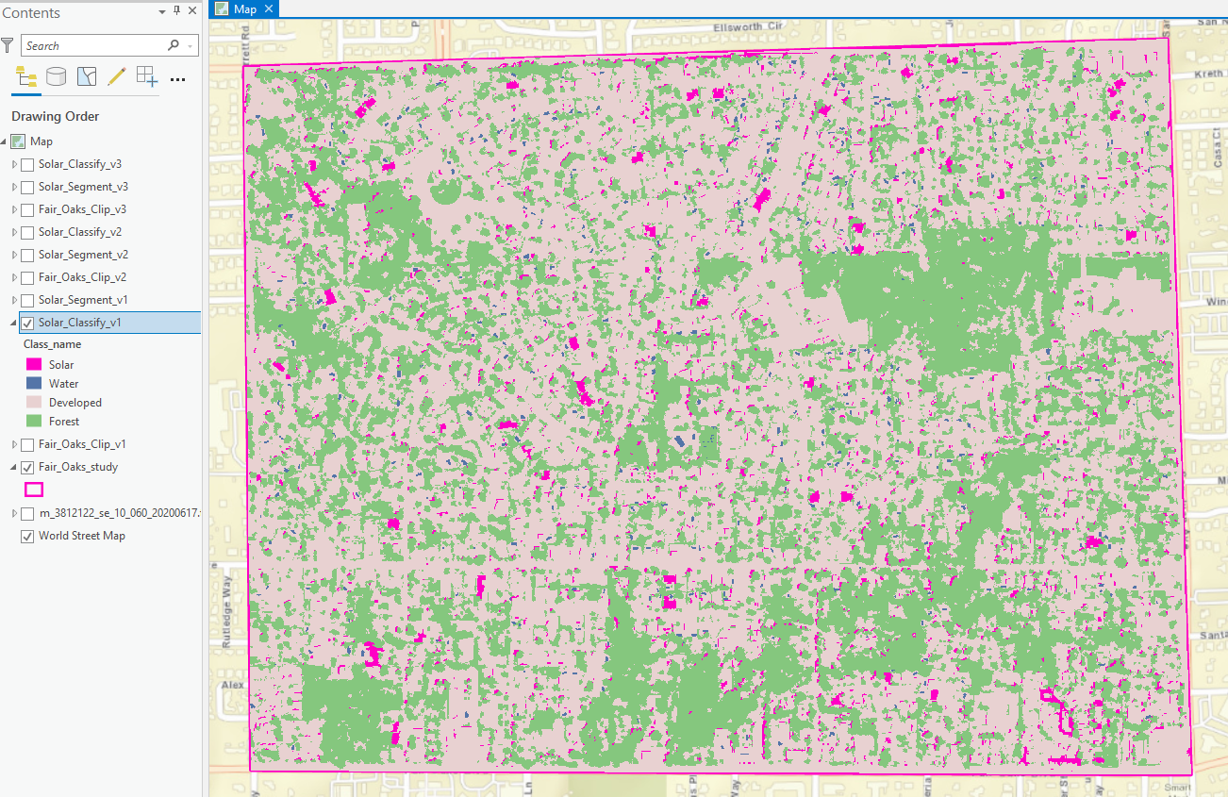
First classification – band combination 2,2,1

Slide 8
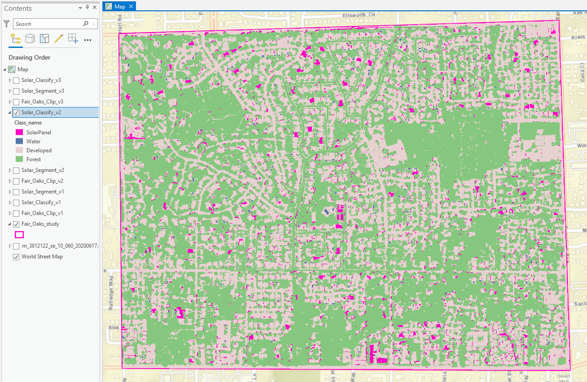
Second classification – band combination 2,4,3

Slide 9
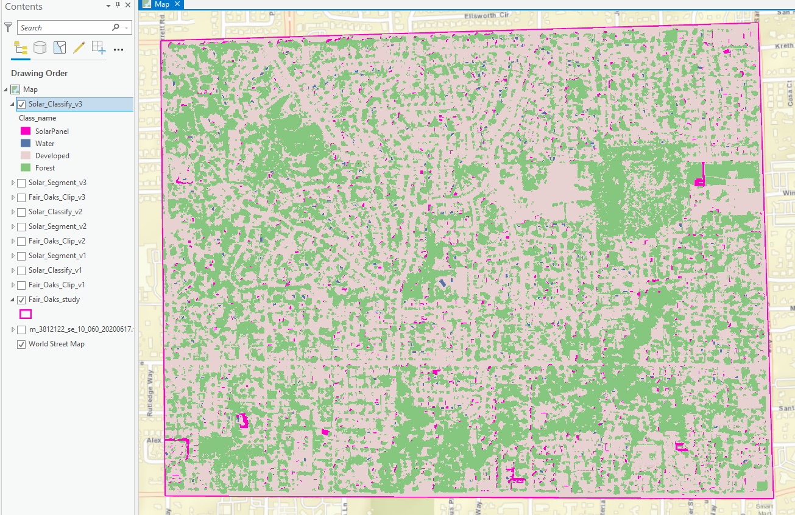
Third classification – band combination 4,2,4

Slide 10
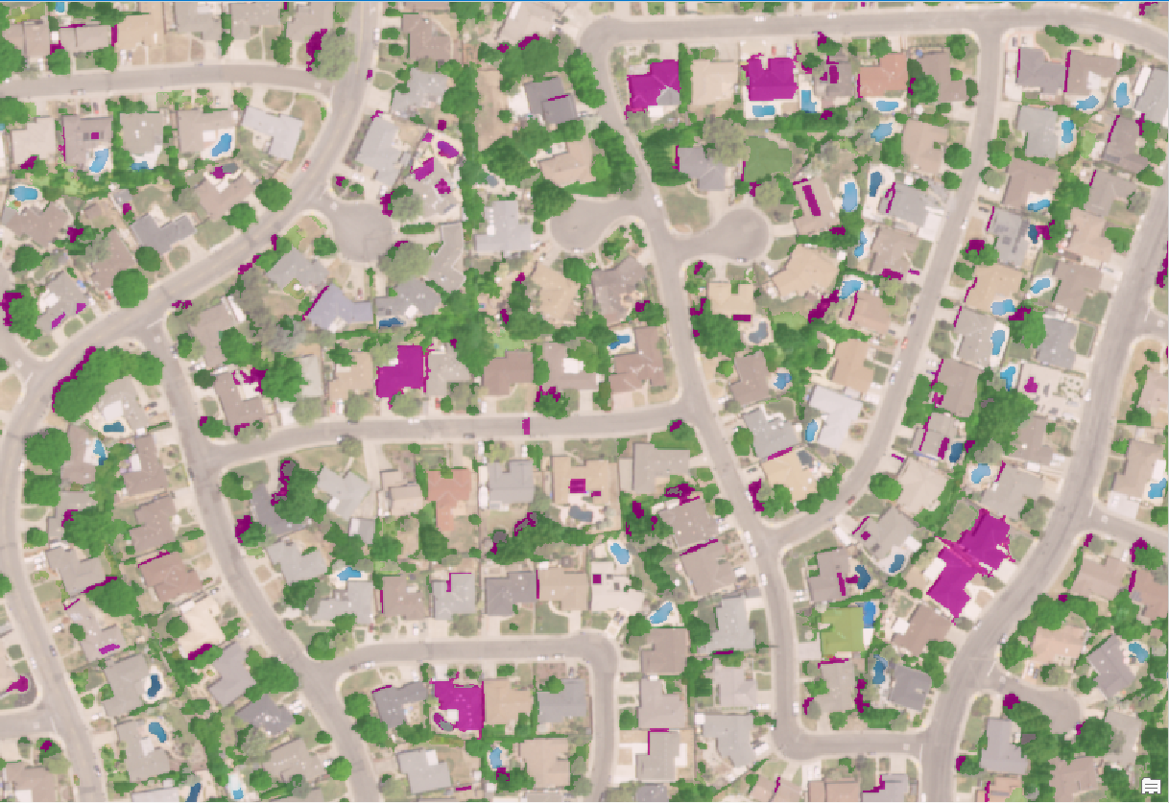
Sample from classification 1, band combination 2,2,1
It appears in this sample that many of the present solar panels were registered in the classification process.
However, many rooftops, shadowed areas, some pools and other miscellaneous areas registered as well.

Slide 11
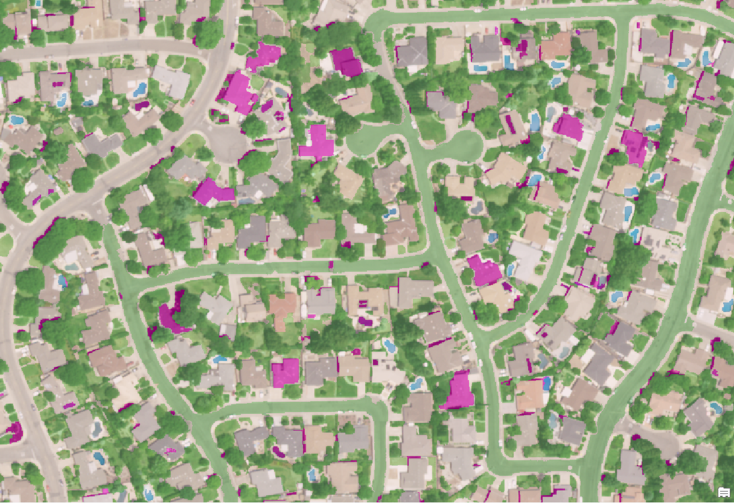
Sample from classification 2, band combination 2,4,3
It appears again in this sample that many of the present solar panels were registered in the classification process.
The highlighted panels were retained.
However, many rooftops, shadowed areas, some pools other miscellaneous areas still registered.
It almost appears that some of the rooftops were swapped for others.

Slide 12
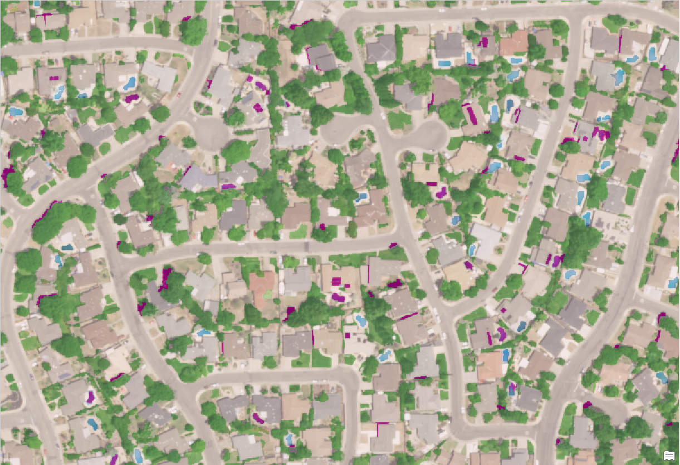
Sample from classification 3, band combination 4,2,4
The third classification attempt was much cleaner.
No roofs, less shadows
However, some pools and other minor objects were retained.
With this classification, it is much easier for a user to pick out panels.
Some panels faded out
With some cleanup reclassification, things may shape up.

Slide 13
Image classification takeaways
The classification process in Pro seems satisfactory for selecting out solar panels from imagery.
Running through multiple band combinations and subsequent segmentations and classifications can yield better results.
Segmentation based on band combination matters

Slide 14
Image classification questions
Do multiple attempts over time create a better output in the end?
  Likely, as an analyst becomes better at selecting samples from the segmented image
Or… is it that various band combinations that accentuate the target features on the landscape help to produce better segmented images for classification?
  Yes, the third iteration of my clipped image was based on a band combination that optimized the segmentation tool for my purpose

Slide 15
Image classification concerns
Is bias introduced when working with the same study area’s image across multiple classification runs?
  I think so, unfortunately. I started to see a lot of the same solar panels so I did select many of those as samples through each run as some were “prime” examples of the class.
  Though, if trying to determine solar panels for training, maybe this isn’t a bad thing.
  Depends on size of area and how the training samples are extrapolated to the entire image.
What about similar rooftop or yard objects?
  As I looked a bit closer at the Esri basemap imagery, which was higher resolution than NAIP, I noticed some solar panels may not have been panels, rather rooftop water heating flats or small areas of a roof that were too similar to panels.

Slide 16
Conclusion
There may be better ways to approach a project like this with other GIS tools from the deep learning suite, or script something out, or work in some other software that can work with objects once learning data is provided.
  How much time do you have, and how important is the project?
  Lots of combinations and analysis
All in all, the Pro Image Classification Wizard workflow seems to work pretty well for something like this project because it is very intuitive and doesn’t take a whole lot of user experience to run.

Slide 17
Future ideas
Search for data with more bands available (there may be a better way to look specifically at solar panels built with special materials not found elsewhere from an aerial aspect.) Time started mounting for acquiring data…
Search for higher resolution imagery
Spend more time with training samples so there is much more data the system has to work with.

