Slide 1
Folsom and Auburn State Recreation Area Trails Query
Final Project, Geography 375, Spring 2020
Creator: Austin Demshar

Slide 2
General concept and purpose of script
Our family (with 10 month old Murphy), like going on hikes and visiting recreational areas within the region.
There are many parks and trails in the area, it is hard to know all of what is out there. I thought, “GIS might be good for tracking (or at least visualizing) this”, and hence the script idea.
The idea morphed into something different than the original idea for parks and local American River Trail pathways. We’ve enjoyed hiking around the Folsom and Auburn areas, so I narrowed the script focus to these areas. There are quite a few trails within these SRAs.
The output from this script may not be as functional as I’d liked, but a fully operational system would take significantly more programing and resources (including network analysis for getting to the areas, more detailed trail information, more complete datasets, possibly a Web application, etc.) And, ultimately, GIS may not be the best method for this type of program, as there are other applications out there (think All Trails, Google maps, etc.)

Slide 3
Overview of workflow
Import appropriate modules
Setup folder and geodatabase workspaces
Define primary variables to be used within the script
Project all datasets to the same projected coordinate system (transform datum if needed)
Query trails by attributes to narrow selection to the Folsom/Auburn units
Query trails by location from the point of origination (address)
Dissolve trails to consolidate records in the parks data
Spatial join both river and water body information to the trails data
Run near tool to determine distance from point of origination to “start” of dissolved trails
Create a table with only the most appropriate fields for the purpose defined above
Create search and insert cursors to populate this table from the geoprocessed layers
Create a new geodatabase feature class that will reflect the same information as the table
Create an excel file that will also reflect the information above (for ease of access)

Slide 4
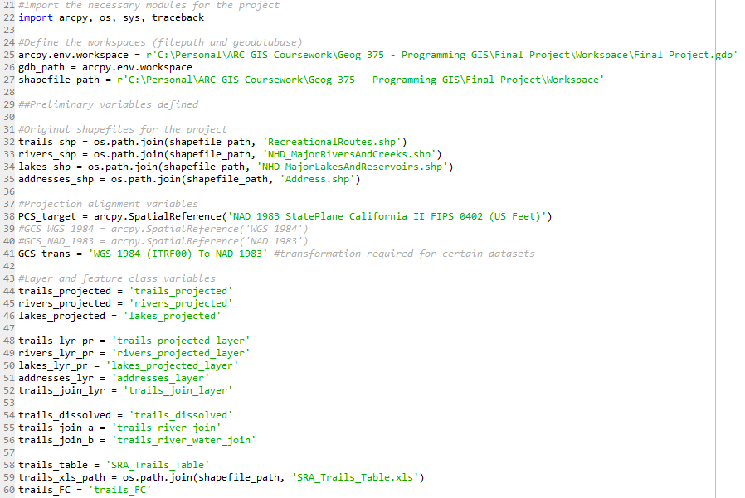
Import modules, create workspaces and primary variables

Slide 5
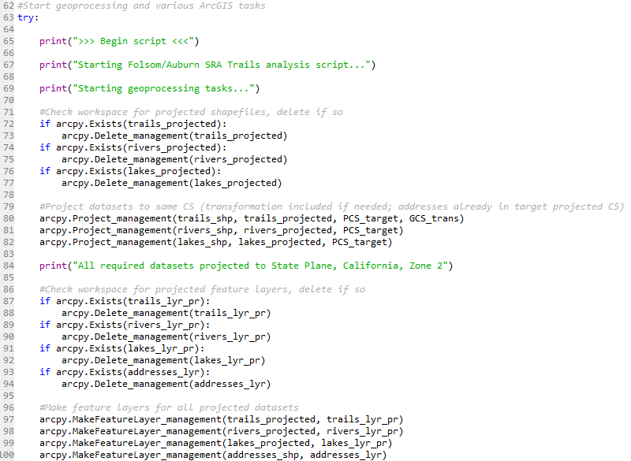
Begin try block, project datasets
This part of the script first checks for existing projected data, projects the original datasets to the State Plane California Zone 2 projection, as well as checks for and makes layers for projected data.
This was an original sticking point when doing some work in Pro, as I couldn’t get the measurements (using measure tool) to align with what I seeing in the data as distance to trails, rivers, lakes, etc. I realized most the data were in different projected coordinate systems, with only one needing a datum transformation.

Slide 6
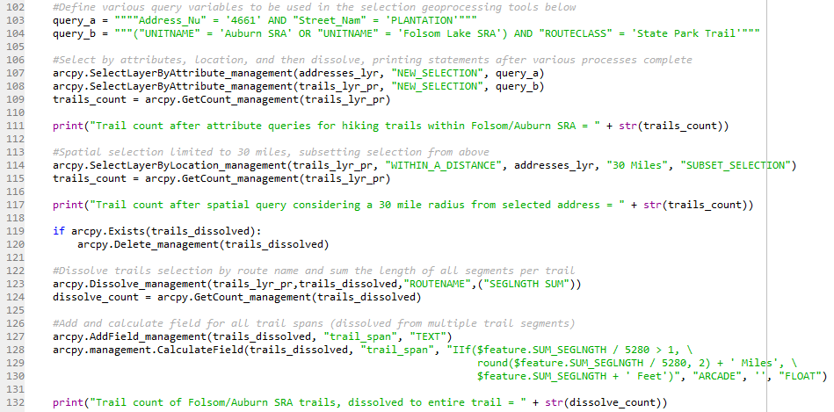
Attribute/spatial queries, and dissolve
This block of script starts the queries to narrow down trails within the SRAs (query b) and the point of origin (query a). Then it spatially selects those trails, within 30 miles of the origin.
Since, the original trails/recreation data was partitioned into multiple segments per route, creating unnecessary polylines for this purpose, a dissolve is performed on the trails data into entire routes. A field is added and calculated to reflect the trail length, in feet or miles (conditional statement).
Throughout this block, print statements are created to reflect query/dissolve trail counts after various processing is performed.

Slide 7
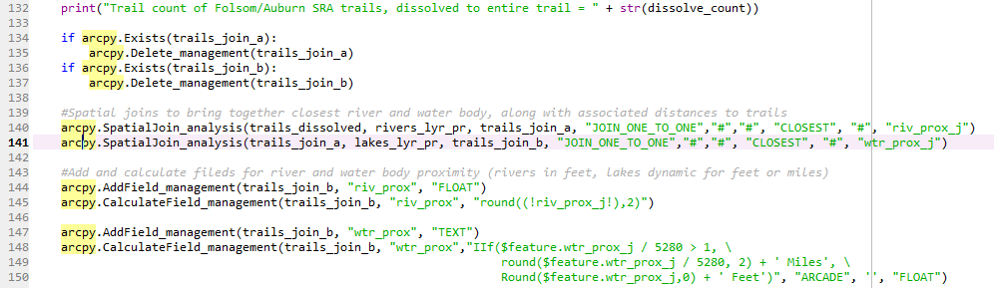
Spatial joins of major rivers and lakes
This block of code checks for existing feature classes for the spatial joins, performs the joins and adds fields for the hydrographic information. The joins use a ‘closest’ 1-1 join that shows each dissolved trail route’s closest major river and closet major water body.
Fields are added and calculated to reflect the distance to the river and lake in alternative units. The ‘wtr_prox’ field, for proximity to closest lake, is written to show miles or feet, depending on the distance (as a text field, using Arcade). As with the dissolve method above, calculating the field to either miles or feet exclusively created too broad a range of values either way, so I used something a little more intuitive (I think).

Slide 8
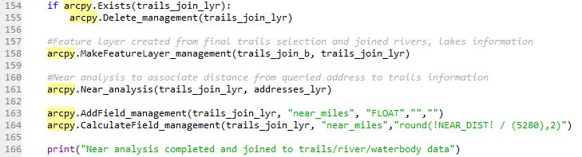
Near analysis: distance of trails to queried point of origin (address)
This block checks for an existing trails layer that is created for a near analysis, then adds and calculates a field that shows the distance of each trail’s “starting point”, the polyline’s closest point to the address, in miles. The variable ‘query_a’ is defined above in the script (see slide 5), for consistency with the select by attribute/location block.

Slide 9
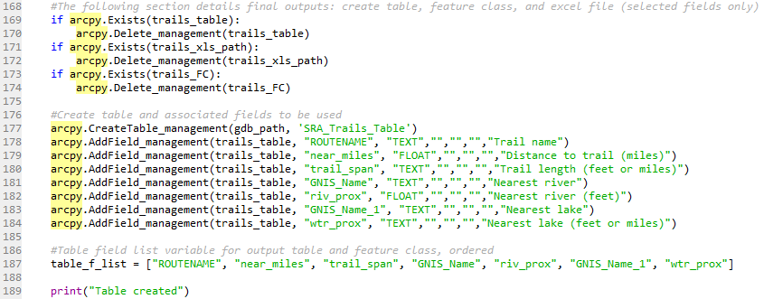
Creation of geodatabase table
This block checks for an existing final trails table, creates the table, defines fields to be used and then creates an ordered list of those fields (for the next code block).
Since the output is setup to be created within a geodatabase, field aliases were used. These aliases are intended to make it more user friendly (the 10 character limit of shapefiles wasn’t feasible here). Originally, I had all the information output as shapefiles and tables (.dbf) outside of a geodatabase, but I wanted to use aliases so I transitioned all output to the .gdb. Basically all that required changing was my primary workspace to the .gdb and removing the .shp extension from output variables.

Slide 10
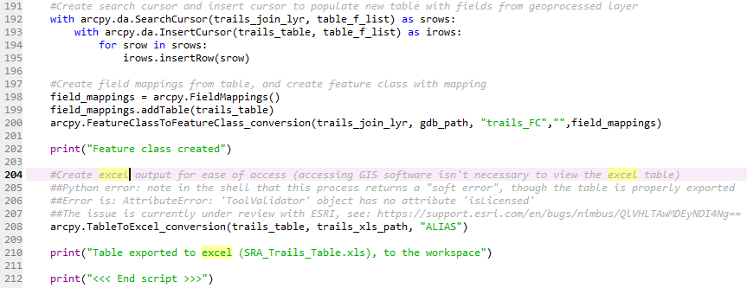
Search cursor/insert cursor; Create feature class and export to excel
This final block of code creates a search cursor to look for the fields within the geoprocessed layer, confined to the the above defined ‘table_f_list’, and insert them into the new table and the new feature class. Then, a table to excel conversion is performed. This excel file makes it so the user doesn’t necessarily need to enter ArcGIS Pro to obtain results.
Note the double ‘##’ notation was added for an error that was continually present until 5/13/20. However, I’ve chosen to keep it in case this represents itself again somewhere, for the time being.
This is the end of the script, with the exception that the ‘except block’ follows on line 214.

Slide 11
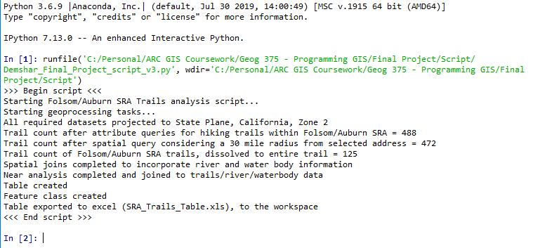
Python console output (using Spyder 3)

Slide 12
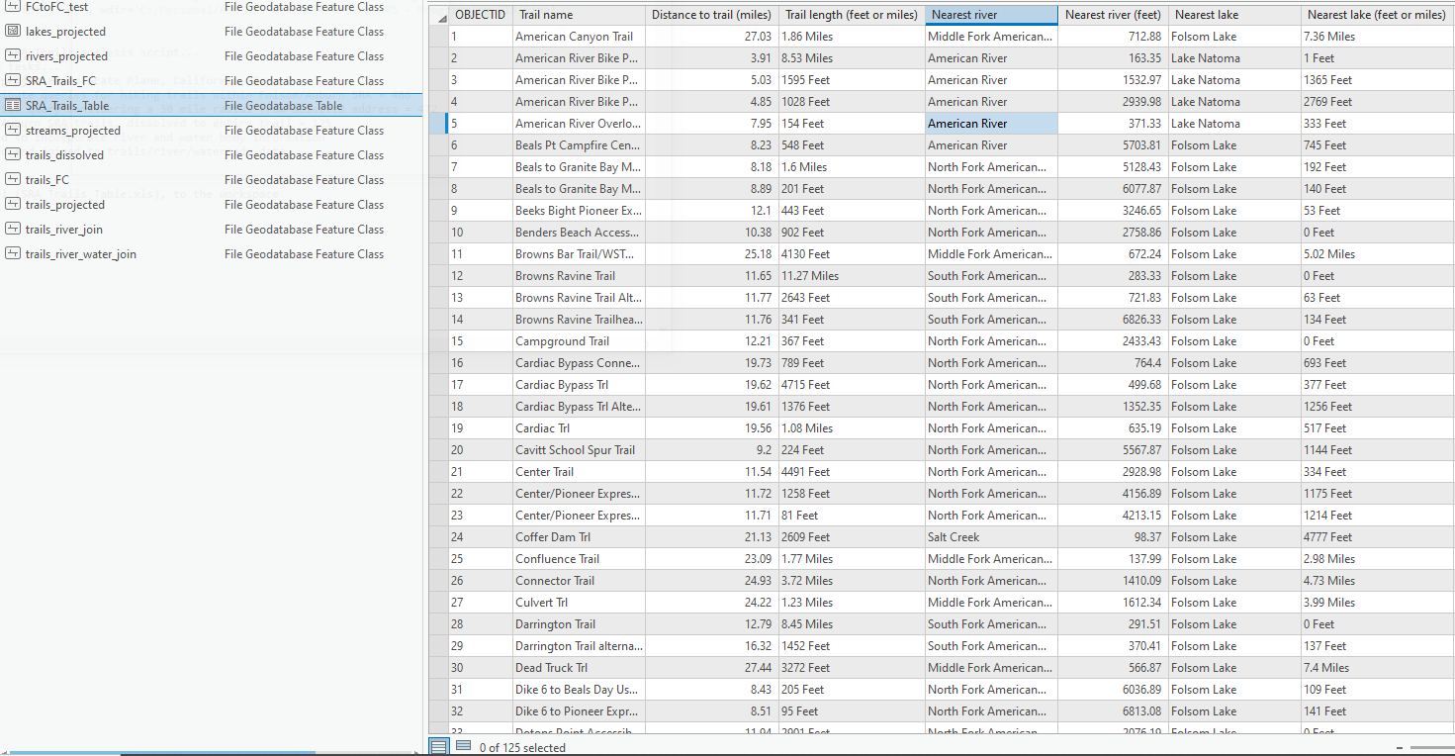
Trails table in Pro (standalone)

Slide 13
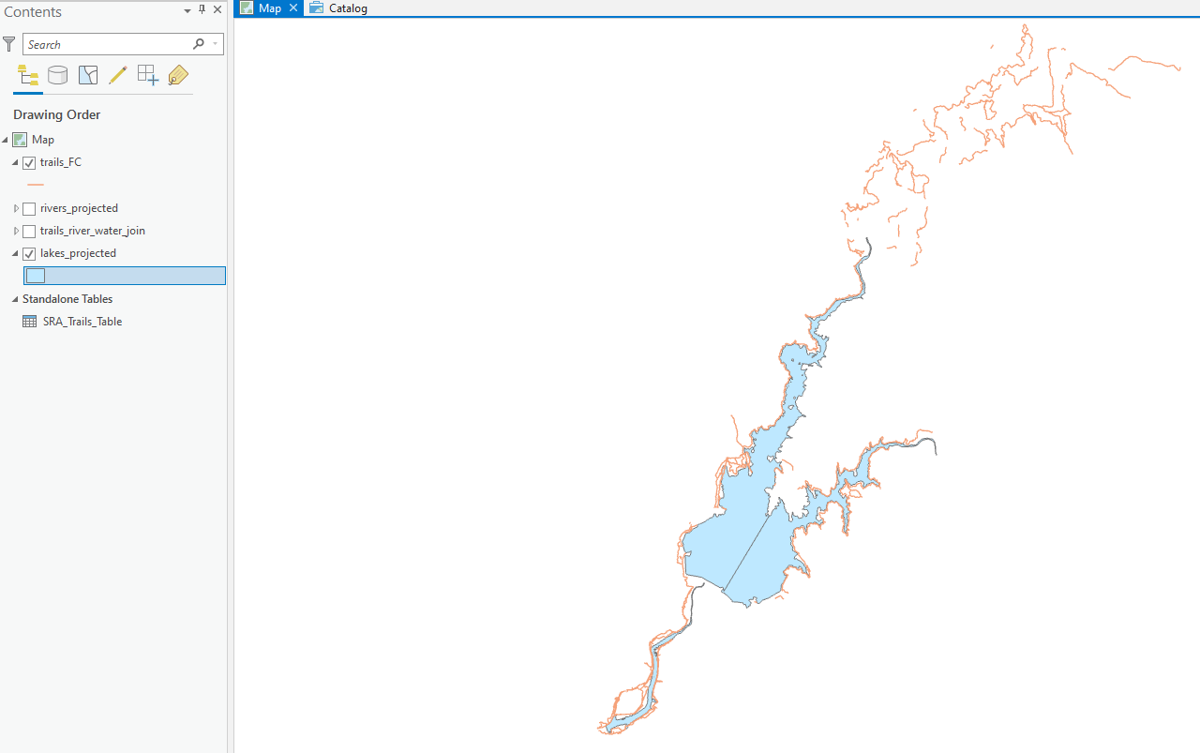
Trails feature class in Pro (as map)

Slide 14
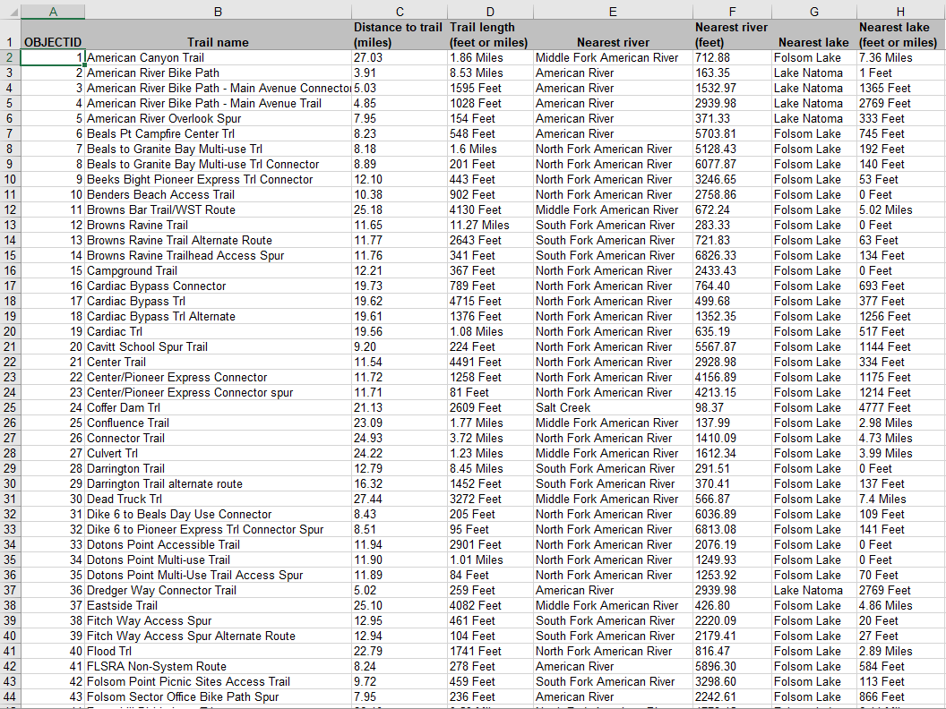
Trails table converted to Excel

Slide 15
The end
Thank you!
Contact: abdemshar@gmail.com

