Slide 1

Spencer Day
Network Analysis Python (Service Area and Closest Facility)

Slide 2
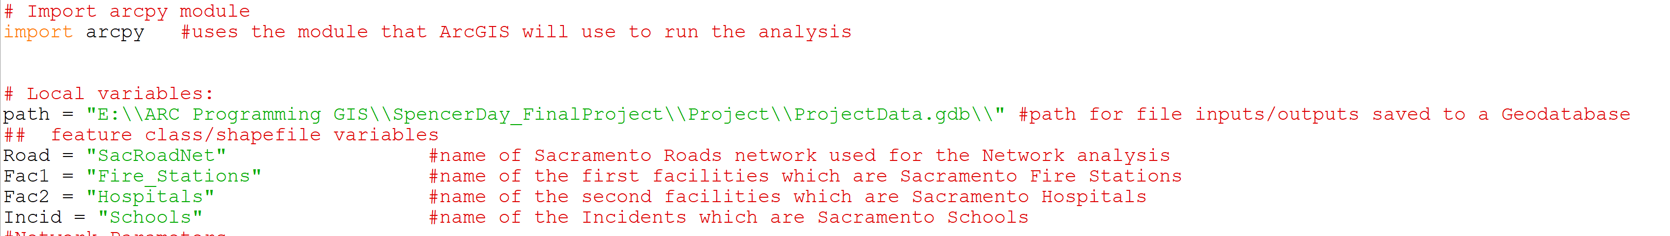
The Script:
(Local Variables)
Defines the path for the inputted data and where the analysis will export the derived output.
Simplifies the code by assigning local variables for each inputted feature class/shapefile.
Road network, two facilities, and one incident file.

Slide 3
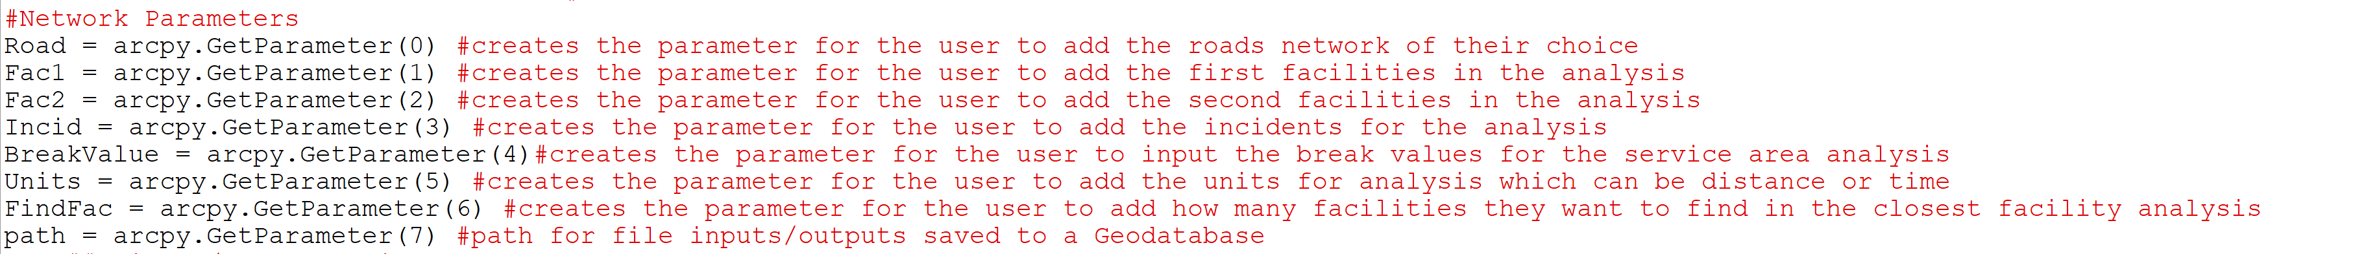
The Script: (Network Parameters)
This script allows the user to add their road network, facilities, and incidents for the analysis.
Users can set the break values for the service area analysis and define the units of measurement.
Allows the user to set how many facilities they want the closest facility analysis to find.
Retrieves a user defined path for the inputs and outputs.

Slide 4
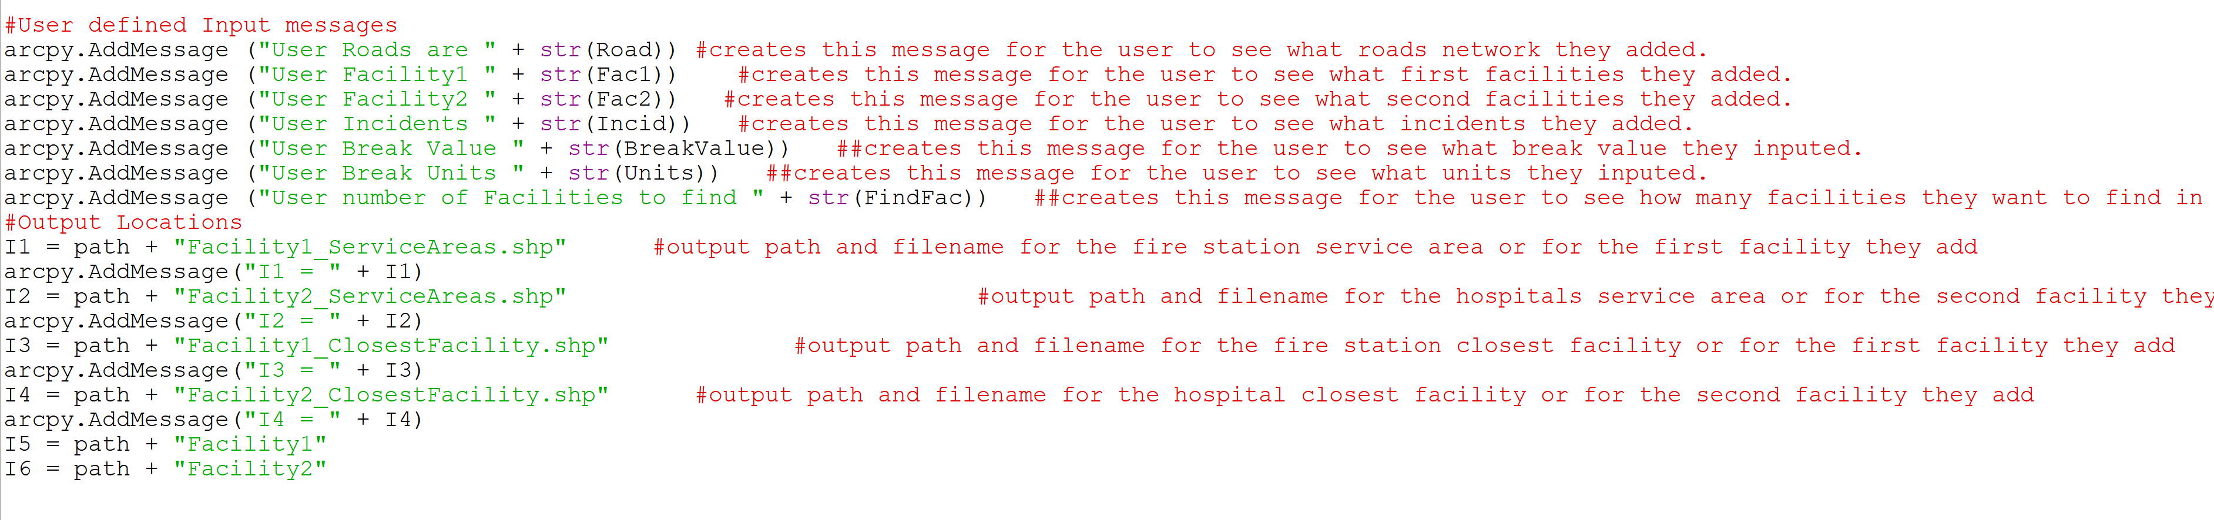
The Script: (Code Feedback)
A set of messages that will show the user what imputes are assigned to each variable in the analysis.
Sets the output locations for each shapefile and lets the user know the path for each output.

Slide 5
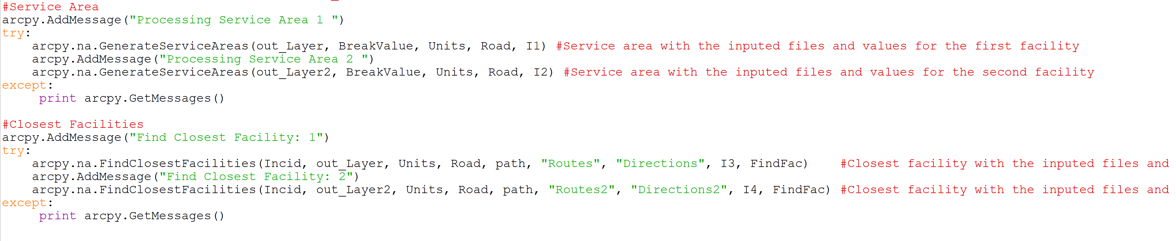
The Script: (Network Analysis)
Runs the service area analysis tool with the user defined imputes and outputs.
Runs the closest facility analysis tool with the user defined imputes and outputs.
Each analysis uses the try and except method for error handling.
If an error occurs the script will print it for the user to see what problem may have occurred.

Slide 6
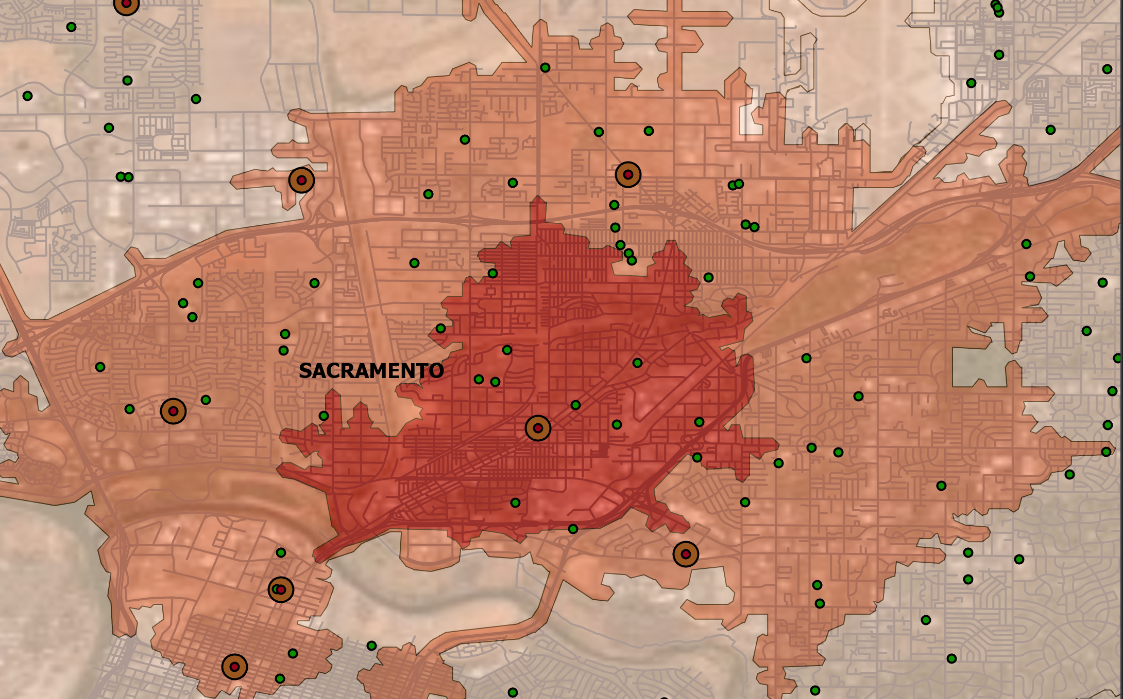
Derived Outputs Service Area: (Fire Stations)
Maps the fire stations in red with 5, 10, 15-minute service areas.
The schools are shown in green which represent the incidents in the analysis.
The fire stations represent the first imputed facility.

Slide 7
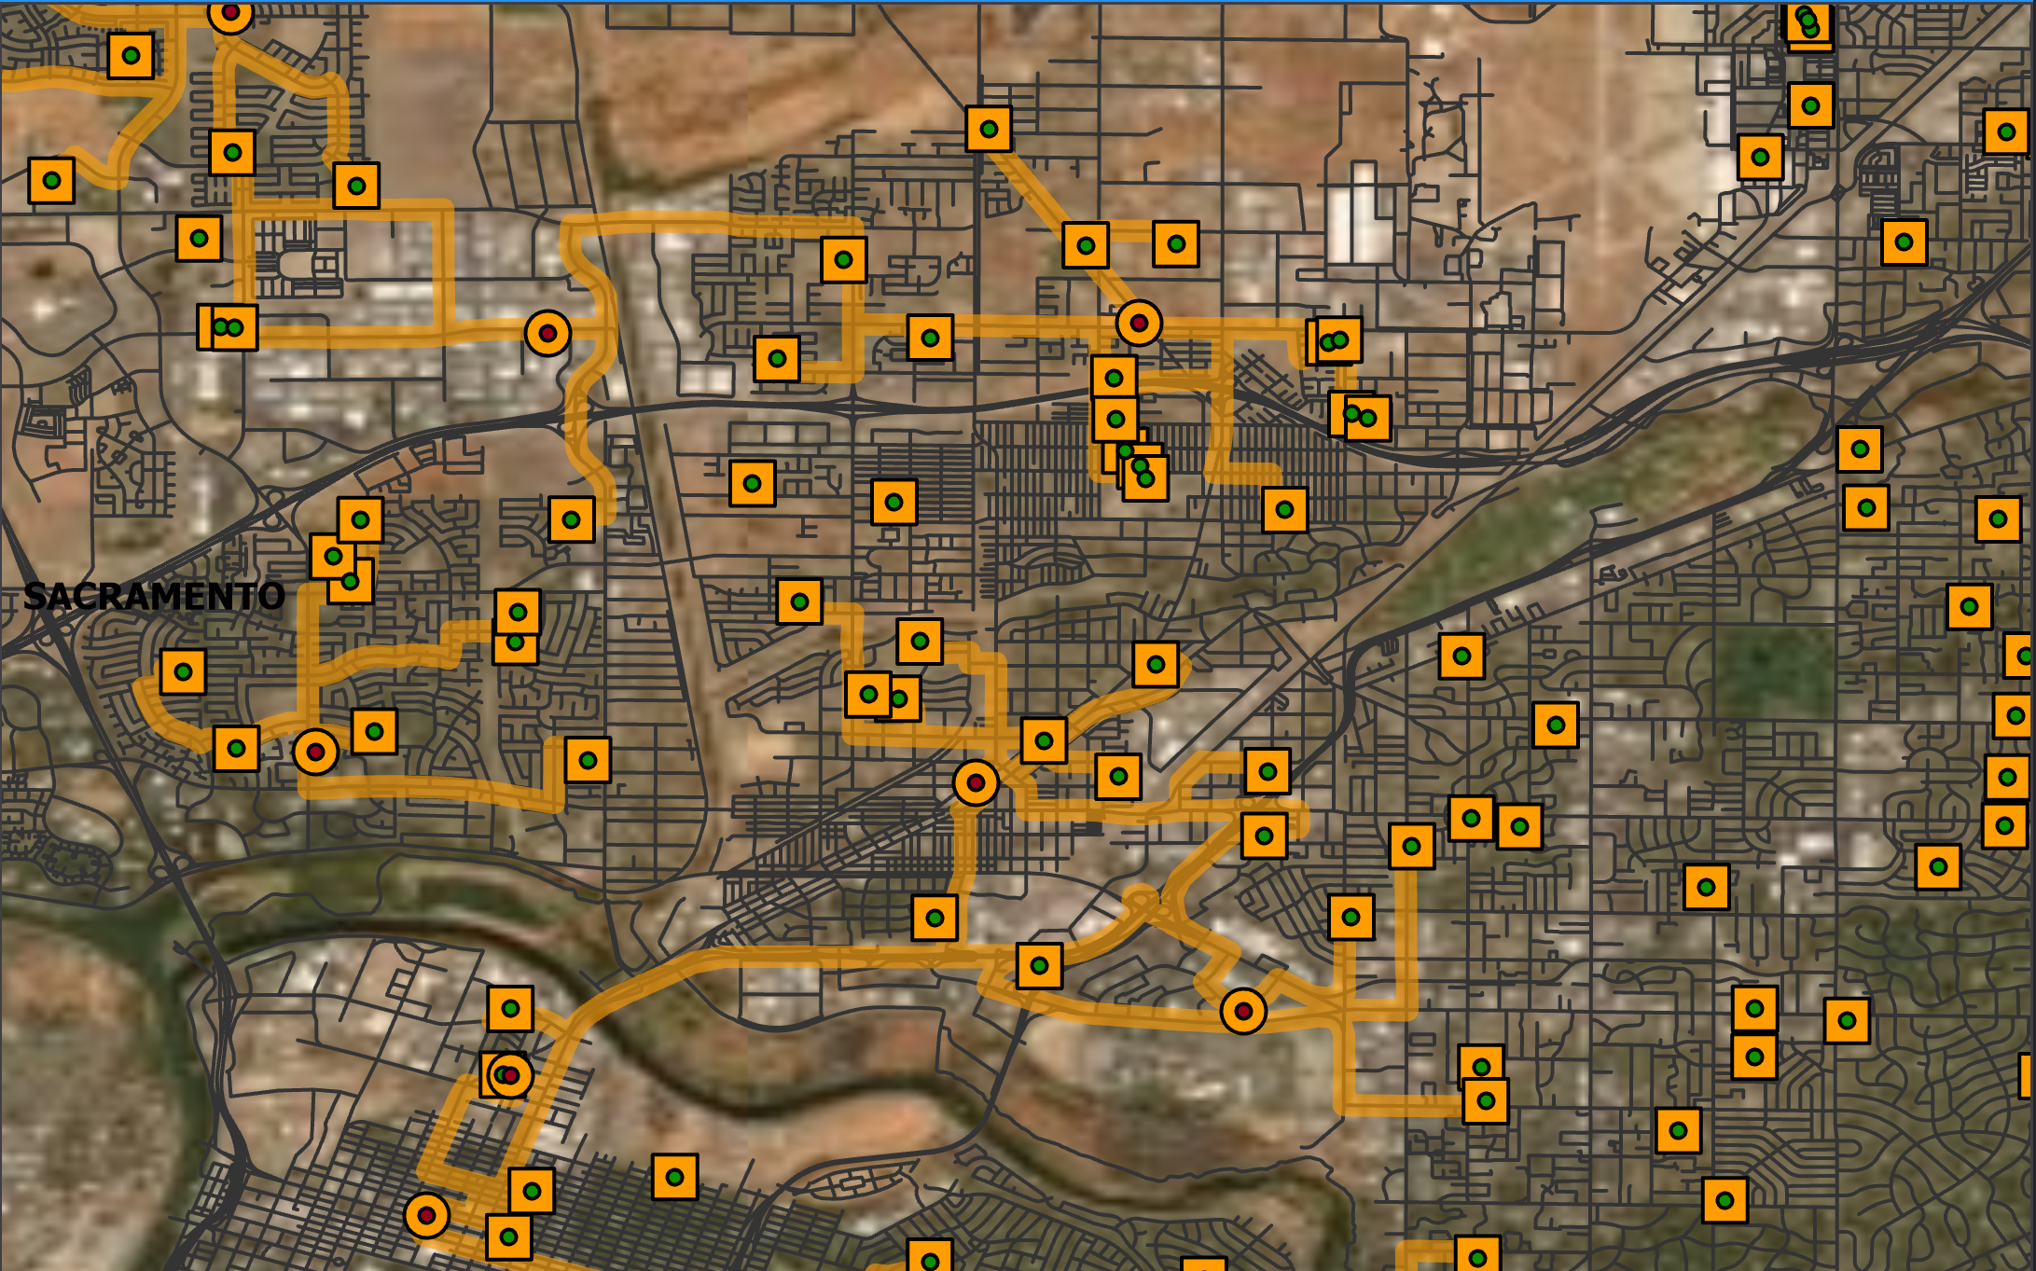
Derived Outputs Closest Facility: (Fire Stations)
Maps the closest fire station to each school.
Connects the closest fire station to each school following the road network.

Slide 8
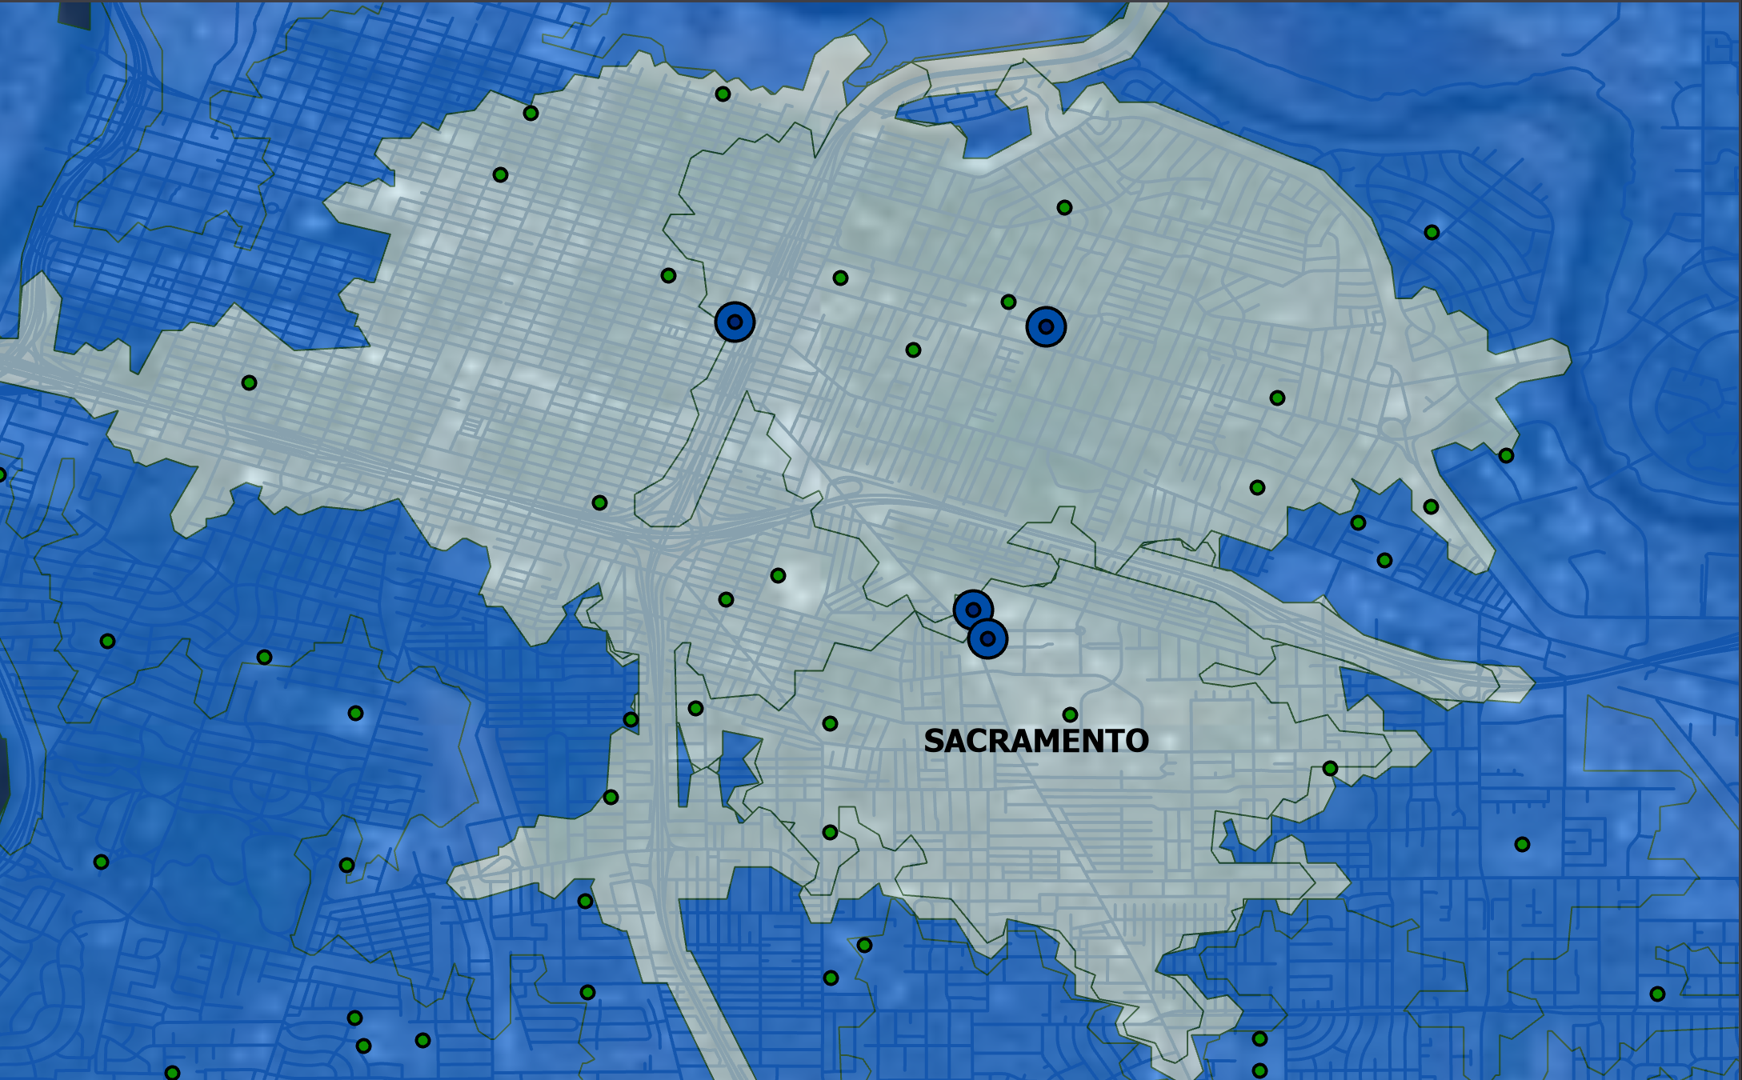
Derived Outputs Service Area: (Hospitals)
Maps the hospitals in blue with 5, 10, 15-minute service areas.
The schools are shown in green which represent the incidents in the analysis.
The hospitals represent the second imputed facility.

Slide 9
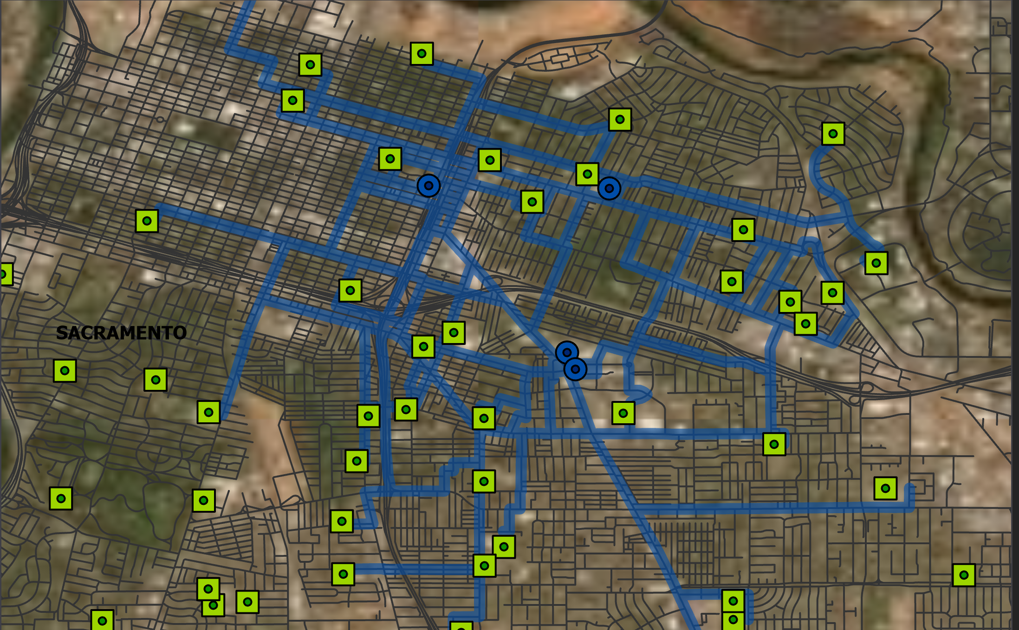
Derived Outputs Closest Facility: (Hospitals)
Maps the closest hospital to each school.
Connects the closest hospital to each school following the road network.

Slide 10
Challenges
Finding data for the schools, hospitals, fire stations, and roads.
Creating a road network from road data.

Slide 11
My Learning Outcome
Network analysis requires many imputes to function.
Creating a road network is not simple.
I am now able to understand how to create python scripts for basic network analysis.

Slide 12
Data Sources
http://data.cityofsacramento.org/datasets/fd3677bd8ff44a2cbe6b8cc67a3d2c1c_0/data?orderBy=STATUS&where=CITY%20%3D%20%27Sacramento%27%20AND%20SCHOOL_TYPE%20%3D%20%27Public%27
http://data.cityofsacramento.org/datasets/614bdde2a4714b2098d4c2532fd2c6e7_0
http://data.cityofsacramento.org/datasets/0363364d7ddb4ff4aadd7057187a7a05_0
https://www.census.gov/cgi-bin/geo/shapefiles/index.php?year=2019&layergroup=Roads
http://desktop.arcgis.com/en/arcmap/latest/tools/network-analyst-toolbox/make-network-dataset-layer.htm
http://desktop.arcgis.com/en/arcmap/latest/tools/network-analyst-toolbox/generate-service-areas.htm
http://desktop.arcgis.com/en/arcmap/latest/tools/network-analyst-toolbox/find-closest-facilities.htm

