Slide 1
HEATING AND COOLING DEGREE DAYS
DATA PRODUCTION WITH PYTHON
BY: TED DANG
GEOG 375

Slide 2
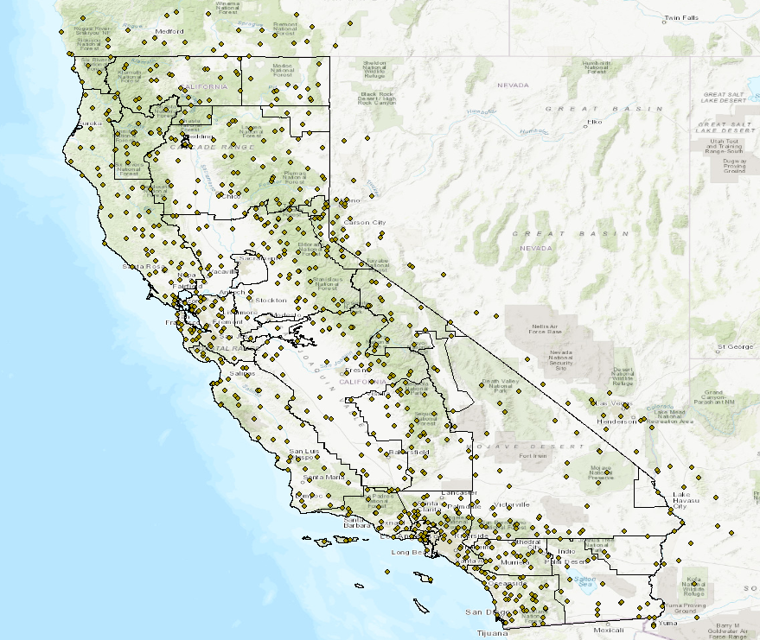
DATA COLLECTION
Data from over 500 weather stations are used
For interpolation purpose, weather stations up to 50 miles outside of California are included.
Produced thematic layer has to be larger so smaller state boundary can be clipped

Slide 3
DATA INPUT FILE
ID,date,LAT,LON,year,avg
USC00020100,1985-01-01,34.2281,-113.5778,1985,49.55
USC00020949,1985-01-01,33.9431,-114.0242,1985,47.57
USC00021050,1985-01-01,35.1411,-114.5686,1985,53.96
USC00022790,1985-01-01,33.6133,-114.4706,1985,54.95
USC00024645,1985-01-01,35.2,-114.0167,1985,41
USC00024702,1985-01-01,33.2742,-113.9653,1985,50.99
USC00024759,1985-01-01,34.45,-114.3667,1985,55.49
USC00028396,1985-01-01,32.7225,-113.9192,1985,51.44
USC00029309,1985-01-01,34.7056,-113.6125,1985,48.56
USC00029376,1985-01-01,35.8686,-114.6611,1985,50
USC00029645,1985-01-01,34.8775,-114.1344,1985,45.05
USC00029652,1985-01-01,32.6114,-114.635,1985,51.98
USC00029657,1985-01-01,32.7167,-114.7167,1985,51.98
USC00040136,1985-01-01,32.8358,-116.7775,1985,51.44
USC00040161,1985-01-01,41.49,-120.5436,1985,17.51
Accessed daily maximum and minimum temperature data from from NOAA
Calculated average temperature as (max temp + min temp)/2
Saved as csv file with date attribute in yyyy-mm-dd format

Slide 4
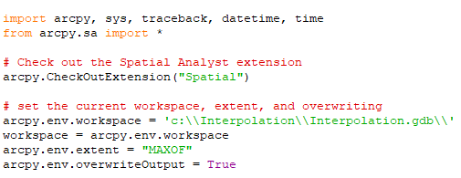
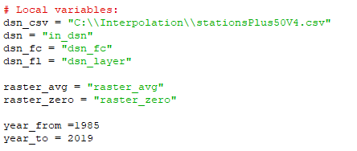
DATA COLLECTION & CREATION
Script set up with appropriate imports
Local variable assignments

Slide 5



DATA COLLECTION & CREATION
Initializing raster_hdd with zero values
Use Raster Calculator to accumulate values
Output raster_hdd
at end of loop

Slide 6
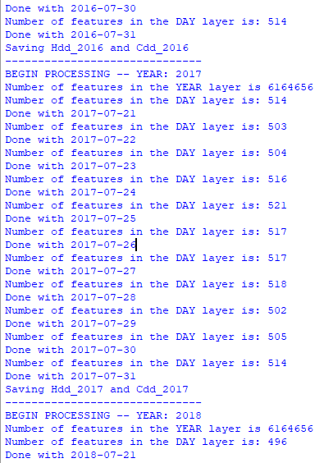
SCRIPT RESULT
Displaying selected date attribute
and number of records read

Slide 7
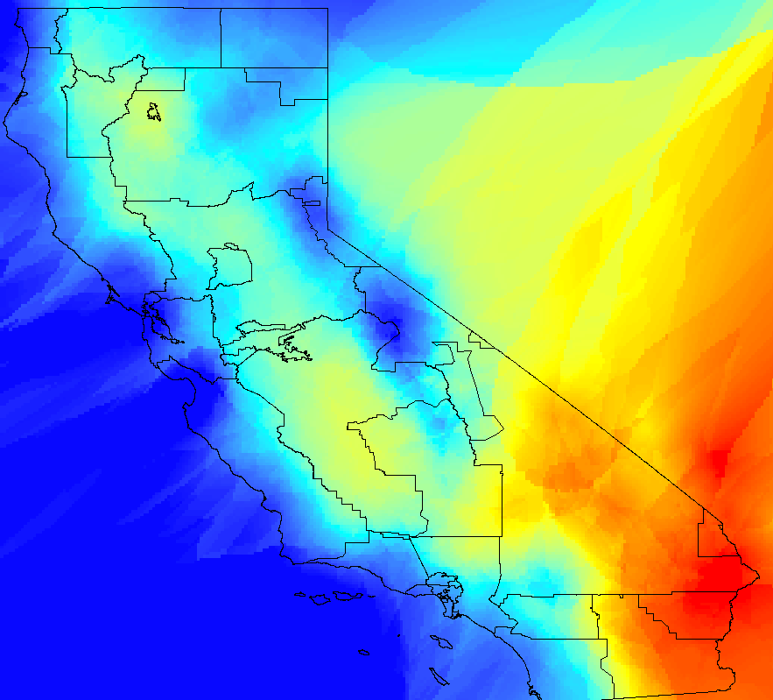
FINAL OUTPUT: HDD AS A SURFACE

