Slide 1
Advanced GIS
Working with the South Yuba River Citizens League
Created by Joey Brisson

Slide 2
Objective
Use existing data provided by South Yuba River Citizens League (SYRCL) to create an engaging geospatial tool to highlight the work of the Organization and the River Sciences department.

Slide 3
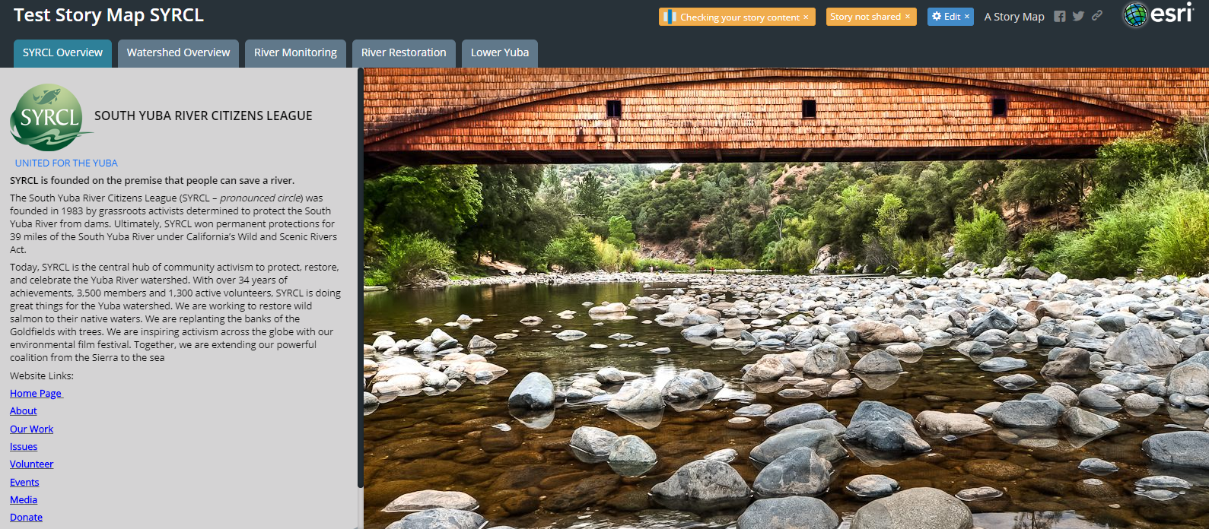
Story Map Home Page.

Slide 4
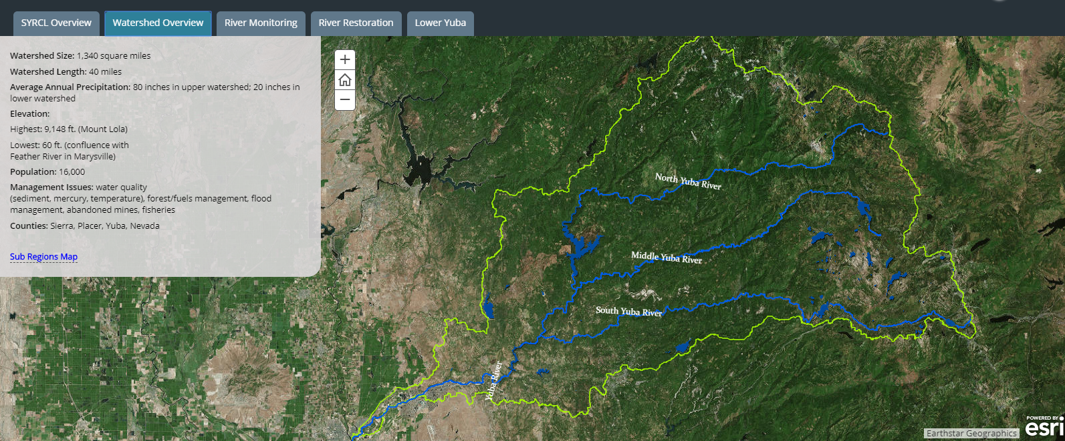
Watershed Overview map With a selectable Sub regions map
This is a WebMap so it is interactive and the viewer can click and zoom to see different information at different scales.

Slide 5
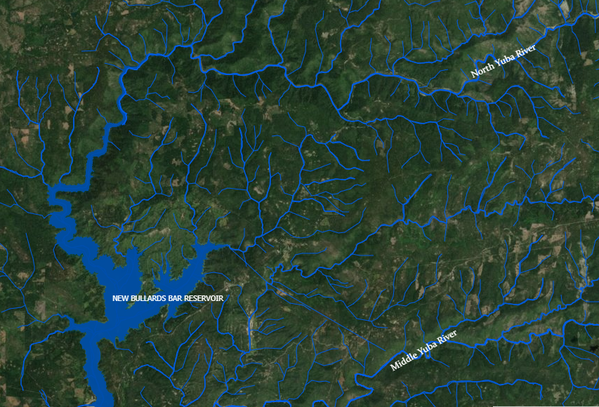
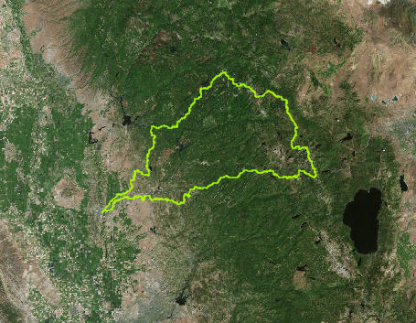
New layers appear as you zoom in and layers go away as you zoom out.
Total of 6 Layers for this map including the basemap.

Slide 6
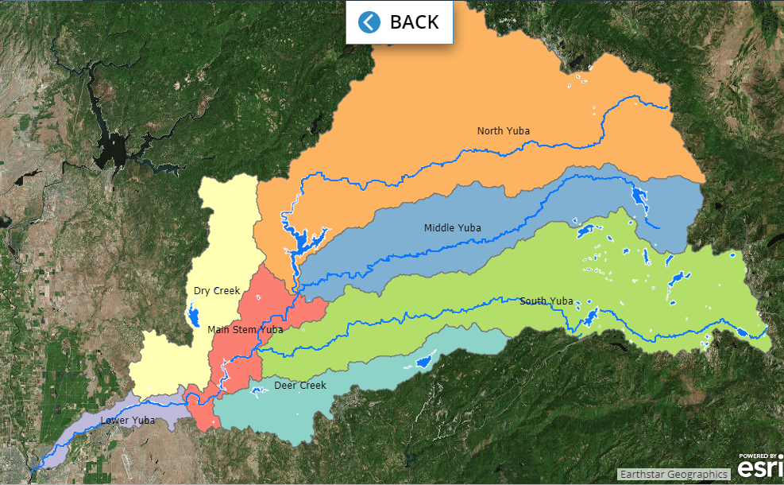
Sub Regions Map

Slide 7
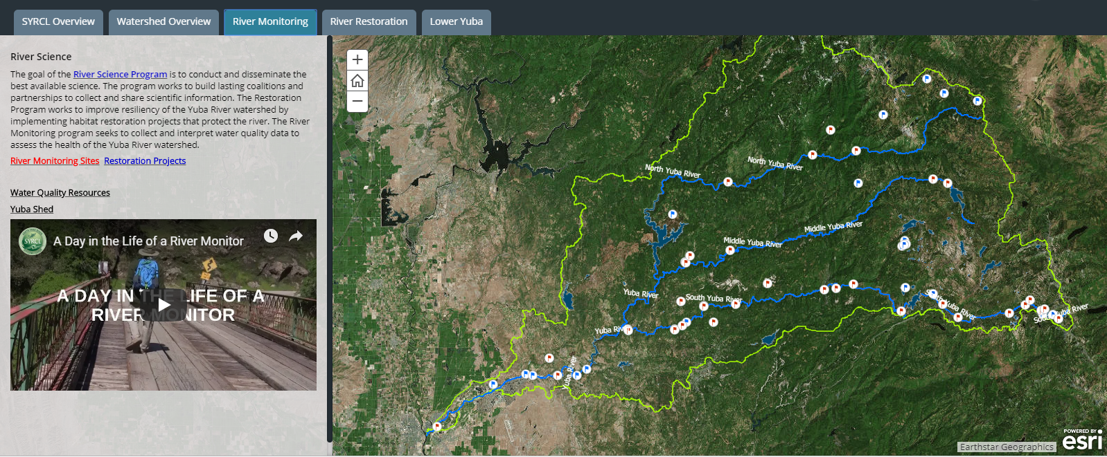
River Monitoring Map with links to organizations website.

Slide 8
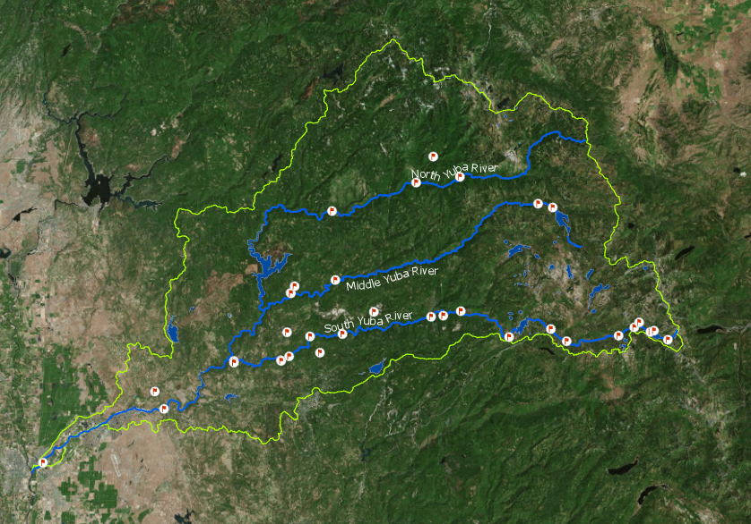
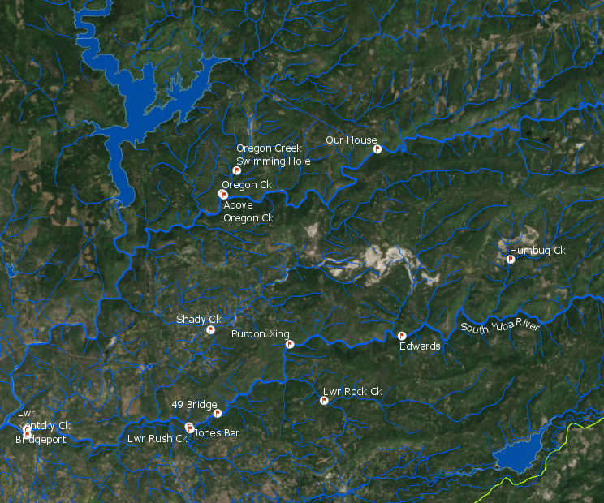
Different features labled at different scales.
10 layers including the Basemap.

Slide 9
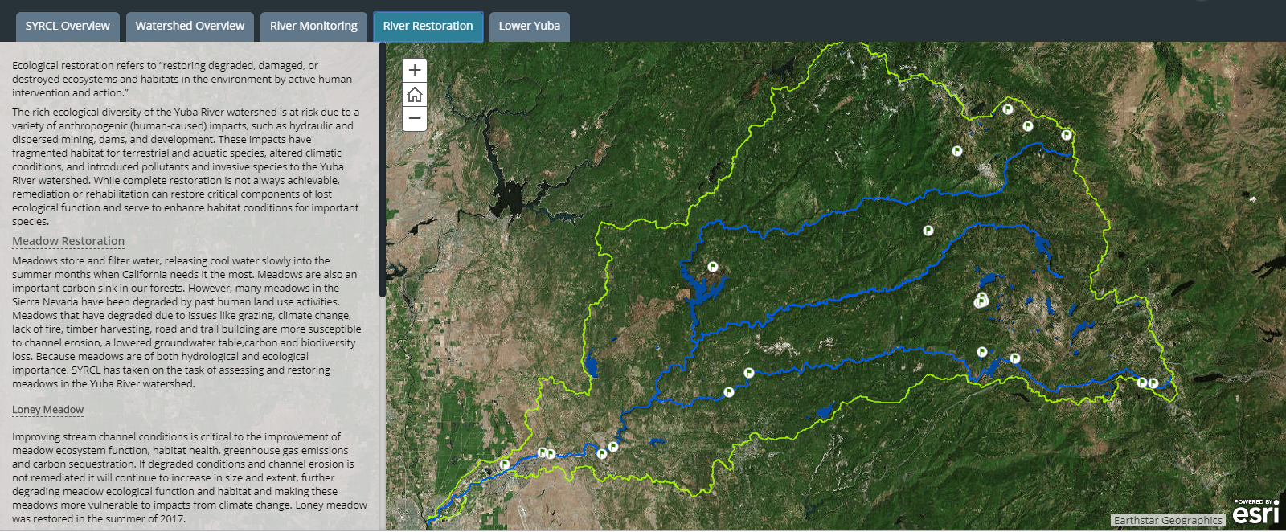
River Restoration Map

Slide 10
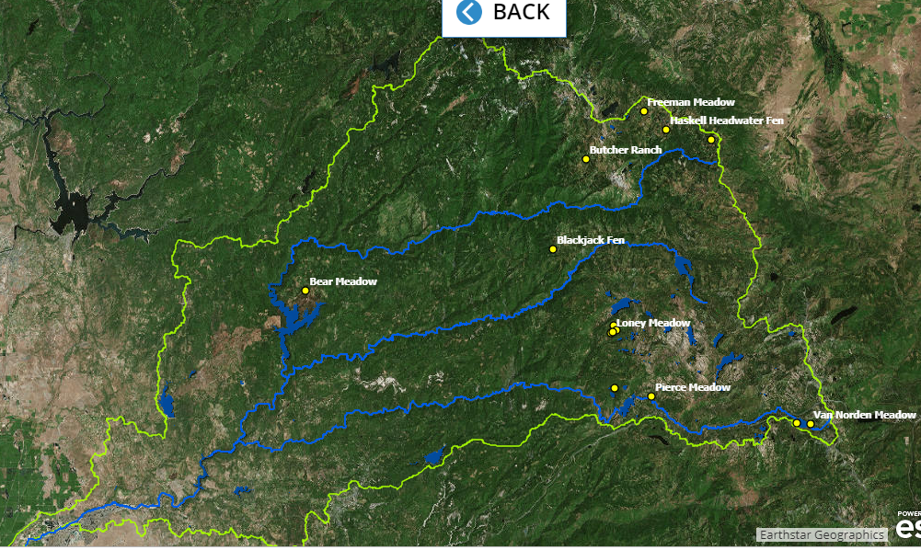
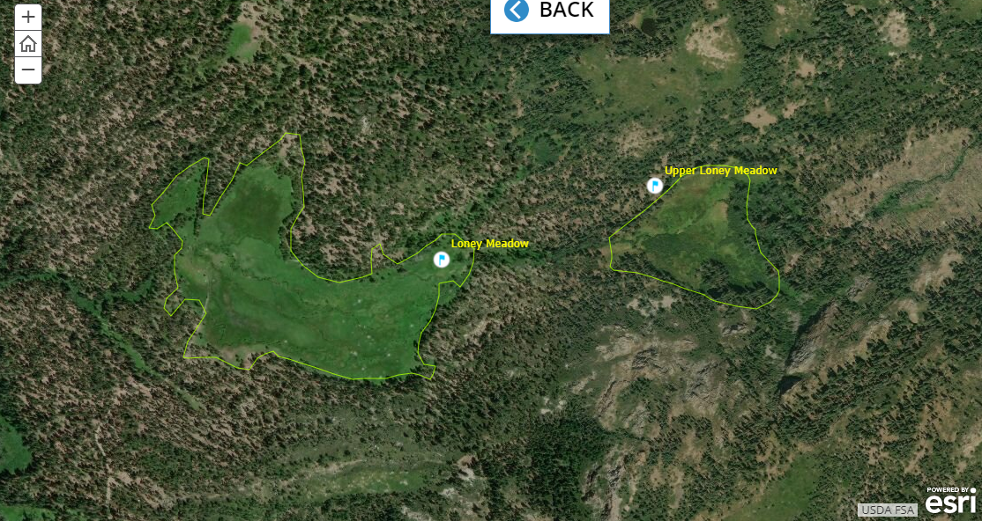
Zoomed in map opens from the River Restoration Page if you click on the Loney Meadow Link. The restoration page consisted of all the meadows within the watershed. I had to select only the meadows that SYRCL was actively involved in and then highlight those on the map. Some of the meadows consisted of multiple polygons so I needed to use the dissolve feature to display them as single polygons.
New Map opens from River Restoration Page if you click the Meadow Restoration Link. This map only displays the Meadow Restoration Sites. If you zoom in the dots turn to polygons of the meadows. The labels remain.

Slide 11
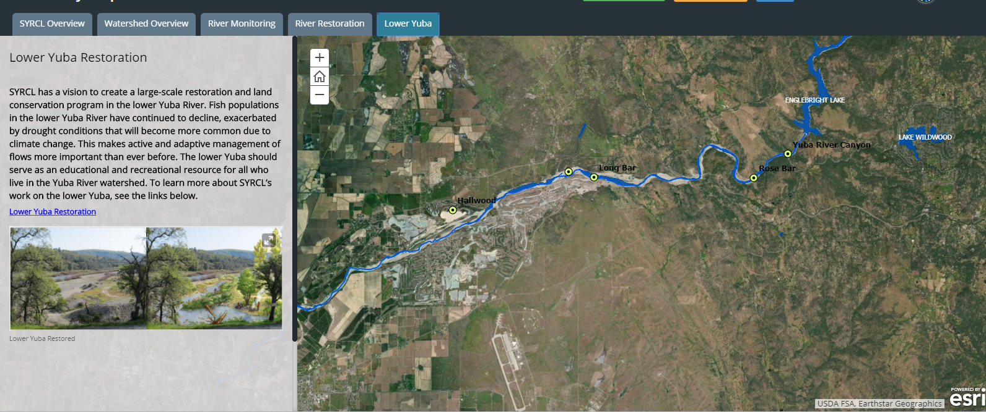
Lower Yuba Restoration Map

Slide 12
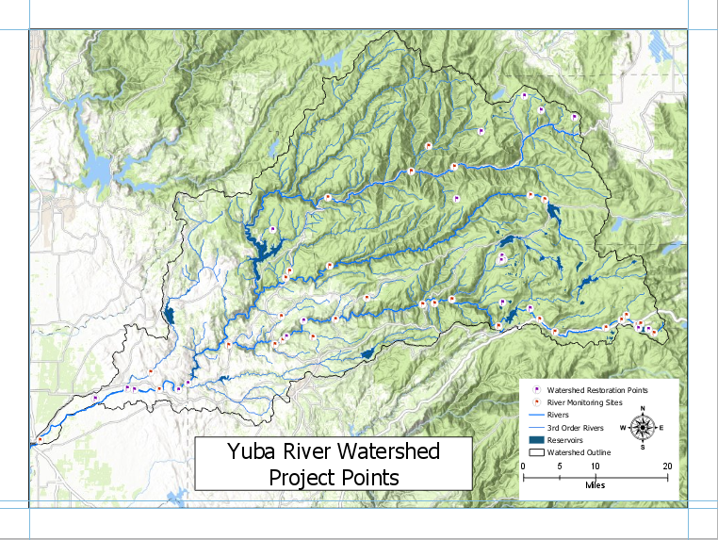
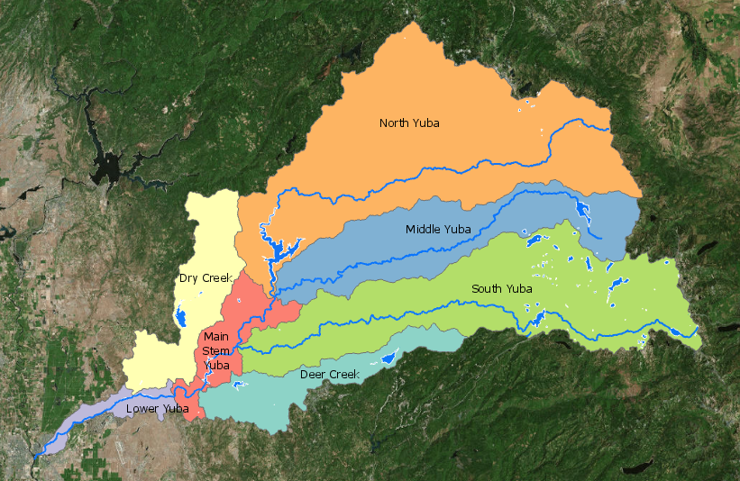
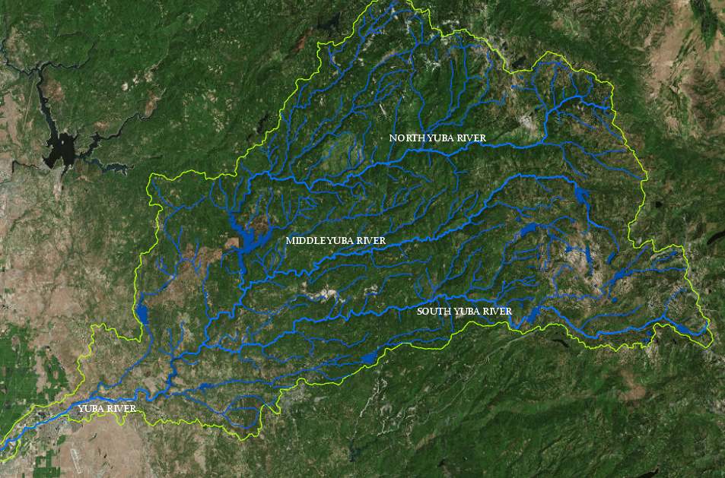
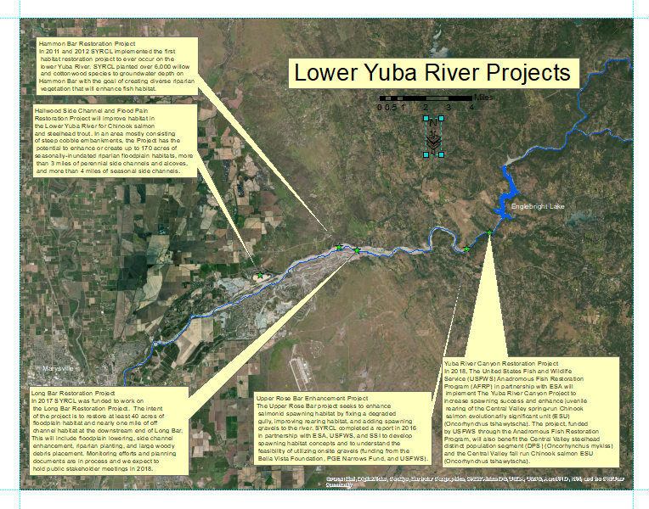
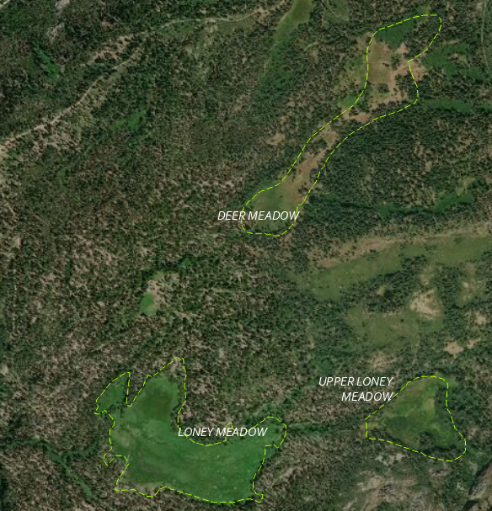
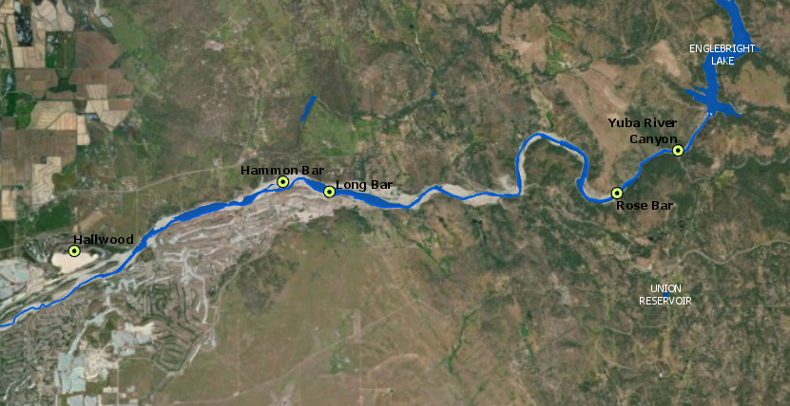
Some of the maps Created For This Project

Slide 13
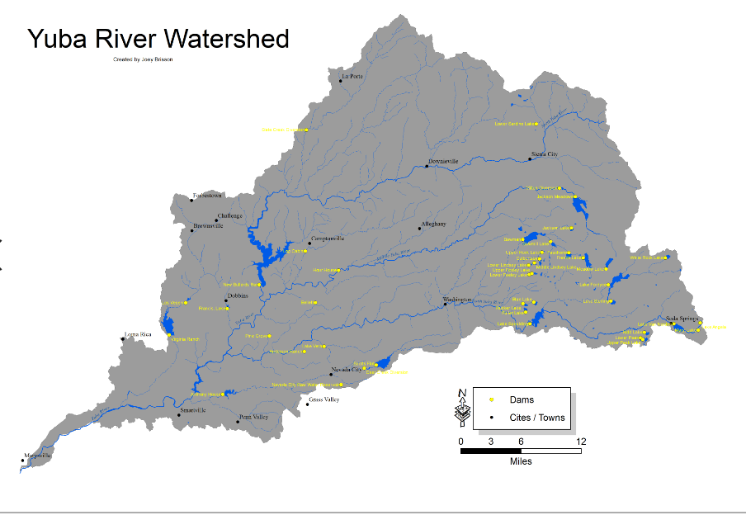
I used ArcMap to create this. It is used as a clickable jpeg in the Story Map.
It contains all major dams within the watershed as well as two layers of hydrologic features.

Slide 14
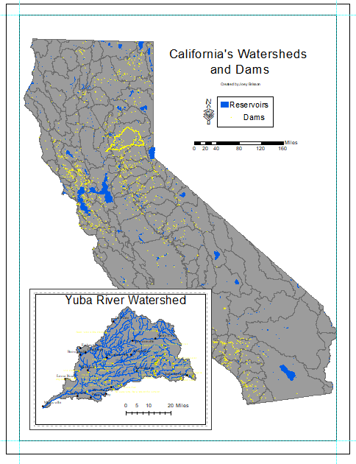
A map made in ArcMap and used as an expandle jpeg within the Story Map application.

Slide 15
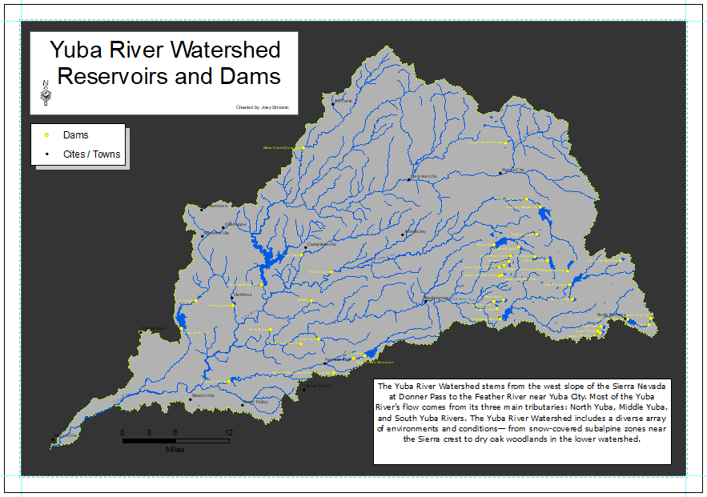

Slide 16
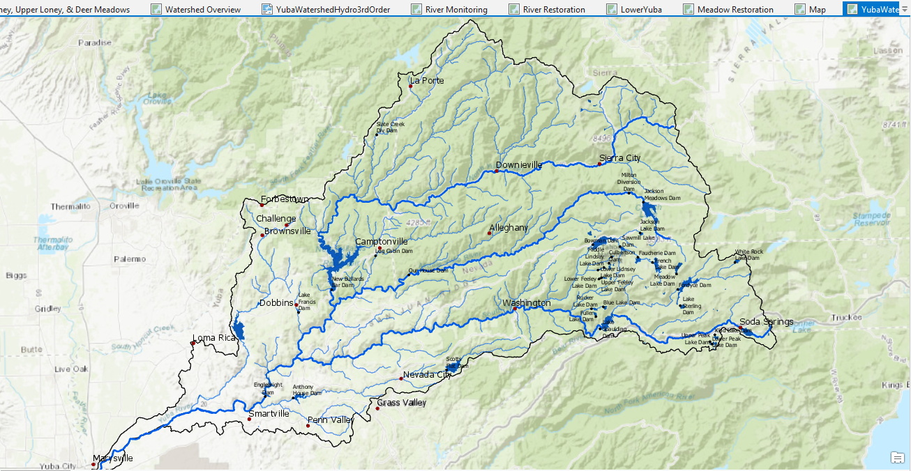
Snapshot of an interactive map in ArcPro. This map displays reservoirs, dams, major rivers and towns within the Yuba River Watershed.

Slide 17
Problems I ran into.
The main struggle through this entire project was my learning curve with all of the mapping applications used.
I had never used ArcPro before so it took me a few months to get comfortable with it.
On the other hand I was a bit more familiar with ArcMap so making documents in that was a bit easier. Although I did refer to my “Getting to know ArcGIS Desktop” book many times.
I also struggled with getting products produced in ArcPro to display lables correctly in the Story Maps. For some reason the Story Map application wouldn’t adhere to all the labeling rules I used in ArcPro.
Lastly, I need to work on finding ways to analyize data. This product was challenging in that there was a ton of symbology to work with and attribute selections but no real data to analyze. If I were to do this again I would find a project that needed to answer some questions about data instead of just producing something that a business wanted. Although, I did get real world experience using GIS with an outside organization.

