Slide 1
GEOG 375
Anna Bellini

Slide 2
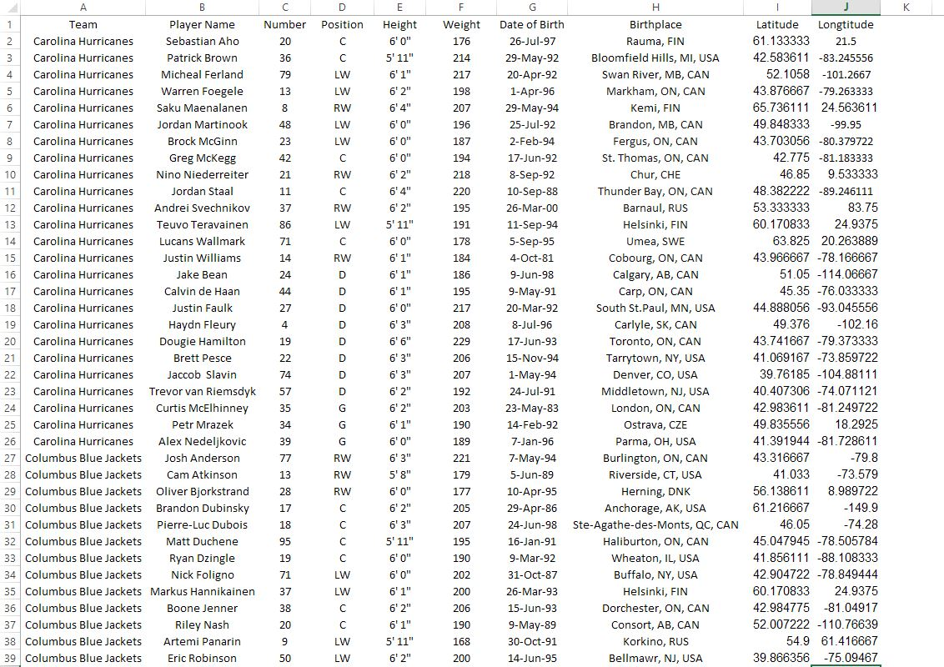
Creating Data
I found the player data on nhl.com and then used Google Maps to get the Latitude and Longitude in decimal degrees for their hometown

Slide 3
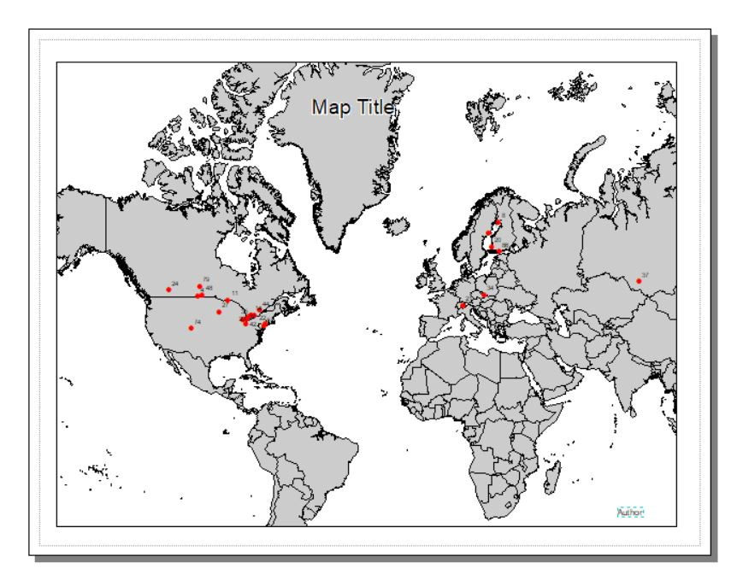
Formatting in ArcMap
I imported a general country map into my map document and added the Excel table to my map document and created a shapefile from it. I made a note of the text element labels and the X position of the Map Title

Slide 4
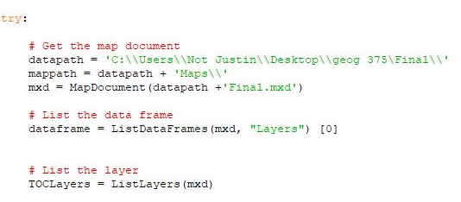
I accessed the path to my map document and listed the data frames and layers in the map document

Slide 5
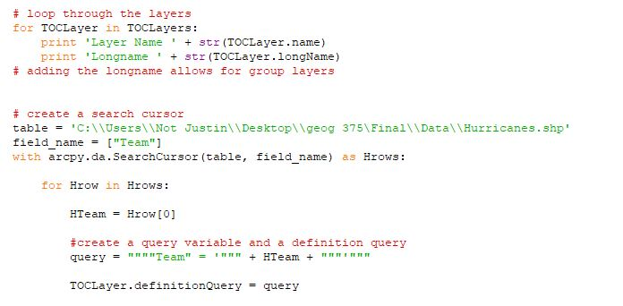
I looped the layers and used “longname” to be able to use my group Hockey layer. I then began a search cursor with a definition query on the Team field in my defined table

Slide 6
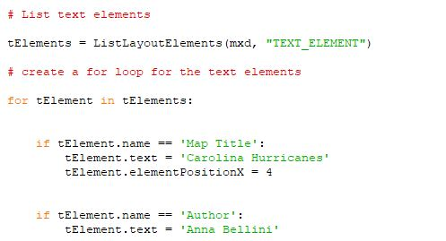
Then I used the tElements variable for my Text Elements and formatted the text elements that I definied in ArcMap. Position X was difficult for me to find, but through trial and error I decided on 4

Slide 7
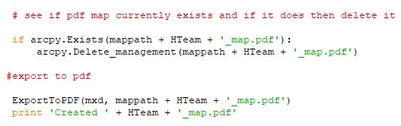
I then looked to see if the pdf of the maps existed. If it did exist I deleted it and then used export to pdf to create a new one

Slide 8
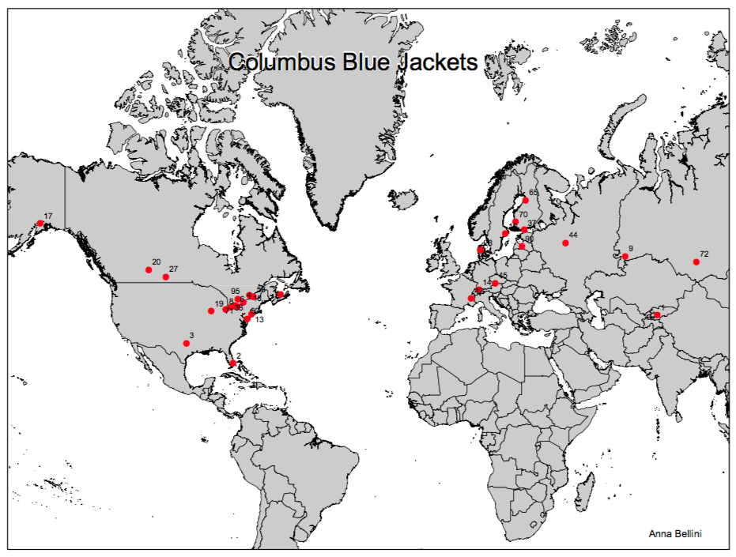
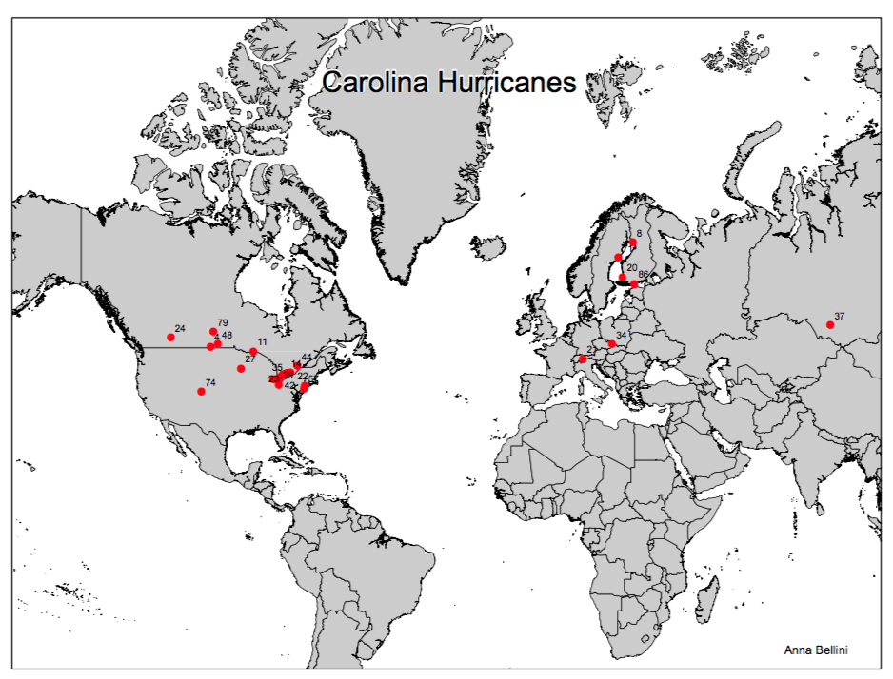
Finished Product

