Slide 1
California Highways
Right of Way Acquisition
Joseph Watkins
GEOG 375
Final Project

Slide 2
Background
Caltrans maintains and improves more than 50,000 lane miles throughout California. While some projects are designed to repair existing roadbed, others increase the footprint by expanding freeways to mitigate traffic congestion. Identifying parcels impacted by future projects is the responsibility of the Division of Design and information is passed on to the Division of Right of Way for acquisition.
Objective
Write a Python script that allows the user to:
  Clip statewide parcel and highway datasets to a selected county.
  Query a project work zone (section of single highway).
  Generate a list of impacted parcels intersecting with the work zone.
  Generate a map of the work zone to accompany the list of parcels.

Slide 3
Purpose
With over 300 projects being developed each year, Caltrans is always looking for ways streamline project development while properly vetting each step for accuracy, transparency and record keeping. This project takes an innovative GIS approach that explores alternative methods for quickly ensuring accuracy. Working for Caltrans, I am able to showcase some of the more hidden power of GIS and python programming.

Slide 4
Project Development
Data Acquisition
  The California state highways and county boundaries data used for this project were provided in shapefile format by the California Department of Transportation. The parcel data was acquired from the Sacramento County GIS Open Data website. Acquiring the data was easy since both resources are public entities with open data standards. The data was staged in a local file to be used for script writing.

Slide 5
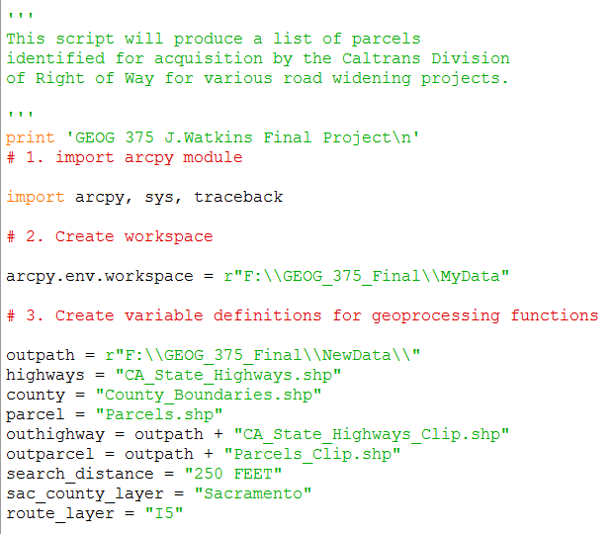
Project Development
Python Script
  I imported acrpy, sys, allowing the script to perform data analysis, conversion management and map automation of the data. Traceback was used to quickly find any errors buried in lines of code. I created a workspace that pointed to my local drive and folder where I had previously downloaded my data and variables were defined for the outpath, shapefiles, search distance and clipped layers. I also utilized the “# comments” to keep my script well organized.

Slide 6
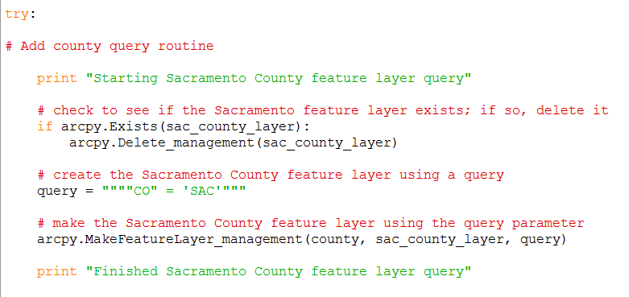
Project Development
Python Script
  In the try block, I first needed to isolate Sacramento County from the statewide data set and create a new Sacramento County layer. I did this by using the “if” statement to see if the layer existed and to delete if needed. Afterwards I reviewed the data table and identified “SAC” within the “CO” (County) column and ran a query. With the County layer created I was able to run a Clip routine on the statewide highway dataset using a similar method as above to generate a layer of highways specific to Sacramento County.

Slide 7
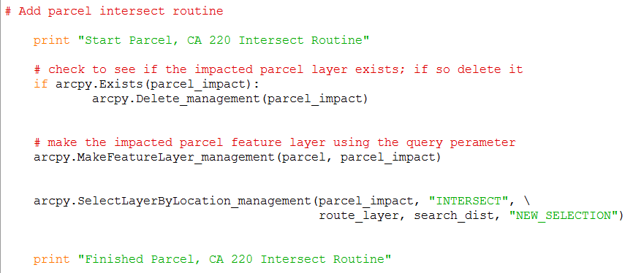
Project Development
Python Script
  My next step was to query a highway route within the newly created “outhighway” layer. This section of code is easily customizable to any given stretch of highway within the county. I continually used the “print” statement as a quick visual confirmation that my script was running properly. With my subject area identified and data isolated I was able to run the following intersect routine. I used the “select layer by location” command to generate a new selection of parcels that were within 250 feet of the queried highway route 220.

Slide 8
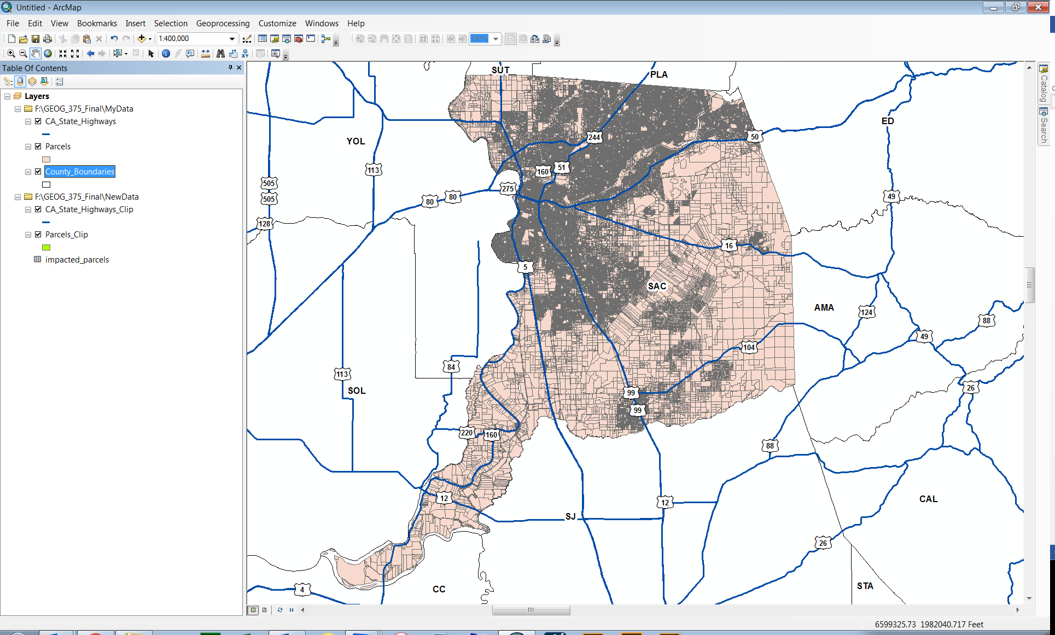
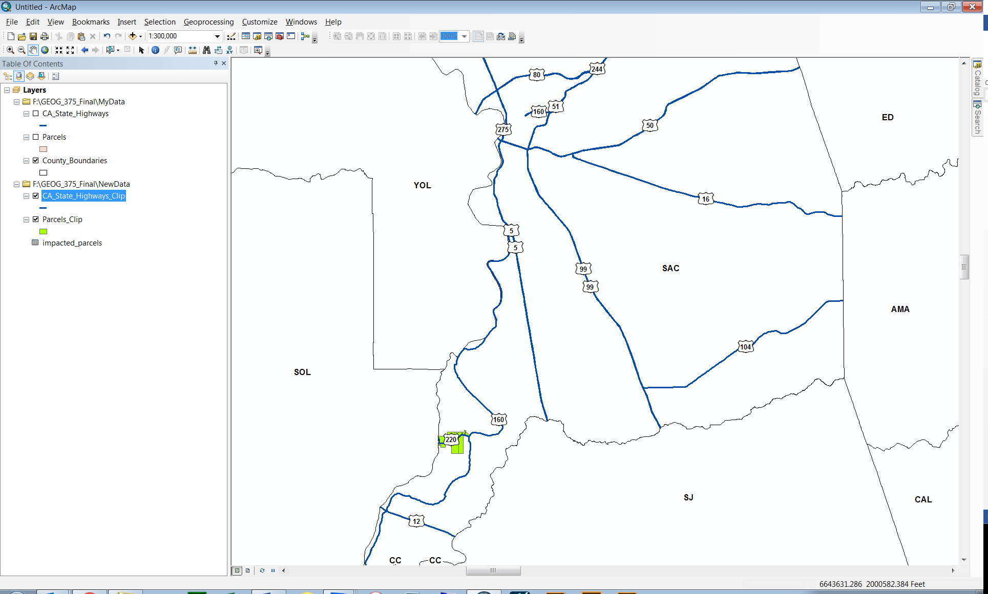
Project Development
Python Script
  Next I created an outparcel layer of the impacted parcels and saved it both as a shapefile and a .dbf. This allowed me to share the impacted parcels as both a visual map and accompanying list. With the impacted isolated data now available, I used ArcMap 10.5 Google Maps to confirm accuracy. I imported the data, created labels and saved the .mxd within “MyData” folder for conversion to .pdf in further scripting. Below are screenshots of the highway system and parcel layers before and after processing my script.

Slide 9
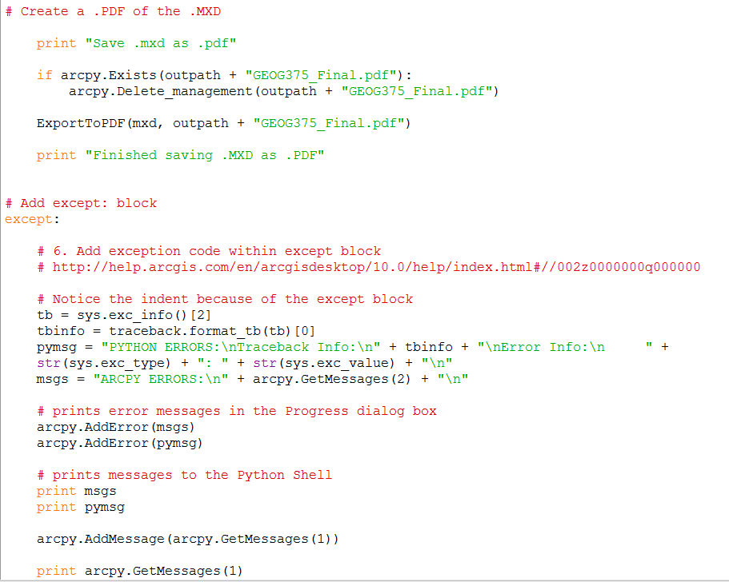
Project Development
Python Script
  Finally I wrote the script to save my .mxd as a .pdf. The except block was one of the first sections of code written and included as the final component to my script.

Slide 10
Conclusion
This being an introduction to GIS Programming course, the final product meets my expectations. I was able to successfully write python coding to execute a series of commands which relied on each other to perform properly. The script generates results that are both accurate and malleable. With a few small changes, the script is customizable to any county and any stretch of highway within California, generating a completely new set of impacted parcels. Although I was not able to create a .pdf or excel list of the parcels, I did create a standalone database table and new feature layer that can be joined or related to other layers for future projects. The final component of saving my .mxd as a .pdf made this project a complete package, however if this project was part of my daily workload, the map would need to be fine-tuned to include title, legend, and orientation detail based on the layers created through the script. I’m happy with the results and look forward to refining my script and showcasing the power of python programming in conjunction with GIS.

Slide 11
References
http://www.dot.ca.gov/hq/tsip/gis/datalibrary/Metadata/StateHighway.html Web. 25 Apr. 2018.
https://data-sacramentocounty.opendata.arcgis.com/datasets?q=parcel Web. 25 Apr. 2018.
https://gis.stackexchange.com/questions/82316/export-mxds-files-to-pdfs-using-python Web. 25 Apr. 2018.
https://support.esri.com/en/technical-article/000012420 Web. 25 Apr. 2018.
https://www.google.com/maps/@38.5697883,-121.4970293,15z Web. 25 Nov. 2018.

