Slide 1
Uses for Remote Sensed Data
An Analysis of Vegetation Coverage in the Mojave Desert and
A Comparison of MODIS and Landsat 8 Vegetation Indices
Britnee Pannell
GEOG 342

Slide 2
Questions:
Are differences in vegetation coverage between a wet (2017) and dry (2015) year in the Mojave Desert Preserve detectable with MODIS data?
Are NDVI and EVI values calculated with ArcGIS Pro comparable to those provided by MODIS?

Slide 3
Steps:
Obtain needed MODIS and Landsat 8 data
Process Data
Examine Results
Share Results

Slide 4
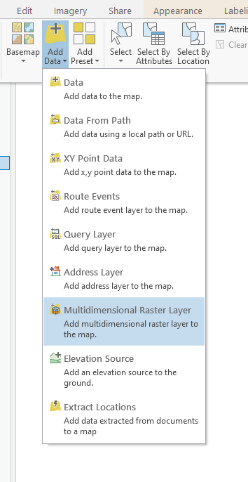
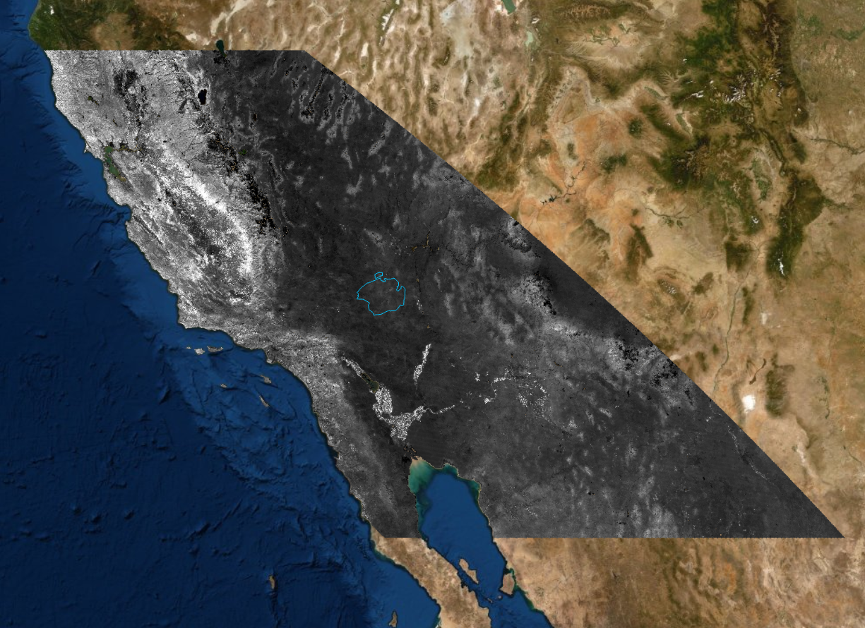
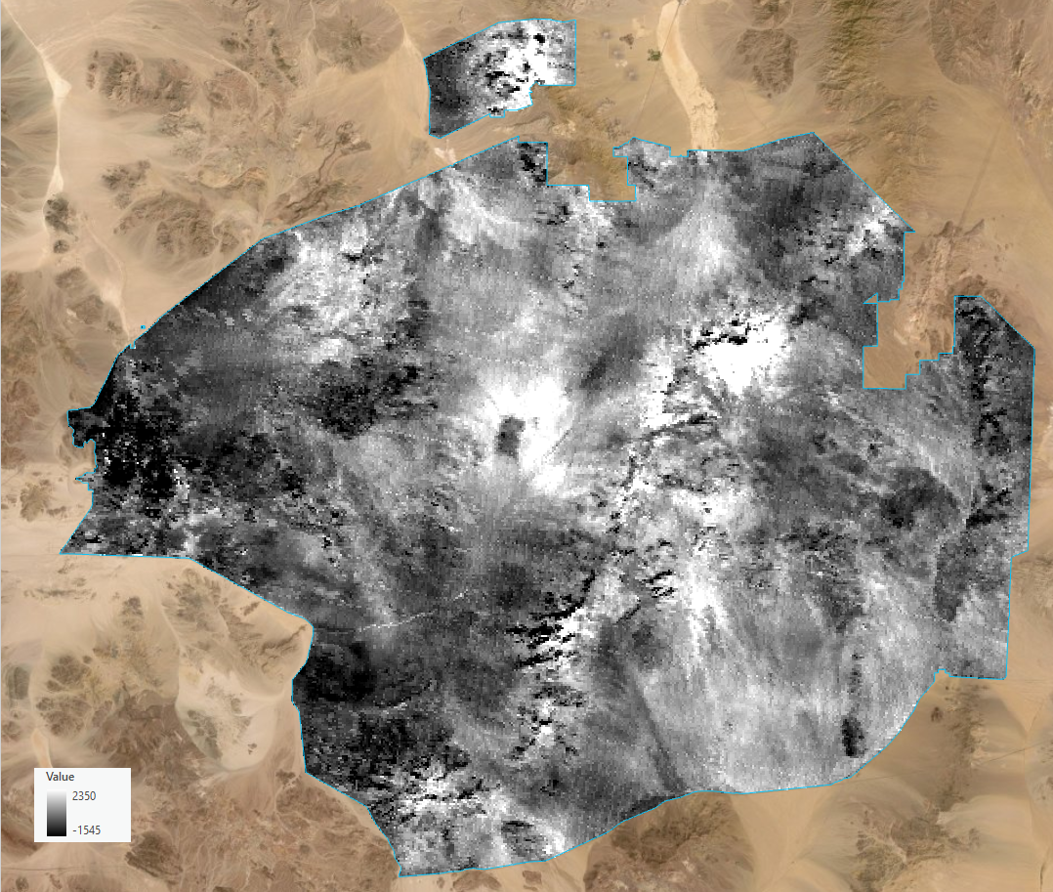
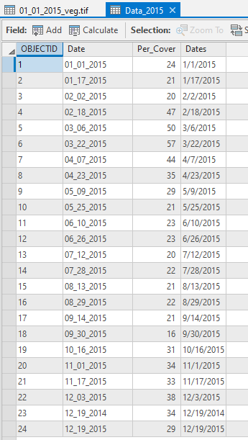
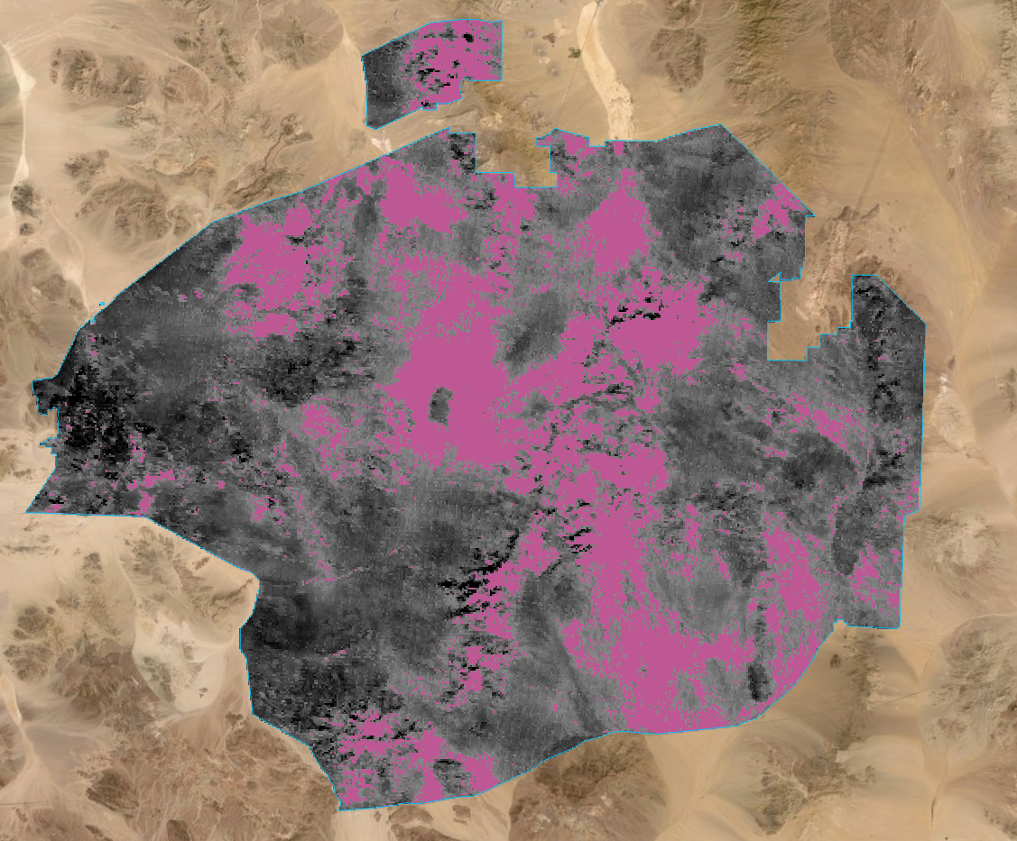
Processing MODIS Data
Extract Data
Mask Data
Extract Data
Normalize and Export Data
Aggregate Data
Graph Results!

Slide 5
NDVI and EVI
NDVI is calculated with the following equation:
NDVI = ((NIR - Red)/(NIR + Red))
EVI is calculated by MODIS and ArcGIS with the following equation:
EVI = 2.5*(NIR - Red) / (NIR + 6 * Red – 7.5 * Blue + 1)

Slide 6
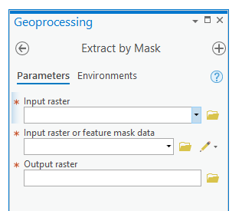
MODIS NDVI and EVI
Only needs to be masked to the study area!

Slide 7
Landsat 8 Requires Pre-Processing
Mask Layers to Study area then:
Use Mask algebra to convert Landsat 8 bands to Top of Atmosphere (TOA) Reflectance values with the following equation:
ρλ=(MρQcal+Aρ)/cos(θSZ)
ρλ = TOA reflectance adjusted for sun angle
Mρ = band specific multiplicative scaling factor
Qcal = raw values in Landsat 8 bands
Aρ=band specific additive scaling factor
ΘSZ = angle of the sun elevation in degrees
*All values are contained in the Landsat 8 Metadata file

Slide 8
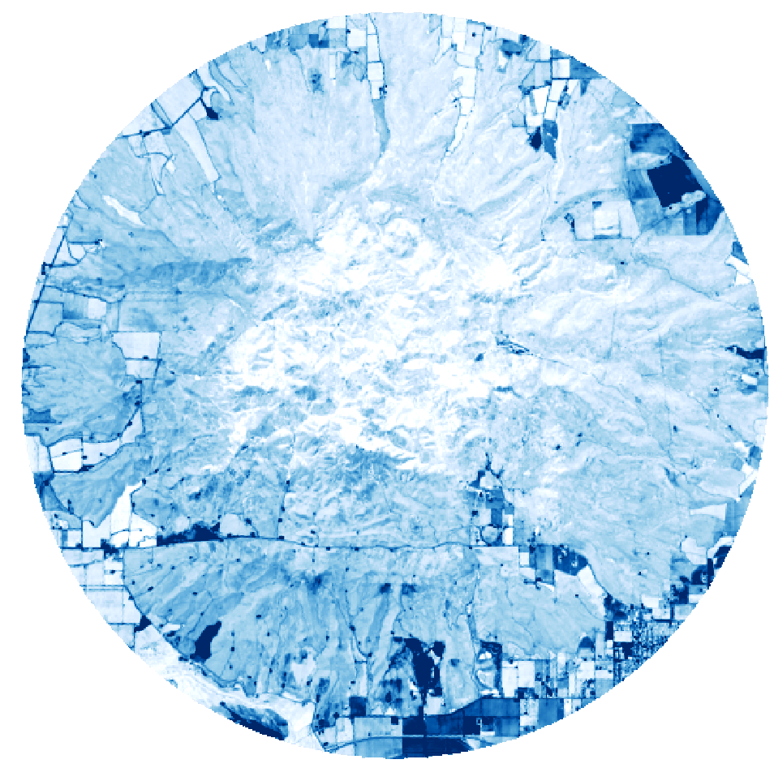

Landsat 8 Blue Band

Slide 9
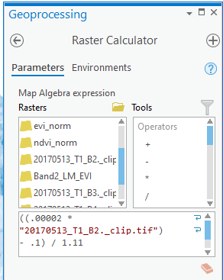
Raster Calculator

Slide 10
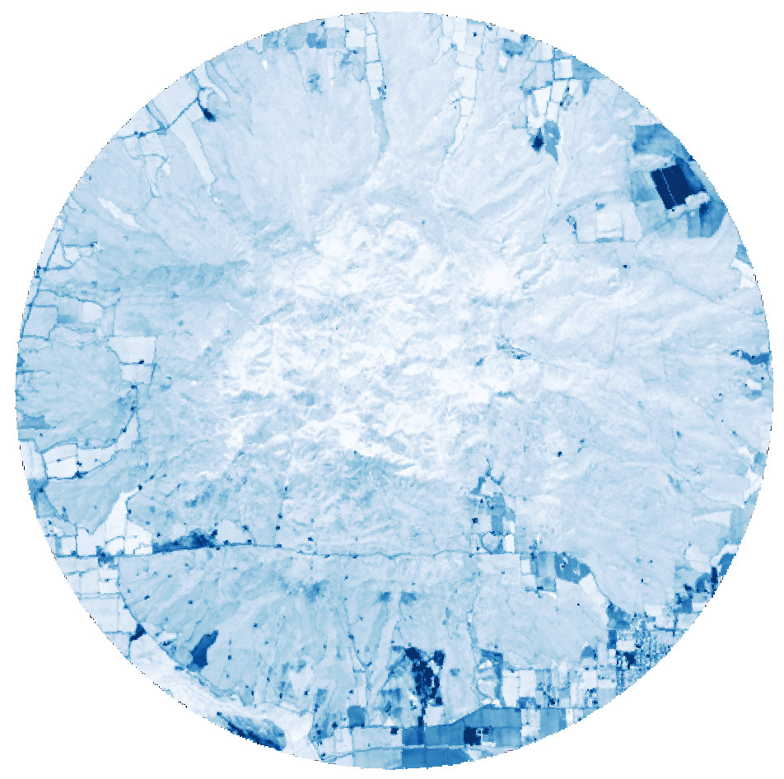

Processed Blue Band
Note the change in values.

Slide 11
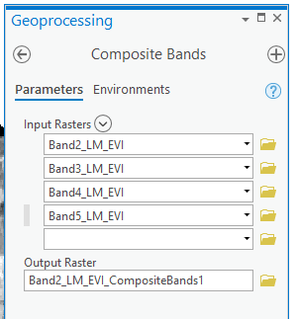
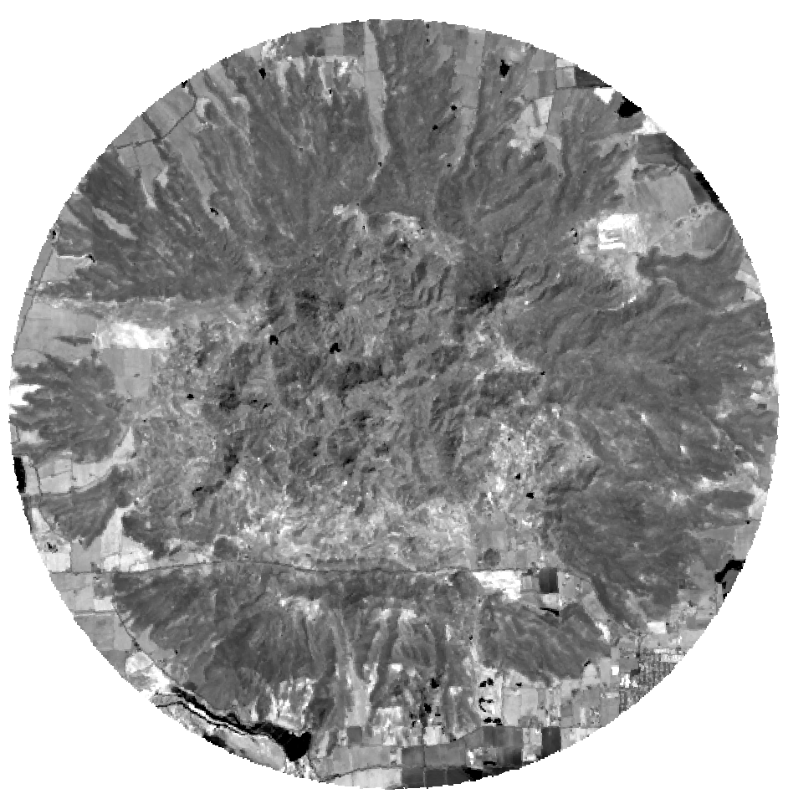
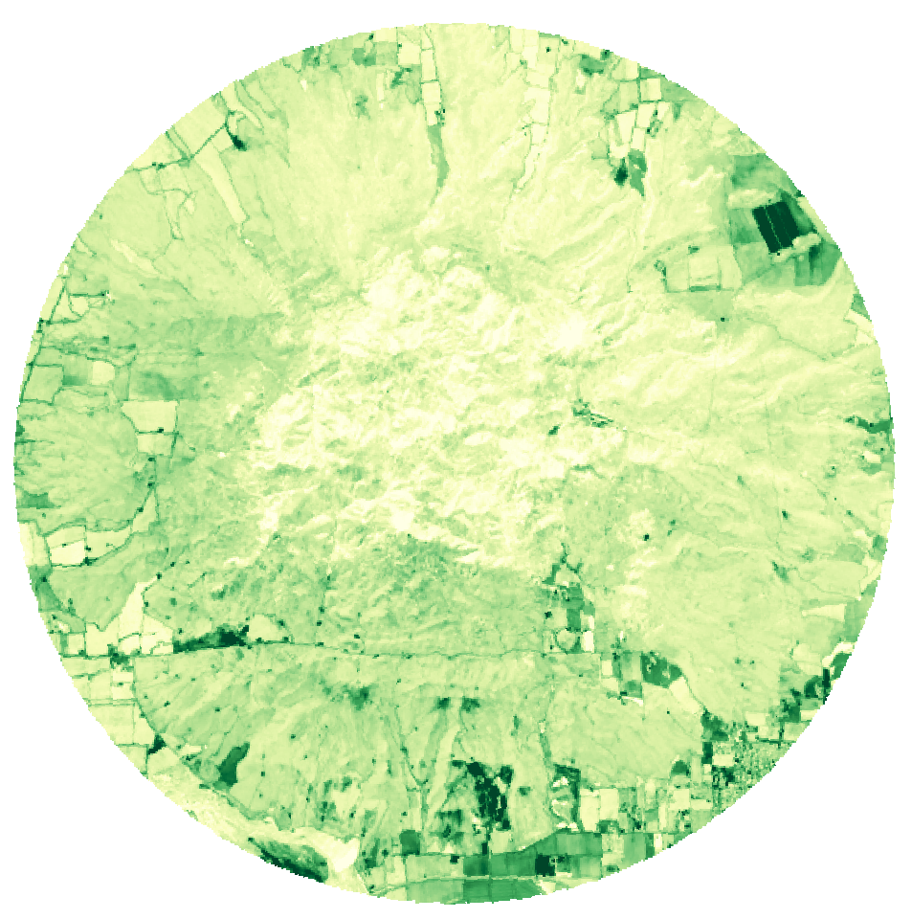
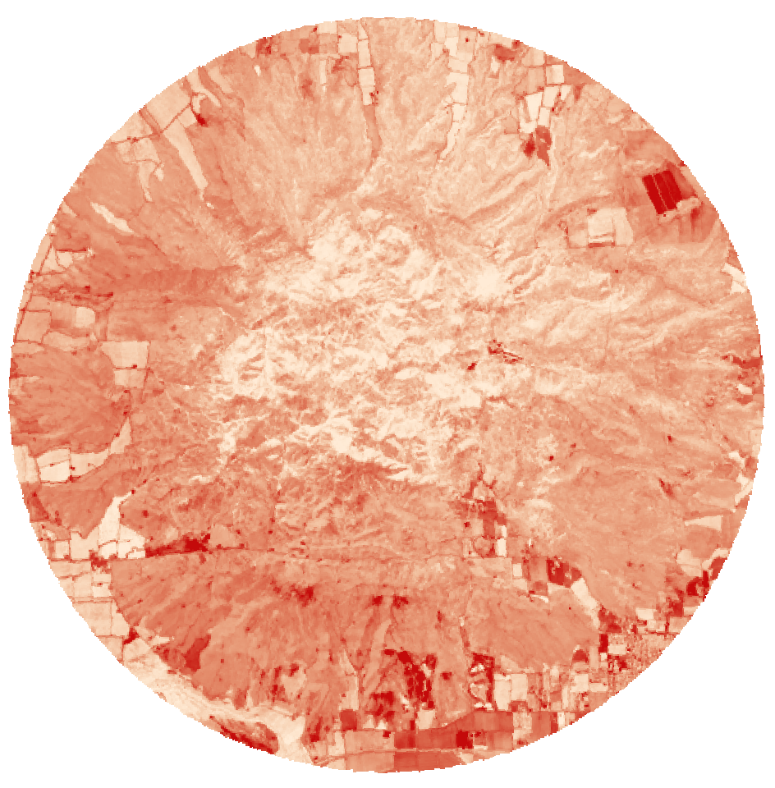
Composite Band

Slide 12
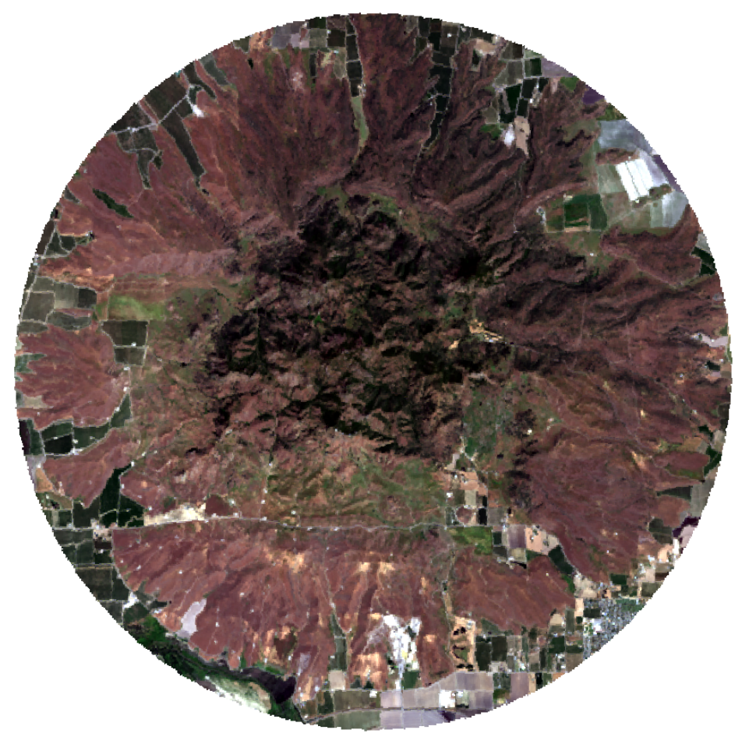
Landsat 8 Composite

Slide 13
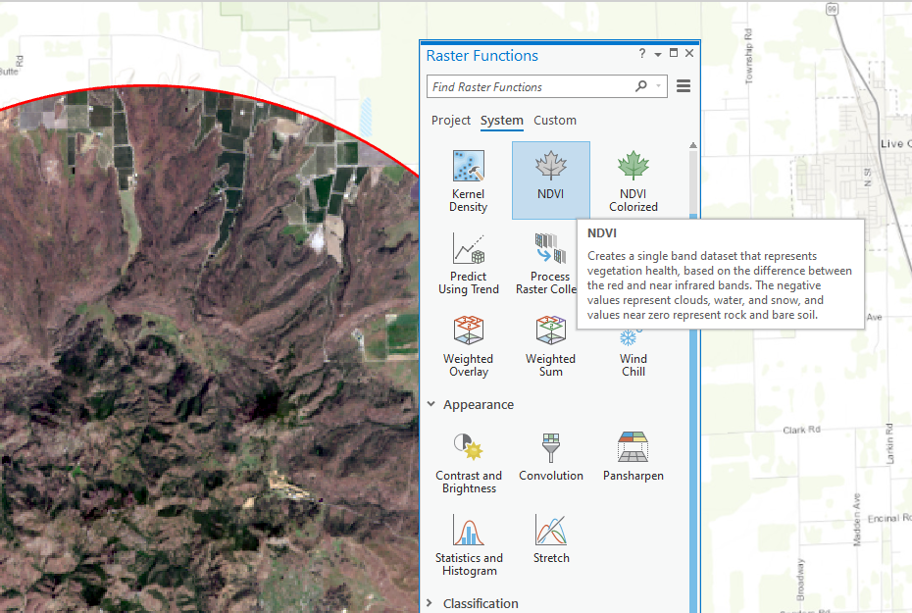
ArcGIS Pro NDVI Tool

Slide 14
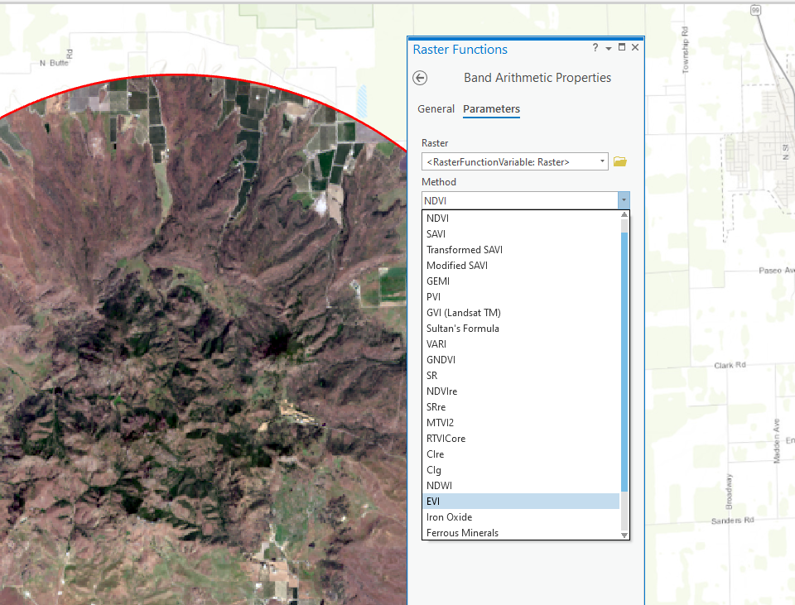
EVI Via Band Arithmetic

Slide 15
Results!

Slide 16
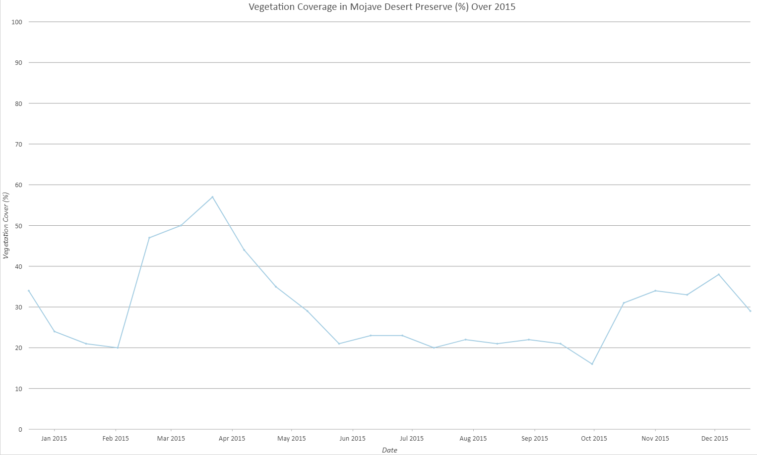
2015 Vegetation Coverage

Slide 17
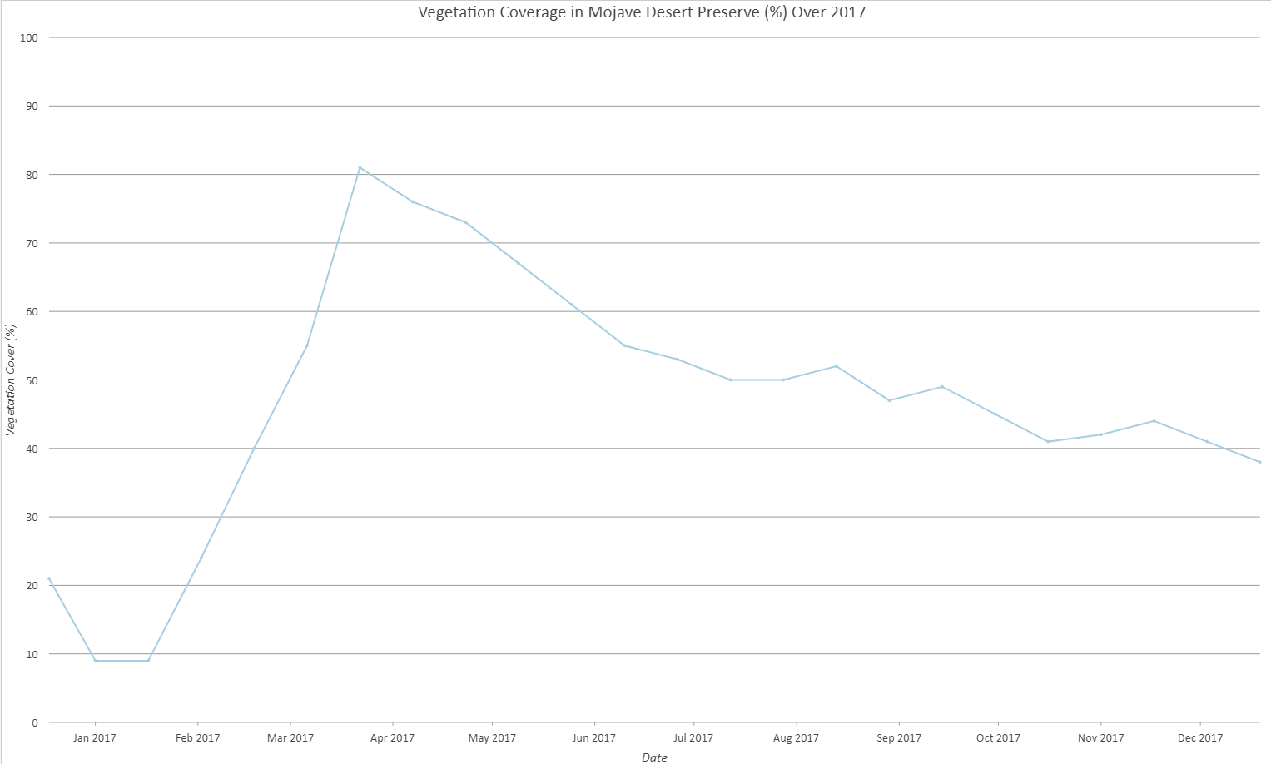
2017 Vegetation Coverage
Increase in Vegetation cover!

Slide 18
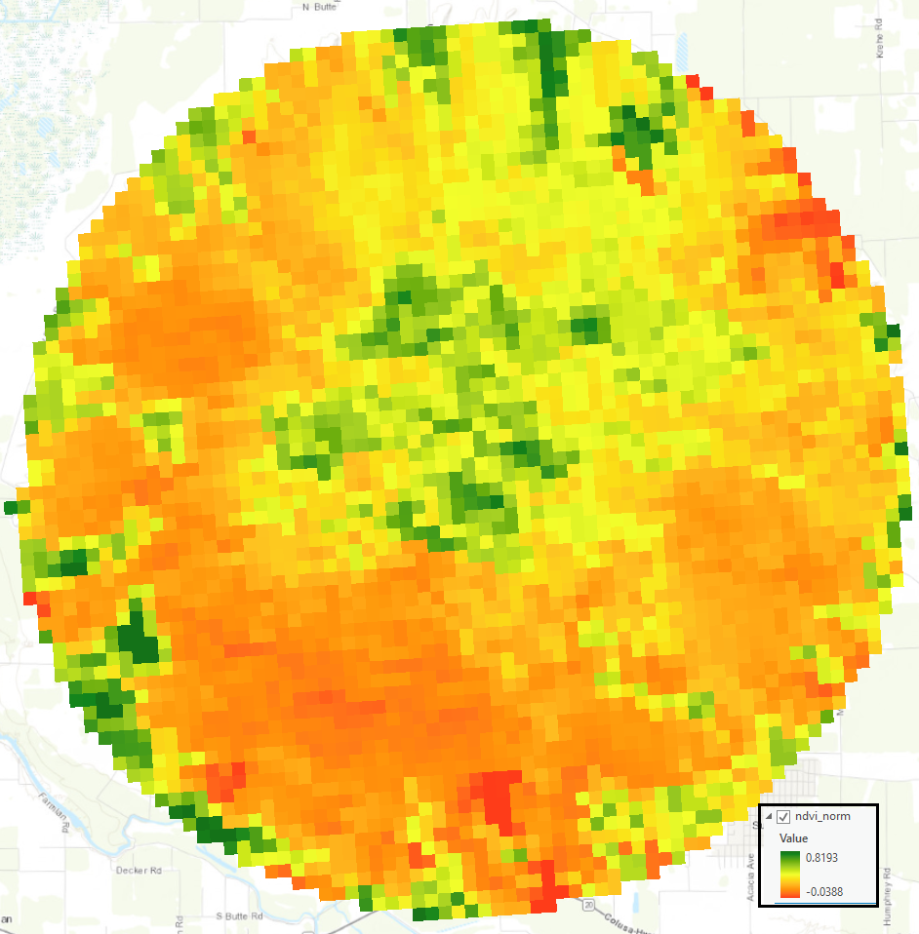
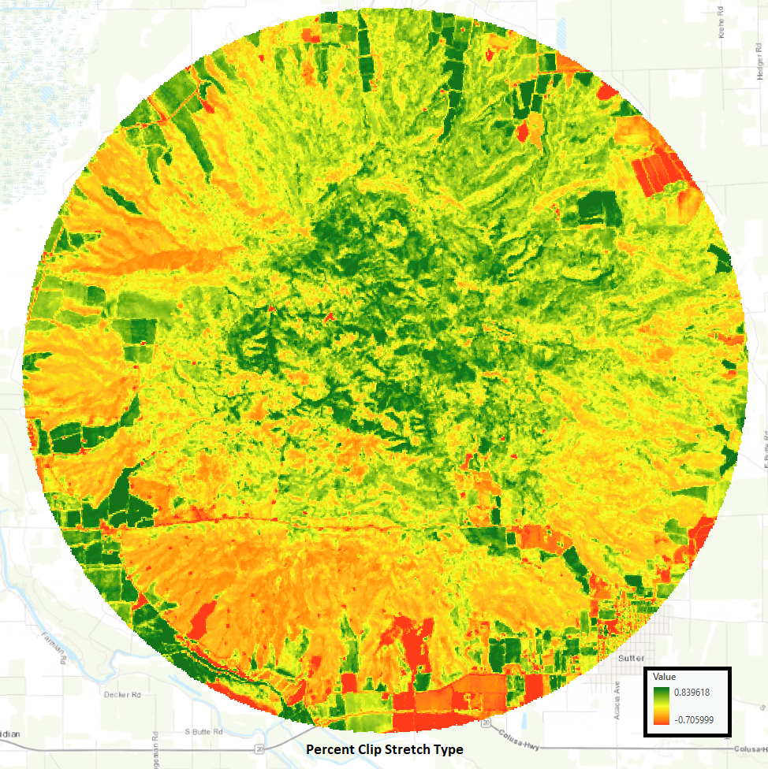
MODIS derived NDVI from May 9th 2017
Values range from
-.0388 to .8193
ArcGIS Pro Landsat 8 derived NDVI from May 10th 2017.
Values range from -.705999 to .839518

Slide 19
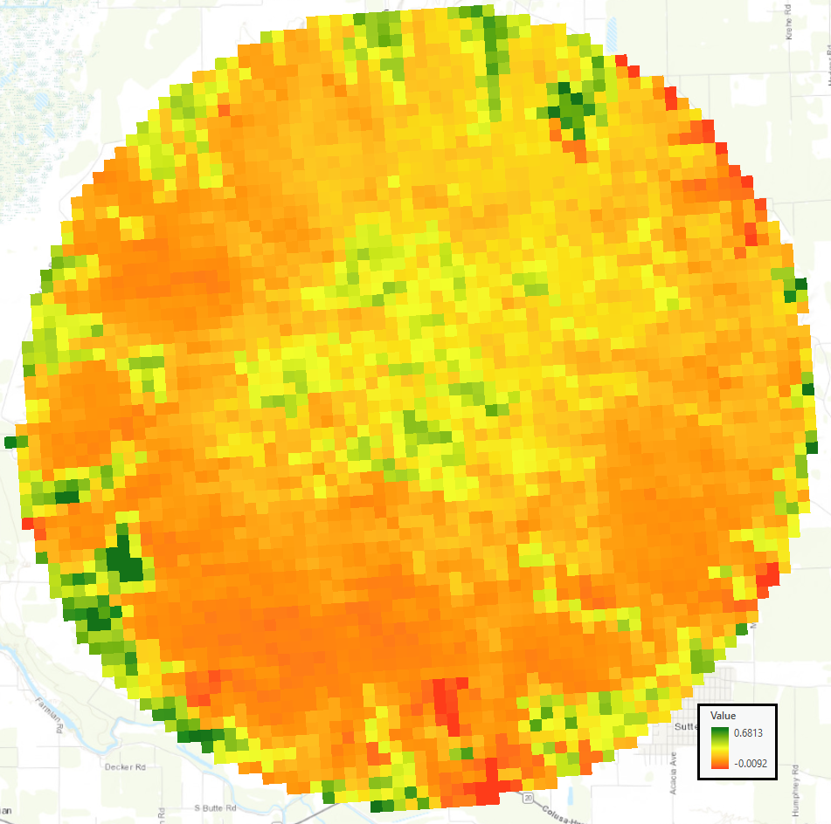
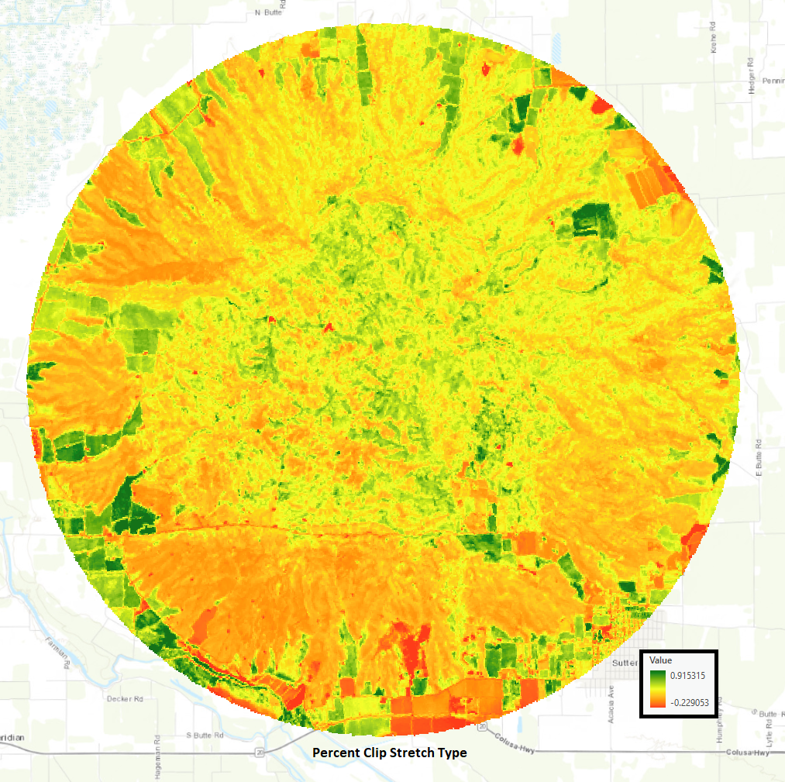
ArcGIS Pro Landsat 8 derived EVI from May 10th 2017.
Values range from -.229053 to .915315.
MODIS derived EVI from May 9th 2017
Values range from
-.0092 to .6813

Slide 20
Are differences in vegetation coverage between a wet (2017) and dry (2015) year in the Mojave Desert Preserve detectable with MODIS data?

Slide 21
Yes!

Slide 22
Are NDVI and EVI values calculated with ArcGIS Pro comparable to those provided by MODIS?

Slide 23
For NDVI data? It appears to be comparable
For EVI data? Maybe, but additional studies will be needed to see if something about the Sutter Buttes has impacted the data, or if it is user error.

Slide 24
End

