Slide 1
Sacramento Railyards Project
Fred Ortiz
May 2018

Slide 2
Background
The study area for this endeavor is the Sacramento Railyards. This location is an urban infill project of approximately 244 acres located within the City of Sacramento’s Central City community, between the downtown Central Business District and the River District, near the convergence of the American and Sacramento rivers. The anticipated completion time frame is expected to continue until the late 2020s.

Slide 3
Project Objective
Automate raster processing for loading into MS SQL server database.
Populate database and ArcGIS 10.5.1 for the initial state of analysis.
Provide GIS data for a historical perspective of project site.

Slide 4
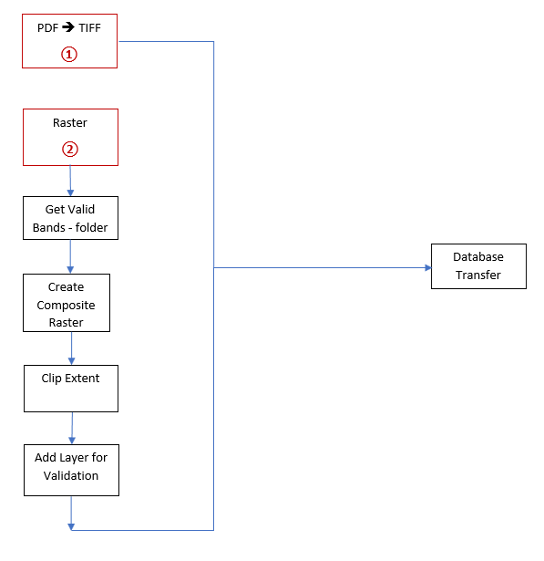
Main sections for 1st python script
Traversing input folder
Filter for geoPDF files
Remove prior TIFF files from output folder
Convert PDF to TIFF
Provides pyramids to improve the display performance

Slide 5
Main sections for 2nd python script
Remove pre-existing files from output folder
Select valid raster bands to process
Remove pre-existing layers from ArcGIS map document
Composite band processing
Clip composite band into the extent of study area
Provide image feedback via ArcGIS map document

Slide 6
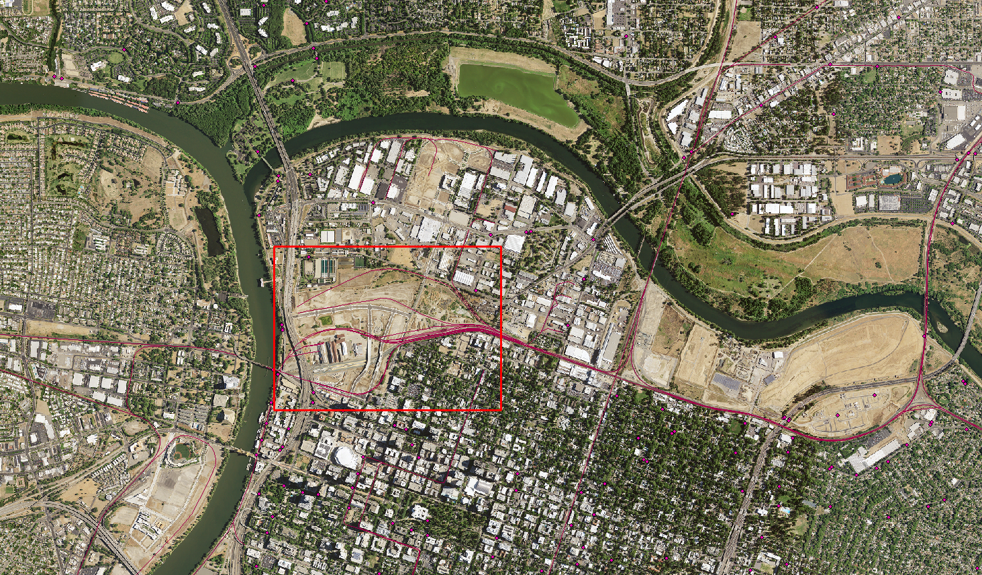
Study Area
This image shows the approximate area of the study for this project within the red rectangle. The Railyards region is comprised of approximately 244 acres. The basemap consists of two ortho images provided by USGS.
1:24,000

Slide 7
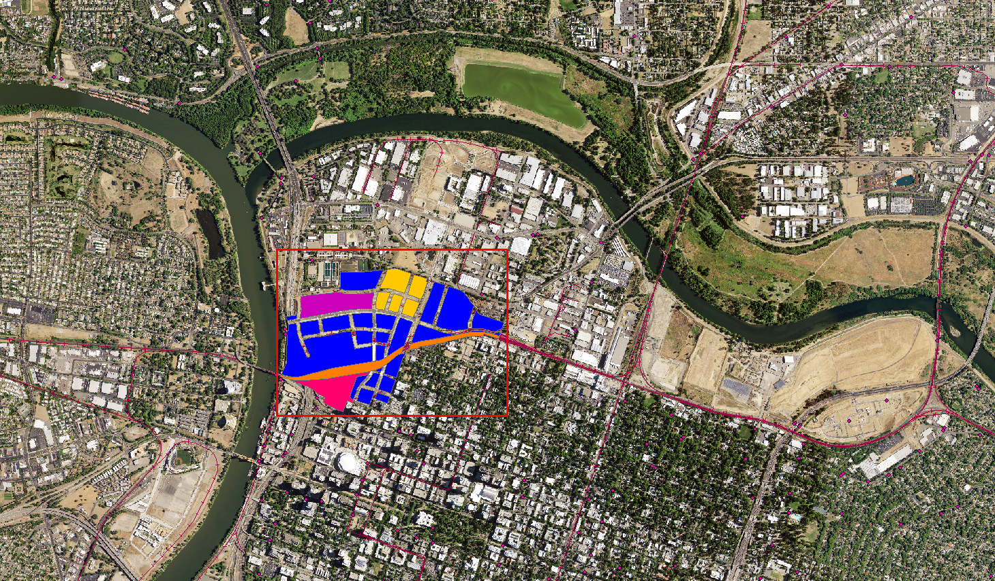
Zoning - Symbolized
The symbology reflects the zoning types in the study area which was provided by the City of Sacramento.
1:24,000

Slide 8
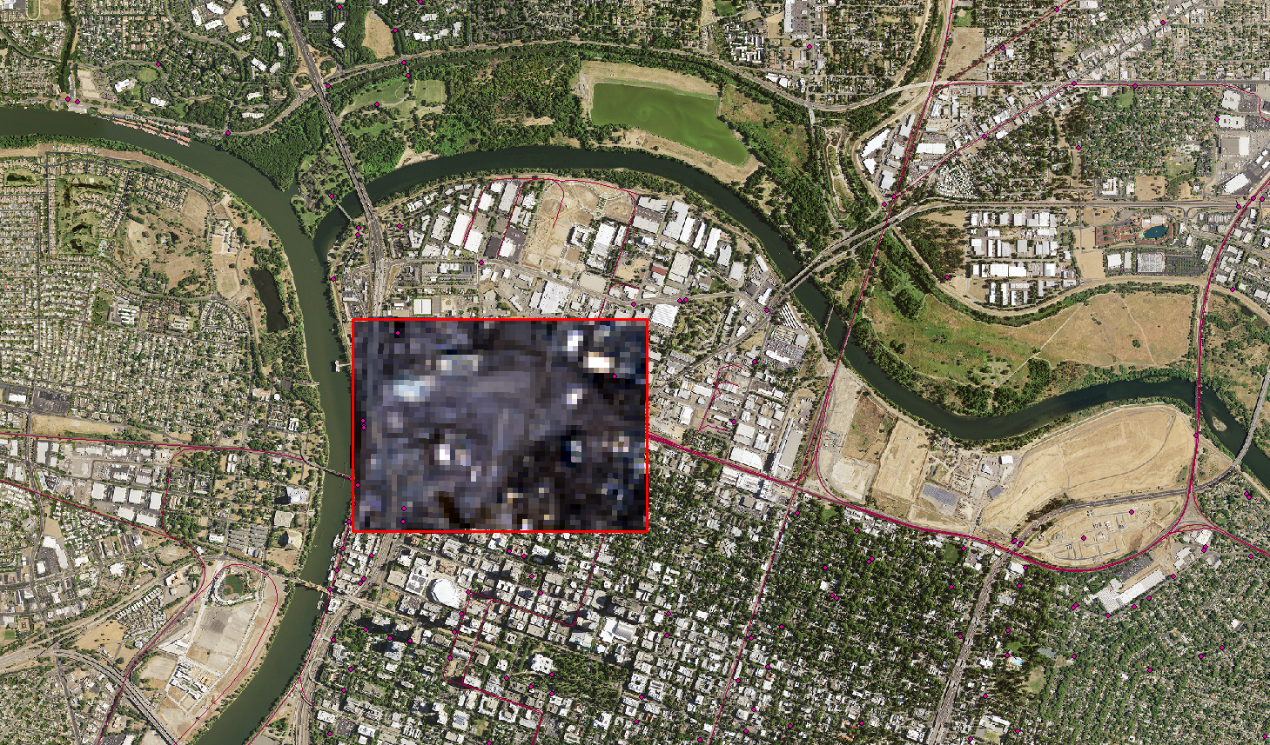
Composite Raster – Clipped
The benefit of using a python script is the reduction of processing time as opposed to execution of the multiple rasters via ArcMap. Scripting results in a reusable object that can be further generalized into a class object.
1:24,000

Slide 9
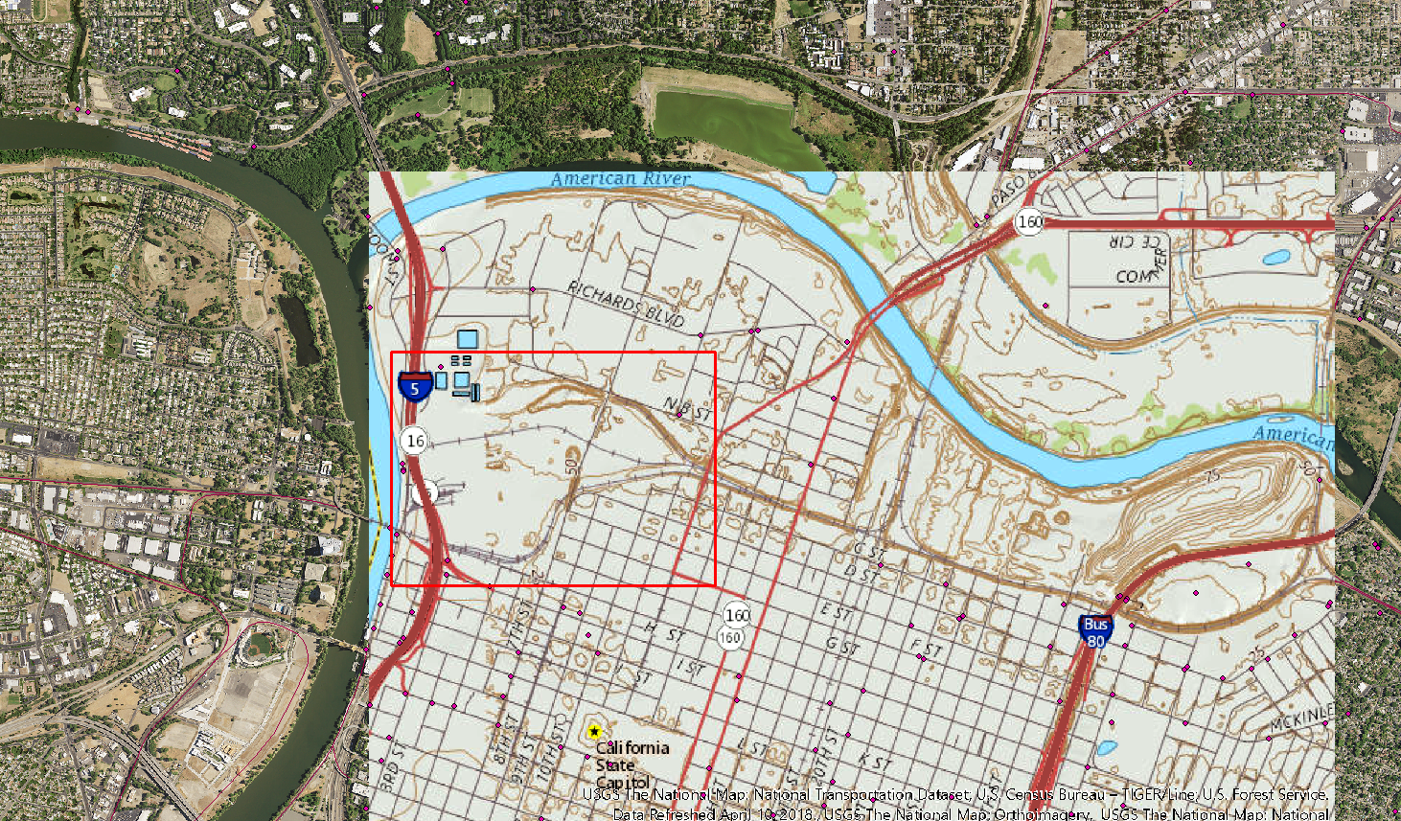
Historical geoPDF - Converted to TIFF
For this initial phase, twelve geoPDF files were processed with the PDF to TIFF python script from a specific folder. This map depicts a 1967 map, via USGS, that was rendered as a .tif file and included in MS SQL server and subsequently into ArcMap.
1:24,000

Slide 10
Challenges
Acquiring data - not easy to obtain free data
Level of effort - within time constraints
Learning curve using the arcpy python library
The resolution to the learning curve for the arcpy library was read the online documentation for both python and ArcGIS for syntax, and method usage.

Slide 11
Data Sources
Landsat:
https://landsatlook.usgs.gov/
City of Sacramento – Open Portal:
http://data.cityofsacramento.org/
National Railways:
https://catalog.data.gov/dataset/2015-rails-national-geodatabase
Earth Resources Observation and Science :
https://eros.usgs.gov/
USGS:
http://historicalmaps.arcgis.com/usgs/

Slide 12
References
Python website:
www.python.org
Esri:
www.esri.com
ArcGIS:
https://desktop.arcgis.com/en/arcmap/10.5/analyze/arcpy-classes/alphabetical-list-of-arcpy-classes.htm
Stack Overflow:
stackoverflow.com
Sacramento Railyards Specific Plans:
http://railyards.com/Portals/0/Documents/ProposedRailyardsSpecificPlanDRAFT.pdf?ver=2016-08-18-213326-060
Jennings, Nathan. A Python Primer for ArcGIS Workbook II, 2015
Lutz, Mark. Learning Python, 5th Ed. Beijing: O’Reilly Media, Inc., 2013

