Slide 1
Sensor Comparison
NDVI Classification
GEOG 342, FALL 2019

Slide 2
Comparing Sensors/Data Sources
There are many sources for multispectral remotely sensed data
Compare adequacy of sensors for Morrison Creek area analysis
Run unsupervised classification on NDVI layers produced from Landsat, SPOT, and NAIP imagery

Slide 3
Sources
Earth Explorer
  Government Sponsored: Landsat 4-8 Analysis Ready, Surface Reflectance data set – JULY 2019
  30m Resolution
  Commercial: SPOT (1986-1998) – JULY 1986
  20m Resolution
ArcGIS Online
  USA NAIP Imagery – 2017
  1m Resolution

Slide 4
Issues
Finding Landsat Data
  Cloud Cover
  No Coverage Stripes
  Need to compose bands into new raster
SPOT
  Ended in the 1990’s, limited datasets
NAIP
  Longer time to process due to larger size

Slide 5
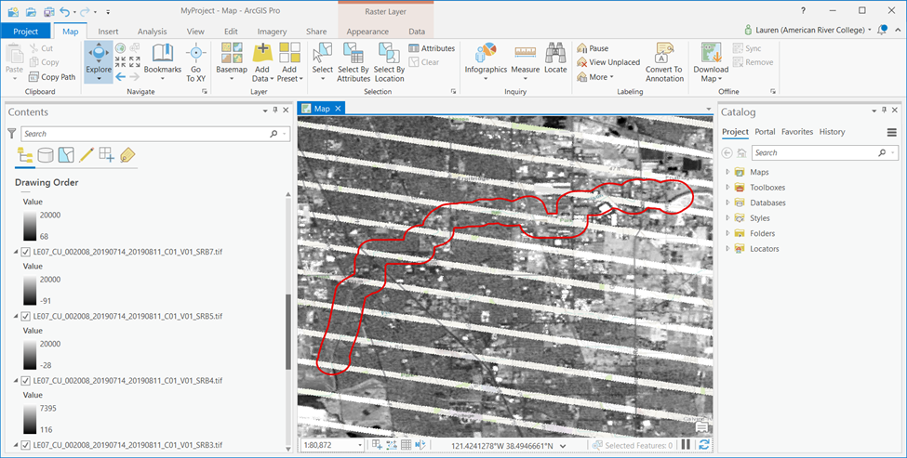

Slide 6
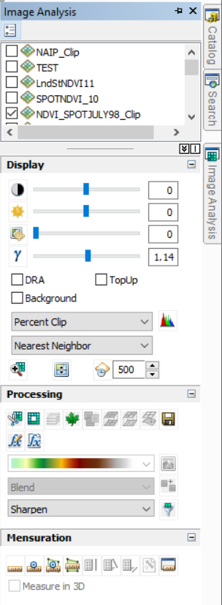
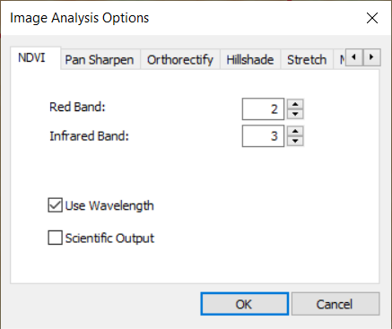
NDVI Creation
SPOT only had three bands, already a composite from source download
Landsat needed to have bands 1-4 composited, used different Image Analysis NDVI settings
NDVI

Slide 7
Normalized Difference Vegetation index

Slide 8
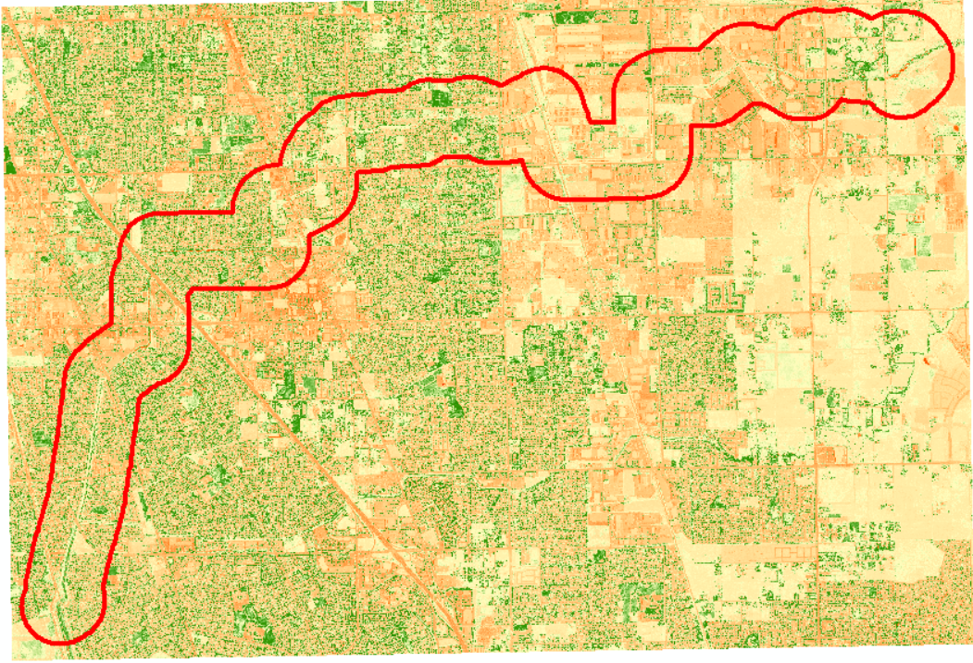
NAIP

Slide 9
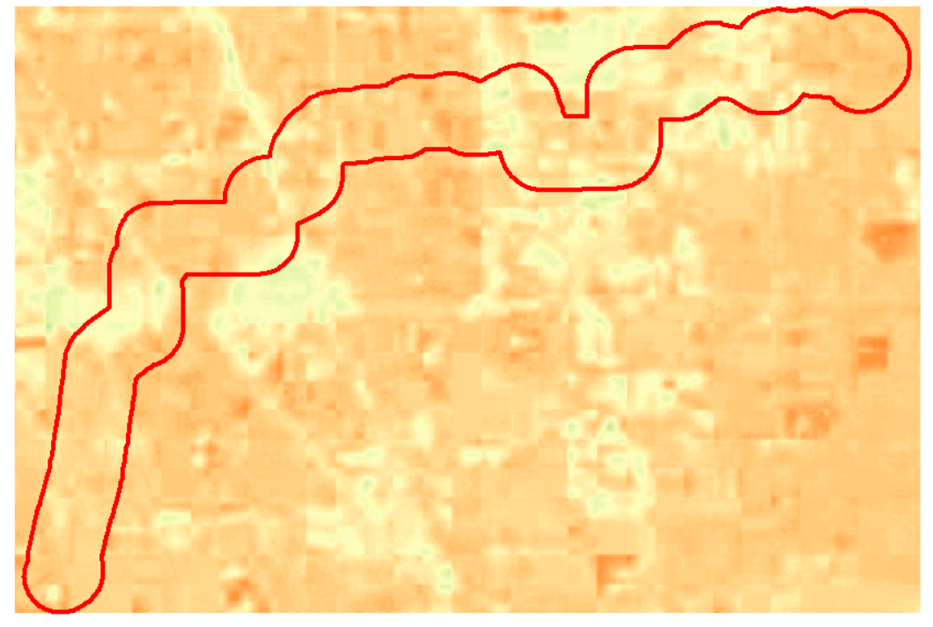
SPOT

Slide 10
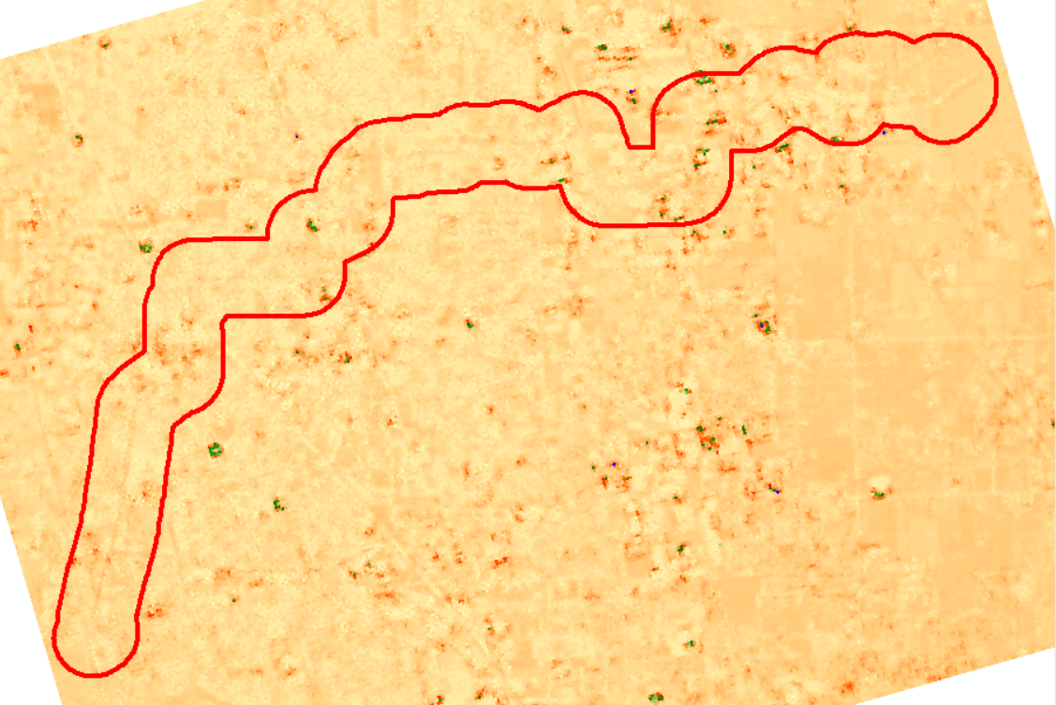
Landsat

Slide 11
Unsupervised Classification
ISO Cluster

Slide 12
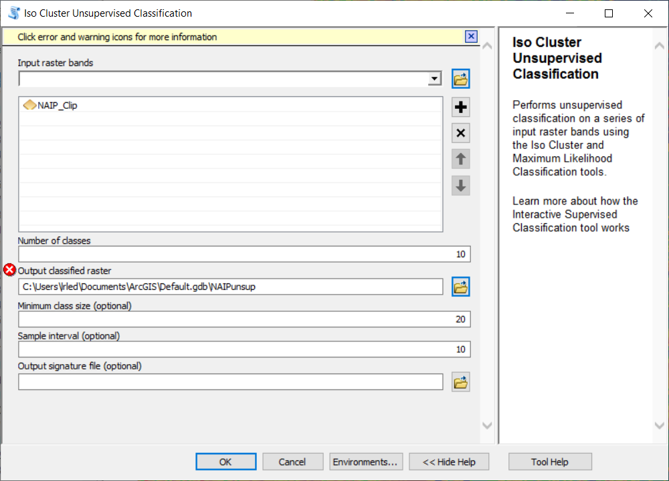
Same Settings…

Slide 13
Different Results

Slide 14
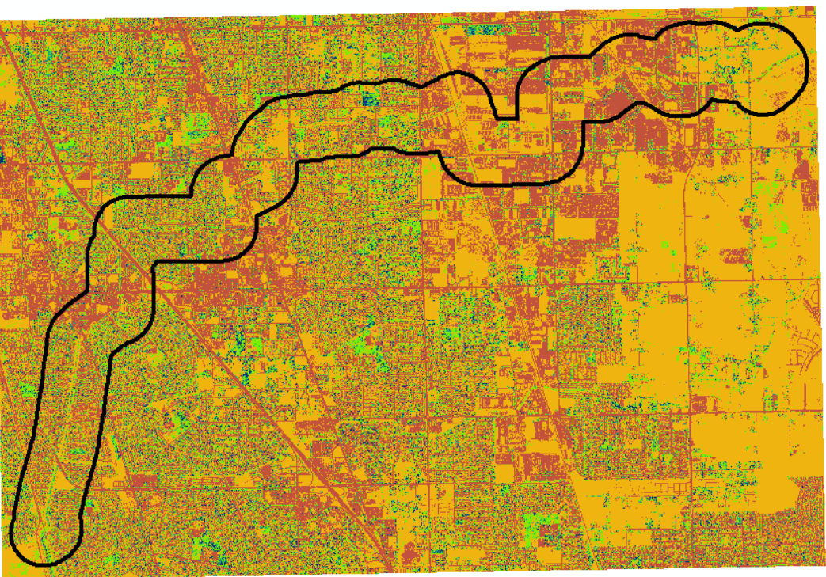
NAIP

Slide 15
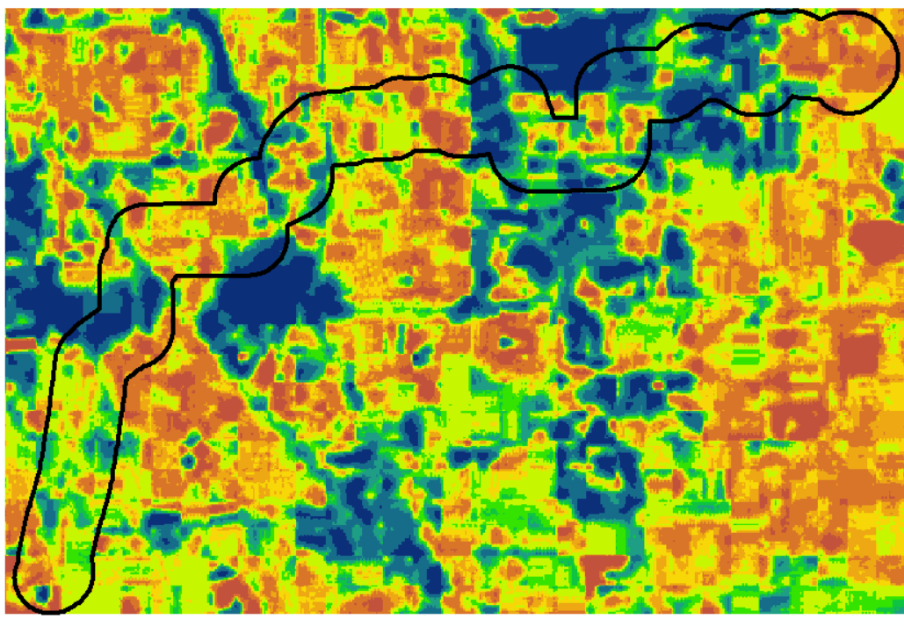
SPOT

Slide 16
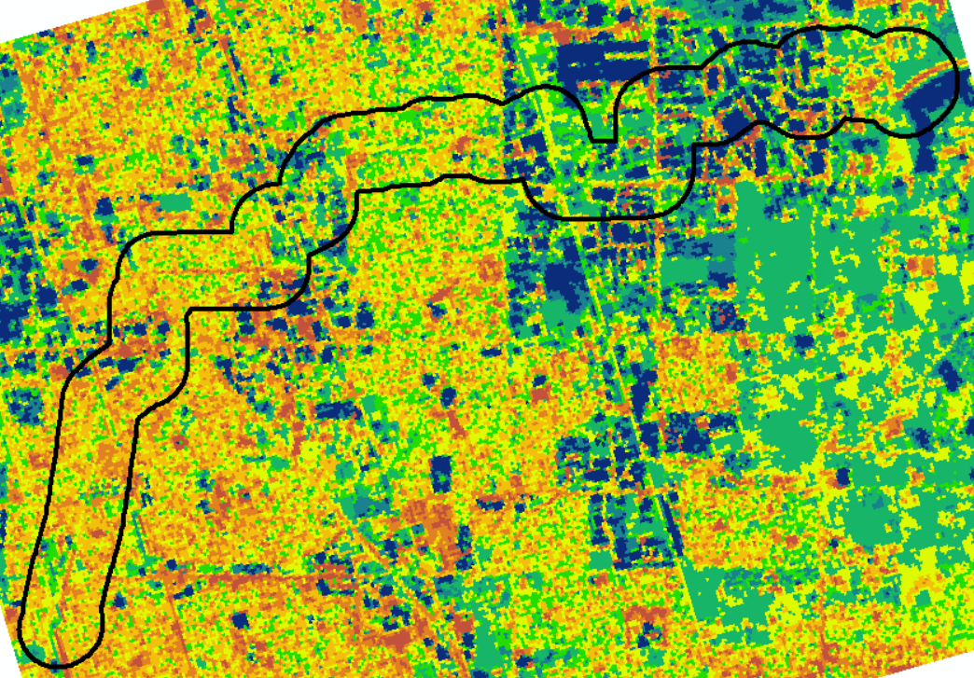
Landsat

Slide 17
Conclusion
NAIP Imagery appropriate for the Morrison Creek Project, but larger study areas should consider using Landsat.
Raster Analysis or modeling will take much longer with NAIP. This could impact timelines for any proposed project.
Interesting how SPOT has smaller pixel size, but Landsat had better precision. Likely from improvements of technology from 1986 to 2019.
Also consider analyzing other sources for imagery.

