Slide 1
Prospecting New Winery & Vineyard Opportunities in Amador County
Focus of Study
City of Plymouth Area
Kent Heiner kaheiner@ucdavis.edu
GEOG 375 Spring 2018
Introduction to GIS Programming/Prof. Nathan Jennings

Slide 2

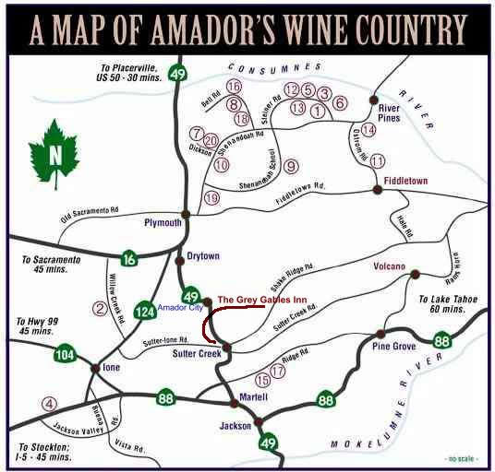
Amador Wine Country
A rapidly expanded wine country, excellent opportunity for prospecting winery owners
Still plenty of undeveloped Ag land available, as opposed to Napa county, for example

Slide 3

Project Purpose
Develop a python script that is designed to help clients seek out new winery and vineyard availability within Amador County (Plymouth area focus)
Sufficient unfarmed land within the agriculturally zoned areas that are available for purchase
Rapidly growing wine country, values expected to rise soon
Demonstrate python-coded geoprocessing functions to achieve desired processed data

Slide 4
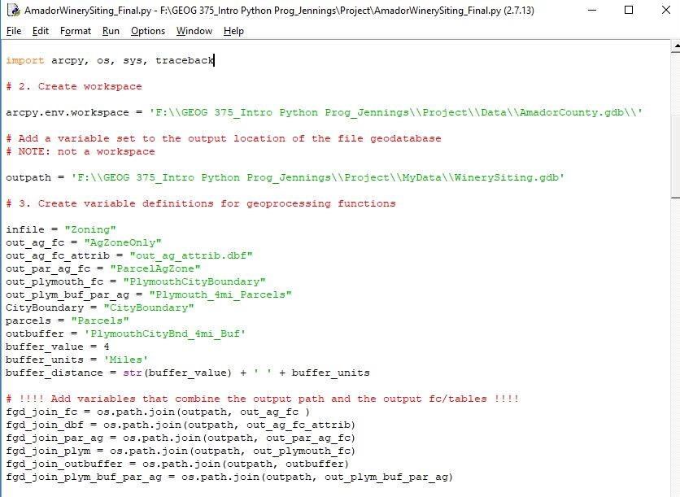
Starting the Script
AmadorCounty.gdb as my workspace (raw county data)
WinerySiting.gdb as separate output location of the file geodatabase for feature class exports (processed data)
Variable definitions for many of the subsequent geoprocessing functions
os.path.join variables

Slide 5
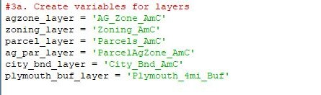


Variables for Layers and Queries
Geoprocessing routines required the making of layers
Variables created for my query statements
  To select the AG field from the Zoning layer
  To select the Plymouth field from the City Boundary layer

Slide 6
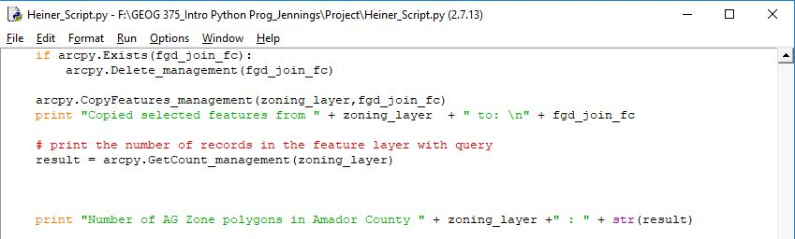
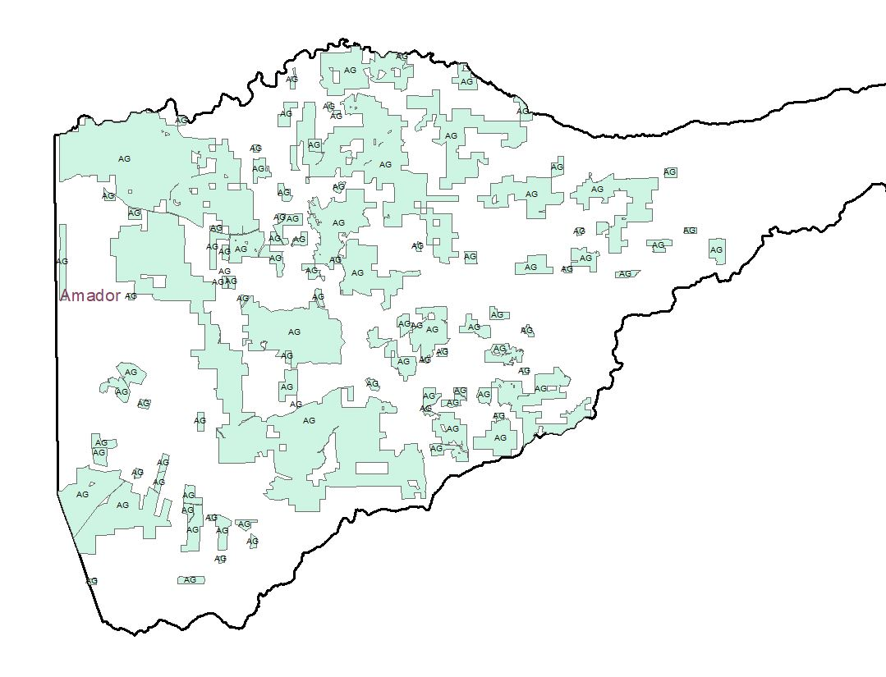
Copy Features
&
Get Count
Queried Features are copied to a new “AgZoneOnly” feature class in WinerySiting.gdb
Get Count management routine returns a count of polygons in new shapefile
Ag Zone Only layer drawn up in ArcMap

Slide 7
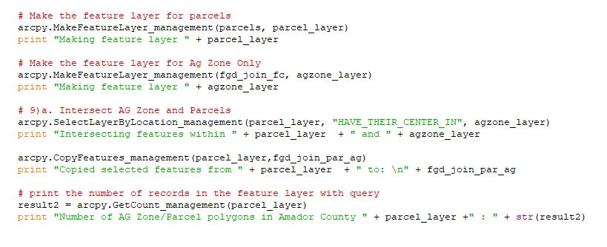
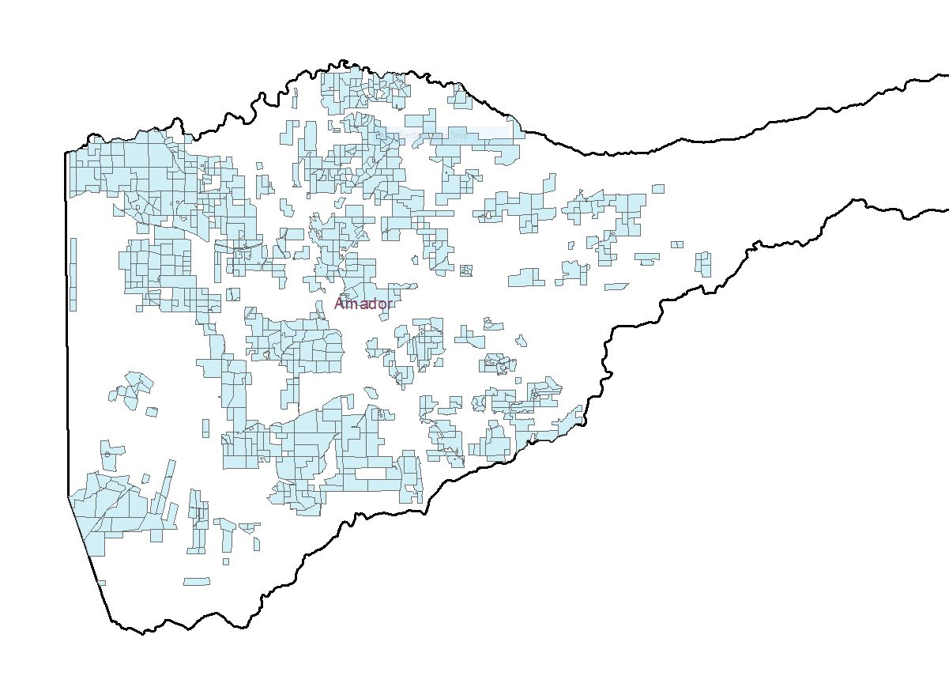
Ag Zone Parcel Overlap
Feature layers made for Select Layer by Location
Overlap type "HAVE_THEIR_CENTER_IN“ best choice to retain parcels of interest integrity
Copy Features routine used to create “ParcelAgZone” new output feature class
Parcel Ag Zone layer drawn up in ArcMap

Slide 8
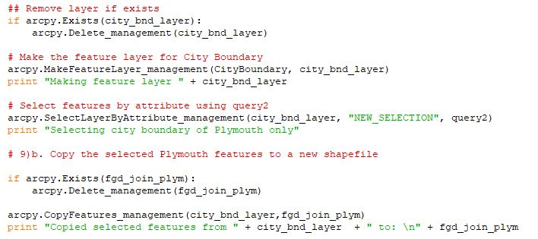
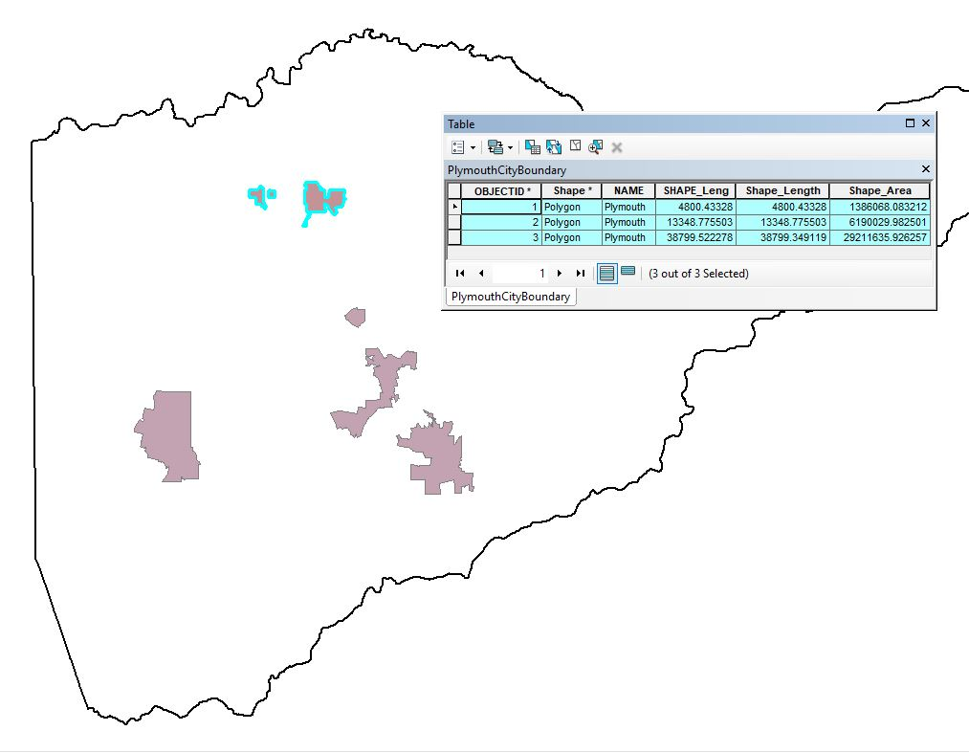
Plymouth Boundary
Queried Features are copied to a new "PlymouthCityBoundary“ feature class in WinerySiting.gdb
Plymouth City Boundary layer will be used for intersection with Ag Zone Parcel

Slide 9
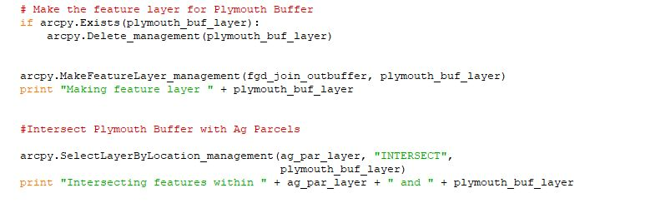
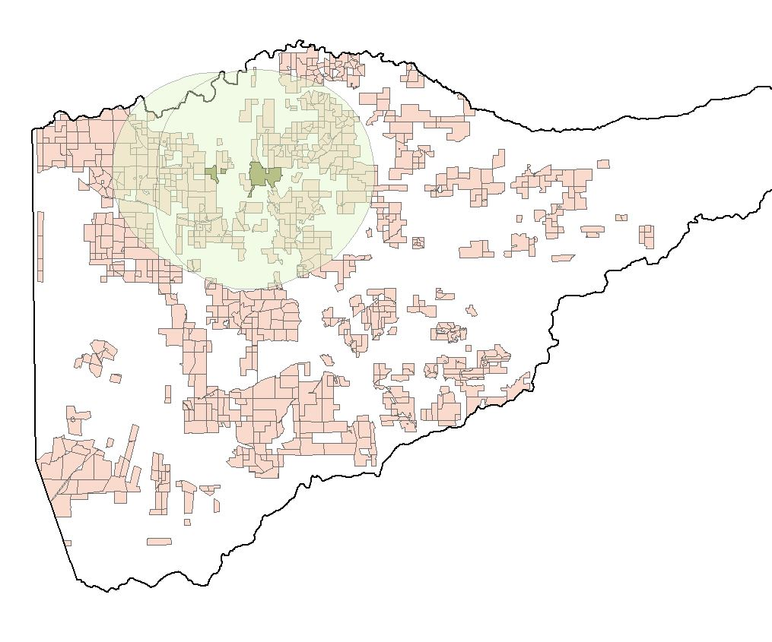
Plymouth 4 mi Buffer
Plymouth 4 mile buffer created
Buffer layer must intersect with Parcel Ag Zone layer to create the desired feature class for final product

Slide 10
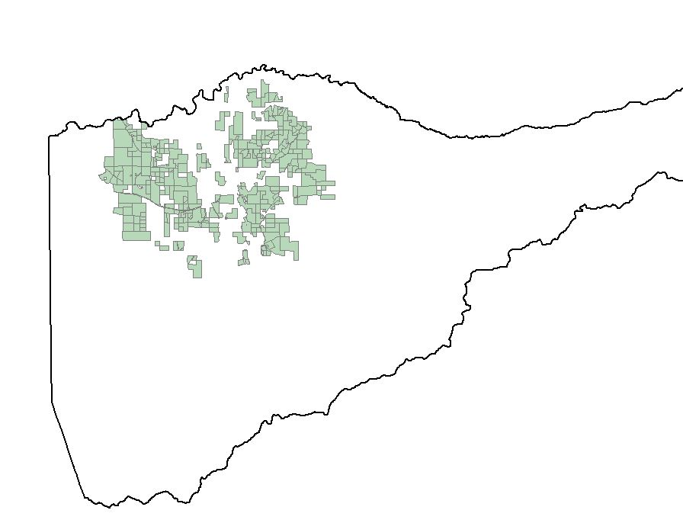
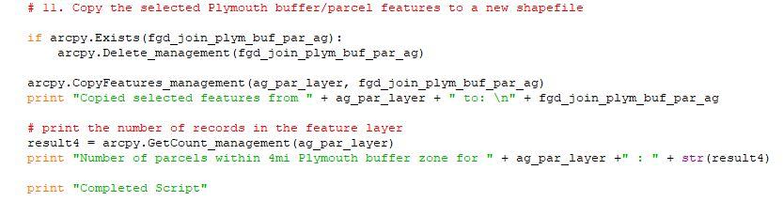
Plymouth 4 mi Buffer Parcel Feature Class
The final "Plymouth_4mi_Parcels" feature class created
Attributes contain pertinent parcel information and situs addresses
Situs is actual assessors office “geolocation” as opposed to billing addresses

Slide 11
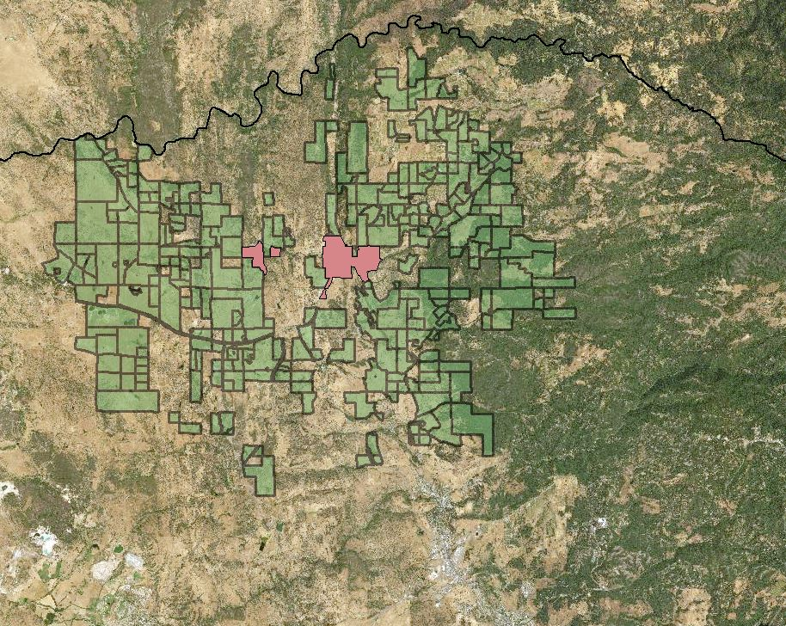
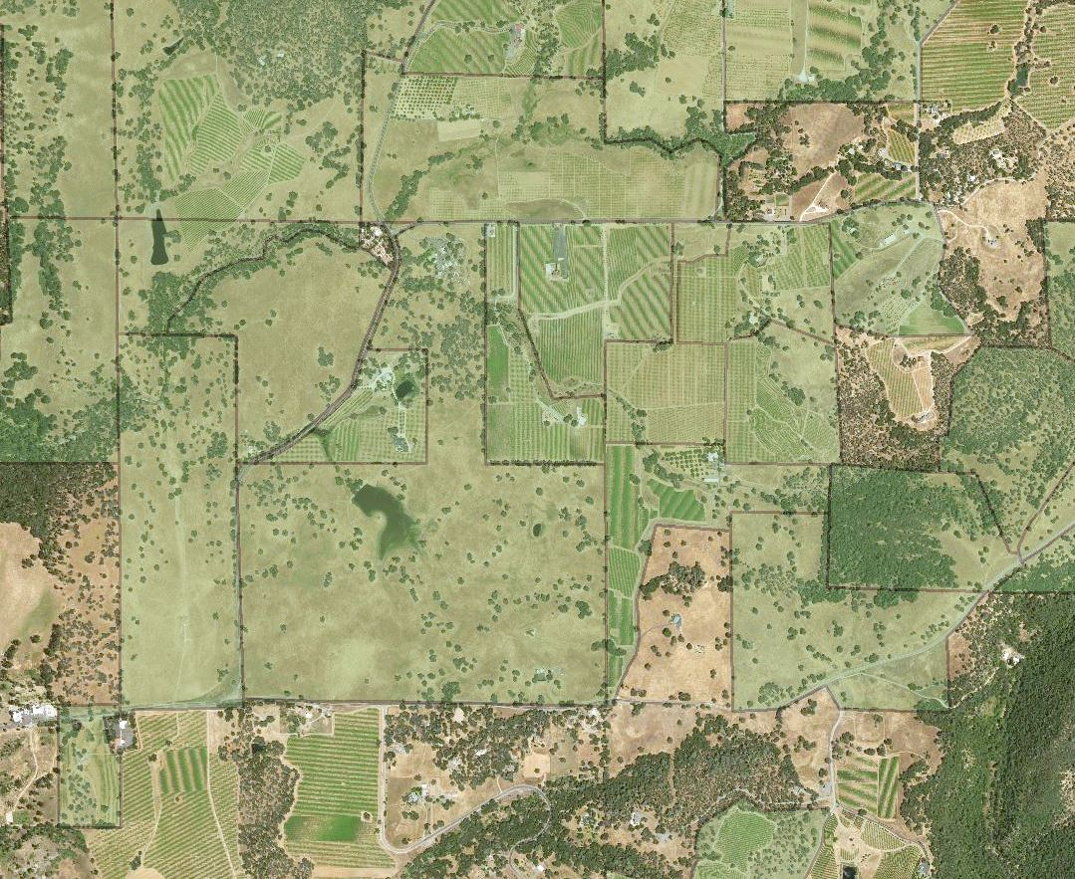
Plymouth 4 mi Buffer w/NAIP Imagery
Ag parcels zoomed out show range of parcel availability 4 mi outside of Plymouth city center
Ag parcels zoomed in reveal both undeveloped parcels and cultivated parcels for prospective buyers

Slide 12
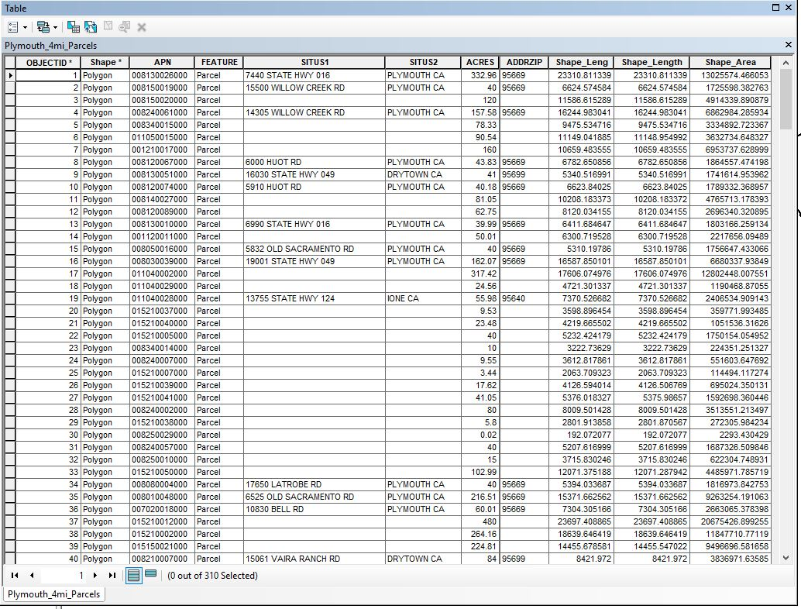
Plymouth 4mi Radius Parcel Data
Parcel APN and Situs Addresses can be reconciled with Assessor’s Office to determine what is privately owned, publicly owned (BLM, for example), or any other ownership status for potential purchase negotiations

Slide 13
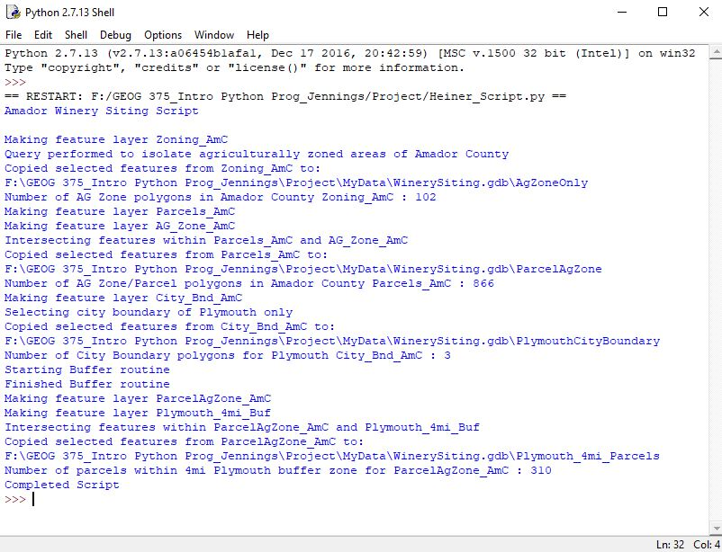
Completed Script
Run module through python shell
Provides user with geoprocessing information as script runs
Provides record counts
Shows location of feature classes created by Copy Features routine

Slide 14

Challenges
Most often just a simple typo, missed punctuation or indent (the usual problems)
I had to reverse my layer placement within the parameters of my Select Layer by Location (SLL) routine (input/output parameter placement issue)
Finding the correct overlap type for SLL
Keeping track of all the variables that were necessary for this script to run correctly

Slide 15

Further Considerations
My script could be added with mapping module functions that could automate map making for prospective client
Locations of interest must be identified by client first
If clients have ArcMap, they can add layers from WinerySiting.gdb and select, zoom, identify, and read attribute properties at will

