Slide 1
Introduction to GIS Programming: Final Project
Richard Gadberry

Slide 2
Background & Intent
Identify individual milk producing plants
Select plants within identified dairy regions
Consider Proximity to Truck Routes
Identify nearest intermodal shipment points to selected milk plants
Notes:
In California, raw milk production tends to be concentrated in the Central San Joaquin Valley in counties such as Kings, Kern, Merced, Madera, Fresno, and Tulare (California Department of Food & Agriculture 2017), while a majority of the state’s population, and consequently its dairy consumers, reside in much denser urban areas clustered in the southern portion of the state as well as to the north-east. Typically, producers transport raw milk to processing plants by truck, where the milk is pasteurized and either packaged as drinking milk or processed into other products such as cheese and butter. Products intended for interstate or international shipment often undergo transshipment from truck to rail or truck to ship at intermodal transportation points.
The script analysis seeks to identify individual milk processing plants which fulfill a set of geographic and attribute criteria. Specifically, the analysis seeks to identify plants processing fluid milk within core dairy producing regions. Additional criteria include proximity to established trucking routes. The script identifies the nearest intermodal transportation point to each selected plant and calculates the distance between the points.

Slide 3
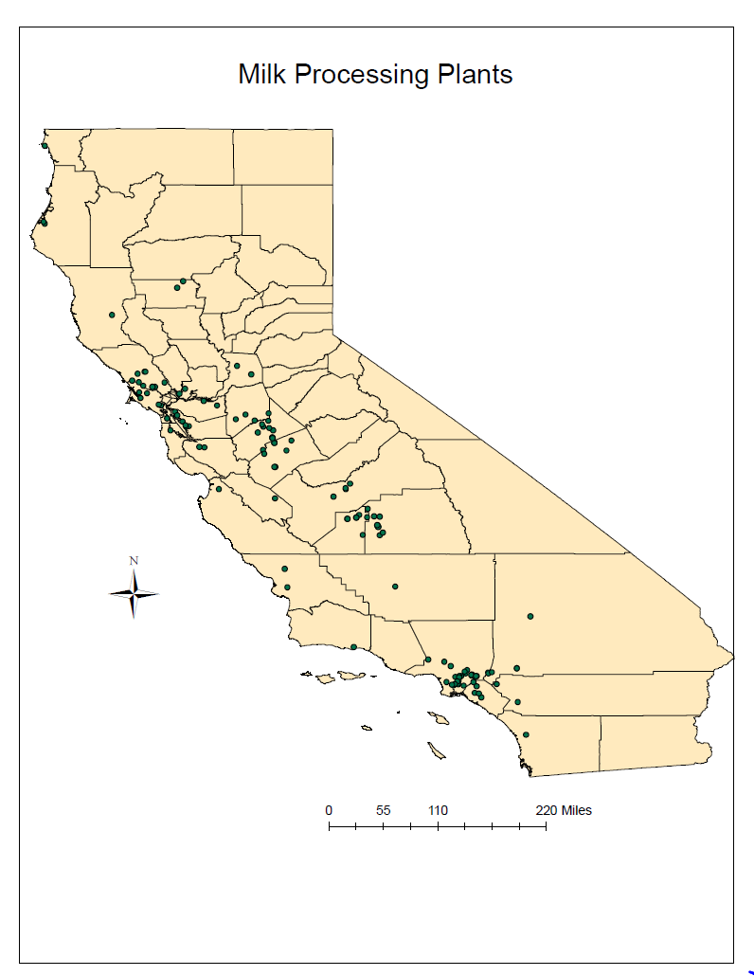
Dairy Processing Plants
Notes:
Above is map displaying all dairy producing plants registered with California Department of Food & Agriculture.

Slide 4
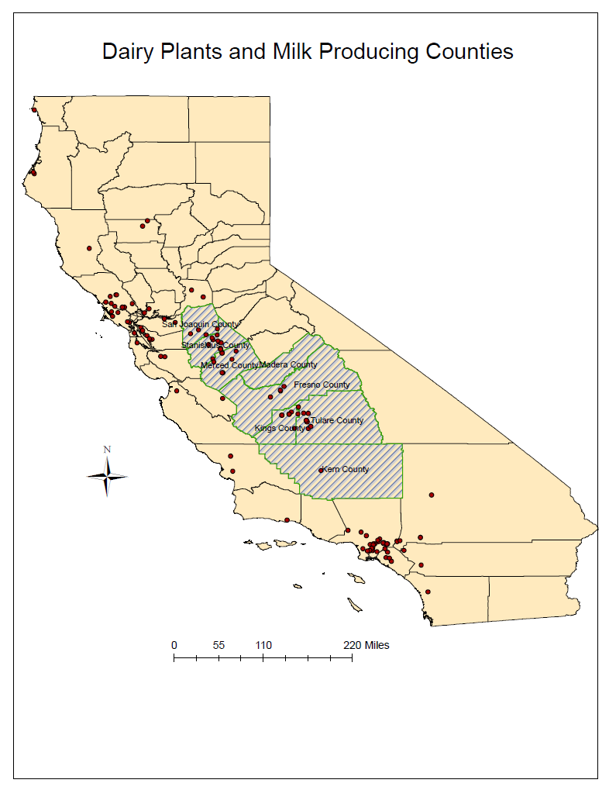
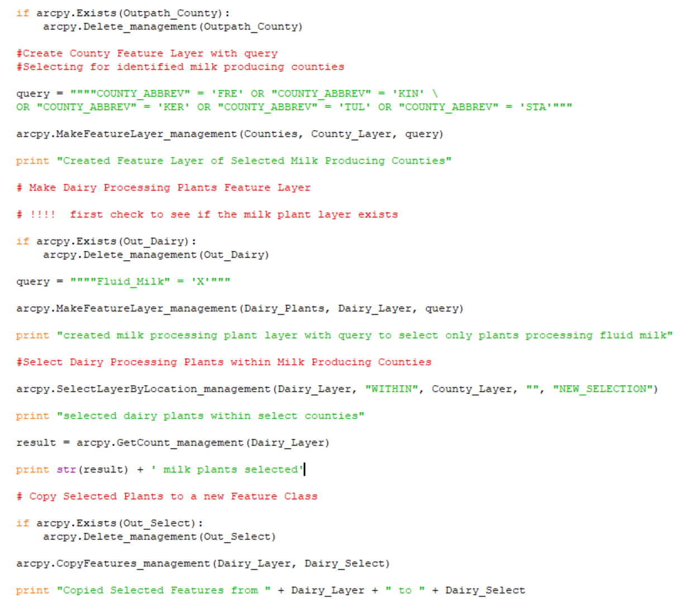
Dairy Producing Regions
Notes:
The script initially draws the county feature class as a layer. A query selecting by name selects the identified dairy producing counties. These include Kern, Tulare, Kings, Fresno, Madera, Merced, Stanislaus, and San Joaquin counties.
The script also draws the milk processing plants feature class as a feature layer, with a query selecting only those plants producing fluid milk. Utilizing Select by Location, the script identifies those milk producing plants within the selected counties. Next, the Copy Features tool copies the selected plants to a new feature class.

Slide 5
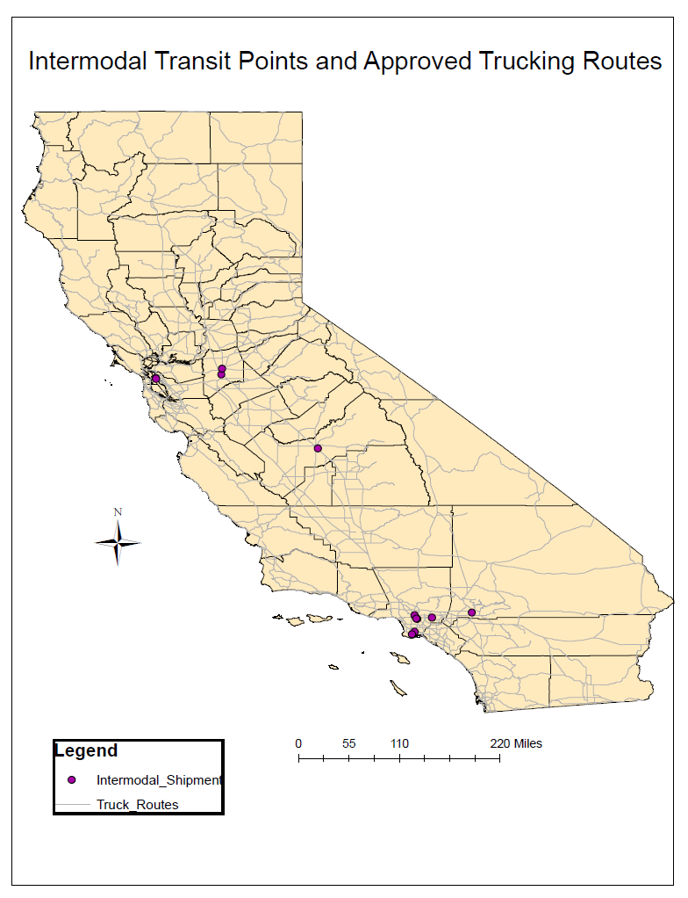
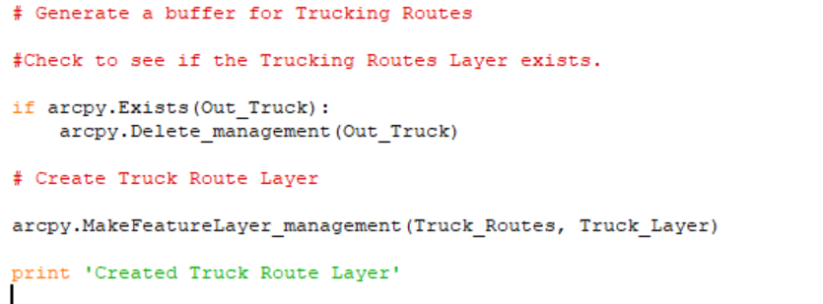
Truck Routes and Intermodal Transportation Points
Notes:
The above map displays approved trucking routes as well as the locations of Intermodal Transportation Points where freight can be transshipped between truck and rail or truck, rail, and ship. Both layers originated as shapefiles obtained from California Department of Transportation.

Slide 6
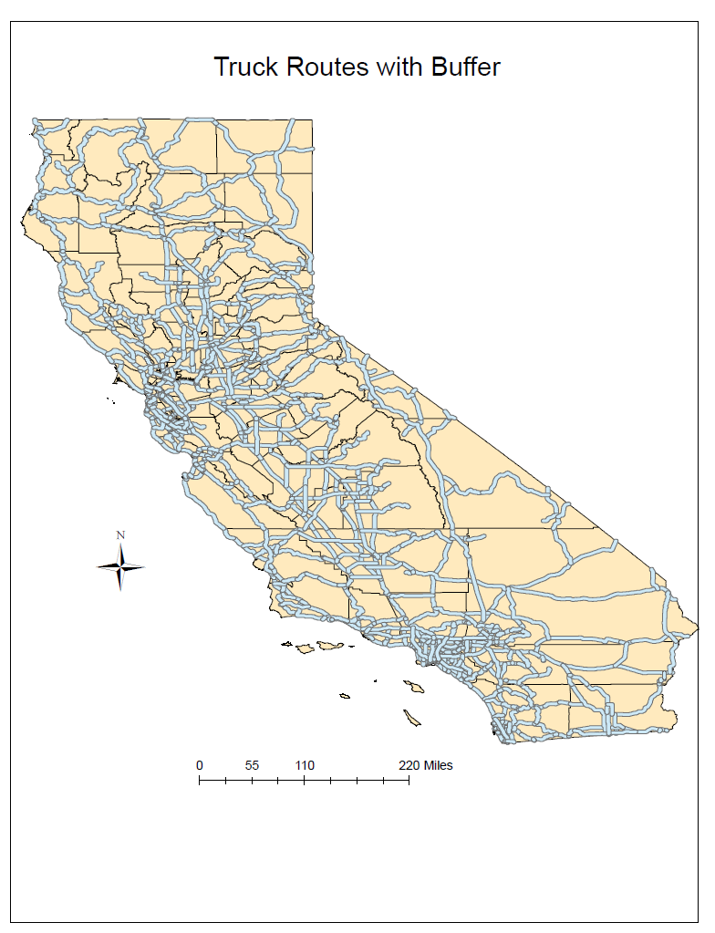
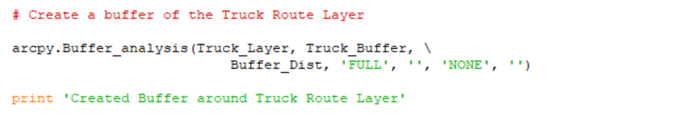
Truck Route Buffer
Notes:
The script draws a buffer around the truck routes layer. In this instance the buffer distance variable was set to 10,000 feet.

Slide 7
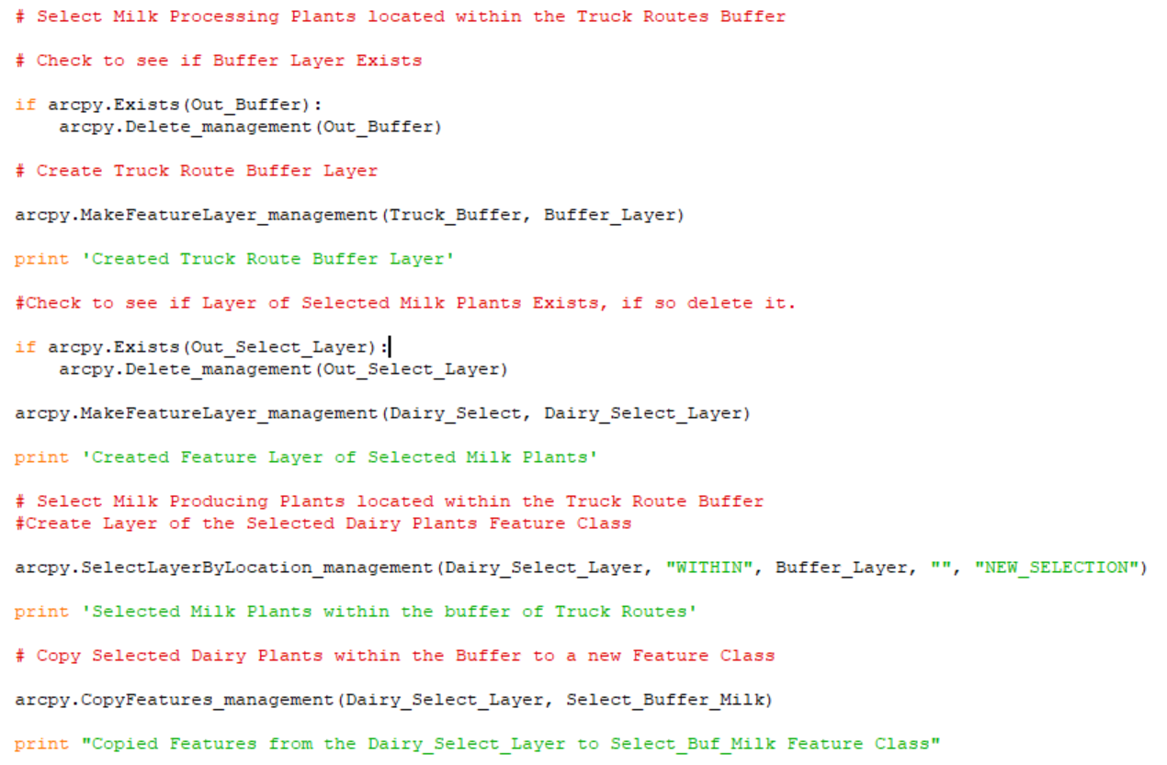
Identifying Selected Milk Plants within the Truck Routes Buffer
Notes:
Next, both the truck routes buffer and the selected dairy plants are each drawn as layers. The script then utilizes Select by Location tool to identify the selected milk producing plants that fall within the buffer layer. The resultant output produces a feature class of plants producing fluid milk, located within selected dairy producing counties, and located within 10,000 feet of an approved trucking route. The selected features are copied to a new feature class (Select_Buffer_Milk).

Slide 8
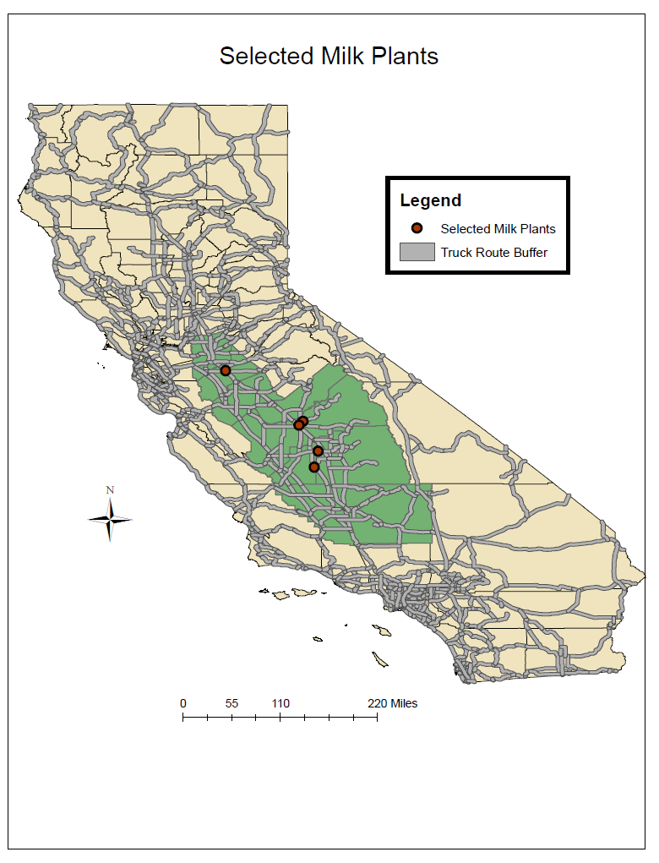
Selected Milk
Plants
Notes:
The above map depicts the output (Select_Buffer_Milk) of the script milk plant selection method. Depicted are plants producing fluid milk, located within dairy producing counties, and within 10,000 feet of an approved truck route.

Slide 9
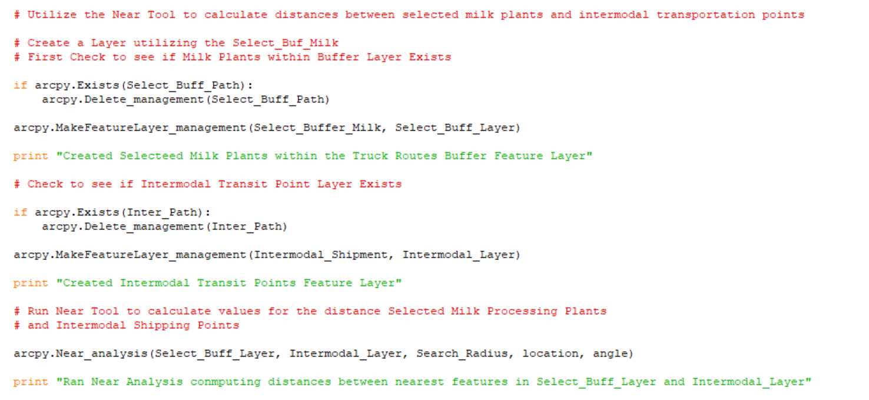
The Near Tool
Notes:
Employing the Near Tool, the script generates attribute values within the selected milk plants, including the object id (Nearid in the attribute table) of and distance to the nearest Intermodal Transportation Point.

Slide 10
Near Tool Output
Notes:
The attribute table above depicts the values generated by the Near Tool and displayed in the attribute table of the Selected Milk Plants Layer (Select_Buff_Layer).

Slide 11
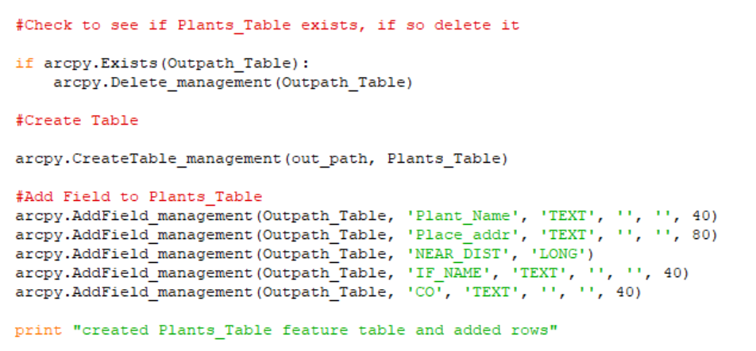
Create New Table
Notes:
A new table (Plants_Table) is created to which the selected data will be written to in the following steps utilizing a Search Cursor and an Insert Cursor.

Slide 12
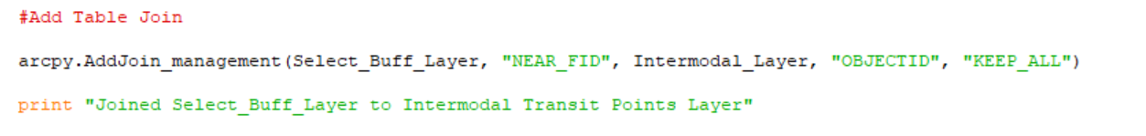
Table Join
Notes:
In the previous code excerpt, the near tool generated values within the milk plant layer attribute table which include the Object Id number of and distance to the nearest intermodal facility. However the name of the facility as well as its location information can only be found in the intermodal transportation layer attribute table. This section of the script joins the selected milk plants to the Intermodal Transportation Points Layer utilizing the shared identification field (NEAR_FID and Objectid). This generates an attribute table within the milk plants layer that includes the name of each milk plant, plant address, the name of and distance to the nearest intermodal facility and the county of the corresponding intermodal facility.

Slide 13
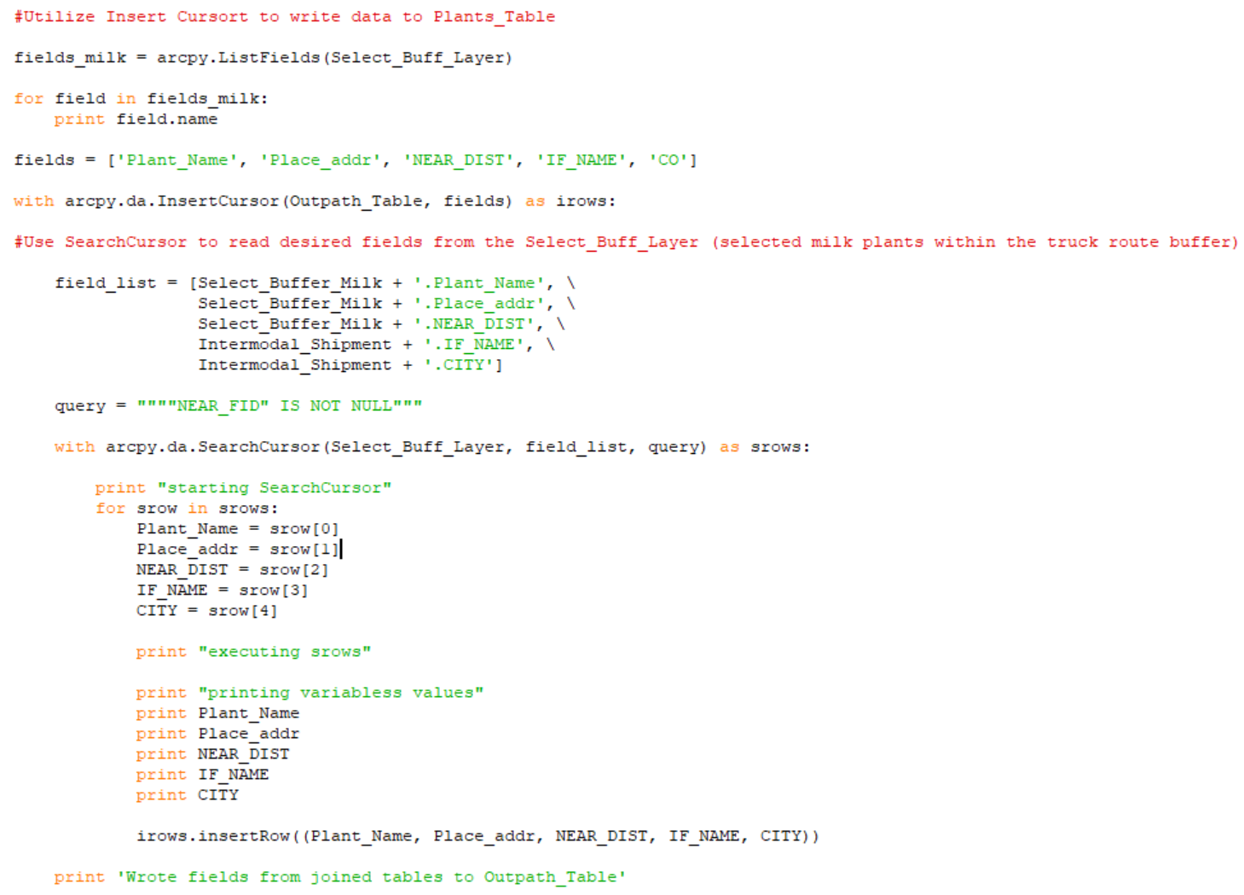
Insert Cursor
& Search
Cursor
Notes:
The script employs an Insert Cursor to insert the values from the table join to the newly created table. Within the Insert Cursor, a Search Cursor, iterates through the desired fields in the joined table.

Slide 14
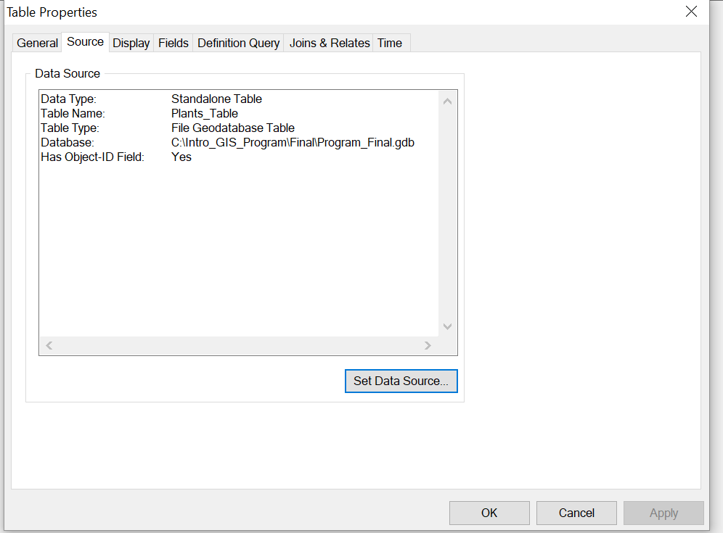
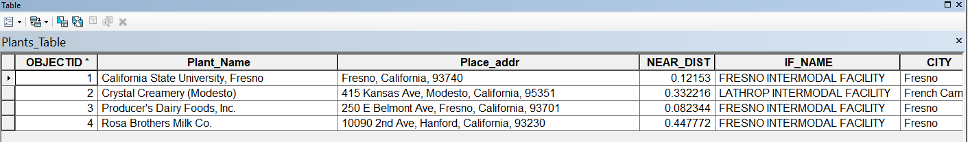
Notes:
The script ultimately created the new table (Plants_Table). The desired values were successfully read from the joined tables of the Select_Buffer_Layer (selected milk plants) and the Intermodal_Layer (layer of intermodal transit points). The resultant output includes a table with each of the selected milk processing plants, the plant address, the distance to the nearest intermodal facility, and the city in which the intermodal facility is located.

