Slide 1
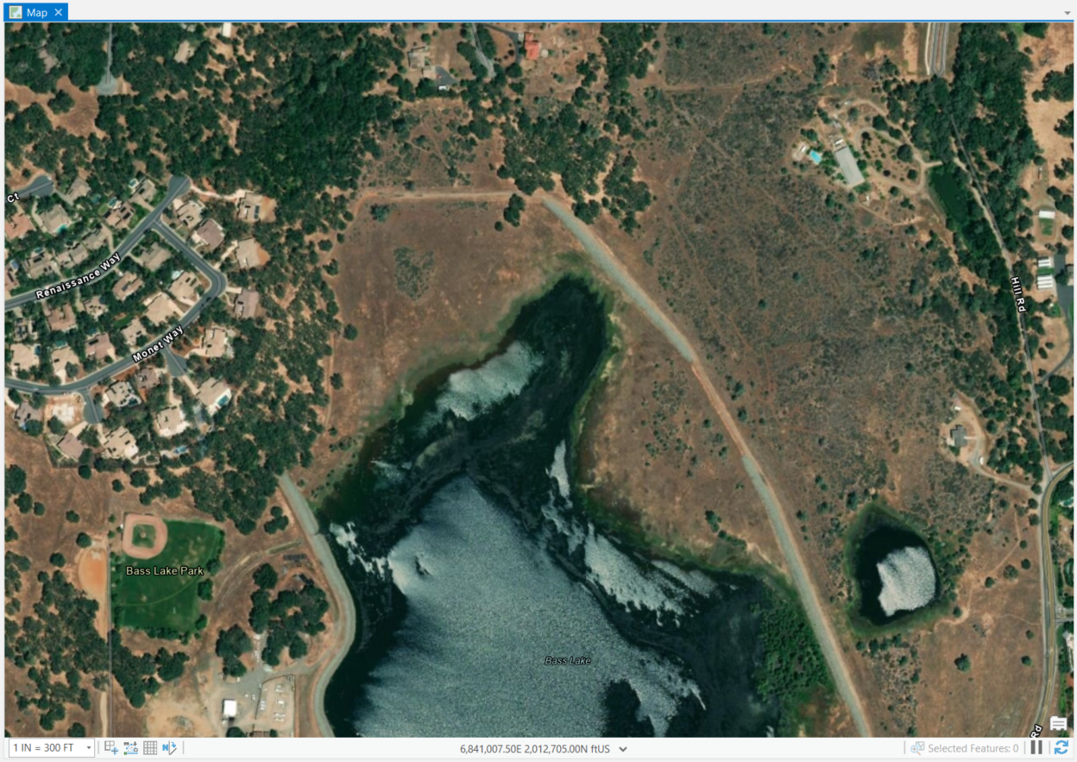
DRONE IMAGERY PROCESSING
Supervised Land Classifications of Northern Bass Lake, El Dorado Hills, California
By: Mariko Falke
GEOG342 – Spring 2020 – Final Project mariko.falke@gmail.com

Slide 2
Project Summary
Northern portion of Bass Lake located in El Dorado Hills, California.
Drone imagery collected on December 9, 2019.
Supervised land classification methods were applied.
Result: generally accurate after running reclassification of the data
  highly dependent upon the experience of the analyst with the processing tools.

Slide 3
Tasks and Methods
Import Base Map ESRI Aerial Imagery
Import Drone Imagery
Segment Imagery
Configure Classification Wizard
Generate Classified Image
Image Reclassification

Slide 4
Import Base Map ESRI Aerial Imagery

Slide 5
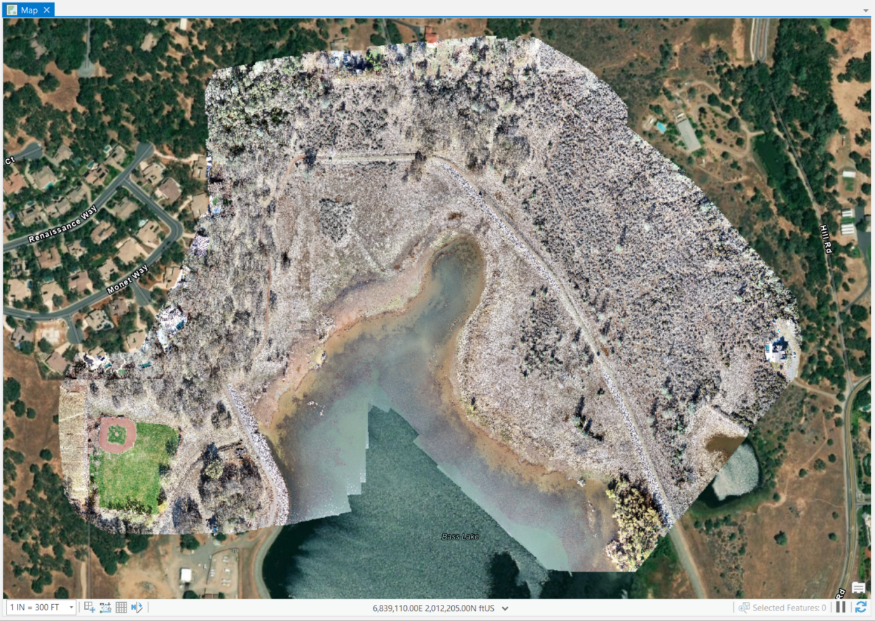
Import Drone Imagery
Black background needed to be removed upon importing imagery.
  Mask – “No data”. (Symbology)
Projected into NAD 1983 StatePlane California II FIPS 0402 (US Feet)
Drone imagery taken on December 9, 2019, by GIS Specialist Greg Gallagher (LSA) overlain the ESRI Basemap Imagery

Slide 6
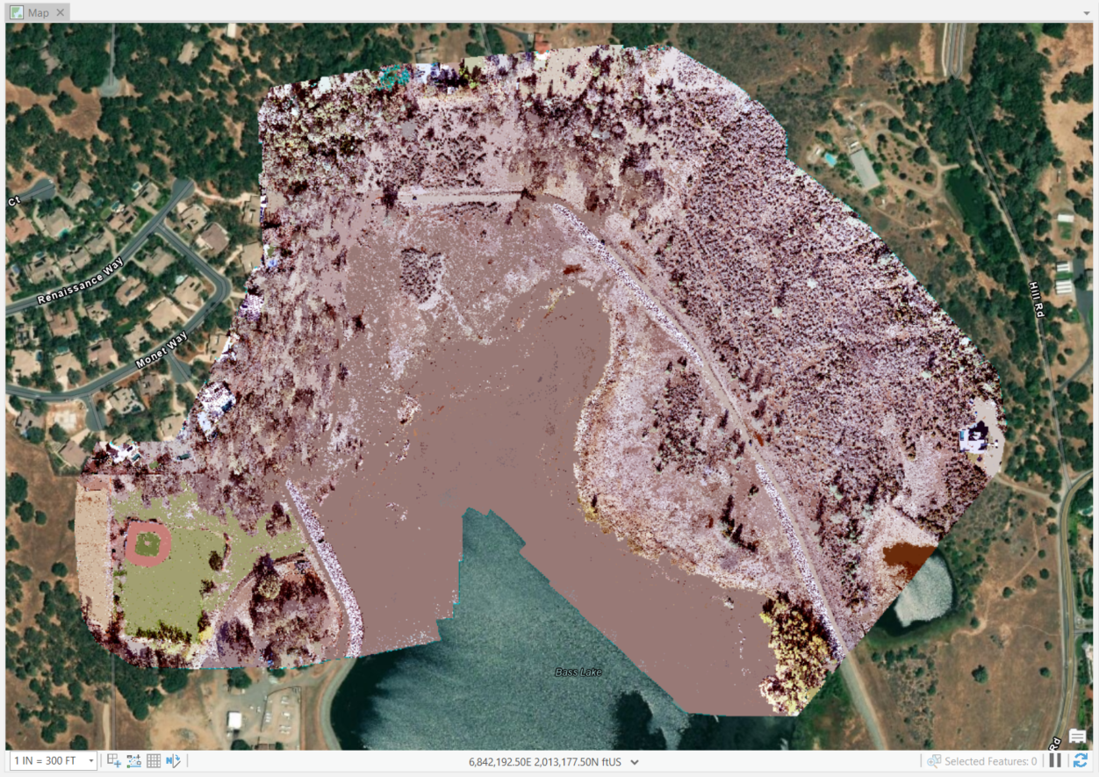
Segment Imagery
Classification tools and selected segmentation to segment the image before conducting image classifications

Slide 7
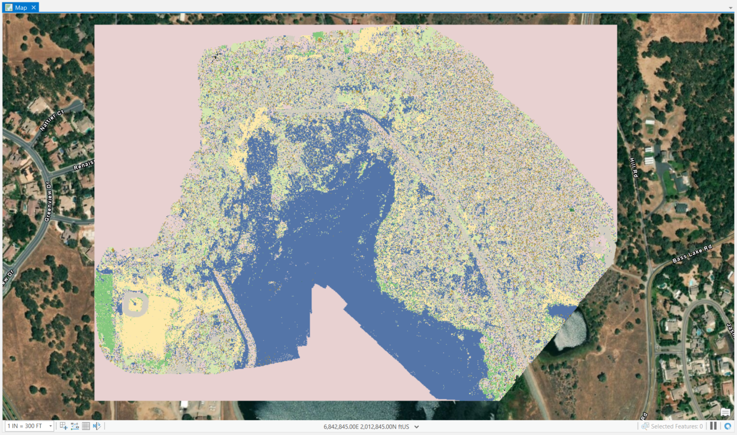
Configure Classification Wizard
“Supervised” Classification Method
“Object Based” Classification Type
“Use Default Schema” to select the NLCD2011 (National Land Cover Dataset 2011) Classification Schema
Segment Picker to select the Training Samples for each land classification
  dirt roads as “Barren”
  buildings and concrete areas as “Developed”
  pine trees as “Evergreen”
  desert shrub areas as “Shrubland”,
  Bass Lake extended into areas that were wet adjacent to Bass Lake was designated as “Water”.

Slide 8
Configure Classification Wizard
Observations:
Selecting water bodies extended past observable water extent in imagery
Original background was included from importing the drone imagery

Slide 9
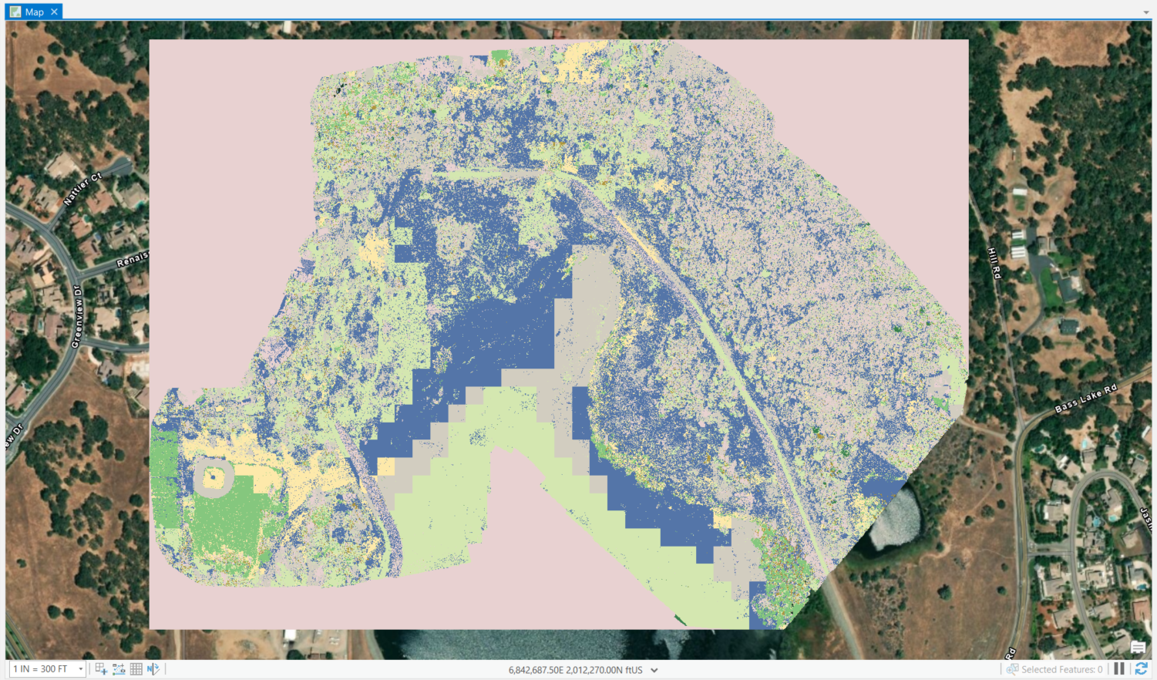
Generate Classified Image
After previewing the classified image, I generated the classified image.
The image generated was not the same as the preview.
Baseball field which should be herbaceous is classified as “Deciduous Forest”
Water is partially classified as “Mixed Forest”
Dirt roadway should be classified as “Barren”

Slide 10
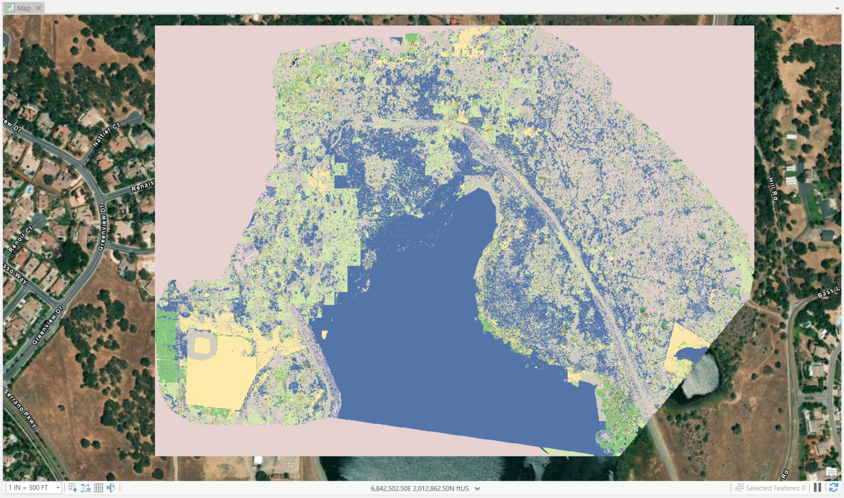
Image Reclassification
Identify areas severely misclassified
“Reclassify within Region” to create polygons that reclassify the entirety of Bass Lake as water and the baseball field as herbaceous
Reclassified developed areas as barren in the eastern portion
Area near the pond (east of Bass Lake)
  Water was identified much further than the extent of the pond based on the high resolution imagery
    Reclassed the water as herbaceous since this area is somewhat grassy

Slide 11
Final Thoughts
Drone Imagery
Masking the background wasn’t useful
High-resolution imagery generates smaller pixels
  Makes classifying pixels more tedious.
  Shadows caused problems since it was observed as “no data”.
  Season – collecting imagery during winter created more “water” areas since there was observable water on the ground surface.

Slide 12
Final Thoughts
Image Classification
Generated preview several times to refine land classifications identified
  Each time was more accurate based on sampling
Generated Image
Very different than the preview
Reclassified Image
Tedious
  Water has smooth rounded geometry – difficult to capture
  Modify area surrounding the pond
Most accurate in compared to intermediate phases

