Slide 1
Crime and marijuana dispensary centers
is there a problem?
Elaine Carlton
Geog 375
5/13/2018

Slide 2

The hot topic
In November 2016 Proposition 64 was passed, legalizing marijuana for adults in California beginning January 1, 2018
In order to sell or grow marijuana for purposes of distribution, a state business license is required
In addition to state regulations, there may be city regulations that must be followed
As more dispensaries open throughout the state, cities are becoming concerned about the potential increase in crime surrounding these businesses

Slide 3

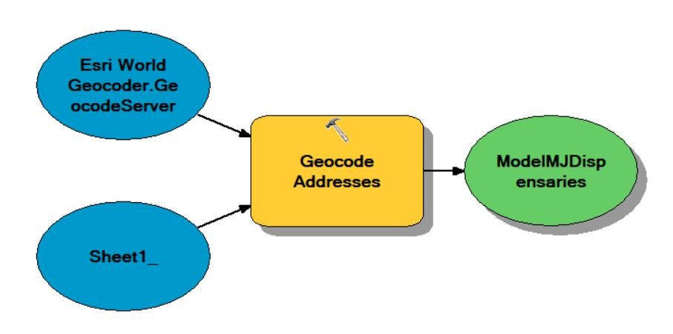
Python script - challenges
Initial intent was to write script to geocode the marijuana dispensary addresses using esri world geocoder
  Received error:
  After conducting extensive research, discovered many other people encountered the same problem, with no apparent solution for the script
  Used modelbuilder in arcmap instead to geocode the addresses
  ATTEMTED to use the python script from modelbuilder but it didn’t work

Slide 4
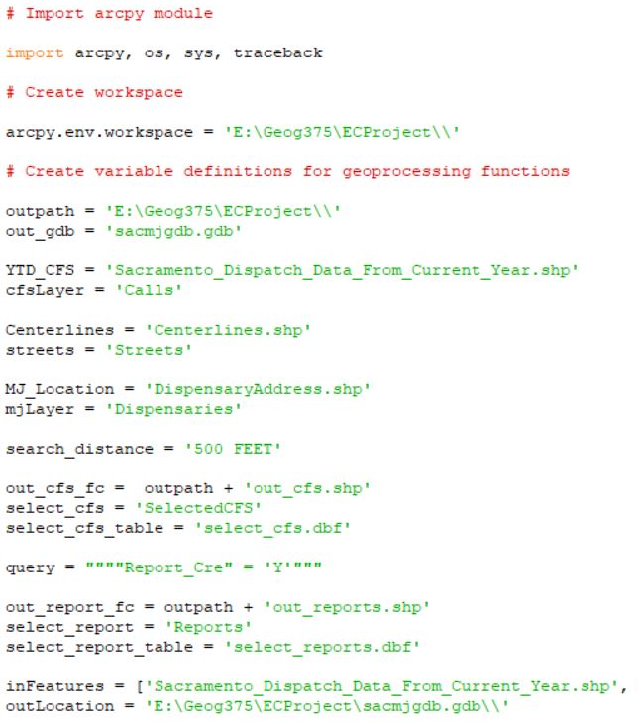
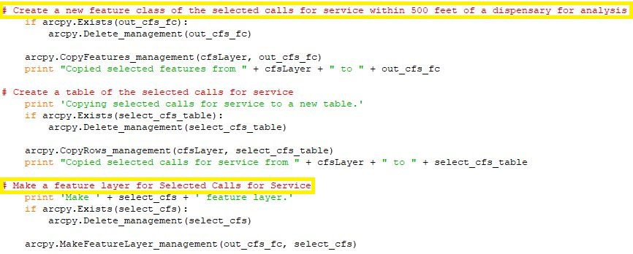
Python script – challenges
File management (location, naming, etc) is important when using multiple/similar data sets
Don’t forget to close down arccatalog and arcmap before running the script!
Proper indenting will make or break your script
Order of process is crucial to pay attention to
VARIABLES
FEATURE CLASS AND FEATURE LAYER

Slide 5
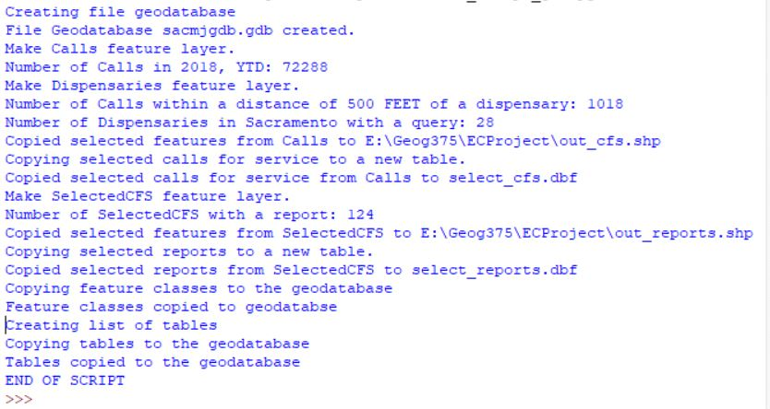
PYTHON SCRIPT – Geoprocessing
ALTHOUGH A MINIMAL NUMBER OF DATASETS WERE USED, MULTIPLE AND REPEAT FUNCTIONS WERE REQUIRED
  GEOPROCESSING:
    Create geodatabase
    Copy .shp and .dbf files to geodatabase
    MAKE FEATURE LAYER
    SELECT LAYER BY LOCATION
    SELECT layer BY ATTRIBUTE
    CREATE FEATURE CLASS
    COPY ROWS (CREATE TABLE)
    GET COUNT (SHOW RESULTS)

Slide 6
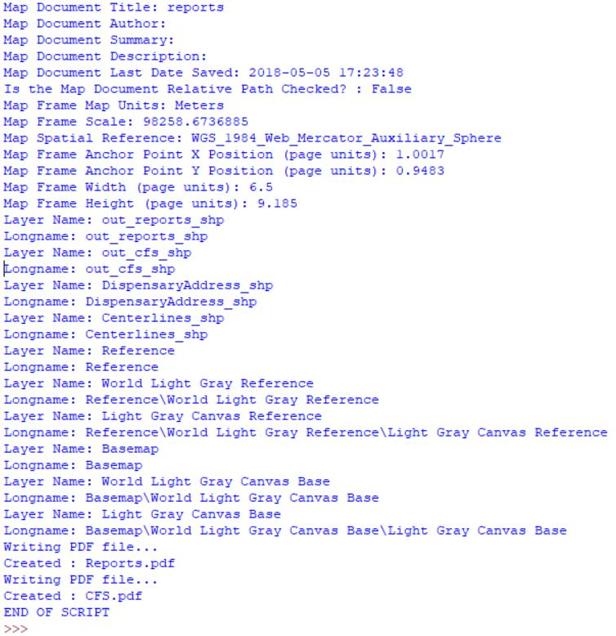
Map creation
Two maps were created
  Calls for service within 500 feet of a marijuana dispensary
  Reports within 500 feet of a marijuana dispensary
Was not as confident in modifying the map elements via python script

Slide 7
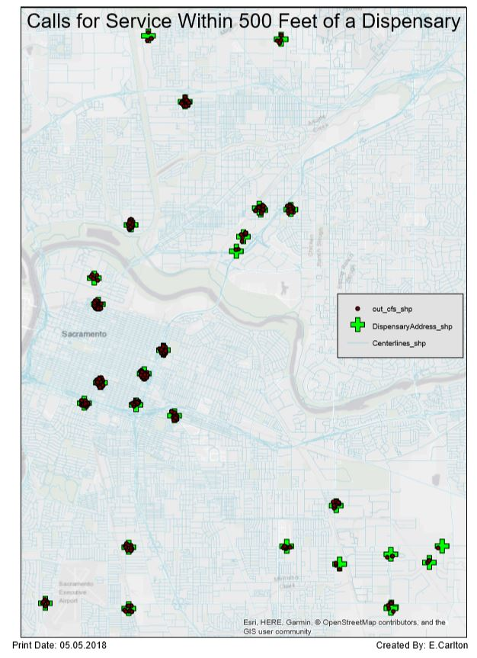
CALLS FOR SERVICE AT
DISPENSARIES
Based on basic analysis, there were 1,018 cfs within 500 feet of a dispensary
  (1.4% of all 2018 cfs)
On face value, some locations have more incidents than others
  could be related to neighboring businesses
  Initial locations for calls for service aren’t always accurate

Slide 8
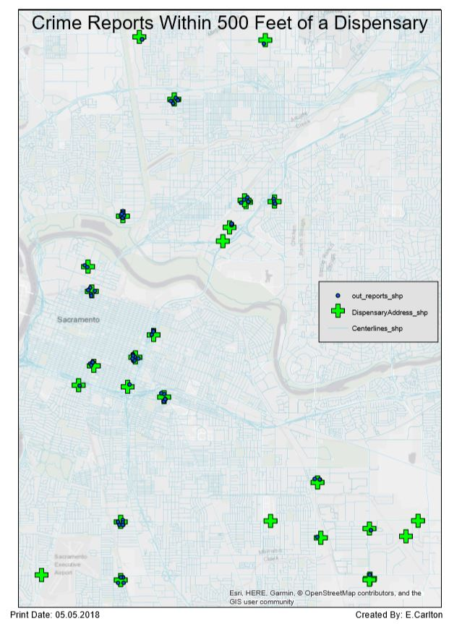
REPORTS AT
DISPENSASARIES
23% of the 124 reports taken were traffic related – not relevant for crime at a dispensary
Too many unknown factors to determine if there is a true problem
  Would need to obtain more information about the reports from the police department

