Slide 1
Supervised vs. Unsupervised Classification
Anna Bellini

Slide 2
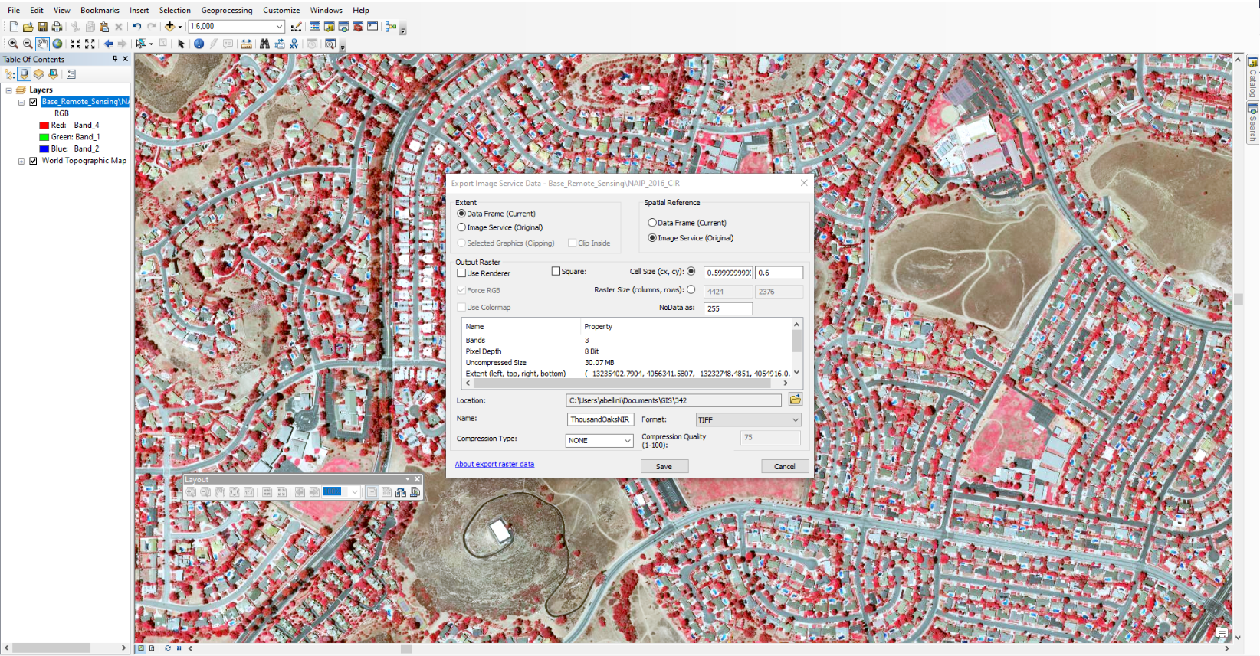
Data
California Fish and Game Image Services – CIR imagery, 2016
3-band
1 meter pixels
Exported data only of Thousand Oaks
“False Color” image display

Slide 3
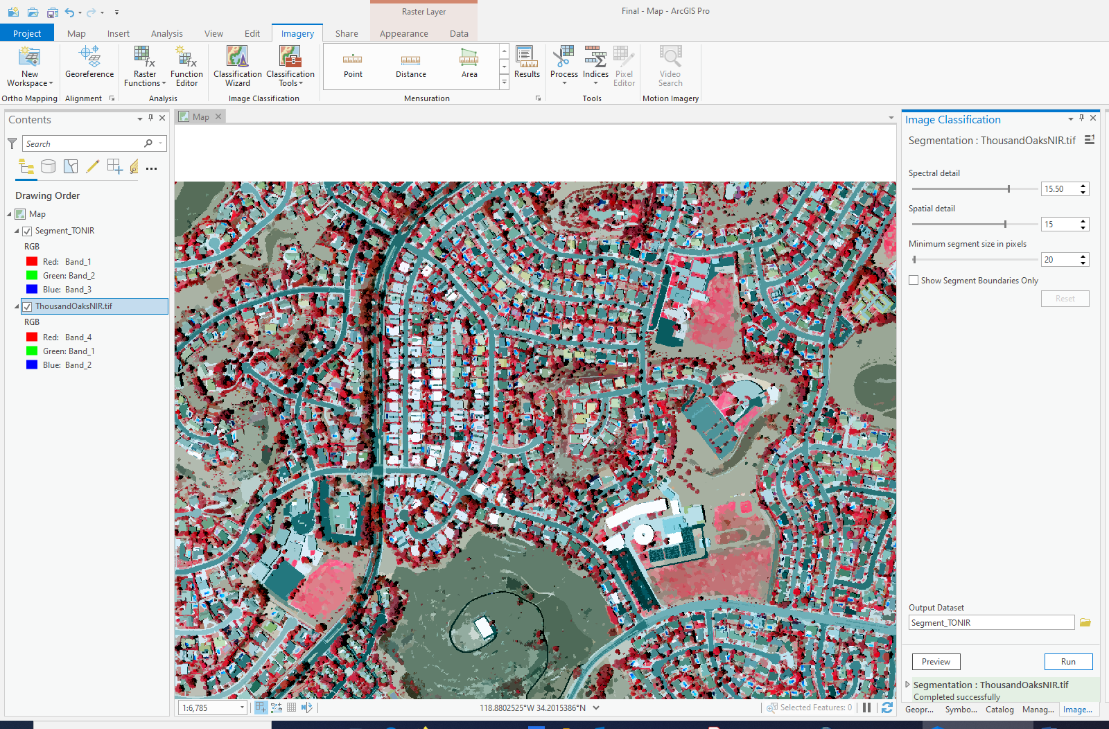
Image Segmentation
Segement Image Tool in the Classification Tools

Slide 4
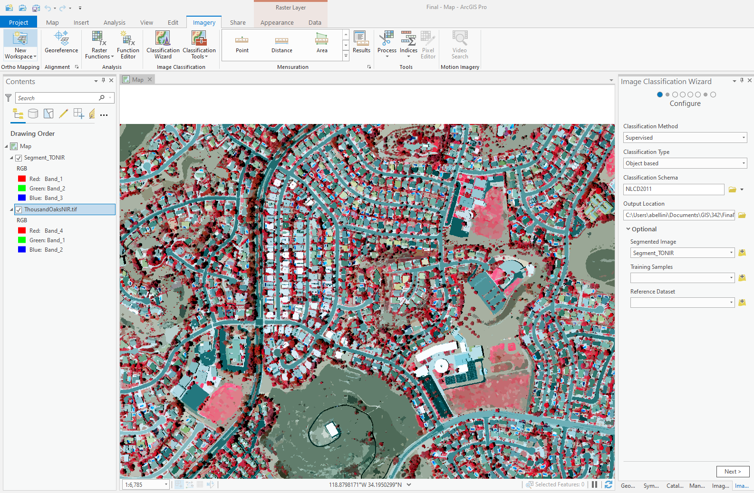
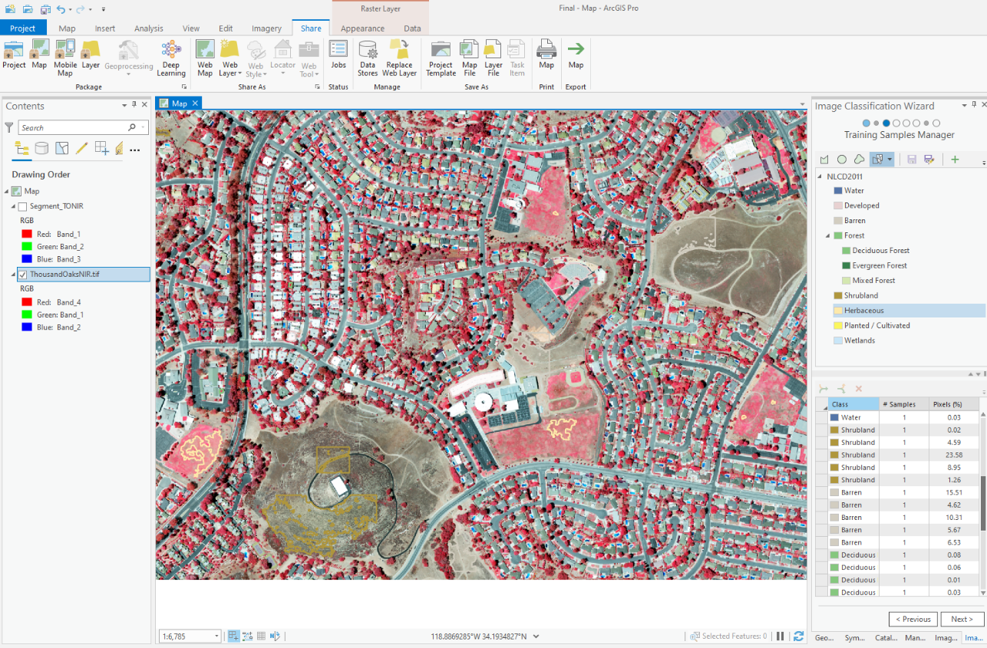
Supervised Classification
Object-based Supervised Classification
Training

Slide 5
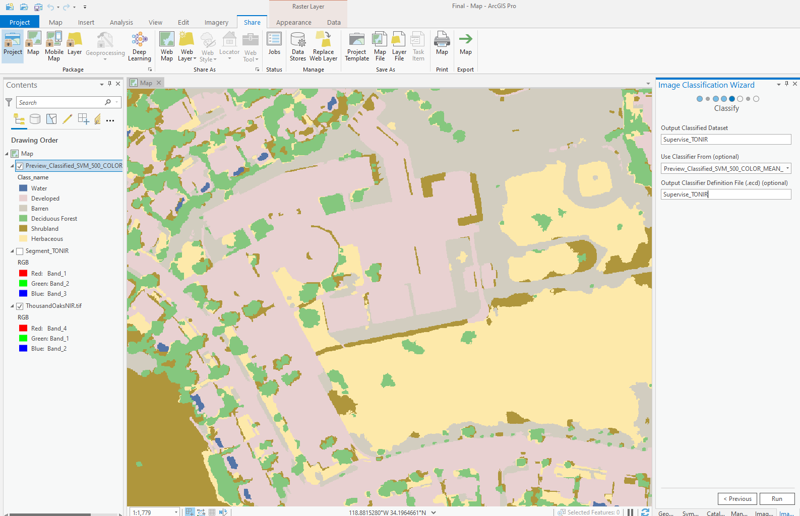
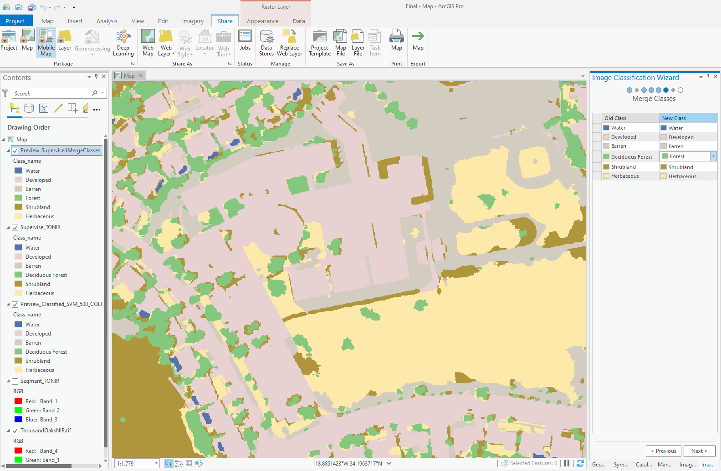
Supervised Classification cont.
Classified
Merged Classes

Slide 6
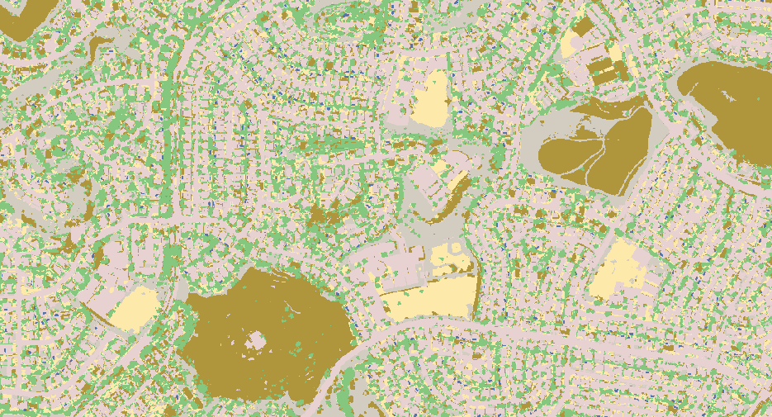
Supervised Classification cont.

Slide 7
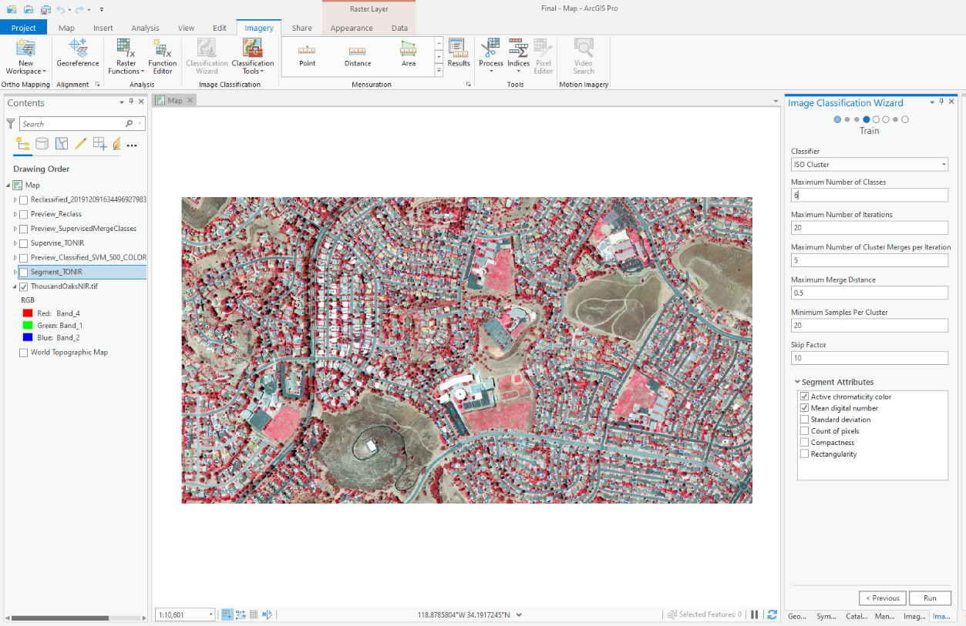
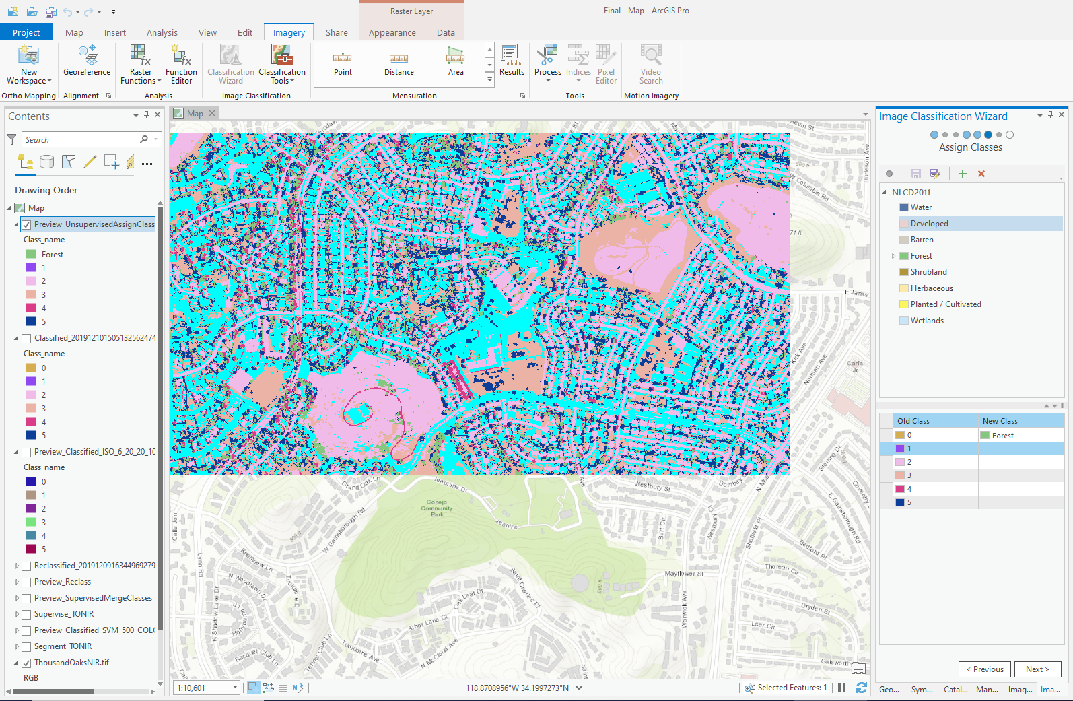
Unsupervised Classification
Trained
Assigned Classes

Slide 8
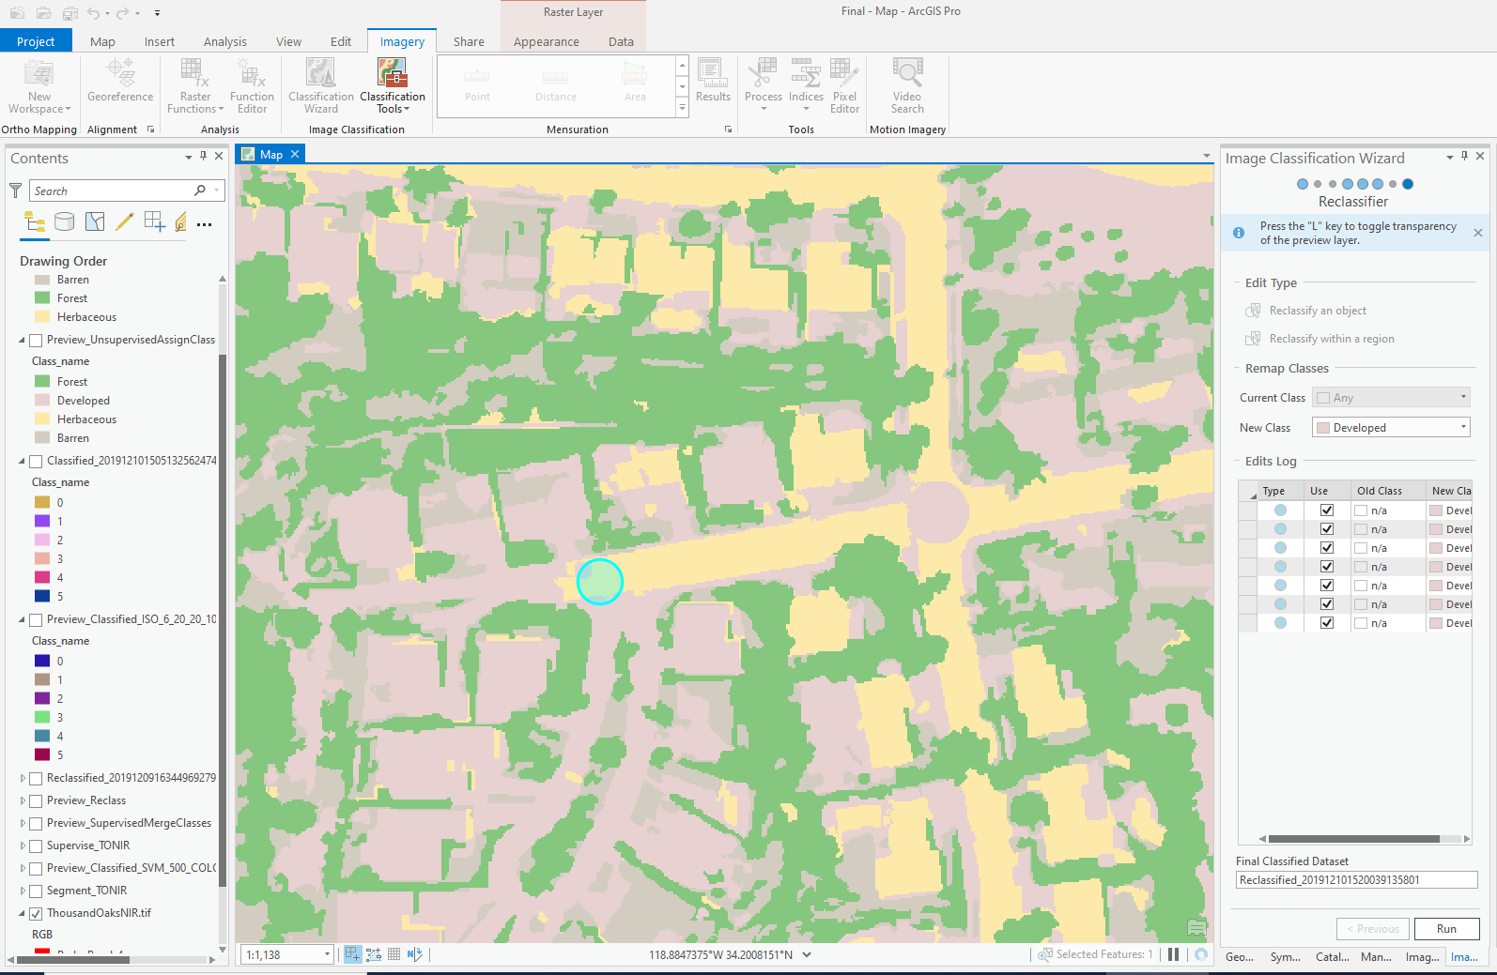
Unsupervised Classification cont.

Slide 9
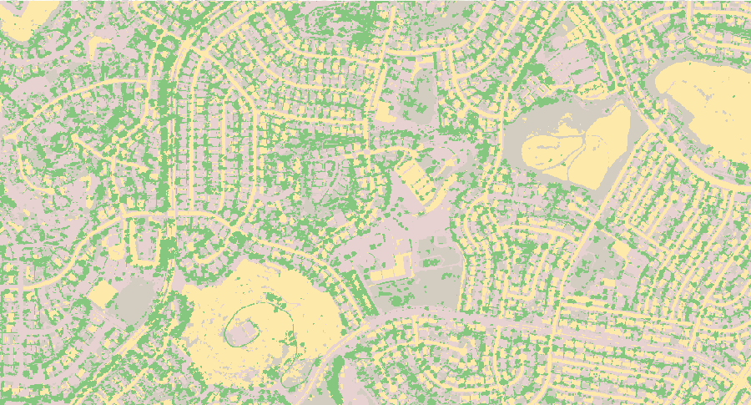
Unsupervised Classification cont.

Slide 10
Supervised vs. Unsupervised
Supervised
Unsupervised

