Slide 1

National Parks to Visit
By: Bill Walter

Slide 2
Geog 0090 Final Project Map
A map I can use when planning trips over the 10-15 years
I have currently visited 9 different national parks in 4 different states
I choose to make a map of the National Parks in the US and Canada that I hope to see.

Slide 3
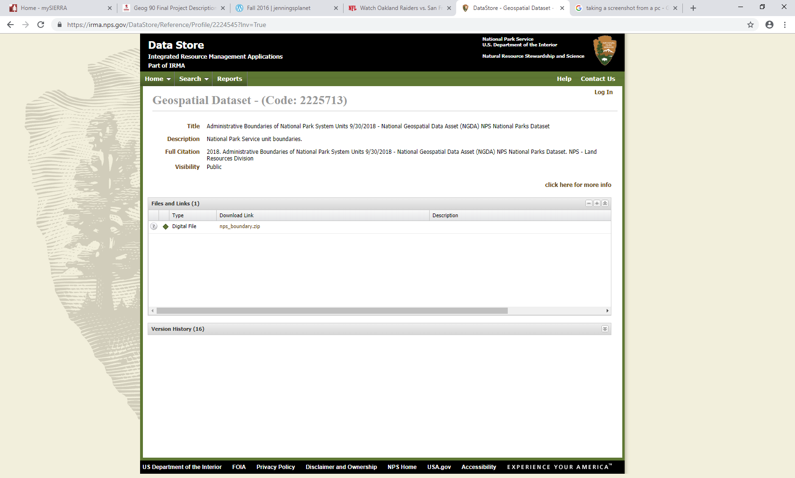
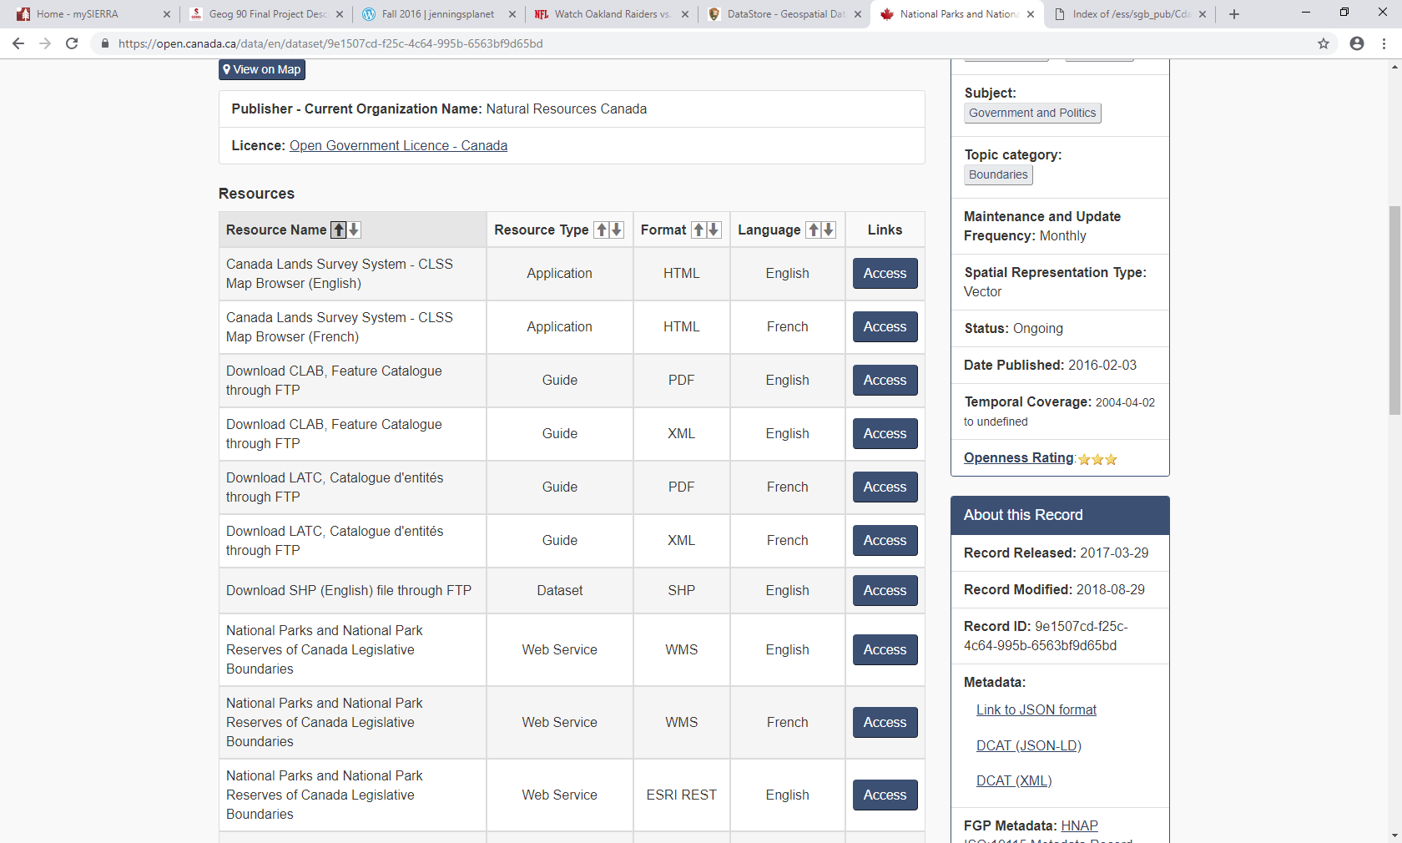
Finding the Data
I started by searching for the shape files of the National Parks as well as the Canadian National Parks.
I was able to find the data on NPS and Open Canada
Save the data to the thumb drive

Slide 4
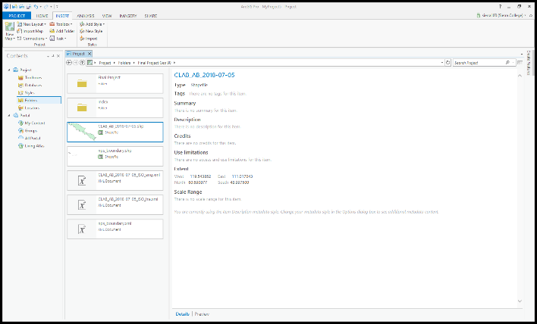
ArcPro and Project
I started ArcPro and added a folder connection to the shape files on my thumb drive.

Slide 5
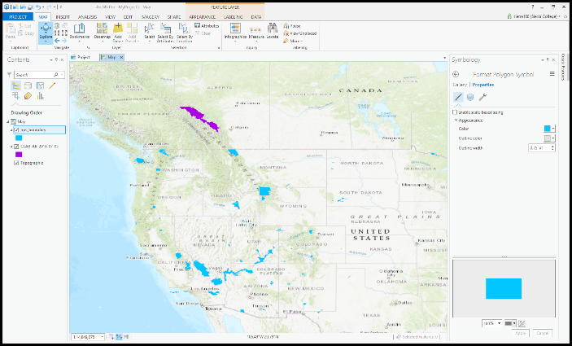
Adding the data to the Map
After creating the folder connection I added the data to the Map
I had to add data from the US National Parks as well as the Canadian

Slide 6
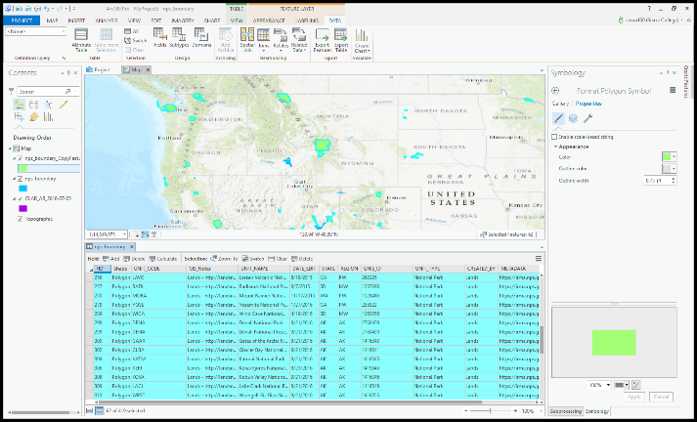
Narrowing down the data
Once I had the data in the map I needed to narrow down the 419 National Parks down to the parks I was interested in. I queried the data based on the type = “National Park” which left me with 62 National Parks.
This took me several tries as I had tried to query by state and accidentally changed all the data for all the parks to CA.

Slide 7
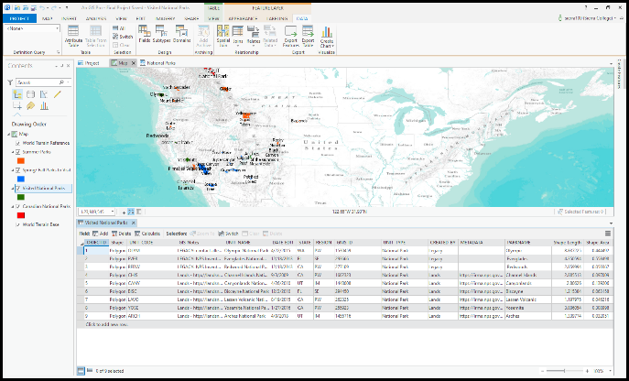
Creating New Layers based on seasons or prior visits
I was able to select the parks that I was interested in and export them by right clicking the Data (export feature)
I used the technique for each layer to create my 4 layers.

Slide 8
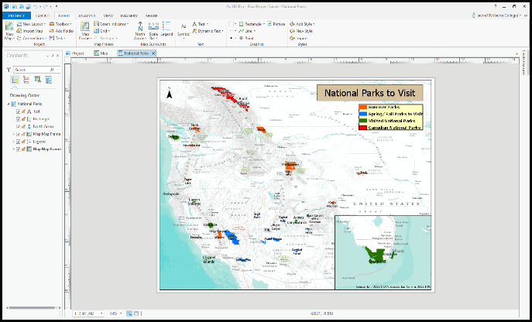
Creating the Map Frame
Next I had to size and color the map to be useful for the maps intended purpose.
I researched on Esri’s website how to inset a second map frame in order to make selected areas larger and more visible

Slide 9
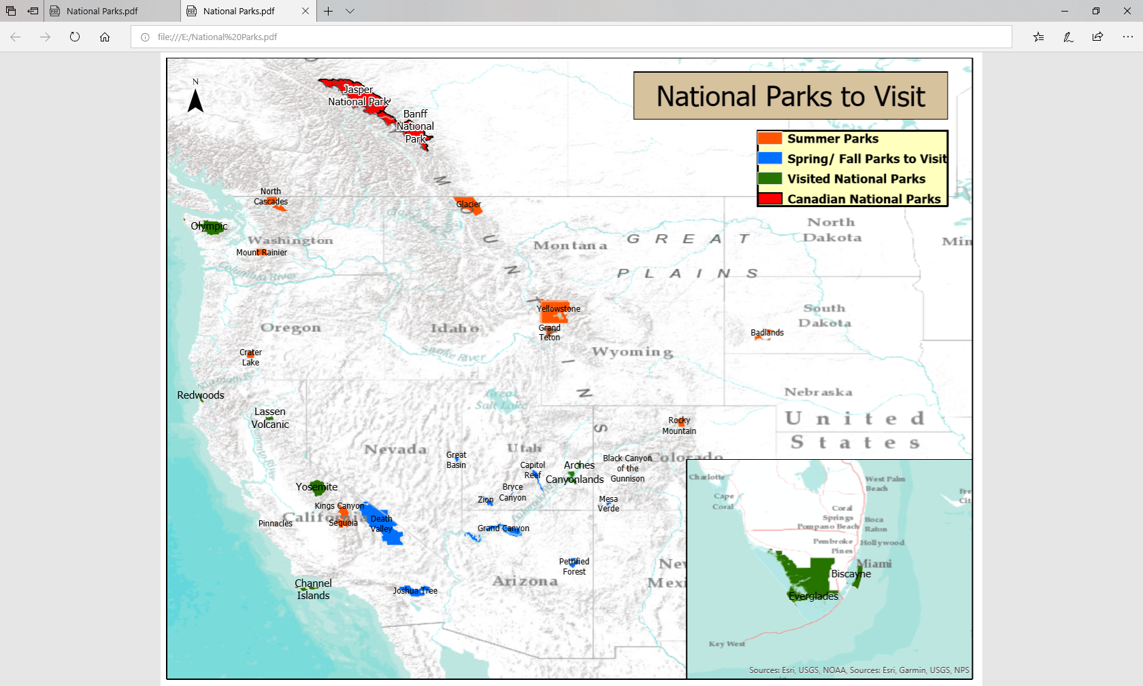
Labels, Legend and Title
I next added a legend, title and labels
I had to create a field in the data for the National Parks to shorten the names to just the first name in order to unclutter the map.
I selected a base map that was very simple so the user can focus on the selected data
Final Map

