Slide 1
Critical Habitats in Parks and Open Spaces in LA County
By. Ashlyn Tambini

Slide 2
What is my project
Shows Critical Habitats in parks and open spaces in LA County.
Critical habitats are places with endangered or threatened creatures that may require special treatment
Wanted to see how many of them are located in open spaces or unowned land.

Slide 3
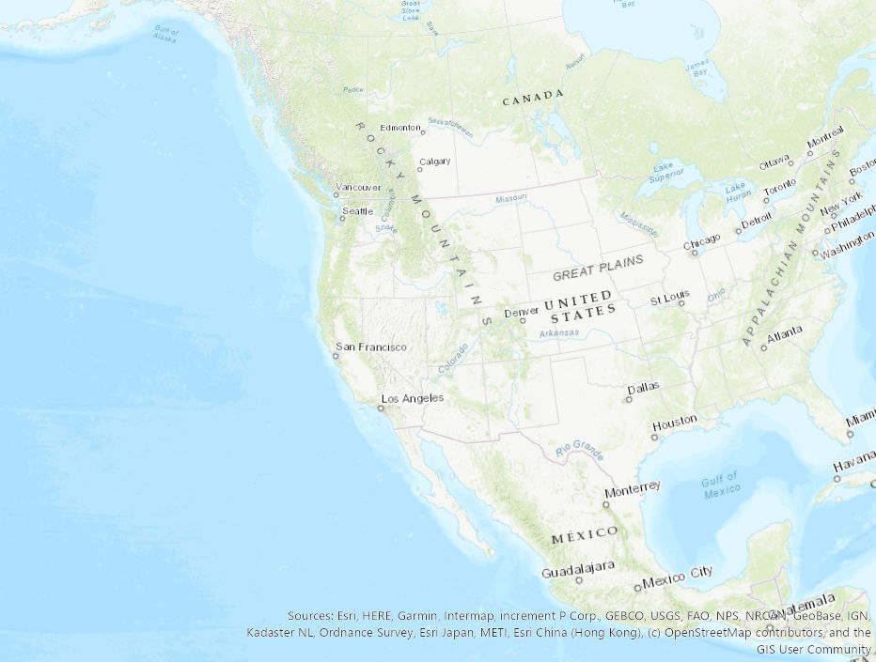
New feature class
- Changed the spatial reference

Slide 4
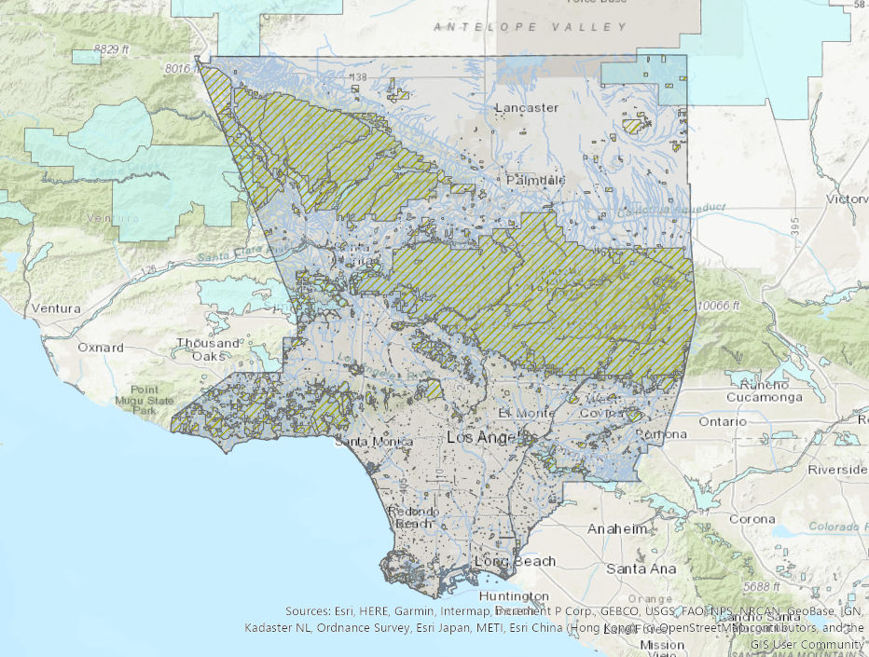
Add data to map

Slide 5
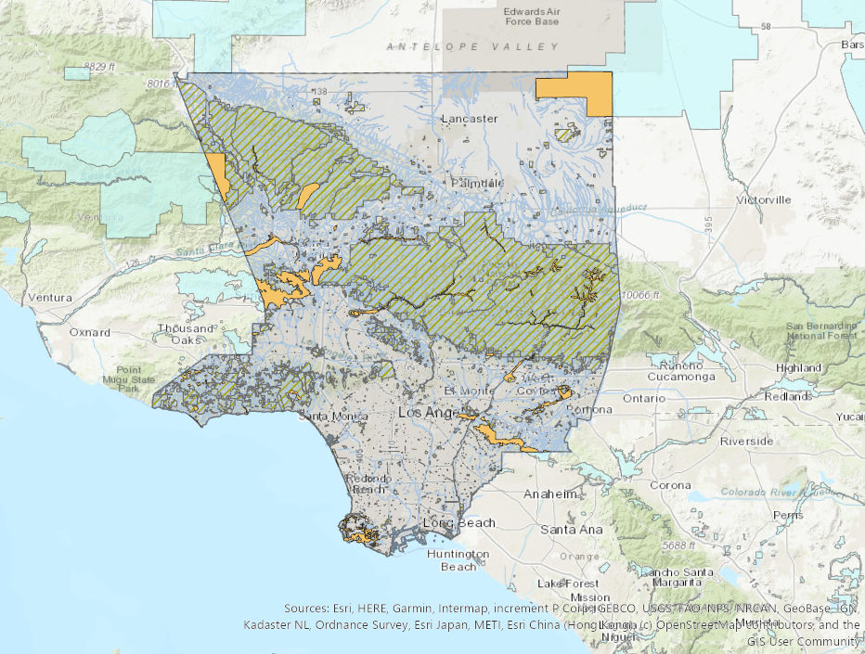
Clip critical habitat layer
- Intersect tool to combine attributes

Slide 6
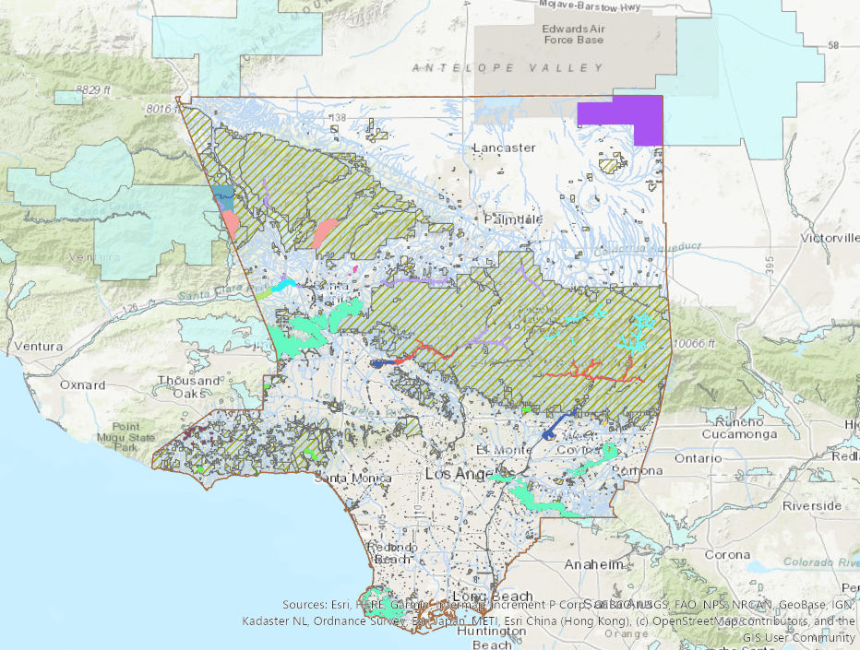
Change symology

Slide 7
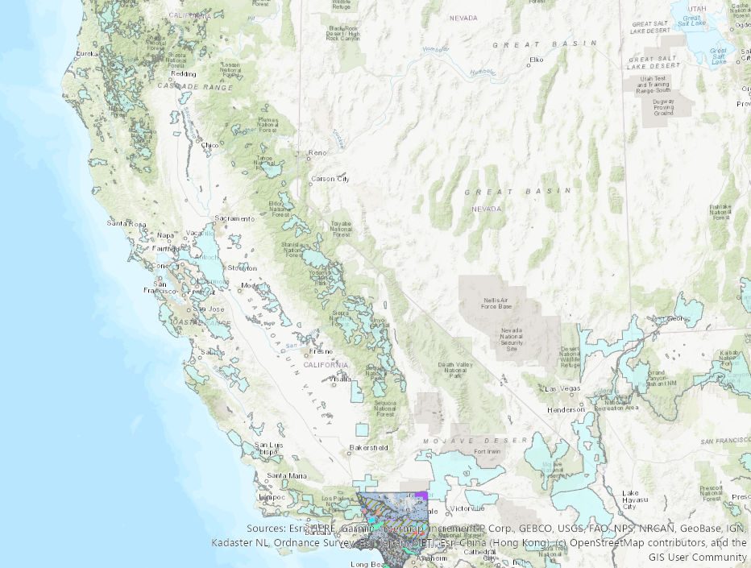
Problems I had
Problems I had
- Original plan wasn’t working to much data
- Attributes didn’t transfer with clip
- Attributes where seperating for some reason
- Trouble changing the attribute names
- Data corruption

Slide 8
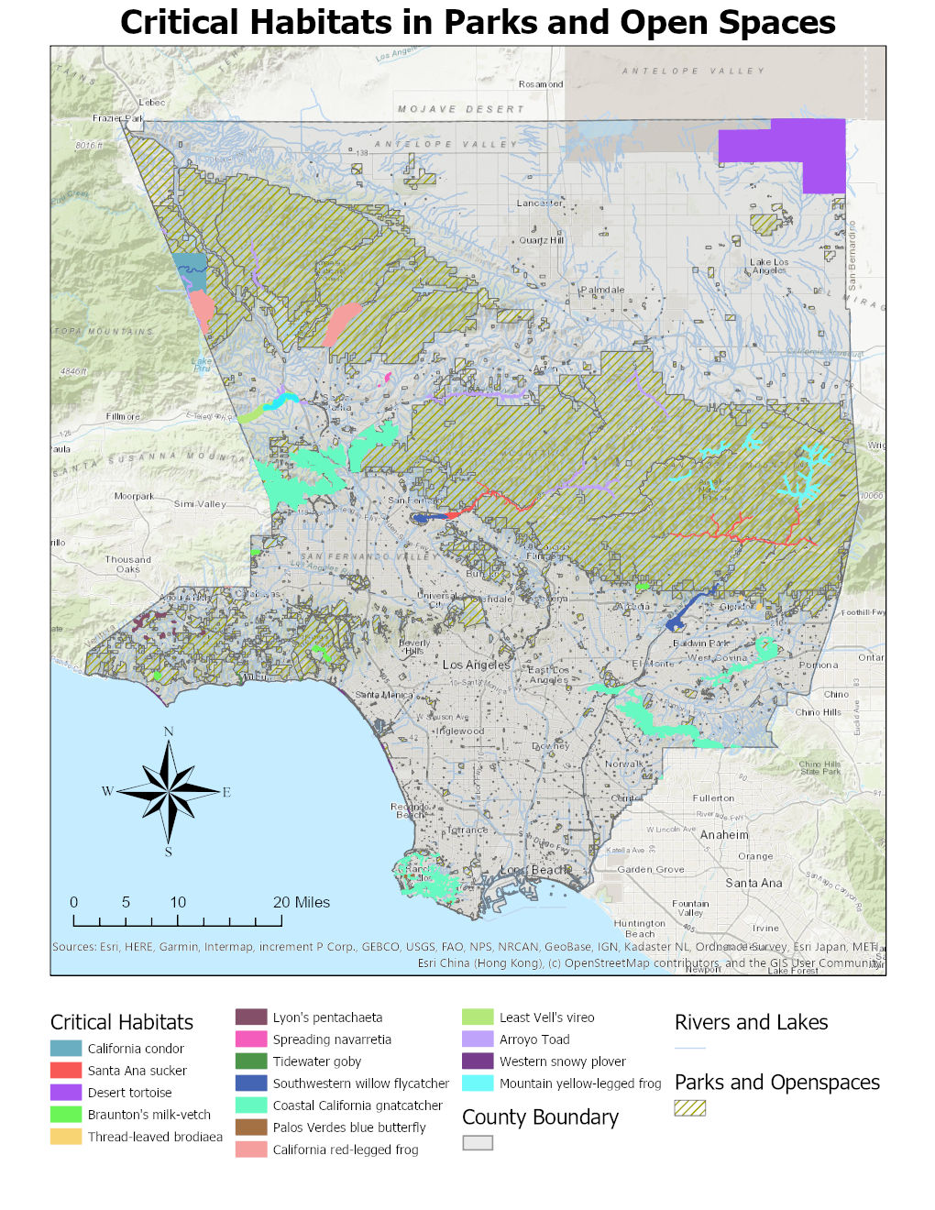
What I learned
- Learned how navigate ArcGIS Pro

