Slide 1


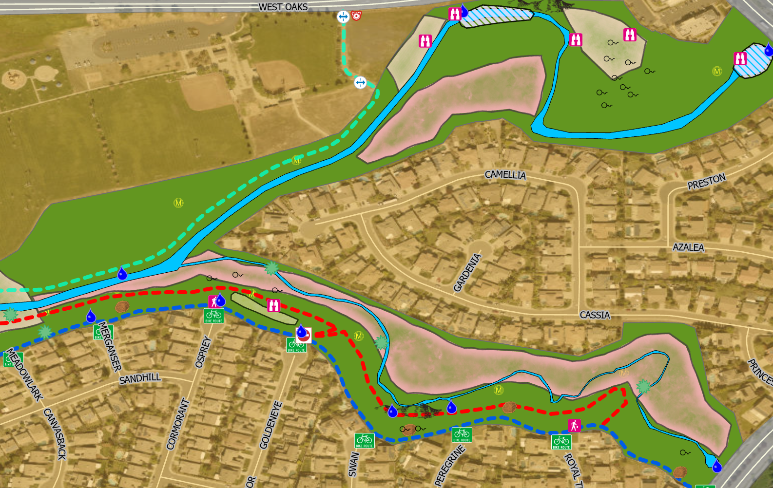



Pleasant Grove
Creek Greenbelt
MAPPING WILDLIFE HABITAT IN AN URBAN SETTING
Dickie Rigdon • GEOG 90 • Fall 2019

Slide 2

Purpose of Map:
Spatially represent the remarkable abundance and diversity of wildlife in an urban greenbelt setting
Layer map with existing public trails, paths, man-made and natural features

Slide 3
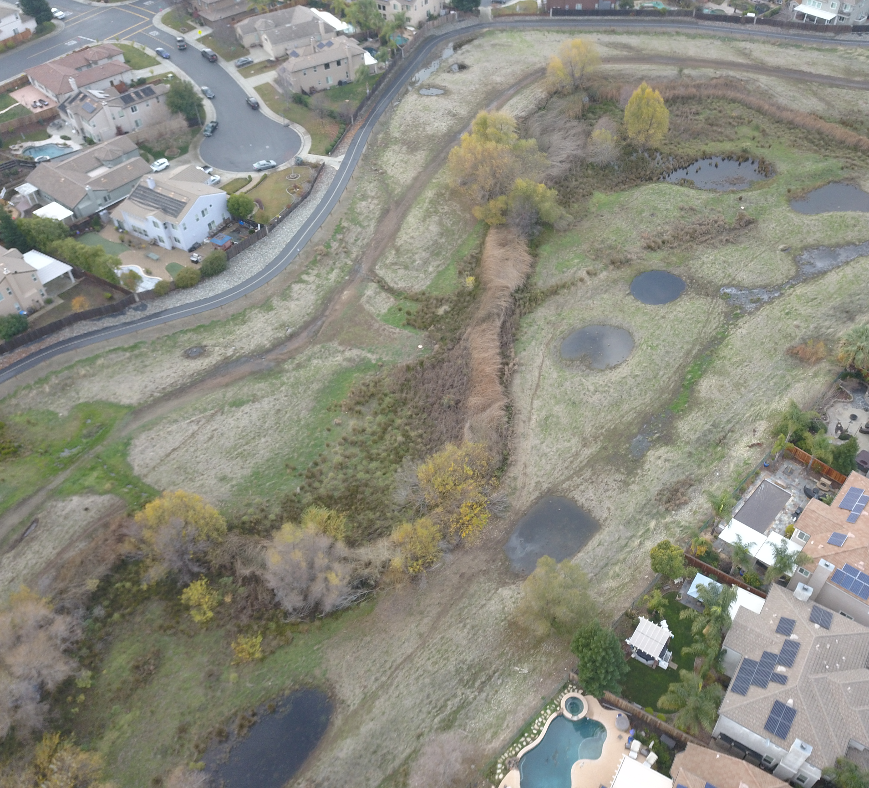
Greenbelt aerial view captured from my drone

Slide 4
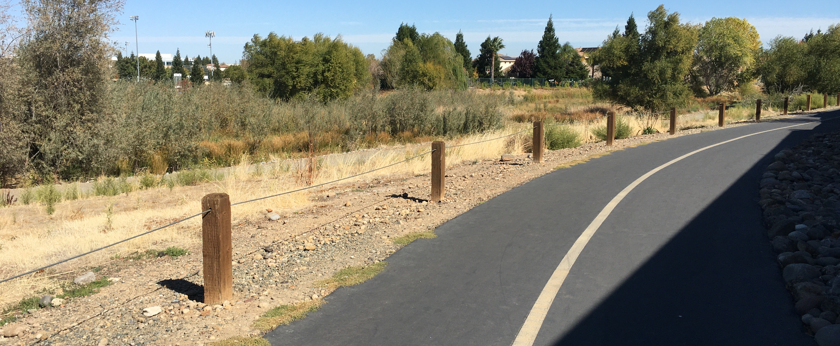
Bicycle Path along Green Belt

Slide 5
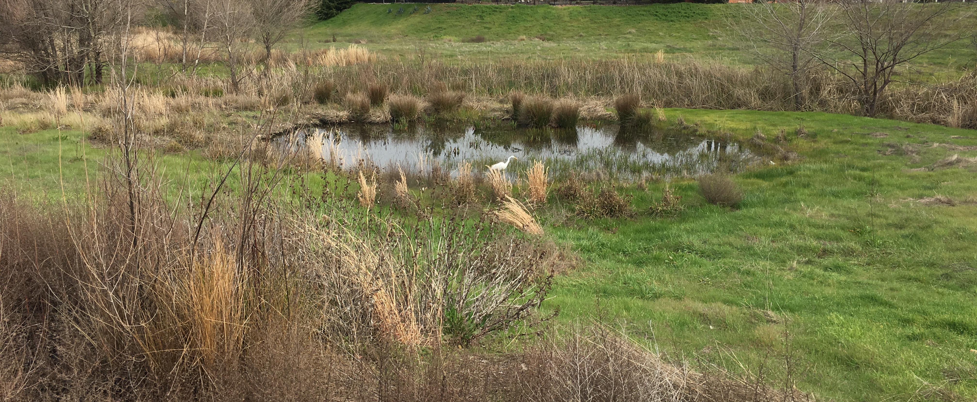
Vernal Pool

Slide 6
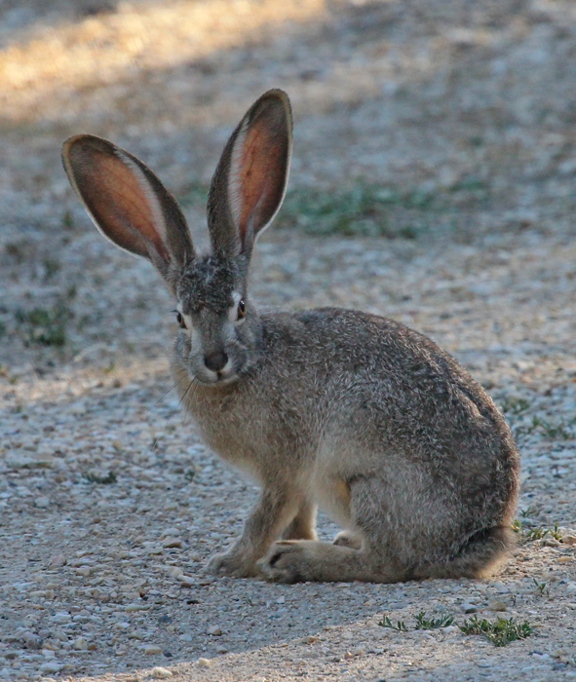
Black Tailed
Jack Rabbit
Greenbelt Year-Round Resident

Slide 7
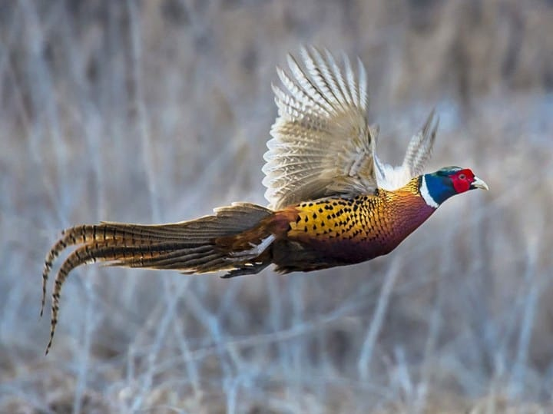
Ring-necked Pheasant
Greenbelt Seasonal Resident

Slide 8
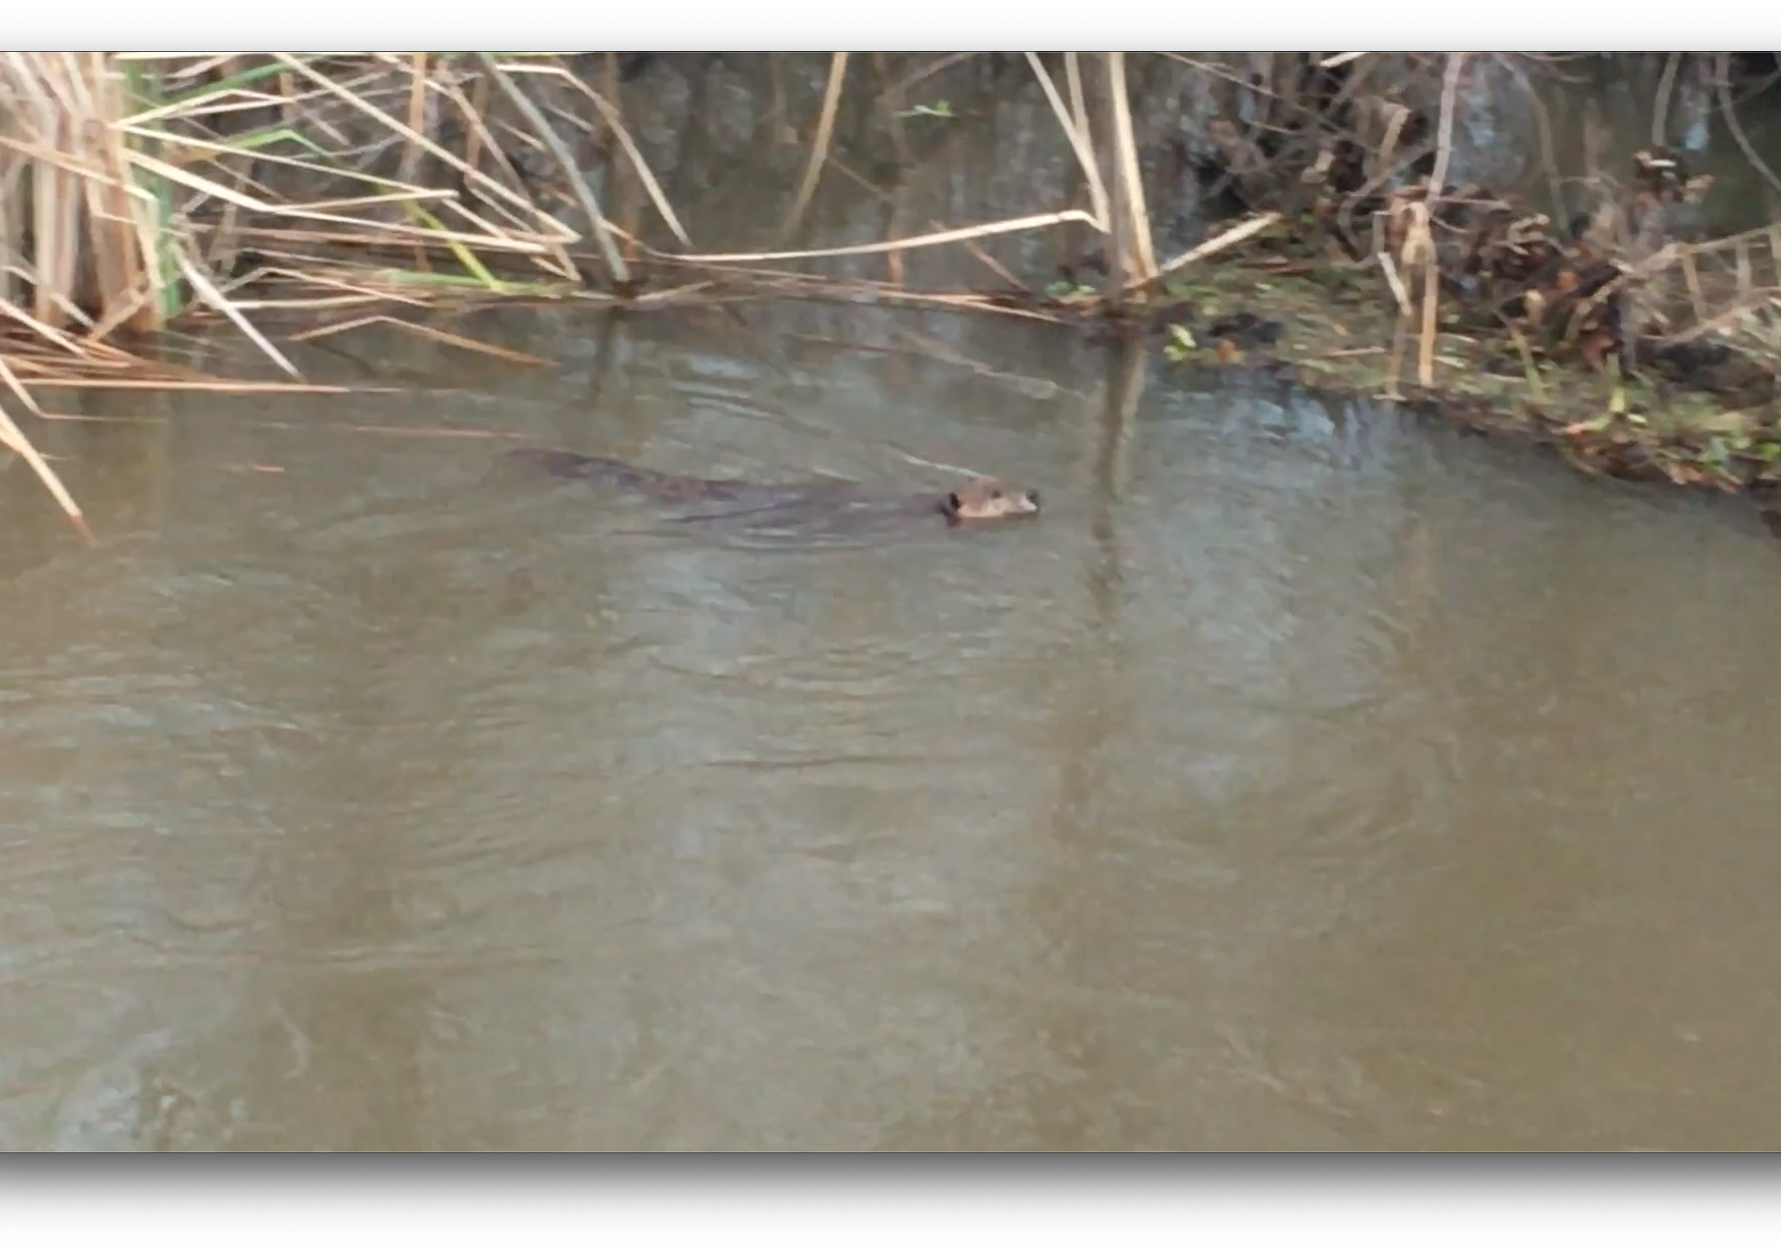
Beaver
Greenbelt Year-Round Resident

Slide 9
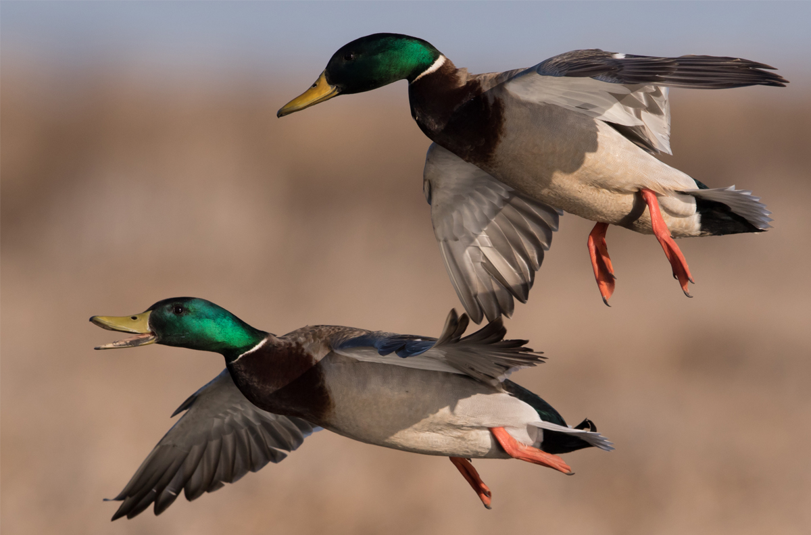

Mallard Duck
Greenbelt Seasonal Resident

Slide 10
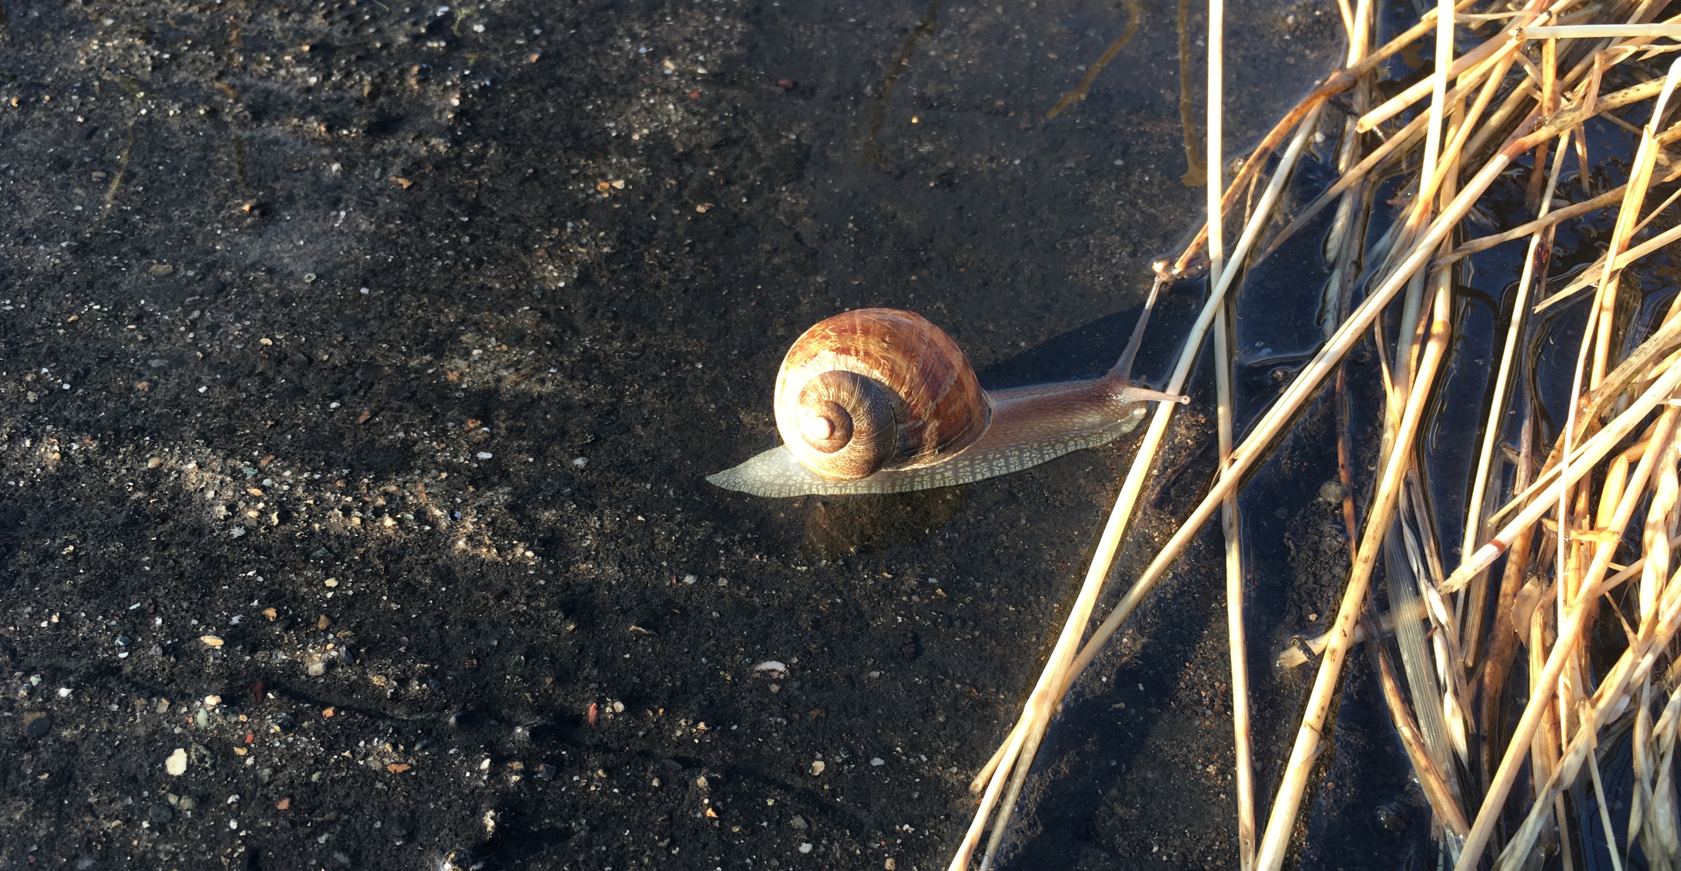
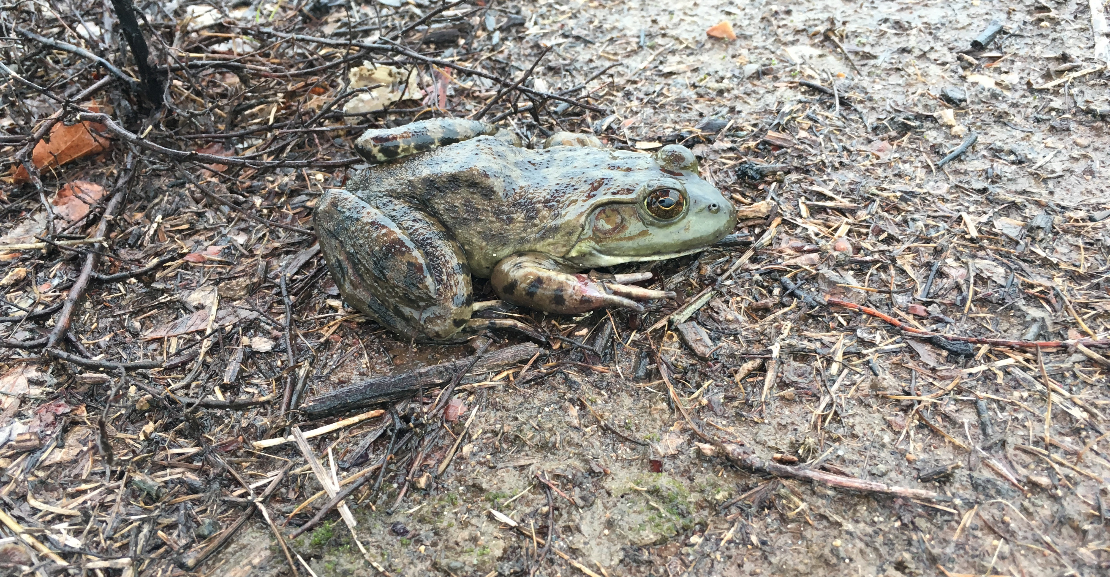
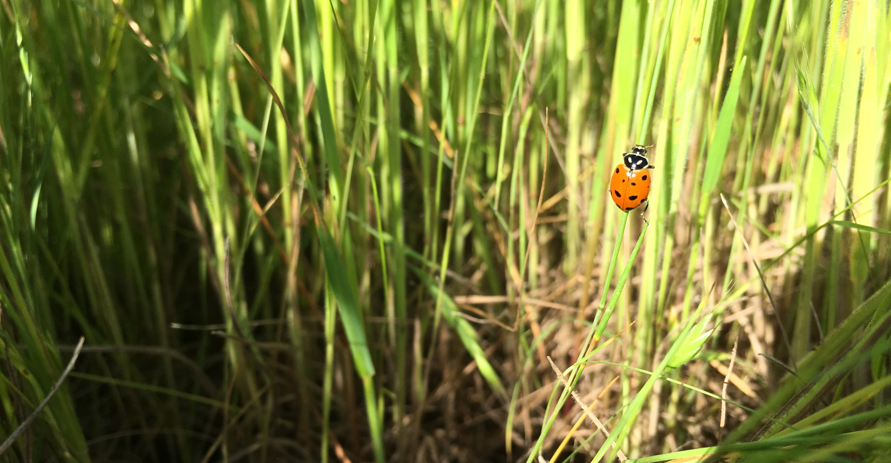
Healthy Ecosystem
Invertebrates
Vertebrates
Insects

Slide 11
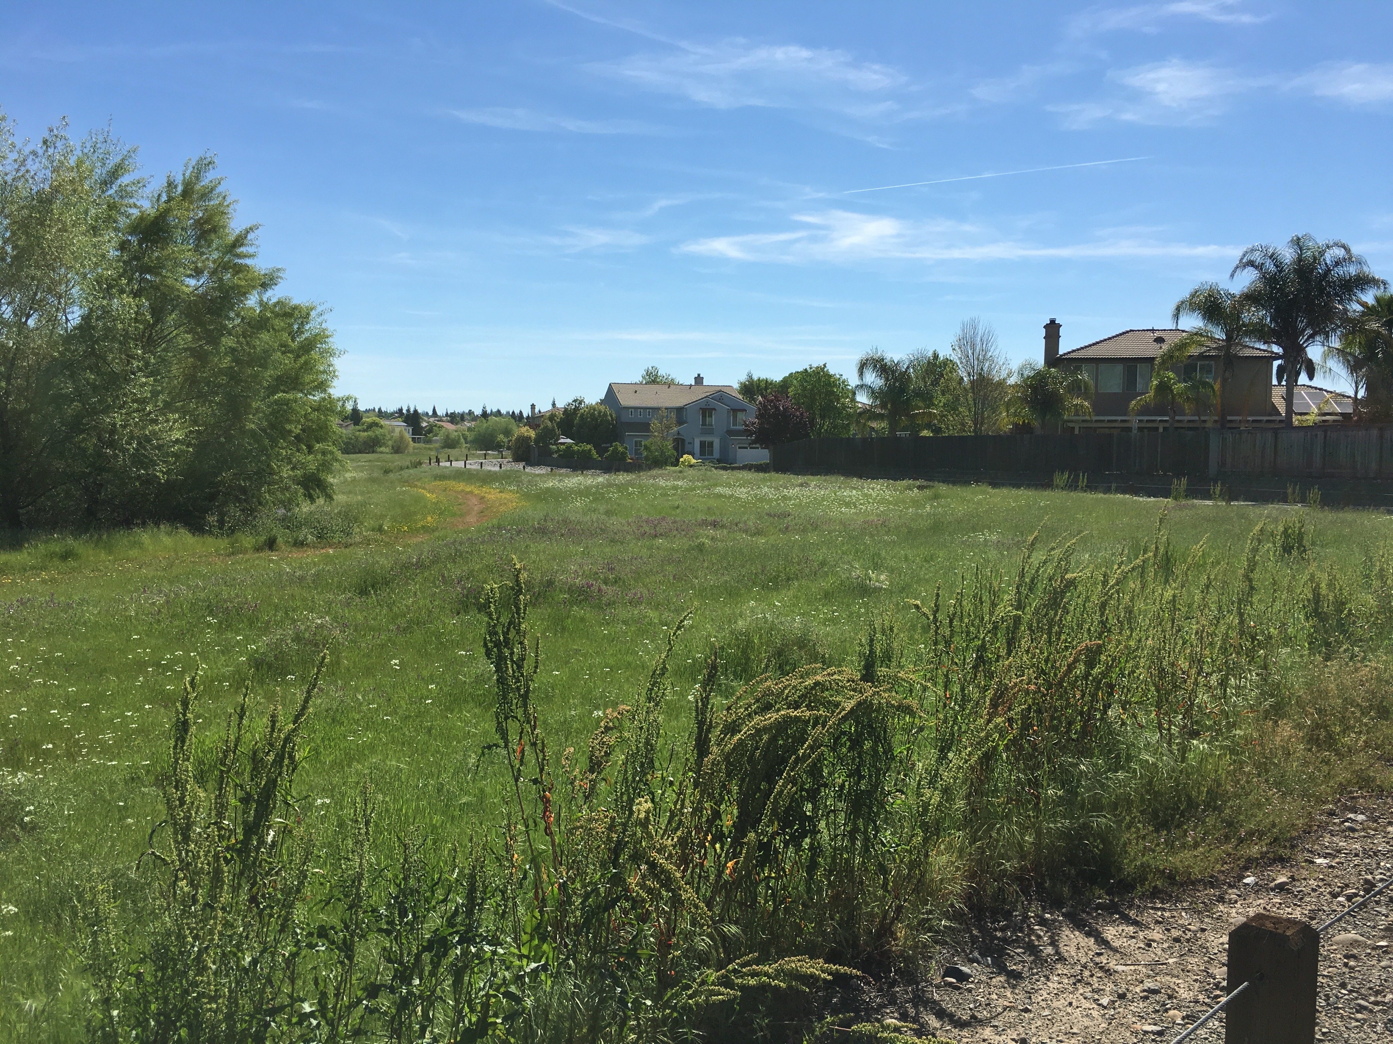
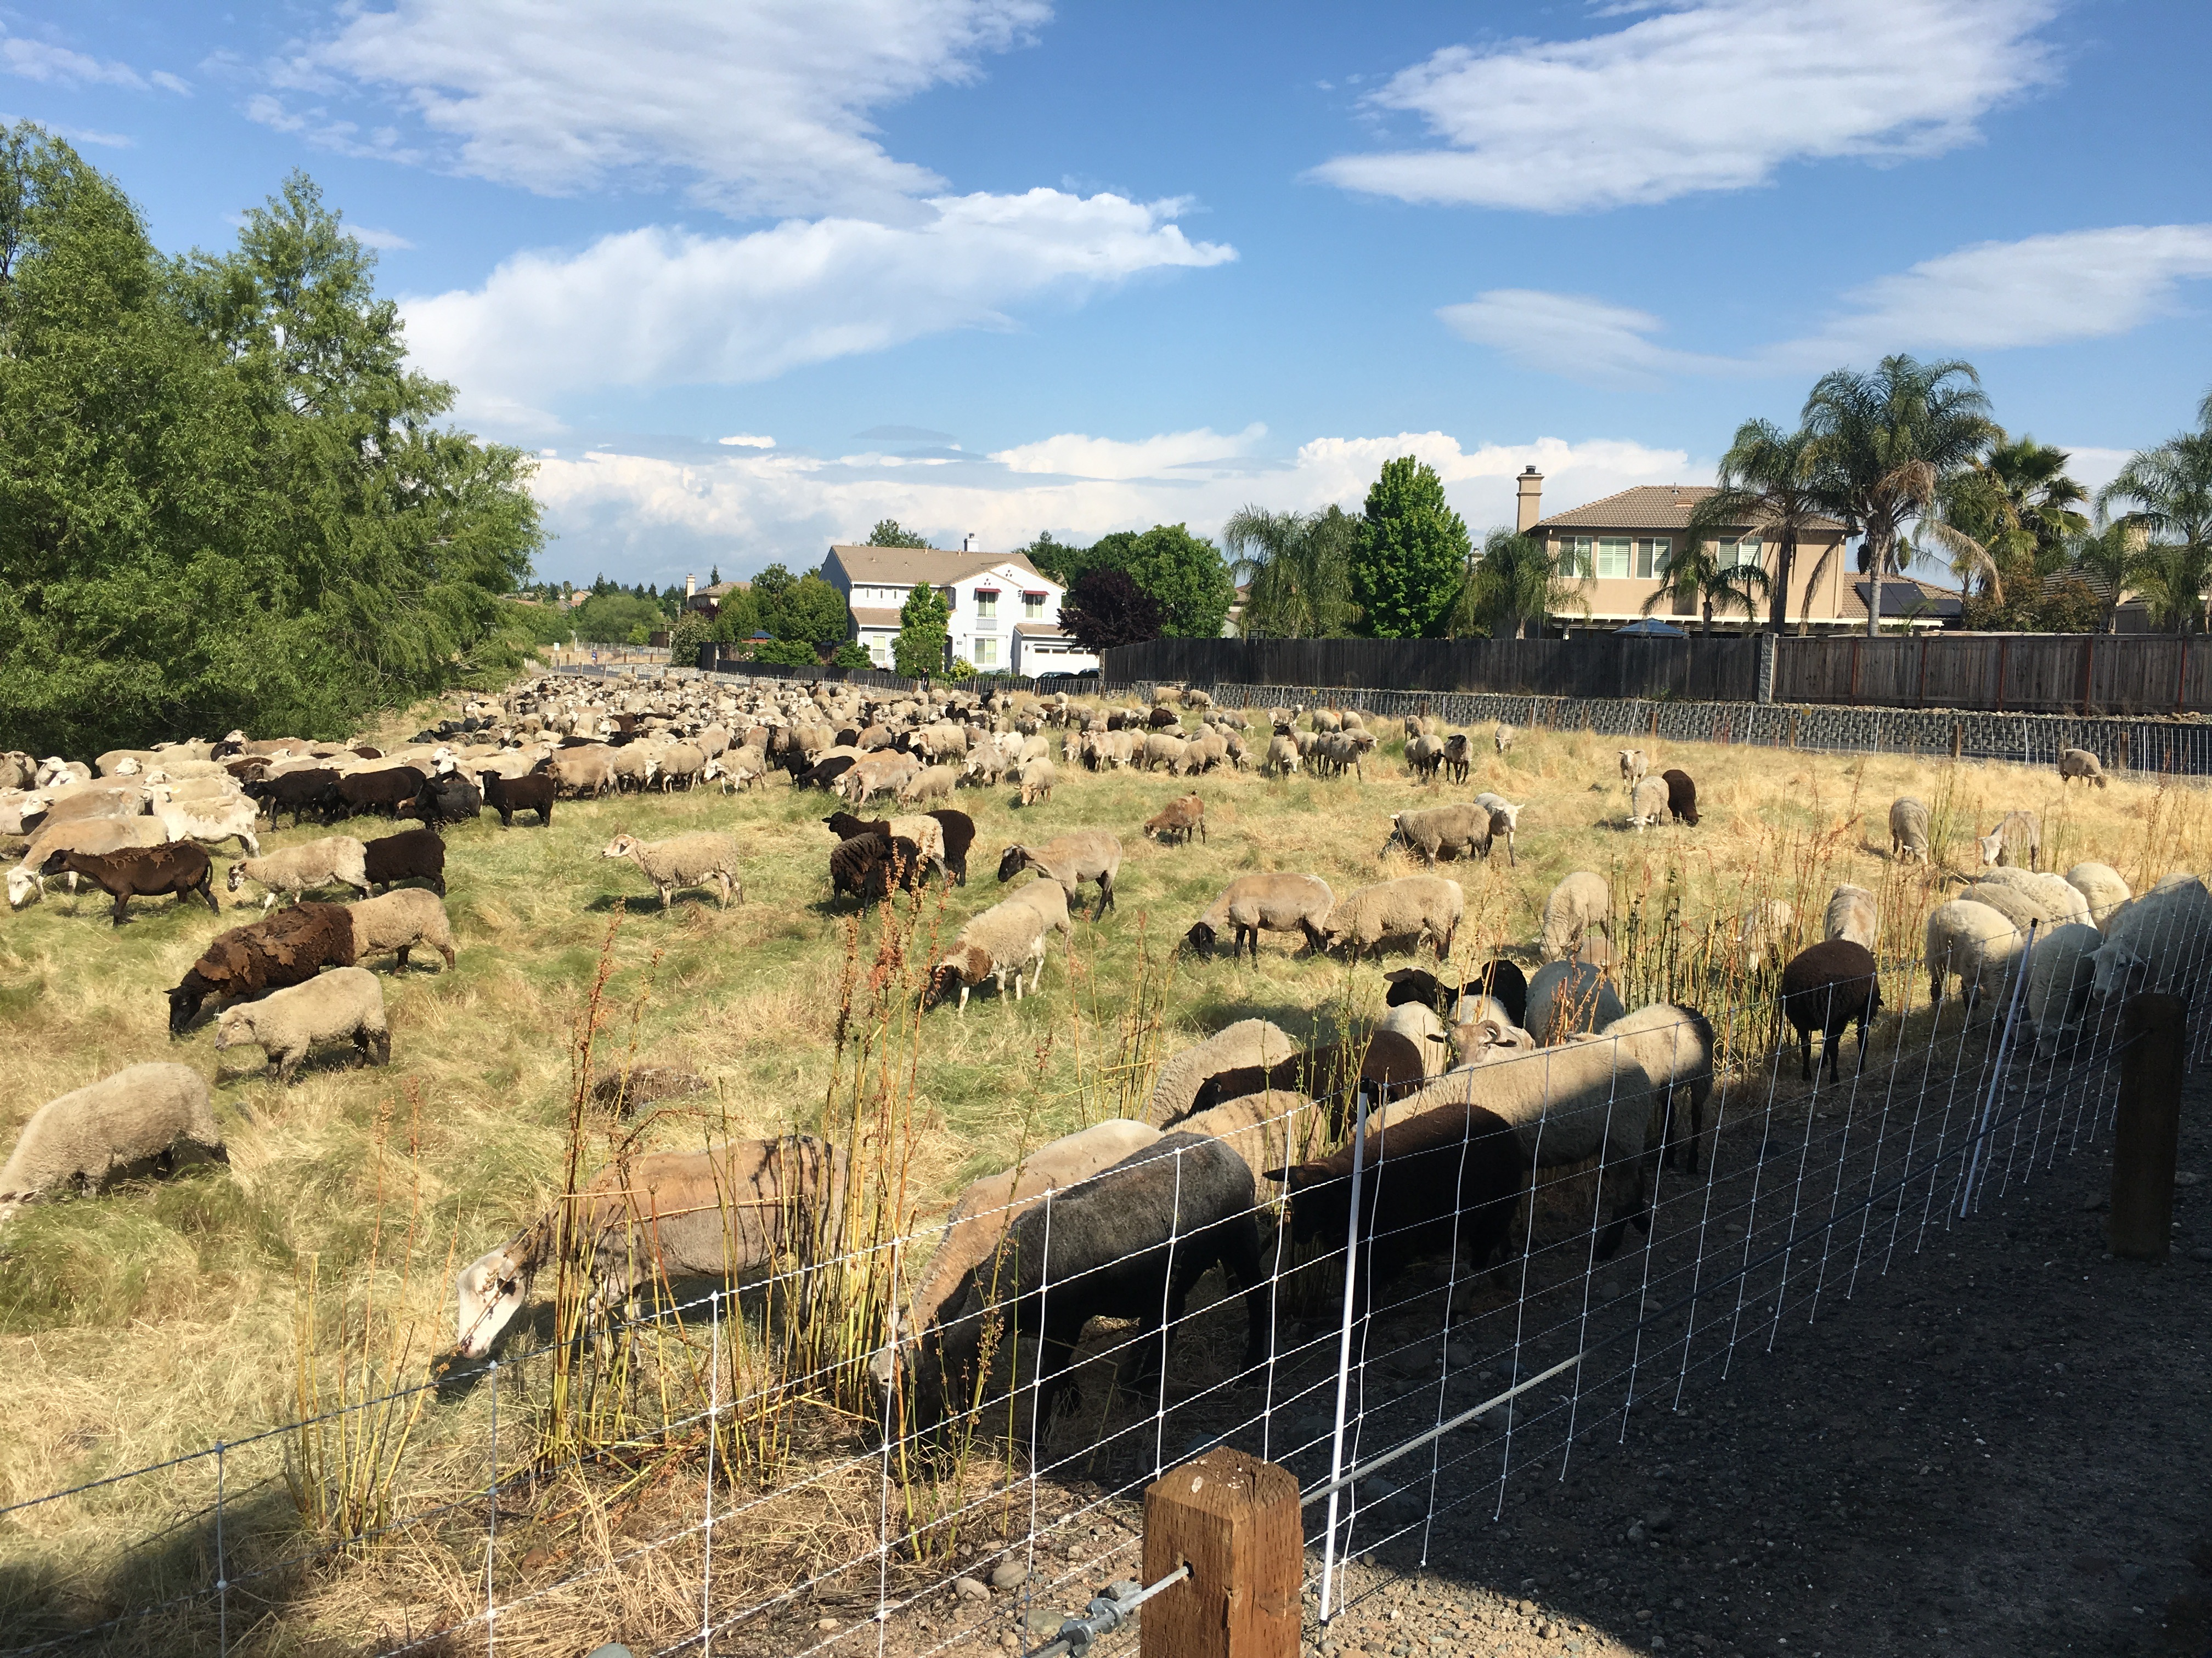
Grazing Animals as Fire Control
Spring Growth
Goats & Sheep Summer Graze

Slide 12
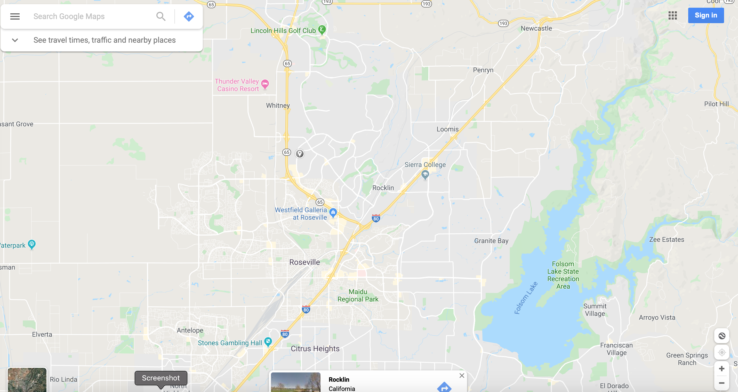
Greenbelt Area is located off Hwy 65 in Rocklin, CA
Between Lonetree Boulevard and Blue Oaks Boulevard along Pleasant Grove Creek

Slide 13
Aerial Shots showing Features used to create Greenbelt map

Slide 14
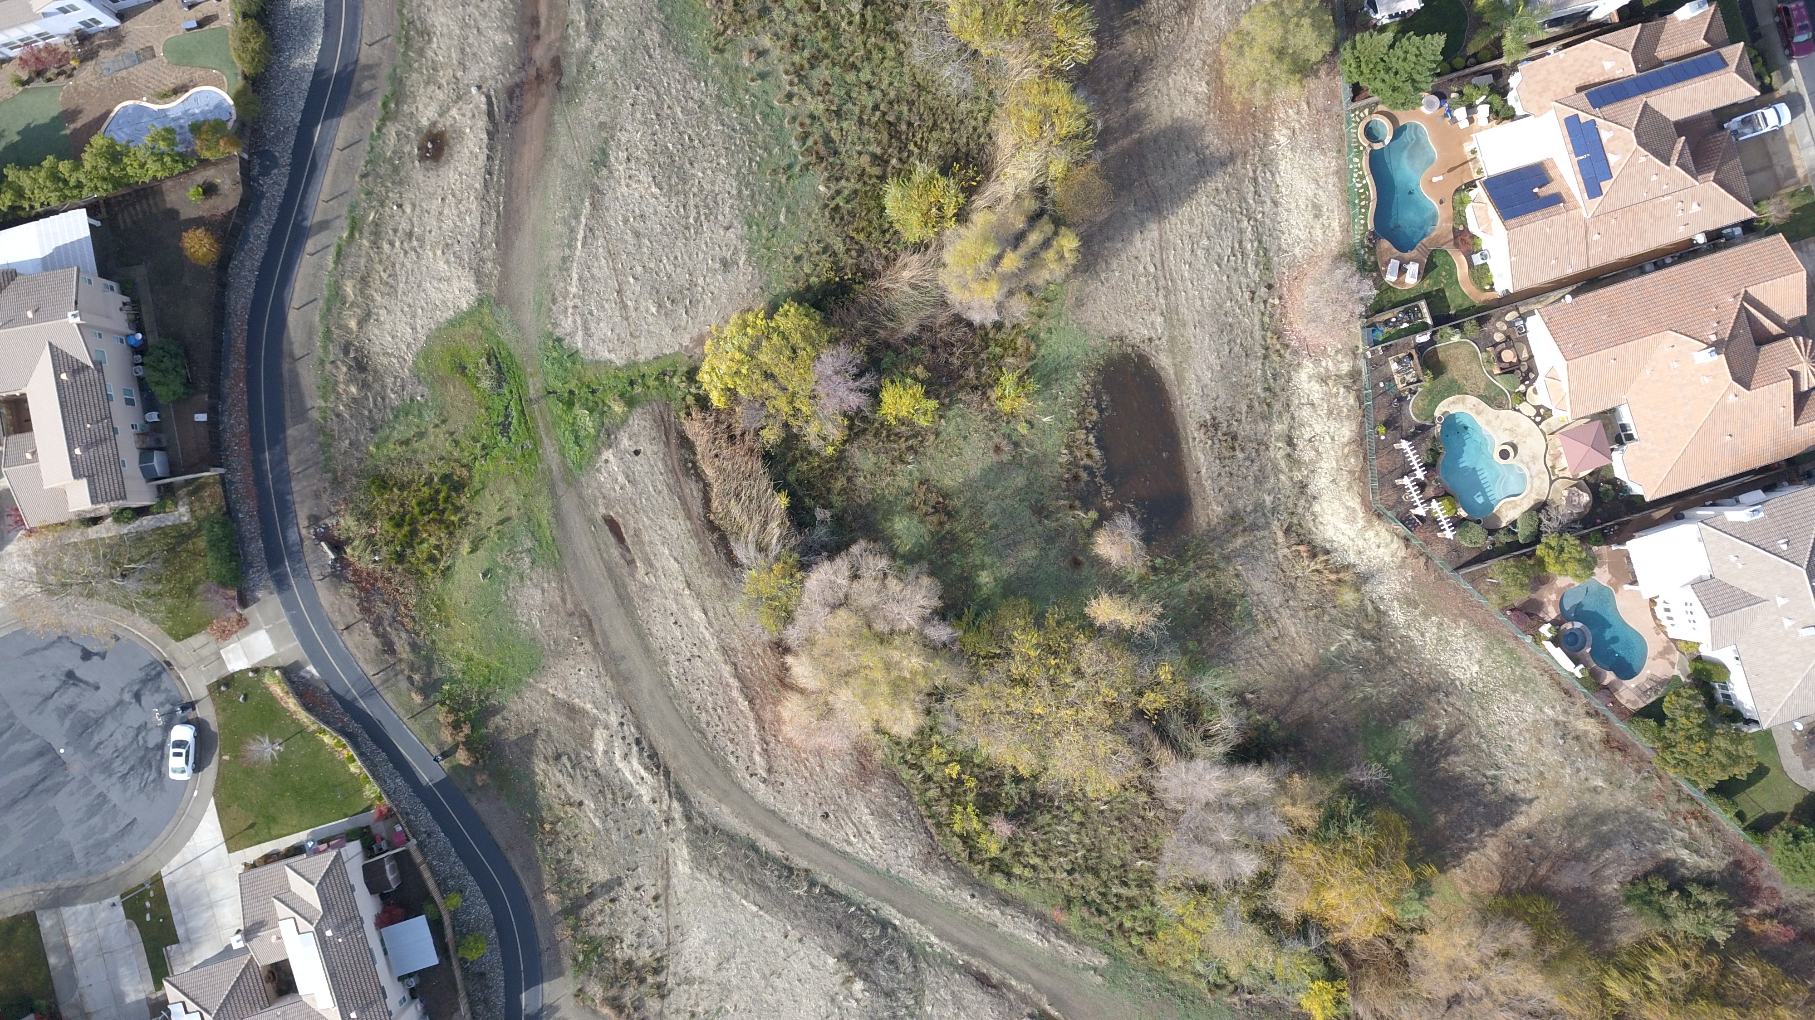
Creek Channel
Bicycle Path
Vernal Pool
Bicycle Path
Access
Fire Road

Slide 15
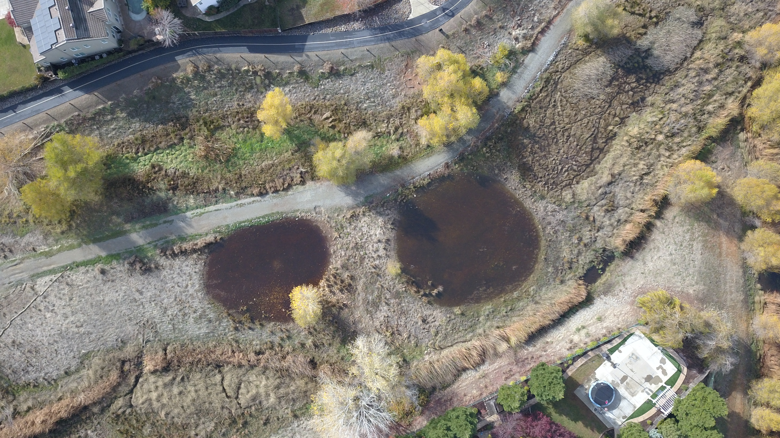
Bicycle Path
Mallard Nesting Area
Vernal Pool
Vernal Pool
Creek Channel

Slide 16
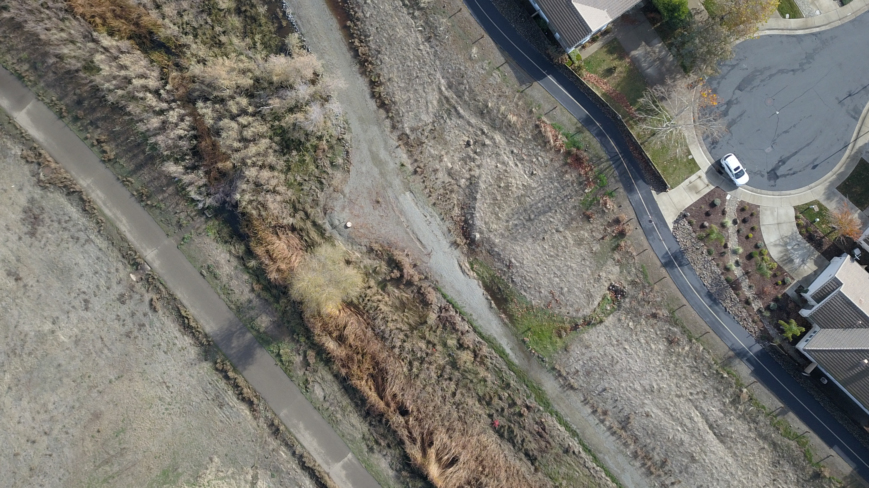
Fire Road
Bicycle Path
Bicycle Path Access
Manhole
Culvert
Park Trail
Creek Channel
Jack Rabbit Habitat

Slide 17
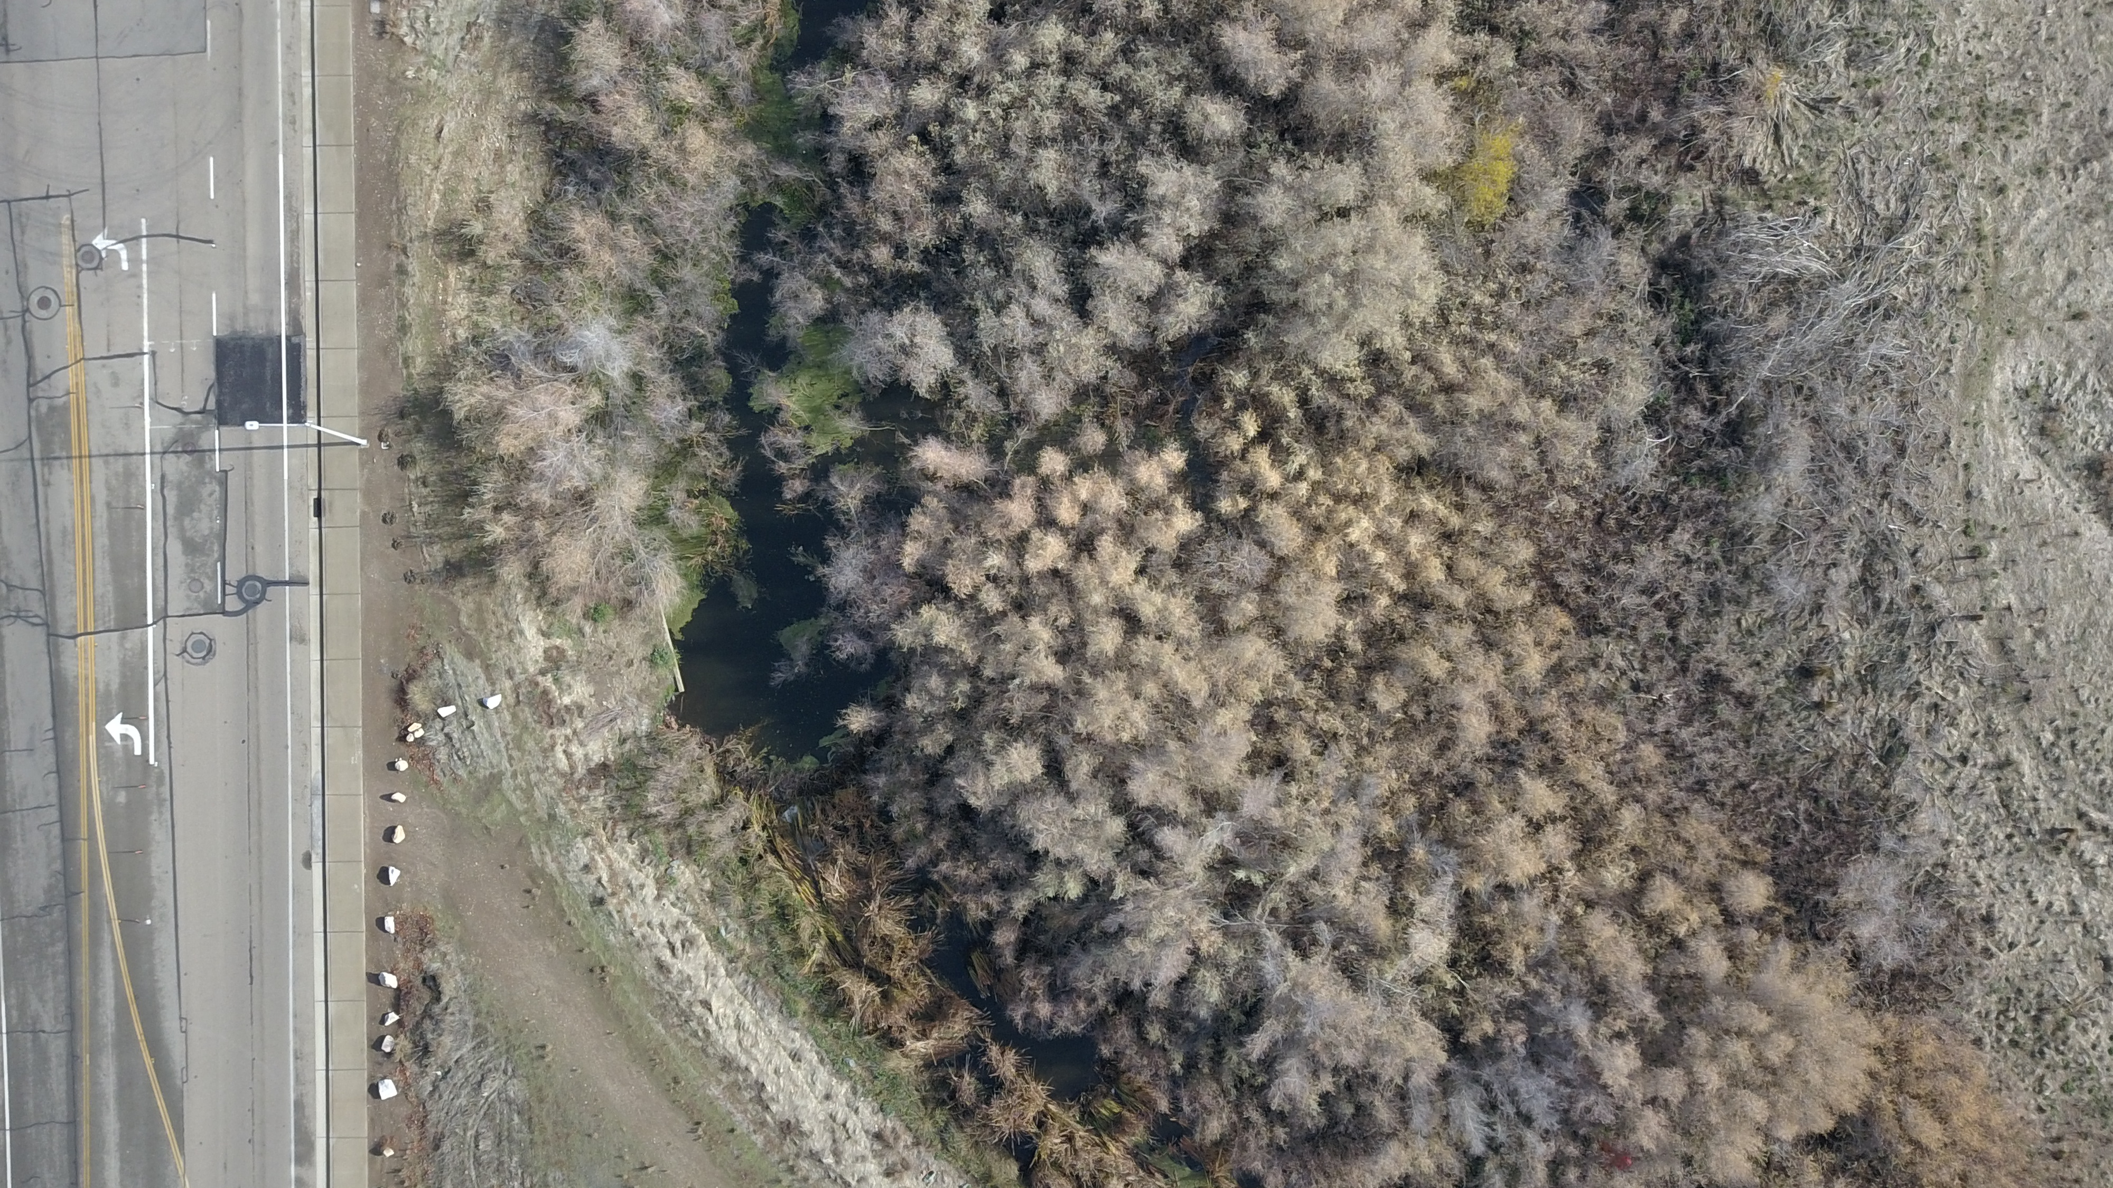
Creek Channel
West Oaks Blvd
Beaver Pond
Beaver Dam

Slide 18
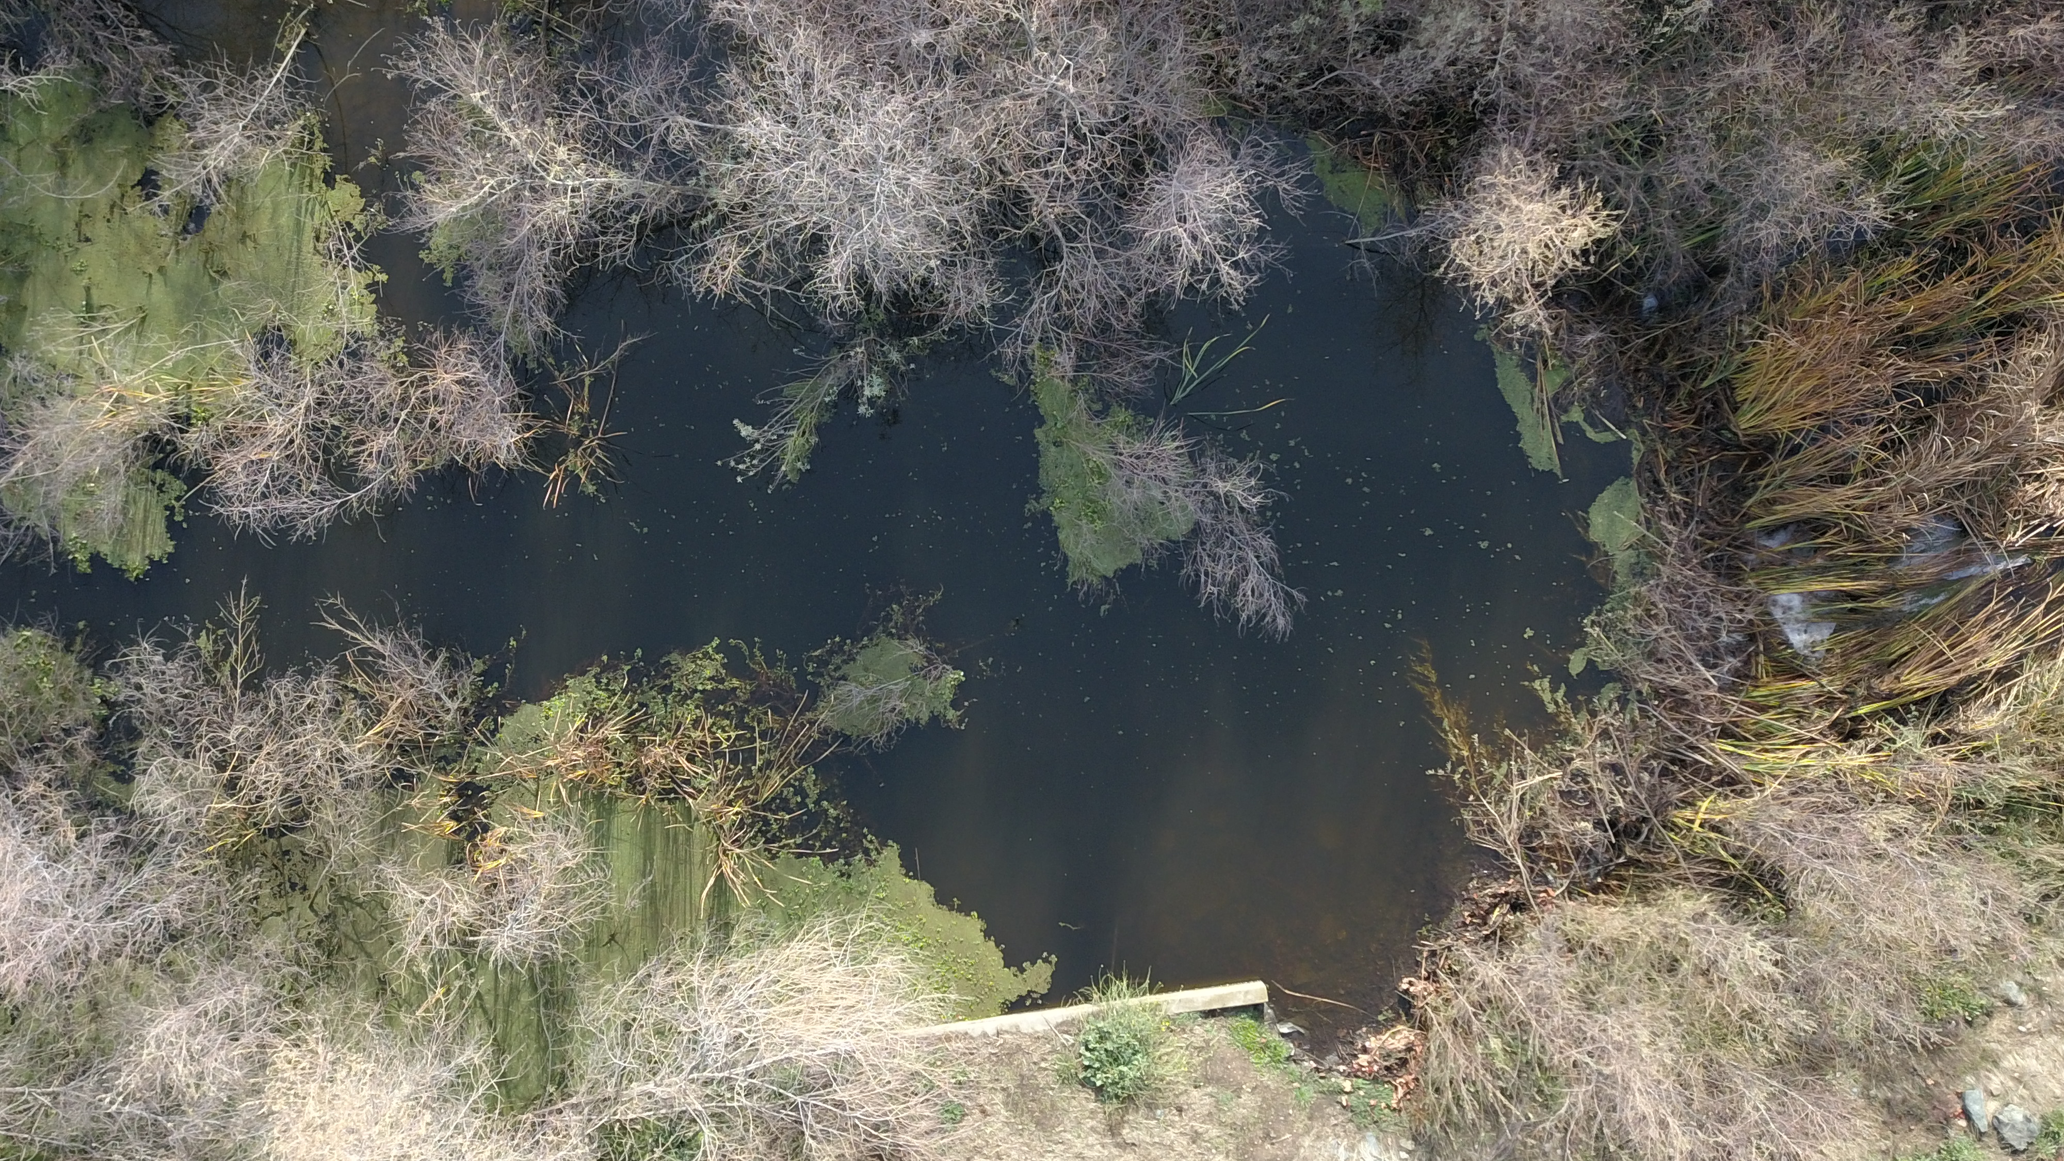
Beaver Dam
Beaver Pond
Culvert

Slide 19
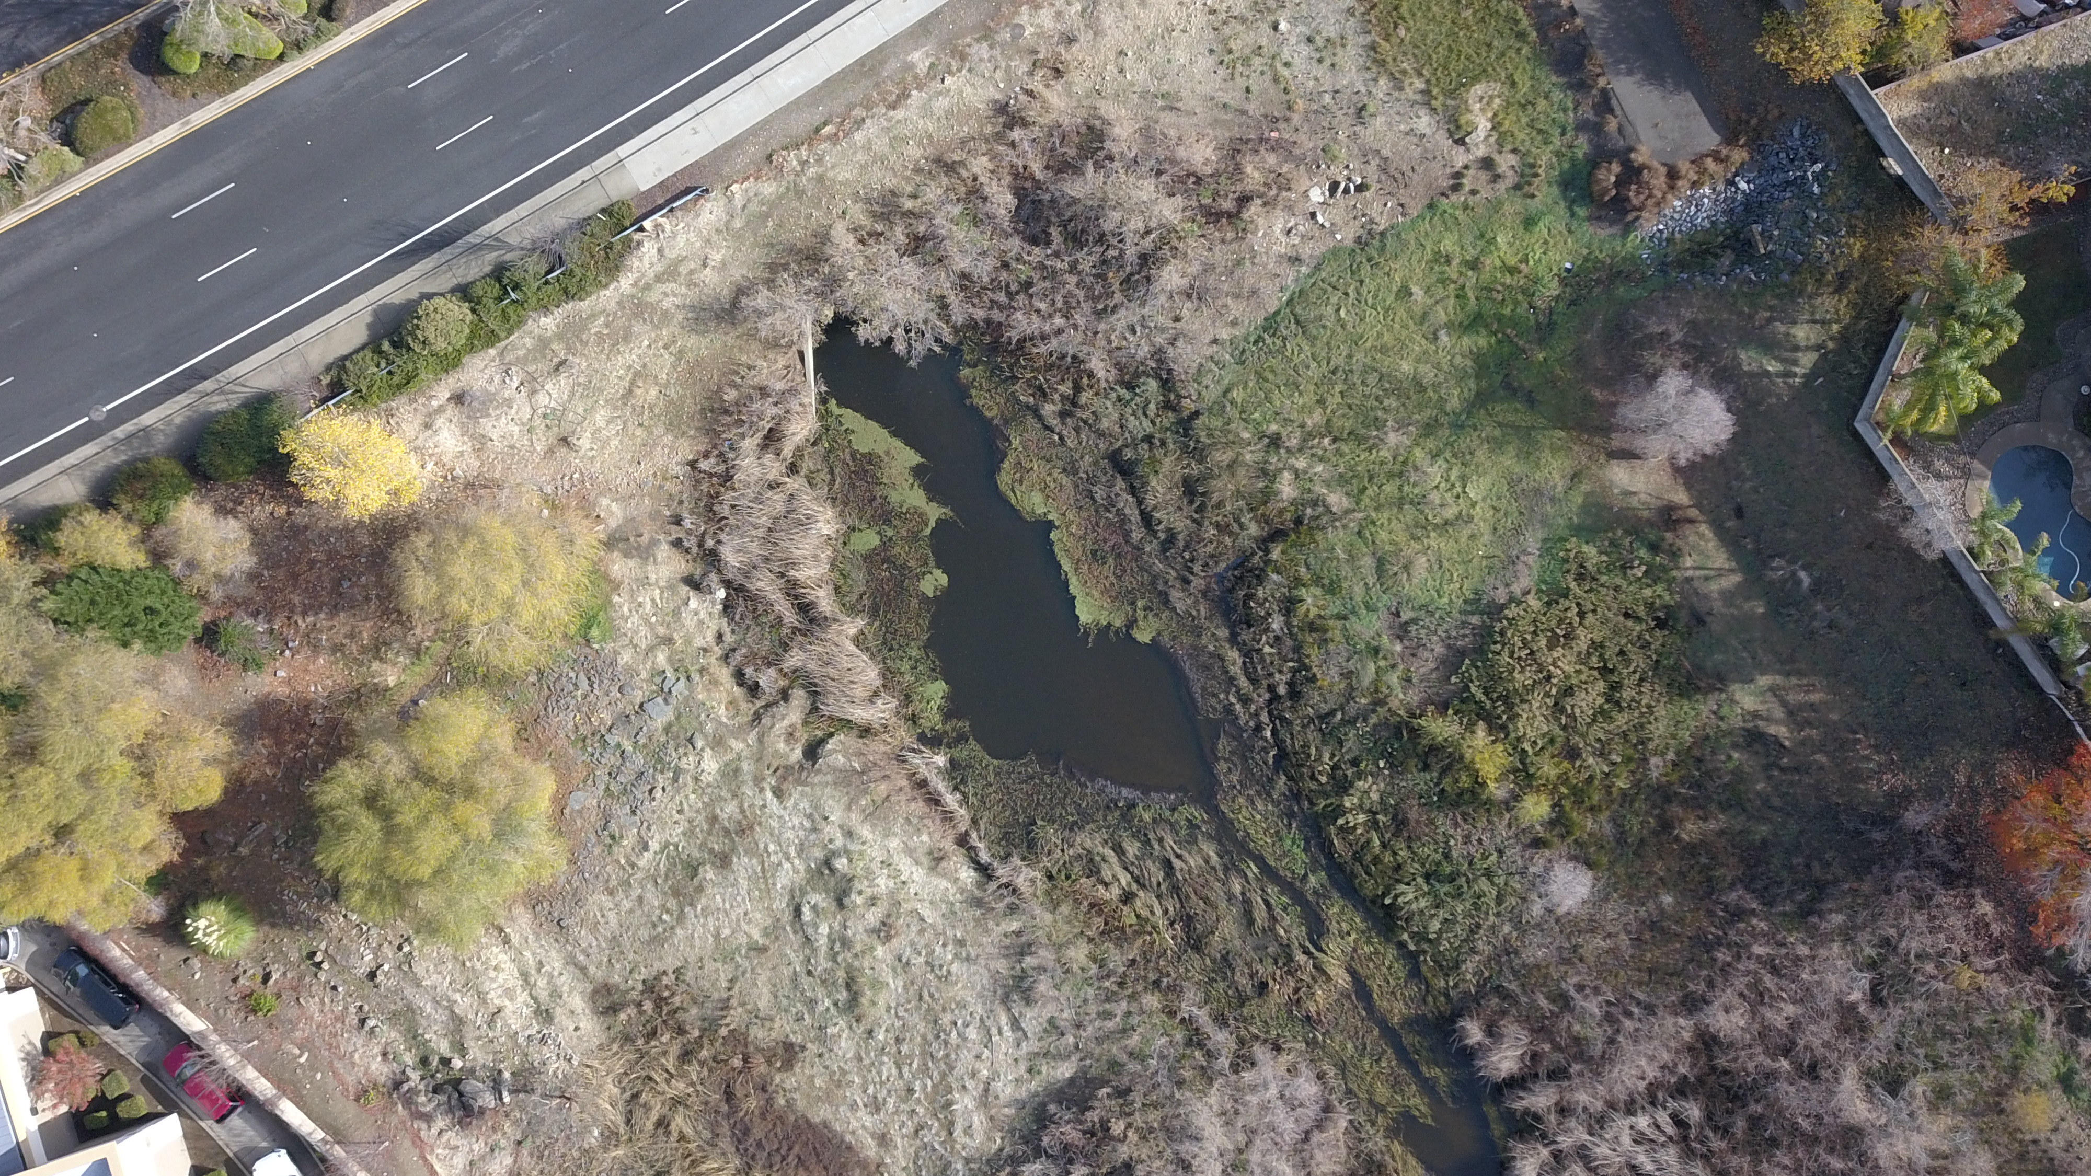
Sunset Blvd
Main Creek Inflow Culvert
Beaver Activity

Slide 20
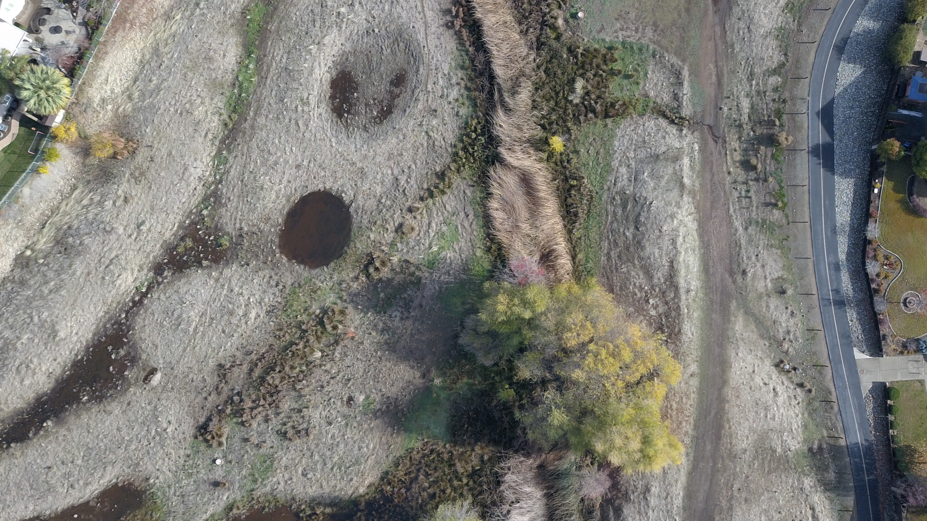
Manhole
Vernal Pool
Bicycle Path
Vernal Pool
Creek Channel
Ring-necked Pheasant Habitat
Bicycle Path Access
Manhole
Fire Road

Slide 21
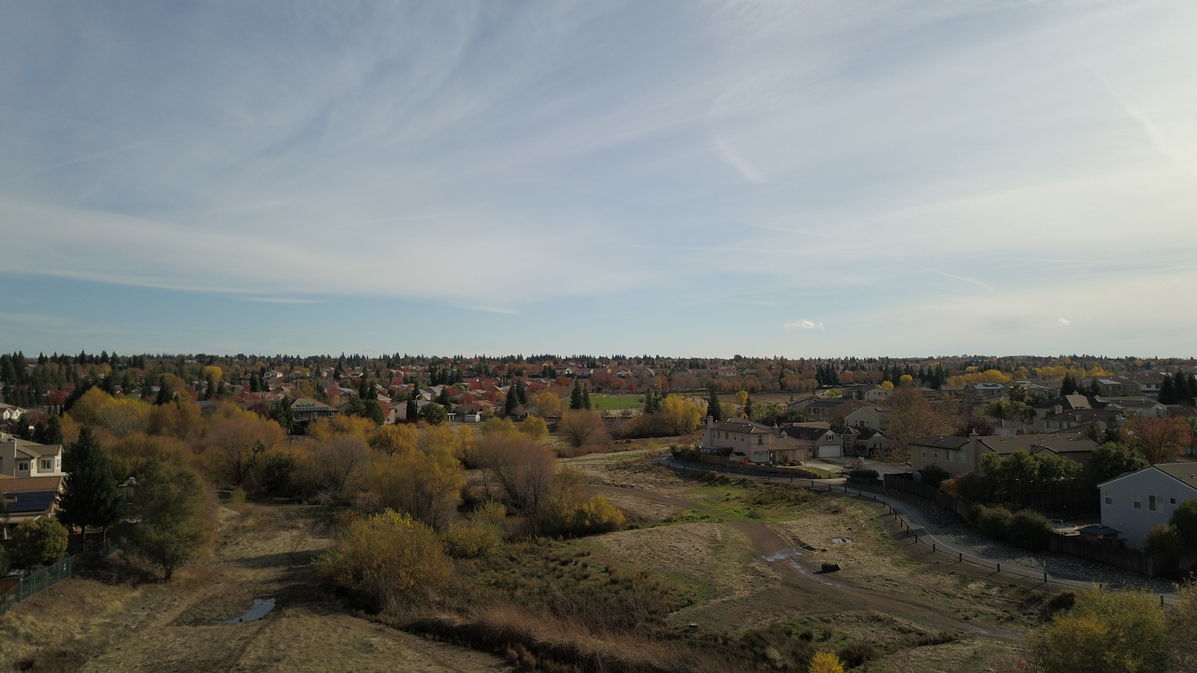
Greenbelt Looking East Toward Blue Oaks Blvd

Slide 22
GPS Unit and ARCGIS Pro Problems/Solutions
Original Unit didn’t communicate with mac
Traded in for new unit, works with Mac!
ArcGis Pro doesn’t work with Mac
Purchased Parallels DESKTOP, works great!

Slide 23
GPS Unit records both Points and Tracks
Tracks recorded with “time” - too many points for arcgis PRO, changed to recording with “distance”
Imported all data using Toolbox - GPX TO Features
Converted tracks in geoprocessing as points to lines

Slide 24
For Waypoints and Tracks, I created separate folders before importing as GPX to Features
That way, I had a separate organized feature class for the data
Input WAYPOINT/TRACK names in THE field on gps and in office used garmin basemap to identify and categorize each waypoint

Slide 25
Problems encountered:
Overall ArcGis Pro learning curve, joining polygons, modifying vertices
Some Base Maps had creek in wrong place
Limited symbology and colors in ArcGis Pro so I imported new data
Some bugs/freeze ups when editing imported symbology
Align in Edit Mode was buggy and caused polygon issues and crashes

Slide 26
What I’ve Learned:
• Increased comfort level with ArcGis Pro software
• Geoprocessing
• Toolbox, GPX to Features, Points to Line
• Drawing Polygons
• Editing Vertices and Alignment and Editing Symbology
• Drone Deploy software and New GPS to Garmin BaseCamp to ArcGis Pro workflow
• Understanding Layer Order for Best Map View
• Labels and their best look for Features, Halo
• Parcel Track Data

Slide 27
Final Map with Aerial Layer

Slide 28
Final Map with Solid Layer

Slide 29
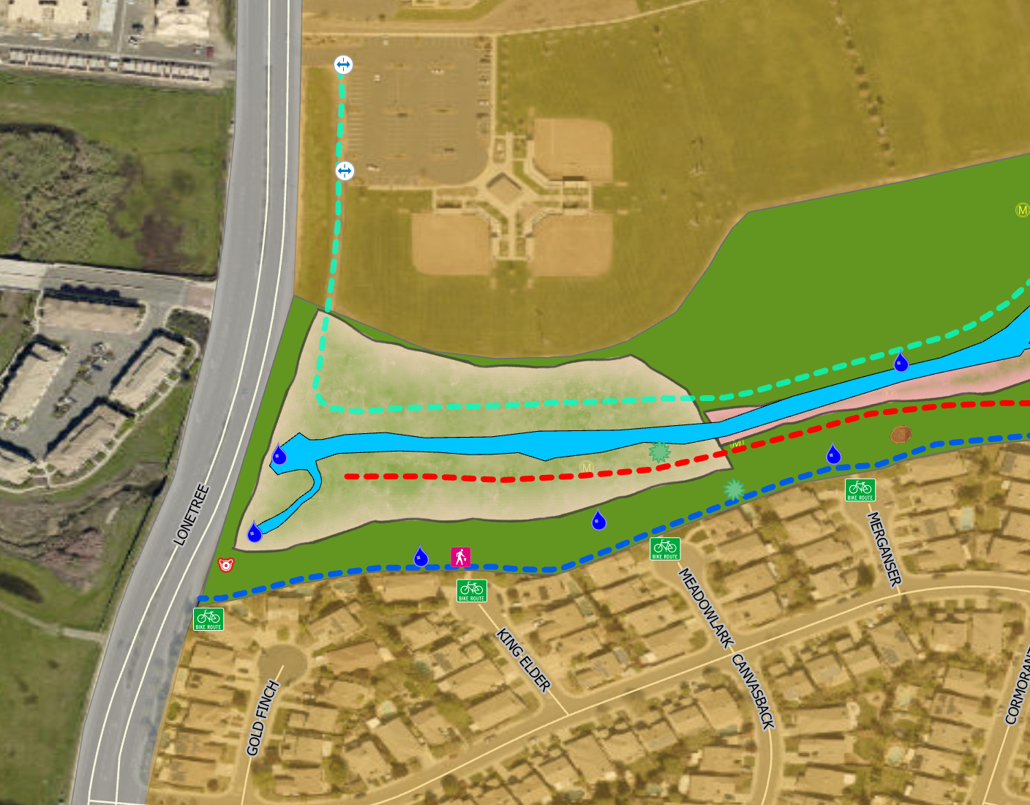
Jack Rabbit Range - Closeup

Slide 30
Ring-necked Pheasant Range - Closeup

Slide 31
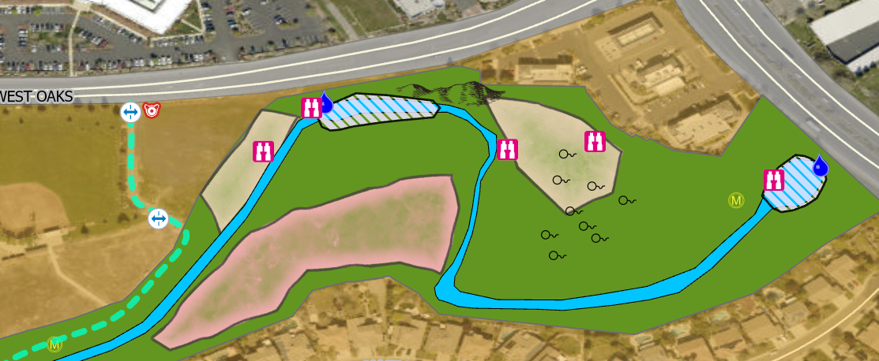
Beaver Range - Closeup

Slide 32
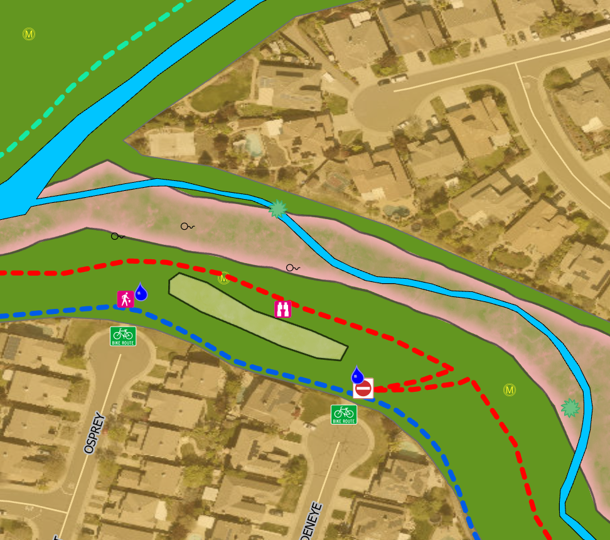
Mallard Nesting Area - Closeup

Slide 33
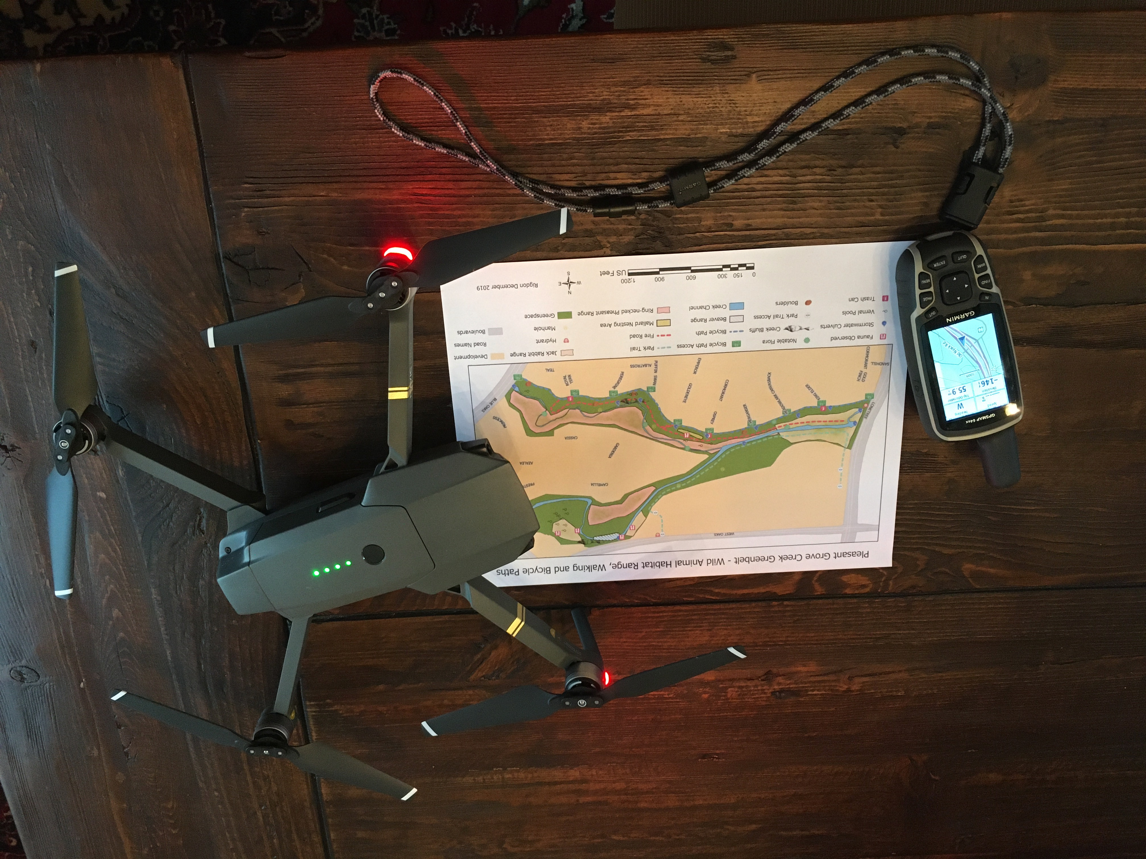
Questions

