Slide 1
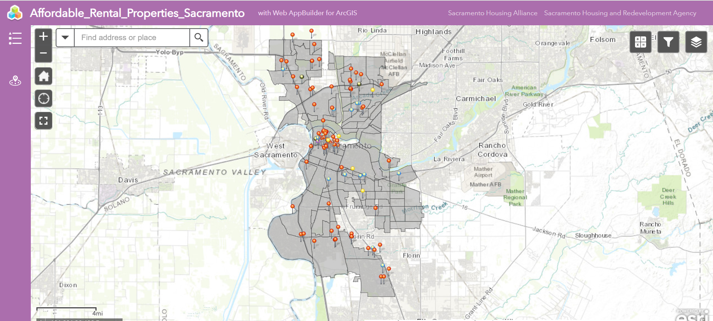
Affordable Rental Properties
Web Map Application C. Marisol Ramirez

Slide 2
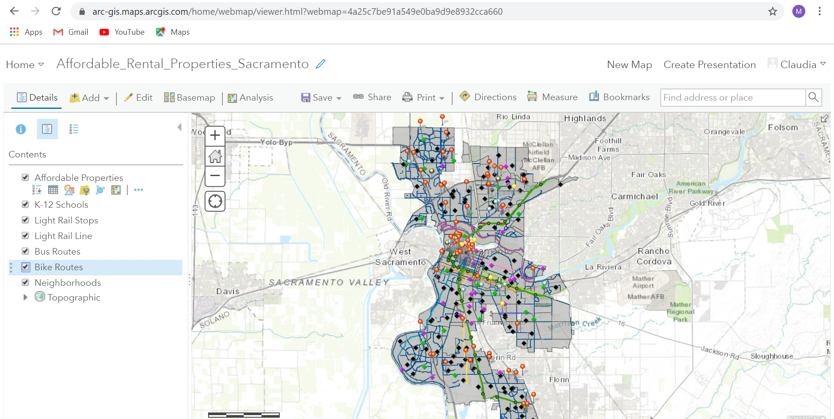
Layers from a map document were shared as a web map, creating web feature classes.

Slide 3
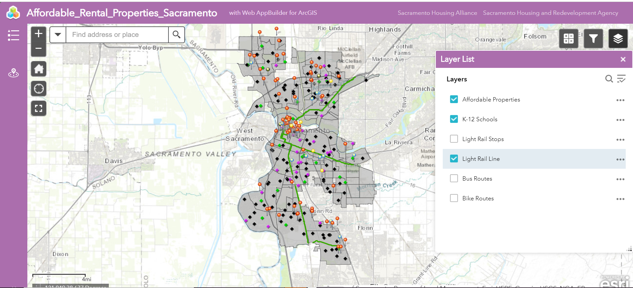
A web map app was then created to incorporate widgets. The layers widget lets the user turn off and on certain feature classes.

Slide 4
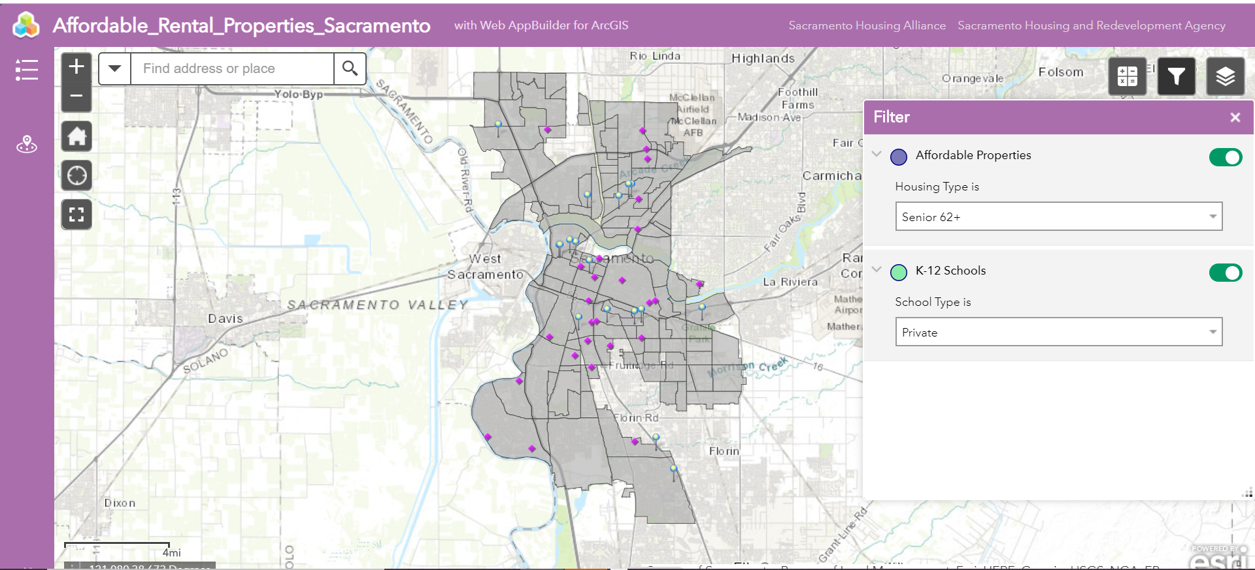
The filter widget filters the properties layer and schools layer for a more refined inquiry.

Slide 5
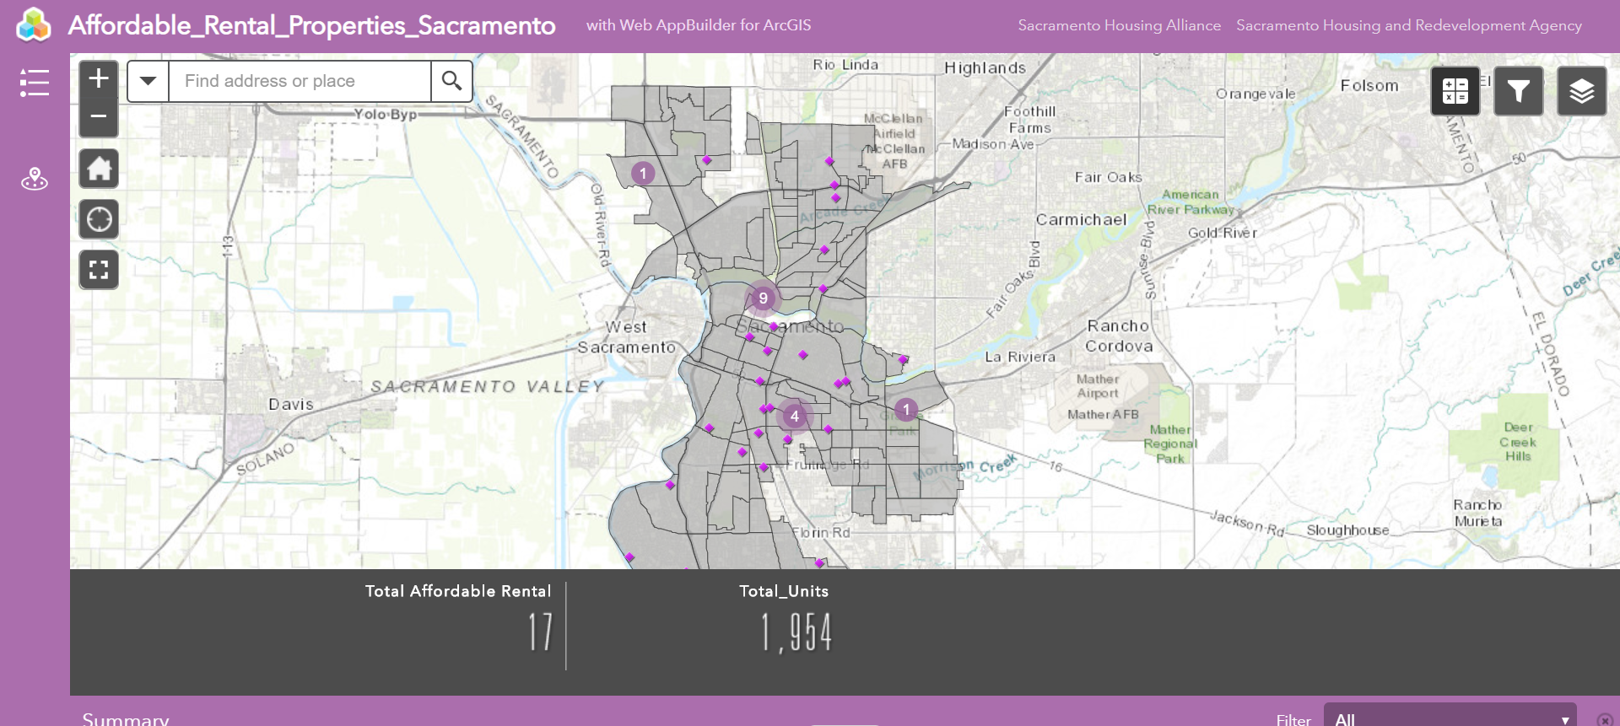
Use the summary widget to get a summary on total number of affordable rental properties and total units available, based on your screen view and filter settings.

Slide 6
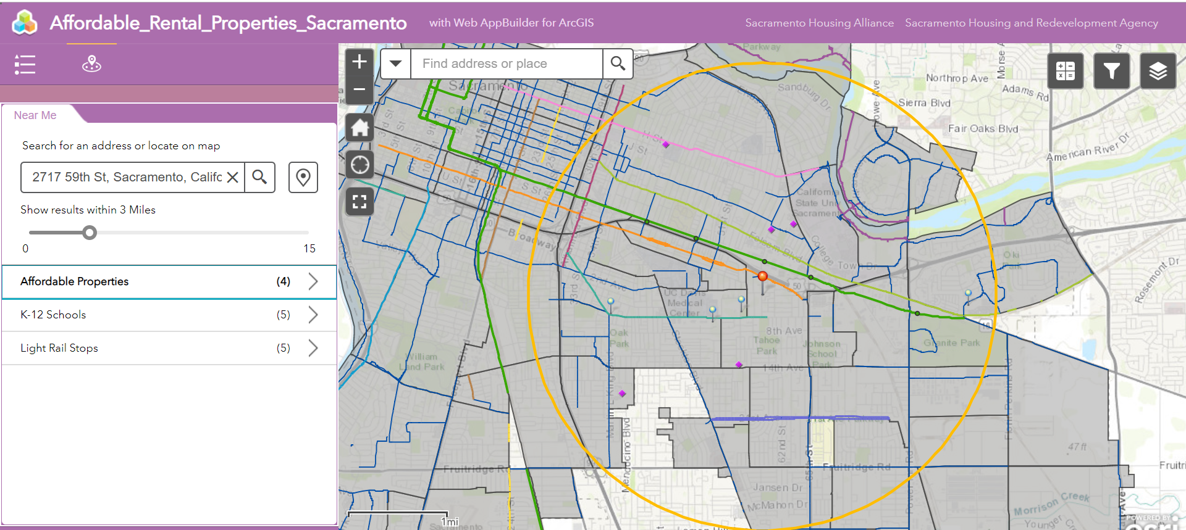
The near me widget gives a list of what is nearby any selected location.

Slide 7
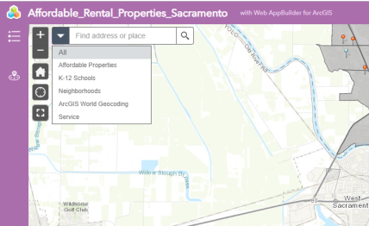

Final features of the app:
Search bar allows user to
search for a specific
neighborhood, school,
property, or any location.
Useful links to housing
resources in Sacramento
available online.

