Slide 1
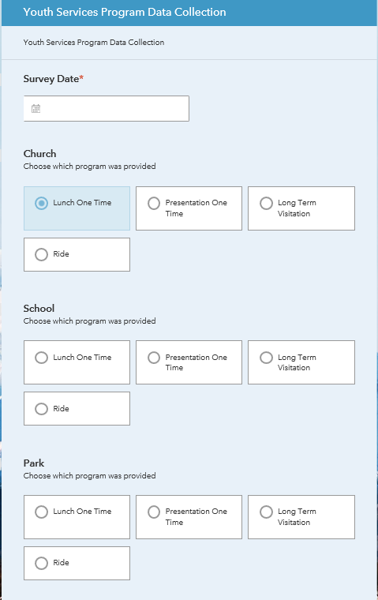
Annette Poole
GIS 385
Youth Services Program
Survey 123 and Dashboard
A simple survey created with ESRI Survey 123 allows the deputies to select date, type of destination, and event held. In addition, pictures can be uploaded and lat/long is provided automatically.
The analyst now has captured the data and Survey 123 creates bar charts, maps lat/long and creates a table.

Slide 2
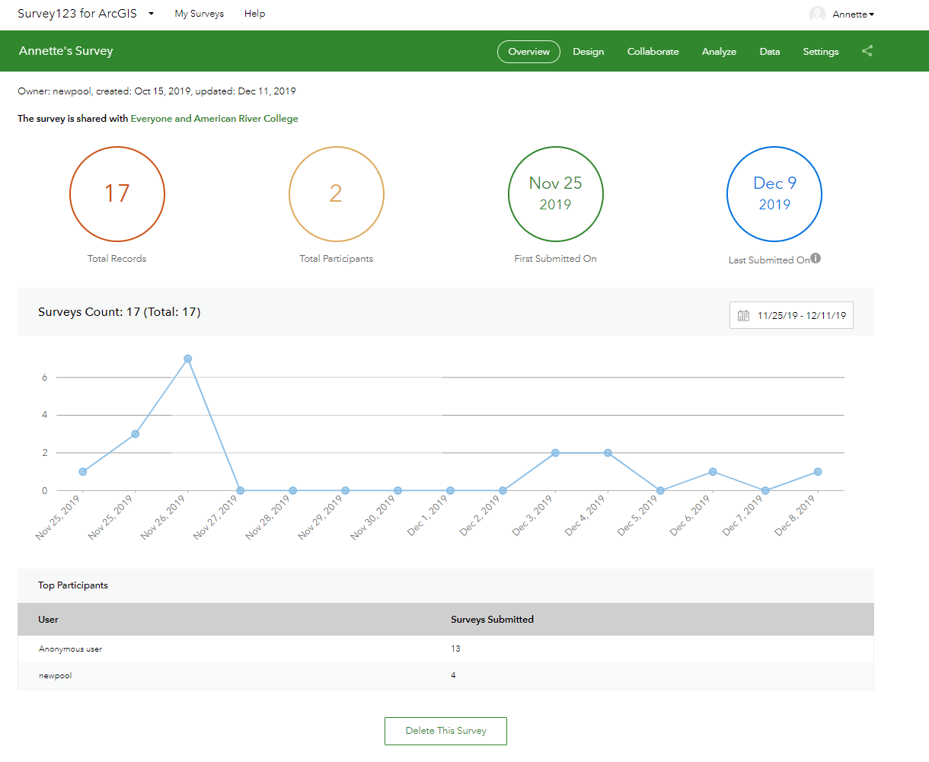
Annette Poole
GIS 385
Youth Services Program
Survey 123 and Dashboard
Displays data from
the survey

Slide 3
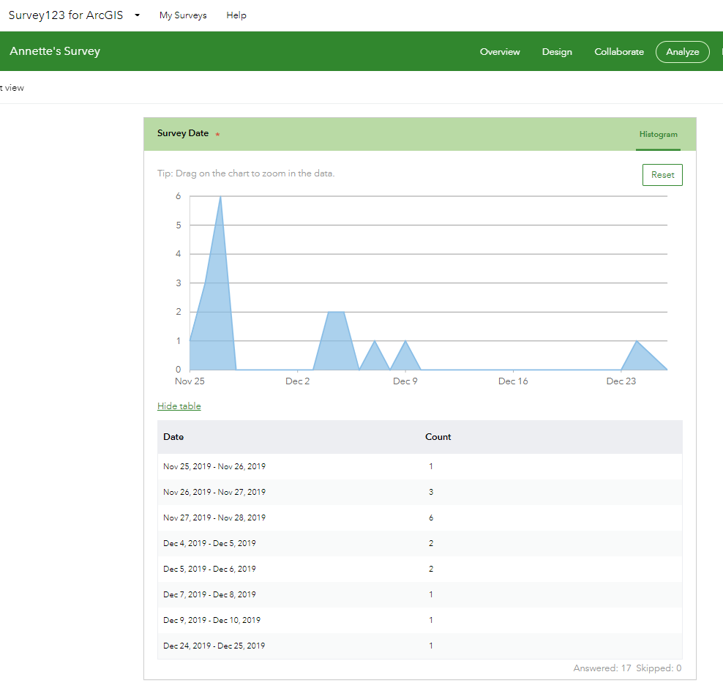
Annette Poole
GIS 385
Youth Services Program
Survey 123 and Dashboard
A total count and the dates

Slide 4
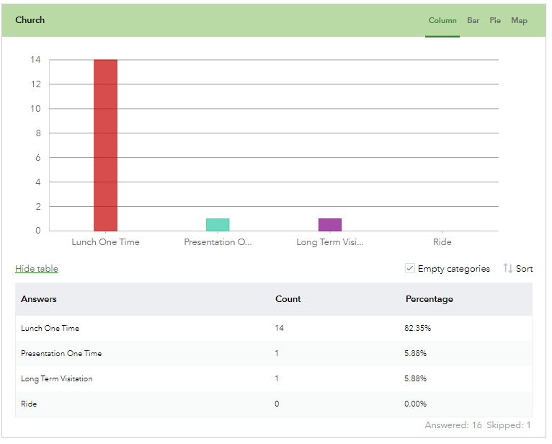
Annette Poole
GIS 385
Youth Services Program
Survey 123 and Dashboard
Creates bar charts. This
chart displays information
about the type of event

Slide 5
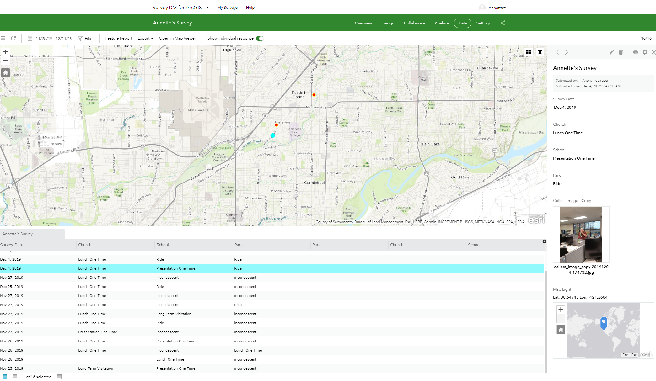
Annette Poole
GIS 385
Youth Services Program
Survey 123 and Dashboard
Plots points on map, creates table with info, and loads pictures.

Slide 6
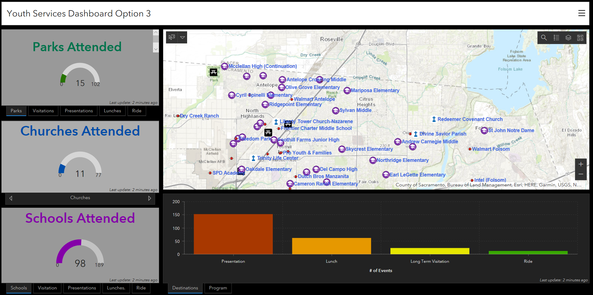
Annette Poole
GIS 385
Youth Services Program
Survey 123 and Dashboard
Dashboard updates and displays data from Survey 123

Slide 7
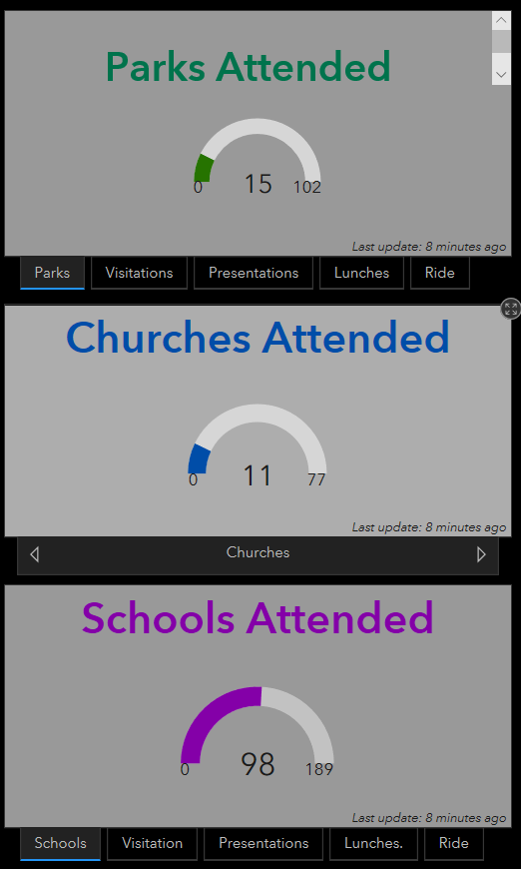
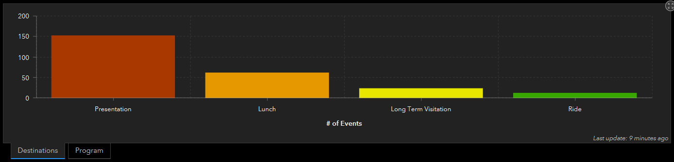
Annette Poole
GIS 385
Youth Services Program
Survey 123 and Dashboard
The gauges on the left display the three types of destinations the deputies attend such as parks, churches, and schools. The gauge tracks each time a destination is updated and indicates how close we are to achieving the goal. At each event, the deputies do visitations, presentations or lunches. These are tracked as well. I used the stack feature which created a tab for each event.
Below a bar chart displays the number of different events.

Slide 8
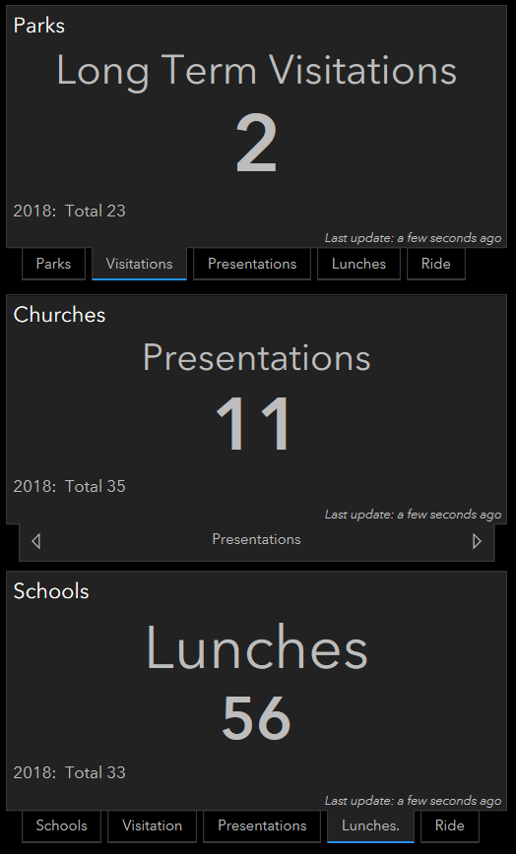
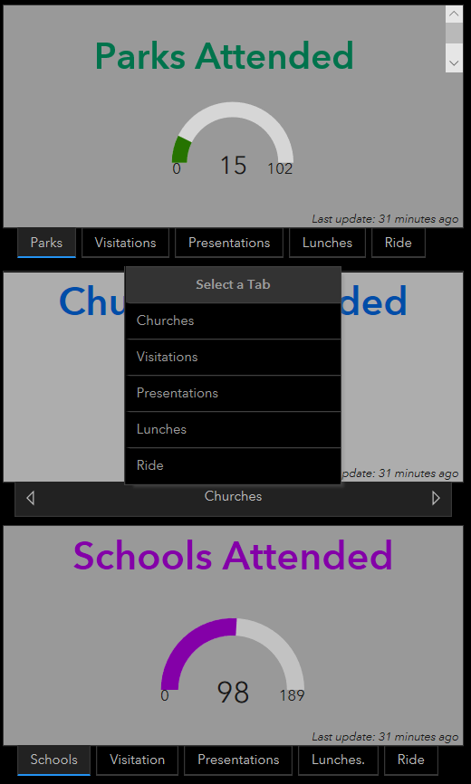
Annette Poole
GIS 385
Youth Services Program
Survey 123 and Dashboard
Each tab is an indicator that represents the number of
events. It also indicates the prior years total number of events. Notice the Church
gauge only displays one tab, but if
if you click on the tab,
then all the others are
displayed.

Slide 9
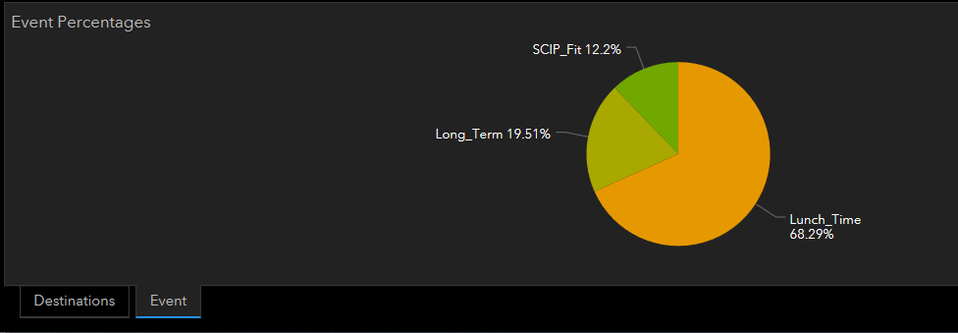
Annette Poole
GIS 385
Youth Services Program
Survey 123 and Dashboard
The Destinations tab contains the bar chart, next to that we have the Event
tab which indicates the percentages of the events as shown below.

Slide 10
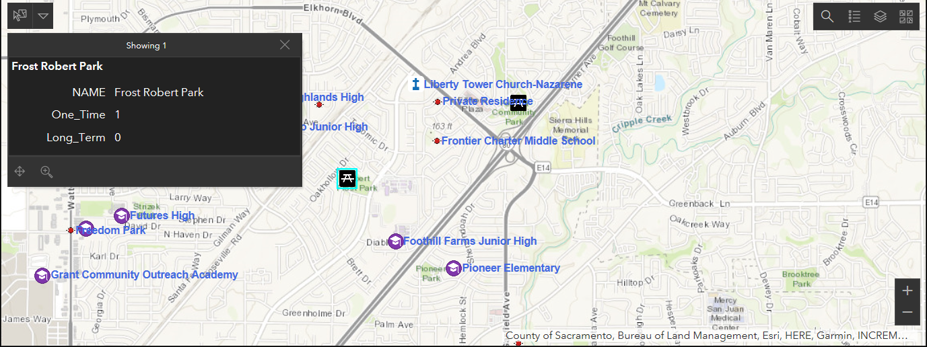
Annette Poole
GIS 385
Youth Services Program
Survey 123 and Dashboard
The dashboard has an interactive map. Each destination is represented by a symbol.
The pop-up shows the destination name, the type and number of events held at the
Destination. The map allows you the opportunity to display each destination by itself
or with other destinations.

