Slide 1
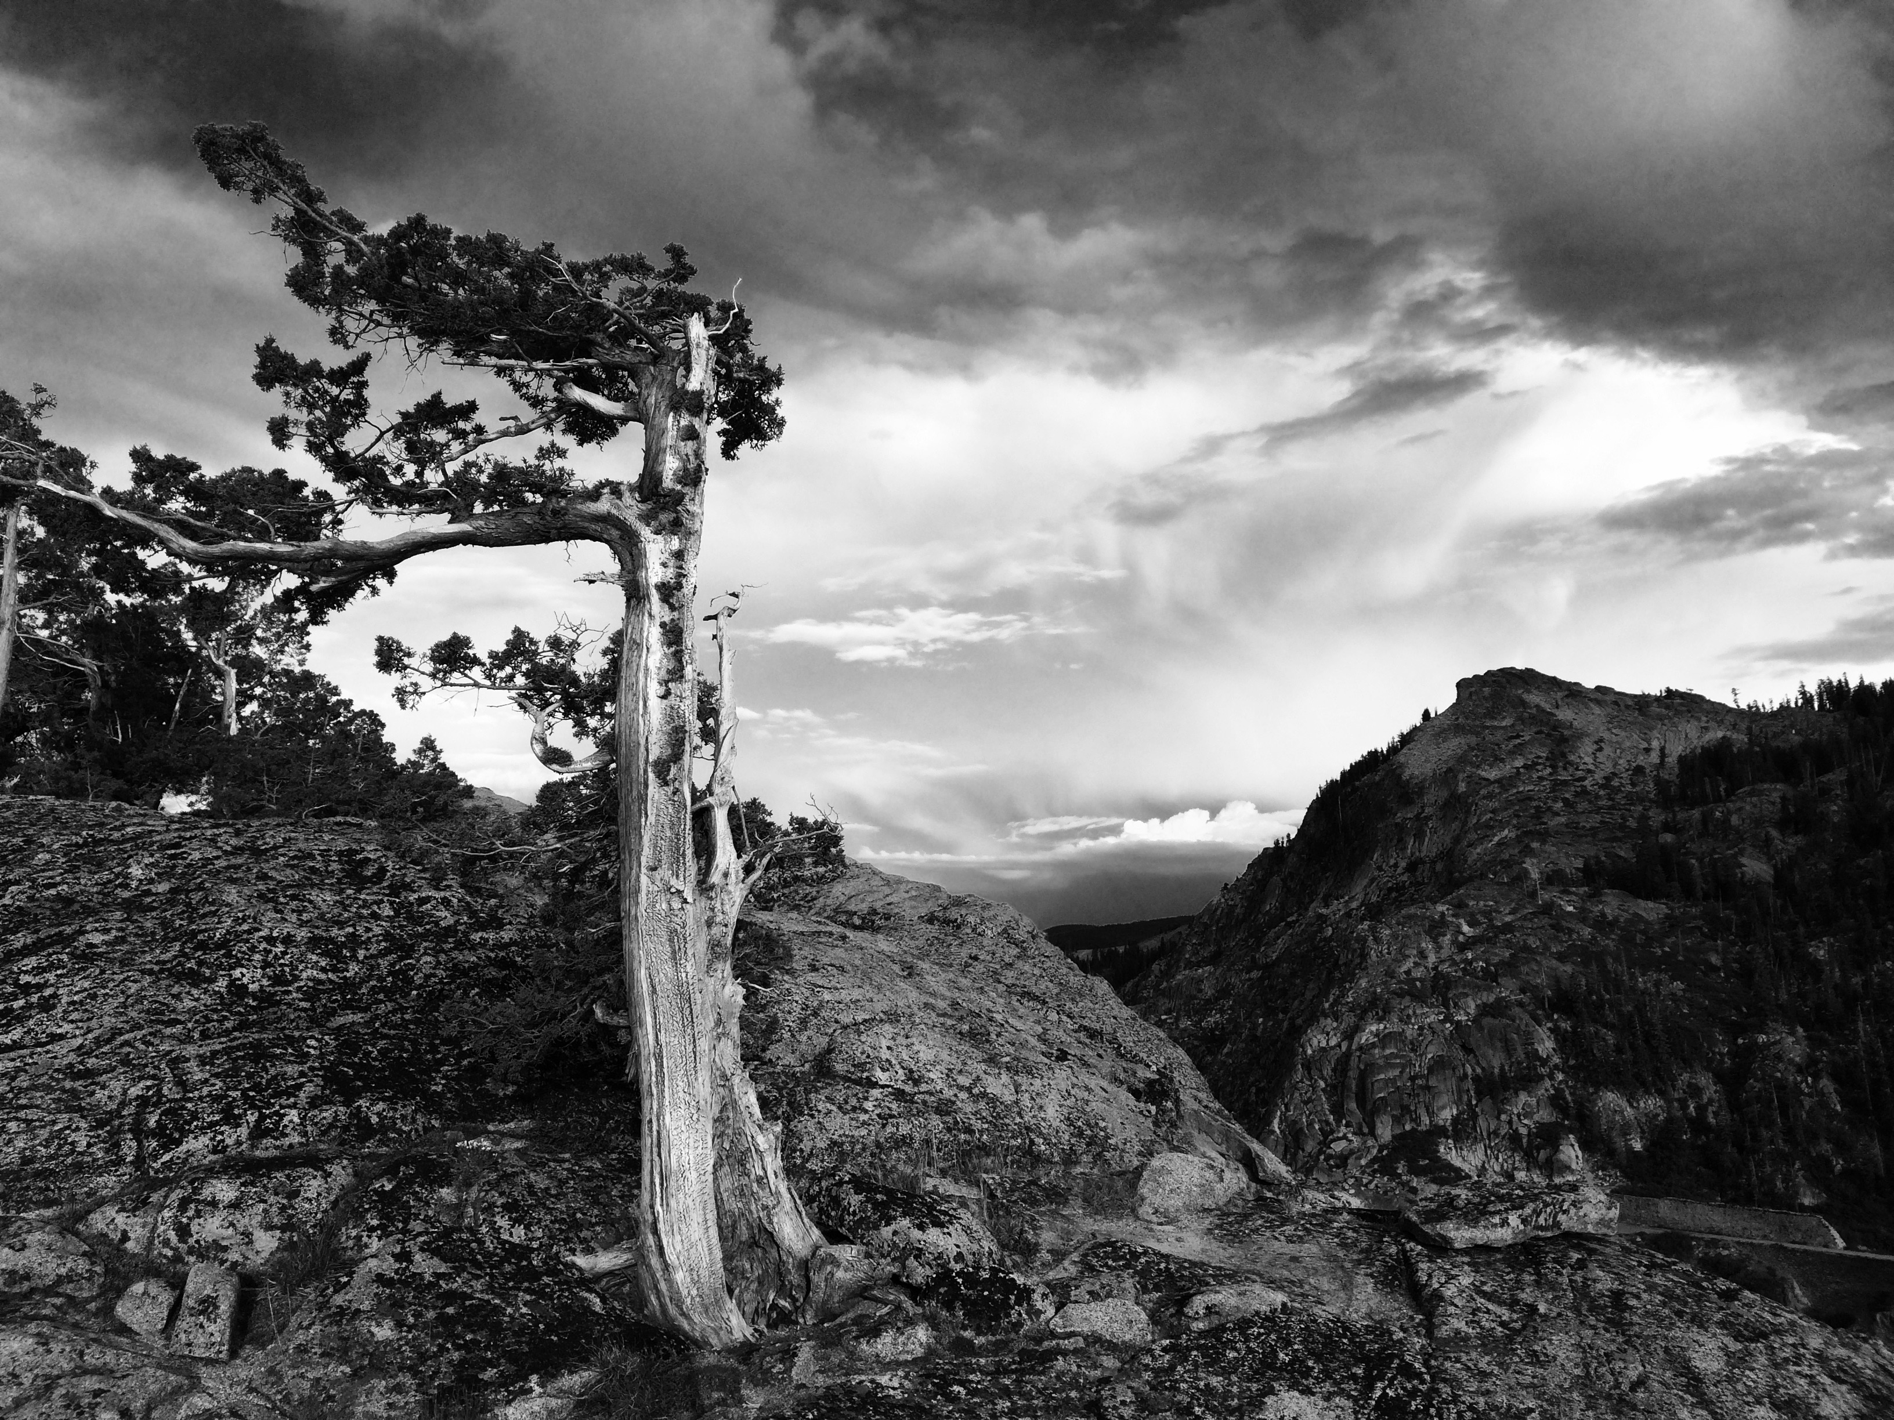
Climbing Areas of
Donner Summit
Geog 90 final project
Katie Mansfield

Slide 2
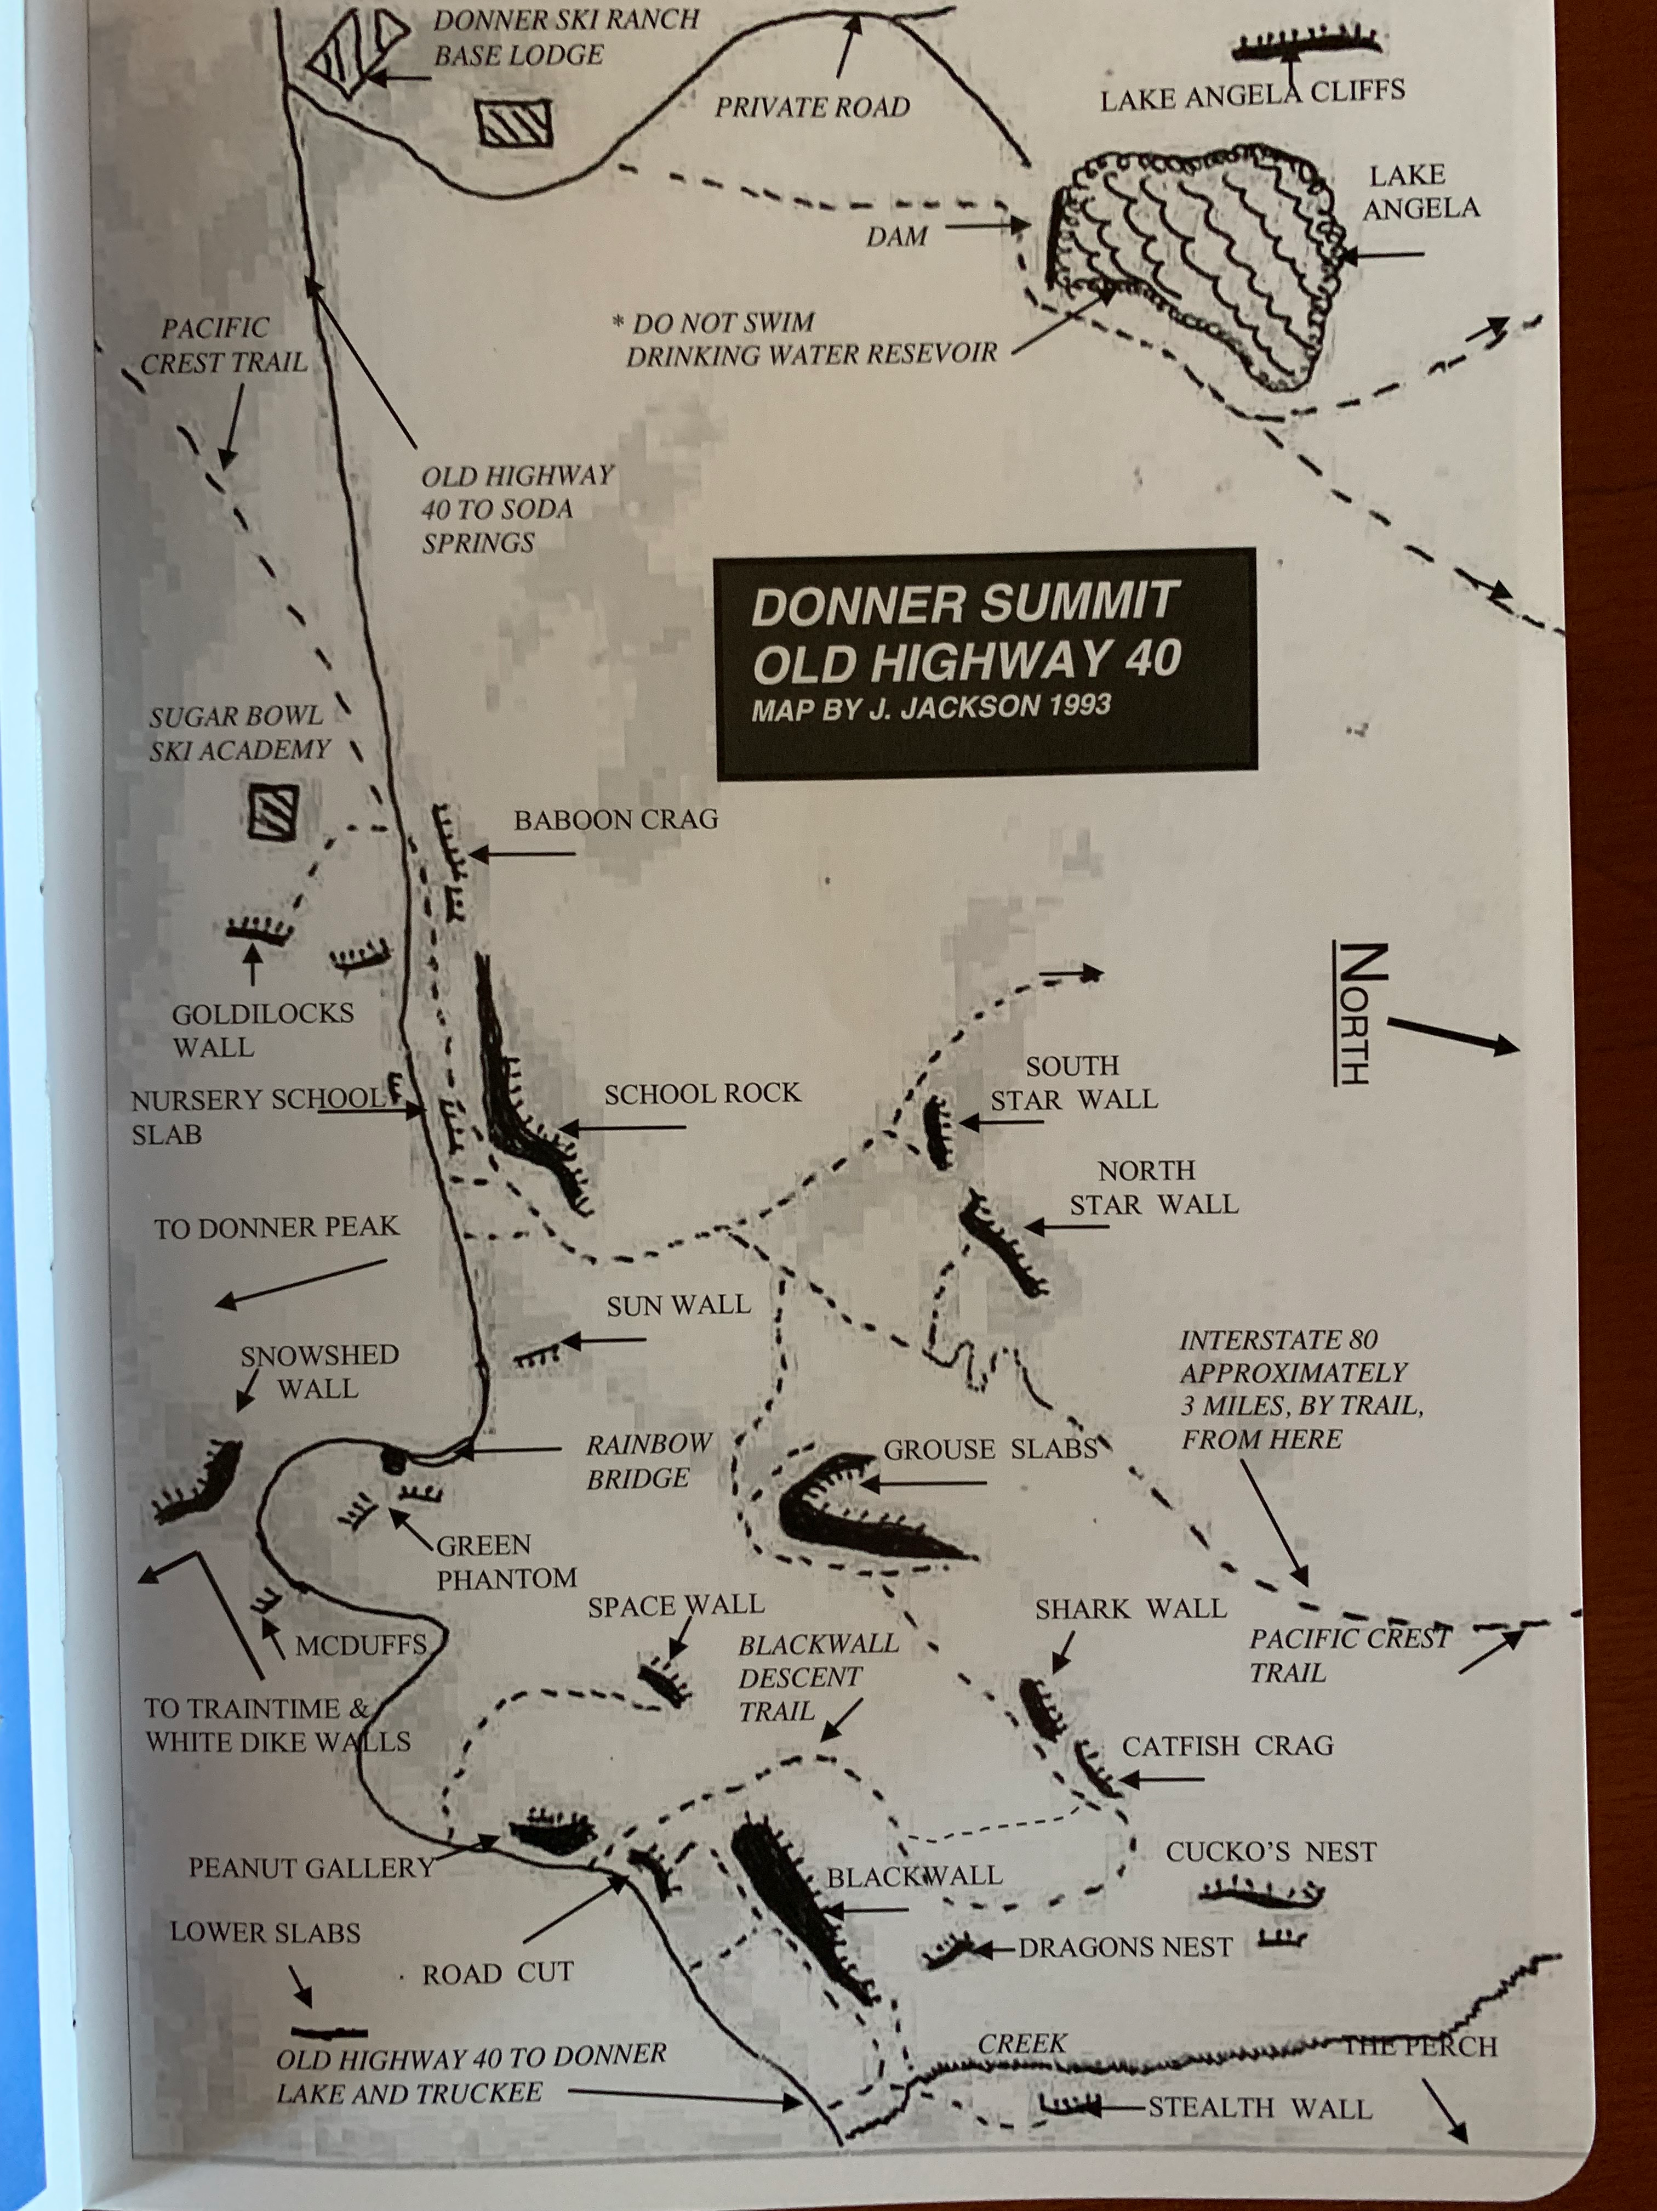
Project Purpose
Donner summit Climbing Areas
Create a map to show climbing areas, access trails, parking areas, and how many routes are at each climbing area
Focus on data creation
Use data from the Portal and properly manage all created data
From Rock Climbs of North Tahoe by John Jackson, 2011

Slide 3
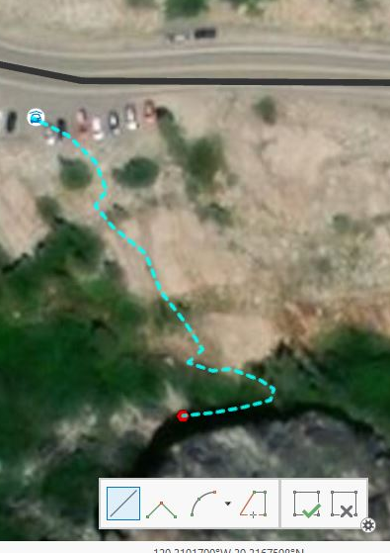
Data Creation
Donner summit Climbing Areas
Created a geodatabase
Created three feature classes
  Parking areas - points
  Climbing areas - points
  Access trails - lines

Slide 4
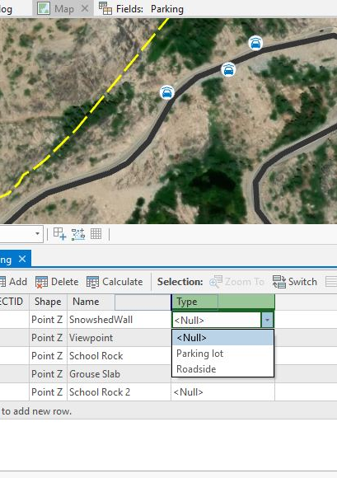
Data Creation/Editing
Donner summit Climbing Areas
Added fields to feature classes that I created
  Name, number of routes, type, etc.
Created domains for types of parking areas and parking surface type

Slide 5
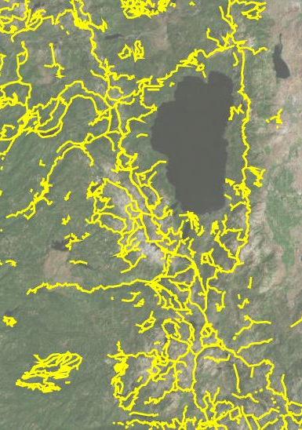
Reduced large datasets
Donner summit Climbing Areas
Select by Location and created a new layer from selection
  Used for Trails and Railroads
Definition Query
  Used for Roads

Slide 6
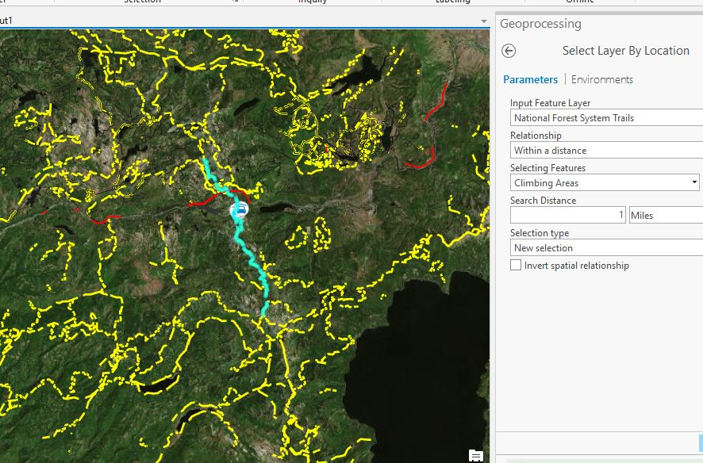

Slide 7
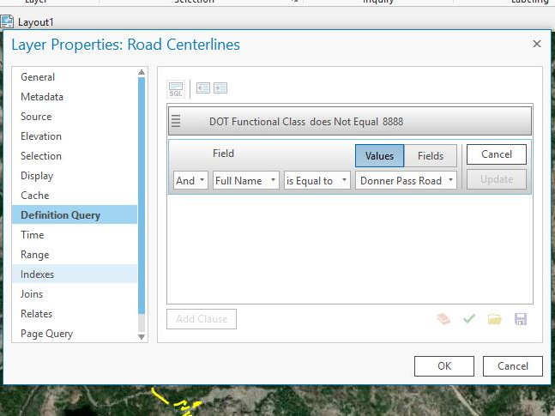

Slide 8
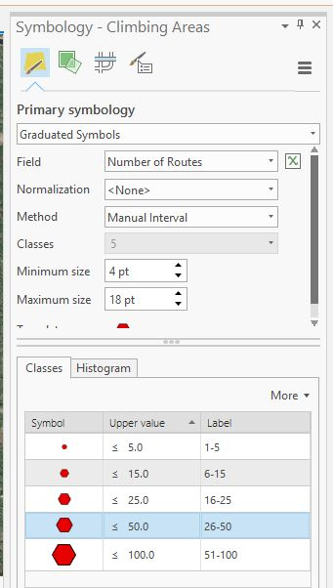
Layout Formatting
Donner summit Climbing Areas
Symbology of climbing areas
  Graduated symbols for number of climbing routes per area
Added and formatted labels, legend, scale, north arrow and title
Added an extent indicator
Tried portrait and landscape

Slide 9
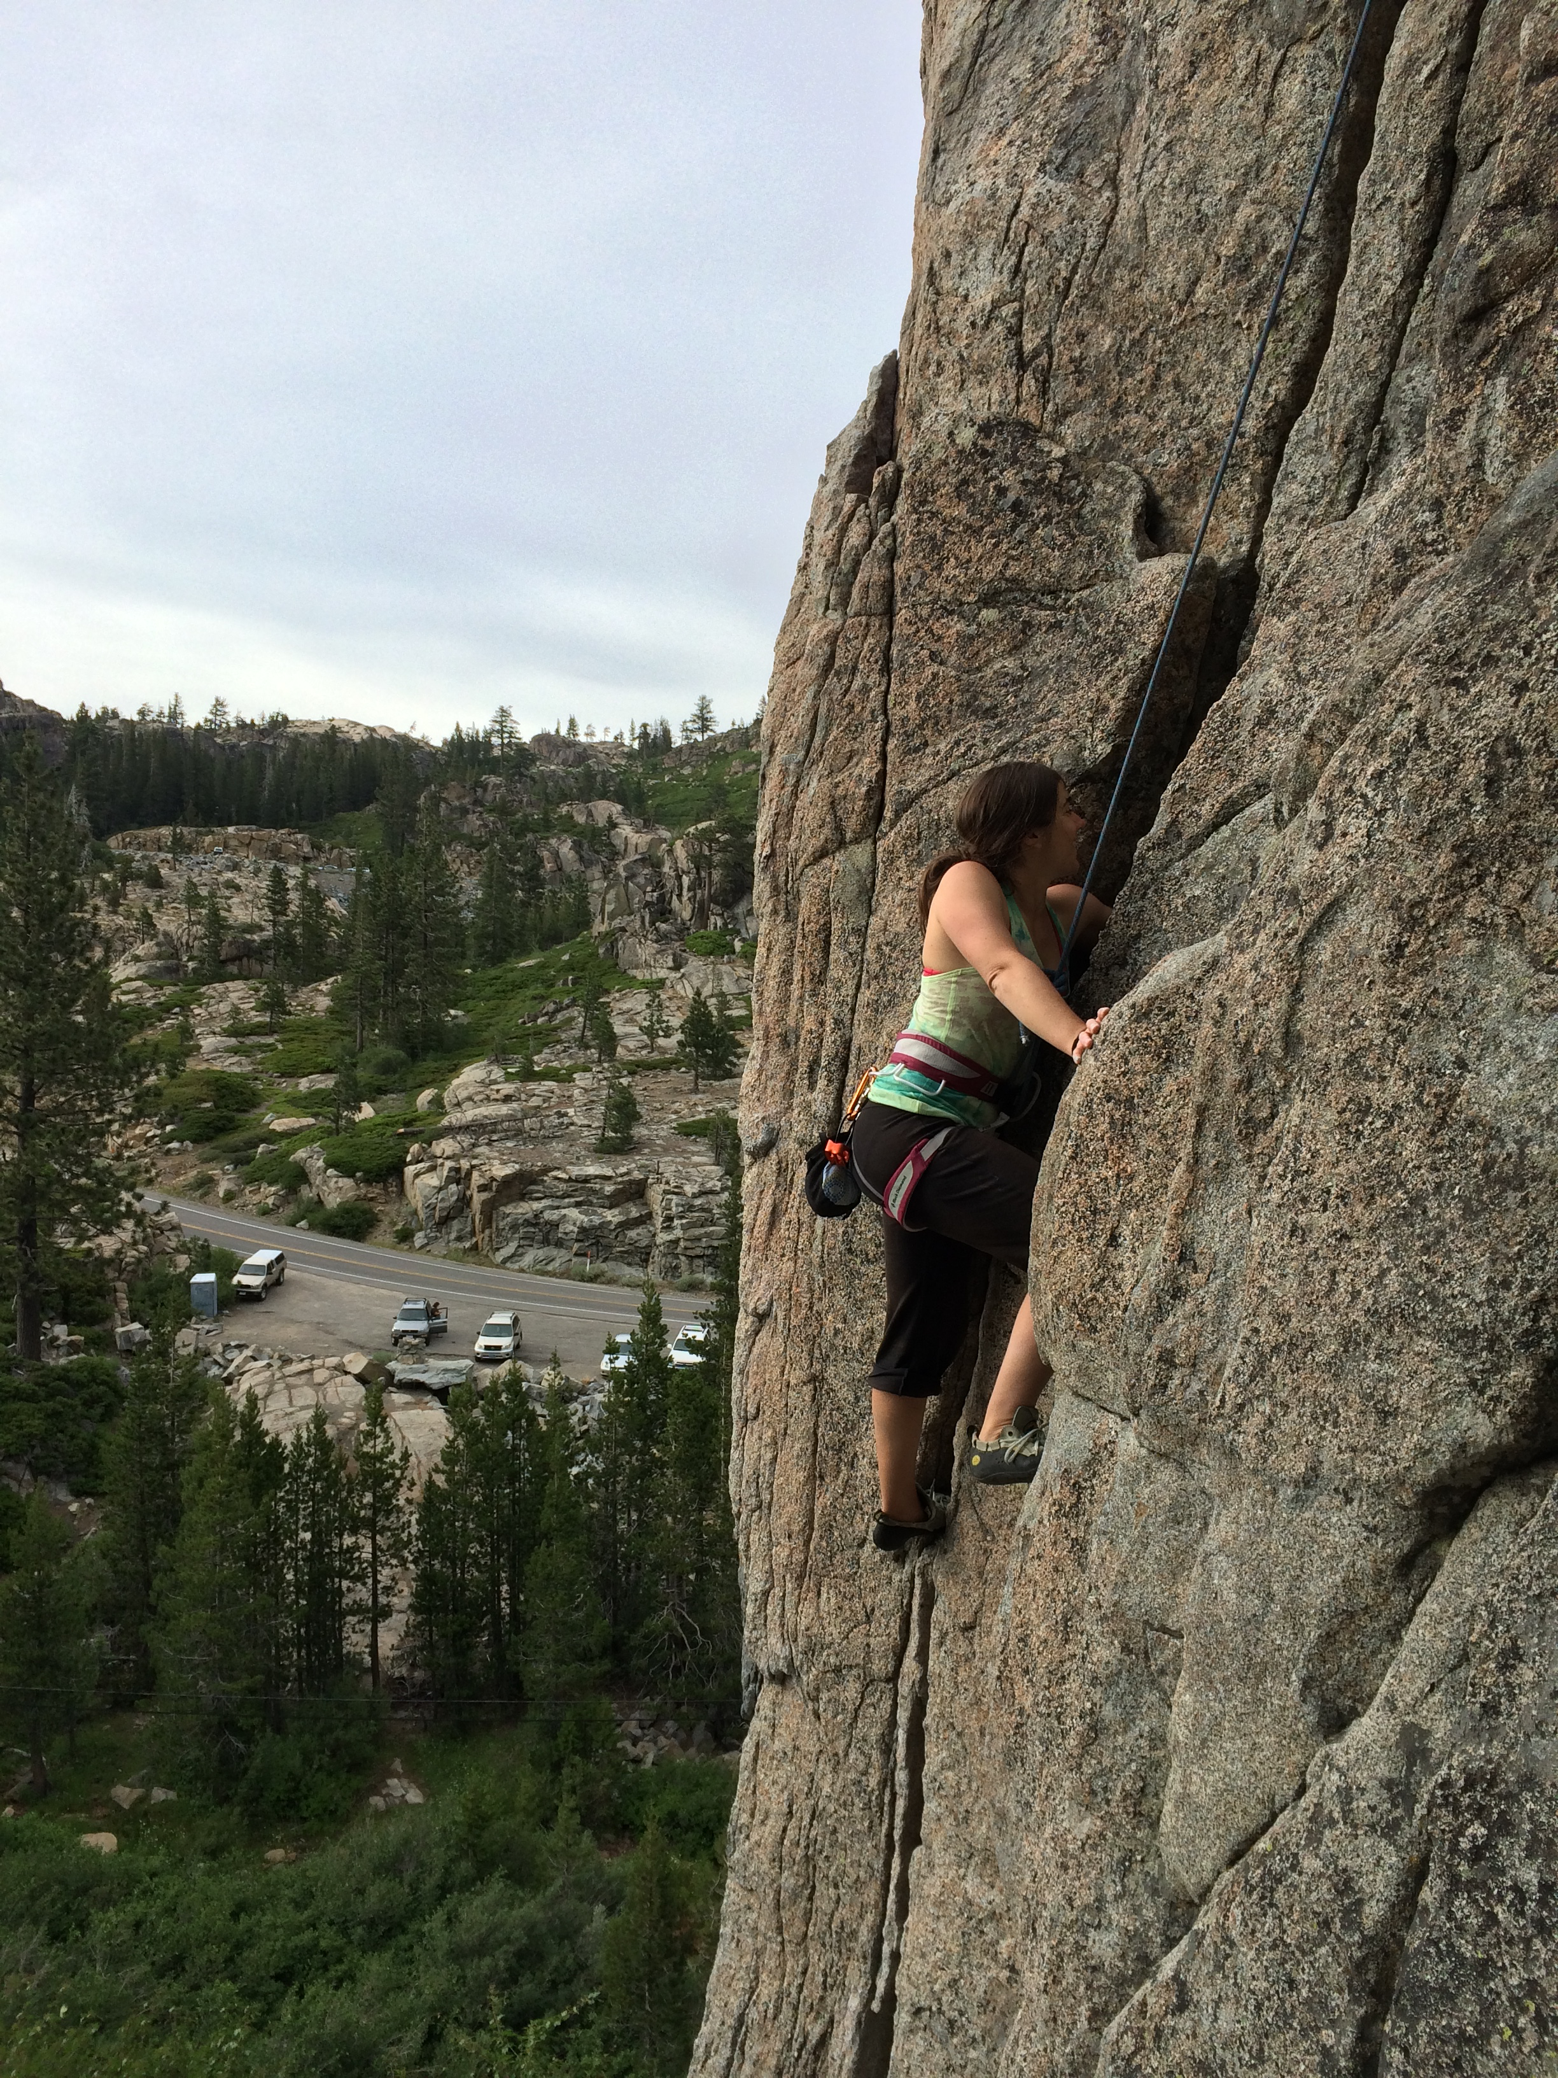
Challenges
Donner summit Climbing Areas
Difficulty finding which data source to use
  Federal, state, county or something else
  Finding an authoritative source
  Some features were too generalized
Finding the appropriate scale for the project to show useful information
Glitches with the extent indicator
Trails selection weirdness

Slide 10
What I Learned
Donner summit Climbing Areas
Data creation/editing
Domain creation
Extent indicator
Where tools, processes, and formatting are located in ArcGIS Pro

Slide 11
