Slide 1
Parcels and Roadways in Sacramento County
Meghan Lyons

Slide 2
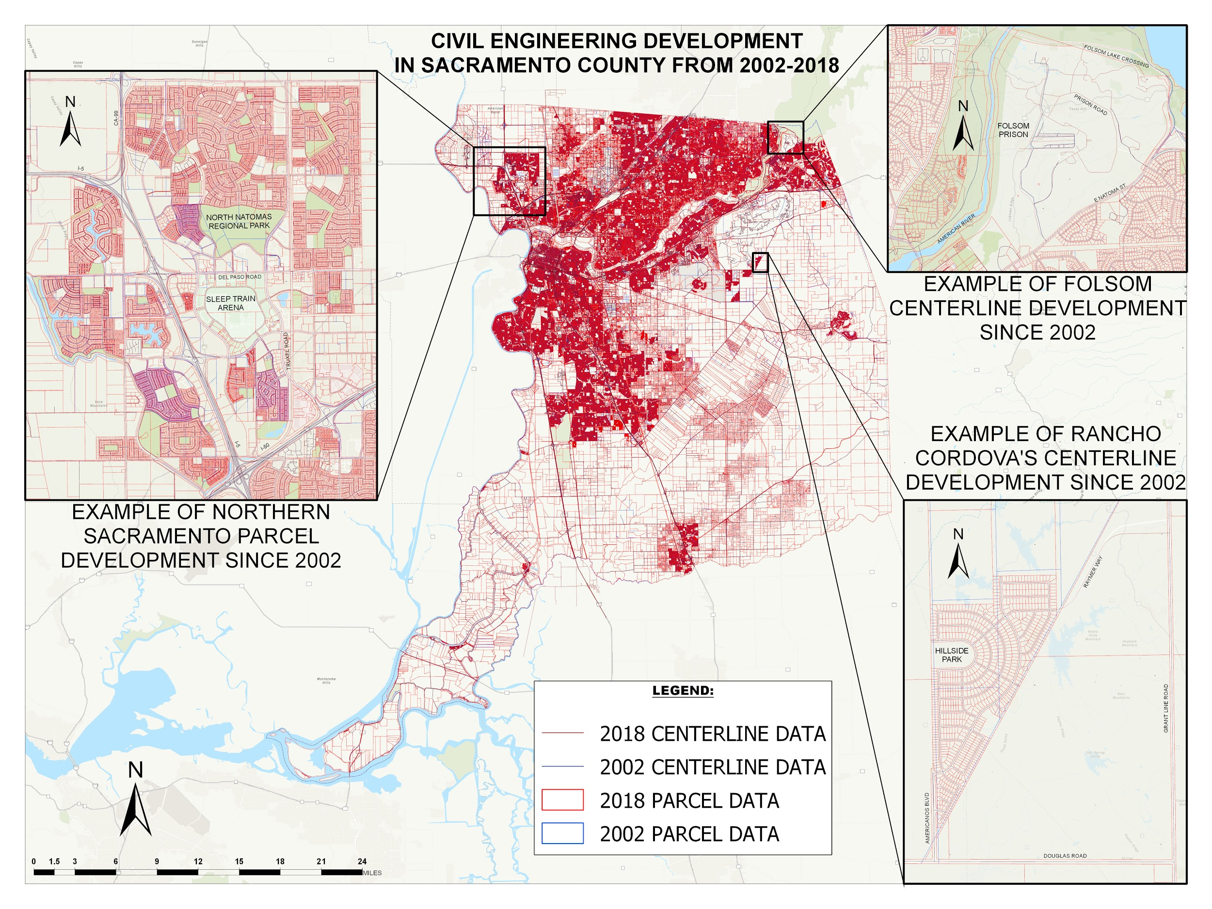
Notes:
b. Purpose. Include what you hope to accomplish with this project
as an employee of a company that has been working for 65 years in the Sacramento and Bay Area, I thought it was important to share a few things about my industry
Everyone talks about mechanical and architectural, but no one gives credit to the civil engineering firms that literally PAVE THE WAY for the mech. and arch. engineers
w/ bad press and misunderstanding - not about owner/company profit - environmental & community concerns ARE addressed
a. Project Summary
With job at MacKay and Somps, the last 16 years of records in the Sacramento area were accessible in our office.
The office has its own GIS department so all of the data was already in GIS format.
Able to compare development in the Sacramento area over time.
Overlaying the data year over year became a tool to analyze the way the city was growing, and see the planning structure of the cities civil engineering firms.

Slide 3
data choice
analysis
design
multi-
map
frames

Slide 4
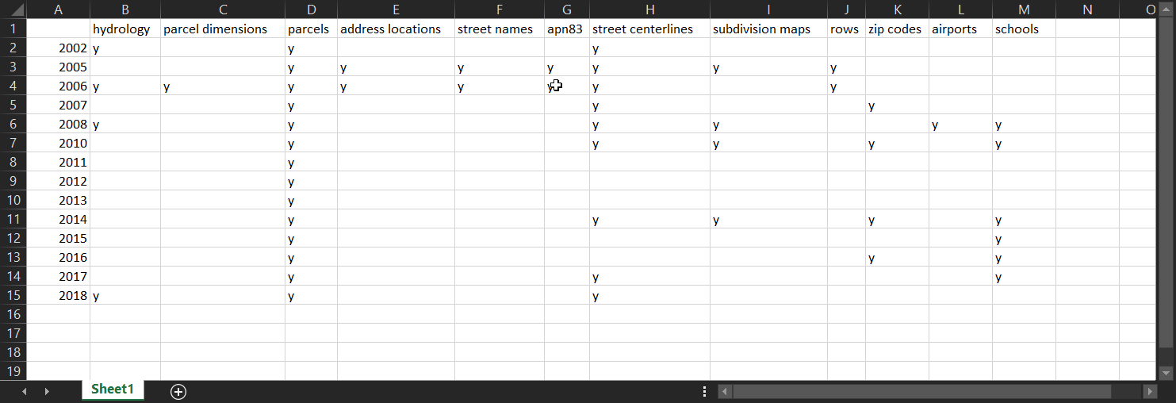
Notes:
Internal server has GIS data from all over north Cali from projects
Decided on SacCo -> had fascinating amount of historical data
13 of 16 yr span had data
Varied but not consistent data -> chose parcel & centrelines
Data too busy to use all years - chose 2002 - 2018 for best contrast

Slide 5
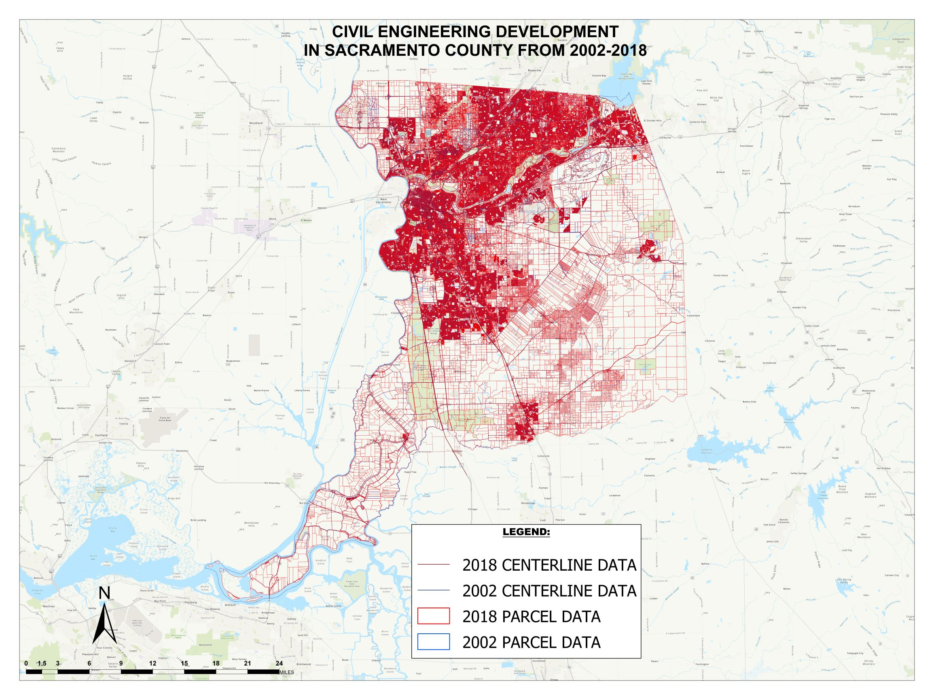
Notes:
Now i have data, but it it something to report on?
Doesn’t look like it from here -
Needed a new plan of action

Slide 6
data
choice
analysis
design
multi-
map
frames

Slide 7
Notes:
When first observing this there was greater change present then anticipated
Try and fail to clean up data further
Join and delete overlap left too many gaps
Highlighting non-overlap was too busy on top of the rest of the linework
Could have limited it to only residential or commercial - gaps
Busy was best

Slide 8
data
choice
analysis
design
multi-
map
frames
Notes:
After data finalised - had to do best to make it look good

Slide 9
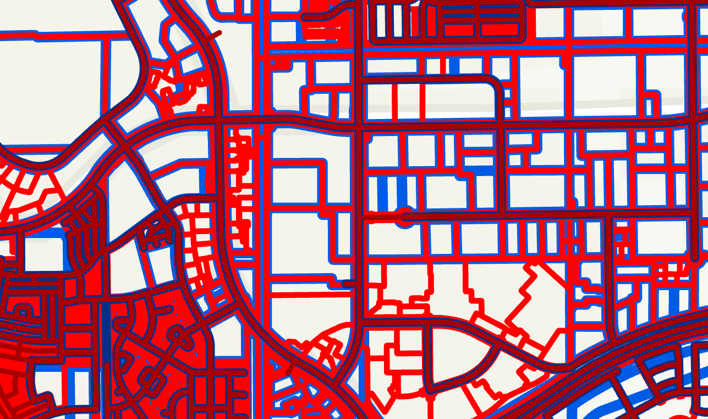
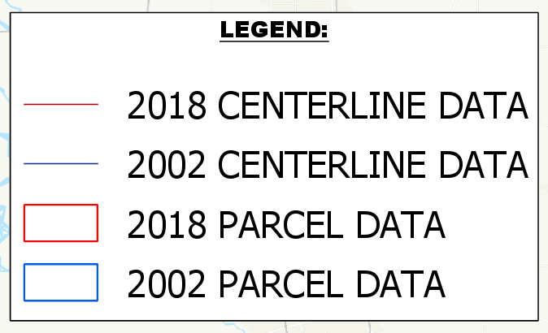
Notes:
Had to play with lines/colour
without losing
Visibility
Differentiating parcel vs centreline

Slide 10
data
choice
analysis
design
multi-
map frames
Notes:
That’s all good if you have the ability to zoom in and see the details
How to bring those details out?
MAP FRAMES!

Slide 11
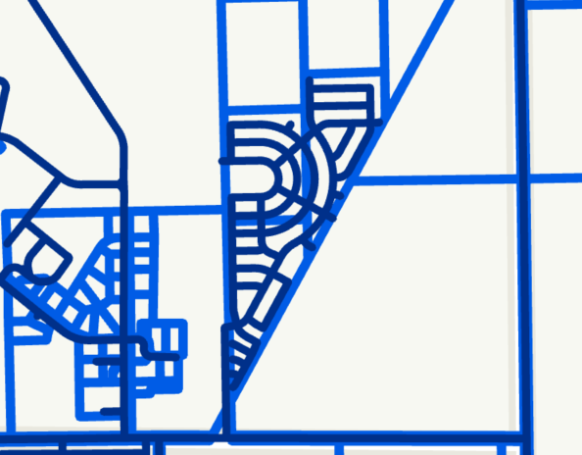
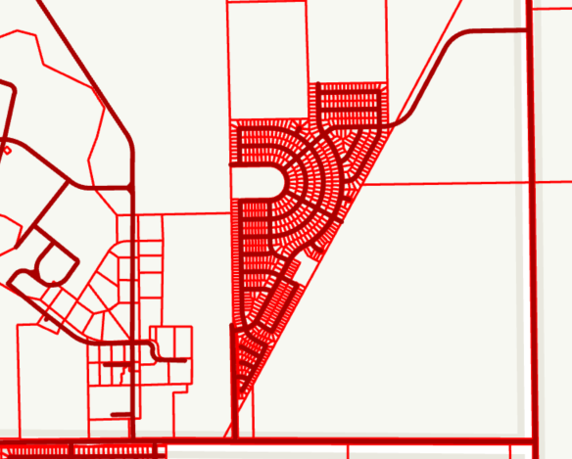
Rancho Cordova Centerlines:
2002
2018
Notes:
Centreline growth map frame

Slide 12
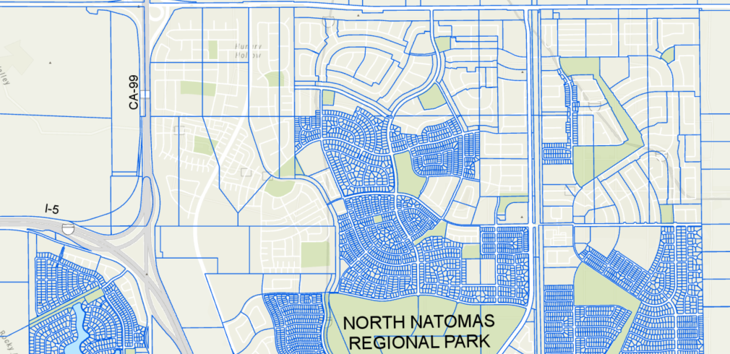
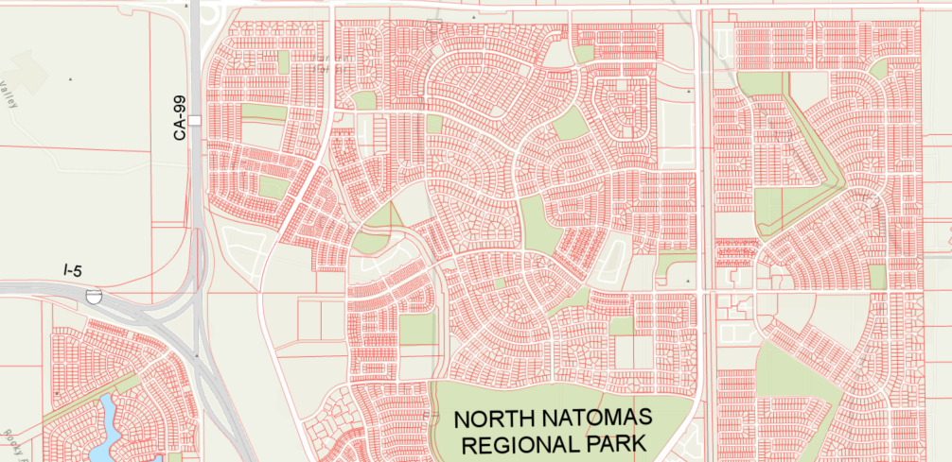
Northern Sacramento Parcels
2002
2018
Notes:
Parcel growth map frame

Slide 13
Issues vs solutions
So...much...data…
Scale???
Layer Management
Excel chart, trial & error combos
Multi-map frames
No resolution

Slide 14
?

