Slide 1
Web GIS Application Final Project
Joan Lopez
12/17/2019
GEOG 385

Slide 2
Purpose
Display 15 minute time series data collected by the U.S. Geological Survey at 17 specific gage sites in the Bay Delta area in a web map application
The period of time covered the Oroville Dam spill in February of 2017

Slide 3
Data Development
excel file of data for each USGS gage site
eliminated all the time series data values with “N/A” and then converted all the csv files into text files
imported the text files into ArcPro and display the x,y data as vector feature layers

Slide 4
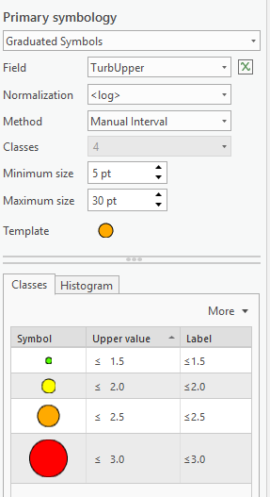
Data Development
Symbology and normalization of
each of the gage sites by editing only
one site in particular.
For this single site, I defined the
following symbology settings:

Slide 5
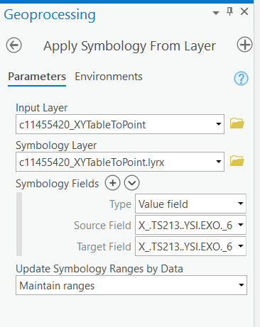
Data Development
Saved the symbology of that single layer as a layer file (.lyr)
Imported that layer file into the symbology of each of the other gage sites

Slide 6
Web Services Development
Exported the entire ArcPro map to ArcGIS Online as a single service definition, a single feature layer with multiple layers within, and a single web map
Edited the layer names and pop-up information for each site layer within the web map
Edited the field names of each site layer within the feature layer

Slide 7
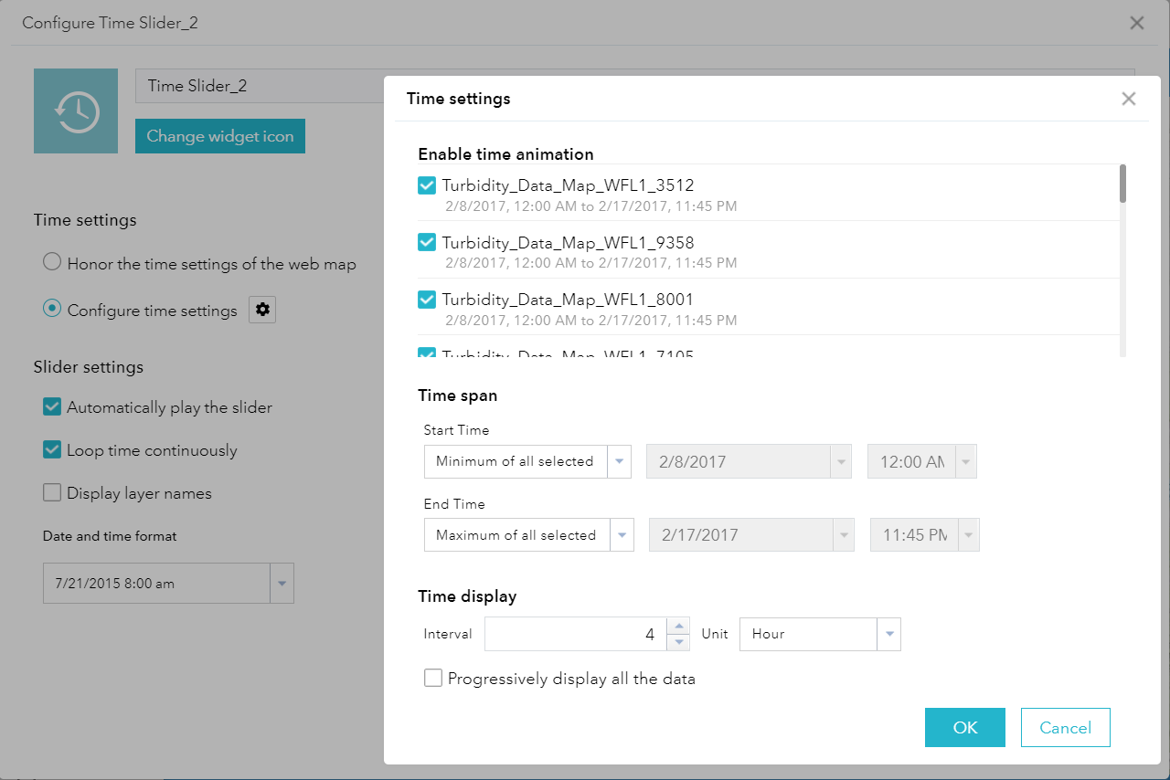
Web Application Development
Published web map as a web mapping application
Selected the ‘Tab Theme’ with a blue color scheme within the web mapping application
configured the time slider widget with the following settings:

Slide 8
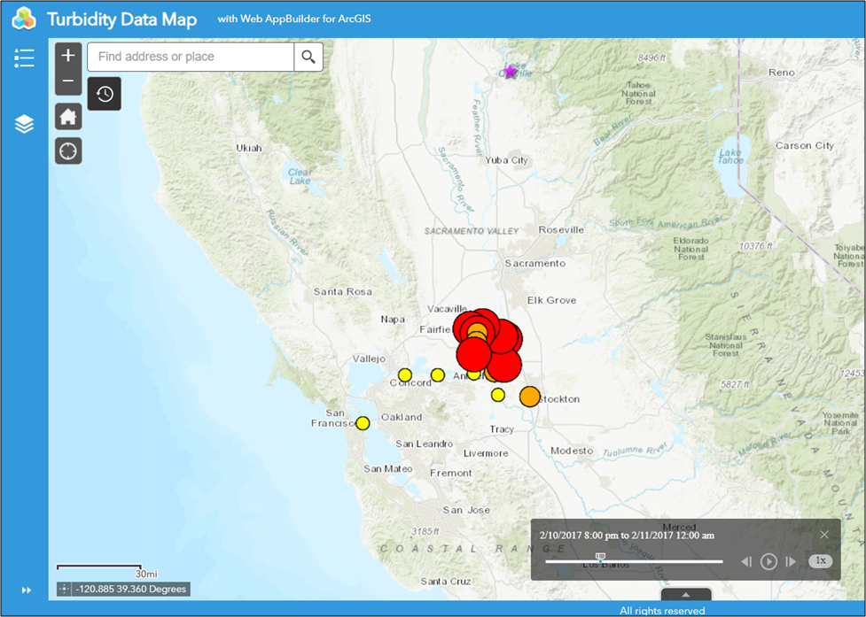
Web Application Development
The following web mapping application was produced:

Slide 9
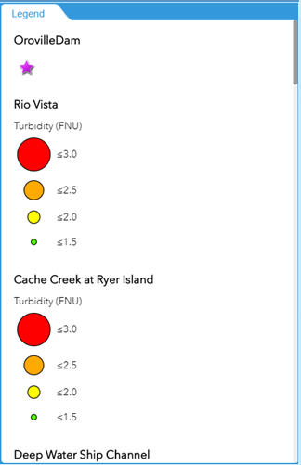
Web Application Development
Each layer represents one gage site with a legend that represents turbidity
The time slider shows the turbidity measurements taken between February 6th and 20th at 4-hour increments at each gage site

Slide 10
Conclusion
Learned a lot about data formatting and data uploaded from ArcPro to ArcGIS Online
Many challenges within this project but learning how to resolve these problems have made me more comfortable using web GIS
Steps that I would do differently to improve the functionality of the web application: combine all the time series data together manually within a csv file, convert that single file into a text file and upload it to ArcPro; convert the text file to a single vector feature layer and upload that to ArcGIS Online; symbolize the layer’s turbidity data with a single legend; add the filter widget to the web application to filter on specific sites, parameters, and value ranges
Add turbidity data from 13 more gage sites that are closer to Lake Oroville

