Slide 1
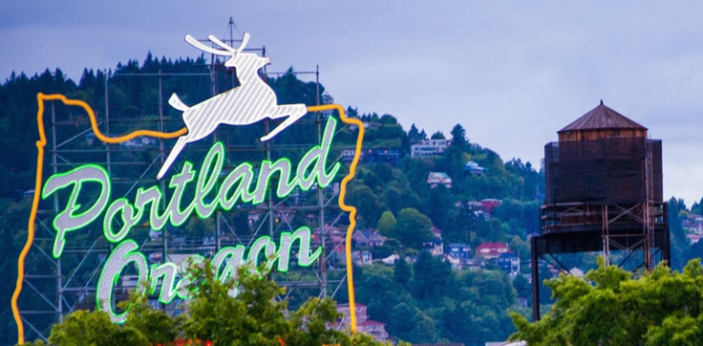
Map of Affordable, Accessible and Safe Neighborhoods in Portland, Oregon
Zen Landis
Notes:
1

Slide 2
Map Objectives
Find neighborhoods in my rental price range (no more than $1200/month)
Map public transportation (MAX) light rail stations
Color-code neighborhoods by crime rate
Notes:
2
Goal is to create a map that will enable me to narrow down my search area when apartment hunting next spring.

Slide 3
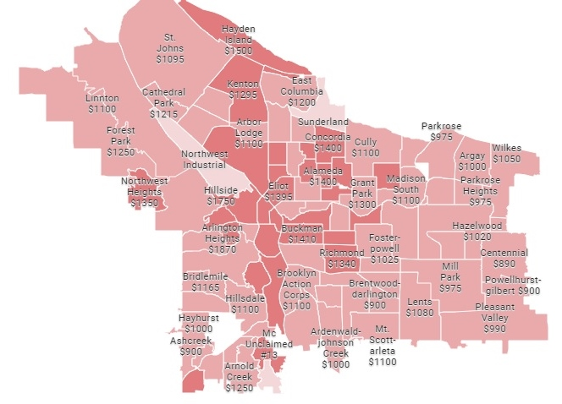
Median One Bedroom Rent Prices as of January 2018
Notes:
3
Data collected from Zumper, a real-estate blog found online.
Darker pink neighborhoods indicate a higher median rent price for a one bedroom apartment.

Slide 4
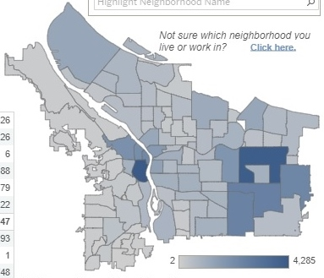
Monthly Neighborhood Offense Statistics 2017-2018
Notes:
4
Data collected from the City of Portland Police Department.
Darker blue color indicates neighborhoods with higher-than-average crime rates committed against person, property or society (anything from homicide to vandalism).

Slide 5
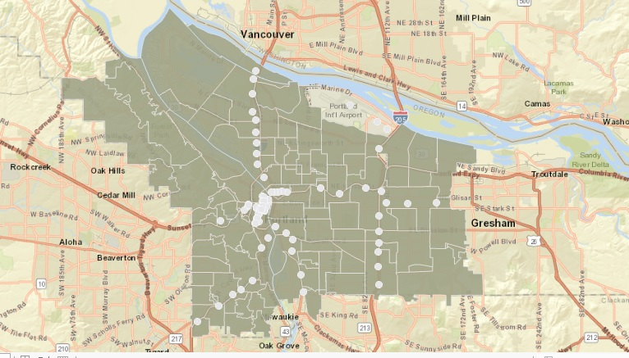
Neighborhoods & MAX Stations
Notes:
5
Using city streets as a basemap, I uploaded data from PortlandMaps, the Portland open source data platform.
Originally I had planned to add another layer to my map with the locations of local nurseries to help me narrow down by job search, but decided against it when I realized how cluttered it would look.
Additionally, potential employers have little bearing on where we will decide to live when we first move there.

Slide 6
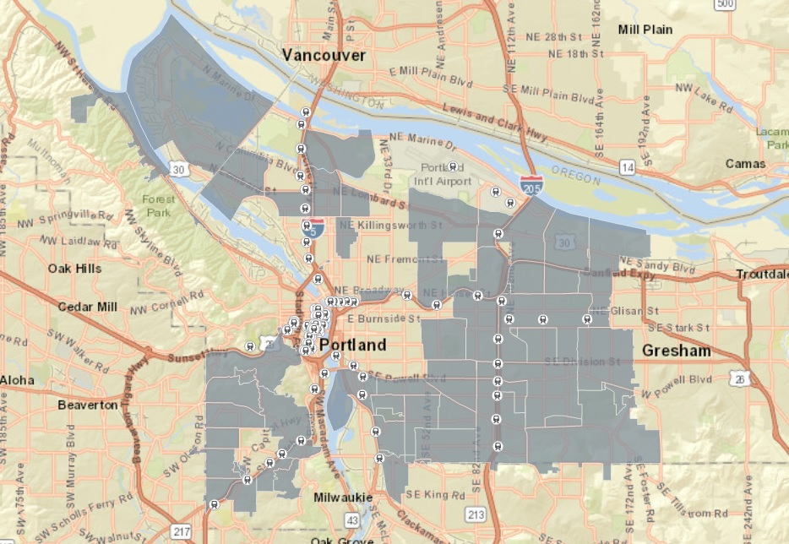
Affordable Neighborhoods & Max Stations
Notes:
6
Cross-referencing my map with the data from Zumper, I removed all neighborhoods which are above my desired price range.
This was the most time-consuming portion as I had to delete them one-by-one from the attribute table.
I also messed around a bit with the styling and found a light rail icon to depict the MAX stations.

Slide 7
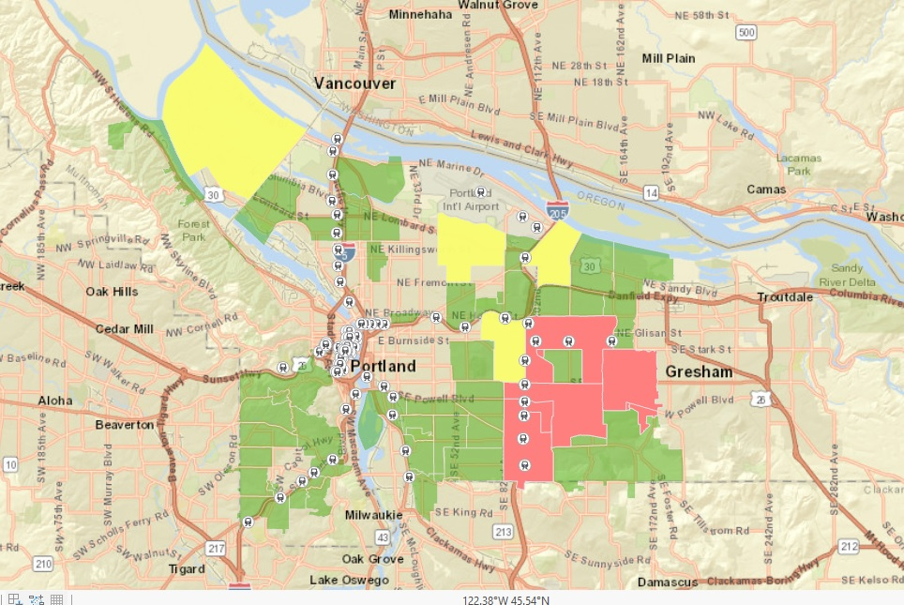
Affordable Neighborhoods
Color Coded by Crime
Notes:
7
I classified my remaining neighborhoods into three categories:
Low crime (green)- <1,000 incidents per year
Medium crime (yellow)- 1,000-2,000 incidents per year
High crime (red)- >2,000 incidents per year
Accomplished this by selecting and exporting each group, then color coding them (except low crime, I just renamed the neighborhood layer after I exported the other groups.)

Slide 8
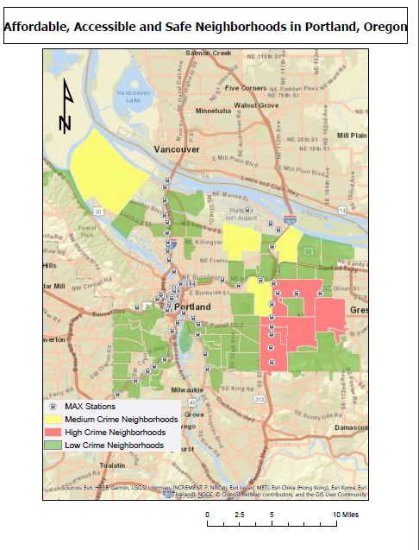
Notes:
8
Final map after adding essential map components.
I saved my data improperly so I wasn't able to work on it at home. If I had, I would have tweaked the styling a bit to be more attractive and arranged the key in order of least-most crime.

