Slide 1



California Epicenter, Fault, and Volcano Locations
By: Kristin Kettenhofen

Slide 2


Project Description
A legible and aesthetic map of California showing
  Volcanoes
  Fault lines of the Quaternary period (this is the current geologic time period)
  Earthquake epicenters from 1906 - 2015
Initial focus is on query, select and data export
Secondary focus is cartography and symbology
Almost all data used was from searching the online portal
Maps of fault lines and seismic activity are important for many reasons like
  Consideration from commercial construction projects
  Proposed dam sites (the proposed Auburn Dam site is located on a fault line)

Slide 3
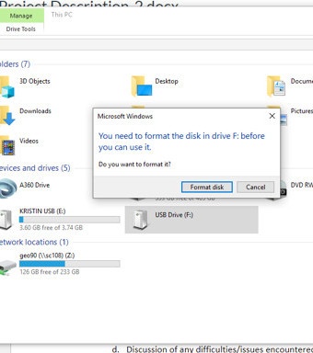
Problems
The biggest problem I had was a crashed USB drive that had my original map and project information on it.
The only real solution to this… start over ☹

Slide 4
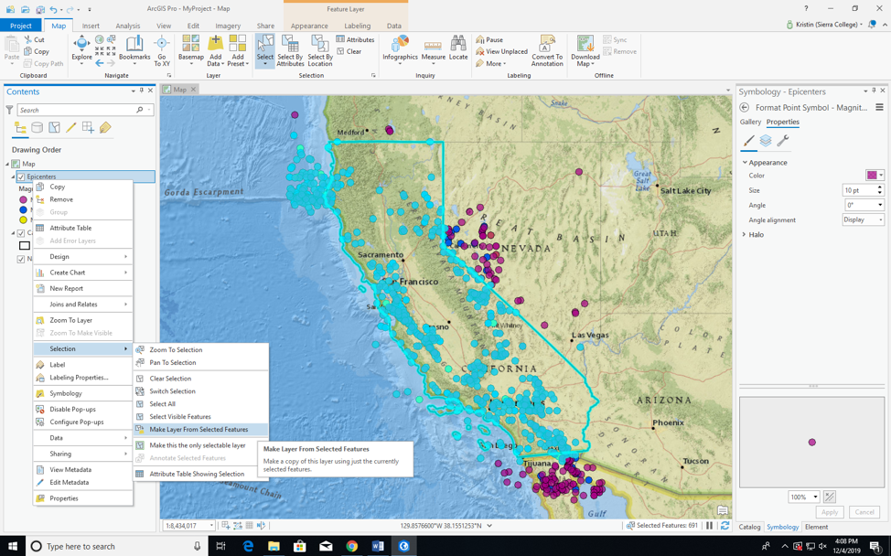
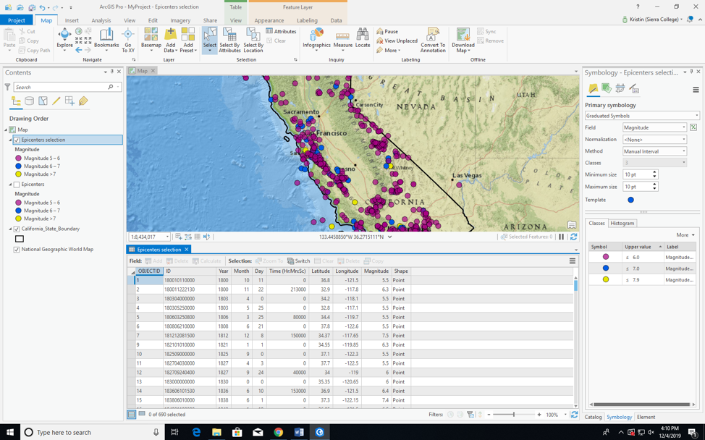
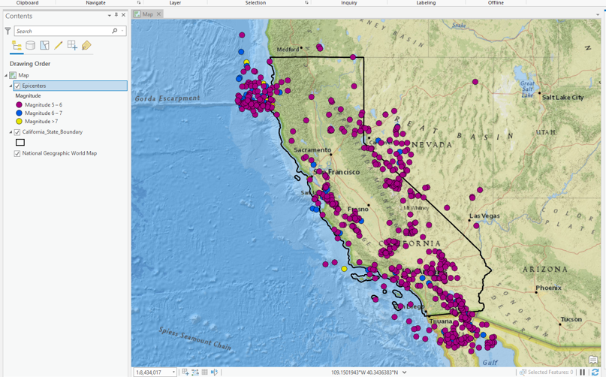
Other GIS Related Problems

Slide 5
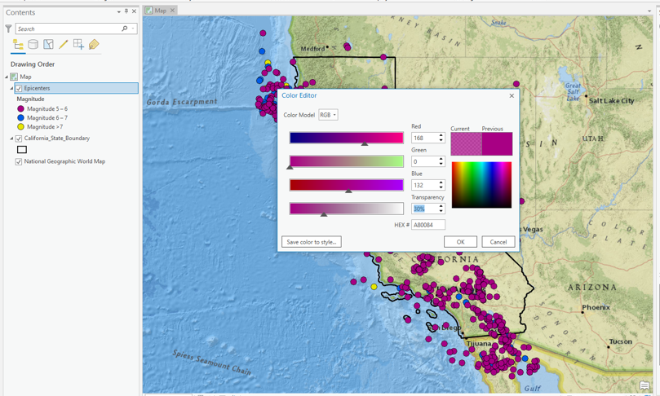
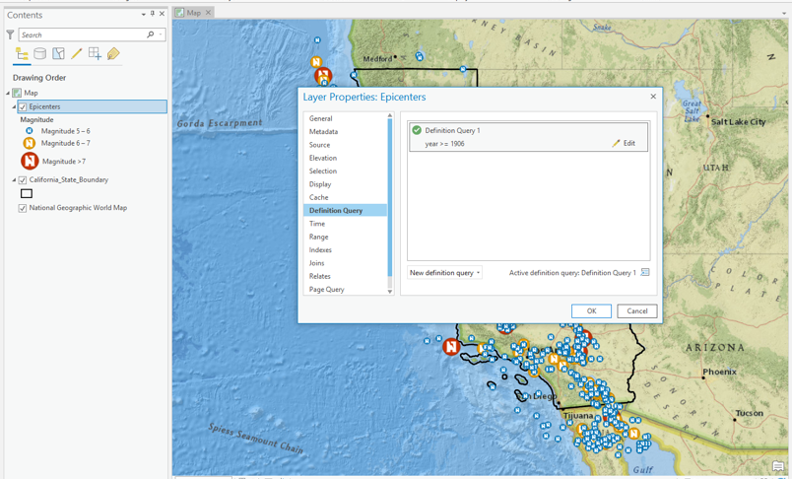
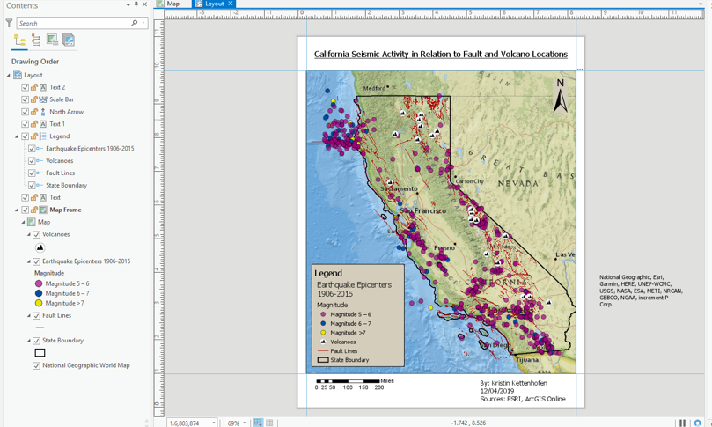
Processes

Slide 6
What I Learned
How to work around not being able to query data
Making symbology work for me when there are a lot of data points close together
Don’t trust ArcGIS software on your USB drive and back up your project data somewhere that it won’t get deleted
The amount of data online is amazing but you need to pay attention to the file type

Slide 7

